Slide 1
Technical Assistance Grants (TAG) Informational Meeting
Nancy Fitzpatrick and Peggy Shaw
Bureau of Waste Site Cleanup
MassDEP
June 6, 2023, 7:00 pm

Slide 2
Presentation Overview
Overview and purpose of TAG Program
Available funding
TAG eligibility requirements
TAG application and award process
Questions & Answers
TAG Program webpage: https://www.mass.gov/service-details/technical-assistance-grants-waste-site-cleanup

Slide 3
Overview of TAG Program
Public Involvement is a key component of the Waste Site Cleanup Program and Massachusetts Contingency Plan (MCP)
TAG purpose is to support effective public involvement during assessment and cleanup of disposal sites by:
Assisting community and citizens’ groups in obtaining expert technical assistance to understand and evaluate disposal site cleanup response actions
Enhancing public education about and participation in disposal site assessment and cleanup activities

Slide 4
Background of TAG Program
First TAGs were awarded in 1995
Continued for most years though 2002
Additional funding rounds 2007-2010
Offered funding round in 2022 and 2023

Slide 5
Available TAG Funding, SFY24
Total funding anticipated to be $200,000
Grant award to any individual applicant up to $20,000
Payment is made as reimbursement for costs incurred by grantee

Slide 6
Who can apply?
Eligible applicants include:
Groups of individuals, such as community groups and neighborhood associations (also, existing "PIP groups")
A district or other body politic that owns or operates a public water supply
A city, town or agency
“[A]ffected by oil and/or hazardous materials from any eligible disposal site”

Slide 7
Who is ineligible?
Groups that:
Own or operate the disposal site
Are conducting or funding assessment or cleanup work at the disposal site
Do not have legal authority to manage grant funds

Slide 8
Which disposal sites are eligible?
Disposal sites in Massachusetts that are actively involved in the assessment and cleanup process:
Classified as a Tier I or Tier II disposal site
Listed on EPA’s Superfund National Priorities List
Considered “Adequately Regulated” by another regulatory program

Slide 9
https://www.mass.gov/find-out-about-a-contaminated-property

Slide 10
How May TAG Funds be Used?
Eligible activities include:
Obtaining expert advice
Licensed Site Professional (LSP), environmental consultant, attorney, other professional (e.g., interpreter/translator)
Interpreting technical information and environmental data from the disposal site
Conducting public education activities

Slide 11
TAG Funds May Not be Used
Develop new environmental data
Conduct or arrange any cleanup actions
Litigation or other adversarial proceedings

Slide 12
Recent TAG Projects
Funded Licensed Site Professional services to review and interpret existing disposal site information to encourage better public participation in the ongoing cleanup
Funded risk assessment experts to review existing disposal site data sets and provide an evaluation of risk characterization
Funded translation of information on response actions being conducted at disposal site in multi-lingual neighborhood
Funded creation of a website to educate the affected community and encourage public participation

Slide 13
Estimated Grant Timeline
Grant Procurement Activity | Date | Time
Pre-TAG Grant Release Informational meeting | Tuesday, June 6, 2023 | 7 P.M.
Notice of Grant Opportunity (posted on COMMBUYS and MassDEP website) | Thursday, June 29, 2023
TAG Grant Opportunity and Grant Application Release Date (Posting Date) on MassDEP website | Thursday, June 29, 2023
Deadline for submission of written questions via email to MassDEP TAG POC | Friday, August 25, 2023 | 5 P.M.
Official answers for Q&A published on MassDEP webpage | By Friday, September 8, 2023
GRANT APPLICATION DEADLINE | Friday, October 13, 2023 | 5 P.M.
Estimated announcement of Grant Awards (posted on COMMBUYS and MassDEP webpage) | Friday, January 26, 2024
Estimated contract start date | Monday, April 1, 2024

Slide 14
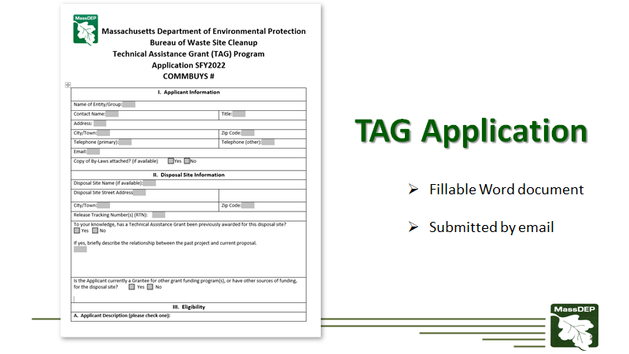

Slide 15
TAG Application Review Process
Eligibility Criteria
Evaluation Criteria
Grant Review Team – composed of MassDEP staff
Projects awarded funding will be those that best address the TAG Program goals

Slide 16
Application Evaluation Criteria
Severity and Complexity of the Disposal Site relative to potential impacts on health, safety, public welfare, and the environment.
Connection to Waste Site Cleanup Program Goals - Relationship of proposed project to the impacts of the disposal site on health, safety, public welfare, and the environment.
Promote Public Awareness - Potential of proposed project to foster increased public awareness and understanding of response actions.

Slide 17
Application Evaluation Criteria (cont’d)
Outreach Capability - Applicant's demonstrated capacity to communicate with and involve individuals affected by the disposal site.
Implementation Potential - Applicant's demonstrated capacity to implement the proposed project.
Project Budget and Timeline - Feasibility of meeting identified goals, completing project within work schedule and budget, and proposed types of experts to be hired.

Slide 18
Application Evaluation Criteria (cont’d)
Benefits to Environmental Justice Communities - MassDEP is particularly interested in projects which benefit Environmental Justice Communities. http://maps.massgis.state.ma.us/map_ol/ej.php
Benefits an Economic Target Area - Relevance of the disposal site for local economic development efforts.

Slide 19
Elements of a Successful TAG Project
Fulfills Evaluation Criteria
Presents focused and clearly defined mission and goals
Applicant group has the ability to manage funding and successfully move the project forward

Slide 20
TAG Application Process
All application materials will be available for download on Friday, June 29, 2023 (tentative) at: https://www.mass.gov/service-details/technical-assistance-grants-waste-site-cleanup
Applications and all supporting documents must be sent electronically by 5pm on Friday, October 13, 2023 (tentative) to Nancy.Fitzpatrick@mass.gov

Slide 21
Grant Award Details
One award per applicant group
One award per disposal site
An award may be used by a group for more than one disposal site
Duration: contract ends on June 30, 2025; contract extension is at MassDEP discretion

Slide 22
Grant Contracts
Commonwealth Standard Contract
Scope of Services Agreement
Commonwealth Terms and Conditions
Contractor Authorized Signatory Listing
Payment:
Electronic Funds Transfer form
MA W-9

Slide 23
Award Payment Details
Reimbursement for expenses incurred after TAG contract has been executed
Group receiving the award must have legal authority to receive and disperse funds at the time the grant is awarded
https://www.sec.state.ma.us/divisions/corporations/corporations.htm
Taxpayer ID Number required to receive funds

Slide 24
Question and Answer Period
Official Q&A period: June 29 – August 25, 2023(tentative)
Begins when TAG Opportunity and Application are posted
Official answers to written questions will be posted online by September 8, 2023 (tentative)
Prior to the TAG Opportunity and Application Announcement
Applicants may contact us directly with questions about the grant opportunity or to discuss potential projects

Slide 25
For further information….
Nancy Fitzpatrick
Nancy.Fitzpatrick@mass.gov
(617) 997-9474
Peggy Shaw
Margaret.Shaw@mass.gov
(617) 874-6467
https://www.mass.gov/service-details/technical-assistance-grants-waste-site-cleanup

Slide 26
Questions???

