Slide 1







Tax Season
2026
Resources available for
families in Massachusetts

Slide 2
Agenda
  Healthy Families Tax Credits Coalition - who we are
  What are tax credits?
  Available state and federal tax credits
  Free tax preparation (VITA)
  Resources to share with clients and community members - FindYourFunds.org

Slide 3

Our Coalition
  The Healthy Families Tax Credits Coalition is a statewide network working to expand access to the state Earned Income Tax Credit (EITC) and Child and Family Tax Credit (CFTC)
  Led by Children’s HealthWatch, coalition of 80+ organizations across MA
  Since 2015, we have increased the state EITC three time, passed a robust and inclusive CFTC, and invested state dollars to free tax preparation services
  We also lead an outreach campaign to make sure all who are eligible
  know about and claim the money they are owed

Slide 4
What are tax credits?
  Refundable tax credits reduce the amount of taxes a family owes, providing a refund if the credit is larger than their tax liability. This means that families with low and moderate incomes can get direct, flexible cash back into their pockets
  At the federal level, the Child Tax Credit and Earned Income Tax Credit provide the largest anti-poverty benefit to children, working people, and people under 65. In 2024, these credits lifted 6.8 million people above the poverty line (1)
Building on the success of these federal tax credits,
many states, including Massachusetts, have
implemented their own state versions
(1) Butkus, Neva. Institute on Taxation and Economic Policy. September 16, 2025. https://itep.org/child-poverty-remains-unacceptably-child-tax-credit-changes/

Slide 5

Overview of available tax credits
Massachusetts
Federal
Earned Income Tax Credit (EITC)
-earned < $69,000 in 2025
-average credit of $996
Child and Family Tax Credit (CFTC)
-$440 per child < age 13, disabled dependent, spouse who needs care
-no income required, immigrant inclusive
Earned Income Tax Credit (EITC)
-earned < $69,000 in 2025
-up to $8,046, depending on income and number of children
-average credit of $2,491
Child Tax Credit (CTC)
-up to $2,200 per child < age 17
-income required (phases in)

Slide 6
Massachusetts Earned Income Tax Credit
About this credit: The Massachusetts Earned Income Tax Credit (EITC) is designed to support low to moderate workers
How much? The amount of the EITC is an equation, based on income, number of children, and filing status. MA EITC is a 40% match of the federal EITC. In 2025, the average MA EITC was $996.
Who qualifies? To claim this credit, you must:
  have earned income during 2025 ($68,675 or less)
  You, your spouse, and your qualifying dependents must have a Social Security Number

Slide 7
Massachusetts Child & Family Tax Credit
About this credit: The Massachusetts Child & Family Tax Credit is designed to offset the costs of caring for children and other qualifying dependents
How much? For tax year 2025, you can be eligible for $440 for each qualifying dependent
Who qualifies? To claim this credit, you must care for:
  A child under the age of 13;
  A dependent or spouse with a disability; or
  A dependent ages 65 years or older
If you are married, you must file taxes jointly to claim this credit
There are no income requirements to claim this credit
This credit is immigrant inclusive

Slide 8
Examples
Family A:
Jane is a single adult worker, age 28, without children. Jane works 20hrs/week at minimum wage (annual income: $15,600). Jane is eligible to receive $374 in state and federal EITC
Family B:
Liz is a single parent with two children, 13 and 15 years old. Liz works 20hrs/week at minimum wage (annual income: $15,600). Liz files as Head of Household and is eligible to receive $8,750 in state and federal EITC and $1,965 in federal Child Tax Credit. She is not eligible for the MA CFTC.
Family C:
José and Amy are married with two children, 13 and 15 years old. José works full-time and Amy works part-time (combined income $55,000). José and Amy receive $2,773 in state and federal EITC and $4,400 in federal Child Tax Credit.

Slide 9
Examples
Family D:
Fran is age 68 and is cares for her 90-year-old mother, who she claims as a dependent. Fran is retired. Fran is eligible to receive $440 in the MA Child and Family Tax Credit. She is not eligible for the federal EITC or Child Tax Credit.
Family E:
Beth and Leslie are married, ages 45 and 44. Beth and Leslie have a 15-year-old child, a 11-year-old child, and care for a 75-year-old parent who they claim as a dependent. They earned $72,000. This family is eligible to receive $880 in the MA Child and Family Tax Credit and $4,400 in federal Child Tax Credit. They are not eligible for the EITC.

Slide 10
Examples
Family F:
Single parent with two children, 8 and 12 years old. The parent works a $15/hr minimum wage job 20hrs/week (annual income $15,600). This family is eligible to receive $8,750 in state and federal EITC, $880 in MA Child and Family Tax Credit, and $1,965 in federal Child Tax Credit.

Slide 11

Tax credits do NOT affect eligibility for other benefits (MassHealth, SNAP, WIC, etc.)
You can file your taxes from a previous year for up to three years after the original due date
Even if you don’t typically file or aren’t required to file taxes, you must file a tax return to claim these credits
Did you know there are free tax filing services available?

Slide 12
Volunteer Income Tax Assistance Program
The Volunteer Income Tax Assistance (VITA) program offers free tax help in multiple languages through IRS-certified volunteers to people who generally make $69,000 or less
Filing your taxes for free means you can keep more of your refund and tax credits, which can add up to thousands of dollars
VITA services are available across the state, and are often co-located in other community resources, such as public libraries or social services centers
  Local Community Action Centers (MassCAP network) and the Boston Tax Help Coalition offer in-person VITA services

Slide 13
Information for Immigrants
Historically, tax information gathered by the IRS has been kept private; that privacy has since been breached
In April 2025, the IRS signed an agreement with the Department of Homeland Security (including ICE) to share taxpayer information (such as name and address) for immigration enforcement
Several lawsuits have been filed in attempt to overturn this decision. While we wait for the court rulings to play out, families can consult with an immigration attorney if they have concerns about the privacy of their tax information or tax filing obligations
For assistance, email: taxbenefits-help@gbls.org or call: (617) 371-1234 for the low-income taxpayer clinic

Slide 14

FindYourFunds.org
Our coalition maintains FindYourFunds.org,
a trusted tax filing resource for
Massachusetts residents
FindYourFunds.org is available in 11 languages,
including:
  How to file taxes and documents needed to file
  Where to file taxes for free (online and in-person)
  Information on available tax credits
  Information for immigrant families
  Other resources and support (food, utilities, cash, and health care)
  Outreach materials (flyers, social media)

Slide 15
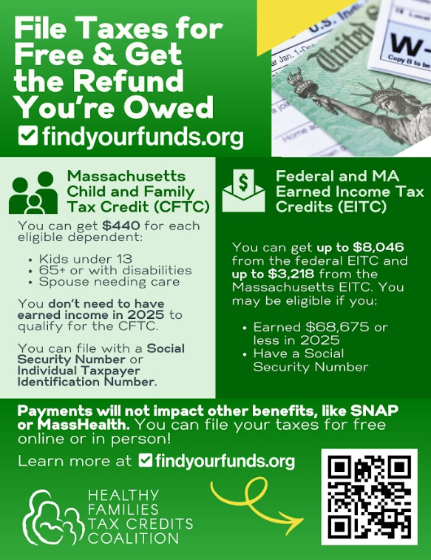
Available in 11 languages (color & BW)
Communications & social media toolkit
Draft newsletter language
Short communications
Sample social media posts

Slide 16

Other opportunities
Parent newsletter or existing outreach materials? We have suggested language to include for your next edition!
Does your program have a social media presence? Consider using our social media toolkit!
Could you hang our flyer in your child care center? Share with parents and staff?
Are you a part of any WhatsApp, Facebook groups, or other community information forums that you could post this information?
Other ideas?
Please share!

Slide 17

This tax season, please share these resources with your clients and communities!
Questions? Please contact:
Carley, carley.ruemmele@bmc.org
Charlotte, charlotte.bruce@bmc.org

