Slide 1
Review of Telehealth and Interstate Licensure Policies
March 11, 2026

Slide 2
Telehealth Taskforce Charge
Primary focus: address barriers and impediments to the practice of telehealth across state lines.
Continuity of care
Providing quality care
Interstate Medical Licensure Compact
Regional Agreements
Telehealth Registry
Telehealth
Across State Lines

Slide 3
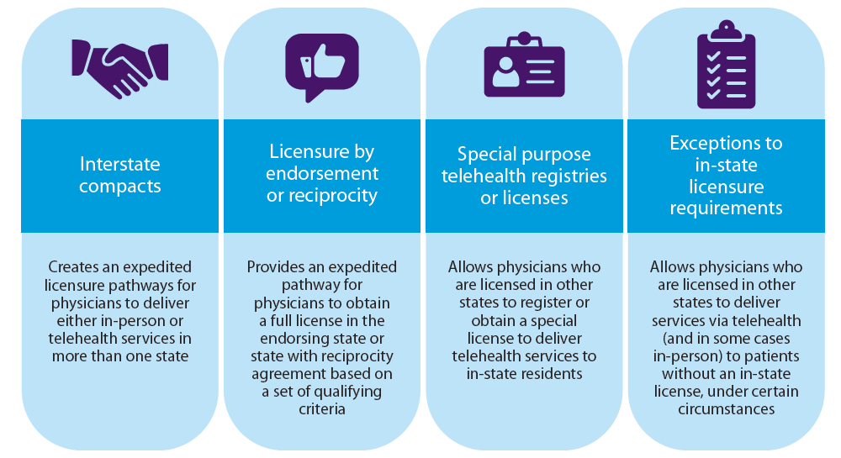
American Medical Association: Telehealth Licensure Issue Brief (May 2023)

Slide 4
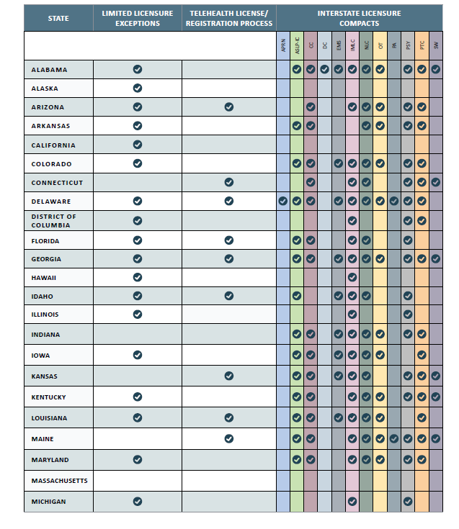
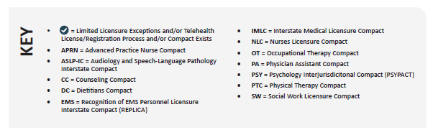
CCHP: The Cross State Licensure Continuum, July 2024

Slide 5
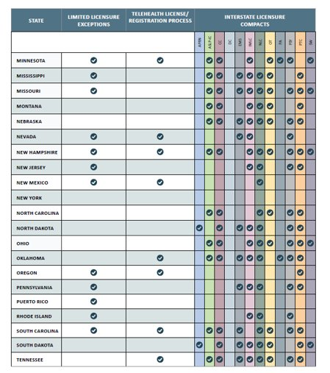
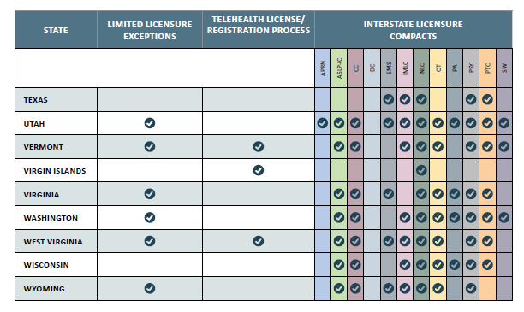

Slide 6
Federal State Medical Boards Workgroup on Telemedicine Report April 2022
Model Guidelines
Licensing Exceptions
Standards of Care
  Does not alter scope of practice or authorize delivery of health care services.
  Place welfare of patients first
  Maintain acceptable and appropriate standards of care
  Adhere to ethical codes
  Properly supervise non-physician clinicians
  Protect patient confidentiality
  A physician must be licensed or authorized where the patient is located.
  Exceptions to licensure:
  Physician to physician consults
  Prospective patient screening
  Episodic follow-up care
  Follow-up after travel
  Clinical Trials
  Same standards of care and professional ethics as in-person encounter.
  Scope of practice
  Establishment of physician to patient relationship
  Evaluation and treatment of the patient (including documentation and appropriate diagnostics)
  Informed consent
  Continuity of care and referrals
  Medical records
  Privacy and security of patient records

Slide 7
Uniform Telehealth Act Model Language, July 2022
Standard of care
  Does not supplant state statutes
  Can not create a new standard of care or new requirements exclusively applicable to telehealth
Exemptions to licenses for out of state practitioner
  Physician consult
  Second opinion
  Follow up care to travelers
Registration system
  Creates a registration system for out of state practitioners
  Must identify the licensing boards that will participate
  Criteria applicants must qualify for registration
  Practitioners may be subject to disciplinary action

Slide 8
MA Telehealth Interstate Policy Options
NE States (5)*
Legislation needed
Voluntary Process
BORIM maintains authority over discipline of traditional licensed MA physicians
IMLC
5
Regional Agreement
Telehealth Registry
4
Exemptions to Licensing
3
*NH, VT, ME, RI, CT are represented

