Slide 1
Massachusetts Telehealth Task Force
Interstate Licensure Approaches

Slide 2


Who's this guy, anyway?
Jeremy Sherer
Representative experience
Partner, FDA + Healthcare Regulatory
Invited industry expert contributor, Uniform Law Commission Model Telehealth Laws
Contributor, Federation of State Medical Boards Model Policy on Telemedicine.
Advisor to the Federation of State Medical Boards on telehealth and healthcare innovation.
Represents telemedicine companies, health systems, and other stakeholders operating telemedicine programs across all 50 states and the District of Columbia.
Has advised 100+ digital health companies on developing and implementing robust regulatory compliance programs addressing issues that involved professional licensure, scope of practice, supervision, prescribing practices and patient consent.
Full Bio
LinkedIn
Jeremy provides business-oriented guidance to help those reshaping the U.S. health care industry.
Widely recognized as a digital health thought leader, Jeremy counsels stakeholders in health tech, digital health, and healthcare innovation– from seed stage startups to national health systems and publicly traded companies – on issues involving regulatory compliance, transactions and innovative business arrangements, particularly in virtual care delivery.
Jeremy is based in Boston, Massachusetts.

Slide 3
Disclaimer
This presentation is not legal advice and does not establish any attorney-client relationship with Orrick or any of its attorneys.
Orrick | Private and Confidential

Slide 4
Agenda
Telehealth 101
Licensure in Massachusetts
Types of Licensure Exceptions
Existing Interstate Licensure Examples
Interstate Medical Licensure Compact
Orrick | Private and Confidential

Slide 5
Telehealth 101

Slide 6
Which laws apply?
When care is provided via telehealth, the laws of the state where the patient is located govern the care that is delivered.
Therefore, when a physician in Massachusetts utilizes telehealth to treat a patient located in Florida, the Massachusetts-based physician must be licensed in Florida, and deliver care in compliance with applicable Florida law.

Slide 7
During the COVID-19 PHE, professional boards and public payors (Medicare and MassHealth) relaxed many legal requirements to expand access to telehealth. Is telehealth permitted now?
01: MA Law
  Per 243 CMR 2.01, the practice of medicine includes telemedicine, which is defined as the provision of services to a patient by a physician from a distance by electronic communication in order to improve patient care, treatment or services. "Telehealth" is broadly defined at M.G. L. c. 112, § 5O.
02: Medicare
  Medicare coverage of telehealth services remains somewhat in-flux. Some pandemic-era policies expanding coverage are now permanent; may have been temporarily extended, most recently through the end of September 2025. See CMS Telehealth FAQ CY 2025.
03: MassHealth
  With limited exceptions, MassHealth's permanent telehealth policy includes coverage of medically necessary services via telehealth as long as the applicable standard of care is met. See MassHealth Telehealth Policy.
Orrick | Private and Confidential

Slide 8
Licensure in Massachusetts

Slide 9
Licensure Requirements and Exceptions
01
  Massachusetts licensure is generally required to treat patients located in Massachusetts at the time of treatment. See MA Board of Registration in Medicine Policy on Telemedicine in the Commonwealth, Policy No. 2020-01.
02
  Massachusetts has a longstanding policy of permitting physicians located outside of Massachusetts to consult with physicians located (and licensed) in Massachusetts, without requiring the consulting physician to obtain a Massachusetts license. See MGL Ch. 112 Sec. 7.
03
  Massachusetts physicians may treat patients who are temporarily in New Hampshire, as long as the physician does not establish an office or otherwise regularly operate in New Hampshire. See NH RSA 321:21(III).
Orrick | Private and Confidential

Slide 10
Types of Licensure Exceptions

Slide 11
Licensure Exceptions
Established Patient | States like Washington allow physicians not licensed in Washington to provide limited treatment to established patients while those patients are located in Washington.
Border State | States like Arizona, Colorado, and Georgia have exceptions for physicians located in border states.
Follow-up Care | States like Ohio allow physicians who are not licensed in Ohio to treat patients located in Ohio when the care at issue is follow-up treatment.
Interprofessional Consult | Most states allow physicians licensed in other jurisdictions to consult with locally licensed physicians, even if the consulting physician is not locally licensed.
Infrequent Consultation | States like Alabama allow physicians to provide care to patients in Alabama via telemedicine without an Alabama license if the care at issue is "irregular or infrequent," which they define as 10 days or less in a calendar year.
Special Registration | There are 8 states with special registrations to provide care via telemedicine. In most states, full licensure is required.
State Reciprocity | The District of Columbia, Maryland, and Virginia established interstate reciprocity.

Slide 12
Existing Reciprocity Arrangements for State Licensure

Slide 13
DC/Maryland/Virginia Reciprocity
DC, MD + VA entered into a "Memorandum of Agreement" (MOA) in March 2023 agreeing to:
  Recognize medical licenses issued by other parties to the MOA;
  Expedite the processing of reciprocal licenses received from physicians located in other MOA party states;
  Enable rapid, reliable communication between the MOA parties to ensure necessary information about applicants is quickly received; and
  When requested, promptly provide notice of an application from an individual licensed by another jurisdiction of any private or confidential order or agreement involving that individual, including any restriction on the license of the individual, or pending disciplinary investigation or proceeding.
  See DC Board of Medicine Memo re: Reciprocity Pathway.
  See Maryland Expedited Licensure Pathway.
  See VA Reciprocity Application.

Slide 14
DC/Maryland/Virginia Reciprocity (Continued)
Virginia also applies the following requirements before granting a reciprocity application:
Applicant's license must be in good standing in all jurisdictions where licensed.
Applicant may not be facing pending disciplinary matter or investigation by any other state licensing board.
Individual cannot currently be monitored by another state's health program.
Individual cannot have experienced 3 or more malpractice claims of $75k or more in the last 10 years.
Individual must submit a report from the National Practitioner Data Bank.
Maryland's application asks if the applicant:
Has any pending or past complaints against any state medical license.
Has any past disciplinary actions against any license held.
Has had any actions reported to the National Practitioner Data Bank.
Has any past criminal history.

Slide 15
Two More Reciprocity Examples – Pennsylvania and North Carolina
01: Pennsylvania
  Pennsylvania may issue licenses to physicians practicing without restriction in a neighboring state, near the Pennsylvania border, whose practice extends into Pennsylvania, based on the availability of medical care in the region at issue, and whether the physician's home jurisdiction extends similar privileges to Pennsylvania physicians.
02: North Carolina
  Effective October 1, 2025, North Carolina will require its medical board to issue a license to any physician who establishes residency in North Carolina and:
  Is already licensed in GA, SC, TN, WV or VA
  Has been licensed for at least 1 year
  Has passed any required exams
  Has not lost a license due to unprofessional conduct
  Demonstrates competency in the eyes of the medical board
  Has no pending disciplinary actions in other jurisdictions
  Has no criminal history
  Has paid all relevant fees
Orrick | Private and Confidential

Slide 16
Interstate Medical Licensure Compact

Slide 17
What is the IMLC?
The Interstate Medical Licensure Compact is an agreement among participating U.S. states and territories which creates a voluntary, expedited pathway to licensure for physicians who qualify.
The mission of the Compact is to increase access to health care – particularly for patients in underserved or rural areas.
The Compact makes it possible to extend the reach of physicians, improve access to medical specialists, and leverage the use of new medical technologies, such as telemedicine. While making it easier for physicians to obtain licenses to practice in multiple states, the Compact also strengthens public protection by enhancing the ability of states to share investigative and disciplinary information.

Slide 18
How does the IMLC work?
Compact states expedite their respective licensure processes by sharing information with each other that physicians have previously submitted in their State of Principal License (SPL) -- the state in which a physician holds a full and unrestricted medical license.
Before physicians can participate in the Compact, they must designate an SPL, complete an application, and then receive a formal Letter of Qualification from that state, verifying that they meet the Compact’s strict eligibility requirements. Physicians cannot obtain licenses through the Compact without completing these steps.
After verifying a physician’s eligibility for the Compact, the SPL shares this information with additional states where the physician wants to practice medicine. By using expedited information-sharing, participating states are able to significantly speed up the licensure process.

Slide 19
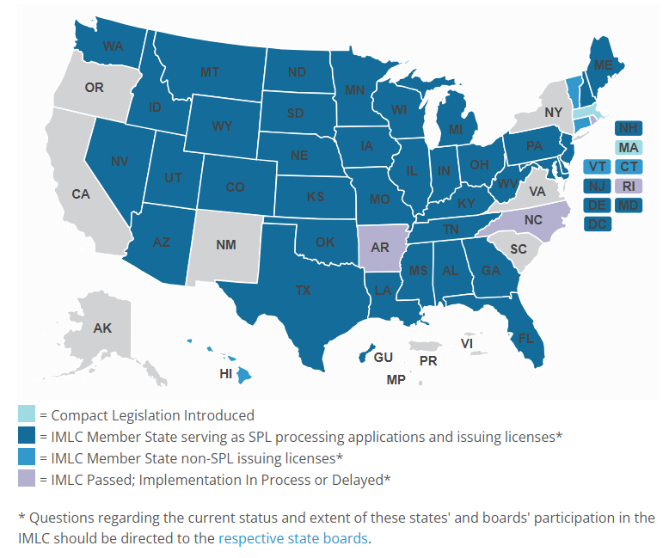
Who participates in the IMLC?
40 states (including DC) currently participate in the IMLC. This includes VT and CT, which are member states, but are not currently issuing SPL licenses.
3 states (AR, NC, and RI) have passed the IMLC, but implementation is delayed.
Massachusetts has introduced IMLC legislation.
7 states do not participate and have not introduced legislation to consider joining the compact: AK, CA, NM, NY, OR, SC, and VA.

Slide 20
What is required of physicians who wish to participate?
The first requirement for physicians to participate in the Compact is to hold a full, unrestricted medical license in a Compact member-state that can serve as a declared State of Principal License (SPL). In order to designate a state as an SPL, physicians must ensure that at least ONE of the following apply:
  The physician’s primary residence is in the SPL
  At least 25% of the physician’s practice of medicine occurs in the SPL
  The physician is employed to practice medicine by a person, business or organization located in the SPL
  The physician uses the SPL as his or her state of residence for U.S. Federal Income Tax purposes.
Because Massachusetts does not participate in the IMLC, Massachusetts cannot be listed as a physician's SPL. This means that Massachusetts physicians cannot participate in the IMLC unless they can satisfy the SPL requirements for another state.
The SPL has the authority to determine if a physician meets any or all of the qualifications listed above. Physicians must maintain their SPL status at all times. Physicians may change the location of their SPL -- through a process known as “redesignation” – after they receive a Letter of Qualification to participate in the Compact.

Slide 21
Interaction Among State Laws
Does the IMLC supersede state law? No. The Compact does not change in any way a state’s Medical Practice Act, or a state’s full authority in administering its duties of oversight. The Compact simply creates another pathway for licensure in other jurisdictions.
What laws apply to IMLC physicians? The laws of the state where the patient is located at the time of treatment govern. If a physician treats a patient in Texas, that physician is subject to Texas law. The IMLC creates an expedited path to licensure to Massachusetts physicians, including in Texas, but does not make a Massachusetts physician automatically licensed in Texas – they must still go through the Texas licensure process, and will only be subject to Texas law upon treating a patient located in Texas.
What are shield laws? Some states have enacted laws declining refusing to provide information to authorities in other jurisdictions regarding care that may be prohibited in those other jurisdictions, which is permitted in the home state.
Note that the extent to which shield laws will protect physicians is not certain.

Slide 22
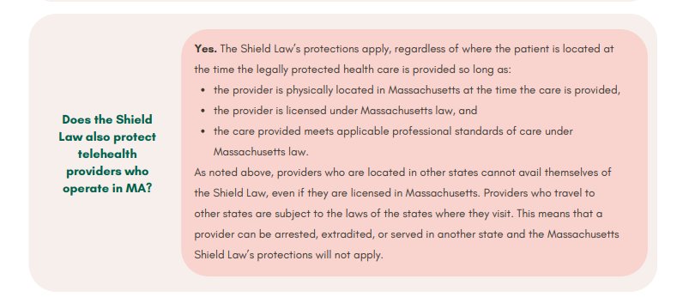
Interaction Among State Laws
Does the IMLC impact the applicability of Massachusetts' existing shield law? No. After the Supreme Court's landmark decisions in Dobbs, Massachusetts adopted a shield law, seeking to protect Massachusetts physicians from inquiries by other medical boards involving reproductive care (but applies to all care permitted under MA law). See MA Attorney General, Shield Law Advisory (excerpt of FAQ below).

Slide 23
Thank You jsherer@orrick.com

