Slide 1
Telehealth Taskforce
Physician Pipeline
October 15, 2025
Office of Health Care Strategy and Planning

Slide 2
Agenda
Overview of the physician workforce in MA
Medical school matriculation/graduation rates
Residency enrollment by specialty and location
Telehealth in medical school education

Slide 3
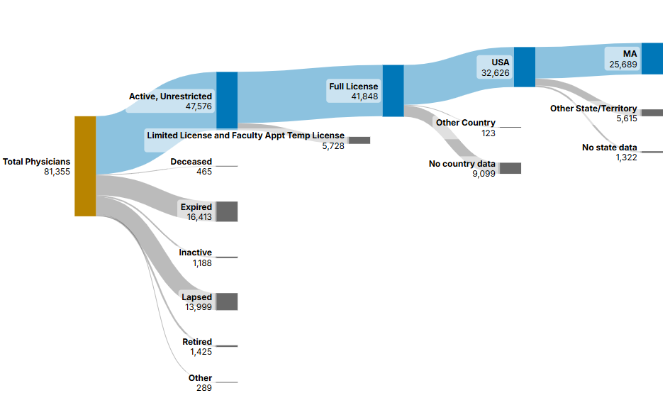
Physicians Licensed in MA: Geography
Of the physicians with full, active, unrestricted licenses*
61% reported a business address in Massachusetts
17% reported a business address in another state or didn't include state information
22% reported a business address in another country or didn't include country information
Source: Board of Registration in Medicine (BORIM)
Standard Release, 8/19/2025
*Note: Physicians licensed by the Board of Registration in Medicine (BORIM) include MDs and DOs. Physicians provided only 1 business address.

Slide 4
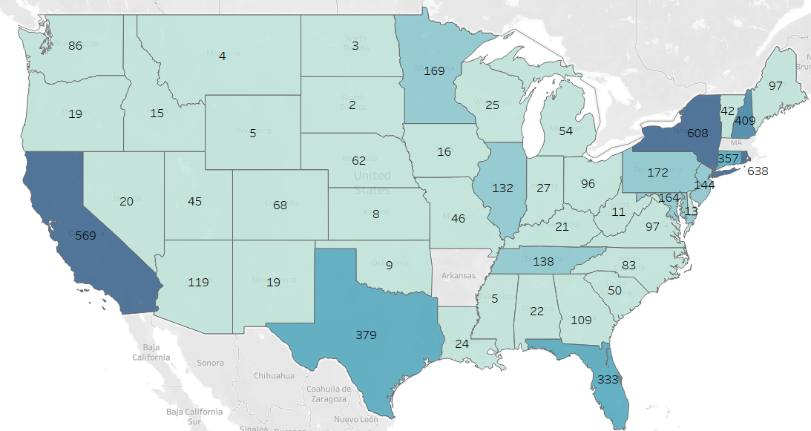
Where are physicians working outside of MA?
Top 5 states other than MA:
RI (2%)
NY (2%)
CA (2%)
NH (1%)
TX (1%)
*Note: Physicians licensed by the Board of Registration in Medicine (BORIM) include MDs and DOs. Physicians provided only 1 business address.
Source: BORIM Standard Release, 8/19/2025

Slide 5
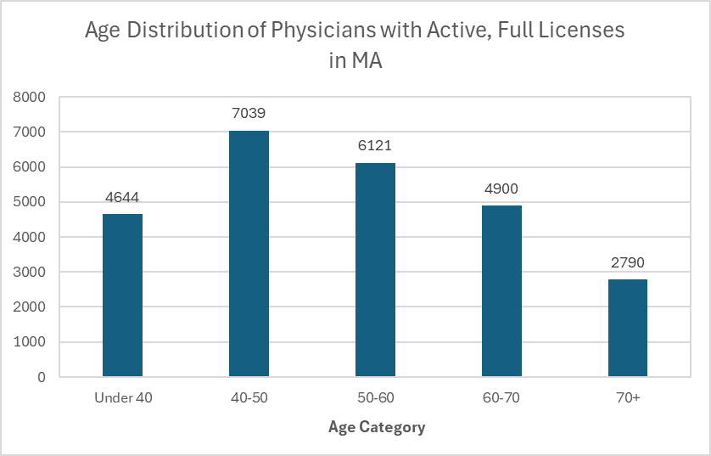
Age Distribution of MA Physicians
Nationally, the probability of remaining "Active" decreases sharply after age 64
Nationally, more physicians are reporting they plan to retire earlier (2022 compared to 2019)
Source: BORIM, 10/9/2025

Slide 6
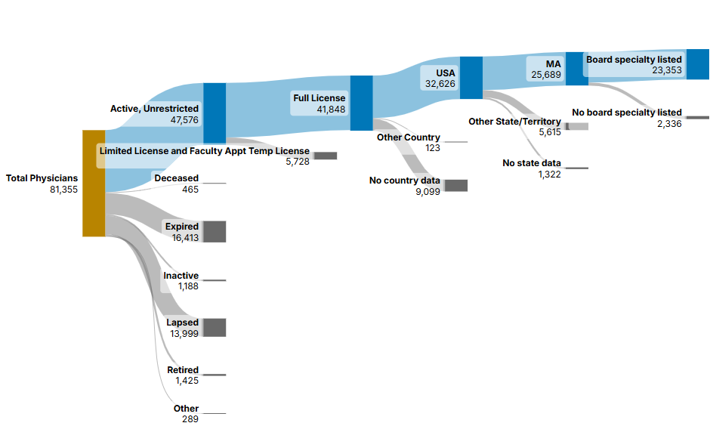
Physicians Licensed in MA: Specialties
Of the physicians working in MA*
91% reported a board specialty
*Note: Physicians licensed by the Board of Registration in Medicine (BORIM) include MDs and DOs. Physicians provided only 1 business address.
Source: BORIM Standard Release, 8/19/2025

Slide 7
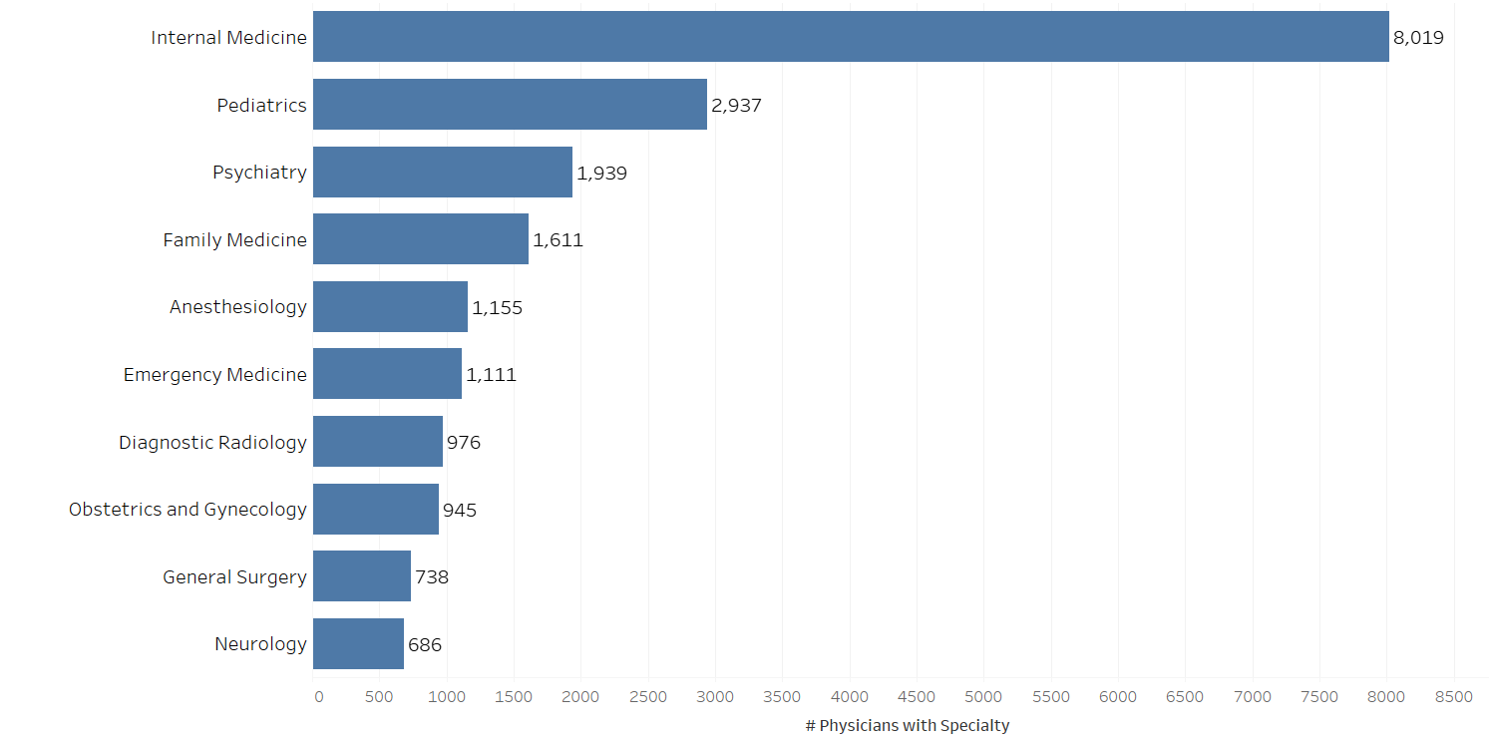
Physician Specialties in MA: Top 10
Note: Includes those with a business address in MA only. Physicians may report more than one specialty. Source: BORIM Standard Release, 8/19/2025

Slide 8
Primary Care Definition for Analysis
For this analysis, we estimated the primary care physician workforce by including the following specialties and subspecialties:
Specialty | Subspecialty
Family Medicine | Adolescent Medicine
 | Geriatric Medicine
 | None
Internal Medicine | Adolescent Medicine
 | Geriatric Medicine
 | None
Pediatrics | Adolescent Medicine
Obstetrics & Gynecology | None
Public Health & Preventive Medicine | None
Neuromusculoskeletal Medicine & Osteopathic Manual Manipulation | None
Includes specialties and subspecialties from both the ABMS and AOA
Source: https://www.mass.gov/info-details/masshealth-primary-care-sub-capitation-included-and-excluded-provider-specialties, Accessed 10/7/2025

Slide 9
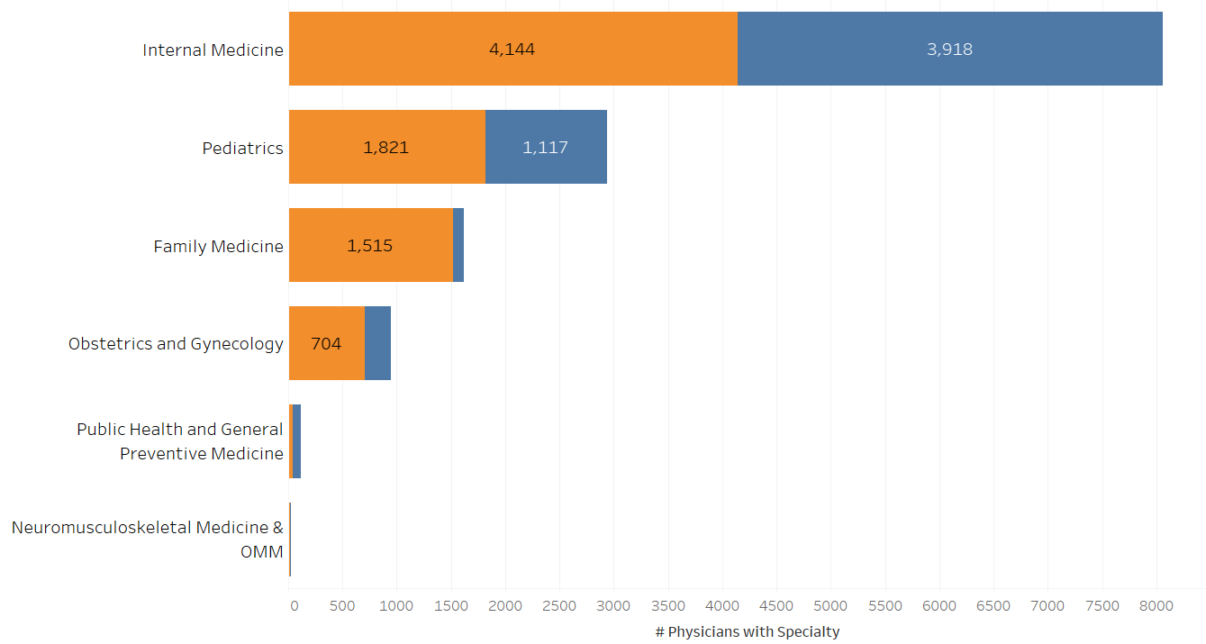

Physician Specialties in MA: Primary Care
MA Physicians Estimated to be in Primary Care by Selected Specialties*
34% of physicians working in MA had specialties that may fall under Primary Care
This includes physicians with no subspecialty, which may result in overestimation of the primary care workforce
*"Primary Care" was defined as either one or more of the displayed specialties and either no subspecialty or a subspecialty in Adolescent Medicine or Geriatric Medicine. Physicians could choose more than one specialty or subspecialty. Source: BORIM Standard Release, 8/19/2025.

Slide 10
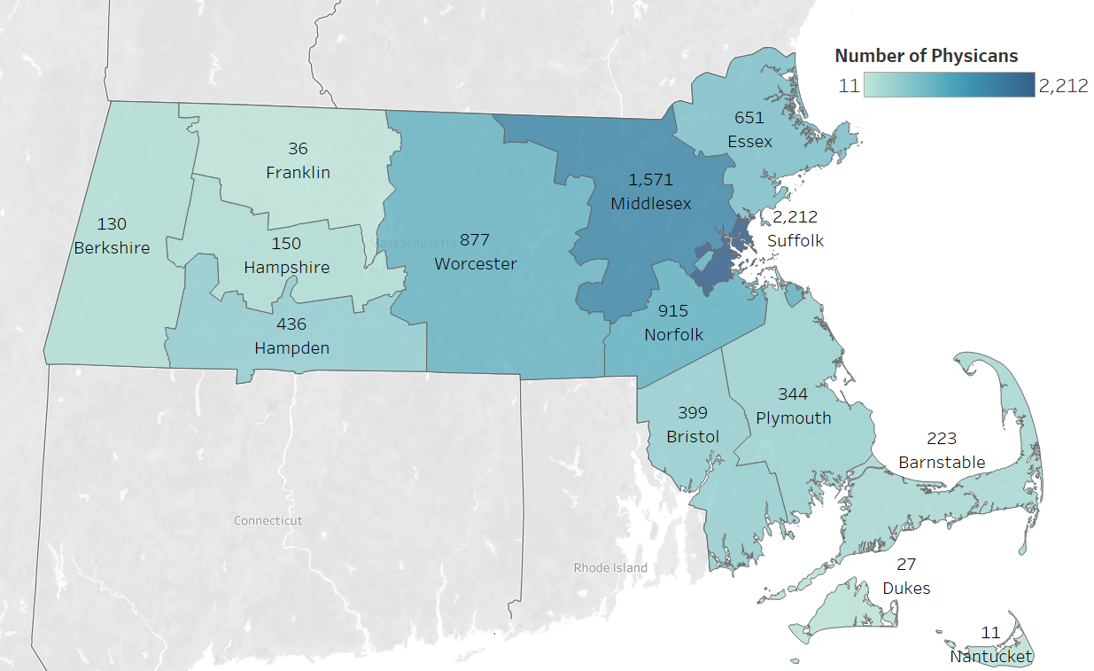
Primary Care Physicians by County: All Primary Care
Primary Care was defined as the number of physicians with one or more of the following specialties:
Family Medicine
Internal Medicine
Pediatrics
Obstetrics & Gynecology
Public Health & Preventive Medicine
Neuromusculoskeletal Medicine & Osteopathic Manual Manipulation
AND
Either no subspecialty or a subspecialty in Adolescent Medicine or Geriatric Medicine.
Physicians could select more than one specialty or subspecialty.
Source: BORIM Standard Release, 8/19/2025.

Slide 11
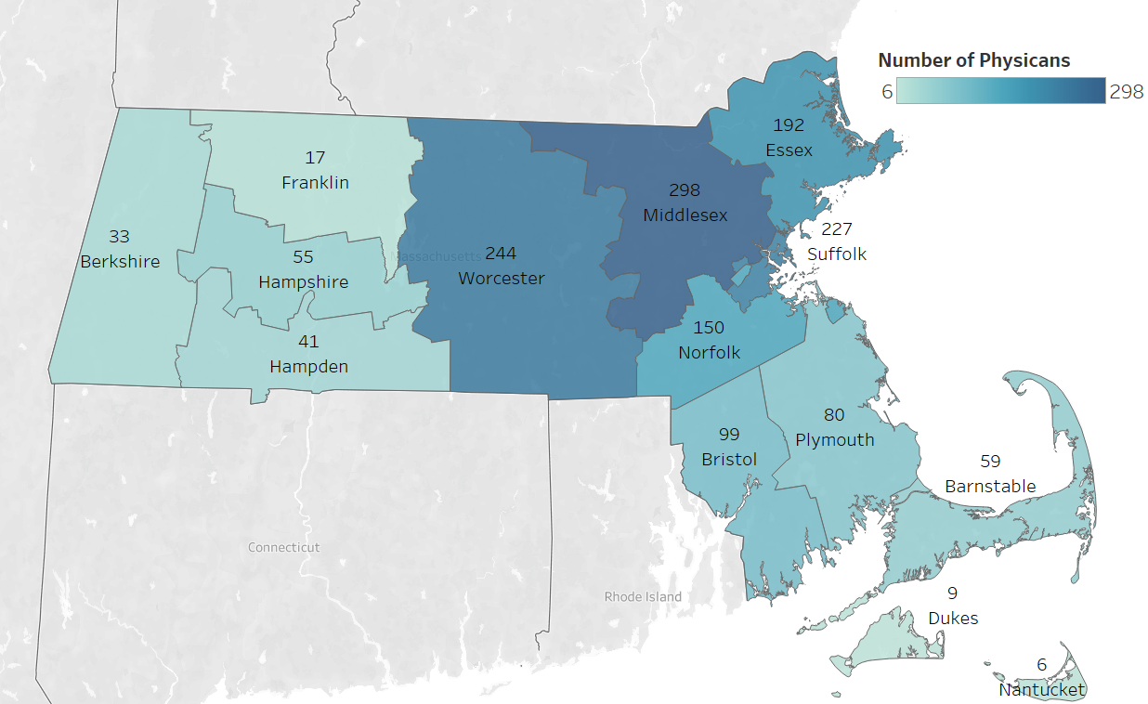
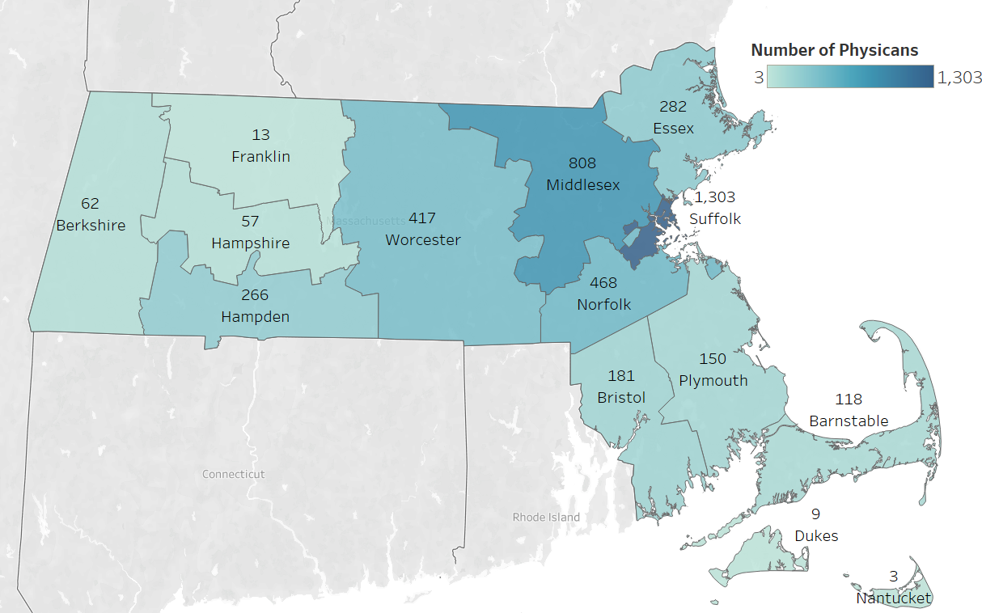
Primary Care Physicians by County: Family and Internal Medicine
Primary Care: Family Medicine includes the number of physicians with the Family Medicine specialty and either no subspecialty or a subspecialty in Adolescent Medicine and/or Geriatric Medicine.
Primary Care: Internal Medicine includes number of physicians with the Internal Medicine specialty and either no subspecialty or a subspecialty in Adolescent Medicine and/or Geriatric Medicine.
Physicians could select more than one specialty or subspecialty. Source: BORIM Standard Release, 8/19/2025.

Slide 12
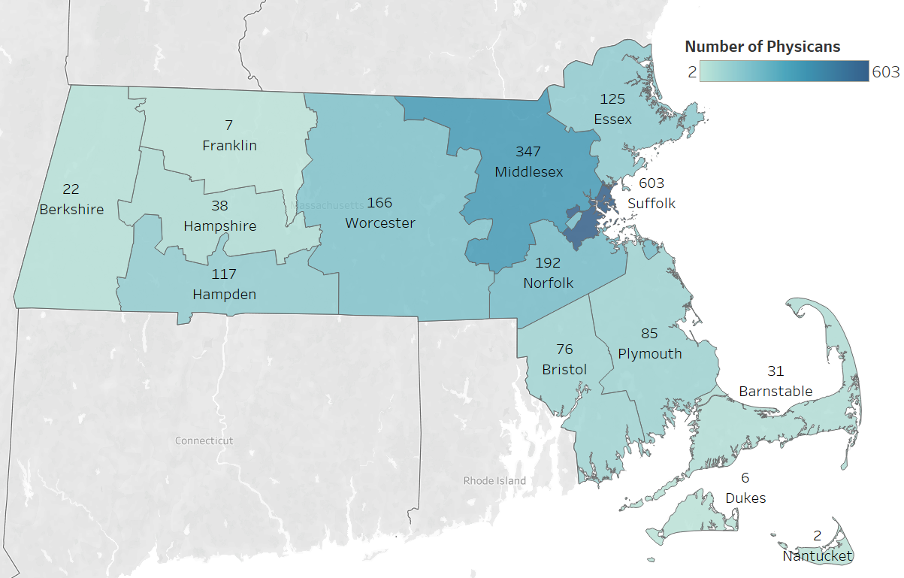
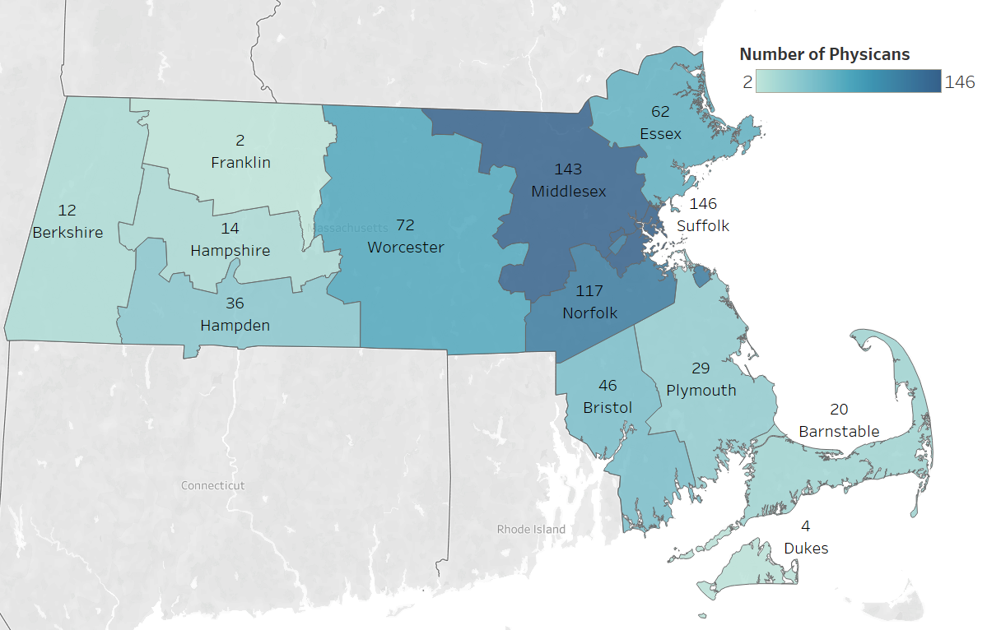
Primary Care Physicians by County: Pediatrics and OB/GYN
Primary Care: Pediatrics includes number of physicians with a specialty in Pediatrics and either no subspecialty or a subspecialty in Adolescent Medicine.
Primary Care: OB/GYN includes number of physicians with a specialty in Obstetrics & Gynecology and no subspecialty.
Physicians could select more than one specialty or subspecialty. Source: BORIM Standard Release, 8/19/2025.

Slide 13
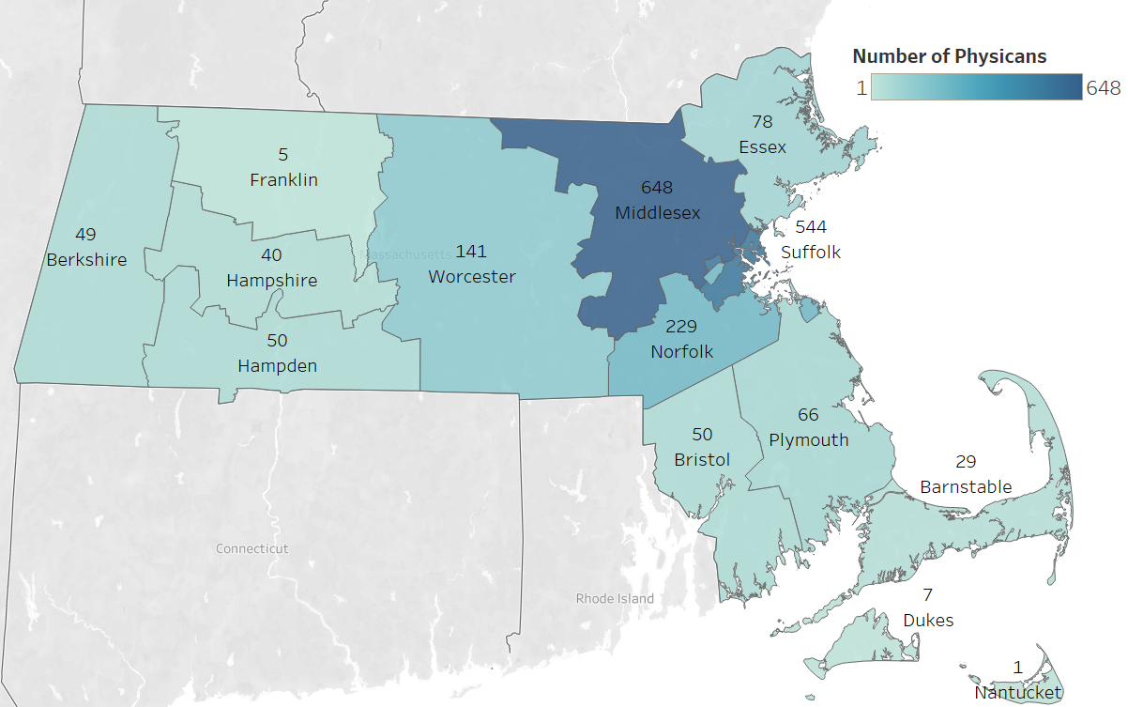
Primary Care Physicians by County: Psychiatry
Psychiatry: Includes number of physicians with all subspecialties and those with no subspecialty.
Physicians could select more than one specialty or subspecialty. Source: BORIM Standard Release, 8/19/2025.

Slide 14
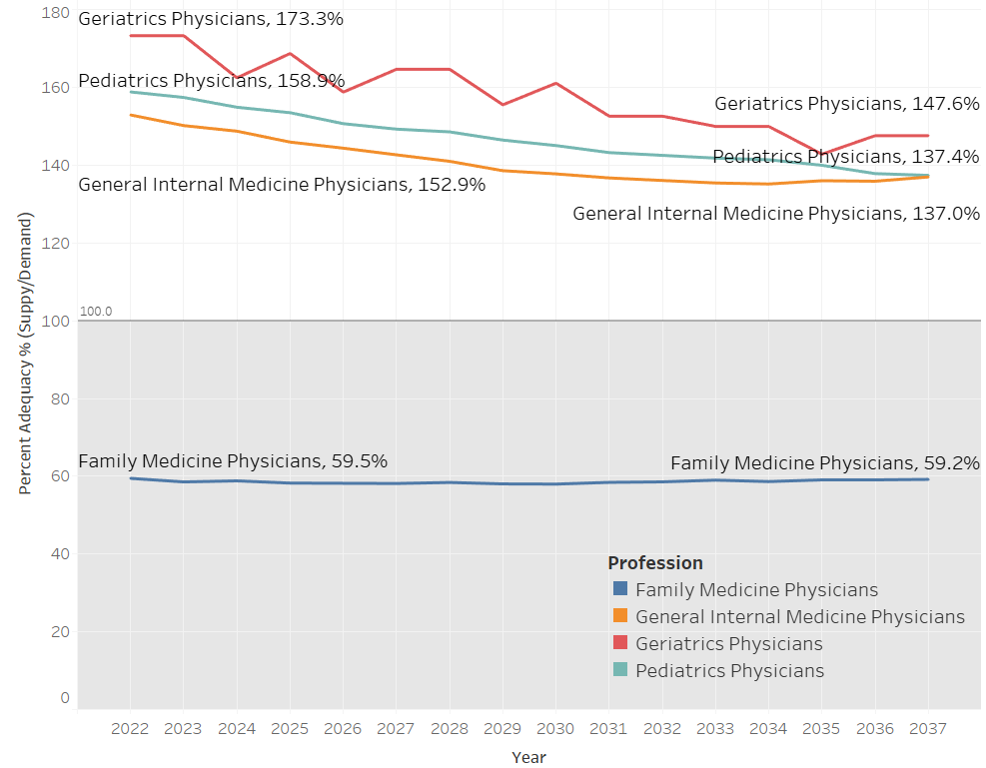
PCP Projections: Health Resources and Service Administration (HRSA)
HRSA Projected Percent Adequacy of Primary Care Physicians, 2022 - 2037
Percent adequacy = supply/demand.
Goal is greater than 100%
Summary:
The number of Family Medicine Physicians will not be enough to meet the need
The percent adequacy is projected to decrease for Geriatricians, Pediatricians, and General Internal Medicine Physicians, but will still stay above 100%
Source: HRSA workforce projections, Accessed 10/9/25

Slide 15
Matriculation & Graduation by Medical School
DPH conducted outreach at the end of September 2025 with the four medical schools in Massachusetts to obtain high-level data on matriculation, graduation, and residency enrollment over the last 3 years.
Medical School | Avg. Matriculation | MA In-State Matriculants (n, %) | Estimated All-time Graduation Rate* | % Enrolled in MA Residency
Harvard Medical School | 165 | 22 (13%) | 99.7% | 53%
Tufts Medical School | 202 | 64 (32%) | 99% | 29%
UMass Medical School | 222 | 139 (62%) | 97% | 42%
Boston University Medical School | 141 | 36 (26%) | 99.5% | 24%
*Includes students who graduated more than 4 years after MD program enrollment due to dual-degree programs, additional research years, or other reasons. BU graduation rate reflects the 2016 matriculant cohort, which is now complete.

Slide 16
Most Common Specialties: All Graduates vs. Graduates Remaining in Massachusetts
DPH conducted outreach at the end of September 2025 with the four medical schools in Massachusetts to obtain high-level data on matriculation, graduation, and residency enrollment over the last 3 years.
Medical School | Years | Top Matched Specialties (All Graduates) | Top Matched Specialties (Graduates Remaining in MA)
Harvard Medical School | 2023-2025 | Internal Medicine, Anesthesiology, Radiology, Psychiatry, OB/GYN | Internal Medicine, Anesthesiology, General Surgery
Tufts Medical School | 2023-2025 | Internal Medicine, Anesthesiology, Pediatrics, Psychiatry, General Surgery | Internal Medicine, Anesthesiology, General Surgery
UMass Medical School | 2022-2024 | Internal Medicine, Pediatrics, Family Medicine, OBGYN, Emergency Medicine | Internal Medicine, Family Medicine, Pediatrics
Boston University Medical School | 2023-2025 | Internal Medicine, Pediatrics, Surgery, Anesthesiology, Emergency Medicine | Internal Medicine, Pediatrics, Anesthesiology/ General Surgery/ Psychiatry

Slide 17




Telehealth Curricula in Medical Schools
DPH also conducted outreach at the end of September 2025 with the four medical schools in Massachusetts to obtain overviews of how telehealth is incorporated into their curricula.

Slide 18

Harvard Medical School
Key Learning Objectives
Understand how COVID-19 accelerated telehealth adoption and its benefits, challenges, and risks
Implement best practices for participating in telemedicine visits, including HIPAA compliance and patient safety
Perform physical exam maneuvers adapted for video visits to support clinical reasoning
Analyze telehealth experiences to develop recommendations for integrating medical students and trainees
Learn about telehealth payment and policy considerations after the pandemic

Slide 19

Tufts Medical School
Key Learning Objectives
Describe the history and role of telemedicine during the pandemic and its future in primary care
Outline the steps of a telemedicine visit
Demonstrate verbal and nonverbal communication skills for history-taking, assessment, and care planning
Perform parts of the physical exam feasible via telemedicine
Incorporated in the Family Medicine Clerkship

Slide 20

UMass Medical School
Key Learning Objectives
Describe the evidence base supporting Hospital at Home quality and safety
Describe current adoption of Hospital at Home in the United States
Describe barriers to further scale of Hospital at Home
Understand patient engagement and portal use in telehealth
Participate in telehealth visits with real patients during clinical training

Slide 21

Boston University Medical School –
Key Learning Objectives
Read and discuss: “Trauma-informed telehealth in the COVID-19 era and beyond” (Gerber et al.)
Explore benefits and drawbacks of telehealth
Best practices for trauma-informed, patient-centered virtual visits:
  Verify patient location and consent
  Ensure privacy and respect patient preferences/environment
  Maintain professional appearance and communication (body language, eye contact)
  Respond sensitively to patient cues and develop a mutual agenda
  Consider social determinants of health
Skills assessed via OSCE telehealth encounter at the end of clerkship
Incorporated in the Family Medicine Clerkship

Slide 22
Thank you!
https://www.mass.gov/the-massachusetts-health-care-workforce-center-hcwc

