Slide 1
Massachusetts
Telehealth Task Force
Executive Office of Health and Human Services
Submitted June 30, 2026

Slide 2
Table of Contents
1. Overview
2. Key Definitions
3. Focus of the Task Force’s Work
4. Models Considered
  Interstate Medical Licensure Compact
    Overview
    Advantages & Concerns
  Other Models
    Exemptions to Licensing
    Telehealth Registries
    Regional Agreements
5. Overall Findings and Recommendations
6. Appendices
  Appendix A – Legislative Mandate
  Appendix B – Task Force Members
  Appendix C – Summary of Meetings
  Appendix D – Interstate Medical Licensure Compact Member States
  Appendix E – Telehealth Patient Scenario Chart

Slide 3
Overview of the Task Force
The Telehealth Task Force was established in July 2025 with the enactment of the FY2026 Budget (Chapter 9, Section 109 of the Acts of 2025).
The Task Force was chaired by Executive Office of Health and Human Services (EOHHS) Assistant Secretary Joanne Marqusee, acting as the designee of the EOHHS Secretary. It was comprised of a diverse panel of public health professionals, representatives from community health centers, hospitals, and health care providers trade associations, as well as experts in health care administration and business regulation (see full list in Appendix B).
The Task Force met eight times from September 2025 through May 2026 and was charged with studying and proposing recommendations to address barriers and impediments to the practice of telehealth across state lines.
All meetings of the Task Force were subject to the Massachusetts Open Meeting Law; minutes were taken and approved for each meeting. Appendix C outlines the meetings and input provided, including the individuals who presented as well as their materials. All materials considered by the Task Force, including meeting minutes, are posted on a publicly-available Mass.gov webpage:
Telehealth Task Force Meeting Materials | Mass.gov
The Task Force was required to submit its report to the Joint Committee on Health Care Financing by July 1, 2026.

Slide 4
Key Definitions
Telemedicine: the remote delivery of healthcare services, including consultations, diagnoses, and treatment, using telecommunications technology like video conferencing, smartphones, or secure messaging. It allows patients to connect with doctors from home, enhancing access to specialists, improving convenience, and reducing the need for travel or waiting room exposures. Just like in-person health care, telemedicine requires that a physician be licensed in the state the patient is located at the time the care is provided. (Note: Throughout this report, we use the terms “telemedicine” and “telehealth” interchangeably.)
Interstate Medical Licensure Compact (IMLC or “the Compact”): agreement among participating states which adopt model legislation creating a voluntary, expedited pathway for licensure for physicians who qualify.
State of Principal License (SPL): Compact member state designated as the physician's primary residence and from which the physician holds a full unrestricted medical license.
Reciprocity Agreement: in the context of telemedicine, an agreement made between neighboring states that recognize the medical licenses issued by the other state based on qualifying criteria.
Regional Agreement: in the context of telemedicine, an agreement made between neighboring states that establishes an expedited pathway for licensing or exemptions to licensing based on qualifying criteria.
Shield Laws: legal protections enacted to protect patients and providers from out-of-state legal actions. These laws, enacted at the state level, vary in scope but aim to prevent the restriction of legally protected health care services.
Telehealth Registries: model in which physicians licensed in other states can register with states’ boards of registration or physician licensing authorities to obtain a special license to deliver telehealth services only.

Slide 5
Focus of the Telehealth Task Force’s Work (1 of 3)
The Task Force spent most of its time reviewing the various models that other states have taken to facilitate the provision of telehealth services across state lines.
It was noted by the Task Force that patients are increasingly mobile, particularly with the growth of remote work since the pandemic, and thus there is increasing demand for physicians to provide telehealth to patients located in another state. As physicians can only provide care to patients located in other states (in-person or through telehealth) if they have a license from that state, physicians must adhere to the laws and regulations of the state in which the patient is located at the time the care is provided.
The primary focus of the group’s deliberations was on facilitating telehealth practice for physicians who work in and are licensed by Massachusetts to provide care to patients in other states.
  For patients who are under the care of a Massachusetts physician, facilitating licensing of Massachusetts-based physicians in other states has the potential to enable more physicians to provide continuity of care through telehealth visits when such patients are temporarily located in another state.

Slide 6
Focus of the Telehealth Task Force’s Work (2 of 3)
  The Task Force recognized improving access to telehealth services would impact various stakeholders:
  Patients living in Massachusetts, but traveling out of state on a temporary basis and looking to maintain continuity of care with their healthcare team through telehealth (vacation, college, snowbirds, neighboring states);
  Patients living outside Massachusetts, but getting virtual care services by Massachusetts-based clinicians (neighboring states, access to highly specialized care);
  Patients living in Massachusetts, but seeking virtual care from providers outside the state;
  Physicians based in Massachusetts, looking to care for established patients via telehealth who are temporarily out of state as part of care continuity;
  Physicians based outside of Massachusetts, looking to care for patients who are in the state on a temporary or permanent basis;
  Physicians who are providing telehealth services exclusively and who care for patients in a multi-state or national practice.
  Additional details regarding how each of the various interstate licensing options might impact patient care appears in the Telehealth Patient Scenario Chart in Appendix E.

Slide 7
Focus of the Telehealth Task Force’s Work (3 of 3)
This report summarizes the learnings and recommendations of the Telehealth Task Force.
The majority of the Task Force’s time was spent on reviewing the Interstate Medial License Compact. Thus, this report delves into significant details about how the Compact works, what it could accomplish for physicians and patients, as well as the risks of joining the Compact.
In general, the Compact appears to offer several notable benefits, namely the potential ease for Massachusetts-based physicians to apply for interstate licenses through an existing, widely-used model. It also has some distinct risks for physicians who have obtained their licenses through the Compact, with regard to another state taking disciplinary action against physicians for activities that are allowable in Massachusetts. Thus, the Task Force dedicated a fair amount of time reviewing and discussing the potential disciplinary impact.
Members also considered other models that could make it easier for Massachusetts-physicians to be licensed in other states and summaries of those are included in this report. While these other models are more limited in what they could accomplish, they also entail potentially less risk for physicians than if the physician pursued the Compact pathway.
It was noted that multiple models could be pursued simultaneously to improve continuity of care for patients.
This report provides further information and clarification on these issues.

Slide 8
Models Considered
Interstate Medical Licensure Compact
Exemptions to Licensing
Telehealth Registries
Regional Agreements

Slide 9
Interstate Medical Licensure Compact – Overview (1 of 2)
The Interstate Medical Licensure Compact (IMLC or “Compact”) is an expedited process for physicians to obtain full, unrestricted licenses to practice medicine issued through the Compact member states’ boards of registration or physician licensing authorities and subject to each state’s medical practice act.
The Compact is overseen by the Interstate Medical Licensure Compact Commission (link).
  This Commission is an 80+ member body comprised of physician members of state medical or osteopathic physician licensing boards, public members of such boards, or executive directors or administrators of state medical or osteopathic physician licensing boards.
  The Commission was established in 2015 with assistance from the Federation of State Medical Boards, a group of state medical board executives, administrators, and attorneys, which drafted a model compact.
While the Commission oversees the work of coordinating multi-state licensing activity within the Compact, the Commission does not issue licenses. Licenses are issued by the states that participate in the Compact – not by the Commission itself.
Currently the IMLC has 44 member jurisdictions. These states and U.S. territories have formally passed legislation to adopt the Compact. Of those, 38 states/territories are active/full member jurisdictions; 3 participate through the issuance of licenses only; and 3 member jurisdictions are actively implementing but not yet participating in the Compact. All New England states have passed legislation to join the Compact, except Massachusetts. (See Appendix D for map of Compact member states.)

Slide 10
Interstate Medical Licensure Compact – Overview (2 of 2)
Unlike the Nurse Licensure Compact, which enables nurses to practice in-person or provide telehealth services to patients across the country without obtaining additional licenses, the IMLC is not based on a reciprocity agreement model, but rather offers an expedited pathway to physicians to obtain medical licenses.
The licenses obtained through traditional pathways vs. Compact pathways are the same; it is the process of obtaining them that differs. However, as referenced earlier, there are implications for physicians who obtained licenses through the Compact pathway, specific to disciplinary actions. More detail on the implications for disciplinary action are described on Slide 13.
If a state is a member of the Compact, physicians in that state can choose to apply for licensure in other Compact states either through a traditional pathway (i.e., the same way they would if there were no Compact) or through an expedited pathway made possible by membership in the Compact. That is, if Massachusetts were to join the Compact, a Massachusetts physician would still have the option to seek licensure in other states through the traditional pathways.
Applying via the Compact pathway does not automatically reduce the time and administrative burden on physicians. In fact, obtaining a license through the Compact may increase licensure costs for some physicians and decrease costs for others, depending on how many licenses they obtain. Physicians interested in applying through the Compact pathway for a license in another Compact state must pay a fee to the Compact as well as to the state(s) boards of registration or physician licensing authorities to which they are applying. Applying through the Compact, however, can lead to cost savings for physicians applying for many licenses by reducing license verification fees applicants are required to pay when applying through the traditional pathway.

Slide 11
Interstate Medical Licensure Compact – Advantages & Concerns (1 of 3)
The Telehealth Task Force concluded that joining the Compact could have positive impacts with regard to the ability of physicians to provide telehealth services across state lines, a stated focus of the Task Force.
In particular, belonging to the Compact may make the process for obtaining medical licenses in other states less burdensome, less costly for some, and potentially quicker for Massachusetts-based physicians. This could improve continuity of care for Massachusetts-based physicians’ who have significant numbers of patients that live full-time or part-time in other states (e.g., people living in neighboring states, snowbirds, etc.). It could also facilitate physicians providing highly-specialized services through telehealth to residents of other states.
Members noted that while the initial administrative burdens for applying and renewing a license may be reduced for some physicians, as noted earlier, the costs and time requirements of maintaining licensure, such as continuing medical education (CME), would be the same whether the physician has attained licensure through the traditional pathway or the Compact pathway.
It was particularly noted that even if Massachusetts joined the Compact, individual physicians could opt to obtain licenses in other states through the traditional pathway, which would not be impacted by the Compact.
The Task Force was unsure how many Massachusetts-based physicians would opt to seek licensure in other states through the Compact pathway, given that the fee to the Compact would only be recovered if the physician were seeking licensure in many states. However, there are clearly some Massachusetts-based physicians who would pursue the Compact pathway, given the populations they serve.
The most significant concern discussed by the Task Force with regard to Massachusetts joining the Compact was the implications if another Compact state were to take disciplinary action against the physician.

Slide 12
Interstate Medical Licensure Compact – Advantages & Concerns (2 of 3)
While the IMLCC has issued policy briefs stating that member states maintain the sovereign right to determine their practice of medicine and another state may not impose their standards, the Task Force devoted significant time and attention to the implications of joining the Compact on the existing Massachusetts Shield laws. Questions and concerns focused on if/how a Massachusetts-based physician having a license obtained through the Compact pathway could be impacted if another state took disciplinary action for care that would otherwise be permitted in Massachusetts, but is not permitted in that state (e.g., reproductive care or gender affirming care).
However, disciplinary actions taken by one state where a physician has a license attained through the Compact pathway can impact the physician in the other Compact states. Whether Massachusetts would be required to take action depends on the level of the discipline.
The next slide provides details about the implications for disciplinary action.

Slide 13
Interstate Medical Licensure Compact – Advantages & Concerns (3 of 3)
If a Compact state revokes, suspends, or accepts the surrender of the license of a physician that attained their license through the Compact pathway, the other states in which that physician attained a license through the Compact pathway (including the state that is the physician’s SPL) must issue a 90-day suspension. If that happened to a physician licensed through the Compact pathway in Massachusetts, the Massachusetts Board of Registration in Medicine (BORIM) can re-instate the physician’s license immediately or move forward with discipline in Massachusetts, as long as the state that revoked license is not the physician’s State of Primary License (SPL). If the state that initially revoked the license is the physician’s SPL, BORIM must revoke the physician’s Massachusetts license if it was acquired through the Compact. However, BORIM can still offer the physician a license through the traditional pathway.
  If the other state takes less substantial disciplinary action, it is up to the other Compact states to determine if they want to take similar actions or not.
  If Massachusetts had to revoke the license, based on another state’s action, even if it is quickly reinstated, the physician’s Massachusetts license would carry a record of the discipline. The physician would be required to note that a revocation had occurred when applying to a hospital and/or insurer for credentialling. (This would be true whether revocation had happened in a Compact state or one that the physician had a license through traditional pathway.)
  This potential impact of disciplinary action was a concern for the Task Force, as was the potential for other actions that states might take in the current political environment that could be at odds with the spirit and letter of Massachusetts Shield laws.

Slide 14
Other Models
As noted, while the IMLC appeared to offer several notable benefits given the large number of states participating, other models were considered that have the potential to facilitate the ability of physicians to provide telehealth across state lines.
The next several slides provide an overview of the three models the Task Force considered:
  Exemptions to Licensing
  Telehealth Registries
  Regional, Compact-like Agreements
Adoption of these models would require further review, including discussions with other states, to operationalize.
It is important to note that multiple models could be implemented simultaneously by the state regardless of whether Massachusetts chose to join the IMLC.
It was recognized that options that do not require full licensure may be more appropriate for the use case of telehealth for temporary continuity of care.
A comparison of how each of the various interstate licensing options above might impact patient care appears in the Telehealth Patient Scenario Chart in Appendix E.

Slide 15
Other Models – Exemptions to Licensing
Many state licensing boards have exemptions that allow physicians to deliver services via telehealth and in some limited cases in-person care to patients without a license under limited circumstances.
Some common circumstances are physician to physician consult, prospective patient screening, episodic follow-up care, follow-up after travel, or clinical trials.
Massachusetts has an existing law allowing limited licensing exemptions: Chapter 112, Section 7
Currently three New England states have some limited exemptions to licensing within their statutes.
The Task Force discussed the feasibility of working with neighboring states (Maine, New Hampshire, Vermont, New York, Connecticut, and Rhode Island) which would expand exemptions to licensing requirements based on specific circumstances and physician-to-patient relationships. The process could consist of a simple application with low cost or no fees for a registration, valid for two years. If established, BORIM would be responsible for publishing the registry of approved physicians and notifying other regional boards.
Such a multi-state exemption to licensing model would require new legislation. While each state in turn would need to pass similar legislation, Massachusetts law could require mutuality before exemption in Massachusetts takes effect.

Slide 16
Other Models – Telehealth Registries
Telehealth registries allow out-of-state physicians licensed in other states to provide telehealth services via registry or telehealth license.
These registries are maintained by state boards of medicine and allow physicians licensed in other states to register or obtain a special license to deliver telehealth services only, with abbreviated applications.
There are currently 20 states with telehealth registries or licenses within their statutes, including four New England states (Connecticut, Maine, New Hampshire, and Vermont), but it is unclear how many remain active given the expansion of the IMLC across most states and territories (currently 44 member jurisdictions).
While useful during the early days of the pandemic, other interstate policy options have now gained popularity over telehealth registries. However, there may be value in Massachusetts exploring a regional telehealth registry model.

Slide 17
Other Models – Regional Agreements
Regional agreements between neighboring states may establish expedited pathways for licensing or licensing exemptions for physicians within their jurisdiction, while offering potentially greater flexibility for participating states to set the terms of the agreement, e.g., the criteria to grant licensure, how disciplinary actions are handled, etc.
One such example is the agreement established between Washington, DC, Maryland, and Virgina. While only Washington, DC and MD are members of the IMLC, in March 2023, all three entered into a "Memorandum of Agreement" (MOA) recognizing medical licenses issued by other parties and creating an expedited process for licenses received from physicians located in other MOA party states.
The Task Force was supportive of Massachusetts further exploring the establishment of a similar regional expanded exemption agreement. Such an agreement could be implemented with neighboring states, thereby making it easier for physicians from one of those states to seek licensure in another. Further, the Task Force concluded that should such an agreement be enacted, that it not include any implications for disciplinary action beyond those that exist in the traditional pathways, e.g., sharing of information among states about disciplinary action taken.

Slide 18
Task Force’s Overall Findings and Recommendations (1 of 4)
Overall Findings
The increased usage of telehealth as a modality has greatly expanded since the COVID-19 pandemic.
There is interest in expanding telehealth services to Massachusetts residents that travel to other states (i.e., college students or older adults that travel to warmer climates). This is viewed as particularly important to maintain continuity of care.
The primary purpose of the Task Force was focused on the provision of telehealth services across state lines, which necessitated a careful examination of the risks and benefits posed for Massachusetts-based physicians that electively choose to practice under the authority of another governing body (i.e. IMLC or other states board of medicine).
Overall, the IMLC offered the most comprehensive pathway for physicians to obtain interstate licensure. However, the addition of other policy options such as regional agreements, exemptions to licensing, or telehealth registries offers the most flexible access for continuity of care for patients.
Entering into the Compact would not dilute any of the requirements that Massachusetts has for physicians licensed in Massachusetts. All state laws and regulations would have to be followed by any physician licensed here regardless of which path they took to attain that license.

Slide 19
Task Force’s Overall Findings and Recommendations (2 of 4)
As outlined earlier, utilization of the IMLC pathway poses some specific risks for physicians, in light of the potential for mandatory disciplinary action based on another state’s actions. Given the current political climate on gender-affirming care and reproductive health care, this was of particularly concern for the Task Force.
There were also concerns expressed that the imposition of disciplinary actions based on another state’s decision starts to blur the lines vis-à-vis standards of care being set at the state level.

Slide 20
Task Force’s Overall Findings and Recommendations (3 of 4)
Recommendations
While some Task Force members concluded that the risks (current and unknown future risks) were too significant to recommend that Massachusetts join the IMLC, others felt comfortable that the risk of joining the Compact could be somewhat mitigated with the following actions and would recommend that those actions be taken if the Legislature chooses to move forward:
  Ensure that physicians are educated that even if Massachusetts joins the Compact, it is up to individual physicians whether to apply for licensure in another state through the traditional pathway or the Compact pathway
  Ensure that physicians are educated about the potential disciplinary risks of pursuing licenses through the Compact pathway.
  Include additional statutory language that clarifies that the IMLC does not impact licenses obtained through the traditional pathway
  Include additional statutory language clarifying the IMLC does not supersede existing Massachusetts shield laws.
The Task Force believes that should the IMLC revise its approach to disciplinary actions, the Task Force would recommend Massachusetts again consider entering into the Compact.

Slide 21
Task Force’s Overall Findings and Recommendations (4 of 4)
Additionally, there was consensus that two of the other three models – specifically the telehealth exemptions to licensing and the regional agreement approaches – while more limited in scope than the IMLC, should be further explored and considered for adoption to facilitating use of telehealth across state lines. (The third option – telehealth registries – does not appear to be well-utilized in most states, but could warrant further exploration.)
While further discussion with other states and likely enactment of state legislation would be required, exploring these approaches could lead to improvements in continuity of care for patients and physicians.
A number of topics were deemed out of scope for the Task Force but worth exploring in the future: payment parity for telehealth services; interstate licensing for non-physician providers (including what the implications are for other compacts and reciprocity licensing models); cost and timeframe of licensing across multiple states; differing states’ telehealth regulations; and continuing medical education (CME) burdens for multiple state licensing.

Slide 22
Appendices

Slide 23
Appendix A – Legislative Mandate
FY2026 Budget – Chapter 9, Section 109 of the Acts of 2025
a) The executive office of health and human services shall establish a task force to address barriers and impediments to the practice of telehealth across state lines. The task force shall consist of the following 9 members: the secretary of the executive office of health and human services or a designee, who shall serve as chair; the commissioner of the department of public health or a designee; the commissioner of the department of mental health or a designee; the executive director of the board of registration in medicine or a designee; the undersecretary of the office of consumer affairs and business regulation or a designee; a representative from the health policy commission; a representative from the Massachusetts Medical Society; a representative from the Massachusetts Health and Hospital Association; and a representative from the Massachusetts League of Community Health Centers.
b) The task force shall conduct an analysis and issue a report evaluating the commonwealth's options to facilitate appropriate interstate medical practice and the practice of telemedicine, including, but not limited to, consideration of the recommendations from the Federation of State Medical Boards Workgroup on telemedicine, the Telehealth Act developed by the Uniform Law Commission, model legislation developed by the American Medical Association, the interstate medical licensure compact and other licensure reciprocity agreements.
The analysis and report shall include, but shall not be limited to:
analysis of physician job vacancies in the commonwealth broken down by practice specialization and projected vacancies based on the demographics of the commonwealth's physician workforce and medical school graduate retention rates;
analysis of other states' entry into the interstate medical licensure compact and any impact on quality of care resulting from entry;
analysis of the ability of physicians to provide follow-up care across state lines, including via telehealth;
analysis of registration models for providers who may provide care for patients via telehealth with the provider located in one state and the patient located in another state; provided, that said analysis shall include delineation of provider responsibilities for registration and reporting to state professional licensure boards;
analysis of impacts to health care quality, cost and access resulting from other states' entry into a medical licensure compact and anticipated impacts to health care quality, cost and access associated with entry into an interstate medical licensure compact;
evaluations of barriers and solutions regarding prescribing across state lines;
evaluations of the feasibility of a regional reciprocity agreement allowing telemedicine across state lines both for existing patient provider relationships and the establishment of new relationships;
evaluations of the feasibility of the establishment of interstate proxy credentialing; and
recommendations to support the continuity of care for patients utilizing telehealth across state lines, including, but not limited to, recommendations to support the continuity of care for people aged 25 and under when providing telehealth across state lines.
c) The task force shall submit its report, including any recommendations, to the clerks of the house of representatives and the senate and the joint committee on health care financing not later than July 1, 2026.

Slide 24
Appendix B – List of Task Force Members and Affiliations
Seat | Member
Designee of the Secretary of the Executive Office of Health and Human Services (EOHHS), and Chair | Joanne Marqusee, Assistant Secretary, EOHHS
Designee of the Commissioner of the Department of Public Health (DPH) | Jess Zeidman, Deputy Commissioner/ Chief Medical Officer, DPH
Designee of the Commissioner of the Department of Mental Health (DMH) | Martha Ryan, Assistant Commissioner for Clinical & Professional Services/Director of Licensing, DMH
Designee of the Executive Director of the Board of Registration in Medicine (BORIM) | Vita Berg, General Counsel, BORIM
Designee of the Undersecretary of the Office of Consumer Affairs and Business Regulation (OCABR) | David Martin, Deputy Undersecretary, OCABR
Representative from the Health Policy Commission (HPC) | Kara Vidal, Director of HPC’s Office of Health Resource Planning (OHRP)
Representative from the Massachusetts Medical Society (MMS) | Philip Ciampa, Medical Director of Digital Health, Optum Massachusetts
Representative from the Massachusetts Health and Hospital Association (MHA) | Adam Delmolino, Senior Director of Virtual Care and Clinical Affairs, MHA
Representative from the Massachusetts League of Community Health Centers | Zandra Kelley, Senior Vice President/Chief Medical Officer, Greater Lawrence Family Health Center

Slide 25
Appendix C – Summary of Meetings
Presenters | Topics Discussed | Resources and Supporting Documents
September 17, 2025
Jeremy Sherer Eric Fish | Overview of interstate licensure policies impacting telehealth | Interstate Licensure Approaches
October 15, 2025
Marschall Smith | Overview of the Interstate Medical Licensure Compact | IMLCC Presentation
Department of Public Health’s Office of Health Care Strategy and Planning (OHCSP) | Massachusetts physician workforce data | Physician Pipeline Data

Slide 26
Appendix C – Summary of Meetings (cont.)
Presenters | Topics Discussed | Resources and Supporting Documents
November 12, 2025
Micah Matthews | Washington Medical Commission compact and interstate telehealth pathways | Washington Medical Commission presentation
Washington, DC Office of Health Professional Licensing Boards | Washington, DC DMV interstate pathways | Washington DC DMV Reciprocity presentation
January 14, 2026
Vita Berg | IMLC vs. Massachusetts physician licensure | BORIM Presentation

Slide 27
Appendix C – Summary of Meetings (cont.)
Presenters | Topics Discussed | Resources and Supporting Documents
February 11, 2026
Marschall Smith | Discussion on IMLC and Shield Laws | IMLC Presentation
Suneer Chander & Vivek Chander | Physician Experience In Multi-State Practice | Physician Experience
March 11, 2026
Patricia Yu | Overview of interstate telehealth policies | Telehealth Interstate Policy Options
Vita Berg | Discussion on alternative regional model | Regional Model based on Exemption from Licensure
Joanne Marqusee | Scenarios impacting physicians in the IMLC or traditional MA License | Scenarios document

Slide 28
Appendix C – Summary of Meetings (cont.)
Presenters | Topics Discussed | Resources and Supporting Documents
April 15, 2026
Joanne Marqusee | Discussion of the Task Force’s findings and working draft of the Task Force’s report
May 13, 2026
Joanne Marqusee | Discussion of the Task Force’s findings and working draft of the Task Force’s report

Slide 29
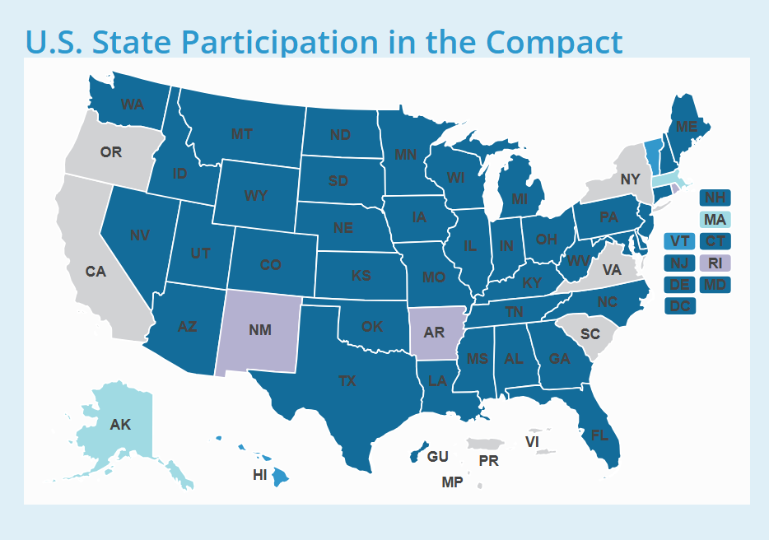
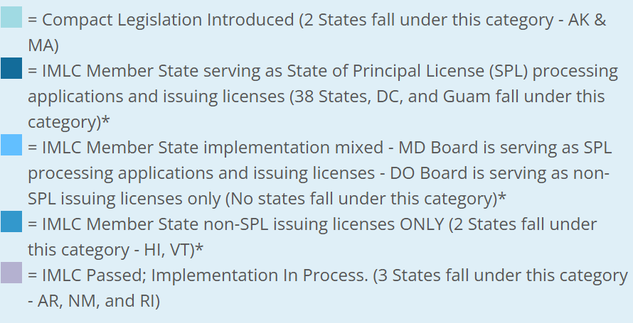
Appendix D – Interstate Medical Licensure Compact Member States

Slide 30
Appendix E – Telehealth Patient Scenario Chart
Telehealth Patient Scenarios vs. Interstate Pathways for Physicians
The table below was developed during the Task Force’s deliberations to help illustrate the commonalities and distinctions between the various interstate licensing options that Massachusetts could pursue.
It was noted that multiple pathways could be implemented, allowing for greater flexibility and access to telehealth services for patients.
Patient Scenarios | IMLC | Regional Agreement | Telehealth Registry | Exemptions to Licensing
 | Expedited pathway for full licensure | Expedited pathway for full licensure or reciprocity agreement | Special license or registration to deliver only telehealth service | Provide services to patients that fall under discrete circumstances
MA Resident travels to another state and needs a new diagnosis and treatment | MA Physician may treat this patient | MA Physician may treat this patient | MA Physician may treat this patient | No, MA Physician may not treat this patient as it does not fall under discrete circumstances (i.e., established patient or follow-up care)
Established MA Resident travels to another state and needs follow-up care, physician consult, prospective patient screening, or clinical trials | MA Physician may treat this patient | MA Physician may treat this patient | MA Physician may treat this patient | MA Physician may treat this patient only under discrete circumstances
Established MA Resident needs care that is outside the other state’s medical guidelines | No MA Physician must follow the other state’s guidelines | No MA Physician must follow the other state’s guidelines | No MA Physician must follow the other state’s guidelines | No MA Physician must follow the other state’s guidelines
Visitor to MA seeking care from doctor from another state | Other State doctor may treat this patient | Other State doctor may treat this patient | Other State doctor may treat this patient | Other State doctor may treat this patient only within discrete circumstances

