Slide 1
Massachusetts Tiered System of Support (MTSS)
Office of Tiered System of Supports (OTSS)
Somerville Public Schools
Winchendon Public Schools
October 26, 2012

Slide 2
Agenda
Overview of MTSS
Panel discussion
  Somerville Public Schools – Debbie Connell
  Winchendon Public Schools – Cindy Landanno
                Jane Ripley

Slide 3
What is going on in your district?
Has your district developed a tiered system of support?
  In what stage of implementation?
Has your district provided guidance on the relationship between a tiered system of support and the special education referral process?
  If yes, do you also include other assessments (e.g., cognitive) in the determination process?
Are you using data collected through the tiered process for determining eligibility for specific learning disabilities?

Slide 4
Who is in the audience?
Have you heard a MTSS presentation before?
Are you familiar with Universal Design for Learning?
Do your district responsibilities include more than just Special Education oversight?
  Title I and Special Education?
  Student Support Services (including Special Education)
  Other

Slide 5
The Massachusetts Tiered System of Support (MTSS)
MTSS focuses on system structures and supports across the district, school, and classroom to meet the academic and non-academic needs of all students, including students with disabilities, English language learners, and students who have already demonstrated mastery of the concepts and skills being taught.
5

Slide 6
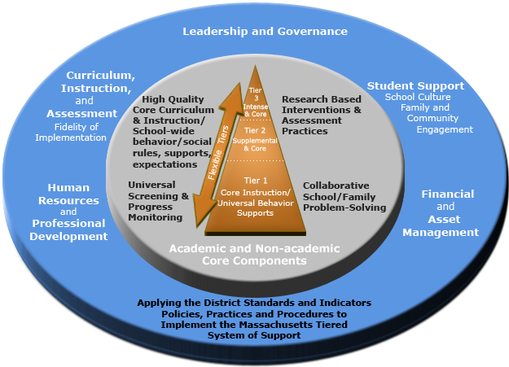
Blueprint for the Massachusetts Tiered System of Support

Slide 7
Website introduction
www.doe.mass.edu/mtss

Slide 8
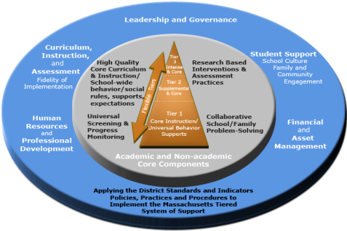




Interrelated Non-academic and Academic Supports
Academic Supports
Academic
Non-academic
Flexible Tiers within the MTSS
Non-academic Supports
Non-related Non-academic and Academic Supports
Notes:
8

Slide 9
  1-5% of total student population receive instruction through these intense interventions
Tier 3
Core & Intense
Increase progress monitoring and provide targeted instruction/supports in a more individualized way.
5-10% of total student population receive
instruction through supplemental interventions
Tier 2
Core & Supplemental
Flexible Tiers
80-90% of total student population learn the key concepts through instruction in this tier.
Robust and Responsive based on the principles of UDL
Tier 1
Core Instruction/ Universal Behavior Supports
The principles of UDL are applied throughout all of the tiers
Notes:
9
9

Slide 10
Universal
Targeted
Intensive
Math problem solving
Reading Comprehension
Math Calculations
Scientific inquiry
Reading Fluency
Social skills
10
Label skills and behavior…
not students in specific tiers
Notes:
10

Slide 11
Special Education Eligibility
Specific Learning Disabilities
Evaluation Method
Districts MAY use a scientific, research-based
intervention model as an eligibility determination process
(Model of Tiered Instruction)
Districts MAY use the IQ / achievement discrepancy model as an eligibility determination procedure
In either instance, the principles of MTSS including universal screening, progress monitoring, and tiered levels of support yield data essential to the determination of SLD.

Slide 12
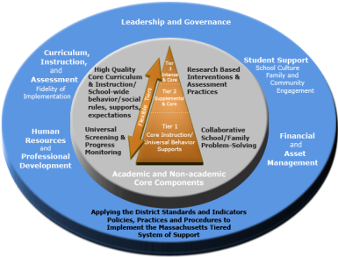
Special Education in the
Flexible Tiers
Core & Intense
  Tiers describe the intensity of instruction; not a placement or steps in a process.
  The type and intensity of
  The instruction is
  determined by the data.
  Data from continuous
  progress monitoring drives
  instructional decisions
  throughout the
  tiered process
Core & Supplemental
Special Education Services
Core Instruction/ Universal Behavior Supports
Notes:
12
12

Slide 13
Panel Discussion
Overview of MTSS in your district
Briefly describe your district’s journey towards implementing a tiered system of support based on the MTSS conceptual blueprint?

Slide 14
Panel Discussion
Eligibility for special education for a specific learning disability
Has your district provided guidance on the relationship between a tiered system of support and the special education referral process?
Are you using data collected through the tiered process for determining eligibility for specific learning disabilities?
Do you also include other assessments (e.g., cognitive) in the determination process?

Slide 15
Panel Discussion
Students with disabilities within the Massachusetts Tiered System of Support
How do you ensure that the tiered system (academic and non-academic) is responsive to the individual needs of students with disabilities?

Slide 16
Panel Discussion
Specially Designed Instruction
Has the role of special educators changed in schools where tiered system of supports are provided?

Slide 17
Thank you!
www.doe.mass.edu/mtss
781-338-3380
mtss@doe.mass.edu
Shawn Connelly
Mary-Ellen Efferen
Debbie Connell – Director of Special Education – Somerville Public Schools - (617) 625-6600 x 6810
DConnell@k12.somerville.ma.us
Cindy Landanno- Director of Special Education – Winchendon Public Schools -978-297-1850 clandanno@winchendonk12.org
Jane Ripley, Director of Curriculum and Instruction – 978-297-0031
jripley@winchendonk12.org

