Slide 1


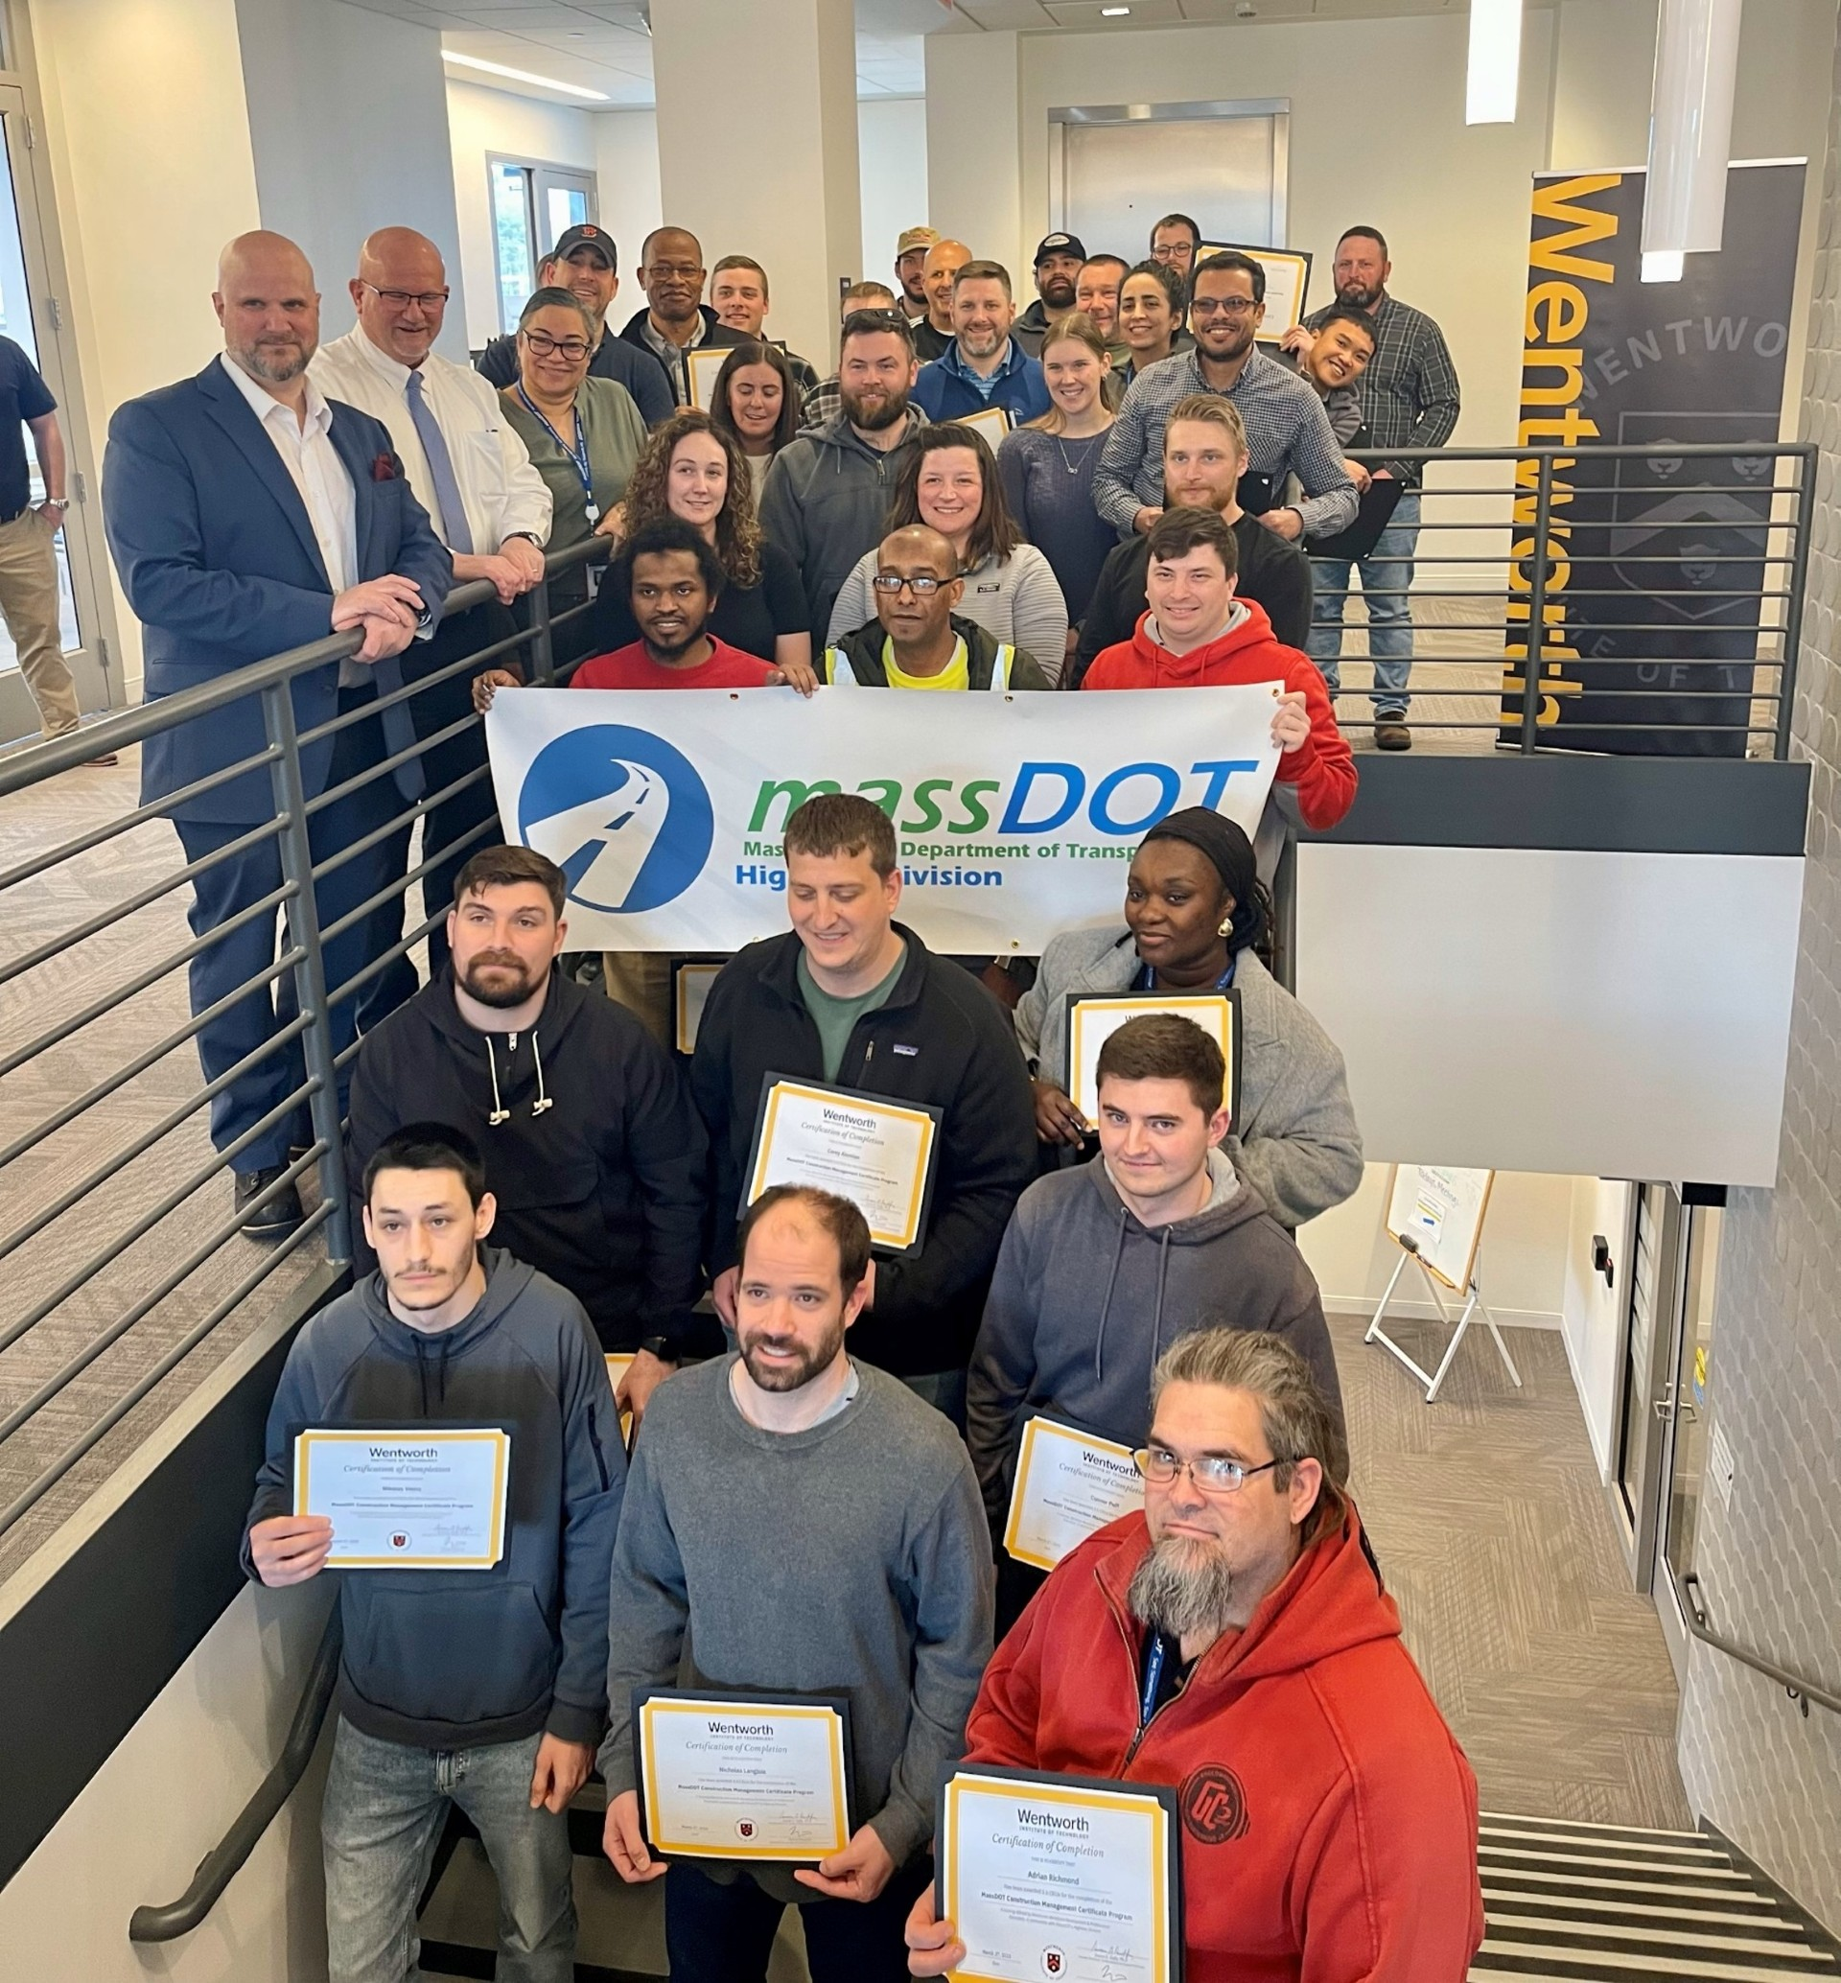

Transportation Research and Technology Transfer
Providing highlights of MassDOT’s transportation research activities and other helpful information 2025
Wentworth Institute of Technology and MassDOT Celebrate Completion of 8th Construction Management Professional Certificate Program
About the Program
This past winter, from January through March, Wentworth Institute of Technology proudly partnered with the Massachusetts Department of Transportation (MassDOT) to deliver the 8th cohort of the MassDOT/Wentworth Construction Management Professional Certificate Program (CMCP). This initiative reflects a shared commitment to advancing the skills and professional development of the Commonwealth’s transportation workforce.
A total of 36 participants, including employees from MassDOT’s Highway Division, successfully completed the 7-week program, earning 3.5 Continuing Education Units (CEUs) along with a Wentworth-verified Professional Certificate and digital micro-credential. This cohort represents one of the largest classes to date, underscoring the Commonwealth’s ongoing investment in developing its workforce to enhance the quality and effectiveness of the services and expertise it provides.
The MassDOT/Wentworth Construction Management Certificate Program is a 7-week, 35-hour in-person training, designed specifically for MassDOT Highway Division employees at the CE 2 level and above. With supervisor recommendation and participation in MassDOT’s Highway Core Curriculum, employees from across the state are invited to engage in this professional development opportunity. Instruction is delivered weekly at MassDOT’s Research and Materials facility in Hopkinton, MA.
Upon successful completion, participants receive 3.5 CEUs and a Wentworth-verified certificate and digital credential, supporting their professional advancement and contributing to a more skilled, knowledgeable workforce within the Commonwealth’s transportation sector.
Wentworth Institute of Technology is honored to support MassDOT in this important workforce initiative and looks forward to continuing this successful partnership in upcoming cohorts.
MassDOT Highway contacts: shannon.t.henry@dot.state.ma.us brian.kelleher@dot.state.ma.us
Visit the MassDOT Research Section web site www.mass.gov/research-and-technology-transfer

