Slide 1
Standardized Assessing Data & MassGIS
The Utility and Importance of Parcels and Assessor Records In MassGIS Projects
(Prepared for MAAO Conference - October 2, 2024)
Dan Marrier – Senior GIS Analyst and Database Architect Massachusetts Bureau of Geographic Information (MassGIS)
Executive Office of Technology Services and Security (EOTSS)

Slide 2
Standardized Assessing Data & MassGIS
Presentation Topics
1
Miscellaneous Projects And Requests From Various Agencies
2
Supporting Land Use Classification
3
Master Address Database & Next Gen 911
4
Zip Code Mapping
5
Challenges of working with statewide parcels and assessing data

Slide 3
Standardized Assessing Data & MassGIS
Supporting Policy Across the Commonwealth
Miscellaneous Projects And Analyses Involving Parcels
Buildout Project
Open Space Mapping Maintenance
Corroboration of state-owned properties with DCAM inventory and to support the MassReal service…
https://massreal-massgis.hub.arcgis.com/
Massachusetts Interactive Property Map…
Neighborhood Profiles of Properties In Proximity of Mass Transit
Wind Energy Siting
Crumbling Concrete Commission Mapping
Broadband Service Area Maps
https://www.mass.gov/info-details/massgis-impacts-and-stories
Notes:
When I say “Parcels”, it intended to represent both the tax map properties and all of their associated CAMA attributes

Slide 4
Standardized Assessing Data & MassGIS
Parcels and Land Use Classification
How was GIS data for land use in Massachusetts historically generated?
Prior to 2005, land use mapping provided to MassGIS was done at UMass Amherst by visual interpretation of orthophotos.
(this methodology was sometimes subjective and prone to human error)
Notes:
1971, 1985, 1999

Slide 5
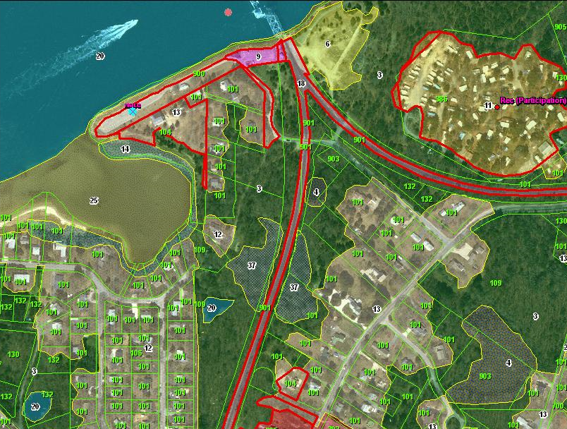
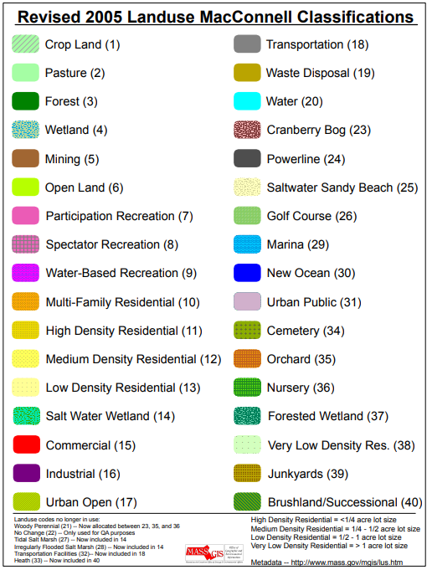
Standardized Assessing Data & MassGIS
Parcels and Land Use Classification
After 2005, parcels provided an ancillary data source to validate land use…
Notes:
20-year old screenshot of pilot, done in ArcMap 8. These were the parcels developed for the buildout project (nominally level 2, but sometimes a mixed bag) Difference between “land cover” and “land use”.

Slide 6
Standardized Assessing Data & MassGIS
The Master Address Database (MAD) and NextGen 911
Why did the Master Address Database (MAD) need to be created?
In the early 2010s, Massachusetts 911 needed to evolve from the existing E911 system to the new NextGen 911 system (NG911). The scope of NG911 included a GIS component that recommended addresses be associated with building locations.
Multiple address lists maintained across the state for specific purposes, but none of them were individually comprehensive, and comparing addresses between lists was difficult without standardization in place.
Limitations of linear geocoding
What existed prior to creation of the MAD?
Various address lists (individual town assessor records, ESL, VRIS, Warren Group) stored in a single table known as the “MAF” (Master Address File)
Various street name lists (MSAG, Census 2010, Dept. of Transportation) stored in a single table known as “MSTR3”
A streets layer with attribution from 911/Navteq/DoT
No address points or statewide standardized parcels or structure polygons
Notes:
Going forward, will refer to the master address database as the “MAD”. These aren’t all the reasons, but represent some of the ones relevant to MassGIS. Linear geocoding in urban areas is reasonable, but in more rural towns the results can be significantly displaced from the location they are intended to represent, both due to the interpolation and the building setbacks from roads.

Slide 7
Standardized Assessing Data & MassGIS
The Master Address Database (MAD) and NextGen 911
What did MassGIS do to create the MAD?
Develop A Database Model
A normalized database model was designed to identify 16 critical tables and feature classes that contribute to a robust addressing solution along with their tabular and geographic relationships.
Acquire New Or Missing Data
MassGIS developed a municipal tax assessment parcel standard and administered a grant program from 2010-2013 to acquire statewide standardized parcel data for 351 cities/towns.
A 2011/2012 aerial orthophotography update was conducted, and a 3rd party vendor was contracted to produce photo-interpreted structure polygons using it as a base.
Process New and Existing Data
Parsing and standardization of assessor property addresses and addresses from other sources
Creation of address points via spatial overlay of parcels and structure polygons
Review of street names for legitimacy and official spelling, and street geometry
Development of python and SQL scripts to process all data inputs into the new data model

Slide 8
Standardized Assessing Data & MassGIS
MAD Model Architecture (not shown: MSAG Community Polygons, MA Towns)
Address Variants
Master Address
Address Points (Multipoints)
Address Points
& Structure Lookup Table
ADDRESS_VARIANT_ID
MASTER_ADDRESS_ID
ADDRESS_POINT_ID
Street Name Variants
Master Street Names
Address Point
Centroids
Structure Polygons
STREET_NAME_VARIANT_ID
STREET_NAME_ID
CENTROID_ID
STRUCTURE_ID
Source Table
Base Range Variants
Base Street Arcs
Parcel Polygons
& Assessor Data
SOURCE_NAME_ID
BASE_RANGE_VARIANT_ID
BASE_SEGMENT_ID
LOC_ID
Table
Site Names
Site Polygons
(geographic relationships)
Feature Class
SITE_NAME_ID
SITE_ID
Notes:
Primary key shown in black italicized text. Green: represent input tables. Blue: represent master tables. Solid line = a primary key in linked table. MSAG communities excluded because they are specific to 911 needs and may not be necessary for a more generic master address model. Towns pre-dated the MAD by decades as a GIS layer, but used for town IDs. (But also had no room on slide to fit them) Parcels included due to their critical nature… only original source that associated addresses with geography.

Slide 9
Standardized Assessing Data & MassGIS
General workflow of parcel data inclusion into the MAD
Processing of Assessor Site Addresses
Sites/Features Identification
Address Matching With Other Sources
Address Points Creation and Classification
Association of Standardized Addresses with Address Points

Slide 10
Standardized Assessing Data & MassGIS
Assessor address processing
Assessor Property Addresses
Initially parsed into 3 fields if not already delivered as such...
FULL_STR values are standardized, fully spelled out, and re-parsed into individual street name components per addressing standards (if FULL_STR is not a street name, it can be re-interpreted as a SITE NAME or something else)
ADDR_NUM values also standardized for spacing and consistency of value representation (dashes, spaces, fractions, “&”)
LOCATION can contain…
subaddressing values like building names, floors, and units – these are recorded in various subaddress attributes in the MAD
or “feature” names like “Lot 3A”, “Monument Beach”, “Cochituate State Park”, “Montague Town Line”, etc... Many of these feature or place names are recorded as SITE NAMES in the MAD and sometimes site area extents (polygons) are built from dissolved parcels
It is an on-going and challenging process to interpret and standardize LOCATION information due to its freeform nature (abbreviations, inconsistencies in unit types…)
Notes:
Mention “OFF” and “REAR” issues with FULL_STR.

Slide 11
Standardized Assessing Data & MassGIS
Street Name Variants and Master Street Names
Street Name Variants
Master Street Names
Street Name Variants contribute to Master Street Names the same way Address Variants contribute to Master Addresses.
42 COMMUNITIES IN MASSACHUSETTS
HAVE A STREET NAMED:
“MASCHSTS AV”
“MASSACHUSETTS AVENUE”
“MASSACHUSETTS”
“MASSACHUSETTS AVENUE BRANCH”
“MASSACHUSETTS AVENU”
“MASCHSTS AVENUE”
“MASSACHUSETTS AV”
“MASS AV”
“Mass Ave”
“Massachusetts Ave”
“MASSACHUSETTS AVENUE”
“S MASSACHUSETTS AV”
“MASSACHUSETT AVE”
“MASS AVE”
“Massachusetts”
“MASS AVENUE”
“Massacusetts Ave”
“MASSACHUSETTS AVE”
“MASCHSTS AVE”
“S MASSACHUSETTS AVE”
Notes:
19 DIFFERENT VARIATIONS OF MASSACHUSETTS AVENUE IN STREET NAME VARIANTS. When MSAG was received every 6 months, some persistent records would actually have different versions of the same street name.

Slide 12
Standardized Assessing Data & MassGIS
Street Name Variants and Master Street Names in the MAD
Fully Standardized Street Names
STREET NAME VARIANTS
MASTER STREET NAME
As of late September, 2024…
Number of unique street name records in street name variants: 1,162,443
Number of unique street name records in the master streets table: 136,340
Notes:
Some of the current master street names are actually feature names and need to be identified and moved to site names table.

Slide 13
Standardized Assessing Data & MassGIS
Address Variants and Master Addresses in the MAD
Fully Standardized Addresses
ADDRESS VARIANTS
MASTER ADDRESS
As of late September, 2024…
Number of input address records in the address variants table: 10,082,918
Number of master address records in the master address table: 3,479,756
Number of features in the statewide address points data layer: 2,187,098
Notes:
Many other attributes not shown, including subaddressing. Segue into ADDRESS_POINT_ID…

Slide 14
Standardized Assessing Data & MassGIS
Address Points in the MAD
Address Points (Multipoints)
Address Point
Centroids
Address Points and their centroids were created together and are intrinsically related but maintained as separate feature classes.
1. Statewide Aerial Photos acquired in 2011/2012
2. Statewide Standardized Tax parcels acquired in 2010-2013
3. Statewide Structure Polygons Photointerpreted in 2012-2013
4. Statewide Address Points Created From Parcels & Structures in 2013-2014
5. Address Point Centroids Created From Address Points & Parcels in 2013-2014
Centroid: “The geometric center or average location of a spatial feature.“
https://support.esri.com/en-us/gis-dictionary/centroid

Slide 15
Standardized Assessing Data & MassGIS
Address Points in the MAD
Multipart Geometry Usage in Address Points
ADDRESS_POINT_ID = Unique ID for each address point constructed from location of the feature in Massachusetts State Plane NAD 83 Meters projection. (e.g. “M_<X-Coord>_<Y-Coord>”)
Example: Multiple buildings in a parcel (condominium) and there are multiple assessor records associated with the parcel.
Each building receives a structure-based address point.
Each point has a unique X and Y coordinate.
Each address record can only reference a single address point ID but not immediately clear which address belongs to each building…
Y
…so points are dissolved into a multipart feature and its centroid is generated with its own unique X/Y.
X
Notes:
Long term holy grail goal is elimination of nearly all multipart points (with a few exceptions), but it requires both a major effort to differentiate primary/secondary structures and unique addresses for every parcel. Geocoding services can’t use multipart geometry points, so simple point geometry centroids are maintained in unison with their address point counterparts.

Slide 16
Standardized Assessing Data & MassGIS
Address Points in the MAD
Address Point Attribution
LOC_ID = Unique ID of the parcel that the address point exists within. “MULTIPLE” when a point feature exists across multiple parcels.
STRUCTURE_STATUS = Primary (“P”) vs. Secondary (“S”) distinction of the structure represented by the point. “N” means “No structure” and “M” means “Mixed” or undetermined.
POINT_TYPE = a classification attribute in the address points that provides information about the constituent structure(s) and/or the underlying parcel(s)…
Notes:
Those familiar with LOC_ID construction should understand the address point id generation. Structure status is going to be a future major effort. Again, parcels are critical to POINT_TYPE classification because they establish the boundaries and extent to associate the address(es) with the contained building(s).

Slide 17
Standardized Assessing Data & MassGIS
Address Points in the MAD
Address Point Classification Domain
PC – “Parcel Centroid”
BC – “Building Centroid”
ABC – “Assumed/Approximate Building Centroid”
BMP – “Building Multipoint”
BMPC – “Building Multipoint Centroid”
DBMP – “Dissolved Building Multipoint”
NBSC – “Non-Building Structure Centroid”
NBAC – “Non-Building Area Centroid”
BEP* – “Building Entry Point”
BIP* – “Building Interior Point”
BEP and BIP are not fully implemented in the MAD yet because they require a review of legacy code to incorporate properly.

Slide 18
Standardized Assessing Data & MassGIS
Address Points in the MAD
Address Point Classification
PC – “Parcel Centroid”
Represents vacant/undeveloped parcels.
Should not co-exist with any other building-based address point in the same parcel, except for possible NBSC, NBAC, and “PLANNED” ABC points.
Every undeveloped parcel polygon that is not a public ROW or a body of water is supposed to receive a PC point regardless if an address has been assigned to the parcel or not.
Notes:
PC Points serve as a placeholder for a future address if none has been assigned yet. If a PC point co-exists with any structure-derived address point that is not a planned ABC, it can potentially indicate questionable parcel boundary linework, or a structure built on the wrong property, or missing assessing information about Year Built or a building valuation. Requiring address points for every parcel, even those without assigned addresses, facilitates QA routines where it is relatively easy to identify parcels with no points in them or the logical co-existence checks that might indicate a problem.

Slide 19
Standardized Assessing Data & MassGIS
Address Points in the MAD
Address Point Classification
BC – “Building Centroid”
Represents individual structures in a parcel with a building footprint greater than 150 sq. ft. (and 250 sq. ft. going forward)
Can co-exist with other structure-based address points in the same parcel if those buildings have different addresses.
There is an expectation that every BC point not identified as “secondary” in nature should be associated with an address record. BC points on ancillary use structures may optionally link to an address record.
Multiple BC points can exist in same building until BEP and BIP points formally implemented.
Notes:
Co-existence can include a 109 property or multiple unattached condos or a large campus. Primary structures without an assigned address are a public safety concern. Optional address linkage for secondary structures includes a residential garage turned into an at-home business or a detached IN-LAW apt.

Slide 20
Standardized Assessing Data & MassGIS
Address Points in the MAD
Address Point Classification
ABC – “Assumed/Approximate Building Centroid”
Represents individual buildings that are either planned development or existing structures possibly missing from the MAD.
Once the planned structure has been built and/or the existing building confirmed on recent aerial photos and a structure polygon has been delineated, the ABC is converted to another point type.
ABC points should link to an address record.
ABC points are highly useful indicators during annual structure inventory review by MassGIS.
Notes:
Mention FDC. When MassGIS is notified of planned development (typically via Notify 911), ABC points are created and linked to the anticipated address. They front run the expected public safety need, proactively preparing for it. They can also be added if a structure is visible on aerial photo but not yet captured as a structure polygon. Also, during structure review, parcels are helpful with the YEAR_BUILT attribute, or where BLDG_VAL > 0 and no structure polygons found yet.

Slide 21
Standardized Assessing Data & MassGIS
Address Points in the MAD
Address Point Classification
BMP – “Building Multipoint”
Represents multiple buildings within the same parcel linked to the same address record.
BMPs are necessary to be able to generate a unique Address Point ID to populate in a master address record when it is uncertain which structure is most appropriate.
Every BMP is a candidate to be split up into individual Primary and Secondary structure-based points.
Building footprint area is not a reliable indicator of which buildings are Primary and which are Secondary.
Notes:
Multipart geometry (as explained earlier). Structure-area weighted centroids. Public safety consideration… at least get to right cluster of structures. Very often represents houses + garages/sheds, but can also be things like a campus or a multi-building commercial center. Prefer to have local authorities make the distinction between primary/secondary buildings. (and that distinction is building usage consistent with the primary property use as indicated by the use code)

Slide 22
Standardized Assessing Data & MassGIS
Address Points in the MAD
Address Point Classification
BMPC – “Building Multipoint Centroid”
Represents a generally centralized location between two or more buildings in the same parcel where the address associated with the BMPC represents the property and/or buildings collectively instead of any individual structure.
Most commonly used for “parent” or “master” condominium records.
The associated address may have a single address number with no subaddress information or may have an address number range.
Notes:
Middle BMPC is “630 Shore Road”… all individual buildings link to address records that include a specific UNIT value. BMPCs allow the parent address of the parcel to be associated with a unique point location, otherwise it would either remain unlinked or linked to a specific structure inappropriately. Continues to show high regard for addresses assigned to parcels even if not in use by anybody else for other purposes like mailing or 911.

Slide 23
Standardized Assessing Data & MassGIS
Address Points in the MAD
Address Point Classification
DBMP – “Dissolved Building Multipoint”
Can represent three different situations…
Structures on two or more parcels where the parcels have been assigned identical non-zero numbered addresses
Structures on two or more parcels where the parcels have different addresses but fieldwork implies the structures are all associated with each other
Structures on two more parcels where the parcel has been split and an address update is likely needed in the MAD.
Notes:
Site address is 13 Finn Street for all 3 parcels. Each is a 101 with a different owner. But owner addresses are 13, 13 ½, and 13A.
Cluster of buildings at 42 Tilda Hill Road. But the 0 Tilda Hill Road parcel has same owner as the 52 Tilda Hill road property, so possible encroachment.
83 West St and 85 West St look distinctly different, but looking at older vintage parcels shows the split that took place.

Slide 24
Standardized Assessing Data & MassGIS
Address Points in the MAD
Address Point Classification
NBSC – “Non-Building Structure Centroid”
Represents locations of structures not considered “buildings**” that have been assigned a civic address, typically to facilitate a public safety response.
Commonly used for police call boxes with a landline, but also other structures like pump houses, cell towers, solar arrays, etc…
** The distinction between a “building” and a “structure” continues to evolve, but usually involves discussion of walls, a ceiling, and intended occupancy.
Notes:
These are Gillette Stadium parking lot lightpoles. Pump houses generally < 150 sq. ft. so don’t get a structure polygon. But database rules check to make sure every structure-based point has an associated structure polygon. NBSCs create the allowable exception.

Slide 25
Standardized Assessing Data & MassGIS
Address Points in the MAD
Address Point Classification
NBAC – “Non-Building Area Centroid”
Can represent two different situations…
Non-structure locations commonly assigned a unique location identifier, or less commonly a civic address for public safety purposes.
An undeveloped location on a parcel, co-existing with but separate from a building where the address assigned to the parcel is different than the address assigned to the building, but the addressing authority has not enforced a single official address.
Notes:
First image = campground. Less common example is a named recreational field part of a larger school property. Second image… single-family residential property, owner self-identifies as 1 Carole Way and even named his private ROW as such. We have to consider both the legitimacy of the deeded address recorded by the assessor and the public safety concerns if a call originates from someone at “1 Carole Way”. This is the unideal compromise solution if the addressing authority can’t or won’t enforce a single address. Follows a philosophy that by default, an address assigned to a property represents the property and any primary buildings on it jointly unless a specific different address is assigned and approved by the addressing authority. This scenario is considered “passive acceptance”.

Slide 26
Standardized Assessing Data & MassGIS
Address Points in the MAD
Address Point Classification Summary
PC – “Parcel Centroid”
ABC – “Assumed/Approximate Building Centroid”
BMPC – “Building Multipoint Centroid”
NBSC – “Non-Building Structure Centroid”
BEP* – “Building Entry Point”
BC – “Building Centroid”
BMP – “Building Multipoint”
DBMP – “Dissolved Building Multipoint”
NBAC – “Non-Building Area Centroid”
BIP* – “Building Interior Point”
POINT_TYPE serves multiple purposes…
Allows for logical consistency checks to maintain data integrity
Utility in crafting analytic queries
Filter for inclusion or suppression of certain types of address points
Notes:
BEP and BIP not really in widespread use yet. Logical consistency checks include structure-based points only exist inside structure polygons, PC points don’t co-exist with structures, NBSC have some kind of value in “NON_BUILDING_STRUCTURE_NAME” or “OTHER_LOCATION” in associated master addresses. Some analytic queries are “How many buildings are currently planned to be built in each town and where?”, “Without having to do a spatial query, how many parcels have more than x number of structures greater than 500 sq. ft.?“, Where is there possible encroaching development into adjacent parcels?” In the weekly 911 product that MassGIS produces, certain types of points are suppressed because they are not relevant for first response. (PC points that don’t link a non-zero numbered address and BMPC points). And points specific to 911 concerns, like NBSC and NBAC, can be suppressed for other non-911 entities for things like generating mailing lists.

Slide 27
Standardized Assessing Data & MassGIS
USPS ZIP Code Mapping
ZIP Codes, Addresses, and Parcels
Why MassGIS Is Working With ZIP Codes
One attribute of the Master Address table is “ZIPCODE”. But it is not well-populated or maintained.
A ZIP Code’s purpose is to facilitate mail delivery. They are primarily assigned to address ranges/numbers along a street, and occasionally to individual buildings. They are not natively maintained as polygons that would make for an easier GIS solution.
Most ZIP Code maps we’ve seen have some level of inaccuracy. And since ZIP Codes are not static, even those maps can quickly become obsolete.
Notes:
Even though dominant use of MAD is for 911, it was designed to be used for many purposes, some of which may include mailing addresses. USPS does not maintain an official zip code map.

Slide 28
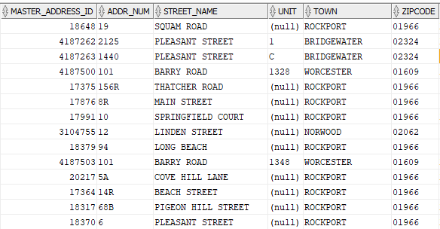
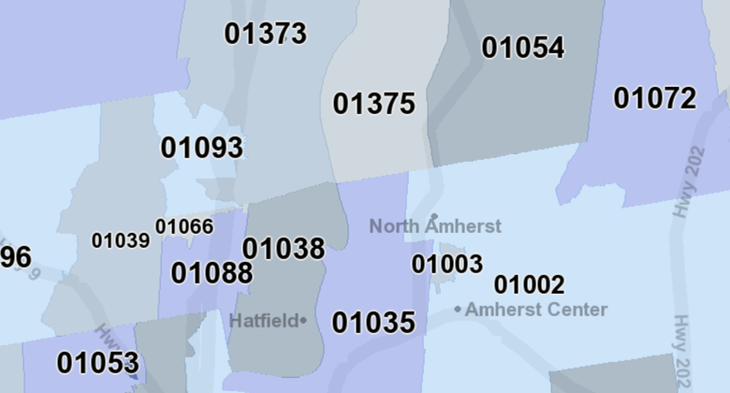
Standardized Assessing Data & MassGIS
USPS ZIP Code Mapping
ZIP Codes, Addresses, and Parcels
Goals
More fully populate ZIP Code values in the MAD and do so on a regular basis using a monthly USPS ZIP+4 product to keep it a useful resource.
Generate a parcel-based map of ZIP Codes that is superior to all current commercial alternatives.
Bonus: Use the USPS ZIP+4 to identify missing streets, typically associated with new development MassGIS has not yet heard about.
Notes:
Secondary bonus is improving the USPS ZIP+4 product by identifying errors or obsolete entries. MassGIS has an open dialogue with the address management systems manager for MA/RI District.

Slide 29
Standardized Assessing Data & MassGIS
ZIP Code Processing – A Python & SQL scripted workflow
Step 1
Step 2
ZIP PREP
ZIP MATCH
ZIP MAP
Unzip, append, and format ZIP+4 files
Upload to MassGIS enterprise database
Add and populate additional fields to facilitate comparison to the MAD
Employ multiple matching techniques to assign a MAD STREET_NAME_ID to each USPS Street Name in each community
Create a copy of the MAD Master Address Table
Add new fields for…
USPS ZIP
Parcel site address ZIP
Parcel owner ZIP
Matching type codes for each of the 3 ZIP fields
Populate USPS ZIP values where matches can be made
Populate Parcel site address ZIP and owner ZIP values where matches can be made
Compare USPS, Parcel, and Owner ZIP values and decide which is correct where they are different
Create a copy of the most recent statewide municipal parcels
Assign ZIP Code values and match type codes to parcels that can be associated with master address records via address points
Employ address relationships and geographic techniques to populate unassigned parcels until none remain
Notes:
Been working on this since February 2024. The whole process currently uses over 8000 lines of code and runs for over 7 hours and still very much a work in progress.

Slide 30
Standardized Assessing Data & MassGIS
ZIP Code Processing – Stage 1
ZIP PREP
USPS ZIP+4 Attributes (subset)
MassGIS Added Attributes
Notes:
Not showing some subaddressing fields like building name and units. Over 960,000 ZIP+4 records in Massachusetts as of August 2024, representing 677 unique zip codes. (about 510K are ranges, 450K are single street numbers) Almost 1100 more records between March and August 2024. This stage heavily uses street name variants and the master street name table in the MAD. About 5K street names could not be matched and MassGIS is currently researching them all. 20 different matching codes assigned in current process using hierarchical process of confidence level in the match type. ALT_COMMUNITY_NAME comes into play when the address exists in a neighboring community.

Slide 31
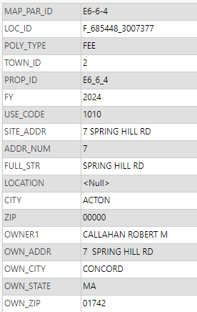
Standardized Assessing Data & MassGIS
ZIP Code Processing – Stage 1
ZIP PREP – Alternate Community Name
Alt Community Match
SPRING HILL ROAD is associated with the USPS community of CONCORD.
But SPRING HILL ROAD does not geographically exist within CONCORD. Of Concord’s neighboring towns, it only exists in ACTON.
Acton parcels corroborate the ZIP Code is correct.
Notes:
Key takeaway: when the owner of a property also receives mail there, the OWNER information in assessor data is extremely helpful to confirm the USPS data.

Slide 32
Standardized Assessing Data & MassGIS
ZIP Code Processing – Stage 2
ZIP MATCH - Methodology
Parcel/Assessor Site ZIP Code
Match each master address record to the parcels using either PROP_ID from address variant sources, or various address value matching techniques (both exact and approximate)
Match each master address record to the ZIP+4 using STREET_NAME_ID, TOWN_ID, and an address number within the USPS range
Master
Address
Table
USPS ZIP+4 (processed)
Parcel/Assessor Owner ZIP Code
Notes:
With ZIP+4 match, also substitute in a USPS building name to MAD building name and a MAD UNIT to USPS address number match. Parcel matching much more involved.

Slide 33
Standardized Assessing Data & MassGIS
ZIP Code Processing – Stage 2
ZIP MATCH – Final ZIP Assignment
Master Address Match Records
Parcel Ownership Categories
Variety Of Match Types
“OWN_RES” – owner is a resident or receives mail at the property
“OWN_NOT_RES” – owner receives mail at a different property in MA
“OWN_PO_BOX” –owner receives mail at a P.O. Box
“OWN_NOT_MA” – owner does not receive mail at an address in MA
# of unique USPS_ZIP_MATCH types: 11
# of unique PAR_ZIP_MATCH types: 32
# of unique FINAL_ZIP_MATCH types: 40
Notes:
Where there are disagreements between USPS-assigned ZIP codes and Parcel-assigned ZIP codes, logical checks are applied to decide on one.
These categories directly affect the logic applied during zip code disagreements.

Slide 34
Standardized Assessing Data & MassGIS
ZIP Code Processing – Stage 3
ZIP MAP – Match to MAD
ADDRESS VARIANTS TABLE
MASTER_ADDRESS_ID
ID_IN_ORIG_SOURCE & PROP_ID
MASTER ADDRESS TABLE
(with “final” assigned ZIP Code)
PARCELS
ADDRESS POINTS
ADDRESS_POINT_ID
LOC_ID
Out of 2.5 million+ attributed parcel polygons* in Massachusetts, 2.1 million+ receive a ZIP Code value this way
Notes:
Address Variants is used when the address point’s LOC_ID is ‘MULTIPLE’, or address point ID in master address is “MULTI_*” *Note: There are closer to 2.2 million parcel polygons, but when joining address records to them, the joined product has over 2.55 million to account for the properties with multiple ownership records (like condos)

Slide 35
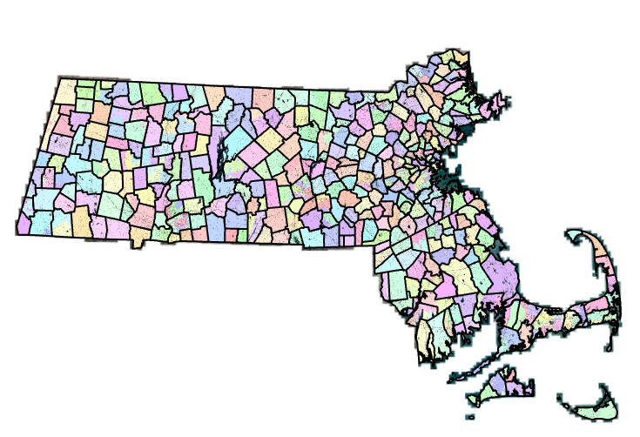
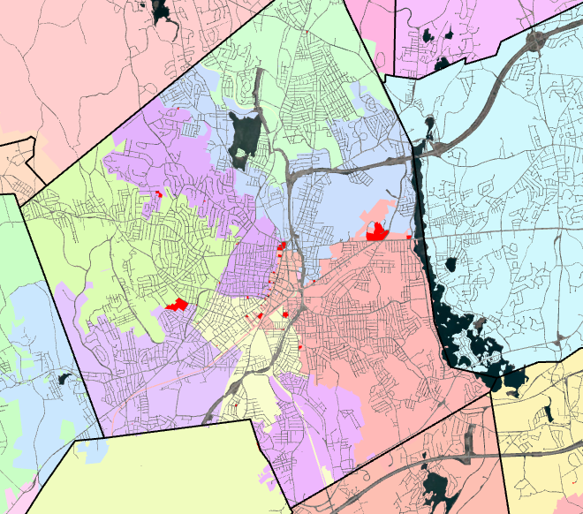
Standardized Assessing Data & MassGIS
ZIP Code Processing – Stage 3
ZIP MAP – Remainder Match & Final Product
The remaining ~400,000 parcel polygons without an assigned ZIP Code are matched with a combination of techniques that include geographic adjacency and proximity checks…
# of unique MGIS_ZIP_MATCH classification types: 24
Notes:
All the various matching codes through the ZIP code processing are evidence that working to create matches remains complicated and nuanced. And the ZIP Code map is only as good as the underlying data, so errors by USPS or in the parcels or incorrect assumptions in the matching heuristics can potentially propagate through into the final product.

Slide 36
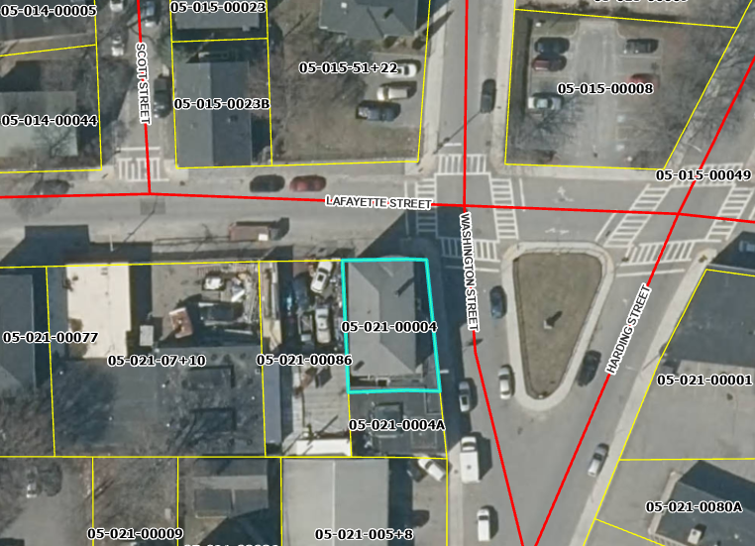
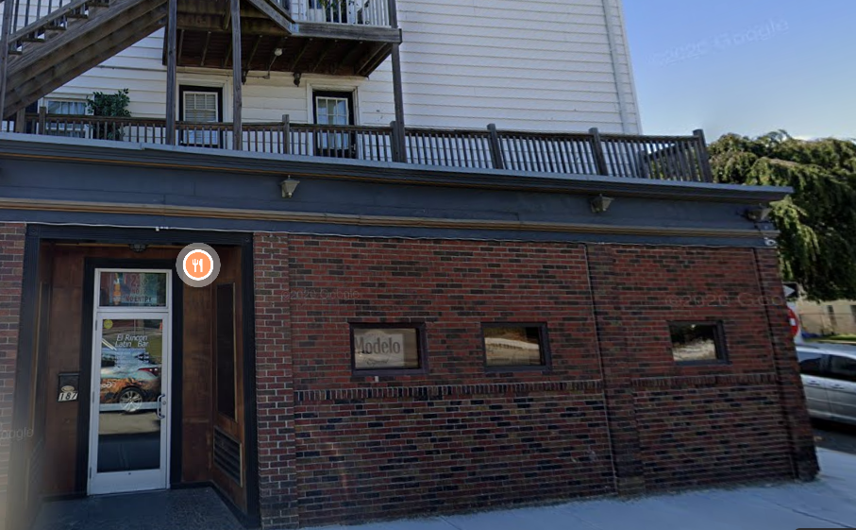
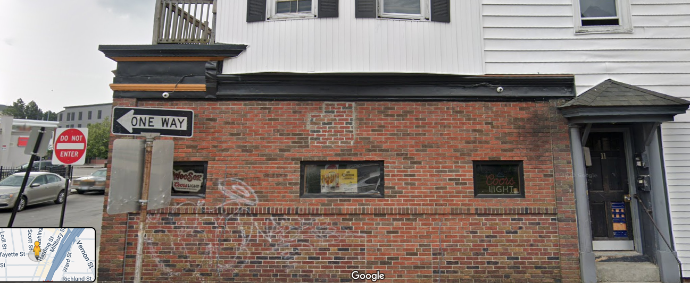
Standardized Assessing Data & MassGIS
ZIP Code Processing – Stage 3
ZIP MAP – “MULTI” ZIP parcels
It is possible for a single property/parcel to be represented by more than one ZIP Code…
WORCESTER: 187 Washington St – ZIP 01610, 11 Lafayette St. – ZIP 01608
Notes:
This property is mixed use on a corner lot. Restaurant/bar on the first floor and apartments on the upper floors. Separate entrances on different streets. This project is still very much in draft mode and undergoing internal review for accuracy and processing efficiency.

Slide 37
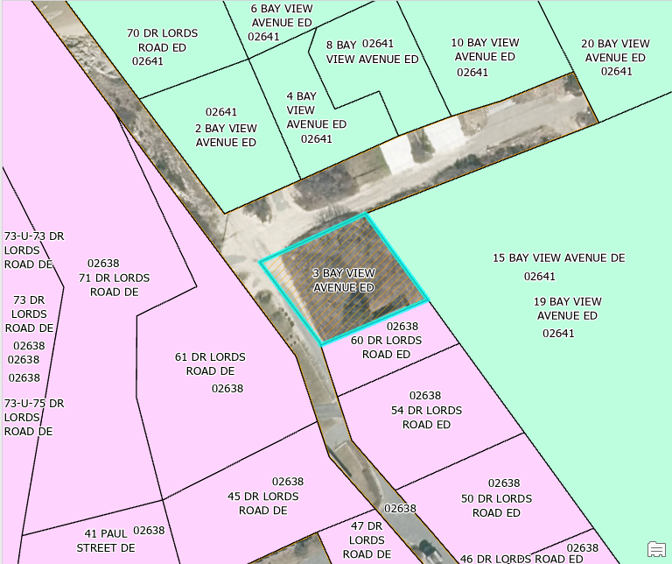
Standardized Assessing Data & MassGIS
ZIP Code Processing – Stage 3
ZIP MAP – Vacant parcels
The intent is for complete parcel coverage, except for public ROWs and Water bodies. This means vacant/undeveloped parcels will be assigned a ZIP Code, despite not being eligible for mail delivery. They are mapped as if they “could” receive mail.
Because the USPS ZIP+4 represents address ranges, any vacant property with an assigned street name and street number that falls within a ZIP+4 record’s range will receive a ZIP Code anyway. It would be inconsistent and “patchworky” to have some vacant parcels assigned ZIP Codes and some not.
Assignment of ZIP Codes to vacant parcels without a street name and address number can be tricky, relying on shared attributes and/or geographic relationships to make a “best” guess.
In this example, 3 Bay View Avenue exists at the boundary between 02638 and 02641. Even though all other Bay View Ave. parcels are assigned to 02641, this parcel will map to 02638 because its owner is the same as the adjacent property southeast of it. If the property is sold and/or developed with Bay View Avenue egress, the ZIP code could change.
Notes:
ZIP assignment also follows the same paradigm for properties that get their mail at P.O. Boxes instead of on premesis (usually rural) USPS ZIP+4 has range 2-12 Elm Street, and 2, 4, 8, 10 are developed but 6 is not. 6 will still match to that zip code during USPS -> MAD matching even though the USPS will not acknowledge it as a deliverable location. The scenario of common ownership between adjacent parcels typically has one parcel with the “primary” structure and other potentially containing “secondary” structures, and sometimes the structures will overlap into both parcels.

Slide 38
Standardized Assessing Data & MassGIS
The Challenges When Using Current Parcel Data
Three focus areas for assessor attributes
Use Codes
Inconsistency in recording and interpretation of use codes and their descriptions leads to ambiguity in large scale analyses
Addresses
(both site
and owner)
Missing, inconsistent/non-standardized, and incorrect addresses pose a public safety risk and create confusion in data that should be synchronized
ZIP Codes (both site and owner)
Missing, inconsistent, and incorrect ZIP Codes influence the accuracy of a potential ZIP Code map and any mailing lists or address validation the MAD is used for
Notes:
Certain assessor attributes figure largely in past and present MassGIS projects… these 3 are of considerable focus and scrutiny.

Slide 39
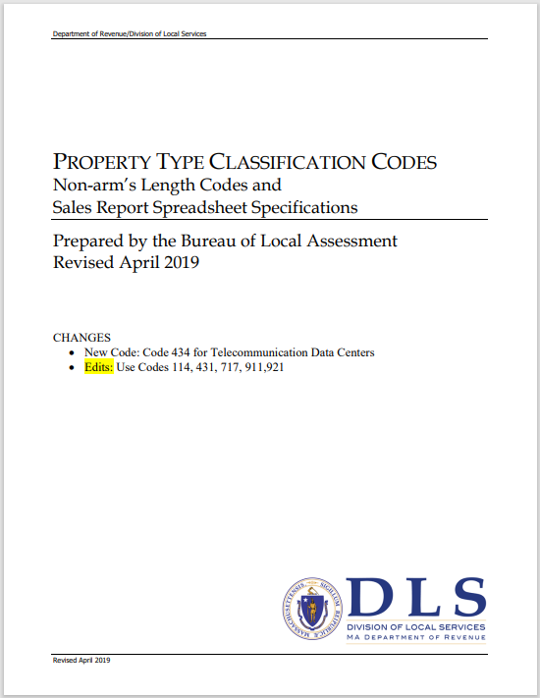
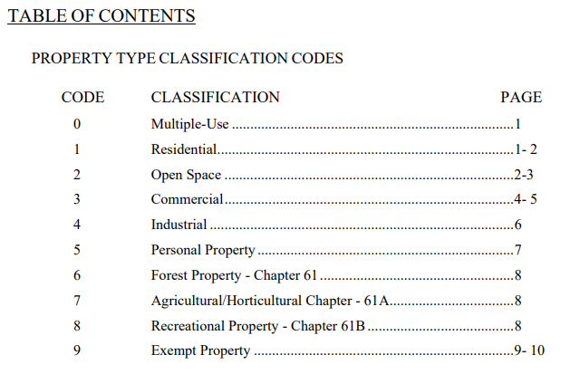
Standardized Assessing Data & MassGIS
The Challenges When Using Current Parcel Data
USE CODE
The MA Dept. of Revenue’s Bureau of Local Assessment provides guidance about standardized property classification codes…
“The coding structure has three digit level of detail. The first digit indicates a major classification. The second digit is a major division and the third digit is a subdivision, both within the major classification of property.”
Notes:
Use codes are significantly relied upon in land use classification. They are also regularly used to respond to requests from various state agencies (e.g. find all residential properties that meet various criteria) and they are being used heavily to inform subaddressing logic.

Slide 40
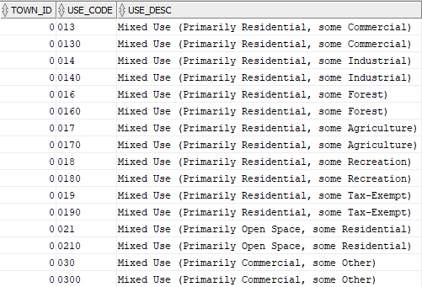
Standardized Assessing Data & MassGIS
The Challenges When Using Current Parcel Data
USE CODE - Multi-use properties and the use of “0”
“The first digit of multiple-use property is always a zero (0). The second and third digits are the major classification of the property represented. The digits following zero (0) are listed in the order of major importance.”
4-digit/character codes are common in the use codes MassGIS has observed in municipal parcel submissions
But leading 0’s are sometimes used incorrectly and can cause confusion in interpretation…
Common examples:
“0130” – “130” or “013”?
“0310” – “031” or “310”?
Notes:
There are 303 standard “default” classification codes in the MassGIS template for the UC_LUT table. Those are doubled to account for 4-digit values that nominally end in “0”. If MassGIS remains faithful to the DOR/BLA definitions, the presence of a leading “0” when the intended classification is not mixed-use creates incorrect interpretations of use in large-scale analyses that use pattern matching.

Slide 41
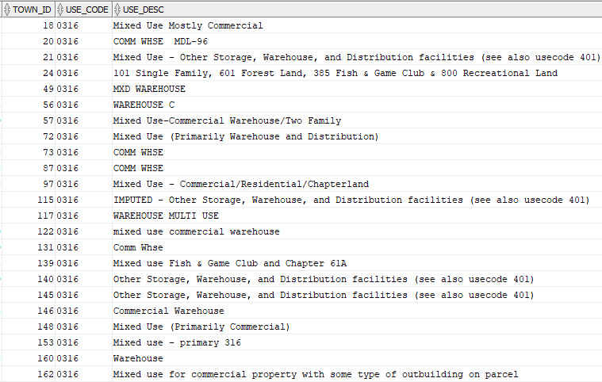
Standardized Assessing Data & MassGIS
The Challenges When Using Current Parcel Data
USE CODE – Inconsistency in interpretation and description
Some towns think “0316” is mixed use while others seem to interpret it as the standard use code “316”.
Additionally, entries in USE_DESC often use abbreviations that may not be obvious to users of the data.
Number of custom codes currently in use across MA?
9,181
116 municipalities (about 1/3 of state) have a mix of 3 and 4 digit/character use codes and have some 4-digit codes that start with “0”
Notes:
And even more problematic than ambiguous abbreviations are the presence of no descriptions at all (some become IMPUTED but the rest remain UNKNOWN). It’s dubious that the existing “mixed use” descriptions are accurate… they appear to be a literal interpretation of the guidance document without a true understanding of the actual property usage or the likelihood that it should be the DOR description for a 316. The two asks are for consistency of use codes and inclusion of useful and easy to understand descriptions of custom codes

Slide 42
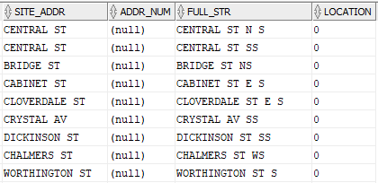
Standardized Assessing Data & MassGIS
The Challenges When Using Current Parcel Data
Site Address
Accurate addressing is obviously important for the MAD.
Ideally, SITE_ADDR is identical to the concatenation of ADDR_NUM and FULL_STR and LOCATION in the standardized parcel deliverables to MassGIS, with proper spacing and consistent values.
Even more ideally, the correct parts of the address are recorded in the correct fields.
EXAMPLES:

Slide 43
Standardized Assessing Data & MassGIS
The Challenges When Using Current Parcel Data
Site Address Linkage To Parcels
And even more ideally the site address assigned to a parcel actually represents that particular property…
Address numbers in the MAD are in ORANGE. These have been researched extensively.
Address numbers in the assessor records are YELLOW.
There appears to be a parcel shift.

Slide 44
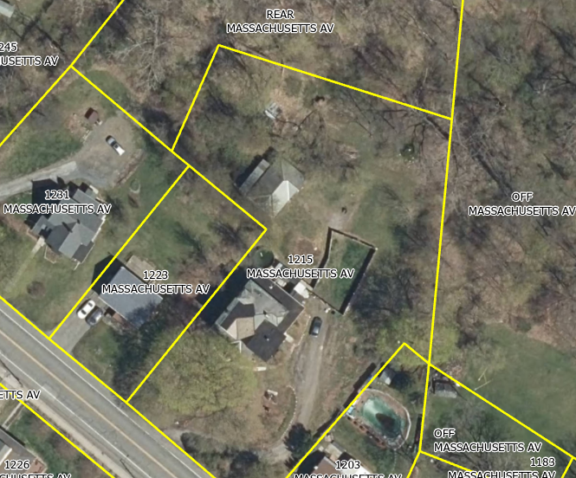
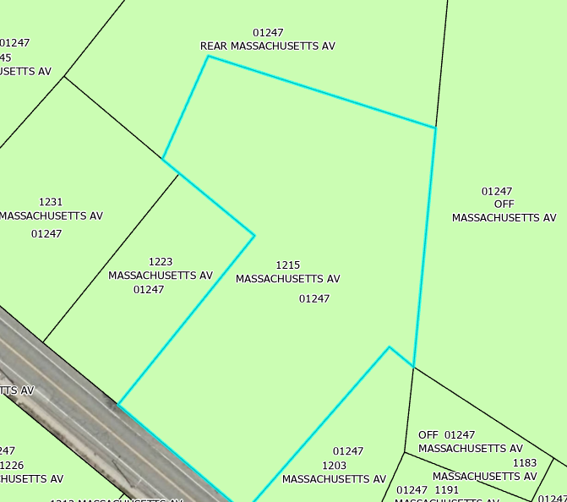
Standardized Assessing Data & MassGIS
The Challenges When Using Current Parcel Data
Site Address and Owner Address
And even more ideally the owner address information matches the site address information if the tax bill is sent to that property and is consistent between multiple properties owned by the same entity…
EXAMPLE:
Notes:
One difficulty of working with owner addresses is they are not parsed into the same address components as site address, so some of the kinds of matching techniques that work on site address won’t work on owner address. One method of checking for resident ownership is pattern matching to see if FULL_STR exists in OWN_ADDR or the non-numeric portion of OWN_ADDR exists in SITE_ADDR. In this example both fail, but fortunately the USPS ZIP and Parcel ZIP match, so it doesn’t come into play as a deciding criterion.

Slide 45
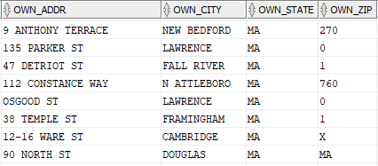
Standardized Assessing Data & MassGIS
The Challenges When Using Current Parcel Data
ZIP CODE and OWN_ZIP
# of current parcels statewide in MassGIS data: | 2,194,796
# of current parcels statewide with a parcel ZIP assigned: | 1,390,621
# of current parcels statewide with an OWNER ZIP assigned: | 2,153,571
It is expected that a ZIP Code would not be assigned to vacant/undeveloped parcels.
But for both parcel ZIP and owner ZIP, there are some problematic values…
Notes:
4-digits is usually an easy fix (“dropped 0”) Also the replacement of 0 with “O” is an issue. One question: if OWN_ZIP is incorrect, do the tax bills still get delivered or are any returned?

Slide 46
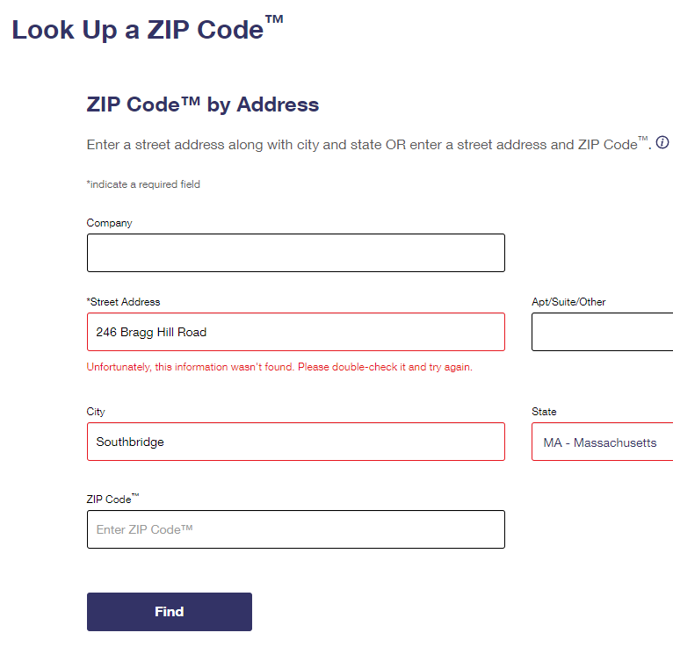
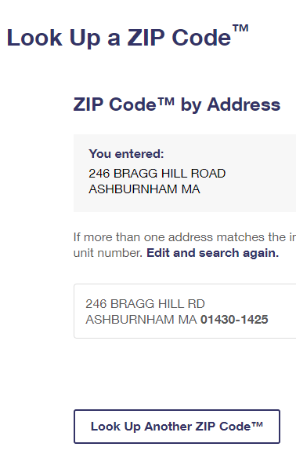
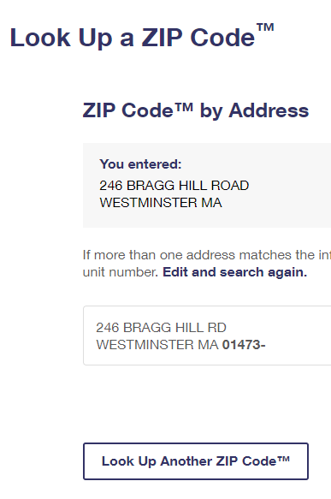
Standardized Assessing Data & MassGIS
The Challenges When Using Current Parcel Data
ZIP CODE Validation
The USPS website is a valuable resource when attempting to confirm individual address ZIP code values… https://tools.usps.com/zip-code-lookup.htm?byaddress
Notes:
We’ve observed and confirmed with USPS that the presence of the +4 component of a ZIP value indicates a deliverable location. The absence of the +4 component seems to indicate a potential “alias” record to help mail delivery, but does not really represent the officially accepted address by the USPS.

Slide 47
Standardized Assessing Data & MassGIS
The Challenges When Using Current Parcel Data
What can MassGIS do to help?
MassGIS staff have a level of technical expertise, familiarity with the data, and an understanding of the impacts on many state GIS products/services, and can share this knowledge to improve everyone’s data…
Mini-MADs – Town-specific extracts of the statewide MAD exported into a file geodatabase.
Customized reports – Many of our existing workflows produce output that can be simplified and sent as a spreadsheet, Word doc, or GIS export along with a discussion of the issues and possible resolutions. (Currently engaged in initial “town-by-town” outreach)
Facilitate dialogue – We maintain relationships with various municipal staff as well as some of our GIS counterparts in state and federal agencies and the private sector. In particular, we would like to collaborate with addressing authorities and other municipal departments to achieve consensus on “correct” addresses.
Muni Mapper – Interested communities can request a MassGIS-hosted web mapping service focused on their city/town. (come back for tomorrow’s presentation!)
Notes:
Mention use code usage in subaddressing and resulting questions produced for town-by-town outreach. Addressing Consensus is particularly important for public safety as ambuity can lead to delayed response and literally every second counts.

Slide 48
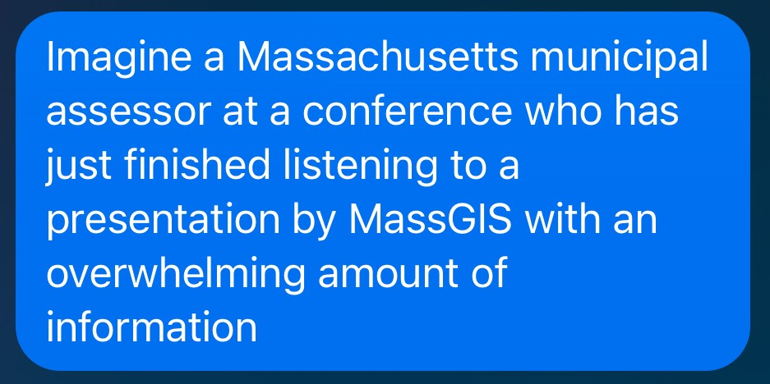
Standardized Assessing Data & MassGIS
Meta AI Expectations
Post-Presentation Impact
Notes:
Recently rolled out on Facebook messenger. Ask it to imagine something and it attempts to create a picture of it. I’m hoping this is not how everybody feels right now, but if you think you might want to learn more or request some potential data products… (next slide)

Slide 49
Standardized Assessing Data & MassGIS
daniel.marrier@mass.gov
Questions??

