Slide 1
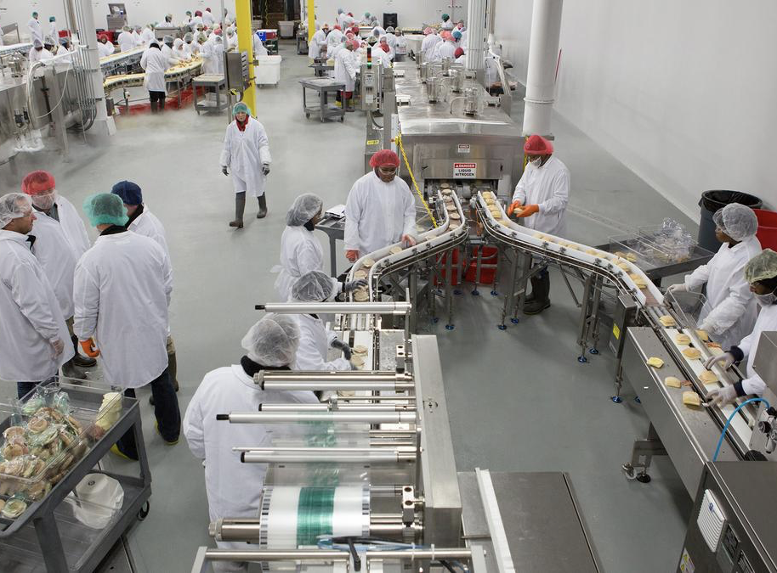
Toxics Use Reduction Act (TURA) eDEP Online Reporting & Planning
Reports due on or before July 1st

Slide 2
Ready to File?
Information to have on hand
eDEP Functionality
eDEP Step-by-Step Navigation
eDEP AMEND

Slide 3
Remember: only file if you have to!
Over 10 FTE’s
Using a listed chemical
Use of the listed chemical is over threshold
Reporting on chemicals below threshold, or if your FTE’s are below 10, may result in an invoice being automatically generated.
Notes:
Before we start, remember only file if you have to and only report on the chemicals that you are using above threshold.
Before you start, ask yourself, do I have over 10FTE’s? Am I using a listed chemical? Is the usage of that chemical above threshold?
If you do not have to report this year (for instance you have less than 10 FTEs or the one chemical you report on was reduced below threshold this year, we ask that you please fill out the Non-Applicability form from our website. That form is beneficial for both your records and ours. You have something on hand to show why you didn’t file a full report for the given year, and the Program knows why you didn’t file and that we don’t have to do pre-enforcement outreach to see if you forgot to file. If you are trying to determine if you need to report and you also report to TRI you can utilize the EPA’s TRI Threshold Screening Tool.

Slide 4
Information to have on hand
Required:
Your eDEP credentials
MassDEP issued Facility ID
Company TIN
Recommended:
Previous year’s filing with noted changes
Online Filing Tips
Form S Instructions and Appendices
Form R Instructions
Planning Guidance
Notes:
Information you will need to have on hand:
Your eDEP credentials, MassDEP’s issued facility ID number, and your company’s TIN.
If you don’t know your facility ID, please contact the TURA program at TURA.Program@mass.gov.
TIN should be entered without dashes.
Information we recommend you have on hand:
Previous year’s filing with any noted changes for this year
Online Filing Tips
Form S Instructions and Appendices
Form R Instructions
You will need to refer to a number of documents while completing your TURA online filing. Links to these can be found by visiting https://www.mass.gov/guides/massdep-toxics-use-reduction-program
EPA Toxic Release Inventory information can be found at www.epa.gov/tri
Other things to consider reviewing environmental monitoring data, permit applications, waste manifests, invoices, vendor receipts, CERCLA, EPCRA, RCRA, NPDES, CAA, and any other environmental reports, waste characterizations, SDS’s

Slide 5
Getting Started
Navigate to eDEP
Log In
Locate TURA filing forms
Notes:
Let’s get started.
The first few things we’re going to cover are how to navigate to eDEP on the web, logging into the eDEP platform, and locating the TURA filing form packet

Slide 6
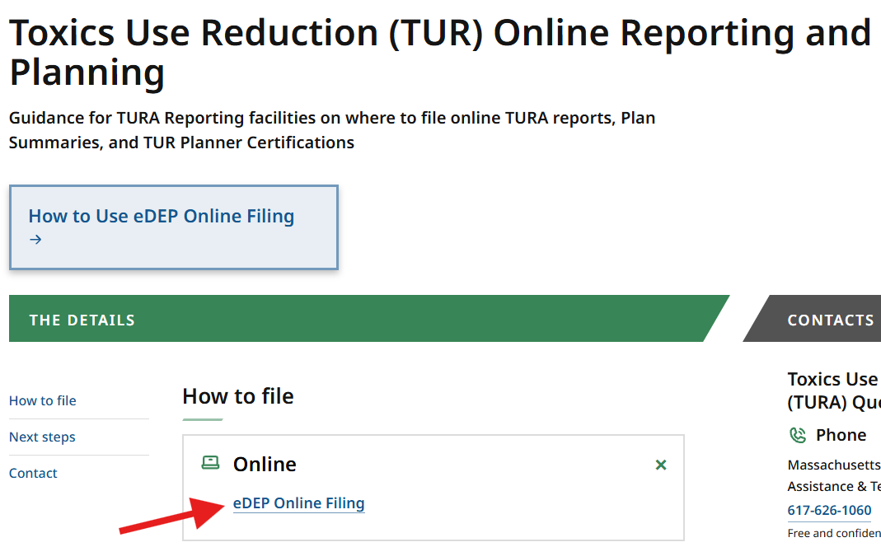
Navigating to eDEP
Toxics Use Reduction (TUR) Online Reporting and Planning
Notes:
There’s a few ways to get to eDEP. The first is on the Toxics Use Reduction (TUR) Online Reporting and Planning page. https://www.mass.gov/how-to/toxics-use-reduction-tur-online-reporting-and-planning. This page is linked to the main TURA webpage and can be launched via a button located at the end of the TURA Reporting and Planning Section. The link to eDEP Online Filing is located in the How to file section.
Also, on this page you can find information about how to use eDEP Online Filing as well as links to the TURA Reporting Instructions, Reporting Appendices, Changes for the TURA Reporting Year, Complete list of TURA chemicals, the Planning and Plan Update Guidance, the RC Planning Guidance, the EMS Planning Guidance, AMEND instructions, the Non-Applicability Form, and the TUR Closure Form.

Slide 7
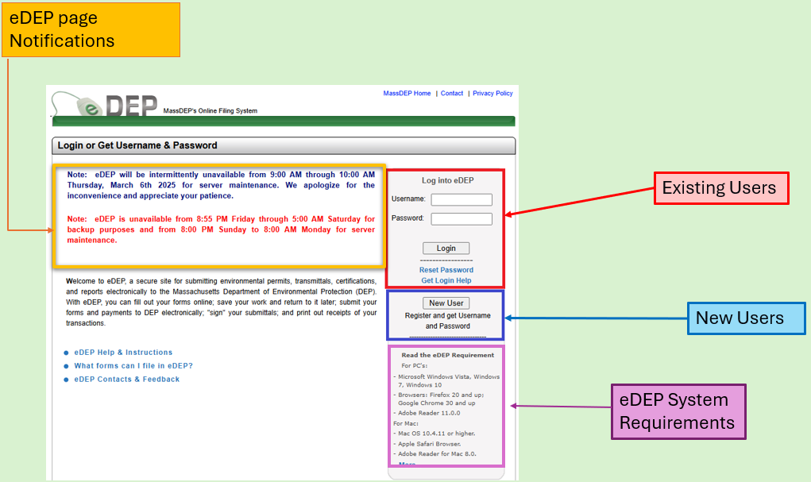
eDEP Home Page & Log In
eDEP home page
Notes:
Another way to locate eDEP is to use the direct link to the platform: https://edep.dep.mass.gov/eDEP/DEPLogin.aspx
I want to call your attention to the yellow box on the left-hand side of the screen. This is where you will see platform messages about system down times and maintenance schedules. Before you log in, take a quick look at this section to ensure that the platform isn’t unavailable.
If you are an existing user, enter your username and password and log in.
MassDEP TURA Program staff do NOT have access to your username and password information. If you forgot your username, need to reset your password, or some other type of log in help, please select on the reset password or get login help buttons and work directly with eDEP user support.
If you are a NEW user, you will need to Register for an account and create a username and password The process is like creating a user account on any other online platform. We do recommend that users write down the answers to their log in questions.
The eDEP platform also displays a list of browsers and versions listed on this log in screen on the bottom right-hand side of the page. Beneath the new user set up. If you are experiencing functionality issues and the system isn’t undergoing maintenance I would recommend you show the requirements to your IT staff to ensure your system and ours are compatible.

Slide 8
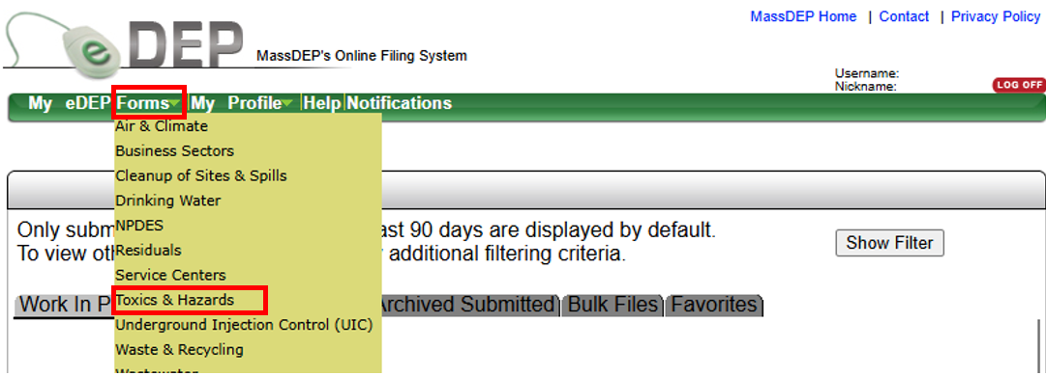
Navigating eDEP: Locating Filing Forms
Once Logged in
Select the “FORMS” tab
Scroll down to select “TOXICS & HAZARDS”
Notes:
Once you have logged into eDEP you need to locate the TURA Forms so that you can file. Directly beneath the eDEP logo is a toolbar. Select on the Forms tab from that toolbar. This will present you with a dropdown list of forms. From that list, select Toxics & Hazards.

Slide 9
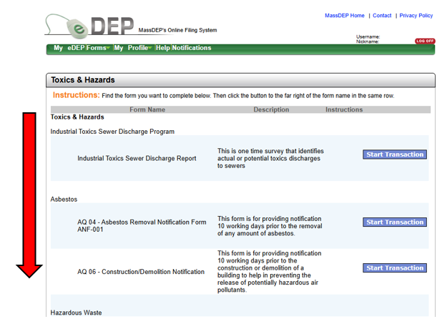
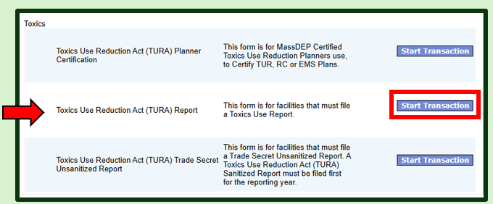
Navigating eDEP: Locating Forms
Scroll down the list of Forms until you find the program section entitled Toxics.
Select “Toxics Use Reduction Act (TURA) Report”
Notes:
A page will load entitled Toxics and Hazards. This is a list of programs and their associated form names that you can file electronically. Scroll down the list and locate the section entitled Toxics. Within that section, locate Toxics Use Reduction Act (TURA) Report. Select the button labelled “Start Transaction” to begin.
*ONLY facilities that have been set up in the system can file electronically. If you are new to the TURA Program, please complete the NEW FILER Form located on Mass.gov so that we can set you up to file.
**If you are a trade secret filer, please note you will need to file both the Toxics Use Reduction Act (TURA) Report which will serve as your Sanitized Filing AND the Toxics Use Reduction Act (TURA) Trade Secret Unsanitized Report. You must complete the sanitized filing first, wait an hour then complete the unsanitized report.

Slide 10
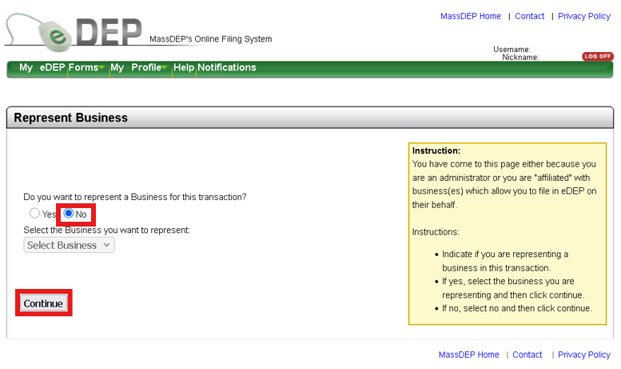
Navigating eDEP: Represent Business
Notes:
If you have completed a proof in eDEP for a separate program you may see this screen. If you are presented with this page, the answer is no.

Slide 11
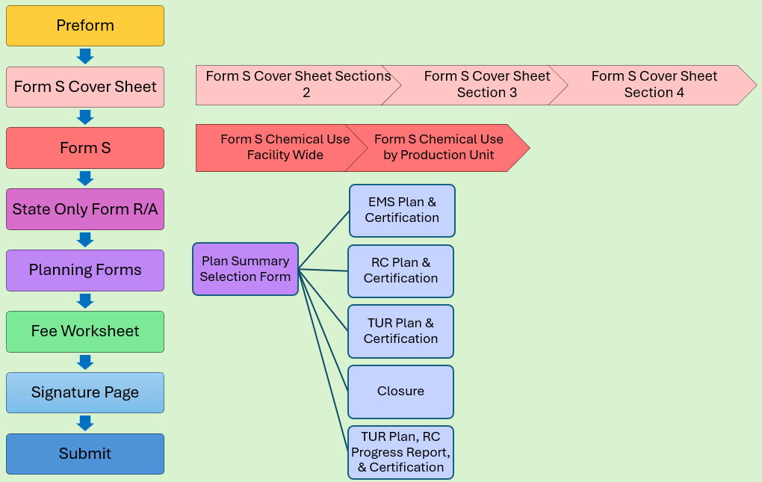
TURA Filing Process: Planning Year Forms
Notes:
The Online TURA reporting process is linear. The system generates forms one at a time based on what information was entered on prior screens. After selecting the Start Transaction button the first form you should be presented with is the Preform. After the preform comes then a set of forms that comprise the Form S Cover Sheet. This includes the Form S Cover Sheet Sections 1 &2, Section 3, and Section 4. You will then presented with a set of Forms that comprise the Form S. Those are the Form S Chemical Use Facility Wide and Form S Chemical Use by Production Unit. Next are the State Only Form R/A’s, then the Planning and corresponding Certification forms. The Planning Forms and Certification you are presented will be the result of your answer on the Plan Summary Selection Form. After completing the planning pages you will be presented with the Fee Worksheet, Signature Page, and the Submittal screen. The forms will appear in the order shown and each step is a separate form.

Slide 12
TURA Filing Process: Forms Packet part 1
Preform
Form S Cover Sheet
  Sections 1-2: General Information and FTE Information
  Section 3: Chemicals Not Reportable This Year
  Section 4: Facility-Wide Description of Production Units (Production Unit, NAICS, Chemicals, Process Codes)
Form S
  Chemical Use Facility-Wide Sections 1-3: Chemical Use Amounts, Materials Balance & Reporting Anomalies, and Chemicals used in Waste Treatment Units
  Chemical Use By Production Unit Sections 4-5: Toxics Use by Production Unit & Comments
Notes:
Forms Packet- part 1: Like I just mentioned here are the forms in a little further detail
The Preform
Form S Cover Sheet
Sections 1-2: General Information and FTE Information
Section 3: Chemicals Not Reportable This Year
Section 4: Facility-Wide Description of Production Units (Production Unit, NAICS, Chemicals, Process Codes)
The Form S
Chemical Use Facility-Wide Sections 1-3: Chemical Use Amounts, Materials Balance & Reporting Anomalies, and Chemicals used in Waste Treatment Units
Chemical Use By Production Unit Sections 4-5: Toxics Use by Production Unit & Comments

Slide 13
TURA Filing Process: Forms Packet part 2
State ONLY Form R/Form A
Planning Forms
  Plan Summary Selection Form
  1. EMS Plan & Senior Management Official Certification
  2. RC Plan & Senior Management Official Certification
  3. TUR Plan & Senior Management Official Certification
  4. Closure
  5. RC Progress Report
Fee Worksheet
Signature Page
SUBMIT
Notes:
Forms packet continued:
State ONLY Form R/Form A
Planning Forms
Plan Summary Selection Form
1. EMS Plan & Senior Management Official Certification
2. RC Plan & Senior Management Official Certification
3. TUR Plan & Senior Management Official Certification
4. Closure
5. RC Progress Report
Fee Worksheet
Signature Page
SUBMIT

Slide 14
Sidebar: eDEP & How it Works
Notes:
Before we get into looking at the forms in depth, I’m going to take a quick sidebar and talk a little about eDEP and how it works. Hopefully, this will help you understand the system a bit better and help make navigating through the filing process easier.

Slide 15
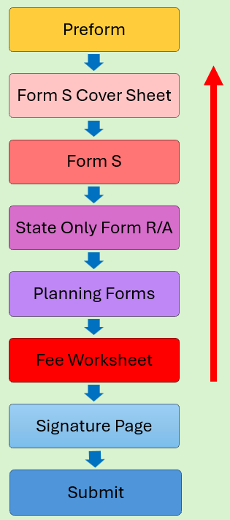
eDEP: Form Generation
The eDEP reporting system is designed in a linear fashion. It takes answers from prior forms to build out the subsequent forms and pre-populate information to save users time doing data entry.
If you realize you made an error in the filing, you will have return, sometimes to the beginning, to fix it.
Notes:
The filing process is linear. What that means is the eDEP system is designed to take answers from prior forms to build out the subsequent forms with pre-populate information. The goal being to save the user some time on data entry. One downside of this type of system is that if you realize you made an error in the filing, you will have return, sometimes to the beginning, to fix it.
For example: If you complete the majority of the filing packet then realize when reviewing the Fee Worksheet that you made an error on your FTE headcount, you will need to return to the Form S Cover Sheet Sections 1-2 to fix the FTE headcount. The good thing is, the system will save your answers as you go. That’s a purpose of the error check and next feature, so depending on the error and where it was made, you should not have to re-enter information. You should just be prompted to revalidate the form answers are still valid.

Slide 16
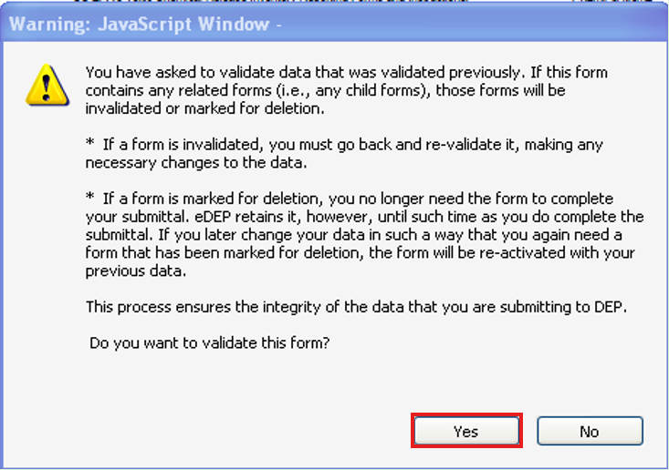
eDEP: Deleting or making changes
Deleting, or changing a form that is connected to another, can affect the entire submittal. In those cases, you will receive a pop-up message.
If you intend to make the change, select YES.
If you selected this option in error, select NO.
Notes:
As previously mentioned, the forms build off of one another, so deleting, or changing a form that is connected to another, can affect the entire submittal. In some cases, you will see a pop-up message.
Select Yes to proceed if you are making a change.

Slide 17
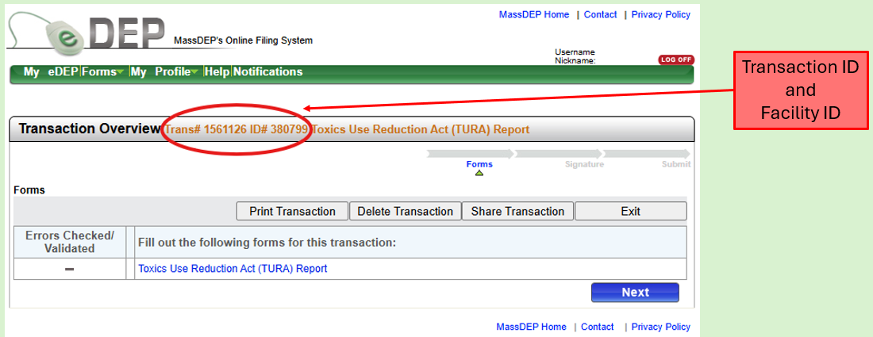
eDEP: The Transaction Overview Screen
Notes:
Once the preform has been completed you will be presented with the transaction overview screen. The Transaction Overview screen displays the Unique Transaction ID# assigned to your transaction/report as well as the Facility ID# that the transaction corresponds with. The location of those two numbers are called out in this screen shot by the oval. The Transaction ID# is important to note down if you don’t intend on completing and submitting the report in one sitting. That way when you log back into eDEP, you can locate the transaction number on your work in progress ta, and pick up where you left off to finish the transaction.
Noting the transaction ID is also helpful when and if you need to AMEND. Especially for those of you that have to make multiple edits. This allows for you maintain version control as a new transaction ID # is generated for every AMEND. This number does print on the submitted reports cover sheet and will show up in the system generated confirmation email if you need to find it.

Slide 18
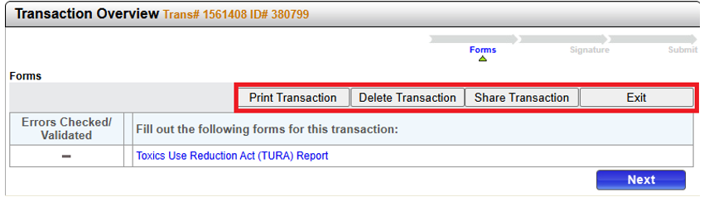
eDEP: Transaction Overview Specific Buttons
Print: Allows you to print a copy of the filing packet
Delete: Allows you to delete an in-process transaction only. **Cannot be undone**
Share: Allows you to share the transaction with other users
Exit: Allows you to leave a transaction to return to later
Notes:
While on the Transaction Overview Page please note the transaction specific buttons:
Print: Allows you to print a copy of the filing packet. Please note, if you print a transaction before it has been submitted it will have a draft watermark on it that can obscure some of the data. Requests have been made to move the watermark or make it transparent. It’s on IT’s list of to do items.
Delete: Allows you to delete an in-process transaction only. **Cannot be undone so please use with caution**
Share: Allows you to share the transaction with other users
Exit: Allows you to leave a transaction to return to later.

Slide 19
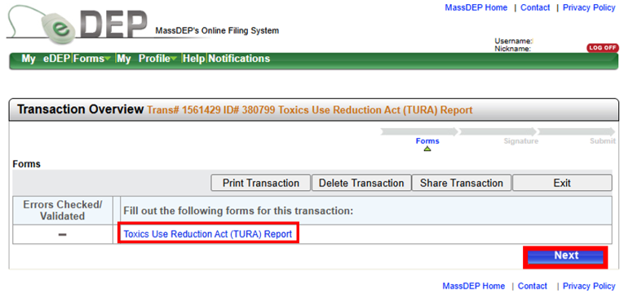
eDEP: Advancing Forms
There are two ways to proceed through the report/form packet. Both work and depend on user preference. Users can either select on the name of each form individually or can advance by selecting the next button.
Notes:
There are two ways to proceed through the report/form packet. Both work and depend on user preference. You can either select on the name of each form individually or you can advance by selecting on the next button.

Slide 20
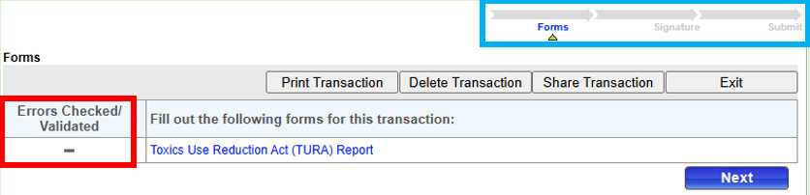


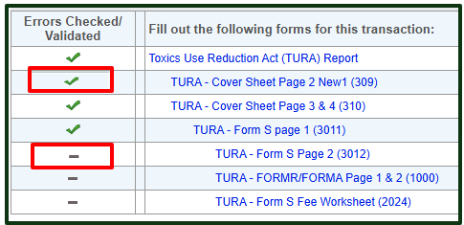

eDEP: Forms Progress/Building Your Packet
Notes:
eDEP tracks your progress through the filing in two places.
The first is the column which runs along the left-hand side, adjacent to the names of the forms in the packet. After the first form is completed, other forms will begin to appear as the system builds out the packet. Forms with a green check mark have been completed and passed the error check process. Forms with a gray dash mark have not been completed or have not passed the error check process.
The second status bar is a set of arrows pointing left to right that runs across the top of the page. This status bar is tracking where you are in the filing and advances as you do. The carat points to the name of the section you are working on. Once a section has been completed the arrow pointing right will darken and the carat will advance.

Slide 21
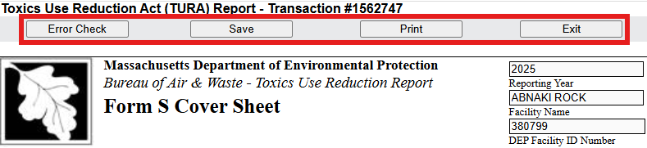
eDEP: Form Specific Navigation Buttons
Error Check: Checks for missing data for the form you’re on.
Save: Saves entries to the form you are on.
Print: Prints only the form that you are on.
Exit: Exits the screen you are on.
Notes:
eDEP also has Form Specific Navigation Buttons. These are located at the top of every filing form.
Error Check: Checks for missing data for the form you’re on.
Save: Saves entries to the form you are on.
Print: Prints only the form that you are on/or as far into the forms packet as you have advanced. For unsubmitted transactions their will be a draft watermark present on the printout.
Exit: Exits the screen you are on.

Slide 22

eDEP: Form Specific Navigation Exiting a Form
Yes: will save changes on the form you are working on and return you to the Transaction Overview Screen
No: will not save any changes made to that form and return you to the Transaction Overview Screen
Cancel: will close this pop-up box and allow you to continue working on the form
Notes:
Just a further note for those of you who exiting a form.
Yes: will save changes on the form you are working on and return you to the Transaction Overview Screen
No: will not save any changes made to that form and return you to the Transaction Overview Screen
Cancel: will close this pop-up box and allow you to continue working on the form

Slide 23
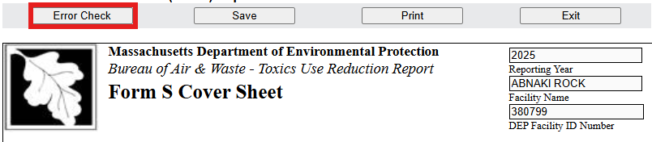

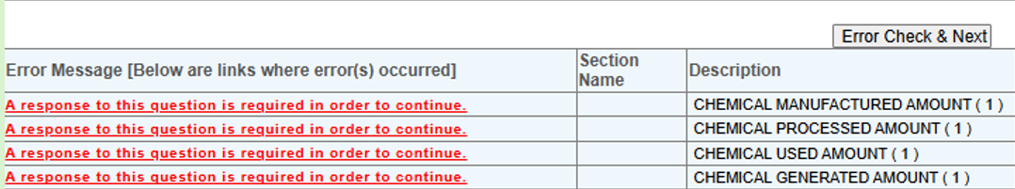
eDEP: Form Specific Navigation Error Check
Notes:
Form Specific Navigation Error Check
Once all the required data for the form (and all blocks) has been entered, select on “error check and next” to save the data and advance to the next form. This button can be found in two different places on the form. It can be found at the top of the form in the header and at the bottom of the form. In both cases, the system will review the entered data, and if there are no errors, will advance to the transaction overview page so that you can select the next form.
If there are error on the form, you will see a list of error messages in red at the bottom of the form with information to point you to the fields that need to be updated to proceed.

Slide 24
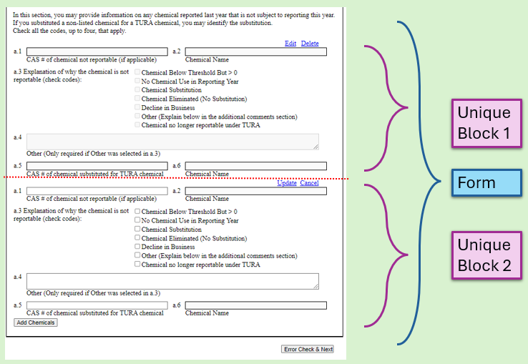
eDEP: Form Structure
To enter data into the data fields on these forms and blocks you will see individual buttons adjacent to the fields.
To begin data entry select edit.
To save your answers select update.
To close a data field without making changes, select cancel.
If you have filled out data in a field in error, select delete.
To add more than one unique block look for buttons that begin with the word Add.
Notes:
Form Structure:
The eDEP TURA system uses a combination of forms and blocks to build your submittal. Each section of the report/forms packet is divided into individual forms. Each form has certain sub-sections with required data elements. (IE: Form S Cover Sheet Sections 1-2, State only form R/A, Fee worksheet). On each form, some data elements will be arranged in blocks. This is to accommodate companies that need to provide the data on more than one chemical, production unit, treatment process, etc. The first block is always provided and must be independently edited. Buttons with the word “Add (followed by description of the block)” will add additional blocks to the page.
This image is an example of the block concept here. The entire page is the form, while the brackets call out the unique blocks. The dotted line in this example separates the two unique blocks. There is no dotted line in eDEP to separate the unique blocks.
To enter data into the data fields on these forms and blocks you will see individual buttons adjacent to the field.
To begin data entry select edit.
To save your answers select update.
To close a data field without making changes, select cancel.
If you have filled out data in a field in error, select delete.
To add more than one unique block look for buttons that begin with the word Add. Depending on what type of unique block you need, you can Add Chemicals, Add Production Unit, or Add Process Codes.

Slide 25
eDEP: Miscellaneous Quirks
Be patient/don’t panic. The eDEP system is older and pages can take time to load or save.
eDEP no longer allows the use of many special characters.
  Refrain from using special characters like ampersand (&), pound sign/hashtag (#), asterisk (*), etc. in free text fields
  Chemical names that contain Greek characters on the chemical list will display in eDEP with the Greek character spelled out.
If you need to submit multiple transactions for a single facility, please wait a minimum of 1 hour between submissions. Remember to file reports in order starting with the oldest year to newest.
If you are working on a filing and experience unexpected behavior, please contact TURA.Program@mass.gov to report the issue or request assistance.
Notes:
Finally I want to talk about some of eDEP’s quirks.
First, I want to remind users to be patient/don’t panic. The eDEP system is older and pages can take time to load or save.
eDEP no longer allows the form of many special characters.
Refrain from using special characters like ampersand (&), pound sign/hashtag (#), asterisk (*), etc. in free text fields
Chemical names that contain Greek characters on the chemical list will display in eDEP with the Greek character spelled out.
If you need to submit multiple transactions for a single facility, for instance if you need to file reports for prior years, please wait a minimum of 1 hour between submissions. Remember to file reports in order starting with the oldest year to newest.
If you are working on a filing and experience unexpected behavior, please contact TURA.Program@mass.gov to report the issue or request assistance.

Slide 26
Back to eDEP Step-By-Step form instructions
Notes:
Now lets go back to eDEP step-by-step form instructions

Slide 27
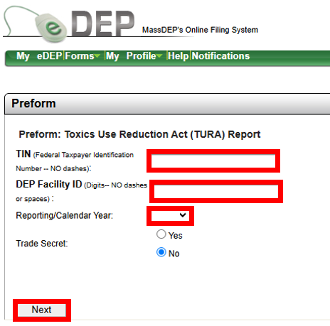
eDEP: The Preform
Enter your facility’s TIN (Federal Tax ID#)
Enter your facility’s DEP Facility ID#
Select the Reporting Year
Trade Secret default is No (Do not change this selection)
Select Next
Notes:
The Preform is the first form to build your report/forms packet
1. Enter your facility’s TIN (Federal Tax ID#) with no spaces
2. Enter your facility’s DEP Facility ID#
3. Select the Reporting Year
4. Trade Secret default is No (Do not change this selection) even if you are filing a sanitized trade secret report
5. Select Next
*Trade Secret Filers (very few) will still check off the no box, as you will submit only Sanitized information on this report type.
If the TIN# (or FEIN#) is entered incorrectly, or is incorrect in DEP’s database, you will get an error message. If you enter in the wrong DEP Facility ID, you will get an error message as well. If you enter in the #’s in reverse order, you will get an error message.
The DEP Facility ID# is a unique number that has been assigned to your facility.
If you get an error message on the Preform, please contact the TURA Program to validate what you are trying to enter matches what information we have on file for you.

Slide 28
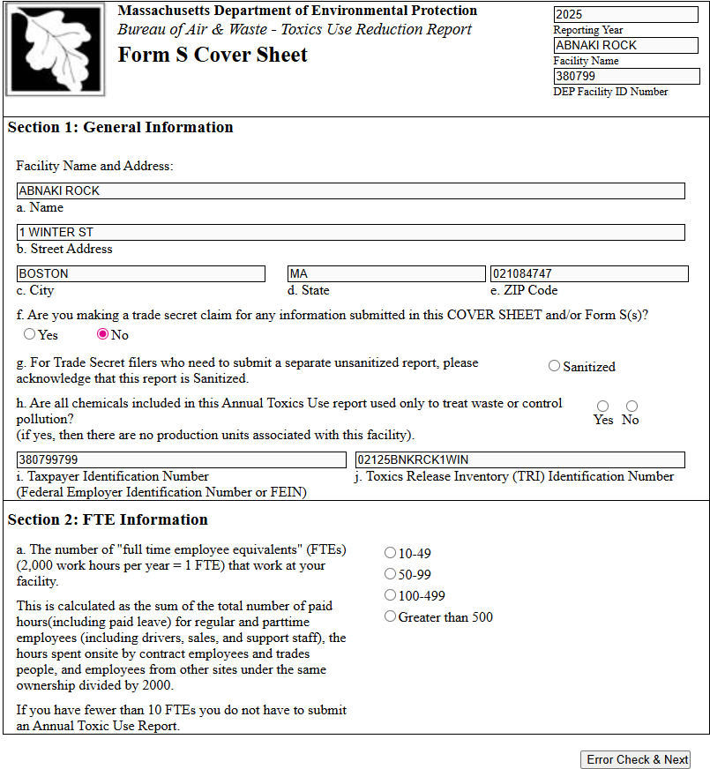
Navigating eDEP:
Form S Cover Sheet Sections 1 & 2
Notes:
After the Preform is the Form S Cover Sheet which has 4 sections.
The first form eDEP will present to complete contains sections 1 & 2.

Slide 29
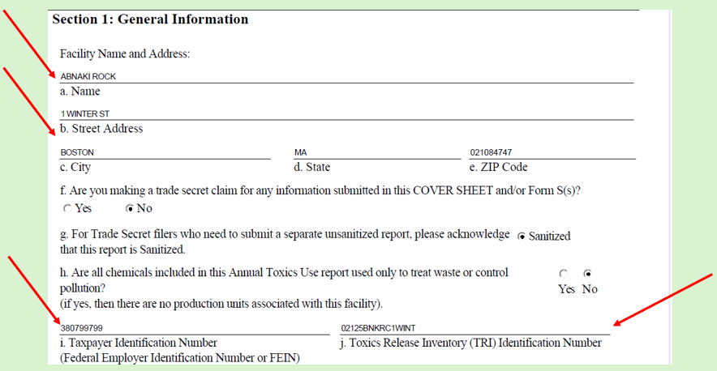
Navigating eDEP: Form S Cover Sheet Section 1
VALIDATE YOUR COMPANY INFORMATION
Check the Facility Name, Address, Tax ID #, and TRI ID # are correct.
If they are incorrect contact TURA.Program@mass.gov
Notes:
Form S Cover Sheet Section 1, displays your company information. This information will auto-fill based on the information that MassDEP has it in our database. Please stop and validate your company’s Name, Address, FEIN/TIN# and TRIFID # are accurate. If the information is incorrect, stop, exit the transaction and contact TURA.Program@mass.gov so that we can get our system updated so your filing populates with the correct information.
Keep in mind, the facility name should be the name that the facility operated under during the prior calendar year. If you underwent a name change in the prior year or were purchased in the prior year and you are unsure which facility should report. Stop and contact the TURA Program.
For those of you who file with TRI, you want your information in this section to match what you are reporting on to the TRI program to ensure that federally filed Form R’s flow into the MassDEP system.

Slide 30
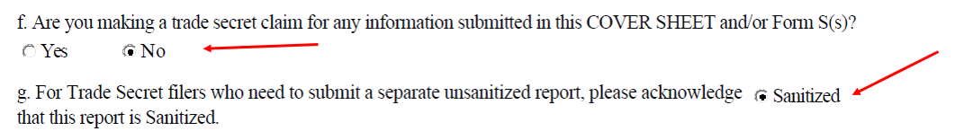
Navigating eDEP: Form S Cover Sheet Section – TS filers
Question f- No is the default for this report type for all users and should not be changed.
Question g is for Trade Secret Reporters only. All other filers can skip this question.
Facilities filing Trade Secret Sanitized Reports must select sanitized on question g
Notes:
Trade Secret Filers:
Question f- No is the default for this report type for all users and should not be changed.
Question g is for Trade Secret Reporters only. All other filers can skip this question without an issue or error. Facilities filing Trade Secret Sanitized Reports must select sanitized on question g.

Slide 31
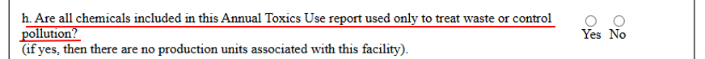
Navigating eDEP: Form S Cover Sheet Section 1- WWT only
Question h.
Are ALL of your reportable chemicals used ONLY to treat waste or control pollution?
For the majority of filers this answer is NO.
For those of you who answer YES, your packet will be built out differently.
Notes:
Section 1, question h asks if all chemicals being reported are used only to treat waste or control pollution. Majority of the filing universe will be answering no to this question. Those of you who answer yes, know who you are. A yes answer to this question will build your packet differently. The program does check on facilities that answer yes, so if you answer yes in error, will be likely be contacted by the program and will have to AMEND.

Slide 32
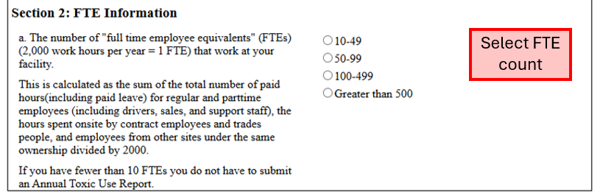
Navigating eDEP: Form S Cover Sheet Section 2
The number of full-time employees is dependent only upon the total number of hours worked by all employees and other individuals (e.g., contractors) for the facility during the calendar year and not the number of persons working.
You must consider all persons employed by the facility regardless of function.
You must add all hours from part-time and full-time employees, including holidays, vacations, and sick leave.
Notes:
Section 2: FTE information. The number of full-time employees is dependent only upon the total number of hours worked by all employees and other individuals (e.g., contractors) for the facility during the calendar year and not the number of persons working. When determining FTE count you must consider all persons employed by the facility regardless of function. You must add all hours from part-time and full-time employees, including holidays, vacations, and sick leave. For further guidance refer to https://guideme.epa.gov/ords/guideme_ext/f?p=guideme:rfi:::::rfi:2_1 and USE EPA’s Q&A Document as a guide FTE questions & answers # 21-48 https://ofmpub.epa.gov/apex/guideme_ext/f?p=guideme:qa-search.

Slide 33
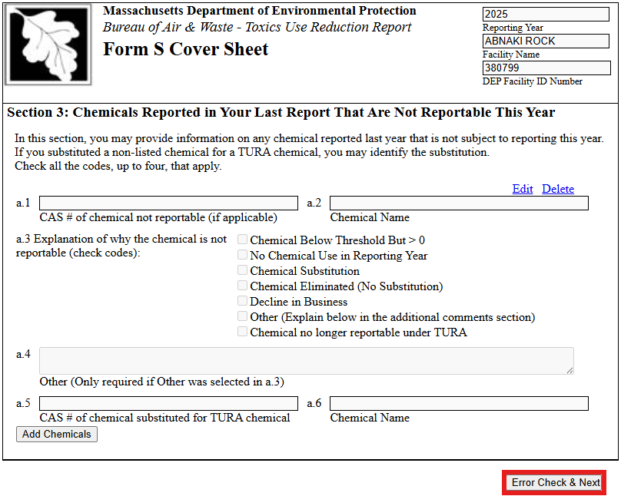
Navigating eDEP: Form S Cover Sheet Section 3
Notes:
Section 3 of the Form S Cover Sheet allows you to indicate chemicals that you had previously reported on (in RY2024) that you will not be reporting for RY2025. Please only enter in chemicals that had to be the prior year, that do not have to be reported for this reporting year). If all of your chemicals are below threshold or eliminated this year, please complete a Non-Applicability form.
Section 3 might be blank for most people, if this section does not apply to you, just select error check and next to advance to the next form.

Slide 34
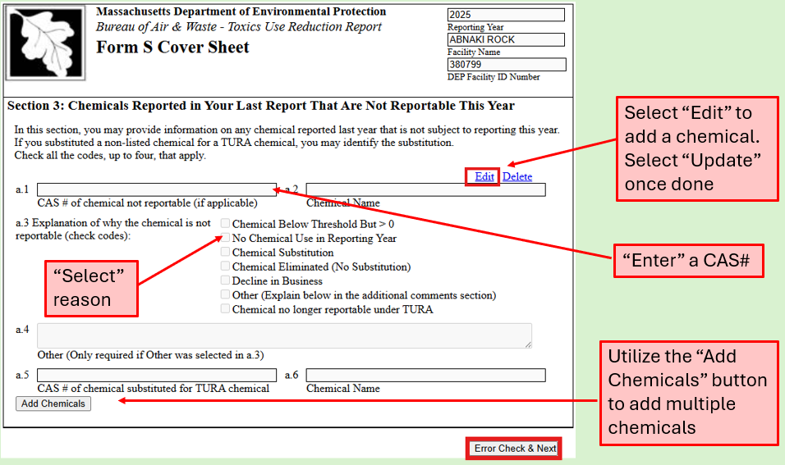
Navigating eDEP: Form S Cover Sheet Section 3, continued
Notes:
For facilities who need to use the Form S Cover Sheet Section 3, select “edit” to add the CAS #. Select a reason(s) the chemical is not reportable, then select “update” once done. The chemical name will fill in after you select “update”. If you select on “edit” in error, you can select on “cancel” to return to the screen without entering a chemical.
If you have more than one chemical that is not reportable this year, they need to be added individually. Use the “Add chemicals” button to create multiple blocks.
If you select chemical substitution; you will need to enter the CAS # of the chemical that you have substituted for. If the CAS# you have substituted for does not pull up. Contact TURA.Program@mass.gov

Slide 35
Document your calculations & source material, reminder 1
Document your calculations & source material
Notes:
Be sure to document your calculations and source materials in relation to chemicals that are below threshold.

Slide 36
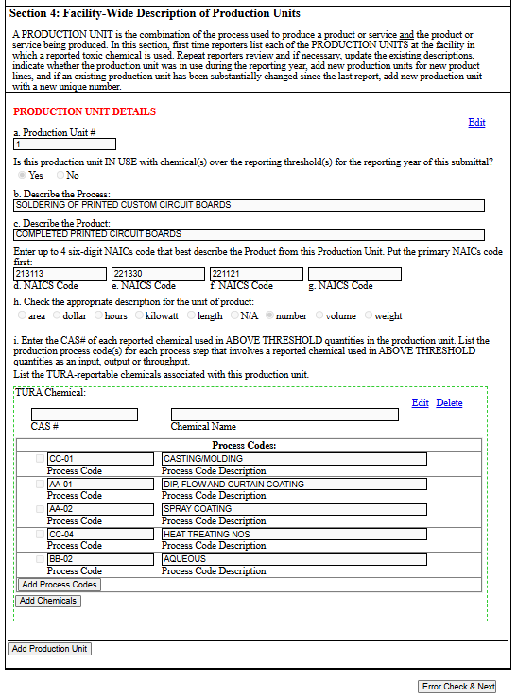
Navigating eDEP:
Form S Cover Sheet Section 4
Notes:
Form S Cover Sheet Section 4: Facility Wide Description of Production Unit
All existing production units will appear with prefilled production unit descriptions on this screen. Each production unit is an individual block that must be separately edited and saved one block at a time. If your facility has multiple production units, you will need to scroll down to see each production unit.

Slide 37
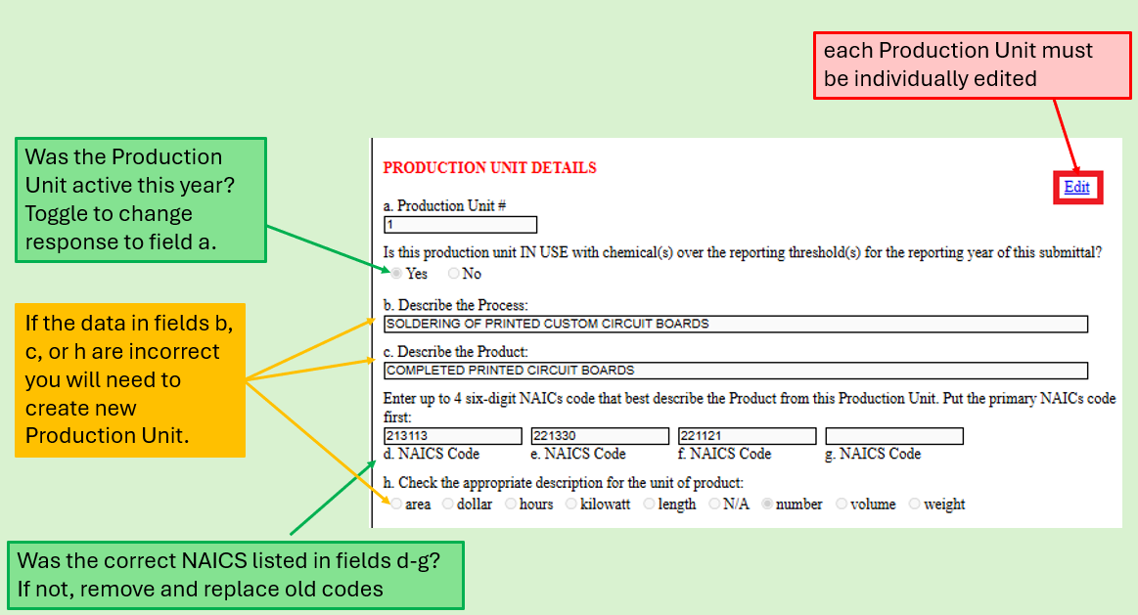
Navigating eDEP:
Form S Cover Sheet Section 4, fields a-h
Notes:
eDEP will populate a list of production units for you. We’re going to review the production unit form in pieces.
The first editable piece contains the production unit number and fields a-h for that production unit.
For each production unit before you edit it, review the information listed in fields b.) the description of the process, c.) the description of the product and h.) the unit of product. These are marked in yellow in this image.
If those three things match a production unit that was in operation in the prior year, select “edit” and toggle the answer to field a.) about the production unit being active to “YES.” Review the NAICS codes entered in fields d-g for the production unit and update if needed. A general comment on NAICS codes. A new list was put out in 2022. That should be the list you utilize. If you haven’t reviewed your facilities NAICS code in a while, we recommend you check out what you have listed. Then select “update.”
If the description of the process, the description of the product, or the unit of product do not match a production unit in operation during the prior year, select “edit” and toggle the answer to “No” then select “update” and move to the next production unit to be reviewed.
If you do not have a production unit in eDEP for a production unit that operated during the prior year, you will need to create one.
If you want to permanently eliminate a Production Unit contact TURA Program at TURA.Program@mass.gov. Please use this sparingly. Once a production unit has be eliminated it cannot be undone.
Please be sure to confirm that if you answer No in question a, that you do not add chemicals in that production unit. Chemicals should be listed only for production units that were in use during the reporting year.

Slide 38
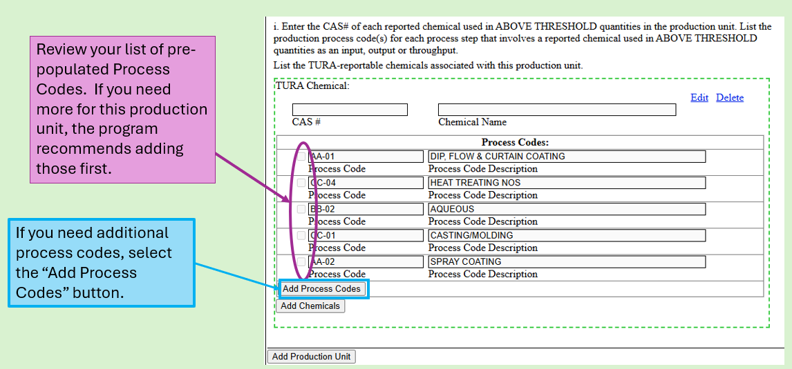
Navigating eDEP: Form S Cover Sheet Section 4, process codes
Notes:
Before you begin adding chemicals in section i, I recommend that you review the list of previously used process codes. If you need an additional or different code, select the “Add Process Codes” button. This will allow you to add process codes to all production units so that you can select the appropriate codes as you add each chemical.

Slide 39
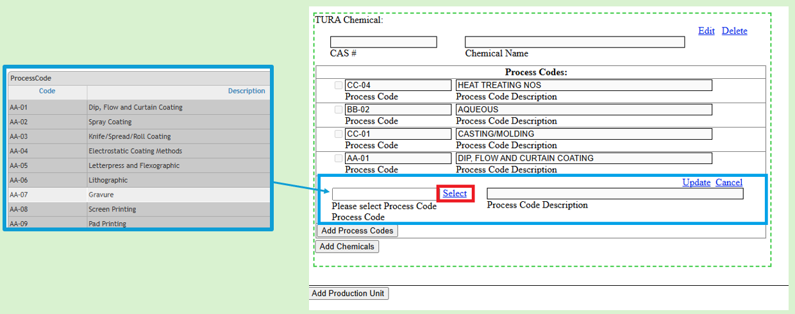
Navigating eDEP: Form S Cover Sheet Section 4, adding new process codes
Notes:
If you need to add new process codes, select the ”add process codes” button, that will populate a new blank process code box, as depicted above. Use the Select Button to open a pop-up window with the pick list of available process codes. Double select on the process code you are looking to select. This will populate the newly selected Process Code and then select “update”. Repeat the process to add multiple new process codes. If you selected on the add new process code button in error, please just select “cancel”.
These newly selected process codes will be available to add to other chemicals in this production unit and should prepopulate in any new production unit as well as for any other active production unit.
A grey box containing the various valid codes for the field you are working on will appear. Double select to select the code.

Slide 40
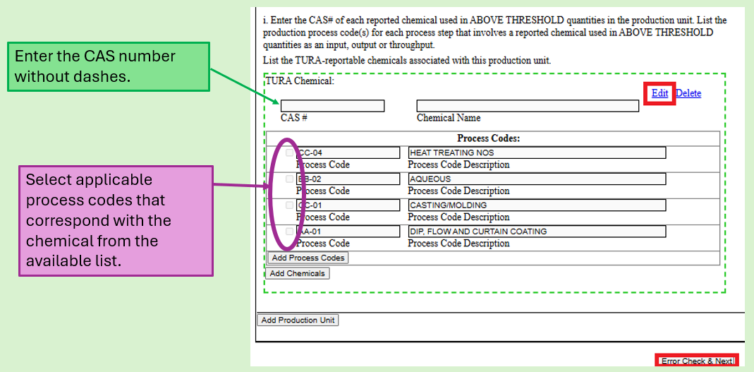
Navigating eDEP: Form S Cover Sheet Section 4, adding chemicals and process codes
Notes:
Now that you have added any needed process codes to the list of selectable options, you need to add a chemical(s). To do so, select the edit button. Enter the CAS # for the chemical, without dashes. Select the box next to each process codes that apply to the listed chemical then select update. Make sure to check off at least one process code per production unit chemical.
Please note that DEP does not accept the US EPA chemical category identifiers ('N###’) IE: N230; please refer to Appendix B of DEP's Toxics Use Reporting Forms and Instructions for the appropriate Massachusetts reporting number for chemical categories).

Slide 41
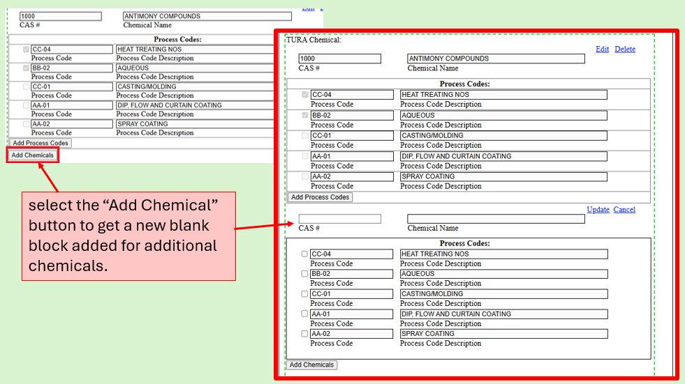
Navigating eDEP: Form S Cover Sheet Section 4, adding additional chemicals
Notes:
If you need to list more than one chemical per production unit, select the “Add Chemicals” Button to add a new unique block, enter the CAS #, select the process codes, then update.

Slide 42
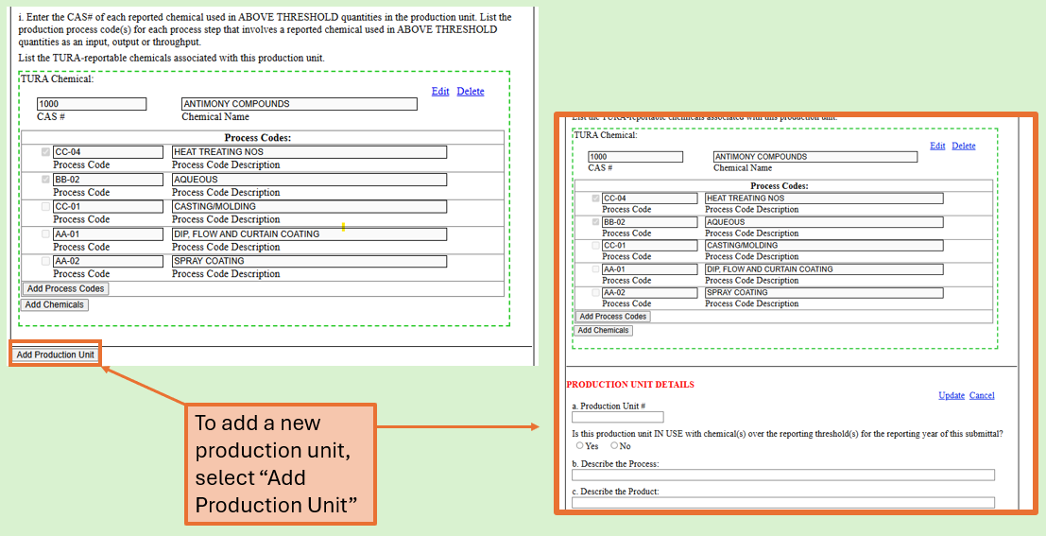
Navigating eDEP: Form S Cover Sheet Section 4, adding production units
Notes:
If you need to add a new production unit select “Add Production Unit,” complete all fields in the block, when complete select on, “update”. When all blocks are completed (all Production Units are entered, all Process Codes checked, all CAS#’s entered for each Production Unit, then select “Error Check & Next.”

Slide 43
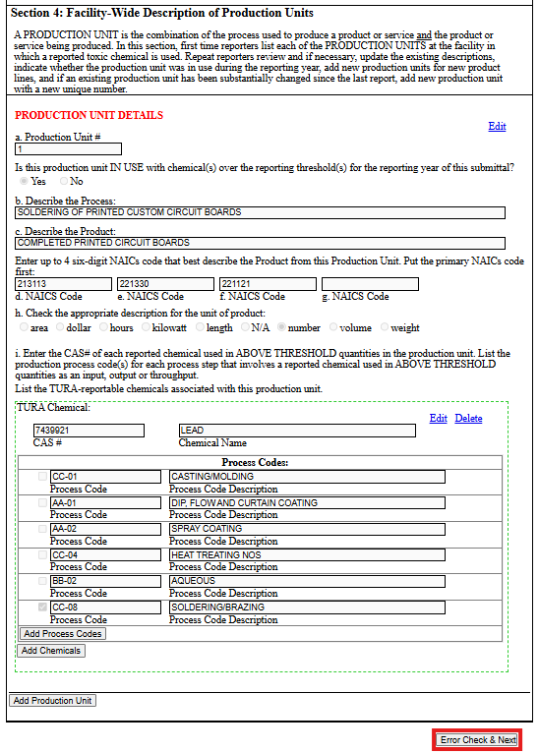
Navigating eDEP:
Form S Cover Sheet Section 4, page validation
Notes:
When all blocks are completed (all Production Units are entered, all Process Codes checked, all CAS#’s entered for each Production Unit, then select “Error Check & Next”. If all the required data elements have been completed, you will be able to advance to the next form.

Slide 44
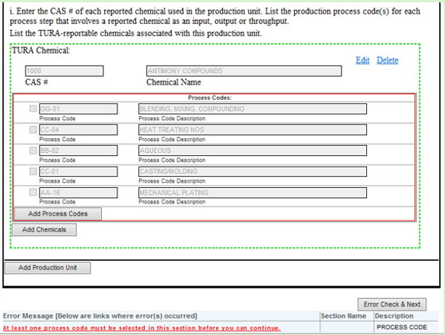
Navigating eDEP: Form S Cover Sheet Section 4
If there are any fields that are missing information or box that are not checked, an error message will show up in red at the bottom of the form.
“Edit” the section with the error, make the necessary corrections, then “select the update button.
Then select “Error Check & Next” again until the form is error free.
Notes:
If there are any fields that are missing information or boxes not checked, an error message will show in red at the bottom of the form. “Edit” the section, make corrections & “Update”. Then select “Error Check & Next” again until the form is error free.

Slide 45
Document your calculations & source material, reminder 2
Document your calculations & source material
Notes:
Be sure to document your calculations and source material as it pertains to production units.

Slide 46
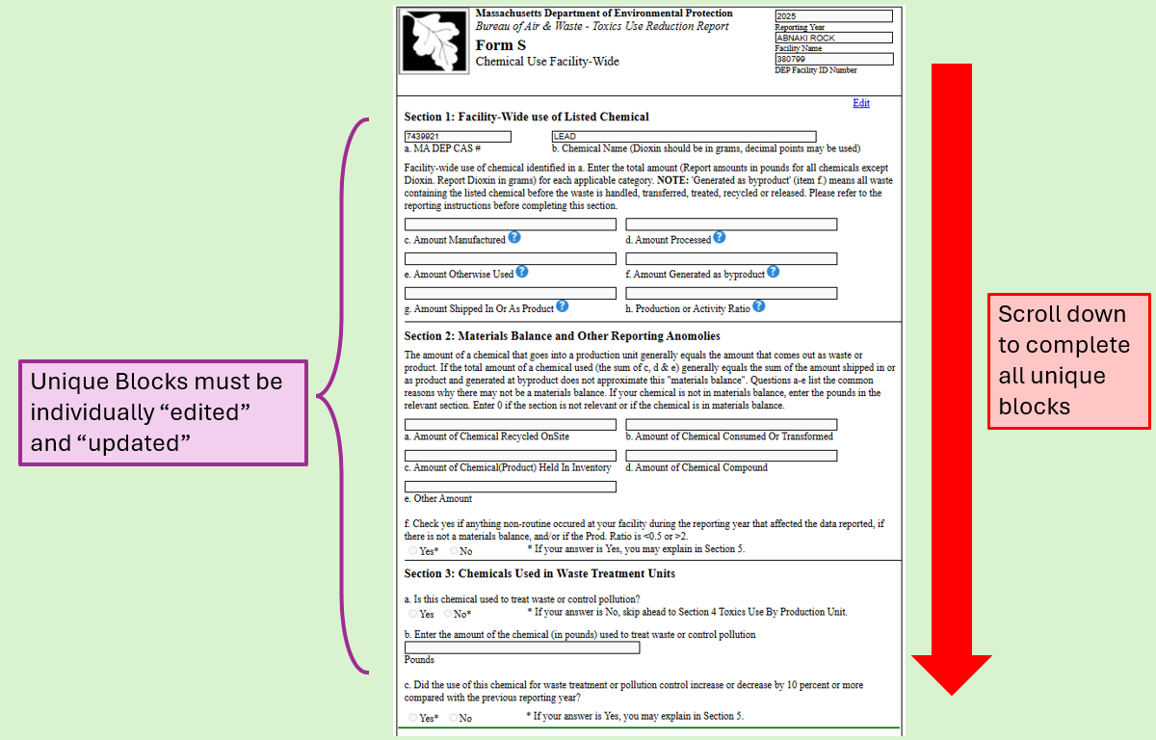
Navigating eDEP:
Form S Sections 1-3… and sometimes 4
Notes:
Now that you have completed the forms associated with the cover sheet we move on to those associated with the Form S.
The first form is the Form S Sections 1- 3. This form will show each of the Form S’s associated with the facility (based on what was entered in the production unit forms.) All CAS#’s/ Chemicals will appear on this form, each in an individual unique block that needs to be edited and updated.
Before you begin data entry, scroll down the form to ensure you have a Form S block for each chemical you are reporting on.
If you are missing a Form S for a chemical that must be reported, you will need to exit this form and return to the Form S Cover Sheet form 3 and 4 (the production unit form), add the missing chemical, then select “error check & next” to return to this Form S form. Likewise, if you see a Form S for a chemical that you did not have to report on, it is because you entered the information into the Form S Cover Sheet Section 3 and 4 (the production unit form), delete that CAS#, then select on “error check & next” to return to this Form S form
**If you indicated that all of your chemical(s) are used only to treat waste back on the Cover Sheet Section 1, the system will skip the production unit description form and go directly to this form. The CAS#’s and name will be blank. You will need to add as many unique blocks as needed for each CAS#/Chemical, then edit each by adding in the required data. Enter your comments in Section 4 then use the “update” button to save.

Slide 47
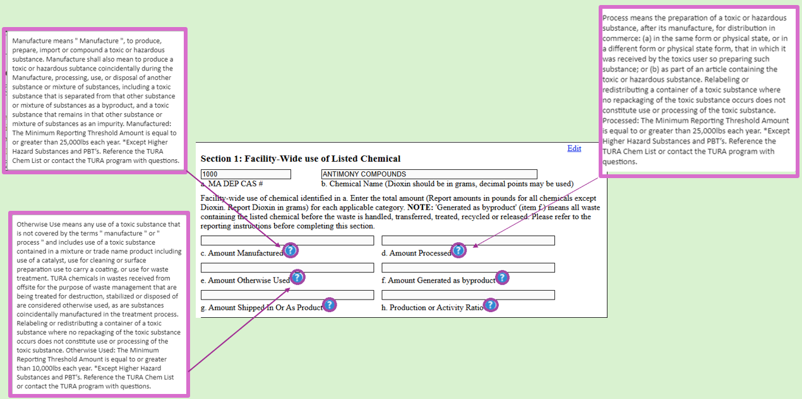
Navigating eDEP: Form S Sections 1
Chemical Use: Be sure to input your chemical usage numbers in the proper fields
Notes:
We have added question mark bubbles to many of the fields on this form. Those bubbles are locations where we have embedded the definition for the data field into the form to help you out. To see the definition, hover your cursor over the question mark bubble to display the definition. Be sure to input your chemical usage into the proper data fields to prevent QAQC outreach questions later.

Slide 48
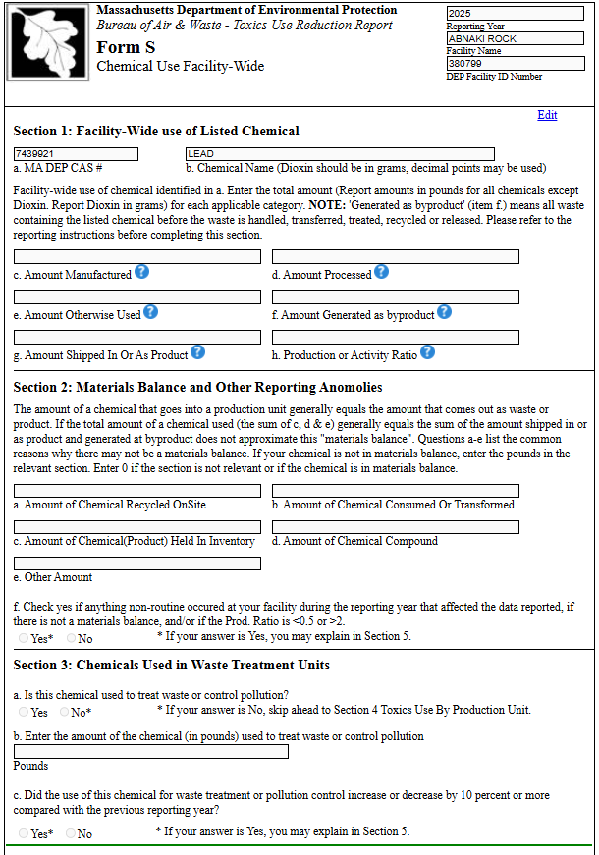
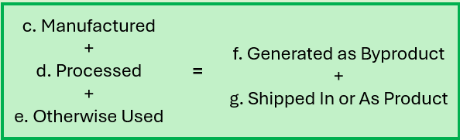
Navigating eDEP: Form S Section 1, Mass Balance
Mass Balance
Notes:
All entry fields must have a number entered, if that field is not applicable, enter a 0. Enter the pounds of chemicals as a whole number, unless you are reporting on PBT’s then you can report less than a pound. For instance, Lead may be entered in as ½ pound or 0.5. Dioxin is the only chemical that you would report in grams. (system now allows 999.9999 grams to be entered)
We do not expect you to report to the 4th decimal point, unless the chemical is Dioxin &/or Dioxin Compounds
In most cases, the numbers listed in the amounts manufactured, processed, and otherwise used data fields when added together should equal the numbers reported in the data fields for amount generated as byproduct plus amount shipped in or as product. Which gives you your material balance.

Slide 49
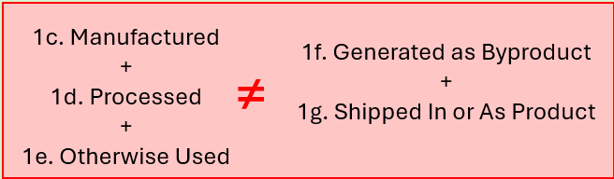
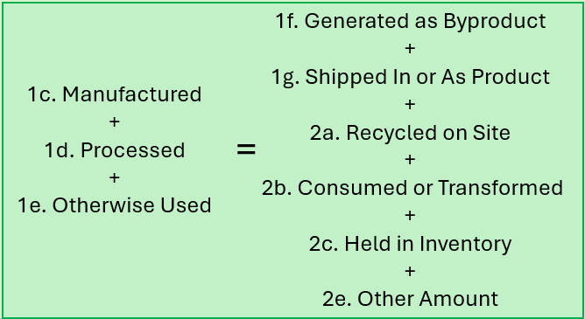
Navigating eDEP: Form S Sections 1 & 2
Use Section 2, a-e in addition to Section 1 g-h to obtain a balance
Notes:
If you are unable to obtain a materials balance between 1.c, 1d, and 1e and the data in section 1 fields 1g and 1h, you should proceed to add 2a, 2b, 2c, and 2e, to 1g and 1h to balance 1c + 1d + 1e.
Section 2 no longer allows for the entry of negative numbers.

Slide 50
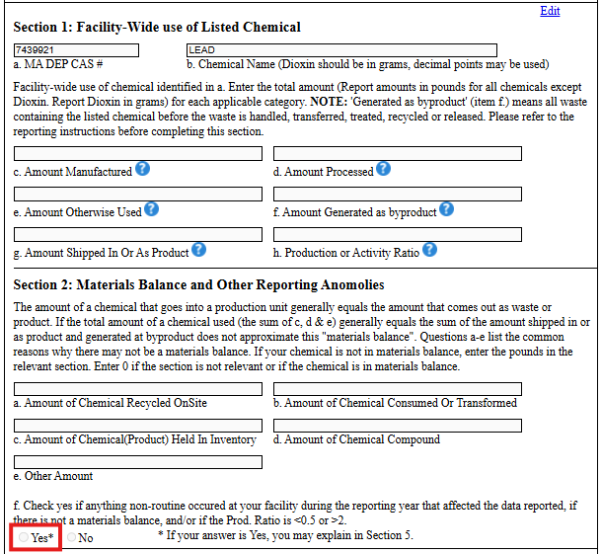
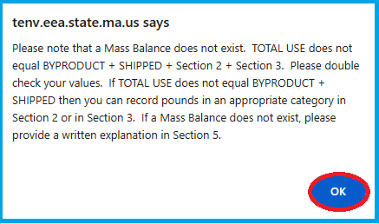
Navigating eDEP:
Form S Sections 1 & 2
Often mass balance occurs input = output but...
If ≠ then please explain by checking “YES” on question f, and noting in Section 5
Notes:
Sometimes however, input does not equal outputs. In those cases, the system will present the following error message: Please not that a Mass Balance does not exist. TOTAL USE does not equal BYPRODUCT + SHIPPED + Section 2 + Section 3. Please double check your values. If TOTAL USE does not equal BYPRODUCT + SHIPPED then you can record pound in an appropriate category in section 2 or in Section 3. If Mass Balance does not exist, please provide a written explanation in Section 5. Please select ok, to close that error message and answer question f as “yes”. For those doing a traditional report you will add your comments on the next form in section 5. For those with a WWT chemical only packet, enter this information in section 4.

Slide 51
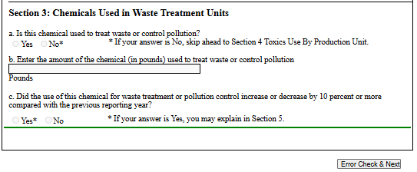
Navigating eDEP: Form S Section 3
Was any of the chemical used to treat waste or control pollution?*
* If you indicated (Form S Cover Sheet Sections 1) that ALL of the chemicals are used ONLY to treat waste, then Section 3.a is fixed at “Yes”. In addition, there will be no production units to report.
Notes:
NOTE: If you have SOME of your chemicals used for production & SOME used for Waste treatment.
IF for example, sodium hydroxide is used to clean mixing vessels as well as to Neutralize waste-water:
you would have a production unit describing the mixing vessel cleaning
You would indicate the amount of chemical otherwise used in the Form S
Indicate the amount of byproduct (waste) (most likely all of the amount used to clean the vessel)
And Indicate the amount used to treat waste or control pollution in Section 3 of the Form S (Chemical use Facility-wide)
Scenario 3) IF you used 2 or more chemicals AND 1 was used ONLY to treat waste and the other was used in production then:
You would have 2 production units
1 describing the production process for the non-waste treating chemical &
1 as a “dummy production unit” (describe as such) – this will trigger a Form S (facility-wide chemical use) for the waste treatment chemicals.
This would also create a Chemical Use By Production Unit(s) Screen, Complete the information understanding that you/we know the waste Treatment Production Unit is a “Dummy”.

Slide 52
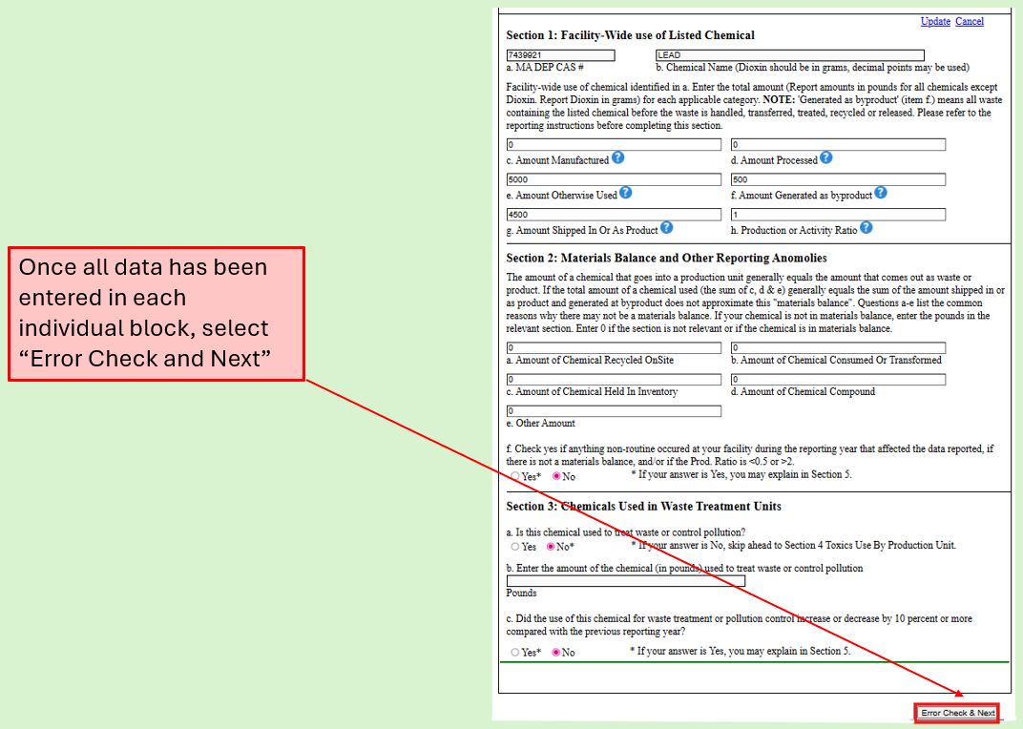
Navigating eDEP:
Form S Sections 1 -3
Notes:
Once all data has been entered/Unique Block completed and when done, select on the ERROR CHECK & NEXT button to move forward.

Slide 53
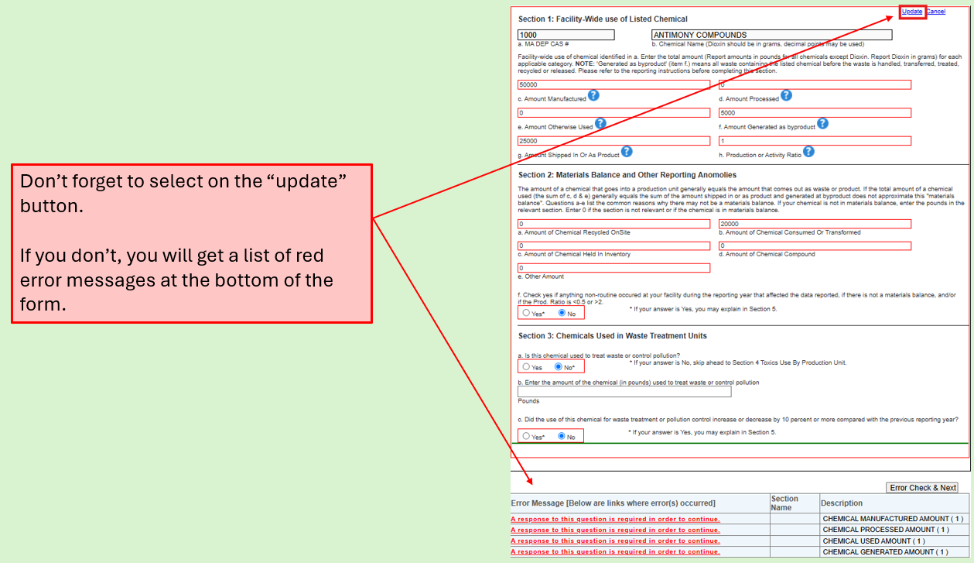
Navigating eDEP:
Form S Sections 1 - 3
Notes:
As a reminder, don’t forget to select on the “update” button after completing all of your data entry. If you don’t, you will get a list of red error messages at the bottom of the form.

Slide 54
Document your calculations & source material, reminder 3
Document your calculations & source material
Notes:
Remember to document your calculations and source materials for your mass balance.

Slide 55
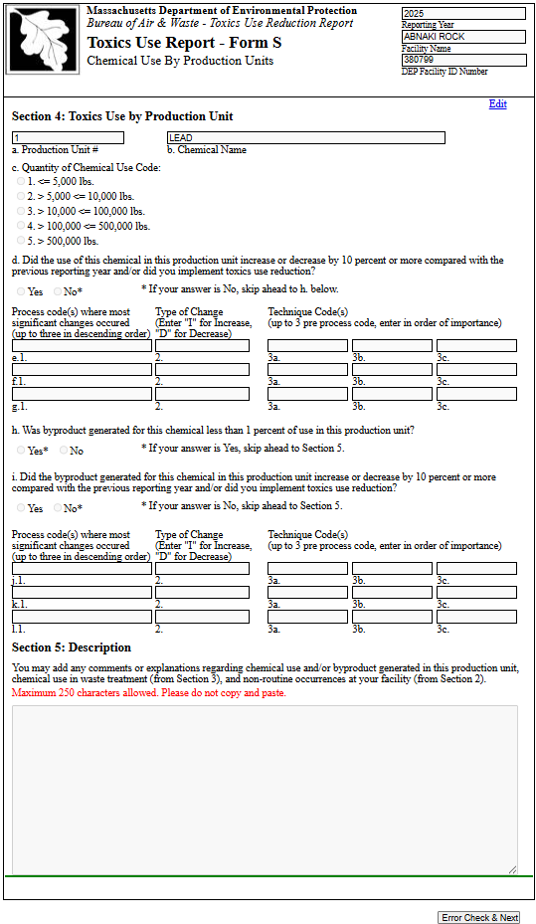
Navigating eDEP:
Form S Sections 4 & 5
Notes:
Form S, Sections 4-5: Chemical Use By Production Unit

Slide 56
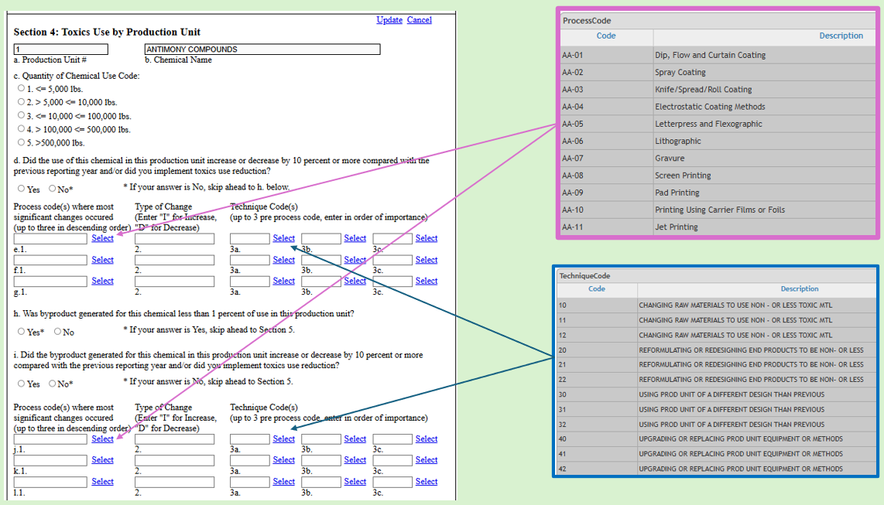
Navigating eDEP: Form S Section 4
Notes:
Form S, Sections 4: Chemical Use By Production Unit
Question 1 asks that you select a Quantity of Chemical used. Please review the list and select the appropriate toggle.
Note* if you reported a chemical in use in more than one production unit you will see a unique block for that chemical for each production unit you reported it in.
Did your Usage Increase or Decrease 10% or more compared to the prior year. If no, proceed to question h. If yes, You can add up to 3 process codes. Those codes can be viewed/selected by selecting on the “Select” button next to e1, f1, and g1. Indicate Increase by adding an I and a decrease by adding a D. You can also add up to 3 technique codes for each process code. Those codes can be viewed/selected by selecting on the “Select” button next to 3a, 3b, and 3c for each process code. If you answered yes, at minimum answers are required in e1, e2, e3a.
Question H-Was byproduct less than 1% of use in this production unit? If yes proceed to I. If no, proceed to section 5.
Question I-Did your Byproduct Increase or Decrease 10% or more compared to the prior year. No should automatically populate if you answered Yes on question H so proceed to section 5.
If yes, You can add up to 3 process codes. Those codes can be viewed/selected by selecting on the “Select” button next to j1, k1, and l1. Indicate Increase by adding an I and a decrease by adding a D.
You can also add up to 3 technique codes for each process code. Those codes can be viewed/selected by selecting on the “Select” button next to 3a, 3b, and 3c for each process code. If you answered yes, at minimum answers are required in j1, j2, j3a. If no, proceed to question h. If yes, You can add up to 3 process codes. Those codes can be viewed/selected by selecting on the “Select” button next to e1, f1, and g1. Indicate Increase by adding an I and a decrees by adding a D. You can also add up to 3 technique codes for each process code. Those codes can be viewed/selected by selecting on the “Select” button next to 3a, 3b, and 3c for each process code. If you answered yes, at minimum answers are required in e1, e2, e3a.

Slide 57
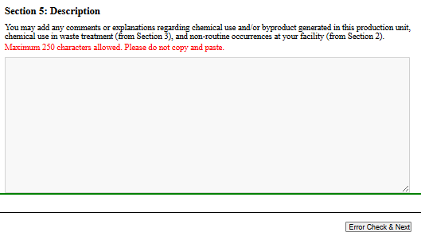
Navigating eDEP: Form S Section 5
Notes:
Section 5 if you had an issue with mass balance explain it here. If you had any non routine occurrences, explain it here. If you have any other additional comments regarding your chemical use and or byproduct generation add it here. If you have any additional information that you need the TURA program to know. Add it here.
Please note these open-ended answers are reviewed by the Department. If you were supposed to put additional information in here based on your answers on the Form S, Section 2, question f, please remember to do so. Keep in mind that there is a character limit of 250 characters, you are not able to copy and paste text here, avoid the use of special characters, and do not enter content in vertical list format. Just a comment on special characters here, if you find that the page will not advance when you click on the error check and next button but you are not being presented with an error message, it is likely because you have used a special character in this text box. Spelling out the word should resolve the issue. If you continue to experience an issue, please contact TURA Program staff.

Slide 58
Document your calculations & source material, reminder 4
Document your calculations & source material
Notes:
Remember to document your calculations and source materials.

Slide 59

Navigating eDEP:
State Form R/Form A Selection
Notes:
TRI Form R & A’s must be electronically submitted via TRI-Meweb. TRI is not accepting paper submissions except for Trade Secret filings. MassDEP requires all filers to report electronically. A State R/A form will appear only if the chemical is “state only” (or unique to the state), and/or if the NAICS code is “state only” code. Note: we have updated the list of NAICS codes in the system, which should result in a more accurate presentation of State Form R/A’s then in prior years.
When eDEP provides a State Only Form R/A, complete the data entry.
There are two filing forms: Form R and an abbreviated Form A. Companies must use the Form R if
1. Their Total chemical use is greater than 1 million pounds. OR
2. They generate more than 500 pounds of TURA Byproduct: (Sum of the amount released on site, treated on-site, recycled on-site, used for energy recovery on-site, or transferred offsite for treatment, recycling, recovery, disposal or release.) IF you are presented with a State Form R/A and you completed a Federal Form R/A, complete the State Form R/A as well.
A State Form R/A should appear automatically if your facility is a State ONLY filer (per NAICS code, or if you are reporting State ONLY chemicals (or State ONLY variants of Federal Chemicals).
If you choose that you are submitting a Form R – the Form is a “State Form R.” If you are sending a Federal Form R to the EPA we will receive it electronically. If you choose the Form A option (make sure you are eligible), the Form R fields will NOT appear.

Slide 60

Navigating eDEP:
State Form A
Notes:
If you filing a Form A, be sure that you are eligible to do so. Confirm that:
1. The total chemical use is less than 1 million pounds. AND
2. They generate less than 500 pounds of TURA Byproduct: (Sum of the amount released on site, treated on-site, recycled on-site, used for energy recovery on-site, or transferred offsite for treatment, recycling, recovery, disposal or release.)AND
3. The chemical is not a PBT.
Answer “No” to the question are you filing a form R then “check” the box in the Form A section and “error check & next.”

Slide 61

Navigating eDEP:
State Form R, Section 4
Notes:
Companies must use the Form R if:
1. Their Total chemical use is greater than 1 million pounds. OR
2. They generate more than 500 pounds of TURA Byproduct: (Sum of the amount released on site, treated on-site, recycled on-site, used for energy recovery on-site, or transferred offsite for treatment, recycling, recovery, disposal or release.)
3. The chemical is a PBT.
If you are completing a State Only Form R, check “Yes.”
Then in Section 4 enter the maximum amount of the toxic chemical on-site at any time during the calendar year. To see the list of 2-digit codes and their descriptions select on the “Select” button.

Slide 62

Navigating eDEP:
State Form R,
Sections 5 and 6
Notes:
Complete Sections 5 which pertains to the quantity of chemical entering each environmental medium On-site
As well as Section 6 which pertains to the transfers of toxic chemicals in waste to off-site locations.
Use the EPA TRI instructions for guidance.
For any data subsections that do not apply to your facility check off the box indicating Check if not applicable.
If the Check if not applicable box is not selected, something must be entered in each field, even if only zeros.
Use “check if not applicable” when there is no possibility of chemical being released to or otherwise managed as waste in that media. Use “zero” when no release occurs or <0.5 pound of a non –PBT chemical from a waste stream is directed towards that media.

Slide 63

Navigating eDEP: State Form R,
Section 7A
Notes:
Section 7A relates to on-site waste treatment methods and efficiency. This is the only Section on the Form R that requires users to “edit” and “update” the block.
For those of you for whom this section doesn’t apply, select “edit” “check the not applicable” box then “update”
For those of you whom this section does apply: before you start entering information in Section 7A, add additional Unique Blocks if needed by selecting the “Add Waste Treatment Method” button. Then select “edit” to enter the information for each block & “Update” as you complete each block.
To see a list of acceptable Waste Stream codes, for section 7A.1a select on the “select” button and choose which media type is appropriate. To see a list of Waste Treatment Method codes for section 7A1b1-7A.1b8, select on the “select” button. At least one waste treatment method code must be entered if section 7A.1a has a waste stream code.
Toggle to select the appropriate efficiency level for each media type and method codes. Once the block is complete select update.

Slide 64

Navigating eDEP: State Form R, Sections 7B and 7C
Notes:
Section 7b, if applicable requires entry of Energy Recovery Method codes. Those can be viewed by selecting on the “select” button. You are able to add up to 3.
Section 7c, if applicable requires entry of On-Site Recycling Process Method codes. Those can be viewed by selecting on the “select” button. You are able to add up to 3. For those of you whom sections 7B and 7C do not apply to please “check the not applicable” button.

Slide 65

Navigating eDEP:
State Form R, Section 8
Notes:
Section 8.1a-8.7 is designed to be a summary of the prior Form R sections. Please report the appropriate information from those sections in their corresponding data fields in column B for the current year.
In column A you would enter the numbers you reported last year, and columns C & D are your predictions for the next two reporting years.
Each field must have an entered value, even if it is a zero. Zero is appropriate, N/A will not work in Section 8.
The goal here is that the sum of column B should equal your byproduct.
Try to avoid double counting here.
If your facility had an unexpected release to the environment that should be reported in 8.8
8.10 is where you would report source reduction if applicable. You can view a list of source reduction activities by selecting on the “select” button and a list of corresponding method codes by selecting on “select” next to a, b, or c in 8.10.1 or 8.10.2. If you enter a source reduction activity you need to enter at minimum one method code.

Slide 66
Document your calculations & source material, reminder 5
Document your calculations & source material
Notes:
Remember to document your calculations and source materials.

Slide 67

Navigating eDEP: Plan Summary Selection Form
Notes:
Plan Summary Selection Form will be presented to all filers.
Plan options available are Environmental Management System (EMS) Progress Reports, Resource Conservation (RC) Plan Summaries, TUR Plan Summaries, Closure, and RC Progress Reports. Please note, RC Progress reports must be filed in conjunction with a Traditional Tur Plan Summary. We will review each option in detail.
For facilities who are reporting for the first time, please just check off 3, then 3a. You should not be presented with any subsequent form options. If you are presented with form options, please contact me.

Slide 68

Navigating eDEP: Plan Summary Selection, EMS Plan
Notes:
Environmental Management Plan (EMS) are only an option for your facility if you have completed a traditional Toxics Use Reduction Plan for at least three prior planning cycles. Unlike RC planning there is no requirement to revert back to TUR planning.

Slide 69

Navigating eDEP: EMS Progress Report, Section A
Please refer to the Environmental Management System (EMS) Planning Guidance when filling out this form.
Notes:
Please refer to the EMS Planning Guidance https://www.mass.gov/doc/environmental-management-systems-ems-planning-guidance/download when filling out this form. The EMS Progress Report is comprised of two sections comprised of open-ended responses and yes/no answers. Please note these open-ended answers are reviewed by the Department. As mentioned in other open-ended answer fields, there is a character limit of 250 characters, you are not able to copy and paste, avoid the use of special characters, and do not enter content in vertical list format.
Section A addresses Significant Aspects – Covered topics
Section B addresses the Integration TUR Planning

Slide 70

Navigating eDEP: EMS Progress Report, Section B
Please refer to the Environmental Management System (EMS) Planning Guidance when filling out this form.
Notes:
Please refer to the EMS Planning Guidance https://www.mass.gov/doc/environmental-management-systems-ems-planning-guidance/download when filling out this form. The EMS Progress Report is comprised of two sections comprised of open-ended responses and yes/no answers. Please note these open-ended answers are reviewed by the Department. As mentioned in other open-ended answer fields, there is a character limit of 250 characters, you are not able to copy and paste, avoid the use of special characters, and do not enter content in vertical list format.
Section A addresses Significant Aspects – Covered topics
Section B addresses the Integration TUR Planning

Slide 71

Navigating eDEP: EMS Plan, Progress Report Certification
Notes:
Corresponding EMS Certification form. As mentioned in the Enforcement presentation, the Print Name of the Senior Management Official should agree with the Signature of the Senior Management Official.

Slide 72


Navigating eDEP: Plan Summary Selection Page, RC Plan
Notes:
If you are completing a Resource Conservation (RC) Plan Summary you must select the Asset(s) that you planned for.
Assets include: Energy, Water, Materials that contribute to solid waste, Chemicals on the TURA Toxics or Hazardous Substance List used (at your facility) below reporting thresholds, or chemical substances that are not on the TURA Toxics or Hazardous Substance List. As a reminder, for each asset selected, eDEP will present you with a corresponding form page that must be filled out.

Slide 73

Navigating eDEP: RC Plan, Sections A-D
Refer to the Resource Conservation (RC) Planning Guidance when filling out this form.
Notes:
Please refer to the Resource Conservation Guidance when filling out this form https://www.mass.gov/doc/resource-conservation-rc-planning-guidance/download.
Section A for Targeted Asset will autofill based on your asset selection on the Plan Summary Selection Form.
Section B, you can select multiple applicable operation codes, requires the use of a drop down
Sections C and D are free text fields.
Keep in mind that there is a character limit of 250 characters, you are not able to copy and paste text here, avoid the use of special characters, and do not enter content in vertical list format. Just a comment on special characters here, if you find that the page will not advance when you click on the error check and next button, but you are not being presented with an error message, it is likely because you have used a special character in this text box. Spelling out the word should resolve the issue. If you continue to experience an issue, please contact TURA Program staff.

Slide 74

Navigating eDEP: RC Plan, Sections E-I
Refer to the Resource Conservation (RC) Planning Guidance when filling out this form.
Notes:
Sections E- I are free text fields.
Sections G and H both have fields that will prepopulate based on answers provided in Section C.
Keep in mind that there is a character limit of 250 characters, you are not able to copy and paste text here, avoid the use of special characters, and do not enter content in vertical list format. Just a comment on special characters here, if you find that the page will not advance when you click on the error check and next button, but you are not being presented with an error message, it is likely because you have used a special character in this text box. Spelling out the word should resolve the issue. If you continue to experience an issue, please contact TURA Program staff.

Slide 75

Navigating eDEP: RC Plan Certification
Notes:
Corresponding RC Certification form. As mentioned in the Enforcement presentation, the Print Name of the Senior Management Official should agree with the Signature of the Senior Management Official.

Slide 76

Navigating eDEP: Plan Summary Selection, TUR Plan
Notes:
There are two options that fall under TUR Plan
Option 3a- Traditional TUR Plan
Option 3b- not submitting any type of plan because the use of all reportable toxics for which a plan is required will have been eliminated or reduced below threshold by the end of THIS calendar year.

Slide 77

Navigating eDEP: Plan Summary Selection, TUR Plan, 3a
Notes:
Option 3a- Traditional TUR Plan is what the majority of folks will complete.

Slide 78

Navigating eDEP: TUR Plan
Refer to the Toxics Use Reduction Planning & Plan Update Guidance when filling out this form.
Notes:
Refer to the Toxics Use Reduction Planning & Plan Update Guidance when filling out this form.
You should receive a TUR Plan page for each chemical that you are reporting in the report, provided it has been reported on in at least one prior year.
Keep in mind that there is a character limit of 250 characters, you are not able to copy and paste text here, avoid the use of special characters, and do not enter content in vertical list format. Just a comment on special characters here, if you find that the page will not advance when you click on the error check and next button, but you are not being presented with an error message, it is likely because you have used a special character in this text box. Spelling out the word should resolve the issue. If you continue to experience an issue, please contact TURA Program staff.

Slide 79

Navigating eDEP: TUR Plan, section A
Notes:
New hover bubbles have been added to question A.3 and A.4 to remind users that if projecting a reduction in use or a reduction in byproduct the difference should be reported as a negative number.

Slide 80


Navigating eDEP: TUR Plan, section A, field A.3- system glitch
Notes:
I would like to call out a glitch that is present on the form. The issue presents in section A, field A.3. The system is pre-populating a #2 in this field for every chemical. Please delete the 2 and replace with the number that is appropriate for your facility. Our IT Team is continuing to work to resolve this issue. IT released a fix on May 4th to replace the 2 with 99999 for the time being. Program staff will be reviewing answers to this data field and reaching out if we see a 2 or 99999 in received reports.

Slide 81

Navigating eDEP: TUR Plan Certification
Notes:
Corresponding TUR Certification form. As mentioned in the Enforcement presentation, the Print Name of the Senior Management Official should agree with the Signature of the Senior Management Official.

Slide 82

Navigating eDEP: Plan Summary Selection, TUR Plan, 3b
Notes:
This section is infrequently used, and when used is often used incorrectly.
It should only be used if ALL chemicals that would need to be reported on have been eliminated or reduced below threshold by the end of THIS calendar year. If not, revert to 3a traditional TURA Plan.

Slide 83

Navigating eDEP: TUR Plan, 3b
Notes:
If 3b does apply, select the edit button, enter the CAS# for the first chemical that needs to be listed, check E for eliminated or R for reduced below reporting threshold, then in section 3b.a.4 add an explanation as to what steps the facility has taken to either eliminate or reduce the chemical in question then click the update button.
If your facility reports on multiple chemicals, you will need to add each chemical individually.
Selection of 3b does not have an associated certification.

Slide 84
Navigating eDEP: Plan Summary Selection, Facility Closure
Notes:
Option 4, Facility Closure
This is only applicable if the facility has already closed or is scheduled to close in this calendar year. Use this option with caution. If your facility does not close in this calendar year, you would need to complete a plan.

Slide 85

Navigating eDEP: Plan Summary Selection, TUR Plan and RC Progress Report
Notes:
If users filed a RC Plan in the prior planning year (RY2023), they must revert to standard TURA planning for this cycle (option 3a). Users will also have to file an RC Progress Report. There is only a certification for the standard TUR Plan not the Progress Report. Since I have already shown the Standard TUR Report option 3a, I will only show what an RC Progress Report looks like here.
Weird little system quirk here, need to select RC Progress Report option 5 first, then select 3, then 3a. If you select 3, then select 5 it will uncheck 3.

Slide 86

Navigating eDEP: TUR Plan and RC Progress Report
Refer to the Resource Conservation (RC) Planning Guidance when filling out this form.
Notes:
Use drop down to select the targeted asset.
Enter the year the RC Plan was completed (2 years prior)
Enter Progress report date- current year
Enter Baseline Information and Reduction Goal
Can add additional Resource Conservation Progress associated with the particular asset. Add Options and their Implementation Status.
If you reported on multiple assets you will need to add each Asset separately.

Slide 87

Navigating eDEP: RC Progress Report, Sections A-B
Notes:
Select the top-level Edit button to complete Sections A and B. This will lock sections C and D.
Section A, utilize the drop down to select the targeted asset. If you included multiple targeted assets in your prior report you will need to complete a progress report for each asset.
Section B:
Enter the year the RC Plan was completed (2 years prior)
Enter Progress report date- current year
Enter Baseline Information and Reduction Goal
Then select “update”

Slide 88

Navigating eDEP: RC Progress Report, Section C
Notes:
Section C, select the edit button on the left side of the page, within the dotted boundary line surrounding section C.
Enter Baseline Information (use the drop down for question c) and the Reduction Goal.
Can add additional Resource Conservation Progress baseline and reduction blocks associated with the particular asset by using the Add Resource Conservation Progress Button. Make sure to use the edit and update buttons to add answers to each block

Slide 89

Navigating eDEP: RC Progress Report, Section D
Notes:
Section D, select the edit button located in section don the left side of the page, within the dotted boundary line surrounding section C.
Enter Add Options and their Implementation Status. If you need to add multiple options and implementation statuses use the Add Option button to get additional lines added. Update to save answers in each section.
If you reported on multiple assets you will need to add each Asset separately, that button is located at the bottom of the page on the right-hand side.

Slide 90

Navigating eDEP: Fee Worksheet

Slide 91

Navigating eDEP: Fee Worksheet, $1,000 late fee
The late fee is NOT a penalty. The late fee is set by the Legislature (M.G.L. 21I § 19 (F).
The Department shall charge an additional administrative fee of $1000 for:
1. Failure to file a complete and accurate report by July 1st of the applicable year OR
2. Failure to pay any fee pursuant to this section in a timely manner.
Notes:
You will note on this form that the fee has been calculated – this cannot be changed. Unless you find that you incorrectly reported your FTE’s back on the Form S Cover Sheet Section 2.
IF the fee is incorrect because of a chemical compound (i.e.: you are reporting on a C1-C4 compound and a PFAS chemical), you would only pay for 1 of the 2 chemicals. This “correction” must still be made ‘behind the scenes’, please email TURA.Program@mass.gov and inform us of this situation.
MassDEP will send an invoice based on the fee worksheet information
The late fee is NOT a penalty. The late fee is set by the Legislature (M.G.L. 21I § 19 (F).
The Department shall charge an additional administrative fee of $1000 for:
1. Failure to file a complete and accurate report by July 1st of the applicable year OR
2. Failure to pay any fee pursuant to this section in a timely manner.

Slide 92

Navigating eDEP: Fee Worksheet, Certification Statement
Notes:
There is a Certification Statement at the bottom of the Fee Worksheet. It requires the user to affirm that you have complied with the law, will pay the fee and that the information is accurate and complete. Understand what you are certifying and what you are responsible for.
First Name, Last Name, Position/Title, and Email Address are mandatory fields. You cannot proceed past this form without entering all of that data. The Authorized Signature and Date are systematically stamped in based on who completes the Certification Statement and selects error check and next. If you aren’t legally the person to sign, please make sure you aren’t the one completing and advancing the form in this section. We use this information to populate a filer contact list and having conflicting names and emails can result in someone getting enforcement because outreach goes to the wrong location.
The fee worksheet is always the final form in in the packet. Once the fee worksheet has been completed and error checked and next, the next step is the signature. Once you advance the forms packet to the signature page the submittal is “locked” and cannot be changed. Solution: double check all information before signing.

Slide 93

Navigating eDEP:
Signature page
Notes:
One signature line appear. Please print this page & certification and the paper forms, keep for your facility records.
The signatures on this page will fill-in at the appropriate places on earlier forms forms
Each box needs to be checked and then “signed” by the appropriate person.
You can share the submittal using the nickname with your facility manager for signatures.
You may want to print this screen, and have each person complete a pen to paper signature & keep this on file. This is not required, but a “suggestion.”

Slide 94

Navigating eDEP:
Submittal Page
Notes:
At this point you have entered in data, signed the submittal, presented an intent to pay, but you have not yet sent the data to MassDEP.
Select the submit button before July 1 (at mid-night).
Late submittals = late filing= Late Fee. Report is not sent to MassDEP until submit is selected
On the submit screen you can add a 2nd person to send an email of your completion of work/submittal of the TURA report.
Remember, until you select on the submit button, MassDEP has not received your report.
If you do not select on the submit button, MassDEP will not receive your report.
If MassDEP does not receive your report by the filing deadline, there is a $1,000 late fee that may apply.

Slide 95
eDEP: Experiencing an Issue
If you are working on a filing and experience unexpected behavior, please contact TURA.Program@mass.gov
Notes:
If you are working on a filing and experience unexpected behavior, please contact TURA.Program@mass.gov
For instance, if you are missing a Form R for a chemical that isn’t Federally Reportable, etc.

Slide 96

How to AMEND your Filing
97

Slide 97
AMEND
MassDEP staff will no longer be able to make revisions for filers. Revisions must be made by users within their eDEP account.
TURA filers can AMEND their TURA filings submitted as far back as 2016 to make corrections or revisions.
Any user who has had a transaction shared with them can initiate an AMEND.
Please pay attention to transaction ID’s when AMENDing to prevent issues with version control.
The TURA Program has a process in place to transfer ownership of filings for instances where a transaction hasn’t been shared and the existing user has left/retired. Contact the TURA Program at TURA.Program@mass.gov to get the process started.
Notes:
TURA filers can AMEND their TURA filings submitted as far back as 2016 to make corrections or revisions.
MassDEP staff will no longer be able to make revisions for filers. Revisions must be made by users within their eDEP account.
Please pay attention to transaction ID’s when AMENDing to prevent issues with version control.
Anyone who has had a transaction shared with them can initiate an AMEND.
The TURA Program has a process in place to transfer ownership of filings for instances where a transaction hasn’t been shared and the existing user has left/retired. Contact the TURA Program at TURA.Program@mass.gov to get the process started.

Slide 98

AMEND: Identify the transaction
Notes:
The first step to AMENDing is locating the correct filing to AMEND. Was the report you are looking for recently submitted (within the past 90 days?)
If so, ‘select’ on the recent submitted tab. Locate the submission that you wish to AMEND and select the blue Amend button. If you need help finding the most recently submitted transaction # email the TURA program at TURA.Program@mass.gov and we can assist.

Slide 99


AMEND: Archive Submitted
Notes:
If the transaction you need to AMEND was submitted more than 90 days ago, you would need to locate it on your Archive Submitted tab.
On the Archive Submitted tab select on the “show filter” button, use any of the filer criteria such as Facility ID, Status, Transaction Tracking ID, Form Name, or date then select “filter.” You should be provided with a small list of forms and select on “AMEND” next to the form you are looking for. If you experience an issue when search for a transaction that you need to AMEND, contact the TURA Program at TURA.program@mass.gov

Slide 100

AMEND: Work In Progress
Notes:
In some instances when you select the AMEND button the system will generate a new transaction and open it for the user immediately. Please save the transaction then exit it and wait one hour then select that new transaction on the Work in Progress tab. If you start working on it immediately you may encounter system and navigation errors.
On the work in progress tab the new transaction, with a new transaction ID# will be visible. Amending a transactions bring in all prior answers. To edit the new transaction, the user should select on the transaction name

Slide 101

AMEND: Transaction Overview
Notes:
Then select the first form that needs to be revised. Make the revisions on each subsequent form that needs revisions (including adding/deleting chemicals, correcting data input). Each form that is revised will need to be error checked and then the next button selected same as regular filings.
Signatures will need to be re-entered, and transaction will need to be submitted.

Slide 102

REMEMBER!
DOCUMENT
  Know where your records are stored onsite
  Understand how you got the numbers that you are reporting
REPORT ONLY WHAT YOU NEED TO REPORT
BE AWARE OF CONTAMINANTS IN YOUR RAW MATERIAL
  PFAS chemicals can be a contaminant or a component of a chemical
  LEAD CAN BE IN “NON-LEAD EU CERTIFIED MATERIALS”
KEEP UP WITH CHANGES IN THE PROGRAM
  New/Added chemicals (and/or “improved SDS’s)
  Lower reporting thresholds
  Frequent additions of additional PFAS/PFOA chemicals
SUBMIT the TUR Report
PAY ON TIME

Slide 103




Contacts
MassDEP Toxics Use Reduction Program
  TURA.program@mass.gov (online filing support and billing questions)
  eDEP Login Help Desk 617-626-1111
Office of Technical Assistance & Technology (OTA)
  617-626-1060
Toxics Use Reduction Institute (TURI)
  978-934-3275
EPA's Toxics Release Inventory (TRI) Program
  TRI Regulatory Support tri.help@epa.gov
  TRI GuideME
  Reporting for TRI Facilities
  Electronic Submission of TRI Reporting Forms Tutorials
  Central Data Exchange (CDX)
  TRI Data Processing Center TRIDPC@EPA.gov

