Slide 1
EEC Background Record Check (BRC)Unit: Background Record Checks for applicants providing services or affiliated with Family Child Care Systems
August 23, 2017

Slide 2
Purpose
Many EEC licensed, approved and/or funded programs work with contractors, subcontractors, and vendors such as medical providers, transportation providers, temporary employees, etc. that provide services directly to the children in an EEC licensed, funded or approved program have the potential for unsupervised contact with children in those programs. These individuals require an EEC background record check (BRC) and will now be able to submit to one under the business or individual he/she is employed or affiliated with even though the business or individual is not licensed through EEC.
This process is only for businesses/contracted individuals affiliated with any EEC program whose employees/volunteers/interns provide services directly to the children in the EEC program in an unsupervised capacity. The BRC requests should no longer be submitted through the center based programs for these individuals.
This new process applies to Family Childcare Systems also.

Slide 3
Purpose
The process described in this presentation is only for use by contracted businesses or individuals (i.e. Transportation companies, Temporary employment agencies, Medical or Mental Health agencies etc. affiliated with any EEC program whose employees/volunteers/interns provide services directly to the children in the EEC program in an unsupervised capacity. The BRC requests should no longer be submitted through the center based programs for these individuals.
These businesses/individuals will be authorized to use this system strictly for the purposes of processing BRC requests for those individuals who will be providing services to or on behalf of an EEC licensed program. For example, once authorized a temporary employment agency may only submit those applicants that will be working in an EEC licensed program and may not use this system to obtain BRC information for any other purpose.

Slide 4
Purpose
This new process applies to Family Childcare Systems also. FCC systems should use this process only for those individuals that have the potential for unsupervised contact with children in an EEC licensed, funded or approved program; excluding FCC applicants.

Slide 5
New Process
Businesses who are not licensed by EEC to submit BRC requests for employees/volunteers/interns in the business that provide services to children attending EEC funded and/or licensed programs, will need to obtain an agency ID. In order to do so, an agency administrator must complete the agency account request form and the administrator request form.
The business can contact the BRC Unit directly and request the agency application via 617-988-7841 or eec.brc@state.ma.us
The agency account request form will need to be completed along with an administrator request form and the supporting documentation requested in the form.
All BRC requests submitted by agencies that may need a discretionary review, will be completed in-house by the BRC Unit.

Slide 6

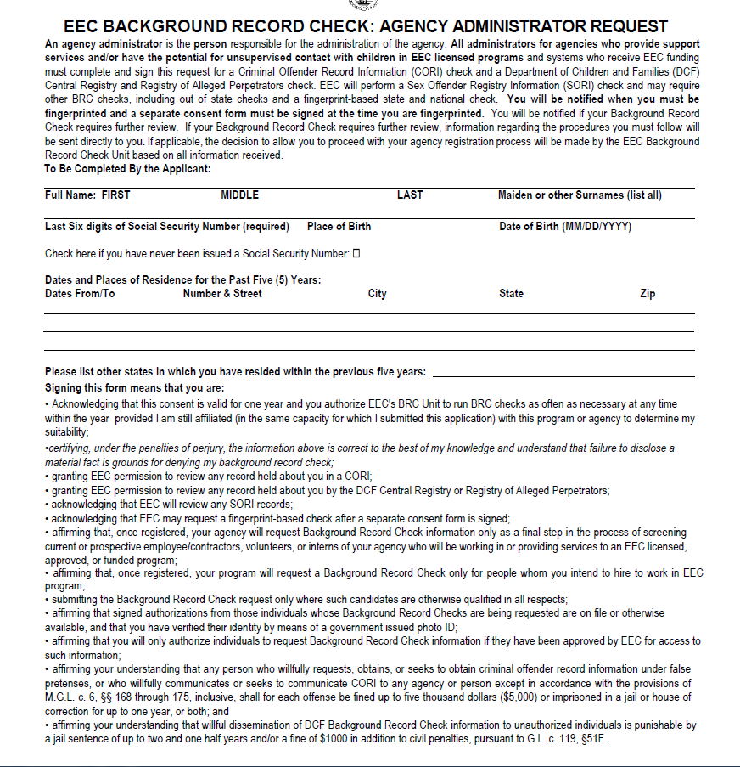
Agency Application Package

Slide 7
Agency Administrator
The agency administrator will need to undergo a CORI, DCF, SORI, and Fingerprint check. Upon approval of the CORI, DCF and SORI the administrator will receive the Agency ID via email from the BRC unit.
The agency administrator will then be able to create the BRC manager account and register for the agency.
If you have a current BRC Manager account already you will need to create a new BRC manager account to register for the agency.

Slide 8
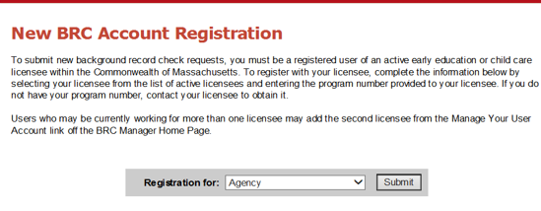
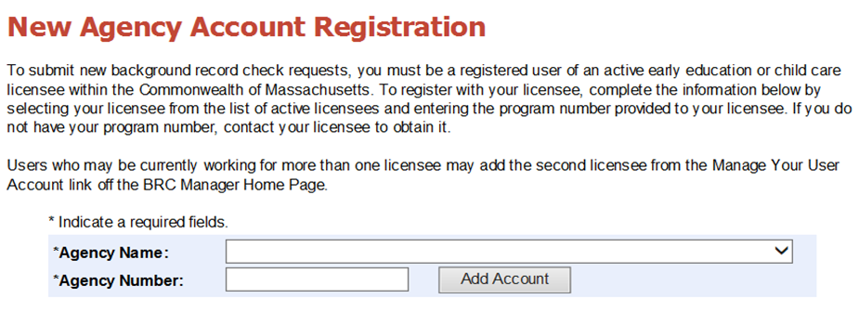
BRC Manager – Agency view
Agency administrators will only be able to submit BRC requests through BRC manager.
An administrator must setup an EEC single sign-in account, add the BRC manager application, and verify his/her status as an administrator.
If a licensee/reviewer already has an account and needs to become an agency administrator, then he/she will need to create a new EEC single sign-in.

Slide 9
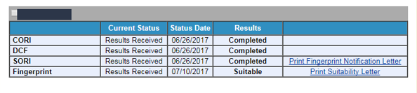
BRC Manager – Agency view
Agency Administrators can only see if the CORI, DCF, and SORI check was completed, print the fingerprint notification and suitability letters for any BRC requests the agency submitted.

Slide 10
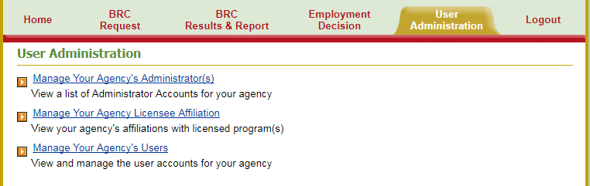
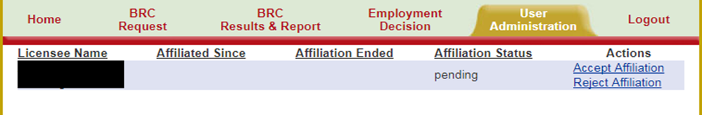
Manage Agency-Licensee Affiliation (Only Administrator)
Apart from submitting BRC requests and viewing results, Agency Administrators can also access and manage Agency-Licensee Affiliation.
Agency Administrators can click on the link “Manage Your Agency Licensee Affiliation” from home page or go to “User Administration” tab and click on “Manage Your Agency Licensee Affiliation” link.
Agency Administrators can either accept or reject the affiliation request from the licensed EEC program. The EEC program needs to initiate the affiliation request and will need your agency ID # to do so.
If the user accepts the affiliation request, then the program will get a notification of acceptance and the agency will have an “Active” affiliation at this point. The program will be able to see the notification and suitability letters for applicants in your agency.

Slide 11
Manage Agency-Licensee Affiliation (Only Administrator) continued
All agencies must have at least one affiliation within 45 days of registering as an agency.
For agencies who want to affiliate with an EEC program that does not have access to BRC manager (Ex. Family Child Care systems) you will need to contact the BRC Unit directly to initiate the affiliation request.
A BRC specialist will submit the affiliation request on behalf of the EEC licensed or funded program and the agency administrator will need to accept the affiliation.

Slide 12
Implementation
This new process will begin August 28, 2017.
Current reviewers must fill out the agency application and administrator form to proceed with submitting BRC requests.

Slide 13
QUESTIONS?
Please contact eec.brc@state.ma.us or 617-988-7841

