Slide 1
Fraud Awareness Introduction
Julie Flaherty, Esq. - Assistant Inspector General & Director of the Bureau of Program Integrity

Slide 2
Why is this training important now?
This training reflects the role of the Self-Determination Advisory Board to help “implement, publicize, evaluate, improve and develop information regarding self-determination”
The Real Lives Law mandates reporting financial abuse to DPPC
The definition of financial abuse in the Real Lives Law is very broad

Slide 3
Definition of Financial Abuse
“when suspicion of financial abuse arises including, but not limited, to:
      mismanagement,
      misappropriation or
      waste
of a participant’s self-determination funds or individual budget”

Slide 4
Financial Abuse and Fraud
Financial abuse of adults with disabilities often involves state or federal public funds
Financial abuse and exploitation may involve criminal charges related to the fraudulent use of public funds

Slide 5
Fraud Awareness and Prevention
Presenter:
Neil Cohen, Deputy Director, Investigations, OIG
Department of Developmental Services
December 2016

Slide 6
Goals
Raise your fraud awareness to prevent victimization

Slide 7
What Is Fraud?
Any intentional illegal act performed for gain and characterized by deceit, concealment, or a violation of trust.
Fraud is committed by individuals and organizations.
Notes:
deliberate deception or cheating intended to gain an advantage

Slide 8
Fraud Is Common
FRAUD is a crime! Like most crimes, fraud occurs with regularity, does not discriminate, can be of any size, complexity, or duration, and can be discouraged by adequate security, internal controls, oversight, and vigilance.

Slide 9
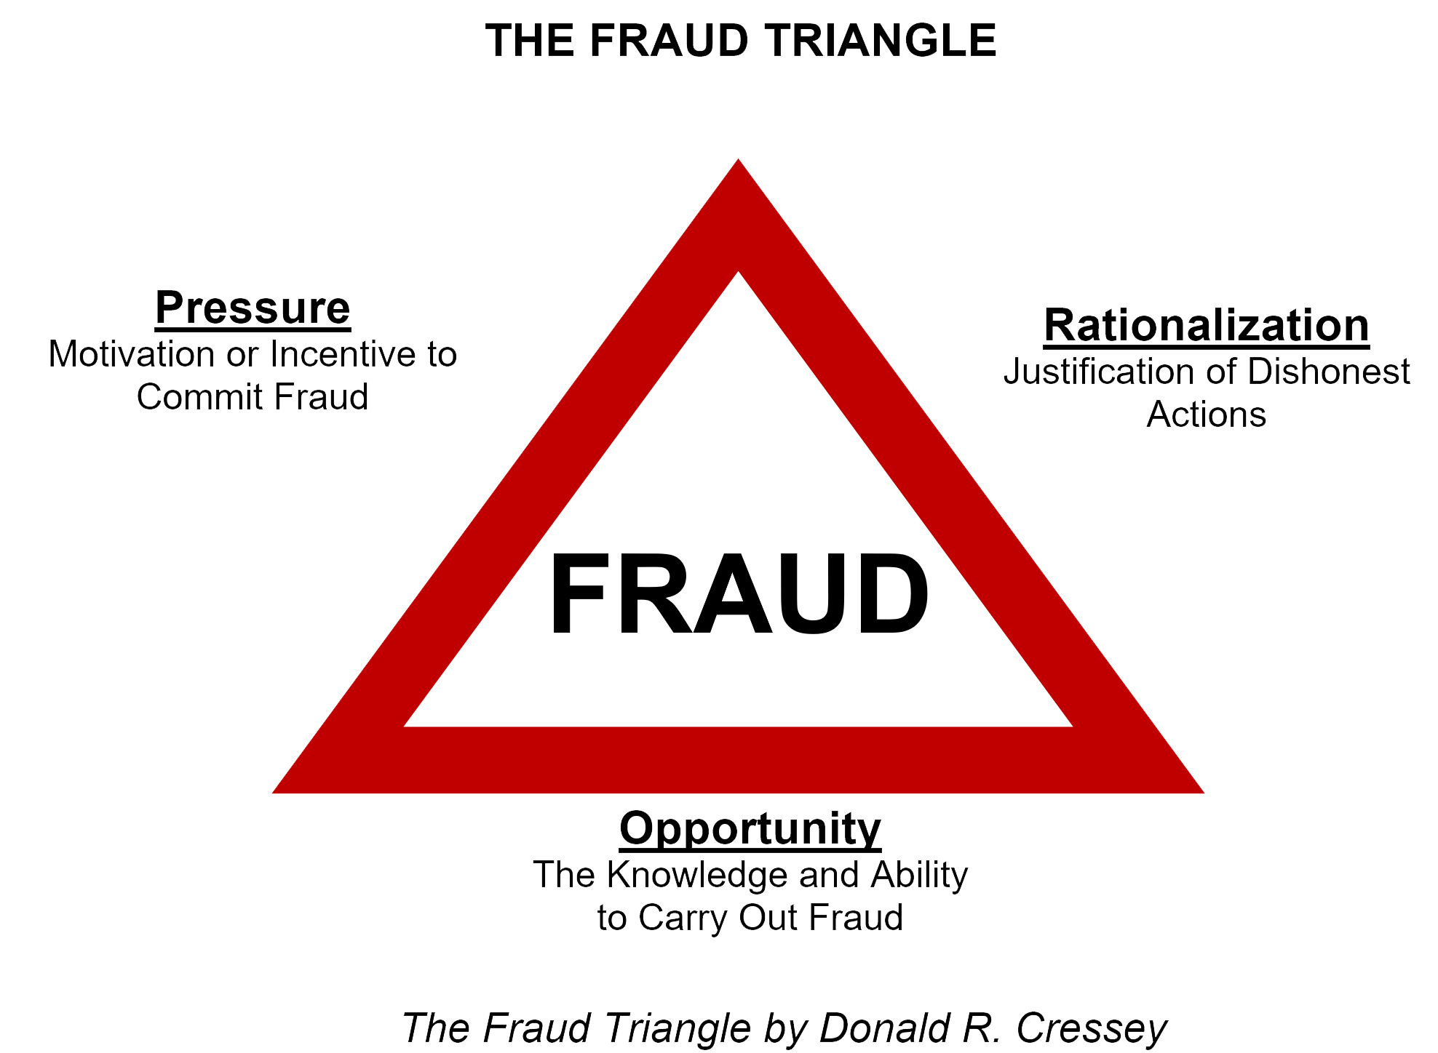
The Fraud Triangle

Slide 10
Fraud Facts
  91% involve multiple transactions
  Average fraud lasts two years
  68% of perpetrators act alone
  Median loss per fraud is $175,000
  At least 1/3 of frauds against government programs!
Notes:
To deter opportunity, divide the responsibility

Slide 11
The Usual Suspects
People in a position of trust & responsibility often with the ability to override controls. Have knowledge of systems and processes.
65% are men [down from over 90%]
Often well-liked, trusted & respected people
The more authority you have the more likely you are to commit fraud

Slide 12
10-80-10 Rule
Refers to an assumption about the population and the likelihood of people committing fraud
Notes:
SPEEDING ON THE INTERSTATE

Slide 13
10%
  10% of the population will NEVER commit fraud. Too many psycho-social restraints.

Slide 14
10%
  10% of the population are evaluating systems and situations to find an opportunity.
  Sociopathic tendencies
  Predatory.

Slide 15
Affinity Fraud
Fraudsters use any “hook” to gain trust — ultimately exploiting that trust for their own benefit or financial gain. Con artists.

Slide 16
“Where there are people there is risk.”
80%
  80% of the population might commit fraud given the right combination of opportunity, pressure, and rationalization.
  MOST OF US!!!
  Addictive
  Stimulates pleasure center of brain

Slide 17
Why?
The willingness to commit fraud is inversely proportional to a perceived risk of discovery.
Like speeding.

Slide 18
Consequences of Fraud
Dollar or asset losses
Potential loss of future funding
Bad press, impact on reputation (of Self-Determination Model) and credibility – “under a cloud of suspicion”
Undermines mission
Creates unmet client needs
Lowers employee morale
Strain on resources

Slide 19
Relevant Examples
PA: $80K stolen from investment accounts
MN: parents took $22K to buy truck
MN: wife withdrew $35K from ATM to gamble
AZ: DES caseworker colluded w/provider
FL: Palm Beach Cty has found $3M in financial fraud since 2011
KS: woman w/schizophrenia hired “con artist” provider
MN: provider hired attorney for $120/hour
OH: daughter used funds for her “lifestyle”
FL: daughter transferred property to herself
Pinellas Cty, FL: 63 guardian audits = $2.2M ($35K avg.)

Slide 20
Abusive Relationships
Rape and sexual abuse by family and friends
Physical abuse by family and friends
Neglect by family and friends
Is it hard to believe that vulnerable populations are at risk for financial crimes by friends and family given these types of crimes???

Slide 21
Contributing Factors
#1: Lack of adequate controls
#2: Lack of oversight
#3: Override of controls
#4: Poor “tone at the top”

Slide 22
Your Red Flags
Client overdependence
Unexplained or undocumented transactions
Extra payments to third party
Unpaid bills/late payments
Change in financial situation
Change in finances (new bank, investments, signatory authority, etc.)
Power of attorney
Cash withdrawals
Checks to CASH
Breach of rules
Client needs unmet
Spending priorities
Related parties providing services

Slide 23
Reasonable, practical, but effective
Prevention

Slide 24
Audits [<10%]
Not intended to identify fraud.

Slide 25
Prevention
All anti-fraud measures are intended to reduce “opportunity.”
We need to make it tough for perpetrators.
Defenses are not a cure but, having no defense is almost an invitation to fraud.

Slide 26
Best Measures
Zero Tolerance
Strong Tone at the Top—lead by example
Ask questions
Enforcement of controls – limit exceptions
Training & Communication
Follow-up on complaints, audits, etc.
Trust, but verify
Be skeptical

Slide 27
Bottom Line
Fraud happens!
You are the best defense.
Be vigilant and address fraud as you would any other crime or potential threat.
We should not be too confident in our defenses or with our PERCEIVED personal ability to detect fraud. This simply compounds the risk.

