Slide 1
June 22, 2022
Transamerica Long-Term Care Insurance
Information Session

Slide 2
Long-Term Care (LTC) Industry Overview
Transamerica’s Commitment to Long-Term Care Customers
Approximately 300 thousand total LTC policies currently in-force nationally (12/31/21)
Total claims paid nationwide over $6 Billion
LTC is Critical and a Growing Concern for Seniors and the Industry
The Need
Someone turning age 65 today has almost a 70% chance of needing some type of LTC.¹
Impacts Entire Family
Two-thirds of caregivers use their own savings to cover expenses
Takes an incredible emotional toll on family members
The Cost – Median Annual Cost in Massachusetts²
Private Nursing Home Room – $162K
Assisted Living Facility – $78K
In-Home care (Home Health Aide) – $71K
¹ 2020 U.S. Department of Health and Human Services (https://acl.gov/ltc/basic-needs/how-much-care-will-you-need)
² ‏Genworth, 2021 Cost of Care Survey

Slide 3
Transamerica's review of Long-Term Care (LTC) Business
Transamerica is actively managing its LTC business
Transamerica regularly reviews its LTC experience to assess future claims and the need to reprice existing premiums to pay for projected future LTC claims.
Every year of customers’ experience data makes us more aware of the customers’ future needs.
Transamerica and Industry LTC Experience continues to develop
Claims data takes decades to develop, which impacts future claims costs.
Transamerica and Industry have seen trends among policyholders that are different from almost all original assumption expectations.
Updated Forecast
Original Forecast
Experience Development
Assumption Updates
LTC Rate Increase Needs

Slide 4
Transamerica’s Long-Term Care (LTC) Business - Massachusetts
Based on our projection of future LTC claims costs, we find it necessary to file another LTC Premium Increase
We have a commitment to our policyholders to be there to help meet their future needs for long-term care
We are seeking to implement a necessary premium rate increase in a reasonable and responsible manner
Approximately 1,700 Massachusetts LTC polices are currently in-force under the Monumental Life Insurance Company as of 12/31/2021 for policy forms:
MLNHCCTQMAMH898, MLNHCCTQMA898, MLNHHCTQMAMH898, MLNHHCTQMA898, FPTQ(MA)99,
FPTQ(MA-MH)99, L5TQ(MA)99, L5TQ(MA-MH)99, P-0001MA 4/98, P-0001MAMH498
Transamerica will be Filing for a 60% to 70% Rate Increase on this LTC Business in Massachusetts

Slide 5
How Massachusetts compares to average Nationwide rate increase
Seeking a 60% to 70% rate increase in Massachusetts
Last approved rate increase of 72.8% in 2007, phased in over three years.
Currently, Massachusetts LTC increases are less than half of the rate increases approved by other states.
Even with the 60% to 70% approval, Massachusetts LTC premiums will be below what other states have permitted.
Massachusetts Cumulative Rate Increase | Other State Average Cumulative Rate Increase
72.8% | 198.5%
Planned Rate Increase will bring Massachusetts closer to the Nationwide Cumulative Average

Slide 6
Rate Increase – Policyholder communications and Options

Slide 7
Rate Increase - Policyholder Resources
We will have resources available for policyholders to help policyholders evaluate options that may lesson the impact of the rate increase:
At the time of a rate increase customers receive the following (mailed 90 days in advance of the rate increase effective date):
A Letter explaining the increase and the new premium
FAQ (Frequently Asked Questions)
Quote sheet - Customer will receive a document designed to provide a simple way to select an appropriate option
Access to dedicated Customer Service team

Slide 8
Policyholder Options
Keep current coverage
Pay the full premium increase (No-action required)
Typical options for policyholders to reduce or offset rate increase
Reduce your lifetime benefit
Reduce your daily/monthly benefit
Increase the length of your elimination period
Remove/reduce your inflation protection
Remove policy riders
Contingent Non-forfeiture Option
If you stop paying your premiums within 120 days after the rate increase effective date, we will provide you a fully paid-up policy equal to your accumulated premiums you have paid

Slide 9
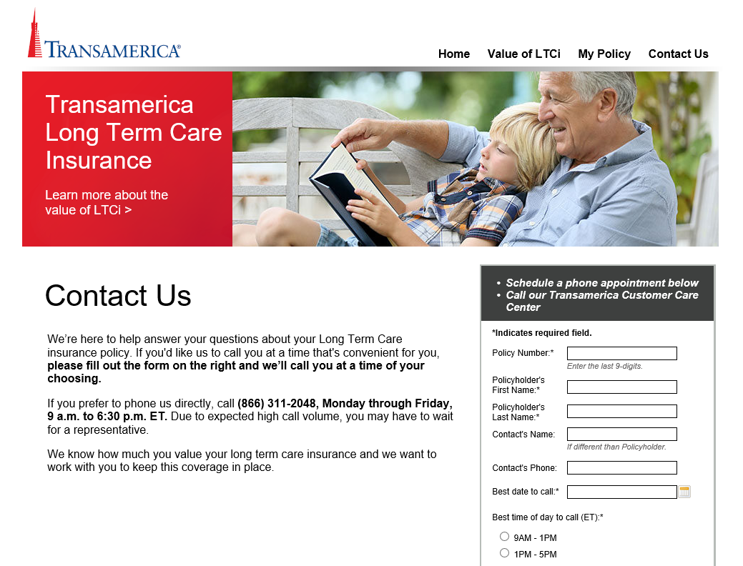
Transamerica Policyholder Website
Transamerica pioneered an interactive Customer Service website that allows customers to:
Find the cost and value of LTC as well as their local cost of care.
View specific details regarding their policies
Get quotes for policy benefit changes.
Schedule a callback from dedicated Customer Service team

Slide 10
Summary and Next steps
Thanks for listening!
Next steps for Transamerica
Plan to submit the Rate increase filing in the next few weeks
Questions?

Slide 11
Thank you
Transamerica Long-Term Care Insurance Information Session | June 22nd, 2022
© 2021 Transamerica

