Slide 1

Transition to Chip/Tap EBT Cards

Slide 2
Agenda
What’s Happening?
Massachusetts Chip/Tap Partners
Chip/Tap Coming Soon
What Retailers Need to Know?
What Retailers Need to Do?
Resources

Slide 3
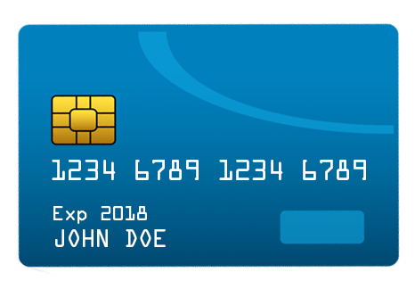
What’s happening?
Transition to Chip/Tap Cards for clients receiving benefits on an EBT card.
Future EBT cards will:
Future EBT cards will contain a Europay Mastercard Visa (EMV) microchip with a unique AID. The card is much more secure than a traditional magnetic stripe EBT card.
Support Chip/Tap transactions, where equipped Point of Sale card readers will use Near Field Communication (NFC) to read the information on the chip to process the transaction.

Slide 4
Chip/Tap Coming Soon
Chip/Tap is coming May 2026!
Retailers need to be ready with Chip/Tap technology, so Massachusetts EBT customers can keep using benefits.
Without retailer POS updates, Chip/Tap cards will not work.
Proper readiness prevents checkout disruptions.
To learn more: https://www.fns.usda.gov/snap/ebt/modernization

Slide 5
Massachusetts Chip/Tap Partners
The Massachusetts Department of Transitional Assistance (DTA) is working closely with the following partners to help retailers and EBT customers make the change to Chip/Tap cards.
United States Department of Agriculture Food and Nutrition Service (FNS) – Sets SNAP program policy, authorizes stores to accept EBT, and provides guidance for Chip/Tap processing
Fidelity Information Services (FIS) – Massachusetts’ EBT processor reaching out to retailers and helping to verify proper transaction processing
Public Consulting Group (PCG) – Partner helping DTA confirm chip/tap card readiness by providing support to retailers and in-store testing before go-live

Slide 6
What do retailers need to know?
Chip cards for EBT are an important step to ensure that benefits are protected.
Chip cards are a more secure payment option meant to protect retailers and customers.
EBT Chip/Tap is different from a standard debit/credit chip transaction and will require updates to your POS system.

Slide 7
What do retailers need to do?
Contact your POS provider TODAY and tell them you want to accept EBT Chip/Tap cards:
  It is strongly encouraged for your system to support full Chip/Tap EBT transactions.
  At a minimum, your system must allow chip cards to fall back to the magstripe, called “ECL fallback.”
Tell your provider that EBT Chip/Tap transactions are different and will use:
  Standard EMV chips
  Both contact-only and dual-interface
  New EBT Application Identifier (AID): A0000000044542
  220 service code on Track II of the magstripe

Slide 8
What do retailers need to do?
Once your POS provider has upgraded your system, confirm that your system is either Chip/Tap or ECL fallback ready:
  Request a test card from your POS provider or Acquirer
  Using the Chip/Tap test card, complete a test of your POS using the chip/tap or ECL fallback functionality

Slide 9
What do retailers need to do?
After you have confirmed your system is either Chip/Tap or ECL fallback ready:
  Email DTA.EBT@mass.gov to confirm your readiness and request an in-store test from DTA
  You must have an in-store test to confirm your POS system is ready to accept the new Chip/Tap card
  Ensure that your cashiers are aware that the Chip/Tap cards have been mailed to Massachusetts cardholders, that the card has a new look, and the functionality has changed.

Slide 10
Resources
FNS provides retailers with the following resources to help you accept new chip/tap cards:
Transactions defined by X9.58-2024 EBT Standard – American National Standards Institute
Instructions to retailers for Chip/Tap Transactions: Retailer Instructions for SNAP EBT Chip Card Transactions at Point of Sale | Food and Nutrition Service
ECL Testing Instructions: ECL Testing Instructions
ECL Test Scripts: snap-ebt-test-scenarios-instructions-072324.docx
Chip/Tap Card Testing Instructions: EBT Chip Card Implementation Details for Retailers
Chip/Tap Test Scripts: snap-ebt-chip-pos-retailer-test-scripts-053024.xlsx

Slide 11
Questions?

