Slide 1
Office of Energy Transformation: Transitioning Away from Everett Marine Terminal LNG Facility Work Group Webinar
October 8, 2024

Slide 2
Agenda
Welcome, Introductions, and Agenda Review (5 min)
Overview of Office of Energy Transformation, Context, and Focus Area Work Group (FAWG) Process (10 min)
Overview of and Background Everett Marine Terminal (EMT) Liquified Natural Gas (LNG) Facility, How It’s Used, Role it Plays in Massachusetts and Regional Natural Gas System, Workforce and Community, Contracts, and Regulatory and Policy (35 min)
Review of Transitioning Away from EMT LNG Workplan and Future Convenings (15 min)
Response to Questions and Next Steps (15 min)

Slide 3
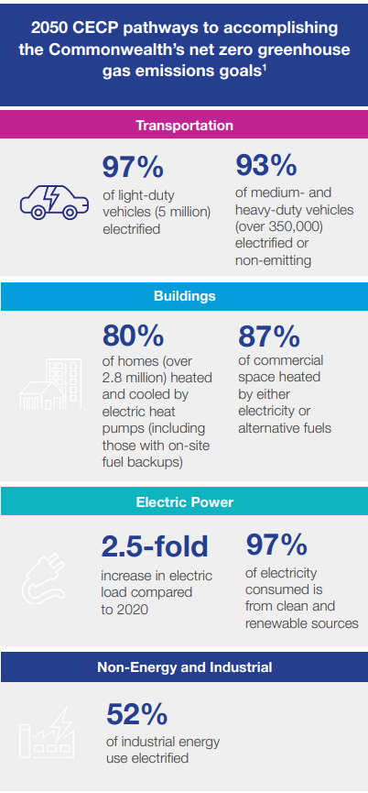
Massachusetts Policies, Programs, and Focus
Mandates to mitigate greenhouse gas emissions, drive efficiency, and deploy clean energy
Programs and regulations that implement mandates and achieve climate, clean energy, and consumer-focused outcomes
A focus on equity, affordability, economic opportunity, and environmental justice

Slide 4
Office of Energy Transformation
Established May 1, 2024, this first-in-the-nation Office of Energy Transformation (OET) is charged with:
Enabling the hands-on execution of the clean energy transition, including:
gas-to-electric transition coordination,
electric grid readiness, and
a just and equitable transition for workers, businesses, and communities.
Establishing an Energy Transformation Advisory Board ("ETAB" or "Advisory Board") to accelerate cooperation, understanding, and action among all stakeholders to transform the energy ecosystem.

Slide 5
Mission and Structure
Energy Transformation Advisory Board
To provide guidance and recommendations on strategic direction to the OET and focus areas work groups to execute the energy transition, including gas-to-electric transition, electric grid readiness, and the just and equitable transition for workers, business, and communities.
Transitioning Away from EMT
Decarbonizing the Peak
Financing the Transition
To develop a coordinated strategy to reduce and ultimately eliminate the local gas distribution companies’ reliance on the Everett Marine Terminal (EMT) Liquified Natural Gas (LNG) facility aligned with DPU Order 20-80 and the state’s climate and clean energy mandates, including those established in the Global Warming Solutions Act.
To demonstrate pathways to reduce reliance on and expeditiously eliminate fossil fuels from peaking power plants and combined heat and power facilities and deploy alternative demand and supply side options to meeting peak load needs in the Commonwealth, in alignment with the electric sector sublimit and clean energy goals established in the 2050 Climate and Clean Energy Plan.
To identify alternative mechanisms for financing/funding electricity distribution system infrastructure upgrades necessary to achieve the Commonwealth’s clean energy and climate mandates that minimizes impacts on consumers' electricity bills, while providing an affordable, sustainable and timely source of revenue to support investments.

Slide 6
Governance, Responsibilities and Expectations of Participants
Governance
Responsibilities
Expectations
Participation is open, with membership affirmed by Advisory Board
Meet at least bi-monthly, or more often, depending on need
FAWGs will conduct work via individual workstreams, which will meet as necessary
FAWG participants can select workstreams
Workstream and full FAWG meetings are Chatham House Rules; all materials provided to the Advisory Board will be made public
Deliver consensus work products and recommendations to the Advisory Board, where consensus is not possible, note participant positions
Execute workplans approved by the Advisory Board and deliver recommendations for Advisory Board deliberation and approval
Establish workstream teams to advance workplans, establish milestones, and make recommendations
Review and seek consensus on deliverables and recommendations
Align around options to be presented to the Advisory Board, where consensus is not possible, participant positions are to be noted and accurately reflected
Commit to a one-year term and actively participating and attending meetings (all meetings will have a virtual option)
Are subject matter experts/have a command of the topic
Have a level of decision-making authority, if participating on behalf of an organization
Follow the workplans and process adopted by the Advisory Board
Work in good faith to seek consensus
Adhere to the Ground Rules and Remote Participation policies adopted by the Advisory Board; failure to comply can result in removal

Slide 7
Approach and Process
Decision-making to follow a methodical approach
Each FAWG launches with a webinar and follows same phased approach:
Start with understanding the issues and perspectives and assessing current state
Identify and assess alternatives and potential solutions
Conduct implementation assessment and make recommendations
Success requires:
Commit and align
Engage and enable
Implement and sustain
Phase I – Assess Current Status and Needs
Phase II – Alternatives and Solutions
Implementation Assessment and Recommendations

Slide 8
Questions in the “101- White paper”
What is natural gas used for?
How does the natural gas pipeline system work?
What happens to the gas delivery system and end use customers if there is a loss of pressure?
Where does New England get its natural gas?
What are the implications of Massachusetts being on the end of the gas transmission systems?
What does Everett Marine Terminal do for the region?

Slide 9
What is natural gas used for?
Residential homes – Heating, hot water and cooking
Commercial operations – Heating and (in some cases combined heat and power) in various facilities like schools, hospitals, offices, restaurants, retail stores and municipal buildings
Industrial operations - Heating, power generation and process feedstocks in manufacturing processes
Transportation – fuel for cars, buses and delivery fleets
Electric power generation fuel
*Massachusetts has approximately 2 million gas customers. Most customers receive service from one of five investor-owned local distribution gas companies (LDCs), with some customers receiving service from four municipally-owned gas companies.

Slide 10
How does the Natural Gas Pipeline System Work?
Natural Gas moves through pipelines via changes in pressure
Large, high-pressure transmission lines transport gas from production facilities to City Gates
At the City Gates, the local distribution companies take custody of the gas, odorize, and reduce operating pressures
Local distribution companies (LDC) transport the gas at lower pressures through gas main pipes typically located under streets
Gas is delivered to customers through gas service lines tapped off the gas mains and metered at the customer premise
Customers take custody of the gas at the meter
Each LDC system is configured differently
All pipelines are limited in capacity by their size and the maximum allowable operating pressure!

Slide 11
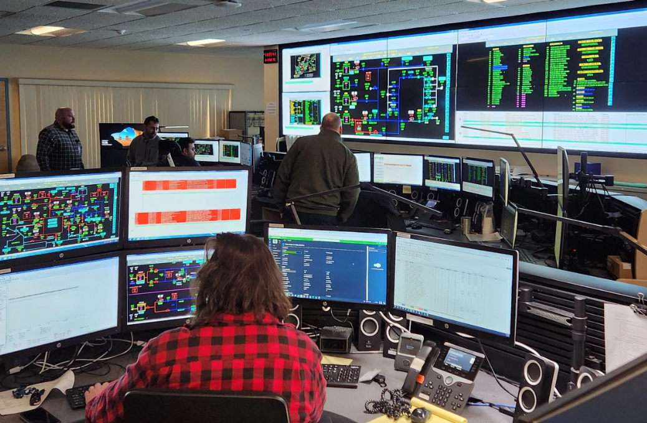
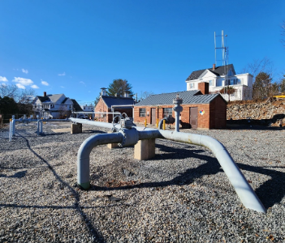
Operating Pressure is Key to Maintaining Reliability
Operating Pressure(s)
LDCs intricate distribution systems operate by utilizing varying minimum operating pressures to ensure safe and reliable delivery to end users
Monitoring Operating Pressure(s)
Highly qualified LDC personnel use complex SCADA platforms and telemetry to monitor system pressures 24 hours/day 365 days/year ensuring safe and reliable operation of critical systems
Maintaining Operating Pressure(s)
Operating pressure is maintained through a network of compressor and regulation equipment located in strategic locations of each LDCs system

Slide 12
Maintaining a Reliable System
Preventing the Risk of Pressure Loss
Long term planning
Long Range Forecast and Supply Planning
Gas infrastructure reliability upgrades
Near term response
Gas System Operations, including automated controls, instrumentation and pressure regulation
LNG storage and vaporization
Portable LNG
What causes a loss of pressure?
Disruption of upstream supply
Upstream equipment failure or pipeline disruption
Planned pipeline system outages for maintenance or repairs
Supply / Demand Imbalance
On-system or upstream demand surge
Market failure
Insufficient supply or pipeline capacity secured
What happens when there is a loss of pressure?
Appliance malfunction
Pilot light extinguishment
Higher risk of CO
Loss of gas service

Slide 13
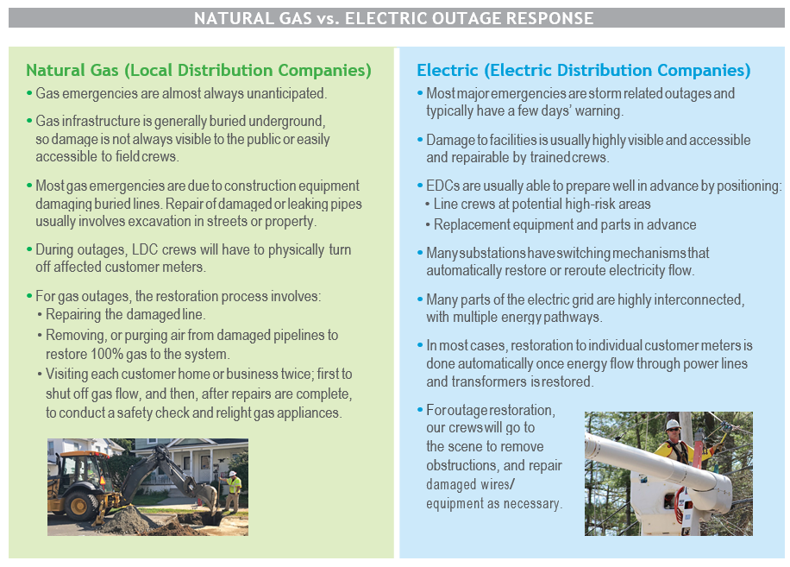
Natural Gas Outages
Unplanned Outages:
Can occur at any time.
Almost always unanticipated
Infrequent
May last hours, days or weeks depending on the number of customers impacted and the reasons for the outage.
Reasons for unplanned outages include:
System Damage
Insufficient gas supply
Loss of pressure on the distribution or transmission system
Blockage in main – such as water
Equipment failure
Demand exceeding capacity to serve
Restoration of gas service is sequential and timely:
Extensive process and timeline

Slide 14
Natural Gas is Heavily Regulated
Local Distribution Companies are subject to both Federal and State Pipeline Safety Regulations
Pipeline safety code currently is promulgated and enforced by the Department of Transportation – Pipeline and Hazardous Materials Safety Administration (USDOT – PHMSA), and by state public utility commissions such as the MA Department of Public Utilities.
Together the Federal code – 192 CFR and 193 CFR, and Commonwealth of MA code 220 CMR Sections 100 and 101, establish hundreds of pipeline safety compliance obligations, including obligations which specify:
How work on gas assets must be performed
How frequently gas assets must be inspected
How frequently gas assets maintenance must be performed
How quickly repairs or replacements of assets must occur following a failure
In addition to Federal and State Pipeline Safety Regulations, in consideration of serious or significant pipeline incidents, oversight organizations, such as the National Transportation Safety Board, may issue recommendations for code change based on their findings from an incident investigation. The US Congress periodically re-establishes funding and mandates for the PHMSA administration
Standards organizations such as ASME and ASTM, may update their standards based on engineering or material reviews, and the federal government may mandate the adoption of the most recently published standards.
All LDCs have Operating and Maintenance Procedures, which are filed with the MA DPU. LDCs are required per Federal and State code to perform all work in accordance with their O&M procedures.

Slide 15
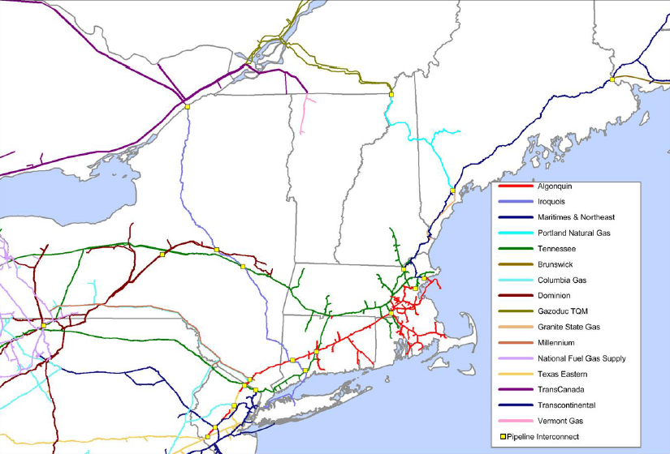
Where does Massachusetts get its natural gas and how is it delivered to customers?
Natural Gas Supply into the Region
New England has no in-region fossil fuel reserves or production.
The majority of natural gas supplies are imported via interstate pipelines into New England from production and storage fields to the west, namely Pennsylvania and Canada
The LDCs also rely upon the critical "on-system" Liquefied Natural Gas and Propane facilities which in some cases rely upon trucked LNG deliveries throughout the year
Natural gas that is imported from LNG tankers is the marginal supply for New England in the winter when pipeline supplies are constrained by gas customers who have secured those resources
Gas Flow
Gas Flow
Gas Flow
Gas Flow
Notes:
Only three pipeline companies operate in MA: Algonquin Gas Transmission Company, Tennessee Gas Pipeline Company, and Maritimes and Northeast Pipelines Company.

Slide 16
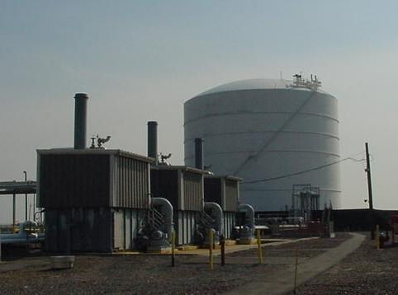
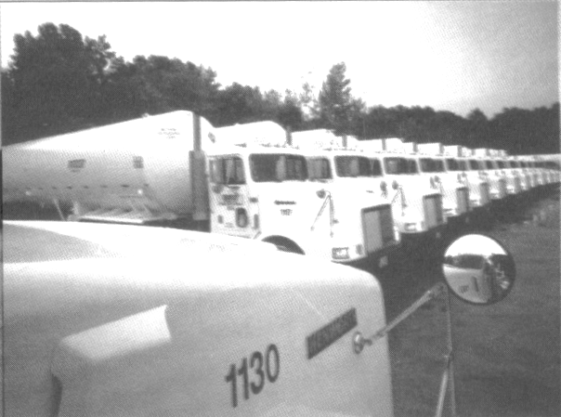
Liquefied Natural Gas is critical to the LDC supply portfolio
Supply Resource: LNG Facilities are critical assets within the LDCs’ gas portfolio. LNG fulfills our supply needs on the coldest of days to help keep customers warm. In addition, maintaining LNG supplies within our portfolio enhances supply reliability and diversity while also helping to mitigate price volatility.
Balancing Resource: LNG represents one of the most flexible supplies in our portfolio since we have the ability to call on the facilities whenever needed, whether it’s for a 24-hour period or a four-hour period. LNG allows us to maintain our supply and demand balance as well as meet our hourly peaks.
Reliability Asset: Our LNG facilities are clearly our greatest reliability asset since we have total control over when they are utilized. They also serve as a backup should supplies being delivered from the upstream pipeline be interrupted for some reason.
Distribution System Resource: We use our LNG to support the distribution system by bringing on LNG when needed to support system pressures. LNG can also be utilized as a portable pipeline to supply customers when pipeline maintenance might interrupt the normal supply of gas.

Slide 17
MA is at the end of the pipeline system and is supplied by just a few pipelines, constraining local gas supply
New England is at the “end of the pipeline” when it comes to natural gas:
Single point failure on any transmission pipeline system can create significant impacts across the entire region causing wide ranging outages which can have long restoration periods
Imported LNG is the marginal supply for the region when the pipeline supplies are already accounted for supporting the delicate energy supply and balance in the region
Imported LNG also represents a N-1 gas back up capacity between it and the two main pipelines. Meaning, in the event of a pipeline outage due upstream supply constraints from well freeze-offs or mechanical issues on the pipeline itself, imported LNG provides a back-up to New England instantaneously for several days so long as it is there to be utilized
The EMT LNG import and storage facility's location within the largest regional metropolitan area of Boston, MA provides the most critical support to adjacent communities with close geographic proximity to the facility as well as throughout the region. The facility also provides critical real-time support as was evidence during the January 21, 2019 incident in Rhode Island when Algonquin called upon EMT multiple times to mitigate its delivery issues

Slide 18
What role does the EMT LNG facility play in meeting natural gas demand and system needs in Massachusetts?
Year-round LNG resource: can provide year-round support, including during peak weather conditions, allowing LDCs to preserve seasonal LNG supply and maintain service to customers. Loss of supply can result in loss of service, requiring extensive restoration efforts.
Redundancy: injects directly into National Grid’s system, Algonquin and Tennessee pipelines. This mitigates operational and supply challenges resulting from unplanned outages elsewhere on the system.
Gas pressure support: Massachusetts is at the end of each pipeline system and can experience low pressures at gate stations.
Outages and pipeline flow restrictions mitigation: regular pipeline maintenance occurs both on Tennessee and Algonquin pipelines between April and October.
Notes:
Ex: Extreme cold weather experienced during the winter of 2014-2015
Constellation Peaking Supply: 1.4 Bcf (Not under contract during this period).
LNG Inventory as of 4/1/2015 was 25% or 1.4 Bcf (usable).
If peaking supplies were not procured and offset with LNG, LNG inventory would have been ZERO.

Slide 19
EMT Utilization by the LDCs
EMT is utilized as a supply resources for the LDCs which require sufficient natural gas pressures are available at its distribution interconnects to serve customers under all weather and operating conditions (typically the coldest days of the year)​
EMT provides supply and “pressure support” to the LDCs directly in some cases like National Grid as well as the interstate pipelines during high demand or planned interruptions (PHSMA/FERC mandated maintenance) or unplanned interruptions (i.e. upstream supply issues or compressor outages or pipeline disruptions)​
The amount EMT supports during offpeak/summer periods is an unknown factor as maintenance involves pipeline inspections and unknown resulting repair durations based upon those inspections​

Slide 20
LDC Design Day Forecast Supply/Demand Imbalance

Slide 21
What is the Status of EMT?
National Grid, Eversource, and Unitil filed for 6-year supply contracts with EMT in February 2024 and asked for expedited review and approval (by May 1st) by the DPU.
Contracts between Constellation and the state’s LDCs needed to be finalized by end of May to secure supplies for Winter 2024-2025.
The Department of Energy Resources (DOER), Attorney General (AGO), Conservation Law Foundation (CLF), Acadia Center, and others intervened.
DOER and AGO advocated that if contracts were approved, DPU should require the LDCs to develop transition plans, consistent with the Commonwealth’s climate goals.
DPU’s Order was issued on May 17th and requires the LDCs to develop and report on transition plans.
Requires the LDCs to include in their April 2025 Climate Compliance Plan filings a description of efforts to reduce or eliminate their reliance on EMT, including a description of costs/feasibility/timeline of alternatives and how each would contribute to greenhouse gas reductions.

Slide 22
EMT: Issue Overview and FAWG Mission
Massachusetts is constrained on its ability to bring natural gas into the state to meet peak demand.
EMT is used as both a strategic supply resource and to maintain overall system integrity and reliability.
To maintain access to supplies from EMT, the state's LDCs signed six-year supply agreements, the costs of which are recovered through rates.
When approving the agreements, the DPU also required the LDCs to develop and file transition plans and update the DPU on progress annually, beginning in April 2025.
Because EMT is a resource relied upon collectively by the three LDCs that entered into agreements with Constellation LNG, a coordinated and shared solution is necessary.
Mission
To develop a coordinated strategy to reduce and ultimately eliminate the local gas distribution companies’ reliance on the Everett Marine Terminal LNG facility aligned with DPU Order 20-80 and the state’s climate and clean energy mandates, including those established in the Global Warming Solutions Act.
.

Slide 23
EMT: Issue Overview and FAWG Mission
Massachusetts is constrained in its ability to bring natural gas into the state to meet peak demand.
EMT is used as both a strategic supply resource and to maintain overall system integrity and reliability.
To maintain access to supplies from EMT, the state's LDCs signed six-year supply agreements, the costs of which are recovered through rates.
When approving the agreements, the DPU required the LDCs to develop and file transition plans and update the DPU on progress annually, beginning in April 2025.
EMT is a resource relied upon collectively by the three LDCs that entered into agreements with Constellation LNG, so a coordinated and shared solution is necessary.
Mission
To develop a coordinated strategy to reduce and ultimately eliminate the local gas distribution companies’ reliance on the Everett Marine Terminal LNG facility aligned with DPU Order 20-80 and the state’s climate and clean energy mandates, including those established in the Global Warming Solutions Act.
.

Slide 24
EMT FAWG Workstream – Overview
Phase 3
Phase 2
Phase 1
Overview of EMT and Current Use Assessment
Supply
System Integrity
Customers
Geography
Demand
Cost
Inventory of Alternatives
Use case
Timing
Ability to Address Use Case
Assessment of Alternatives
Cost
Policy alignment
Feasibility
GHG impact
Electric grid readiness
Implementation Assessment and Recommendation Development
Policy
Regulatory
Cost
Financing
Customer
Land use, equity and environmental impacts, community, and workforce
Climate Compliance Plan Alignment

Slide 25
EMT FAWG Workstream – Phase 1 Focus and Proposed Timelines
Phase 1 –
Overview and Inventory and Assessment of Current Use and Inventory of
Alternatives
(Fall 2024/Winter 2025)
Overview of EMT and Assessment of Current Uses and Attributes
Peak demand projections (customer segment/geography)
Use cases
System support (geography, how often)
Supply (volumes, # of days, overall supply stack/other supply sources)
Existing system operations and impacts (system requirements and impacts of EMT not being available)
Cost of contracts to customers
Workforce and community
Phase 2 – Assessment of Alternatives
(Winter/Spring/Summer 2025)
Inventory of Alternatives
Alternatives to meet current use cases (by LDC and geography)
Feasibility and timing (e.g., availability, impact, needs)
Emissions
Phase 3
Implementation Assessment and Recommendations
(Summer/Fall 2025)
April 2025 CCP Filing Alignment
Parameters
Level of detail/specificity

Slide 26
Phase I - Planned Meetings
November 4 – FAWG Launch Webinar (today)
November – FAWG zoom to discuss foundational knowledge concepts including: natural gas system and state/regional dynamics, EMT use cases by LDC and systemwide, existing contracts, locational value/geographical impacts/uses of EMT, community and workforce, policy and regulatory drivers, Climate Compliance Plan requirements
Mid-December – FAWG meets in Boston to review outline of Climate Compliance Plan update LDC filings and provide comment/feedback
First Week of January – FAWG meets to finalize Climate Compliance Plan LDC filing outline and high-level content recommendations to Energy Transformation Advisory Board
Late January – Energy Transformation Advisory Board Meeting
Mid-February – FAWG zoom:
Review feedback from Energy Transformation Advisory Board
Discuss and review workplan and approach to explore potential alternatives to be evaluated in Phase II
Late March – FAWG zoom:
LDCs to present on Climate Compliance Plan EMT Update Section to be filed
Finalize workplan and timing for Phase II
Phase 2 Begins

Slide 27
Next Steps
Sign up if you would like to participate in the Transitioning Away from EMT LNG Facility FAWG
A link is provided in the chat and will be on the Office of Energy Transformation website
Review the Bylaws, Ground Rules, and approved workplans available on the Office of Energy Transformation website
Registration to participate will close on November 12th
Confirmation will be sent by November 15th
The first convening of the FAWG will be in late-November

Slide 28
Adjourn
Thank you!

