Slide 1
Trauma Systems Committee
Bureau of Health Care Safety and Quality
Department of Public Health
Wednesday, February 28, 2018

Slide 2
Agenda
Welcome
Overview of Conflict of Interest, Training, and Open Meeting Law Requirements
Overview of the Bureau of Health Care Safety and Quality (BHCSQ) and the Trauma Systems Committee
Trauma Registry
Next Steps

Slide 3
Conflict of Interest, Training, & Open Meeting Law Requirements
Conflict of Interest
Elizabeth Chen, Assistant Commissioner
Performance and Care Enhancement (PACE) Learning Management System Training
Elizabeth Chen, Assistant Commissioner
Open Meeting Law
Rebecca Rodman, Deputy General Counsel

Slide 4
Conflict of Interest Law
The Conflict of Interest (COI) law, M.G.L. c. 268A, is meant to prevent conflicts (and appearances of conflict) between a state employee’s private interests and his or her public duties.
As statutory public body members, you are considered to be “special state employees” subject to the COI law.
  The COI law is complex; State Ethics Commission attorneys are available, through the “Attorney of the Day” program, to provide confidential advice/guidance on how the COI law applies to you in a particular situation.
    Contact Attorney of the Day @ (617) 371-9500

Slide 5
Conflict of Interest Law-Training Requirements
All state employees subject to the COI law are required to:
  Certify they received and reviewed the annual Summary of Conflict of Interest Law, and
  Complete the biannual online training program through DPH’s PACE (Performance and Care Enhancement Learning Management System).

Slide 6
Training Requirements
Required Conflict of Interest Law PACE Online Trainings
Conflict of Interest Law Online Training Program
Conflict of Interest Law Summary
PACE Contact
Kathy Creed, Kathy.creed@state.ma.us
State Ethics Commission
For information regarding the Education & Training requirements, refer to the State Ethics Commission website: http://www.mass.gov/ethics/revised-implementation-procedures.html
Phone: (617) 371-9500

Slide 7
PACE Trainings
  An account will be created for each Committee member in PACE. This will give you access to the trainings.
  You will soon receive an automated email from the PACE system with instructions on how to access the system.
    If you do not receive an email this week, please email Kathy Creed.
  You must complete the training within 30 days.

Slide 8
Open Meeting Law (OML)
The OML is designed to ensure transparency in the deliberations of public bodies.
A deliberation is:
  an oral or written communication, through any medium, including electronic mail,
  between or among a quorum of a public body,
  on any public business within its jurisdiction.
If a quorum of a public body wants to discuss public business within that body’s jurisdiction, they must do so during a properly posted meeting.

Slide 9
Deliberation
A deliberation does not include:
distribution of a meeting agenda, scheduling or procedural information, or
reports or documents that may be discussed at a meeting, provided that no member of the public body expresses an opinion on matters within the body’s jurisdiction.
  NOTE: If a public body member sends an email to a quorum of the public body expressing an opinion on any matter that could come before that body, the communication violates the OML, even if no recipient responds.

Slide 10
What is a Quorum?
A Quorum is defined as:
  A simple majority of the members of a public body, unless otherwise provided in a general or special law, executive order, or other authorizing provision. G.L. c. 30A, § 18.
  As applied to the Trauma Systems Committee—a quorum equals 10 members (½ of 19 members + 1)
Notes:
10

Slide 11
Avoiding OML Violation-Best Practice Recommendations
Public body members must not engage in “serial deliberations”—a series of separate, independent conversations outside of a meeting among a quorum of the members regarding a topic within its jurisdiction.
In order to avoid even the appearance of a potential OML violation, the AGO advises public body members to refrain from communications over email except for distributing meeting agenda, scheduling meetings and distributing documents created by nonmembers.

Slide 12
Remote Participation
The Attorney General’s Regulations, 940 CMR 29.10, permit members to participate remotely in future public meetings if the public body specifically votes to allow remote participation.
The AGO strongly encourages all members to be physically present at public meetings, when possible.

Slide 13
Reasons/Minimum Requirements for Remote Participation
Public body members may participate remotely in a meeting “only if physical attendance would be unreasonably difficult.”
  A quorum of the body, including the chair, must be physically present at the meeting location.
  Members of a public body who participate remotely and all persons present must be clearly audible to each other.
All votes taken during a meeting in which a member participates remotely must be by roll call vote.

Slide 14
Procedures for Remote Participation
  A member who wishes to participate remotely should notify the chair (or, in the chair’s absence, the person chairing the meeting) of his/her desire to do so, with the reason and factual support for the request.
  At the start of the meeting, the chair must announce members participating remotely; the meeting minutes must contain this information as well. (No detail as to the reason is required).
  Members participating remotely may vote; roll call vote is required.

Slide 15
Additional References
Conflict of Interest Law:
https://www.mass.gov/laws-regulations-rulings-opinions-and-advisories
https://www.mass.gov/learn-more-about-conflicts-of-interest
Office of Attorney General, Open Meeting Law Website and Guide:
https://www.mass.gov/files/documents/2017/09/25/2017%20Guide%20only.pdf
http://www.mass.gov/ago/government-resources/open-meeting-law/

Slide 16
Overview of the Bureau of Health Care Safety and Quality and the Trauma Systems Committee

Slide 17
BHCSQ Overview
The Bureau of Health Care Safety and Quality’s (BHCSQ) mission is to promote, preserve, and protect the health of everyone in the Commonwealth and to strive to achieve an optimal health care delivery system that ensures safe, effective, high-quality care for all.
The Bureau serves as the primary regulator of health care facilities (including hospitals) and ambulance services in the Commonwealth.

Slide 18
BHCSQ Overview
The Trauma System touches three main areas of the Bureau:
  Licensure and Trauma Center Designation: The Division of Health Care Facility Licensure and Certification assures the delivery of safe health care services through the licensing, registration, inspection and regulation of approximately 1,300 health care facilities and programs and is responsible for the designation of trauma centers.
  Data and Analysis: The Division of Quality Improvement is responsible for developing and leading the performance, accountability and Quality Improvement (QI) and data initiatives, including the Trauma Registry.
  Care Delivery Systems: The Office of Emergency Medical Services ensures the licensure and regulation of ambulance services and specialty care delivery systems including, trauma and cardiovascular care, and total quality management, including oversight of training, testing, certification and recertification of approximately 24,000 EMTs in Massachusetts.

Slide 19
Trauma Systems Committee Overview
  Under MGL c. 111C, §11, DPH is tasked with developing a trauma system, including designating trauma centers, and establishing a trauma registry data collection system.
The Trauma Systems Committee (Committee) is established as an advisory board to the Department of Public Health under the EMS statute, MGL c. 111C, §13(b).
  The Committee is responsible for advising the Department on issues such as data collection, quality assurance, and interoperability among the EMS and trauma systems.
In accordance with the statute, the Committee shall be chaired by the Commissioner (or her designee) and shall be composed of an equal balance of individuals appointed by the Commissioner representing:
    Regional EMS Councils
    Trauma Centers
    Hospitals

Slide 20
  Trauma Registry

Slide 21
Trauma Registry Background
The Trauma Registry data system (Trauma Registry) is comprised of reported hospital data, as submitted by hospital trauma registrars.
The Trauma Registry collects information in accordance with the National Trauma Data Bank as well as some minimal state specific data points that allow linkages with other State systems.
The data element categories are organization and personal identifiers, demographics, clinical information, injury information, pre-hospital information, emergency department information, diagnosis information, injury severity information, and quality assurance information.

Slide 22
Trauma Registry Reporting Requirements
As required by 105 CMR 130.851 (C): a hospital providing trauma services as a designated trauma center must provide:
to the Center for Health Information Analysis (CHIA) the designated trauma center data set specified in Department guidelines;
As required by 105 CMR 130.852 (A), a hospital that is not a designated trauma center may be licensed to provide Emergency Services only if the hospital provides to CHIA the trauma service hospital data set to be specified in 105 CMR 130.851(C).
Uses SENDS/INET software application for data submission; this application is also used by MassHealth.
Chloen Systems functions as Commonwealth’s vendor.

Slide 23
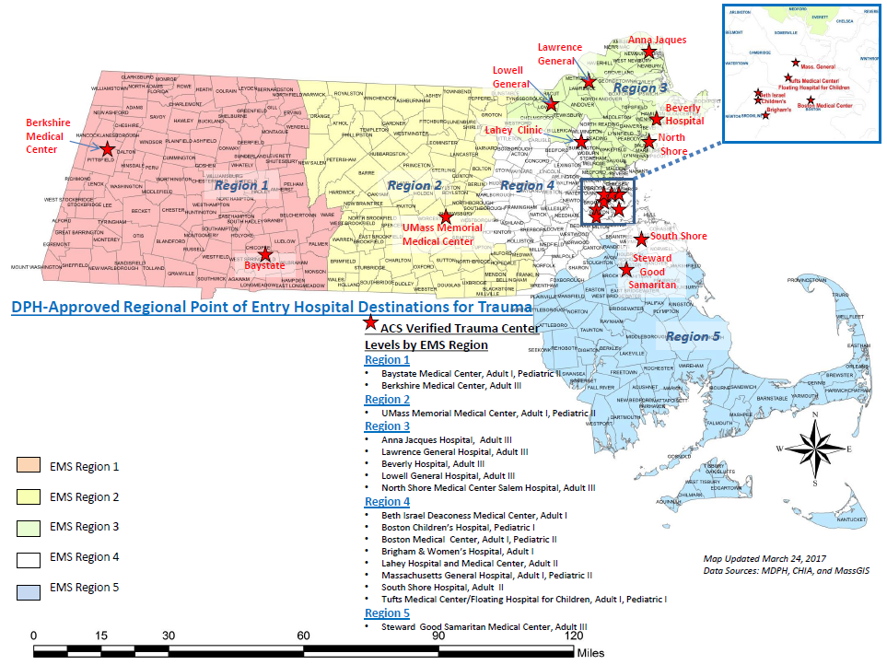
Massachusetts Emergency Medical Service Regions (EMS) and American College of Surgeons (ACS) Verified Trauma Centers

Slide 24
Trauma Registry Data
There are three categories of Trauma Registry Data:
1) Legacy Data (Federal Fiscal Year (FFY)2008-FFY2015):
  Starting in 2008, Massachusetts collected 41 data elements.
  Includes traumas reported with Admission dates of October 1, 2007-September 30, 2015.
  Uses International Classification of Diseases 9th edition (ICD-9-CM) for inclusion criteria, diagnosis and injury codes.
2) Transition Data (FFY2016):
  Transition to ICD-10-CM from ICD-9-CM.
3) Current Data (FFY2017-present):
  In alignment with the National Trauma Data Bank, there are now 96 data elements.

Slide 25
Trauma Registry Data Approach
The Department understands that stakeholders are interested in accessing and understanding the Trauma Registry data and with your assistance, we are committed to improving transparency and access.
Today’s meeting will introduce descriptive statistics analyzed using the Legacy Data.
As we review the data, please consider what additional data sets would be helpful and how we may work together to continue to improve the data submission process.

Slide 26
Legacy Data: Submitted Cases by Year
Data Source: MA Trauma Registry

Slide 27
Legacy Data: Hospitals Submitting Data
Data Source: MA Trauma Registry
Notes:
2/11/18-Phil Mello performed QC on hospital list and identified:
Addison Gilbert-(Is this data in Beverly submission)
Boston Medical Center-Menino (The ED is in Newton campus?)
Dana Farber-(No ED so not an issue)
Hallmark – Melrose Wakefield
Lahey – North Shore
Mass Eye & Ear
MetroWest – Leonard Morse
UMass Memorial / Memorial Campus
To ensure that the data is as complete as possible, the Bureau has focused on the following actions:
Updating the Data Specification Guide to help hospitals with the submission process.
Developing stronger internal processes for accessing the data through Chloen to improve customer service and the opportunities for data analysis.
Continuing to work on an individual basis with hospitals experiencing submission issues.

Slide 28
All Reporting Entities: Required Variables Grouped by Percent of Observations with Valid Values
75-100%
Date Of Birth
50-74%
Location E-Code
Less than 50%
Gender
Patient Zipcode
Work Related
Pulse Rate
BloodPressure
RespirationRate
Primary E-Code
Injury Incident Date
Transfer Organization ID
Diagnosis Code
Incident City

Slide 29
Trauma Center Only: Required Variables Grouped by Percent of Observations with Valid Values
75-100%
Airbag Deployment
50-74%
Child Specific Restraint
Less than 50%
Glasgow Coma Scale Score and Detail
Injury Incident Time
Alcohol Use Indicator
Drug Use Indicator
Abbreviated Injury Scale
Complications
Protective Devices
Co-morbid Conditions
Complications

Slide 30
Legacy Data: Injury Type-Terrorism
Data Source: MA Trauma Registry

Slide 31
Legacy Data: Injury Type-Suicide and Self-Inflicted Injury
MA Trauma Registry

Slide 32
Legacy Data: Injury Type-Homicide and Intentionally-Inflicted Injury
MA Trauma Registry

Slide 33
Legacy Data: Injury Type-Accidental Falls
MA Trauma Registry

Slide 34
Legacy Data: Injury Type-Motor Vehicle Crashes
MA Trauma Registry

Slide 35
Roadmap for Current and Future Data Sharing
Current Data (FFY2017-present)
Descriptive statistics
Severity of trauma and types of trauma by age
Transition Data (FFY2016)
Partnering with hospitals to ensure all trauma cases have been submitted and the completeness of data
Legacy Data (FFY2008-FFY2015)
Data Collection Specification File to be released in March 2018
Seasonality of traumas
Trends over time
Data submissions to begin by May 1, 2018

Slide 36
Discussion
What do you want to see reported from the Legacy Data?
What do you want to see reported from the Transition Data?
What do you want to see reported from the Current Data?

Slide 37
Anticipated Next Meeting Deliverables
Discussion of state-specific data elements of the Trauma Data Collection File Specification Guide for FFY 2019.
Summary of Trauma Registry data for FFY2016 reported using ICD-10-CM.
Based on Committee feedback, sharing and discussion of more in-depth analysis of Legacy Data.

Slide 38
Future Meetings
Meeting Schedule:
  Wednesday, May 30, 2018
  Wednesday, August 29, 2018
  Wednesday, November 28, 2018
  All meetings will be held from 10:00am-12:00pm and are expected to be held at MEMA.

Slide 39
Additional Information
For more information, please visit:
https://www.mass.gov/service-details/trauma-systems-committee

Slide 40
Appendix: Transition to ICD-10-CM in FFY2016
Differences between ICD-9-CM and ICD-10-CM code sets
ICD-9-CM | ICD-10-CM
3 to 5 characters in length | 3 to 7 characters in length
Approximately 13,000 codes | Approximately 68,000 current codes
First character may be alpha (E or V) or numeric; characters 2–5 are numeric | Character 1 is alpha; characters 2 and 3 are numeric; characters 4–7 are alpha or numeric
Limited space for new codes | New codes can be added
Limited code detail | Specific code detail
No laterality | Includes laterality
Adapted from NTDB website

