Slide 1
Trauma Informed Care
ACCS Principles
Notes:
Introduce Trainer

Slide 2
Learning Objectives
During this module you will:
01
02
03
Define
trauma
Consider
the potential effects of traumatic experiences and how it can vary by culture
Consider
ways you can apply a trauma lens in your work
Notes:
During this module you will:
Define trauma
Consider the potential effects of traumatic experiences and how it can vary by culture
Consider ways you can apply a trauma lens in your work
A primary goal of this module is to learn how to apply a trauma lens to your work with persons-served
Ask:
If you have experience working with individuals involved in the mental health system, what percentage of them have you worked with have experienced trauma? (Participants can answer aloud or write in the chat)

Slide 3
Activity
If you have experience working with individuals who have experienced trauma, what kind of traumatic events had they experienced?
Notes:
Ask:
If you have experience working with individuals who have experienced trauma, what kind of traumatic events had they experienced?
(Participants can answer aloud or write in the chat)

Slide 4
Activity
What types of traumatic events do you think might be most common among persons served by ACCS?
Notes:
Ask:
What types of traumatic events do you think might be most common among persons served by ACCS?
(Participants can answer aloud or write in the chat)

Slide 5
What is Trauma?
An Event you Experience that has a negative Effect on you
(3 Es)
Notes:
Explain:
We define trauma as an Event someone Experiences that has a negative Effect on them (the 3 Es)
The EVENT is perceived by the person to be shocking, scary, or dangerous.
The EXPERIENCE is felt in the body. Sensations include quick, shallow breathing; racing heartbeat; sweaty palms; heaviness in body; change in alertness - - Fight or Flight sensations (“The Body Keeps the Score”)
The EFFECT could be acute (an expected traumatic stress response) or the EFFECT could be chronic/persistent. Effects that last beyond a month after the incident would be considered PTSD
Explain that you will break down the 3 E’s in more detail

Slide 6
E #1: Traumatic Event
An event, series of events, or set of circumstances that is experienced by an individual as physically harmful or life threatening​
Has lasting effects on the individual’s​:
functioning​
mental, physical, social, emotional, or spiritual well-being​
Notes:
Explain:
A traumatic event is defined as an event, series of events, or set of circumstances that is experienced by an individual as emotionally or physically harmful or life threatening.
Trauma can have lasting effects on an individual’s functioning as well as their mental, physical, emotional, social, and spiritual well-being

Slide 7
Examples of Traumatic Events:
Abuse and neglect
Domestic violence
Community violence
Painful or frightening medical procedures
Care accident
Loss or separation
Natural disasters
War
Forced displacement
Poverty
Human trafficking
Racial (individual and systemic) and intergenerational traumas
Notes:
Explain:
Traumatic events can include, but are not limited to these examples on the slide (read slide)
Ask:
Do you think this list is missing any traumatic events?

Slide 8
E #2: Defining Experience
An event may be traumatic to one person but not another
Contributing Factors Include:​
How the individual labels the event
Availability of social supports
Degree of powerlessness
Intersecting identities
How the individual is disrupted physically and psychologically
Cultural differences
Notes:
Explain:
An event may be traumatic to one person but to not another.
Some of the contributing factors for different individual experiences are:
How the individual labels the event
Availability of social supports
Degree of powerlessness
Intersecting identities:
Explain: this may be due to age; race/ethnicity; immigration status; religion; gender identification; sexual orientation; disability status
How the individual is disrupted physically and psychologically
Cultural differences

Slide 9
Persons Served May Experience Multiple Traumas
Lack of natural supports
Financial stressors
Chronic mental health conditions
Multiple Traumas
Housing
Reactions from the public
Access to care
Notes:
Explain:
Persons-served might experience multiple traumas regularly due to their circumstances, such as:
chronic mental health conditions,
lack of natural supports,
financial stressors,
housing instability / inadequacy,
lack of access to care,
reactions from the public to their cultural background or sexual orientation.
ACCS can help address those by working with the individual to develop a treatment plan that best suits them and their needs
Ask:
For example, how or why might the experience of siblings who were both removed from an abusive home be different?
(Elicit a few responses from participants)
Why might an impending hurricane be triggering for one person, but not for another?
(Elicit a few responses from participantse be triggering for one person, but not for another? (Elicit a few responses from participants)

Slide 10
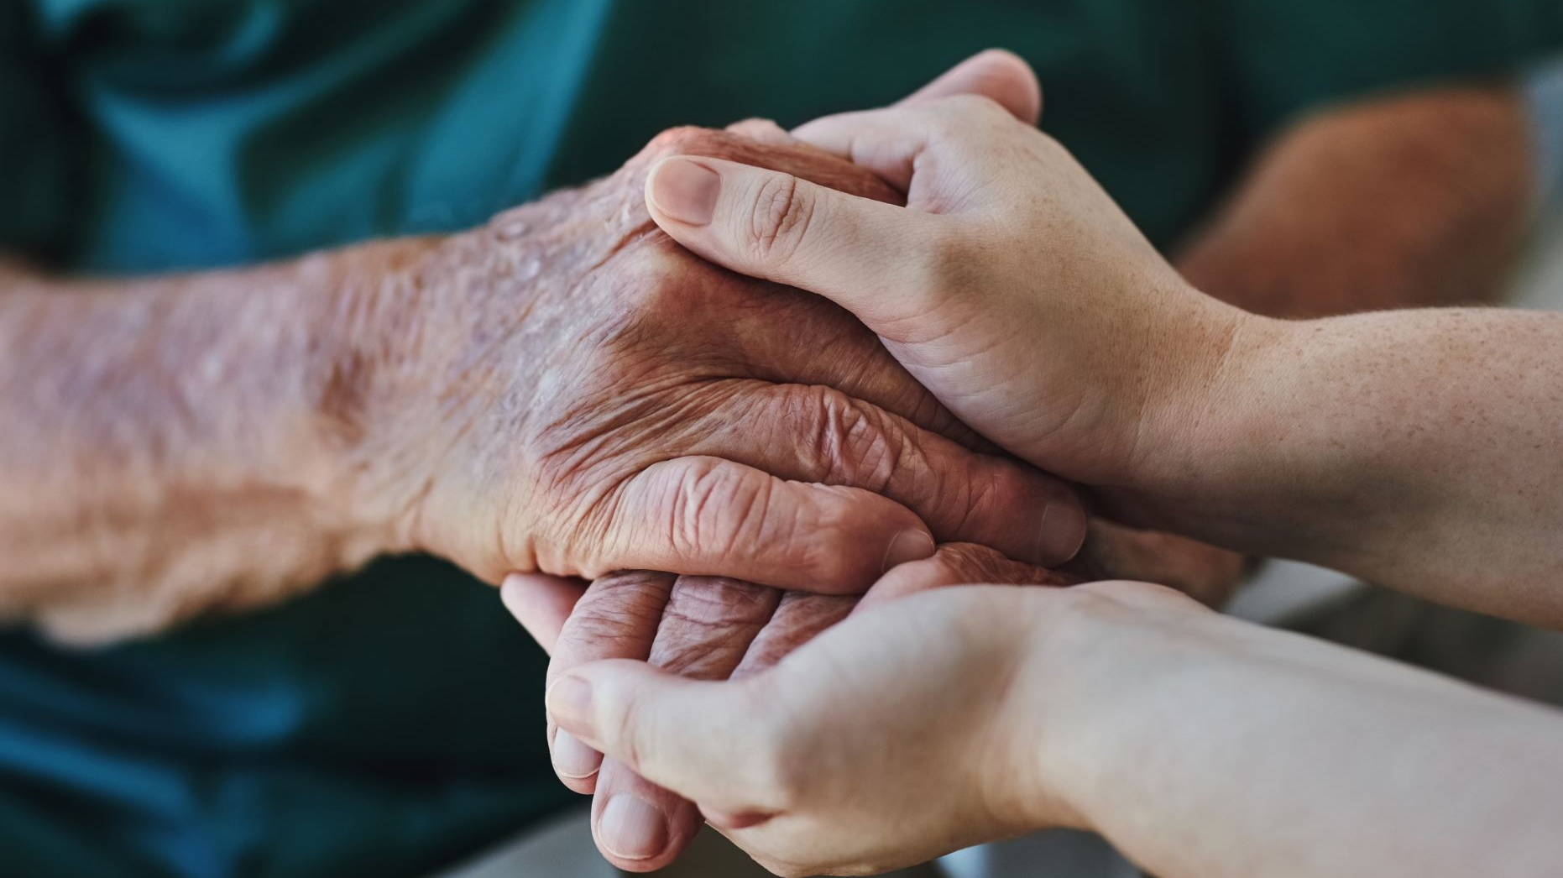
Culture and Trauma
Cultural differences can exist in the perception and interpretation of the trauma event
Some traumas may have greater impact on a given culture
Culture determines acceptable responses to trauma and shapes the expression of distress.
Notes:
Explain:
Cultural differences can exist in the perception and interpretation of the trauma event, the meaning one gives to the traumatic event, and beliefs about control over the event.
Some traumas may have greater impact on a given culture because those traumas represent something significant for that culture or disrupt cultural practices or ways of life
Culture determines acceptable responses to trauma and shapes the expression of distress. For example, some families and cultural groups are less comfortable responding to personal questions about emotional distress
In addition to shaping beliefs about acceptable forms of help-seeking behavior and healing practices, culture can provide a source of strength, unique coping strategies, and specific resources.

Slide 11
E #3: Adverse Effects
Effects may be immediate and/or delayed
Duration of the effects may be short to long term
Effects can impact the victim, the family system, an organization, and the community’s sense of safety and trust
Notes:
Explain:
Adverse Effects:
May be immediate or delayed
Duration of the effects may be short or long-term
Can impact the victim, their family system, an organization, or community’s sense of safety and trust
Facilitator note:
State that when trauma affects an organization sometimes it can organize its procedures around that trauma and that is not an effective reaction.

Slide 12
Common Responses to Trauma
Emotional
Numbness
Mood swings
Cognitive
Difficulty concentrating
Behavioral
Startled reaction
Physical
Anxiety
Guilt
Sadness
Helplessness
Denial
Gastrointestinal Issues
Sleep disturbances
Hyperarousal
Rumination
Memory problems
Intrusive memories or flashbacks
Difficulty making decisions
Restlessness
Increased use of substances
Social relationship difficulties
Engagement in high-risk behaviors
Nightmares
Fatigue
Appetite changes
Elevated heartbeat
Notes:
Explain:
This slide presents various ways in which trauma can manifest
Facilitator Instruction: Read through slide

Slide 13
Review Handout #1: Immediate and Delayed Reactions To Trauma
Activity
Have you noticed any of these reactions in the people you have served in the past? Which ones?
Are any of the trauma reactions on the list surprising or unexpected to you?
Notes:
Refer to Handout: Immediate and Delayed Reactions to Trauma
Review /Explain:
Review handout and explain this is a list of more examples of immediate and long-term effects of trauma.
Ask:
Have you noticed any of these reactions in the people you have served in the past? Which ones?
Are any of the trauma reactions on the list surprising or unexpected to you?
(Participants can answer aloud or write in the chat)

Slide 14
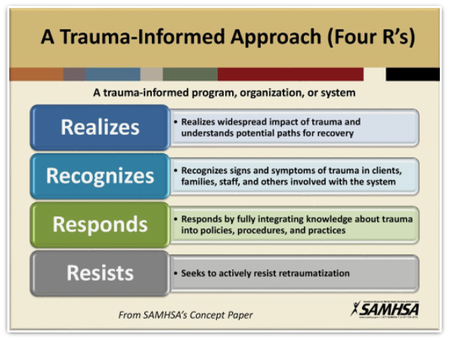
A Trauma Informed Approach (Four Rs)
Notes:
Explain:
What are the “Four R’s” of the trauma-informed program, organization, or system?
Realizes
Realizes widespread impact of trauma and understands the potential paths for recovery
Recognizes
Recognizing signs and symptoms of trauma in persons served, staff, families, and other who are involved with the system
Responds
Fully integrating knowledge about trauma into practices, procedures, and policies.
Resists
Seeks to actively resist re-traumatization

Slide 15
What Integrated Teams Can Do To Help Realize and Recognize the Person's Experience
Understand emotional reactions by asking about and responding to specific behaviors (sleep and eating patterns, jitters, etc.)
Listen to and incorporate the person served’s terms for what they are experiencing into discussion and treatment planning
Notes:
Explain:
Understand emotional reactions by asking about and responding to specific behaviors (sleep and eating patterns, jitters, etc.) [facilitator provide examples as appropriate]
Listen to and incorporate the person’s terms for what they are experiencing into discussion and treatment planning [facilitator provide examples as appropriate]

Slide 16
Transitions can be scary and trigger a trauma response- but our approach can help
Notes:
Explain:
Transitions (e.g., arrest or jail, return to the community, change in residence) can be scary and can trigger a trauma response – but our approach can help if we are aware that persons-served may be really scared

Slide 17
Team Discussion
How should team members approach Mae in a first encounter to transition her into your program?
Using a strengths-based approach, how might you approach her to:
Ensure physical / emotional safety
Establish trust
Offer choices
How would you collaborate with her in her treatment planning?
Mae is a 37-year-old Korean American woman with both mental and physical health conditions. She was recently discharged from a brief inpatient stay into the care of her 66-year-old aunt, who provides some care for her, but it is temporary. This will be the first time Mae has received ACCS services.
Notes:
Explain: This exercise will ask them to pretend they are members of the integrated treatment team assigned to Mae. This is the first encounter from any members of your team with Mae.
Facilitator Instructions:
Read scenario from the slide and refer them to the Team Discussion Handout (#3)
Instruct groups to discuss as a team:
How a team member (or members) should approach Mae in a first encounter to transition her into your program. How would you collaborate with her in her treatment planning?
Using a strengths-based approach, how might you approach her to:
Ensure physical/Emotional safety
Establish Trust
Offer choices
Refer them to the Strengths-Based Questions Handout (#2) to help with the second question
Split participants into groups of 3 to 5 (if there are few attendees create groups of two) and ask them to choose a recorder/reporter
Give them 7 minutes for this exercise.
Facilitator notes: Group responses may include:
Meeting at a mutually-agreed upon location that is private, safe, and has good lighting
Be mindful and track any possible trauma reactions she may be having then make adjustments in current conversation
Being upfront, honest, and transparent
Review the team’s availability, accessibility, and on-call procedures
Avoid judgment language
Explore “what happened to you” as opposed to “what’s wrong with you”
Review the various groups, helpers, and resources ACCS has to offer; ask what they think might be helpful
Explore which goals she might like to start with
Explore what supports she currently has and ways to increase those supports
Explore strengths, accomplishments, and what’s been working for her so far

Slide 18
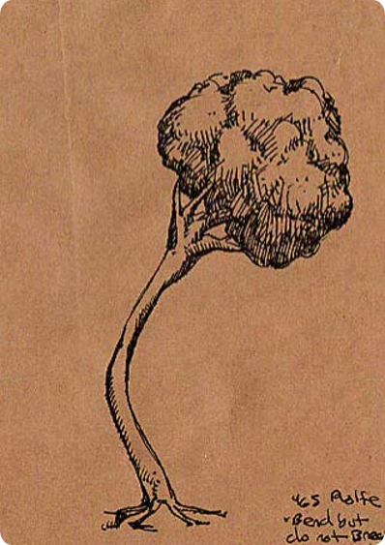
What Does it Mean to be Resilient?
Social Resilience Model
Notes:
Explain:
The picture of the tree represents the ability of an individual to bend, but not break, to bounce back, and to “adapt well in the face of adversity, trauma, tragedy, threats, or even significant sources of stress”
It’s important to point out that being resilient doesn’t mean that a person won’t experience difficulty or distress. It means that even when stimulated/triggered, a highly resilient person can still remain connected to others, still keep their thinking deliberate, and be responsive rather than reactive. Even if they become dysregulated by a stressful event, they have the skills to recognize those sensations inside of them and use coping skills to calm themselves.
Social resilience is the ability for the team or program to grow together, problem-solve together – it is powerful when everyone as a team is collectively resilient

Slide 19
Ways the Integrated Team can Help Persons-served Strengthen Resilience
Assist with accepting and working through the distressing situation
Help them connect to others who have been able to overcome similar situations
Increase overall support network
Teach healthy emotion regulation / distress tolerance skills
Assist with problem-solving by using strengths-based questions
Offer new opportunities / experiences
Empower them to gain independence
Notes:
Read slide:
Assist with accepting and working through the distressing situation
Help them connect to others who have been able to overcome similar situations
Increase overall support network
Teach healthy emotion regulation / distress tolerance skills
Assist with problem-solving by using strengths-based questions
Offer new opportunities / experiences
Empower them to gain independence

Slide 20
Methods for Empowering ACCS Persons-Served
Work on needed skills to progress through steps for independence with managing medications
Schedule and maintain own appointments
Utilize role plays to increase assertiveness with customer service needs
Arrange for and utilize PT-1 transportation
Learn how to independently utilize public transportation
Identify local food pantries: coordinate transportation with neighbors / natural supports
Encourage participation in ACCS-offered groups
Encourage participation in Massachusetts Rehabilitation Commission (MRC) opportunities
Peer support specialists can engage persons-served in a Recovery Learning Center, AA/NA groups
Notes:
Facilitator note:
Provide examples about how to help persons-served gain independence, thereby promoting resiliency. Read examples from the slide.
Ask:
What have you done to empower persons you have served or are serving?
What is one approach you could use to help Mae increase her independence and promote her resiliency? (Have them write this in the chat)
How could a team member empower a person served who comes from a different culture, like Mae who is Korean, or an individual who is LGBTQ? What is an approach you could take?
Potential responses: Give Mae information about a Korean community health center or similar networks and suggest she make an appointment. Pair a person served with a peer specialist who is also LGBTQ and can provide them with information about how to connect with a community.

Slide 21
Closing Activity
What is one take-away from today that you will share with someone else?
Notes:
Ask:
Ask participants to share one take-away from today that they will share with someone else after the training.

