Slide 1
Trauma Systems Committee
Bureau of Health Care Safety and Quality
Department of Public Health
December 15, 2021

Slide 2
Agenda
  Trauma Data Update
  Presentation on Medical Surge Planning at the Department
    Dr. Ryan Schwarz, MD, MBA Director of Policy for Accountable Care, MassHealth
2

Slide 3
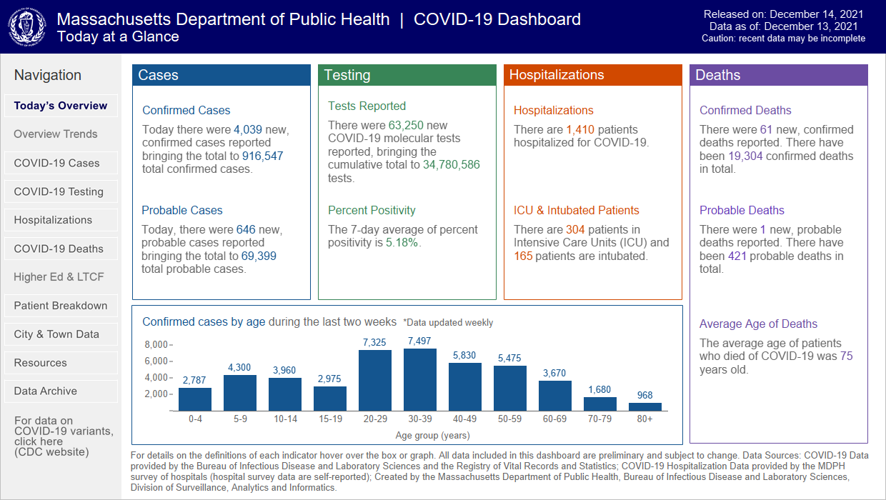

Slide 4
Massachusetts Trauma Registry Update
The new Massachusetts Trauma Registry launched on December 6, 2021
Training on the new Trauma Registry was provided in late November and early December. All trainings were recorded and are available through the registry portal
Please contact support.di@eso.com for registry connectivity and performance issues
Please contact MDPH_TraumaRegistry@mass.gov for questions regarding submissions, log ins, and other questions
New FFY2021 submissions will be due no later than April 30, 2022 and FFY2022 Q1 submissions will be due by May 31, 2022

Slide 5
MATRIS Interfacility Trauma Transports by Quarter
Beginning in Q3 2020 to present There has been an increase in the number of interfacility transports reported in MATRIS; this is likely due in part to a significant upgrade to MATRIS that all ambulance services completed
Source: MA Department of Public Health MATRIS V2 & V3, downloaded 11/12/2021
Notes:
Counts are number of runs, not patients
Data includes only those runs where patient disposition = "Patient Treated, Transported by this EMS Unit“ and incident location is in Massachusetts
Data includes only those runs where primary impression is recorded as “traumatic injury” or is coded as trauma as per the International Classification of Diseases, 10th Edition-Clinical Modification
Ambulance services are required to enter data into MATRIS per A/R 5-403 Statewide EMS Minimum Dataset.
Data are required to be submitted within 14 days; however, actual submission timeframes vary by ambulance service.

Slide 6
MATRIS Interfacility Trauma Transports by Quarter
Median Time in Minutes from Dispatch Notified to Unit Arrived on Scene by Quarter, 1/1/2019 – 9/30/2021
Year | n | median | P Value
Q1
2019 | 1029 | 41 | ref
2020 | 1094 | 43 | 0.5869
2021 | 1232 | 42 | 0.7272
Q2
2019 | 911 | 32 | ref
2020 | 893 | 42 | 0.0082*
2021 | 1444 | 49 | <.0001*
Q3
2019 | 1108 | 39 | ref
2020 | 1536 | 47 | 0.0060*
2021 | 1653 | 57 | <.0001*
Q4
2019 | 1134 | 45.5 | ref
2020 | 1323 | 43 | 0.3143
Both Quarter 2 and Quarter 3 had a significant increase in median time from dispatch notified to unit arrived on scene in 2020 compared to 2019, as well as in 2021 YTD compared to 2019.
Quarters 1 and 4 had no significant differences in median time from dispatch notified to unit arrived on scene from 2019 up to date.
Source: MA Department of Public Health MATRIS V2 & V3, downloaded 11/12/2021
Notes:
Counts are number of runs, not patients
Data includes only those runs where patient disposition = "Patient Treated, Transported by this EMS Unit“ and incident location is in Massachusetts
Data includes only those runs where primary impression is recorded as “traumatic injury” or is coded as trauma as per the International Classification of Diseases, 10th Edition-Clinical Modification
Ambulance services are required to enter data into MATRIS per A/R 5-403 Statewide EMS Minimum Dataset.
Data are required to be submitted within 14 days; however, actual submission timeframes vary by ambulance service.

Slide 7
MATRIS Interfacility Trauma Transports by Quarter
Median Time in Minutes from Dispatch Notified to Unit Arrived at Destination by Quarter, 1/1/2019 – 9/30/2021
Year | n | Median | P Value
Q1
2019 | 1026 | 112 | ref
2020 | 1089 | 112 | 0.9663
2021 | 1228 | 111 | 0.9325
Q2
2019 | 910 | 99 | ref
2020 | 890 | 104 | 0.1108
2021 | 1440 | 118 | <.0001*
Q3
2019 | 1100 | 106 | ref
2020 | 1532 | 115 | 0.0405*
2021 | 1646 | 128 | <.0001*
Q4
2019 | 1130 | 118 | ref
2020 | 1318 | 109 | 0.0532
Both Quarter 2 and Quarter 3 had a significant increase in median time from dispatch notified to unit arrived at destination in 2021 YTD compared to 2019. Quarter 3 also had a significant increase in median time in 2020 compared to 2019.
Quarters 1 and 4 had no significant differences in median time from dispatch notified to unit arrived at destination from 2019 up to date.
Source: MA Department of Public Health MATRIS V2 & V3, downloaded 11/12/2021
Notes:
Counts are number of runs, not patients
Data includes only those runs where patient disposition = "Patient Treated, Transported by this EMS Unit“ and incident location is in Massachusetts
Data includes only those runs where primary impression is recorded as “traumatic injury” or is coded as trauma as per the International Classification of Diseases, 10th Edition-Clinical Modification
Ambulance services are required to enter data into MATRIS per A/R 5-403 Statewide EMS Minimum Dataset.
Data are required to be submitted within 14 days; however, actual submission timeframes vary by ambulance service.

Slide 8
MATRIS Interfacility Trauma Transports by Incident Region
2021 represents 3 quarters while 2019 and 2020 represent 4 quarters of data
Most transfers occur in Region 4, decrease from 2019 to 2020
Region 5 increased from 2019-2021 likely in part due to the transition to the upgraded MATRIS database
Source: MA Department of Public Health MATRIS V2 & V3, downloaded 11/12/2021
Notes:
Counts are number of runs, not patients
Data includes only those runs where patient disposition = "Patient Treated, Transported by this EMS Unit“ and incident location is in Massachusetts
Data includes only those runs where primary impression is recorded as “traumatic injury” or is coded as trauma as per the International Classification of Diseases, 10th Edition-Clinical Modification
Ambulance services are required to enter data into MATRIS per A/R 5-403 Statewide EMS Minimum Dataset.
Data are required to be submitted within 14 days; however, actual submission timeframes vary by ambulance service.

Slide 9
MATRIS Interfacility Trauma Transports by Incident Region
Median Time in Minutes from Dispatch Notified to Unit Arrived on Scene by Incident Region, 1/1/2019 – 9/30/2021
Year | n | Median | P Value
Region 1
2019 | 352 | 9.5 | ref
2020 | 245 | 26 | <.0001*
2019 (Q1-Q3) | 268 | 9 | ref
2021 (Q1-Q3) | 182 | 15 | 0.0010*
Region 2
2019 | 562 | 25.5 | ref
2020 | 888 | 29 | 0.1862
2019 (Q1-Q3) | 380 | 21 | ref
2021 (Q1-Q3) | 737 | 33 | 0.0004*
Region 3
2019 | 520 | 44.5 | ref
2020 | 1123 | 44 | 0.9684
2019 (Q1-Q3) | 330 | 37 | ref
2021 (Q1-Q3) | 887 | 53 | 0.0037*
Region 4
2019 | 2538 | 50 | ref
2020 | 2186 | 55 | 0.0878
2019 (Q1-Q3) | 1931 | 49 | ref
2021 (Q1-Q3) | 1756 | 62.5 | <.0001*
Region 5
2019 | 122 | 23 | ref
2020 | 349 | 27 | 0.0068*
2019 (Q1-Q3) | 72 | 23 | ref
2021 (Q1-Q3) | 741 | 49 | <.0001*
All regions median time from when dispatch was notified to when the unit arrived on scene increased significantly in Q1-Q3 2021 compared to Q1-Q3 2019.
Additionally, Region 1 also had a significant increase in median time in 2020 compared 2019.
Source: MA Department of Public Health MATRIS V2 & V3, downloaded 11/12/2021
Notes:
Counts are number of runs, not patients
Data includes only those runs where patient disposition = "Patient Treated, Transported by this EMS Unit“ and incident location is in Massachusetts
Data includes only those runs where primary impression is recorded as “traumatic injury” or is coded as trauma as per the International Classification of Diseases, 10th Edition-Clinical Modification
Ambulance services are required to enter data into MATRIS per A/R 5-403 Statewide EMS Minimum Dataset.
Data are required to be submitted within 14 days; however, actual submission timeframes vary by ambulance service.

Slide 10
MATRIS Interfacility Trauma Transports by Incident Region
Median Time in Minutes from Dispatch Notified to Unit Arrived at Destination by Incident Region, 1/1/2019 – 9/30/2021
Year | n | Median | P Value
Region 1
2019 | 352 | 75 | ref
2020 | 245 | 79 | 0.7764
2019 (Q1-Q3) | 268 | 79 | ref
2021 (Q1-Q3) | 182 | 61.5 | 0.0247*
Region 2
2019 | 562 | 89.5 | ref
2020 | 888 | 96 | 0.4631
2019 (Q1-Q3) | 380 | 79 | ref
2021 (Q1-Q3) | 736 | 97 | 0.0024*
Region 3
2019 | 517 | 107 | ref
2020 | 1122 | 104 | 0.5467
2019 (Q1-Q3) | 327 | 99 | ref
2021 (Q1-Q3) | 884 | 119 | 0.0056*
Region 4
2019 | 2528 | 122 | ref
2020 | 2171 | 123 | 0.8576
2019 (Q1-Q3) | 1924 | 120 | ref
2021 (Q1-Q3) | 1750 | 131 | 0.0127*
Region 5
2019 | 120 | 110 | ref
2020 | 348 | 107 | 0.6723
2019 (Q1-Q3) | 71 | 108 | ref
2021 (Q1-Q3) | 736 | 129 | 0.0312*
All regions median time from when dispatch was notified to unit arrived at destination were significantly different in Q1-Q3 2021 compared to Q1-Q3 2019. All regions median time increased significantly, except for Region 1, whose median time decreased.
No regions had significant differences in median time from dispatch notified to unit arrived at destination from 2019 to 2020.
Source: MA Department of Public Health MATRIS V2 & V3, downloaded 11/12/2021
Notes:
Counts are number of runs, not patients
Data includes only those runs where patient disposition = "Patient Treated, Transported by this EMS Unit“ and incident location is in Massachusetts
Data includes only those runs where primary impression is recorded as “traumatic injury” or is coded as trauma as per the International Classification of Diseases, 10th Edition-Clinical Modification
Ambulance services are required to enter data into MATRIS per A/R 5-403 Statewide EMS Minimum Dataset.
Data are required to be submitted within 14 days; however, actual submission timeframes vary by ambulance service.

Slide 11
MATRIS Interfacility Trauma Transports by Date
There is a dip in interfacility transports during the Stay-at-Home order in Spring 2020
Source: MA Department of Public Health MATRIS V2 & V3, downloaded 11/12/2021
Notes:
Counts are number of runs, not patients
Data includes only those runs where patient disposition = "Patient Treated, Transported by this EMS Unit“ and incident location is in Massachusetts
Data includes only those runs where primary impression is recorded as “traumatic injury” or is coded as trauma as per the International Classification of Diseases, 10th Edition-Clinical Modification
Ambulance services are required to enter data into MATRIS per A/R 5-403 Statewide EMS Minimum Dataset.
Data are required to be submitted within 14 days; however, actual submission timeframes vary by ambulance service.

Slide 12
MATRIS Interfacility Trauma Transports by Week
Each spring there is a dip in the number of interfacility transports completed followed by an increase in the summer
Source: MA Department of Public Health MATRIS V2 & V3, downloaded 11/12/2021
Notes:
Counts are number of runs, not patients
Data includes only those runs where patient disposition = "Patient Treated, Transported by this EMS Unit“ and incident location is in Massachusetts
Data includes only those runs where primary impression is recorded as “traumatic injury” or is coded as trauma as per the International Classification of Diseases, 10th Edition-Clinical Modification
Ambulance services are required to enter data into MATRIS per A/R 5-403 Statewide EMS Minimum Dataset.
Data are required to be submitted within 14 days; however, actual submission timeframes vary by ambulance service.

Slide 13

Massachusetts vs American College of Surgeons Data Dictionary Comparison – what is the same?
The American College of Surgeons (ACS) Nation Trauma Data Standard (NTDS) and the Massachusetts Trauma Registry (the TR) each maintain a data set of required fields that are largely the same
We will examine the similarities and differences between these two registries and lay out opportunities for increased alignment
There are 74 fields that are captured in both the ACS NTDB Standards and the Massachusetts Trauma Registry
  There are currently 104 data elements in the TR – 71% alignment
  There are 23 data elements in the TR not included in the NTDS
    Most of these were previously collected in NTDS and retired
  The remaining fields contain the same information but are captured differently in each registry
NTDS 2022 Data Dictionary:
https://www.facs.org/-/media/files/quality-programs/trauma/ntdb/ntds/data-dictionaries/ntds_data_dictionary_2022.ashx
Massachusetts Trauma Registry Data Submission Information:
https://www.mass.gov/service-details/state-trauma-registry-data-submission

Slide 14
Massachusetts vs American College of Surgeons Data Dictionary Comparison – Massachusetts Only Demographics and Miscellaneous fields
Massachusetts collects a number of state-specific fields to assist in matching to other databases and related to interfacility transfers
All Hospitals
  First name
  Middle initial
  Last name
  Patient Address - Street 1 & 2¹
  Patient home state
  Medical record number
  Referring facility (for interfacility transfers)
Trauma Center Only Data Elements
  Temperature unit
  Temperature route
  Height unit
  Weight unit
  Admission type
Street address 2 is an optional field

Slide 15
Massachusetts vs American College of Surgeons Data Dictionary Comparison – Massachusetts Only UUID and EMS Fields
Massachusetts continues to collect EMS related fields until the Universal Unique Identifier field is implemented and validated as an EMS-Trauma Registry matching tool
All Hospitals
  Prehospital provider - departed location time
  Prehospital provider – departed location date
  Prehospital provider – call dispatched date
  Prehospital provider – call dispatched time
  Prehospital provider – arrived at location date
  Prehospital provider – arrived at location time
Trauma Center Only Data Elements
  Prehospital vitals - SBP
  Prehospital vitals - pulse rate
  Prehospital vitals – unassisted respiration rate
  Prehospital vitals - oxygen saturation

Slide 16
Massachusetts vs American College of Surgeons Data Dictionary Comparison – which menus are different
Several ESO trauma data elements have expanded menu with additional codes not captured in NTDS, these are available for use if listed in patient record
Comorbidities and complications will be captured with a multi-select field in the Massachusetts TR, but are documented as individual fields in NTDS
  All options are the same
Data Element | NTDS | Massachusetts TR
Location of direct admission | Retired | Combined with ED Discharge Disposition
Gender | FFY2022 adds non-binary | New Gender identity field with more options added
Mode of arrival | Unchanged | Adds two new menu options public safety and water ambulance
Comorbidities | Individual yes/no fields | One multiselect field
Complications | Individual yes/no fields | One multiselect field

Slide 17
Massachusetts vs American College of Surgeons Data Dictionary Comparison – which menus are different
Several ESO trauma data elements have expanded menu with additional codes not captured in NTDB, these are available if listed in the patient record
Data Element | NTDS | Massachusetts TR FFY 2021-2022
Initial ED/Hospital GCS Assessment Qualifiers | unchanged | Split into four fields: Paralyzed Sedated Intubated Eye Obstruction
Abbreviate injury score (AIS) | Abbreviated injury score | Split into two fields: Abbreviated injury score pre dot Abbreviated injury score severity
Protective devices | unchanged | Split into two field: Restraint 1 & 2 Protective devices equipment

Slide 18

Massachusetts vs American College of Surgeons Data Dictionary Comparison – ACS differences
There are several fields included in the NTDS that are not captured in the Massachusetts TR
There are four NTDS fields not captured in the Massachusetts TR
  Highest activation
  Trauma surgeon arrival date
  Trauma surgeon arrival time
  National provider identifier (NPI)
  These are under consideration to be required data elements for trauma centers in the FFY 2023 Massachusetts Trauma Registry
All Trauma Quality Improvement Program (TQIP) measures for processes of care
  30 data elements required for Level 1 & 2 ACS certified trauma centers that participate in TQIP

Slide 19
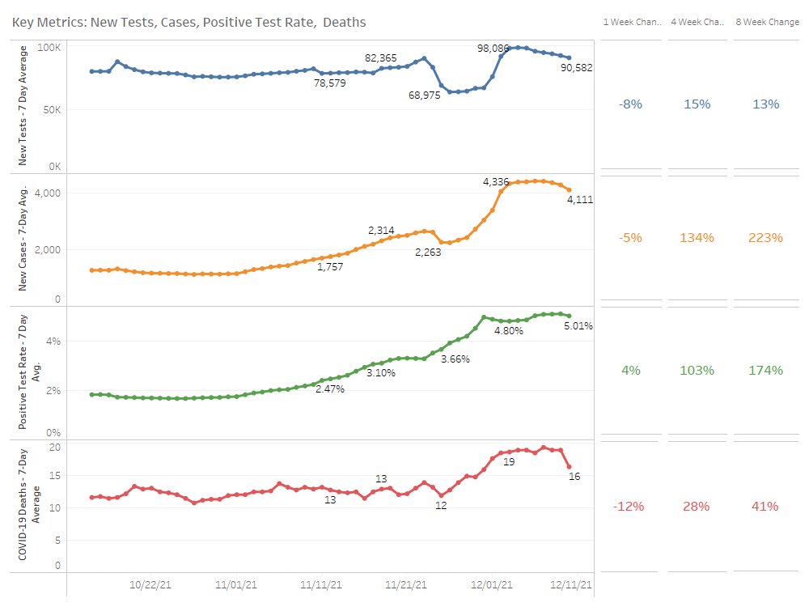

Slide 20
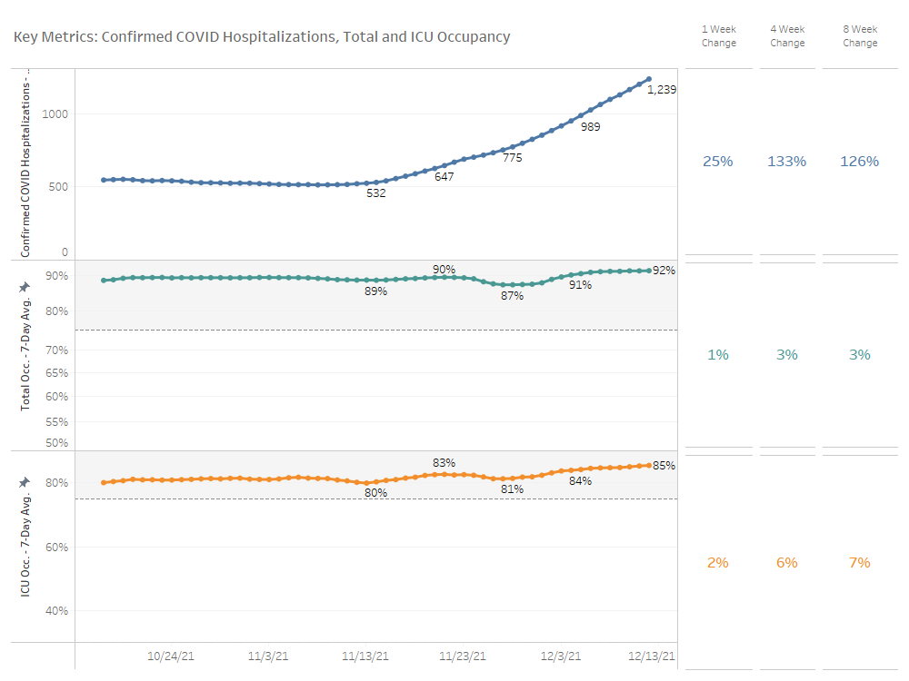

Slide 21
COVID Hospitalization Trends by Region

Slide 22
Statewide Hospital Census Trends
Note: Inpatient census includes statewide occupied adult medical/surgical and ICU beds, and ICU census includes statewide occupied adult ICU beds, as reported in WebEOC. Census figures exclude Boston Children’s Hospital, Massachusetts Eye and Ear Infirmary, and Dana-Farber Cancer Institute.

Slide 23
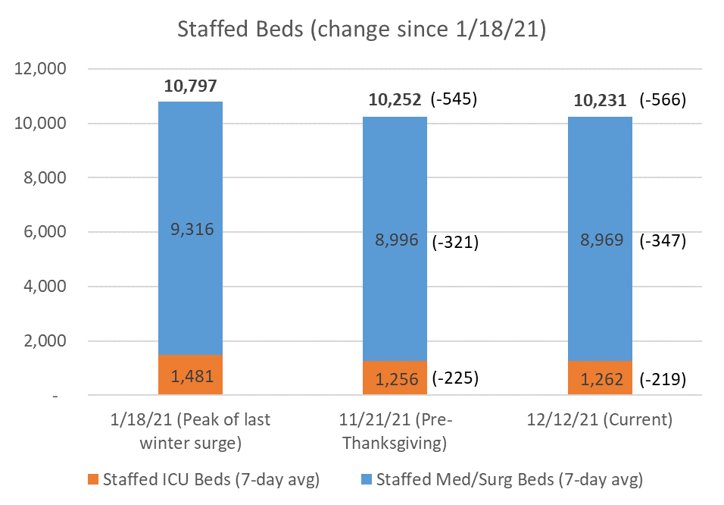
Staffed Bed Capacity in Acute Care Hospitals
  Staffing constraints are significantly limiting hospital capacity – compared to the peak of the winter surge, hospitals have >300 med/surg and >200 ICU beds that are not currently staffed
  Since prior to Thanksgiving, staffed bed capacity has not improved
Note: Staffed beds shown above are statewide totals of staffed adult beds, including staffed surge beds, as reported in WebEOC, excluding Boston Children’s Hospital, Massachusetts Eye and Ear Infirmary, and Dana-Farber Cancer Institute.

Slide 24
EOHHS measures to address hospital capacity constraints
General Administrative Flexibilities/Hospital Capacity
Psychiatric Capacity / ED Boarding
Post Acute Transition Delays
EMS Capacity
  DOI bulletin relaxing prior authorization and credentialing procedures; MassHealth bulletin to be issued in the coming days
  Extended existing temporary licenses and allowed new temporary licenses, through June 2022; reciprocity also extended through June 2022
  Accelerated licensure process for physicians from foreign medical schools
  Established Discharge Support Call Line w/in EOHHS in January 2021 to support hospitals w/ challenging placements; renew communications about the resource lines
  Expedite guardianship proceeding through identified contact at the P/F Court
  DOI to issue bulletin to require commercial coverage of the hospital-at-home program
  Facilitate daily data sharing of available beds within and between regions via HMCC mechanism
  Ongoing expansion of inpatient BH capacity state-wide; EOHHS incentive funding has resulted in net new 288 beds in 2021; 200 additional beds planned in 2022; additional EOHHS funding to support inpatient psychiatric units in general hospitals and free-standing psychiatric facilities.
  Expanding programs to reduce BH boarding statewide (e.g., Youth Villages, etc.)
  DMH has renewed communication re: approval for telehealth waiver exceptions
  DMH will consider waiver requests to its regulatory requirements for temporary relief of BH interfacility provider requirements; however, any admitting facility must ensure that acceptance of an outside physical exam completed by a qualified medical professional has been completed within 24 hours of admission and conforms with any hospital operating standards and accreditation as determined by CMS and the Joint Commission.
  MassHealth to streamline authorization of additional services needed to allow for specific inpatient psychiatric admissions
MassHealth extended coverage of SNF and community-based LTSS for Family Assistance members as of November 1, 2021
DPH issued communication to hospitals informing them of their ability to send patients to SNFs with a supply of their medications to enable SNFs to accept patients during evening and night hours.
MassHealth is providing SNF supplemental payment to incent Saturday and Sunday admissions
  Building interfacility transfer (IFT) capacity through municipal and volunteer ambulance services; communications sent November 12, 2021
  Implemented measures to hold EMS providers engaged in COVID-related activities (testing, vaccines, etc.) more accountable to existing/core lines of work and contracts
  Targeted rate add-on for certain EMS transport services; effective week of December 5th
  Exploring options to augment staffing for non-emergency, interfacility transports

Slide 25
Hospital Guidance and Public Health Order regarding non-essential, nonurgent scheduled procedures
On December 10th, DPH released updated guidance to hospitals to reduce certain non-essential, elective services and procedures via a COVID-19 Public Health Emergency Order, to conserve inpatient hospital capacity and to protect patients, the healthcare workforce and resources
No later than December 15th, 2021, any hospital or hospital system that has limited capacity (<15%) must begin to reduce non-essential, non-urgent scheduled procedures by at least 50% to ensure adequate hospital capacity for immediate healthcare needs.
In the order, non-essential, non-urgent scheduled procedures are defined as procedures that are scheduled in advance because the procedure is not a medical emergency and where delay will not result in adverse outcomes to the patient’s health. Providers at each hospital shall use their clinical judgment on a case-by-case basis regarding procedures that are essential to perform.
The order further states that any hospital/hospital system that maintains or exceeds the capacity threshold and provides an attestation to DPH may continue to perform procedures provided that the hospital/hospital system:
    continues to maintain or exceed the capacity threshold;
    actively participates in the hospital’s regional Health and Medical Coordinating Coalition meetings and makes available medical-surgical and, if appropriate, intensive care unit capacity and regularly accepts transfers from other hospitals; and
    does not transfer patients or seek assistance from other hospitals/hospital systems for the purpose of maintaining or exceeding the capacity threshold.
EOHHS, in partnership with the hospitals, will continue to closely monitor statewide hospital capacity across the Commonwealth to determine if any additional capacity adjustments are necessary.

Slide 26
Future Meetings
Meeting Schedule:
  March 16, 2022
  All meetings will be held remotely from 10:00am-12:00pm

Slide 27
Additional Information
For more information, please visit:
https://www.mass.gov/service-details/trauma-systems-committee

