Slide 1
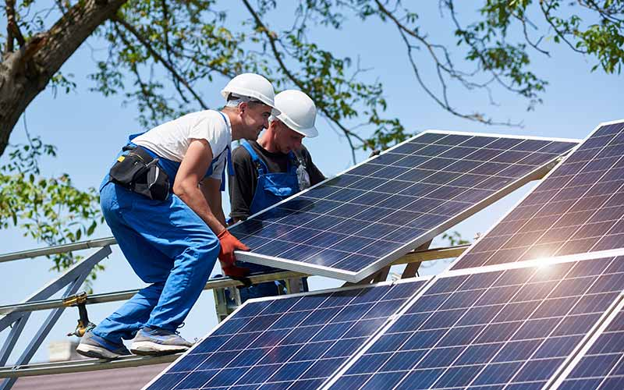

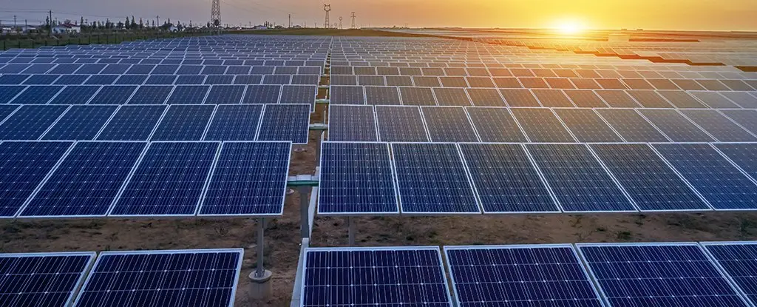
In-Service DER Equipment Change Procedure
Update June 30, 2025

Slide 2
In-Service DER Equipment Replacement Subgroup
Subgroup Membership
  EDC’s
  Solect
  ACT
  Kearsarge Energy
Last Meeting
  June 10, 2025

Slide 3
In-service Facility Revision Application Process
When in-service facility equipment is being changed out (e.g. due to age or repair)
If Facility is off-line due to equipment failure, Customer to notify Company within 20 Business days.
Application for equipment replacement is required
  Specify existing and in-service equipment
  Detail equipment to be changed
No Pre-application required
Company processes application and determines the scope of study required
  Most analysis will be reduced scope
  If changes are not Significant, study should be able to be isolated from group studies

Slide 4
Design and Operational Requirements
All new equipment must meet present certification requirements
  E.g. Inverters
    IEEE 1547 Setting Requirements
    UL 1741 SB
Company reviews requirements in existing ISA
  ISA amended per new equipment and requirements
Requirement for Facility to meet updated EDC technical requirements would be evaluated on a case-by-case basis

Slide 5
Tariff Update
Recommendation to update tariff to add revision requirements
  List requirements of application
  Deadlines of notifications

