Slide 1
Unify Update to the Implementation Council
February 13, 2018
LTSS Program Overview
Role of the LTS Coordinator
Presented by:
Bea Thibedeau, DNP,RN
Program Director, Tufts Health / Unify

Slide 2
Agenda
Member Profile
Population analysis
Assessment and Service Planning
LTS C Engagement
Current State Assessment
Process
Quality
Best practice / ideas for consideration

Slide 3
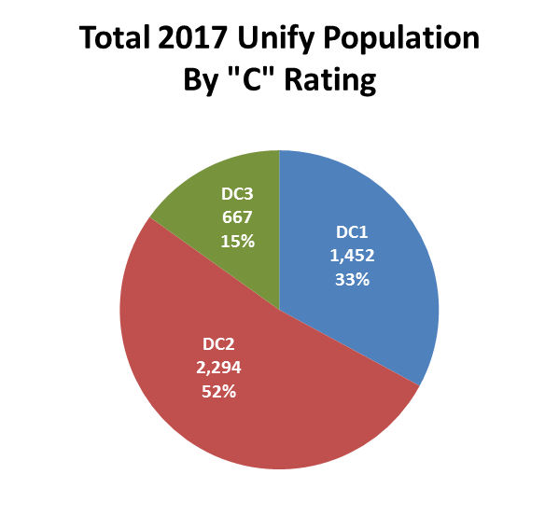
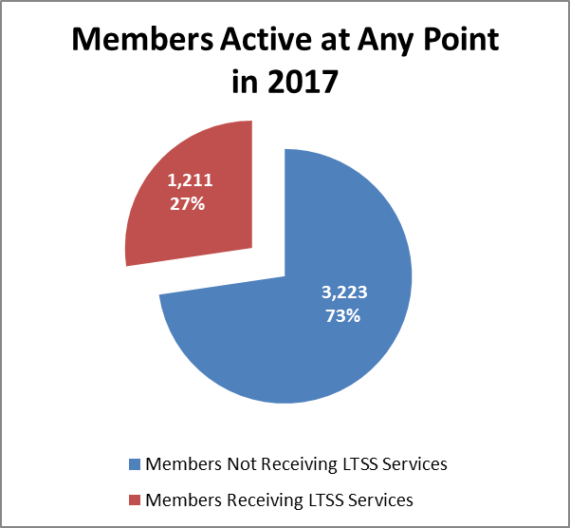
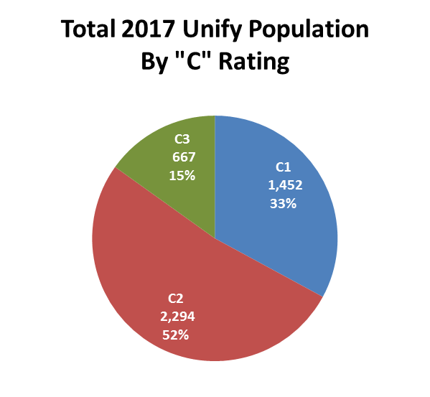
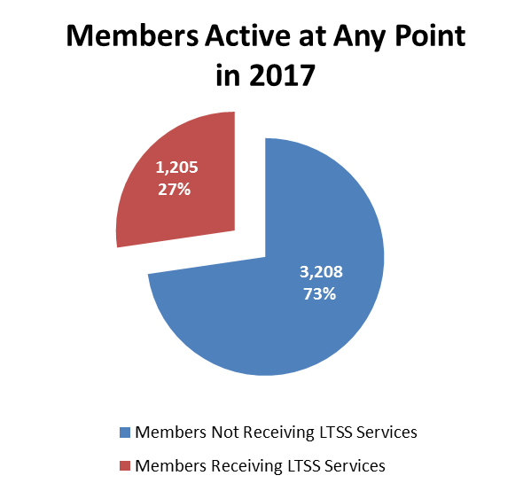
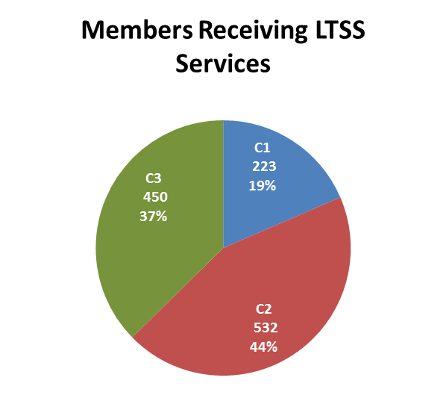
LTSS by membership
27% of the population is
receiving some form of LTSS and 37% of these members are C3s.

Slide 4
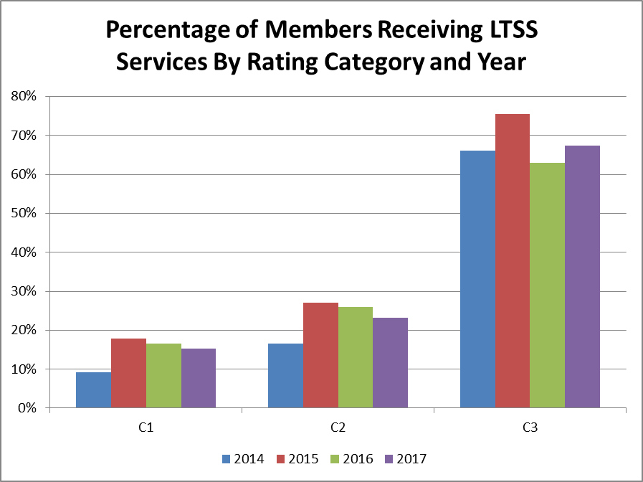
Year over year comparison of Members w/LTSS By Rating Category

Slide 5
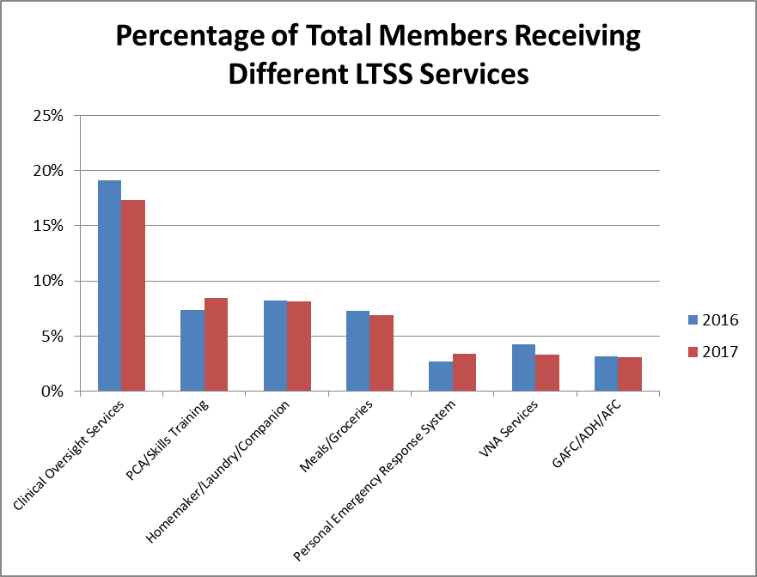
Percentage of Members Receiving LTSS Services by Type
Based on claims data, clinical oversight and care coordination services
drive volume. This is driven by the member’s LTS C.

Slide 6
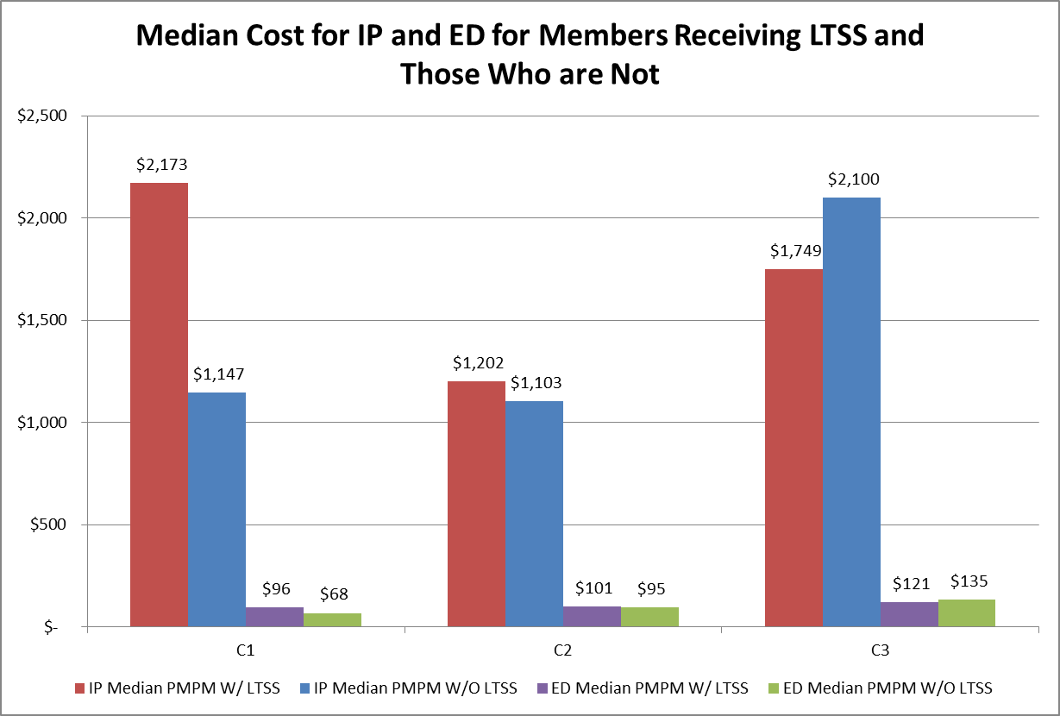
2017 Total Inpatient and ED expense trends comparing members with and without LTSS
Inpatient and emergency room expenses are lower in C3 members
receiving LTSS, while the opposite is true for C 1 and C 2 members
Notes:
one takeaway here is that the $ savings in LTSS services are realized in the C3 category
This is true for ED use and inpatient care

Slide 7
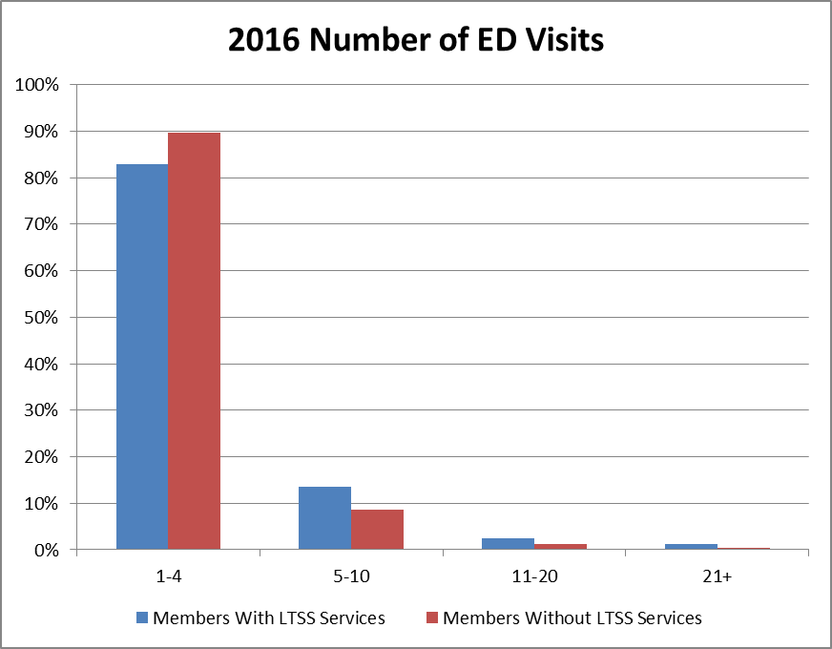
ED utilization based on unique members with and without LTSS
Visit Frequency | With | W/O | Total
1-4 | 498/83% | 742/90% | 1240
5-10 | 81/13% | 72/90% | 153
11-20 | 15/2% | 11/1% | 26
21+ | 7/1% | 3/0% | 10
 | 601/42% | 828/58% | 1429
LTSS Services includes PCA, HM, Meals and Transportation
Transportation is the highest volume service among these members.
Most of the population, with and w/o LTSS fall in the 1-4 visit range.

Slide 8
Population Analysis: Summary
In 2017, 27% of our Unify Population received some form of LTSS service.
C3s had the highest proportion of members receiving services at 67%, while the C1s had the lowest proportion receiving LTSS, at 15%.
This trend has been consistent year over year.
The most utilized services, excluding assessment, were PCA Services, Homemaker/Laundry/Companion services, Meals, and Adult Day Health services.
Compared to C1 AND C2 members, the C3 members with LTSS had lower inpatient and ED costs

Slide 9
Access: How members are referred to an LTS C
1. The care manager completes a comprehensive assessment, including
an initial LTSS screen.
2. As part of this assessment, all members are offered an assessment for LTSS services. If the member agrees, a referral is made to the ASAP or ILC and an LTS C outreaches the member and schedules the appointment
3. The LTS C completes the assessment (social/functional) and discusses a service plan based on what the member wants and needs.
4. Once the LTS C assessment and service plan is completed and services are authorized, the care manager and LTS C create a shared care plan that the member has agreed to and care coordination begins.
5. The LTS C becomes a part of the member’s ICT and serves as the member’s advocate.
6. The LTS C participates in any activities that support the members needs, including case conferences, transitions in care plans, clinical meetings, joint home visits, etc.

Slide 10
Challenges: Members who refuse a referral to the LTS C
Not all members agree to an LTSS assessment.
Members who refuse an assessment for services are not consistently offered an LTS C.
Cases are closed if there are no active LTSS services, but LTS C will remain active if the care manager feels the member is at risk
We have an opportunity to reassess current work flows and ensure all members are offered an LTS C even though they may not be interested in an assessment

Slide 11
Process: Education/Training about the benefits of receiving LTSS and the role of the LTS C is ongoing
Leadership:
Formal Presentations
Informal dialogue
Staff/clinical/admin
Orientation
Ongoing training
Webinars
ASAP/ILC clinical
Staff meetings
Joint visits with LTSC
Case conferences
Rounds
Member:
Enrollment
Assessment
Reassessment
Care Planning
Care Coordination
Care Transitions
ICT participants
Education
Providers:
Onboarding process
ICT participation
Care Transitions
Website/Provider

Slide 12
Process: Quality and Opportunities for Improvement
Satisfaction:
No formal system of measurement
Measures in process (megarule, NQF)
Feedback process and documented
ASAP/ILC clinical and admin meetings
Consistently offer LTSS assessment
CAC / feedback / follow-up
Integration w/ care team:
Clinical meetings
ICT
Transitions
CM/LTS C collaboration well documented
Joint visits(assessment/outreach)
New functional assessment
Access and availability variable
Regulatory Compliance:
TATs
Processing prior auths
Response to member referral to CBO
Receipt of assessment/service plan
Decision determination
Access
Resumption of services post d/c
No consistent referral to LTS C
Improvement / Follow-up
Measure satisfaction
Focus on role of the LTS C
Modify assessment tool
Identify additional supports for BH members

Slide 13
Process: Best practices/How the IC can help…
Access | Integration | BH Members
Leverage members and member stories in promoting LTSS over handouts Promote the benefit of having an LTS-Cs Opportunity to increase peer support through more education Promote ILC services | Increase provider education and awareness to drive LTS-C utilization Focus on positive outcomes associated with LTS-C utilization Provider promotion of LTS-C services may influence utilization | Community-based BH partners are a critical component of the members care plan. This is an opportunity for more education and outreach to provider stakeholders Many BH members have medical disease burden that impact ADLs
Notes:
Access
Handouts and websites are always helpful, but learning about LTSS and the value of the LTS C is more impactful when offered through the eyes of a member . Member stories go a long way!
Greater focus on the role than the services. LTS Cs are advocates and understand all the support services available to members. They can influence members so they can respond positively to these services
Integration
Greater utilization of LTS Cs will result from member and provider education.
A focus on education can influence members and providers in always including an LTSS option for members
Integration of LTSS services, including the value of the LTS C in member outcomes should start at the PCP practices and providers, including discharge planners
BH Members
Community based BH community partners are a critical component of the members care plan. This an opportunity for more education and outreach to provider stakeholders who we can influence.
Medical expenses drive a considerable portion of the medical expense. Many BH members have medical disease burden that impact ADLs. Another potential for education

