Slide 1
TUR PLANNING REVIEW
Reporting Workshops - 2026

Slide 2

Who Has To Create a Toxics Use Reduction (TUR) Plan?
Companies reporting at least one (1) chemical this reporting year (2025) that meets the following conditions:
  It was reported in at least one prior reporting year
  It will likely have to be in the coming reporting year (2026)

Slide 3
Plan Due Date and Approval
Complete By July 1, 2026
Only Complete If Certified By a MassDEP-Approved Toxics Use Reduction Planner
Can be company employee or outside consultant
Planner must determine if plan meets regulatory requirements, and that planning process was done in good faith
Submit a TUR Plan Summary to MassDEP
Done using eDEP portal
Make sure your planner’s certification is current!

Slide 4
TUR Plan Sections
Facility-Wide Planning
Production Unit-Level Planning
Required for all Facilities:
  Management Policy
  Scope
  Employee Notification
  Plan Summary
  Plan Certification
Note: If the facility’s only reportable chemical use is for wastewater treatment, ONLY facility-wide planning is required
For each chemical and each production unit in which it is used:
  Process Characterization
  TUR Options Identification
  TUR Options Technical Evaluation
  Cost of Using Chemical
  TUR Option Economic Evaluation
  Implementation Decision and Plan

Slide 5
Employee Notification
Management Policy
Date
Date of notification (must be completed before January 1 of the Planning Year)
Identify
Identify Production Unit(s)
Describe
Describe Planning Criteria (requirements)
Solicit
Solicit TUR suggestions
Describe
Describe the notification method in Plan
Description of how facility encourages TUR
Description of policies that encourage or discourage TUR
Other optional information – e.g., role of TUR in:
Hiring, salaries, promotions
Research & Development activities
Capital investment decisions
Date of policy review or revision

Slide 6
Scope – The “executive summary” of the Plan
Plan Summary (this is what is submitted to DEP)
Production unit descriptions – Process, product, unit of product, chemicals and associated CAS #s, list of process codes (consistent with Form S)
TUR Options identification process, including dates, participants and sources of information
TUR Options identified
TUR Options disposition and implementation plan
Projected changes in use and byproduct, both by production unit and by chemical
For each chemical
Description of TUR Options considered
Description of TUR Options selected for implementation in this plan
Reason why any TUR Options selected in the prior planning cycle weren’t implemented as planned (if any)
Projected facility-wide change in Use and Byproduct for the following calendar year
Facility senior manager certification
Toxics Use Reduction Planner certification

Slide 7
Certification Statements
Senior Management Statement
TUR Planner Statement
I certify under penalty of law that the following is true:
  I have personally examined and am familiar with this toxics use reduction plan;
  I am satisfied that any supporting documentation used in the development of the plan exists and is consistent with the plan;
  based on my inquiry of those individuals immediately responsible for the development of this plan, I believe that the information in the plan and any supporting documentation used in the development of the plan is true, accurate, and complete;
  the plan, to the best of my knowledge and belief, meets the requirements of 310 CMR 50.40;
  I am aware that there are penalties for submitting false information, including possible fines and imprisonment.
Based on my independent professional judgment as a toxics use reduction planner I certify under penalty of law that the following is true:
  I have examined and am familiar with this toxics use reduction plan;
  the plan satisfies the requirements of 310 CMR 50.40; and
  the plan demonstrates a good faith and reasonable effort to identify and evaluate toxics use reduction options.

Slide 8
Production Unit-Level Plan Elements
Description of the production unit(s) in which a covered toxic is used
Process Flow Diagram(s)
Description of product and unit of product (as listed on Form S)
Purpose served by each covered toxic used
Total pounds and pound/unit of product in prior calendar year:
Manufactured, processed and otherwise used
Generated as byproduct
Released as emission, disposed onsite or transferred offsite
Plan must include calculations, assumptions and estimation methods used to determine these data, and identify the location of supporting documentation used to determine them
Cost associated with use of the covered toxic(s)
All TUR options considered
Technically and economically feasible options identified
Statement of implementation decision on each technically feasible TUR option

Slide 9
Process Flow Diagram (1 per Production Unit)
PFD Illustrates:
Production Unit Number and Unit of Product
Each processing step, including treatment and recycling, consistent with list of processes included in Form S
Entry and exit point of each reportable chemical
Steps where byproduct becomes emission
Date of preparation, review or revision
For Plan Updates:
Revise to reflect changes. If no changes, be sure to note that in Plan

Slide 10
Options Identification (for each production unit/chemical combo)
Consider all 6 TUR Methods
Input Substitution
Product Redesign/Reformulation
Improved Operation and Maintenance
Production Unit Modification
Production Unit Modernization
Integral Recycling
Describe Options Identification Procedures
List Personnel Involved
Describe Information Sources Consulted
Describe Information Gathering Techniques
List All Options Identified As “Potentially Achieving” TUR
For Plan Updates:
Include all options considered but rejected in prior planning cycles

Slide 11
Technical Evaluation
Economic Analysis of Technically Feasible Options
Description of Process
Determination if option is
Technically feasible,
TUR, and
Legal
IF YES: Expected reduction in total use and byproduct amount per unit of product
Cost of Implementing Option
Savings from Reduced Chemical Costs
Analysis is complete when there is sufficient information to make a good faith implementation decision
For Plan Updates:
Review technical infeasibility determination made for options rejected in prior years.
Update use and byproduct information for technically feasible options rejected in prior years
For Plan Updates:
Update economic analysis of previously rejected technically feasible options

Slide 12
Cost of Toxics
Implementation Plan
If technically feasible options identified
Costs to consider
Direct and indirect costs of purchase; treatment and disposal costs;
Worker health and safety costs; compliance costs;
Insurance costs; etc.
If NO technically feasible options
Potential liability; customer good will/market share;
Calculate the full cost of using chemical in the production unit
Provide a list of all relevant costs
Rationale for rejecting technically feasible options
Evaluation schedule and plan for options still under consideration and reason for delay
Schedule and plan for implementation of TUR options selected for adoption
Explanation of reasons for delay/abandonment of TUR options selected for implementation in prior plan
For Plan Updates:
Update cost of toxics assessment with current information

Slide 13
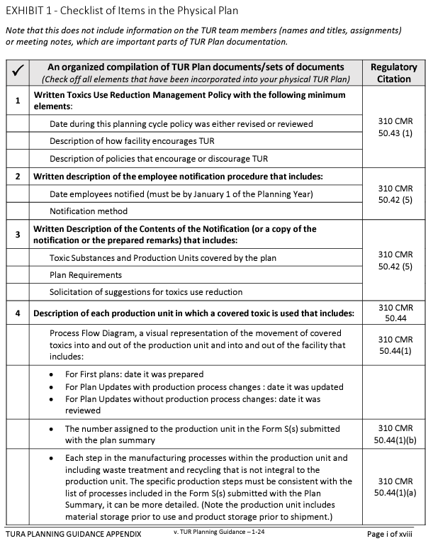
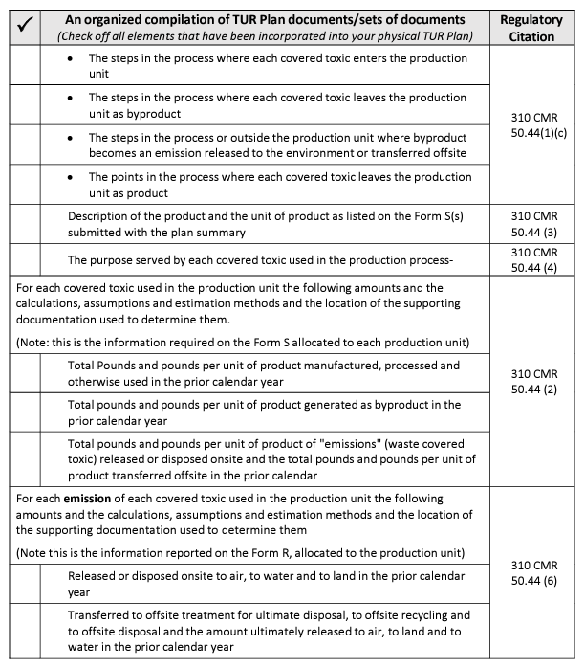
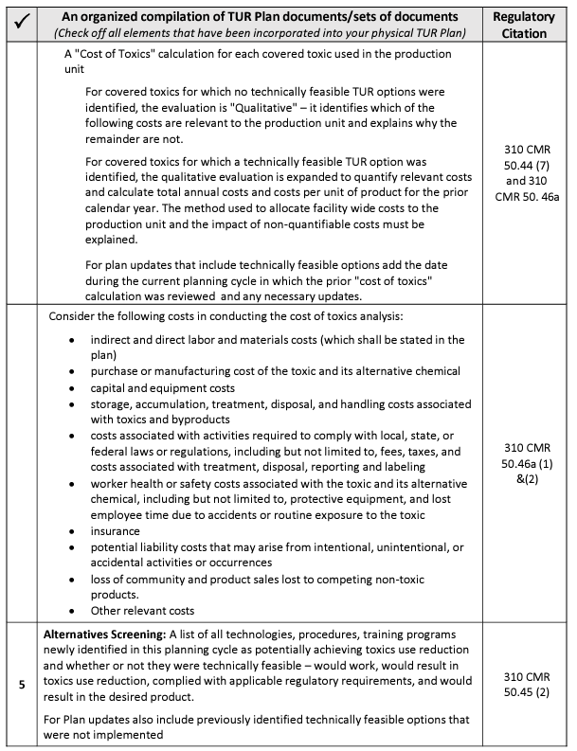
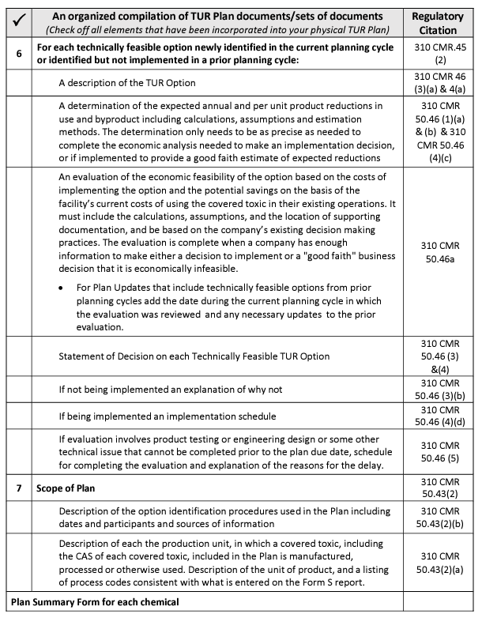
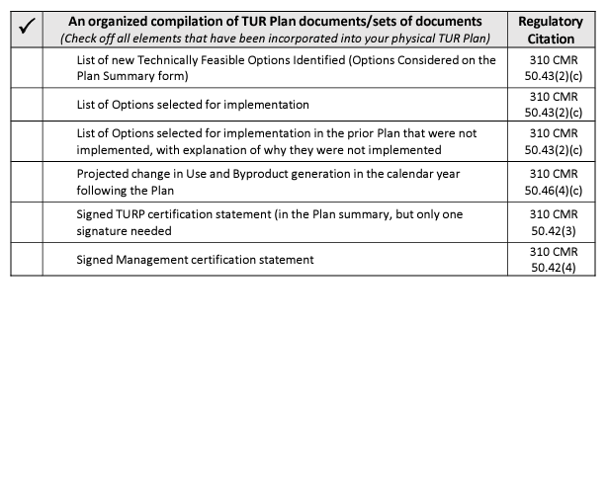
Use the TUR Planning Guidance
https://www.mass.gov/doc/toxics-use-reduction-planning-plan-update-guidance/download
NOTE: Section 4 of the TUR Planning Guidance includes tips specific to special circumstances:
How to update a TUR Plan when your facility has no new options
What to do when your facility has more options than it could reasonably implement in a planning cycle
How to fully incorporate TUR planning into your facility’s ongoing operations
What to do if your facility cannot complete the evaluation or implement an option by the Plan due date

Slide 14
Learn More About Becoming a TUR Planner!
NEXT Class (www.turi.org)
Online portion begins early September;
In-Person classes October-November in Lowell
Email us! (training@turi.org)
Pam Eliason, TURI Training Director: Pamela_Eliason@uml.edu
Agnes Cheng, TURI Training Associate: Agnes_Cheng@uml.edu

