Slide 1
TURI Services
Reporting Workshops - 2026

Slide 2
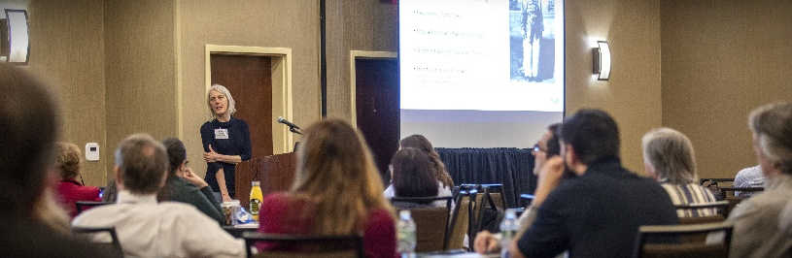
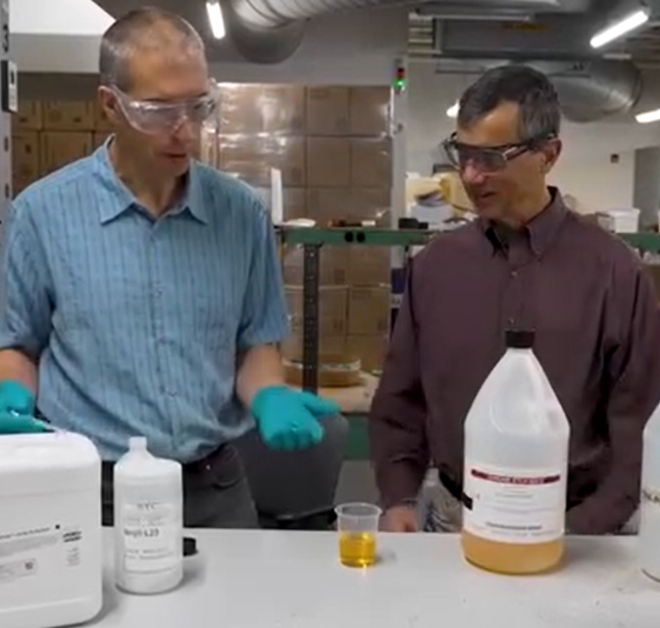
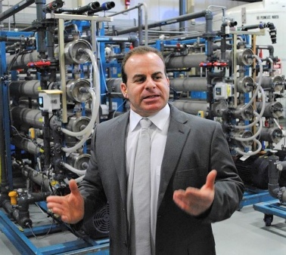
Toxics Use Reduction Institute (TURI)
Education and Training for TUR Planners
Science and Policy
  Science Advisory Board
  Policy analysis, data analysis
Research, development and assessment of safer alternatives
  Academic research grants, collaborative business-researcher grants
  Laboratory services for industrial and janitorial cleaning
  Alternatives assessment
Technical and financial support to businesses and communities
  Grants and information resources
  Business supply chain workgroups and research

Slide 3
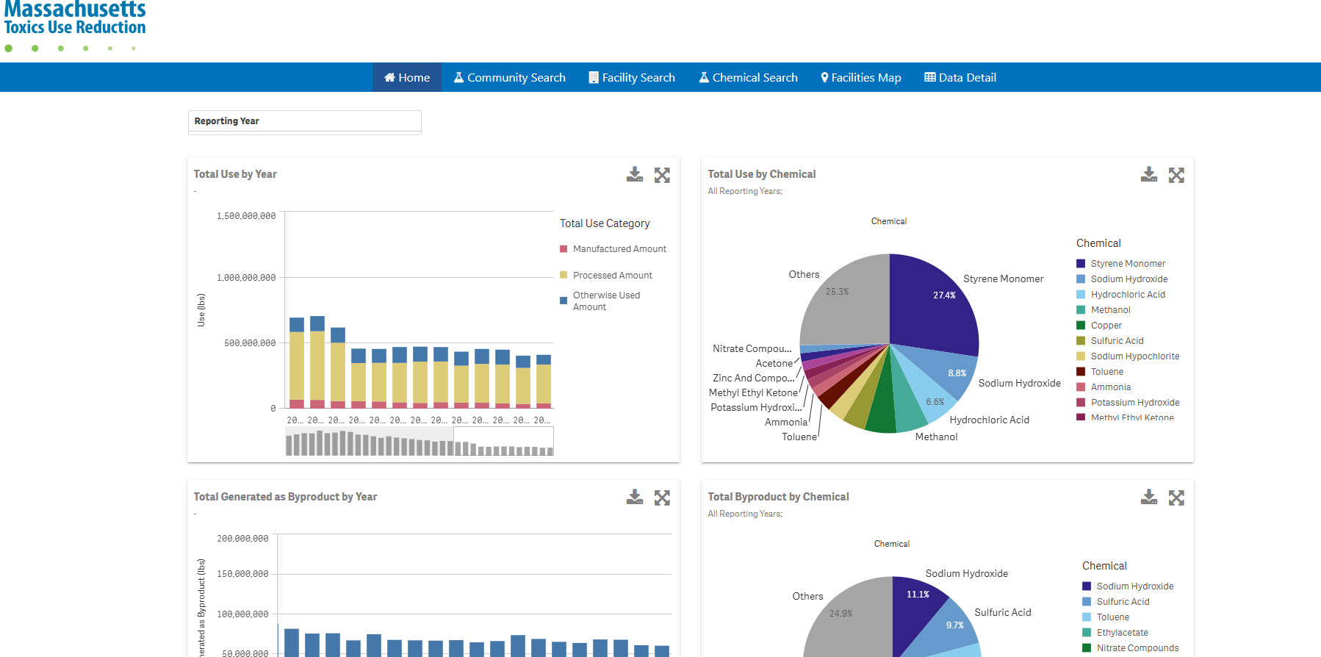
www.turadata.org

Slide 4
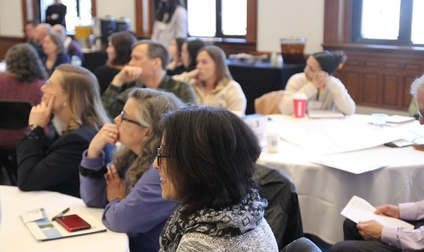
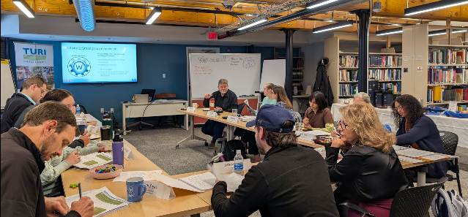
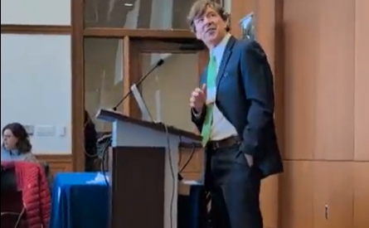
Education and Training
April 2026 TUR conference
  The Fall TUR conference will be held virtually over the course of one or two weeks in early November
TUR Planner certification course (Sept – Nov 2026)
  Begin remote modules in early September 2026
  In person sessions October-November 2026
Alternative planning options – RC and EMS
  RC basics and asset specific webinars offered March-May 2026
  EMS training – look for announcement for 2027 course
Beyond the Safety Data Sheet
  Available any time on TURI’s website
  In-house trainings scheduled in fall and upon request
Track upcoming events from TURI's home page and calendar

Slide 5
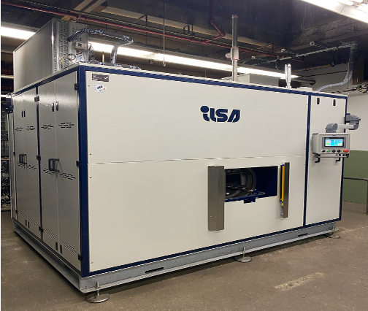
TURI Lab Capabilities
Various Performance Testing Available
Learn more at www.turi.org/lab
Complete the online testing form to begin your journey with the lab: https://www.turi.org/lab/#testing_form
Industrial Parts Cleaning
  Traditional wet lab tests
  Bench scale equipment testing:
    Vacuum Vapor Degreasing bench
    Vacuum Cycling Nucleation
Janitorial and Home Cleaning
  Safer alternatives to common cleaners
Sanitization and Disinfection
  Safer alternatives to quats and other toxic solutions

Slide 6
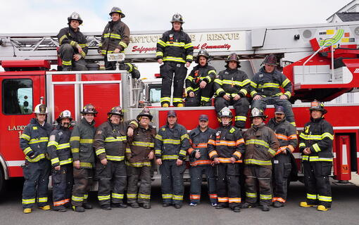
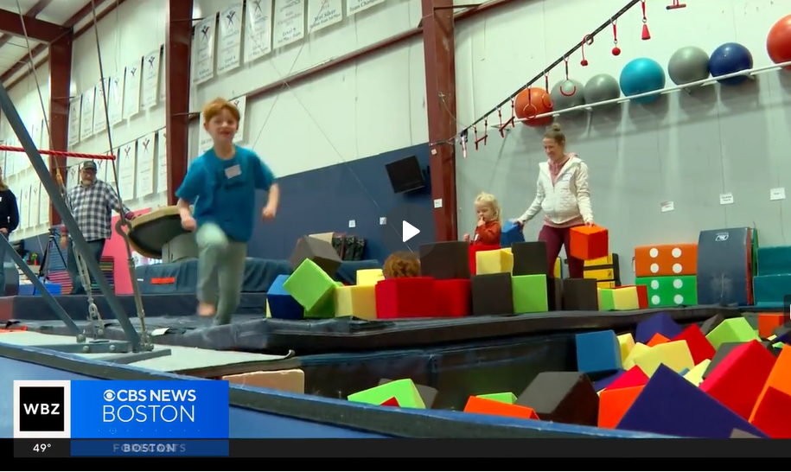
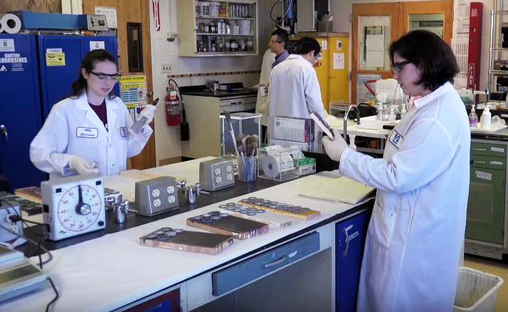
TURI Strategic Priorities
PFAS – Identifying the many uses of PFAS and working with companies to find alternatives
Halogenated Solvents
PFAS
Flame Retardants
Flame retardants – Where are they necessary and are there safer alternatives?
Halogenated Solvents –
  Dealing with EPA TCE, nPB or methylene chloride restrictions?
  Contact TURI and OTA for technical and financial assistance!

Slide 7
TURI FY26 Grants
Business Grants - Research, evaluate and adopt safer alternatives to toxics
New Method Plating
Academic Research Grants - Safer alternatives to PFAS in manufacturing and products
Prof. Ram Nagarajan, UML
Prof. Michael Timko, WPI
Community Grants – Develop capacity for safer MA communities
Berkshire Regional Planning Commission
Safer battery manufacture and recycle
Replace TCE vapor degreaser with safer chemistry in vacuum vapor degreaser
Safer flame retardants in military gear in collaboration with Haartz
Reduced use of plastics and generation of microplastics
Brazilian Women’s Group
Safer home cleaning practices
Read the case study!

Slide 8




Connect with us!
www.turi.org
newsletter – monthly updates and timely information
Linkedin – connect for latest news!
facebook
Instagram – for latest short videos
Connect with our staff!
Don’t know who to ask? 978-934-3275 or info@turi.org

