Slide 1
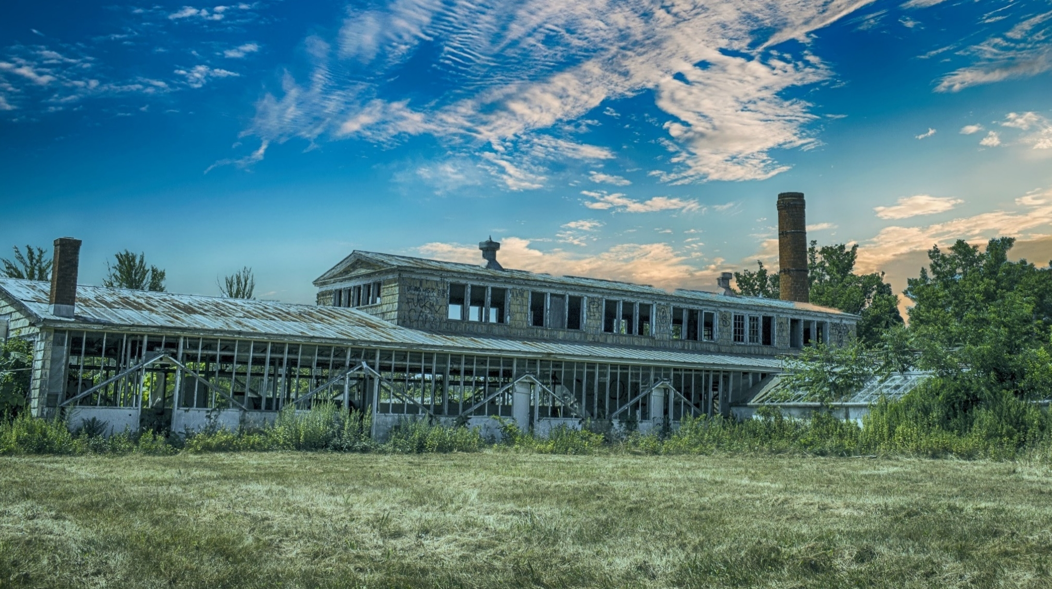
Massachusetts Brownfields Roundtable
UConn TAB

Slide 2
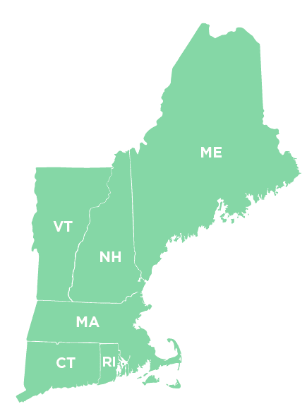
WHAT IS UCONN TAB
Technical Assistance to Brownfields ​
provides technical assistance to communities, states, Tribal Nations and other public entities ​
help address their brownfield sites and to increase their understanding and involvement in brownfields cleanup, revitalization and reuse. ​
TAB is available at no cost to communities. ​
UConn TAB serves Region 1(New England)​
Equal Distribution of Resources in all 6 New England States and Tribes
Over 1000 possible brownfields identified around MA with many remaining unidentified

Slide 3
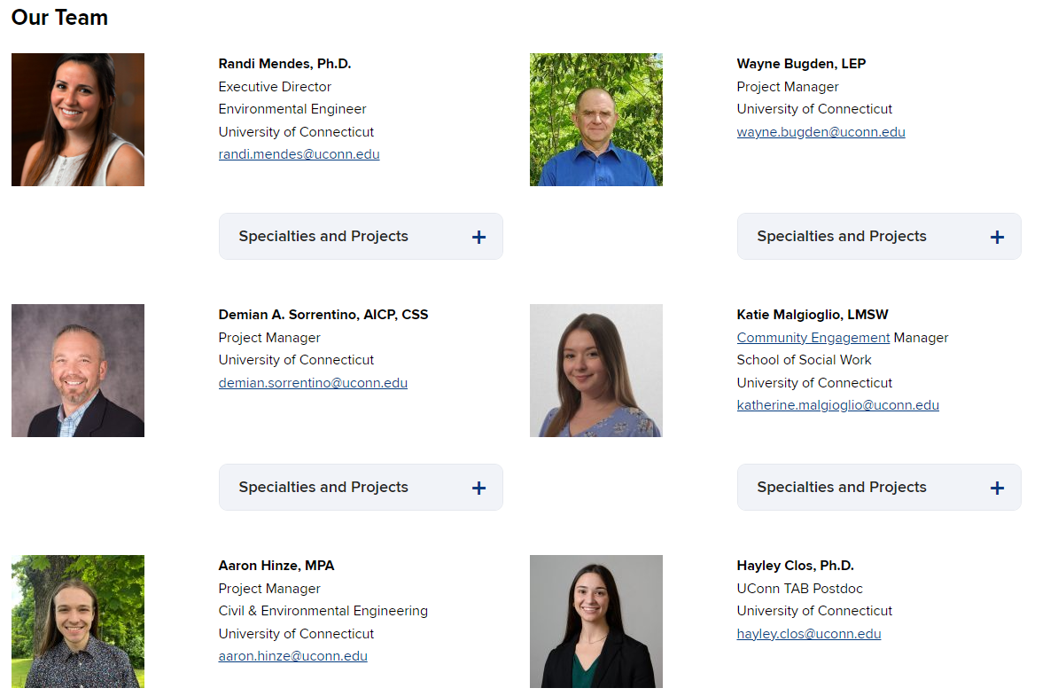
MEET OUR TEAM

Slide 4


NEW ENGLAND RURAL HEALTH ASSOCIATION (NERHA)
For over 25 years the New England Rural Health Association (NERHA) has served as the state rural health association for the six New England states. We are a non-profit organization dedicated to advancing rural health. NERHA provides education, training, consulting, and advocacy in support of the rural health organizations and individuals in our region.
New Partnership
UConn TAB Partner – Rural Outreach and Engagement
NERHA supports UConn TAB by serving as a link between rural communities and technical experts. This helps foster collaboration among communities and municipalities, ensures public health considerations are included in Brownfield assessment and cleanup, and strengthens local capacity to address these challenges.
NERHA Reach, By The Numbers:
10,000+ People Served by NERHA Programs
100+ Partner Organizations Across New England
300+ Communities Impacted
550+ Members
5,500+ Mailing List
Connect with Community Hubs: Libraries, Health Center, State Offices Of Rural Health (SORHs), Rural Caucus
Conduct Individual Outreach: MAP 2025 30+ Municipalities reached
Stay Connected With Us:
Nerha.org
Join our Newsletters
Read "Rural Roots"
Become a Member

Slide 5

DIRECT TECHNICAL ASSISTANCE
RESPONSIVE, ACCESSIBLE, AND EXPERT REFERALS
Direct Technical Assistance
Continuing Education
Municipal Assistance Program
Community Engagement
Technical Document Review
Review of Environmental Site Assessment Reports, Remedial Action Plans, Planning Documents
Brownfields Proposals Review
EPA Brownfields proposals (assessment, cleanup, multipurpose, RLF) and State Program proposals
Access to Resources & Procurement Support
Quick Availability
Answer Technical Questions
Fact sheets, example proposals, RFQ/RFP review, and documents

Slide 6
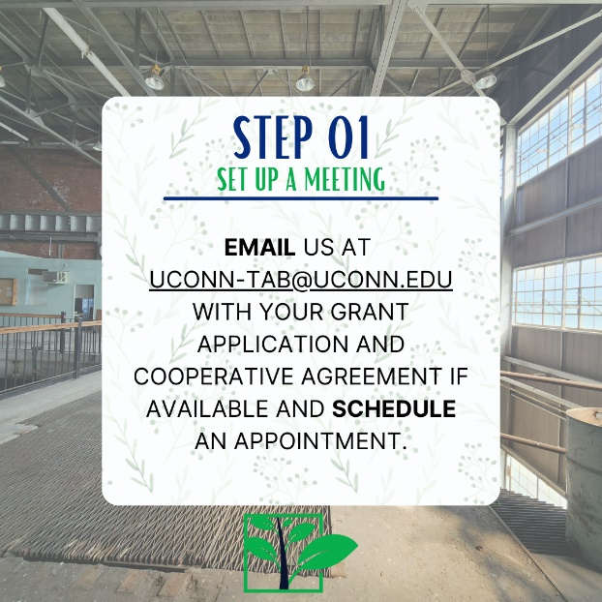
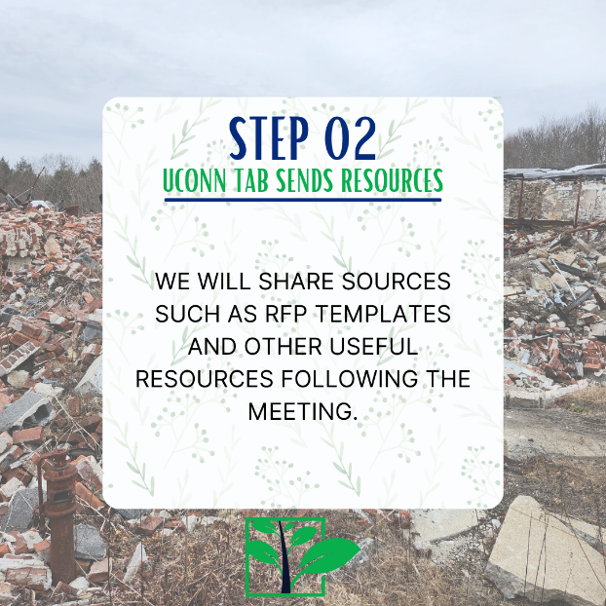
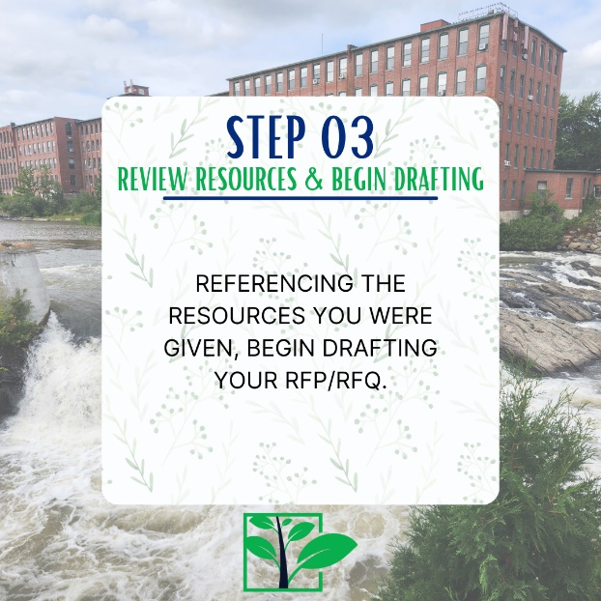
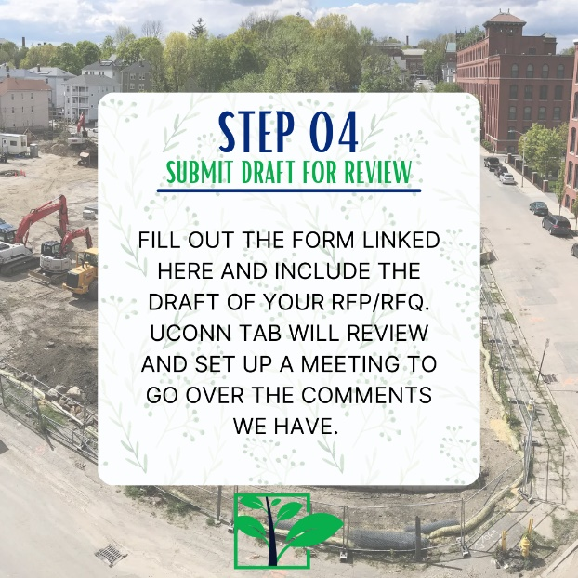
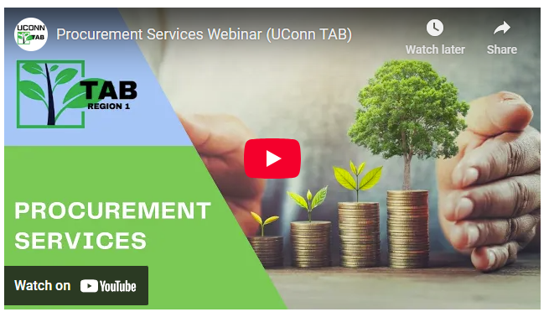
tab.program.uconn.edu/procurement-service/

Slide 7
MAP - SERVICE LEARNING COURSE
STRONG COMMUNITY PARTNERSHIPS & COLLABORATIONS
Direct Technical Assistance
Continuing Education
Municipal Assistance Program
Community Engagement
Sep-Dec
Jan-April
May-Aug
EPA Brownfields Grant Support
TECHNICAL SUPPORT
Target Area and Brownfield Site Description
Community Need (Demographics and health data)
Brownfield inventories
Data Review and Gap Analysis for brownfield sites
Grant Preparation
Site reuse planning
Community Engagement Planning and Materials
Community
Info & Input
TAB Staff
Supervise
UCONN Students
Technical Work

Slide 8
BROWNFIELD INVENTORY
Site Name | Site Size (acres) | Opportunity Zone
Address | Current Zoning | Underserved Community
Zip Code | Current Owner | Vulnerability Index
Assessors Card ID number | Tax Payment Status | Past Uses
Parcel Number | Existing Buildings | Public Utilities
Redevelopment Status | FEMA Flood Zone | Parking Spaces
Site Type | Wetlands | Available Site Documents
Possible Contamination | LUST Designation | EPA Grant Eligibility
Reported Releases
Site Reconnaissance
Tax Delinquency
Sanborn Maps
Known Sites
Existing Brownfield Lists

Slide 9
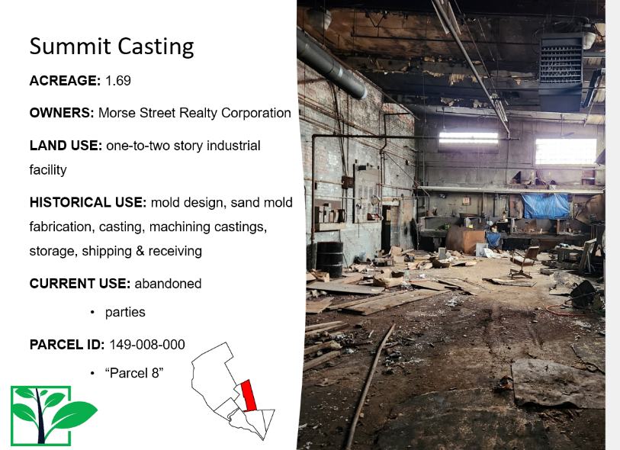
RECORD REVIEW

Slide 10
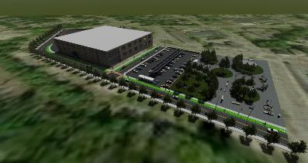
SITE REUSE ASSESSMENT PROJECTS
Property Information
Opportunities & Constraints
Market
Community
Local Economy
Regional Economy
Demographics
Land Availability
Strengths & Weaknesses
Expectations
Useable Acreage
Viability
Accessibility
Structure
Infrastructure
Utilities
Neighboring Land Use
Ownership
History
Tax status
Occupancy
Zoning
Environmental Considerations
GOAL: Identify potential reuse options for the brownfield based on the community’s vision and other site and surrounding area conditions
Provides a full evaluation of the opportunities, constraints and range of redevelopment possibilities related to the reuse of a brownfield site.
Site characteristics and needs
Area economy and demographics
Physical, environmental conditions
Applicable regulations
Real estate market conditions

Slide 11
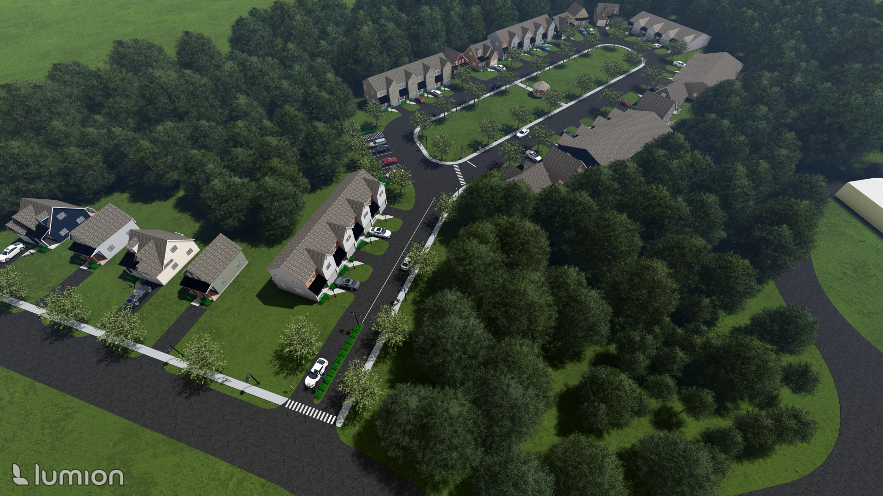
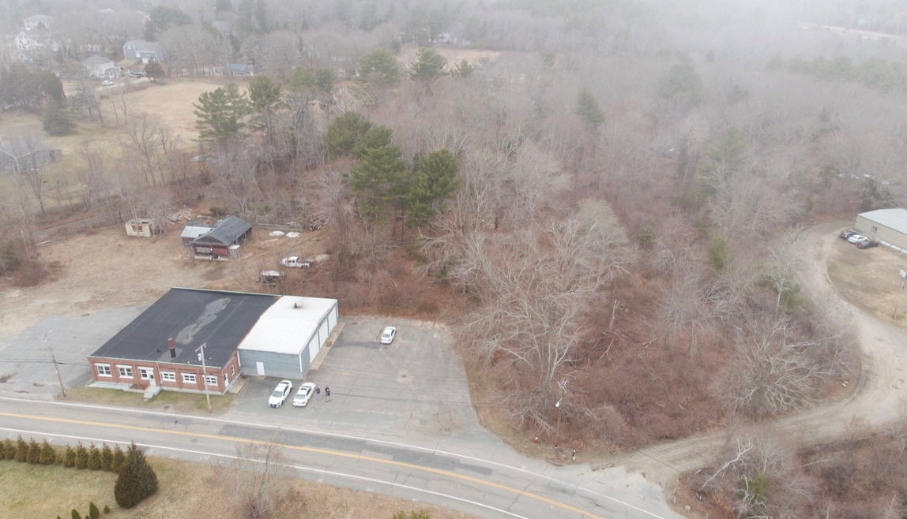

Slide 12
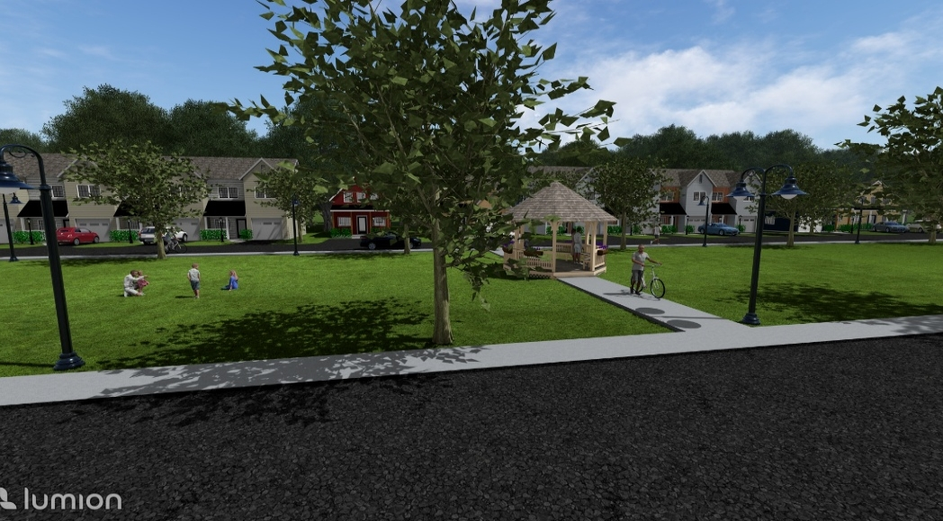
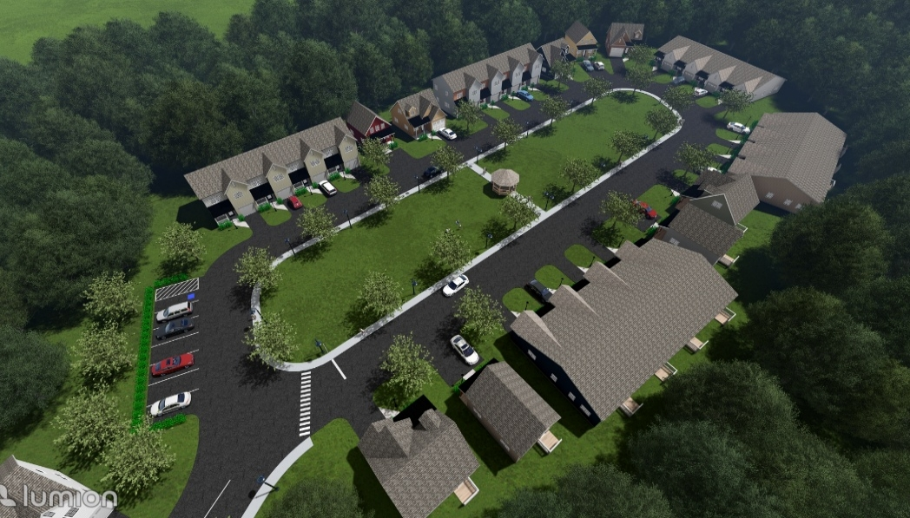
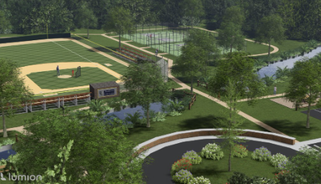
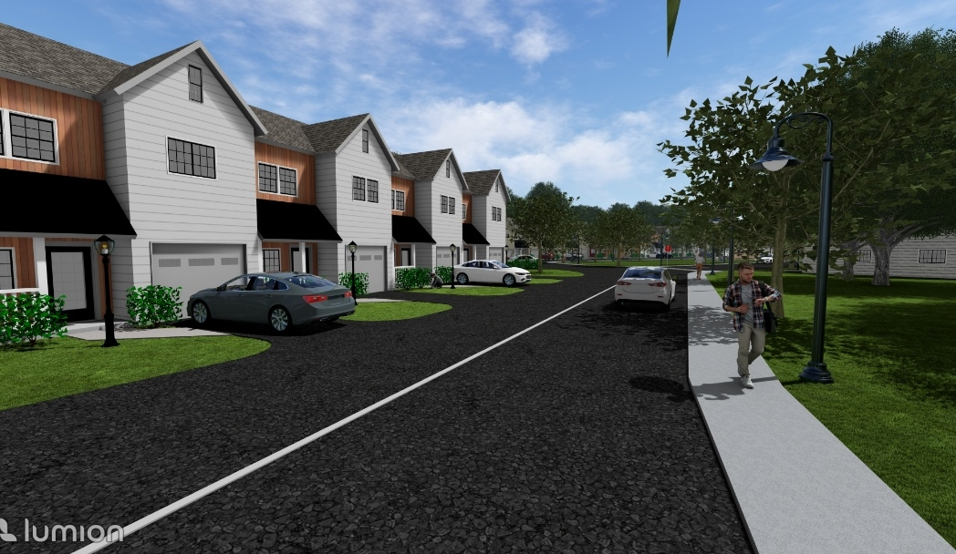
RENDERINGS
(Sketchup and Lumion)

Slide 13
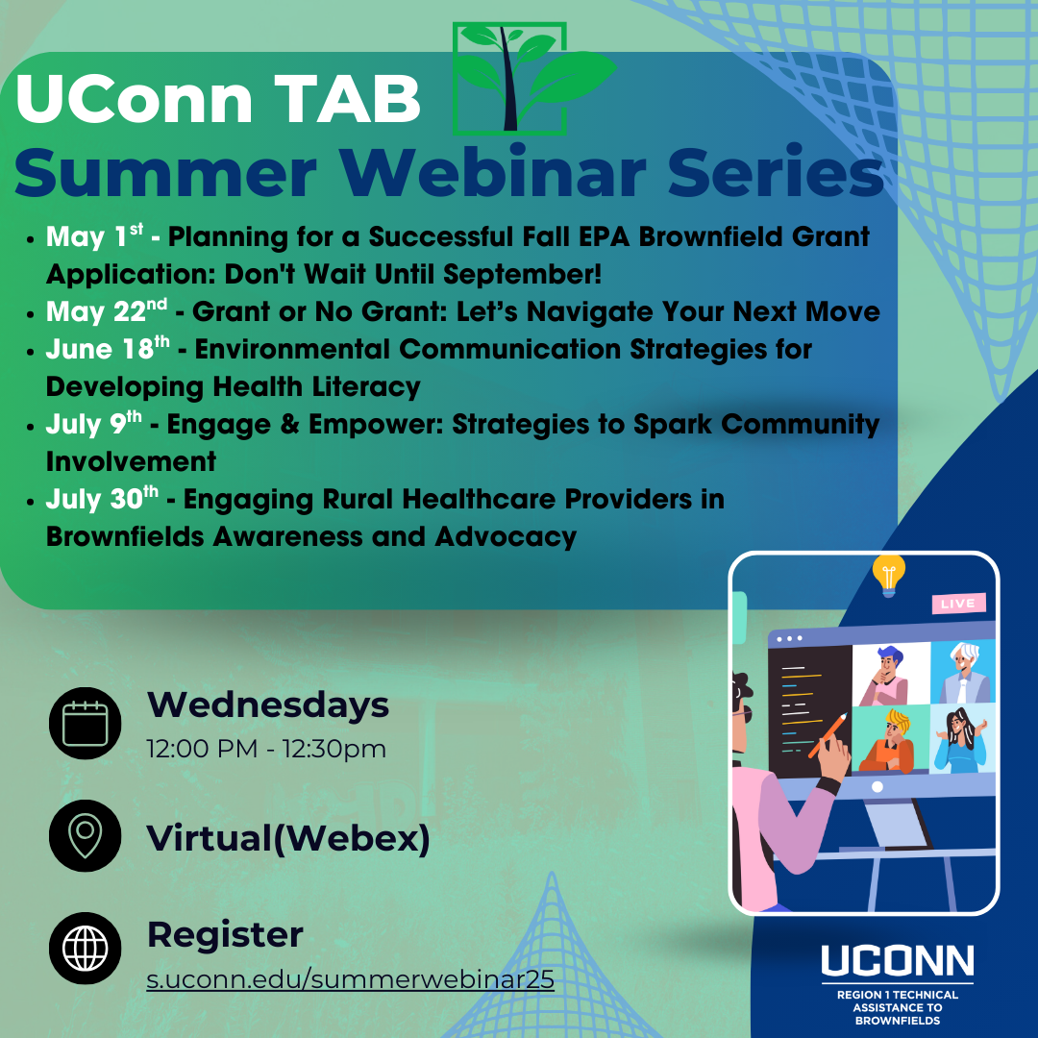
CONTINUING EDUCATION
BREAKING DOWN BARRIERS AND CO-LEARNING
Direct Technical Assistance
Continuing Education
Municipal Assistance Program
Community Engagement
Past Webinars
      Jan 29th Brownfield Redevelopment & TAB Services
      Feb 19th Brownfields: Exploring Disproportionate Environmental Impacts on Communities
  Mar 11th Community Engagement in Aging Communities
  Apr 16th Using Brownfield Funding for Local Planning A Planner’s Perspective)

Slide 14
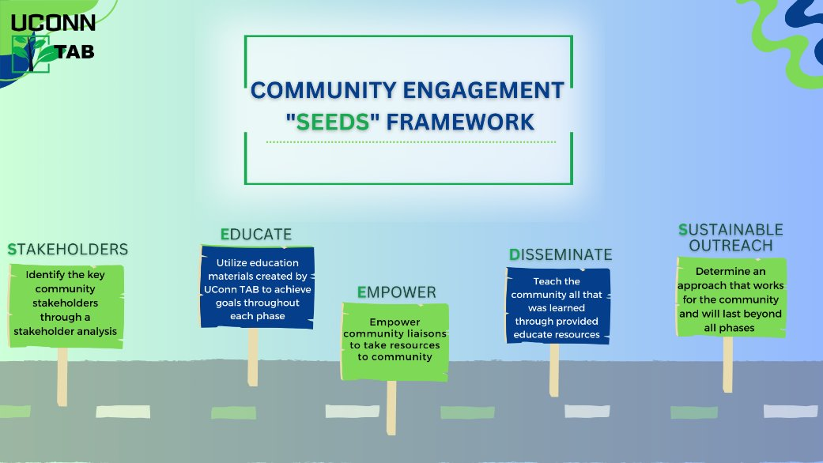
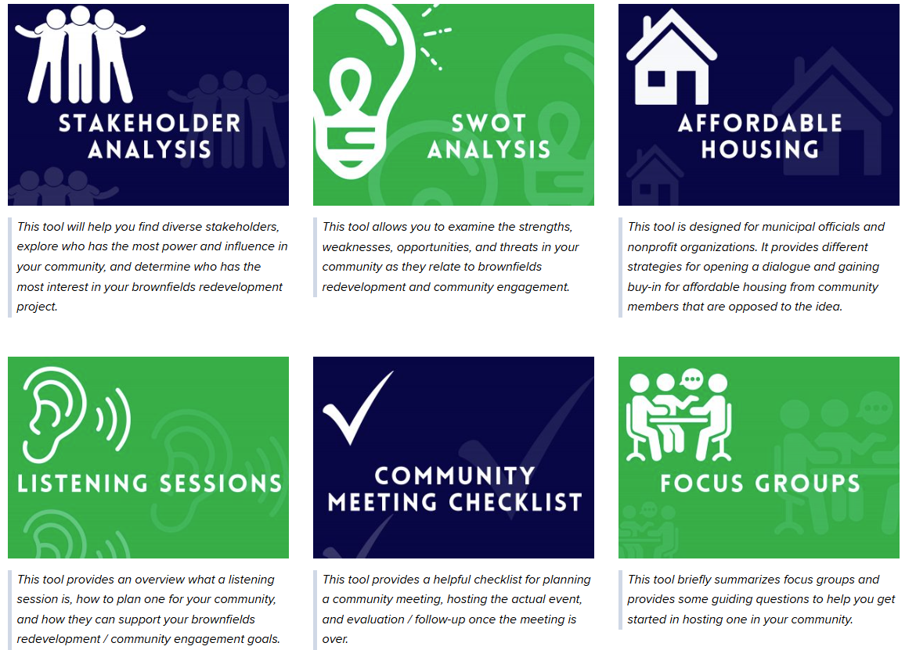
COMMUNITY ENGAGEMENT
BREAKING DOWN BARRIERS AND CO-LEARNING
Direct Technical Assistance
Continuing Education
Municipal Assistance Program
Community Engagement
tab.program.uconn.edu/community-engagement/

Slide 15
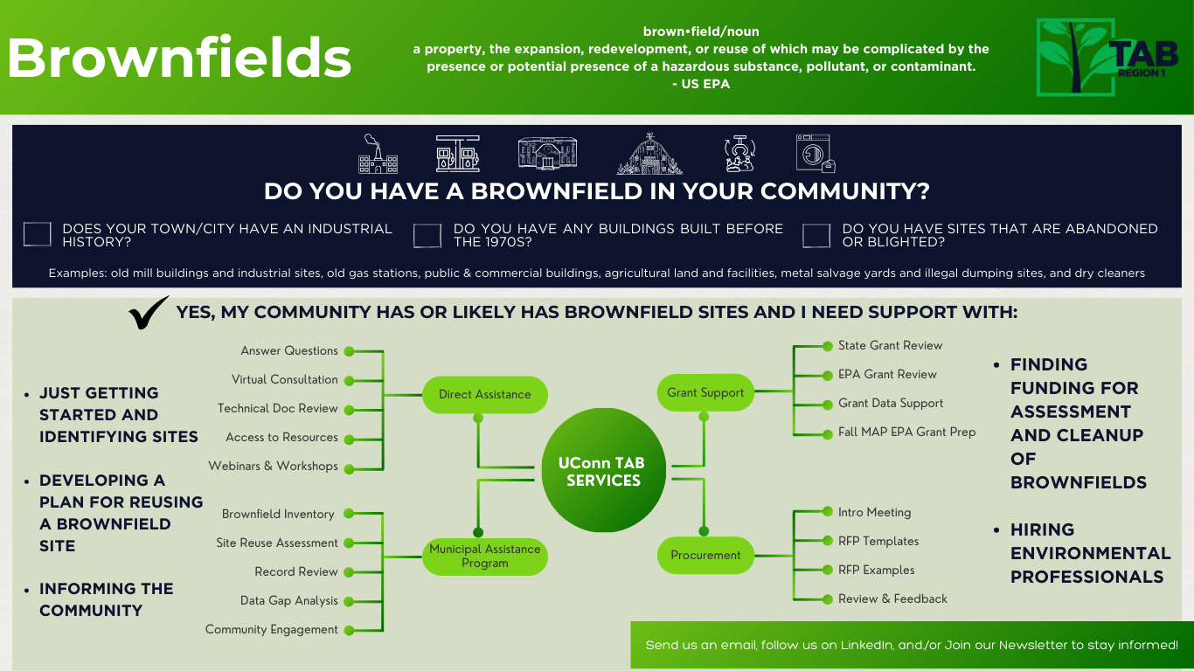

Slide 16
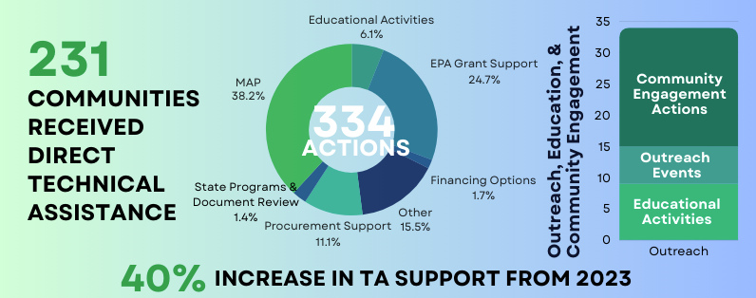
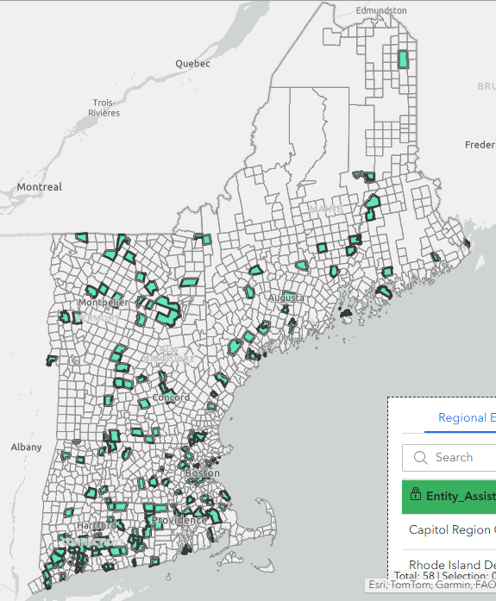
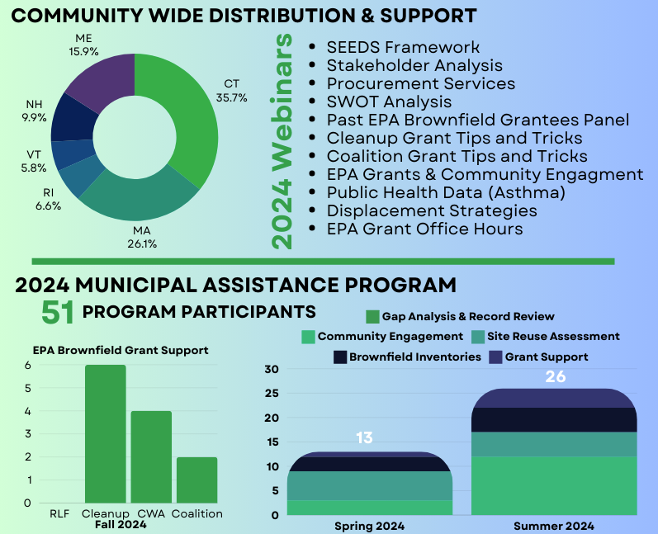
IMPACT AT A GLANCE

Slide 17
Thank you!
Email:Uconn-tab@uconn.edu
Website: Tab.program.uconn.edu
LinkedIn: linkedin.com/in/uconn-tab/
Go to our website to subscribe to our newsletter!
https://mailchi.mp/f82f08428bf1/uconn-tab-april-2022-newsletter-10330475?e=6d63f681bc

