Slide 1
Phase Three
Massachusetts Law Enforcement
Crash Report E-Manual
FFY 2022 Section 405-c Funding AGF
Project Presentation Webinar
January 7, 2022
Recording in Progress
Notes:
•Good morning
•Welcome to the UMassSafe webinar and presentation on our 405c TRCC proposal – Phase Three of the MA LE crash report e manual - LEA Targeted
Resources to Improve Crash Data Quality
•I am going to give a brief overview and then Jenn will give you a demonstration of the Crash E-Manual as it is now and the proposed expansions.
We also have Ben Roney Yeager who is assisting with all the technical portions. If anyone is having trouble accessing zoom, sound etc., type on the chat box, and Ben will assist you
•We are looking forward to a lot of good discussion at the end.

Slide 2
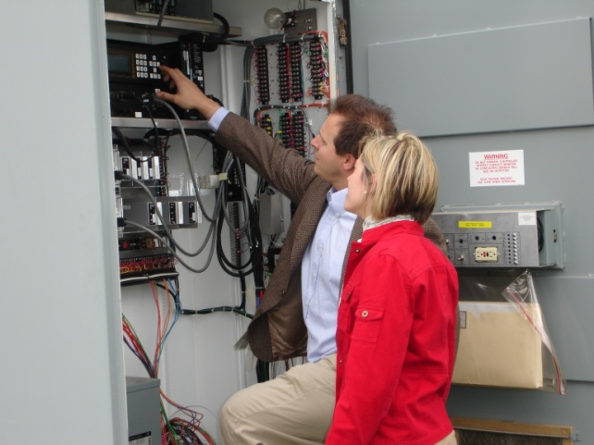
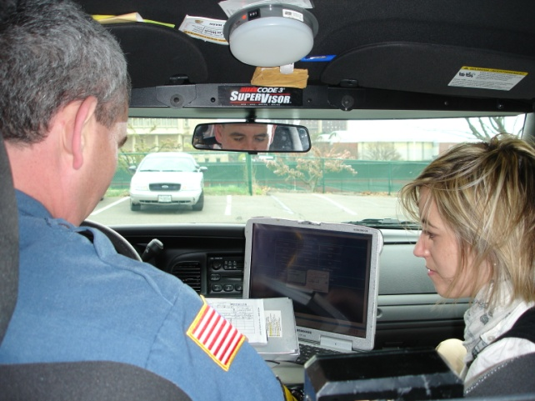
Traffic Safety Research Program
Housed in …
University of Massachusetts Amherst
College of Engineering
Civil & Environmental Engineering
UMass Transportation Center
Support highway safety through combined multidisciplinary approach
Scientific data-driven problem identification, program design, and evaluation
Traditional highway safety practices
(engineering, enforcement, education, & emergency response)
Notes:
I know that many/most of you are aware of the who we are and what we do, but for those that don't.
multidisciplinary HS program with staff with backgrounds in transportation safety, traffic records, public health, policy, engineering, systems management, and programming
NOT JUST ENGINEERING
unique ability to examine highway safety from a variety of perspectives and provide tools and information in a format that is practical for a wide range of users.
Very applied research. Some would even say our name is a misnomer since is it not ‘research’ - support state and federal agencies in their work to prevent crashes. Much of that is to improve the quality of data used to identify problems, create programs and evaluate them.
100% grant funded, usually have between 4-8 projects at a time
We are small with 4 FT staff and Dr. Knodler
We try to bridge the gap between scientifically data driven research and the 3Es
Translate research into practice
We work with most of the highway safety agencies in the state as well as the USDOT
-EOPSS OGR
-RMV
-MassDOT
-MSP
-FMCSA

Slide 3
Traffic Records Assessment Recommendations
Crash #38 – Is data from the crash system used to evaluate safety countermeasure programs? Partially Met.
Expand the site’s content & develop features to further promote its use, leading to improvements in the quality of data which will enhance the ability of stakeholders to use data from the crash system to evaluate safety countermeasure programs.
Crash #41 - Does the data dictionary provide a definition for each data element and define the data element’s allowable values/attributes? Met.
Adding additional interactive overlays will further enhance this by providing data dictionary look-ups specific to various RMSs.
Crash #74 - Is data quality feedback from key users regularly communicated to data collectors and data managers? Partially Met.
An LEA Ratings/Ranking initiative aims to provide information about relative quality to those responsible for LEA reporting success.
Notes:
As described in the proposal, this project addresses these three TR assessment recommendations.
This work is done in collaboration with the RMV and to support the work of Donna DeVeiga, the LEL and Karen Perduyn, the Crash Records Supervisor and all they do to improve crash data quality.

Slide 4
Goal: To Improve Crash Data Quality
Expand Content
Increase Usage
Share LEA Specific Quality Findings
Adapt to LEA's RMSs
Accessibility
Uniformity
Completeness
Accuracy
Timeliness
Integration
Notes:
Accessibility – enhance the usability of crash data publically available by providing definitions & decoding
Accuracy – data collectors having access to detailed definitions improve accuracy of choosing correct attribute
Completeness – data collectors having access to detailed directions/definitions prevent incomplete fields
Integration – provide resources/specs for RMS vendors to improve integration
Timeliness – data collectors able to search to problem solve their own questions on reports will prevent some delays
Uniformity – implementing & disseminating statewide guidelines to increase uniformity amongst all report components

Slide 5
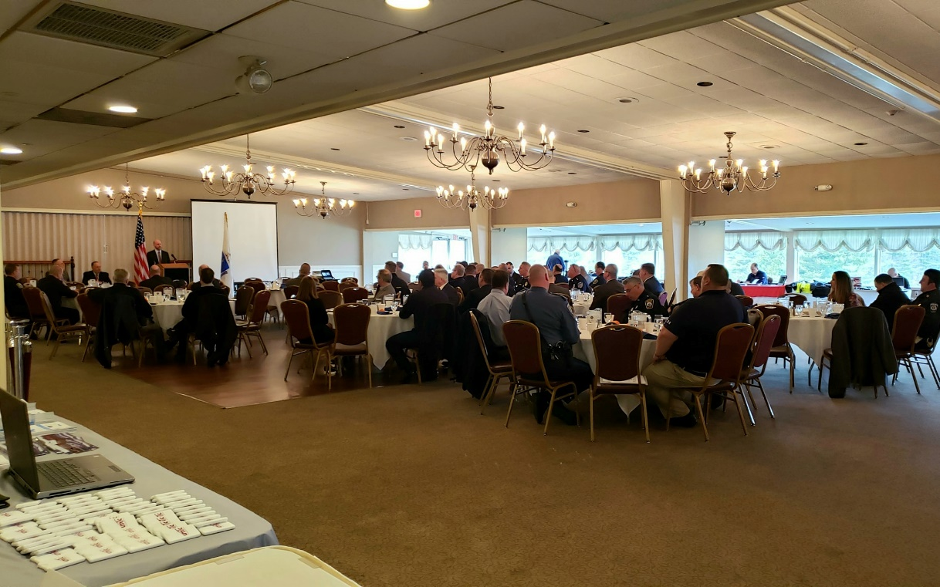
Project Partners
Notes:
There have been many partners involved in the development and promotion of the Crash E-Manual. Special thank you to the RMV and the LELE, Donna.
MSP using this tool regularly and providing ongoing feedback.
MCOPA has helped use distribute materials, give presentations, and all around support.
Each of these agencies has played a significant role.

Slide 6
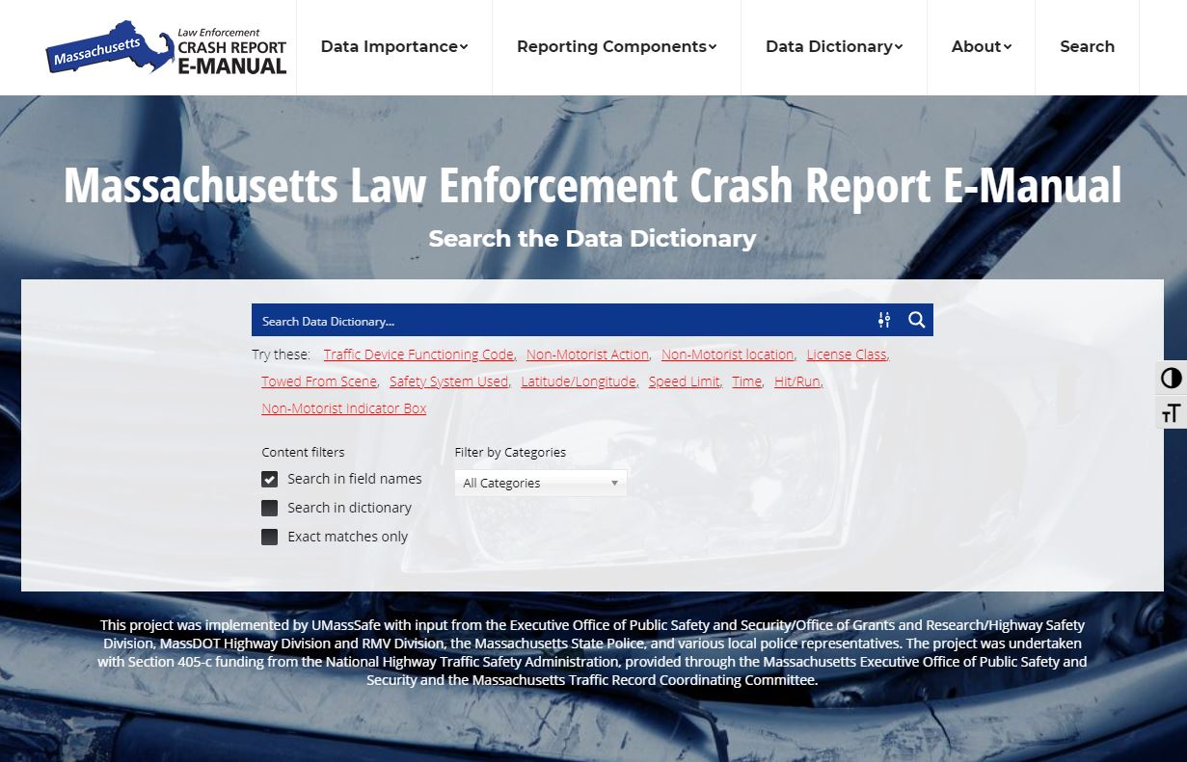
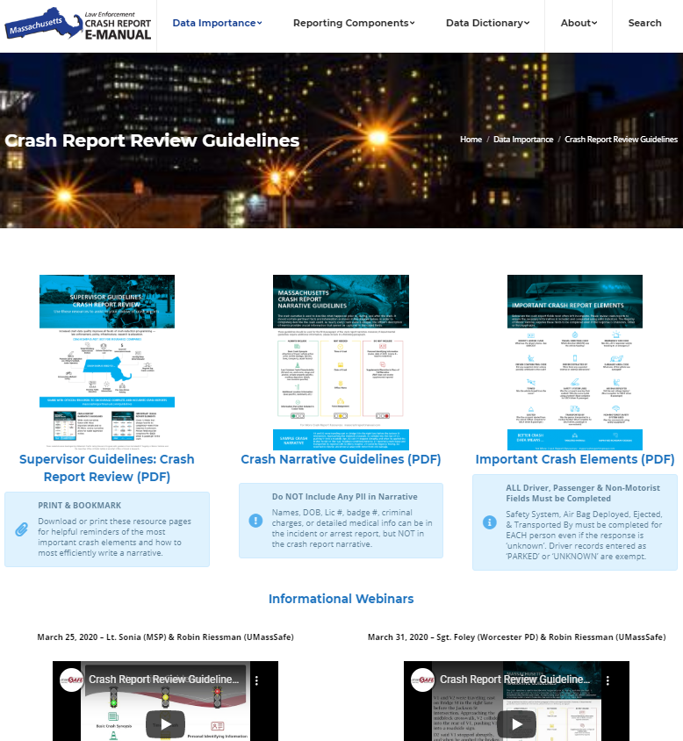
Phase One
Notes:
Phase One of the project, we created the Crash E Manual. It includes a searchable data dictionary, resources on the importance of crash data, assistance with the location method used in crash reporting and a PDF manual.
Web based along with a pdf of the data dictionary. We were surprised to find the many police departments post the pdf at crash reporting desk tops. Others have a link to the crash e manual on the computer.
We then added a section where users can access results of crash data quality research including the crash data audit and the analysis associated with the Accepted with Warning (often called AWW) project.
In addition we have added content to the Crash E Manual on a recently TRCC funded – Tools for Improving Crash Report Reviews.

Slide 7
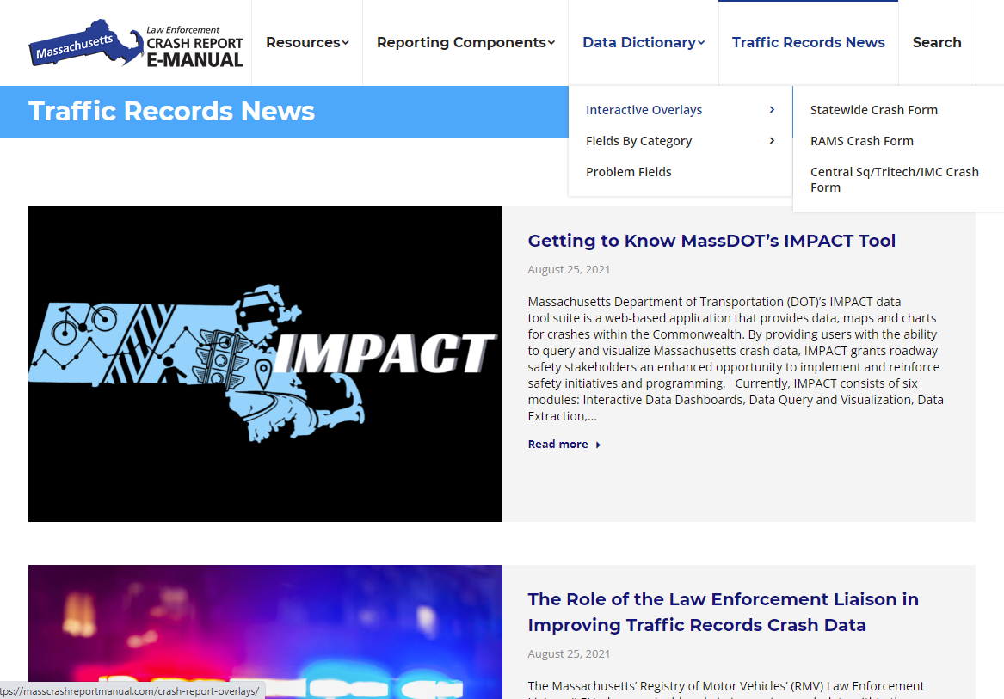
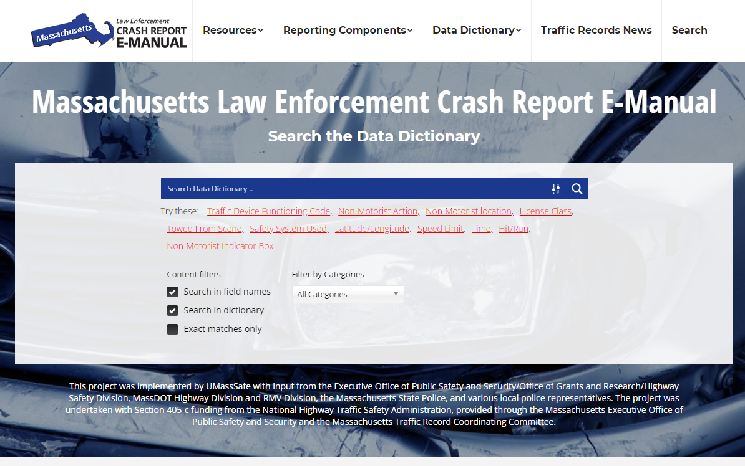
Phase Two
Notes:
Turn it over to Jen Gazzillo, UMassSafe Program Manager. She created the Crash E-Manual and the various upgrades.
Phase Two of the project, we
Expanded Resources – adding a page for RMS vendors to find relevant documents they might need from the RMV
the Crash E Manual. It includes a searchable data dictionary, resources on the importance of crash data, assistance with the location method used in crash reporting and a PDF manual.
We were surprised to find the many police departments post the pdf at crash reporting desk tops. Others have a link to the crash e manual on the computer.
More recently we have added a section where users can access results of crash data quality research including the crash data audit and the analysis associated with the Accepted with Warning (often called AWW) project.
In addition we have recently added content to the Crash E Manual on a recently TRCC funded – Tools for Improving Crash Report Reviews.

Slide 8
Phase Two
Post Resources for RMS Vendors
ANSI D.16 Review and Adaptation
Promotion
Notes:
RMV’s system edit checks and validation rules
As recommended in the MA TR Assessment and the NHTSA TR Prog Ass Advisory, we will review ANSI D.16 (which is XXX) to modify data dictionary and tutorial content to be MMUCC and ANSI D.16 compliant. (to a degree deemed appropriate for law enforcement needs).
For those who aren’t familiar these are 2 separate guidelines that promote uniformity and comparability of motor vehicle traffic crash statistics, to align state data nationally.

Slide 9
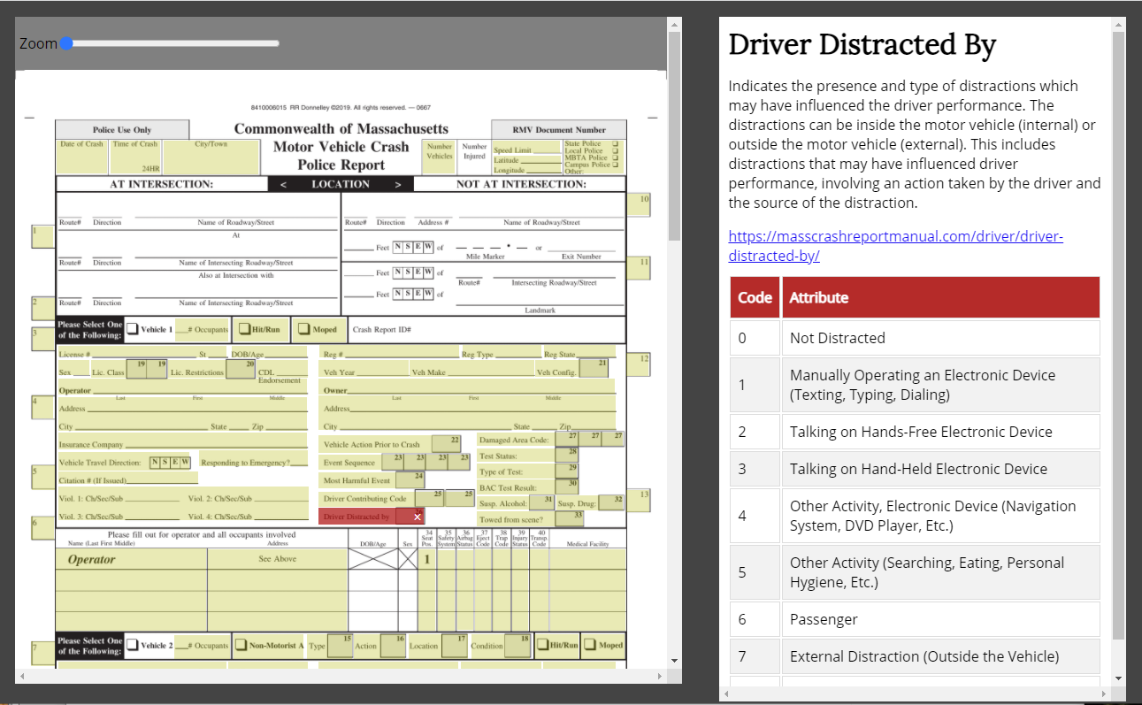
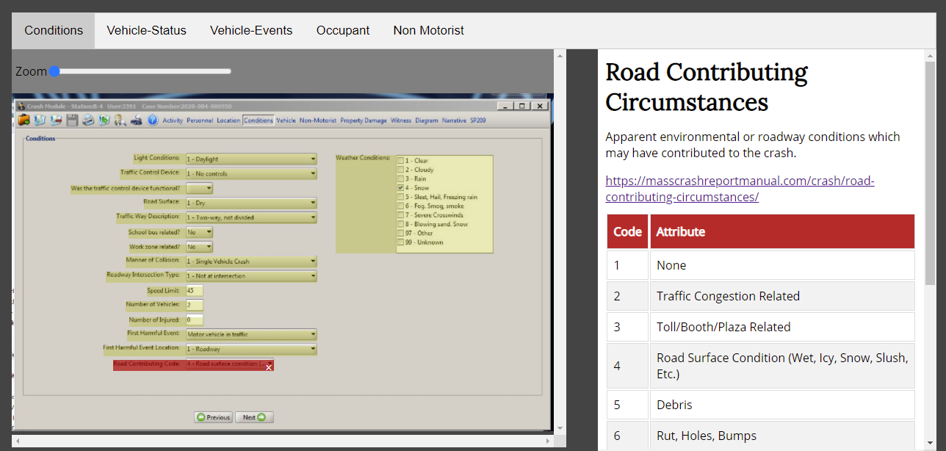
Phase Two
State Form CRA65
RAMS
CentralSq/TriTech/IMC
Notes:
MSP has added to training for academy trainees

Slide 10
Demo
www.MassCrashReportManual.com
Notes:
searchable data dictionary,
resources on the importance of crash data,
assistance with the location method used in crash reporting and a
PDF manual.
We were surprised to find the many police departments post the pdf at crash reporting desk tops. Others have a link to the crash e manual on the computer

Slide 11
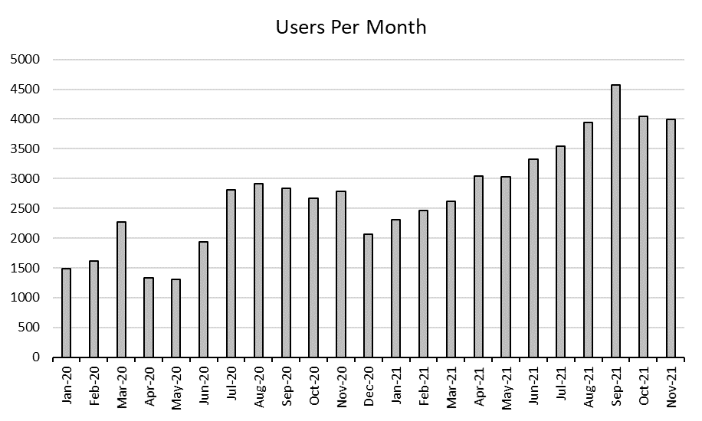
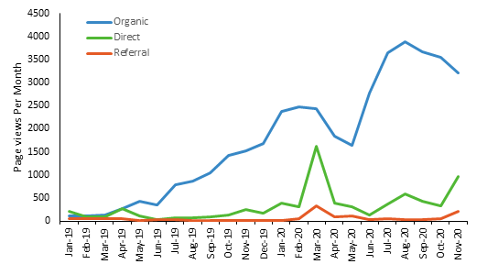
Google Analytics – Usage
Notes:
Usage greatly increased from 1500 users per month in Jan 2020 to 4000 in Nov 21
Examining page views by month it is interesting to see the during March, August & November – simultaneously while organic (google seach) grew continuously

Slide 12
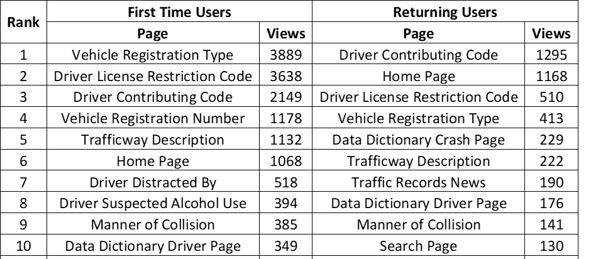
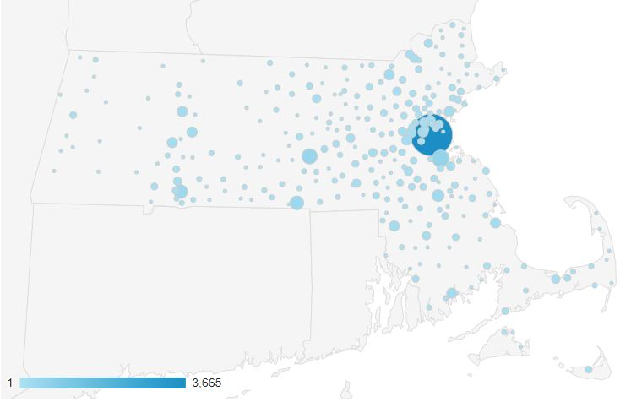
Google Analytics – Location
City | Users | Sessions | Pages / Session | Avg. Session Duration | % Increase '21 vs '20
Nantucket | 65 | 93 | 3.03 | 216.80 | 675%
Hudson | 25 | 32 | 2.75 | 196.25 | 300%
Northborough | 59 | 96 | 2.46 | 124.07 | 231%
Tisbury | 22 | 23 | 1.57 | 43.39 | 229%
Stoughton | 45 | 54 | 2.11 | 86.89 | 157%
Everett | 35 | 41 | 1.68 | 114.24 | 193%
Sunderland | 21 | 205 | 4.23 | 511.90 | 150%
Data Snapshot: 1/1/21 - 12/31/21
Notes:
Medium/small departments % increase

Slide 13
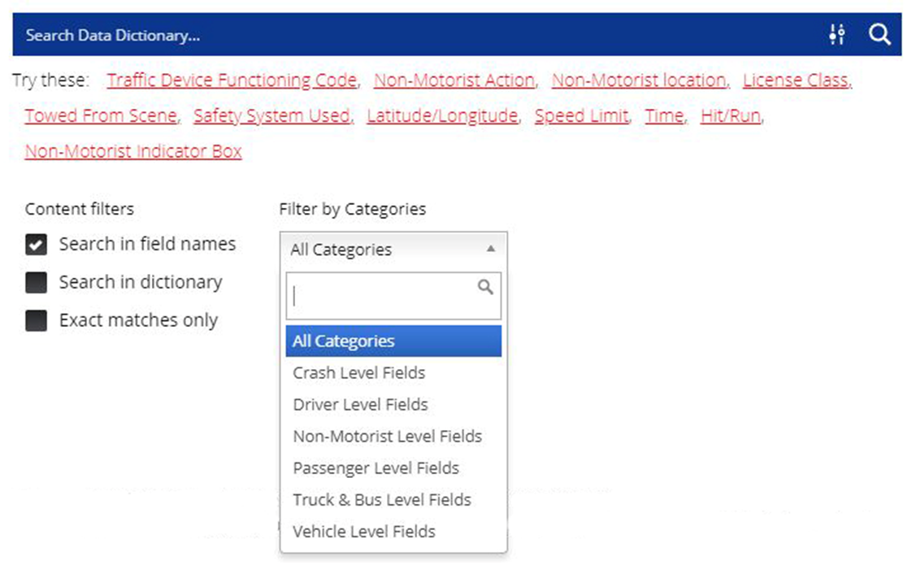

Slide 14
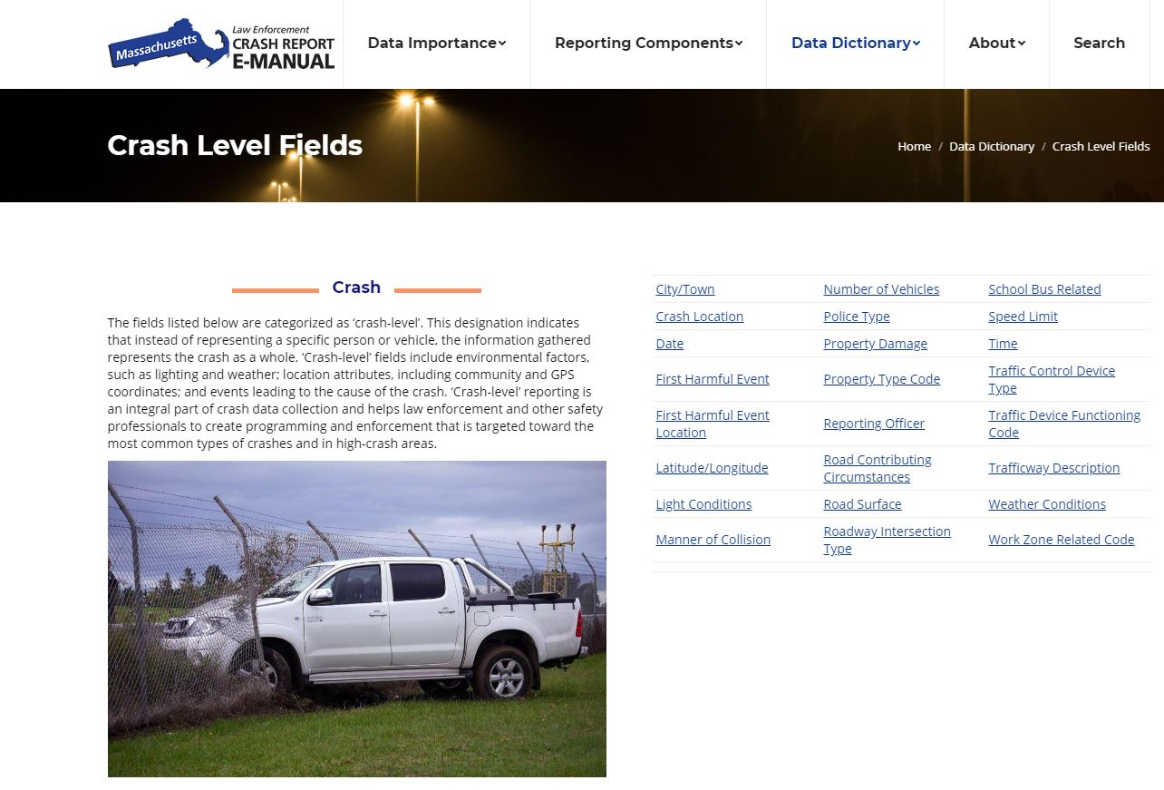

Slide 15
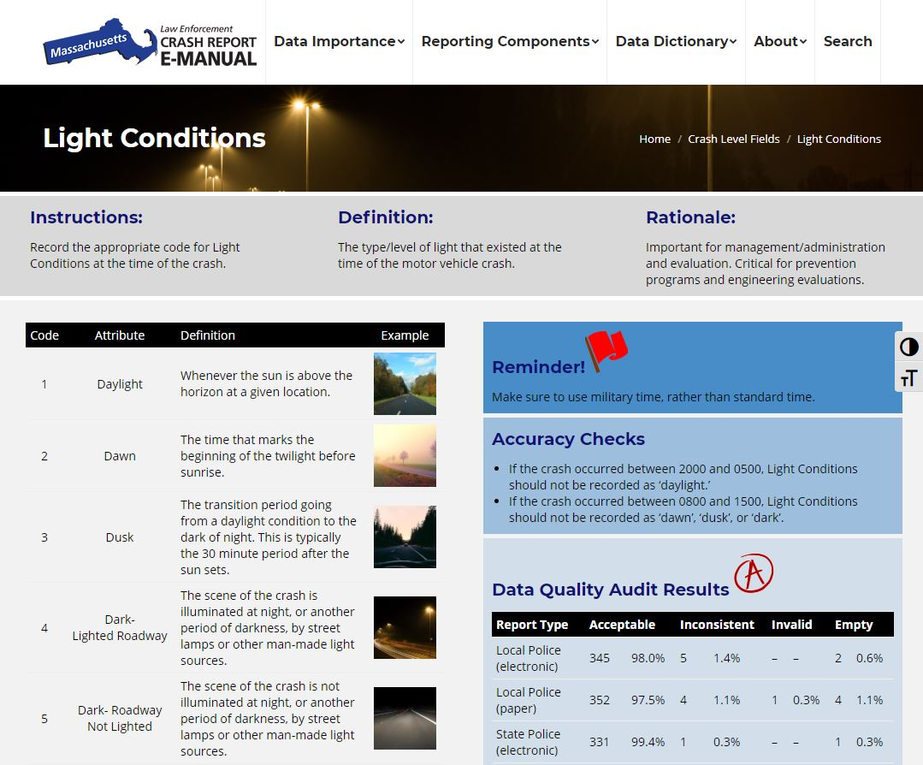

Slide 16
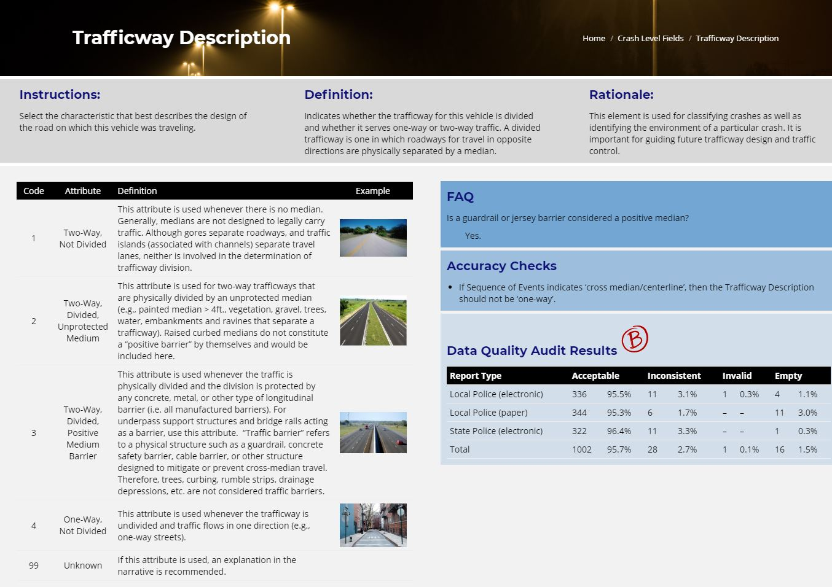

Slide 17
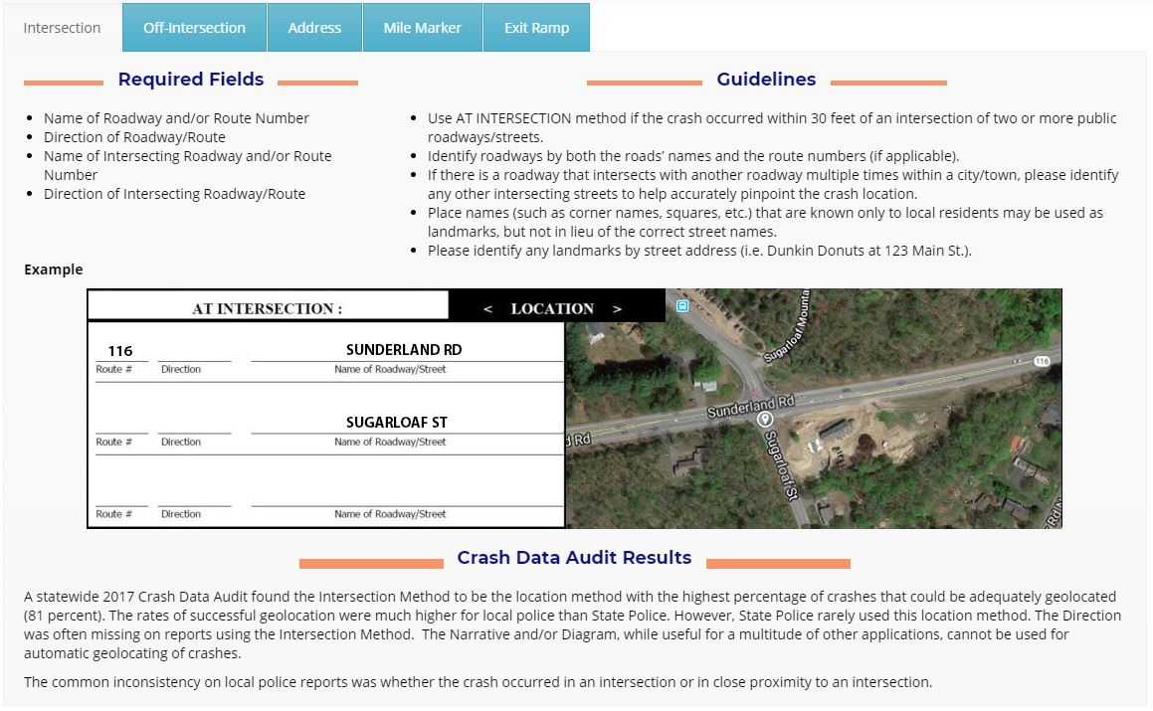

Slide 19
Phase Three
Phase Three
Develop LEA Crash Completeness Rating Reports
Maintenance: Content & Efficacy Updates
Expand Interactive Overlays
Further Promotion & Inclusion in Related Projects

Slide 20
Phase Three: Expand Interactive Overlays
RMS Vendors
State Form CRA65
RAMS
CentralSq/TriTech/IMC
QED
Pamet
Nexgen
Microsystems
MAACS
Larimore
Keystone
Notes:
#1 question on webinar was when their RMS would be available – first step is to find an LEA to work with and get more overlays going!

Slide 21
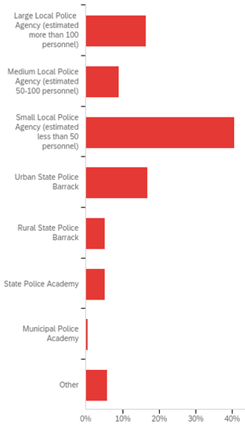
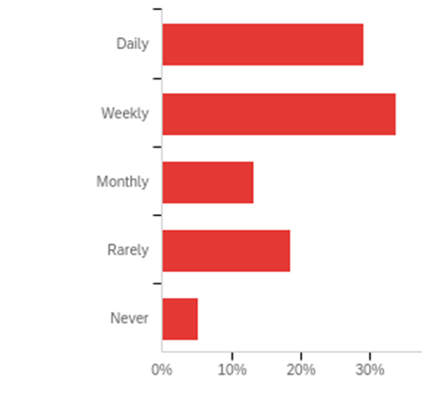
Phase Three: Expand Interactive Overlays
Respondent Crash Reporting Frequency
Results from FYY20 E-Manual User Survey to inform next expansion steps
Respondent LEA Type
How Respondents Heard of E-Manual
Notes:
Results from survey to inform next overlay steps

Slide 22
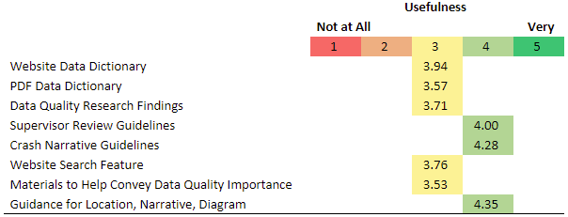
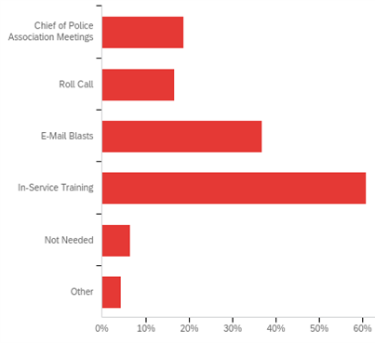
Phase Three: Expand Interactive Overlays
Results from FYY20 E-Manual User Survey to inform next expansion steps
Notes:
Results from survey to inform next overlay steps

Slide 23
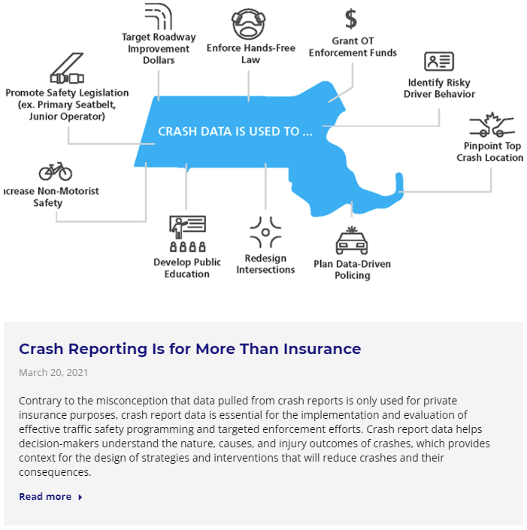
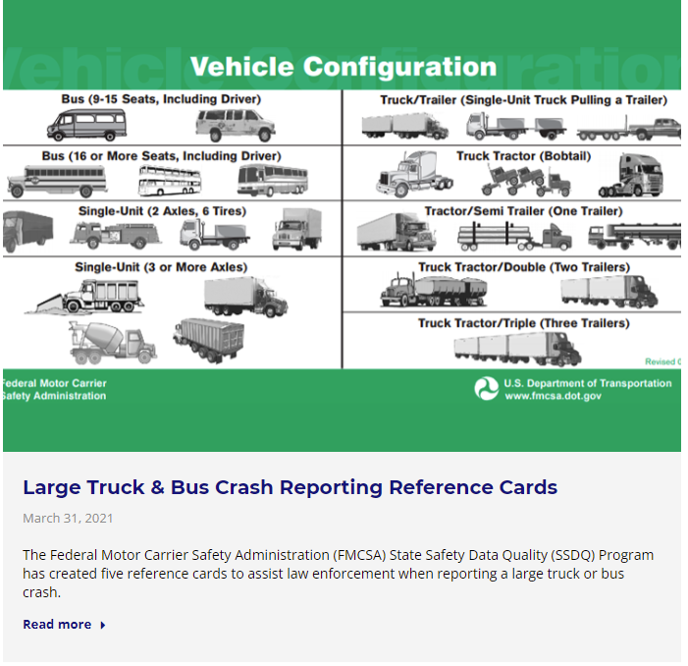
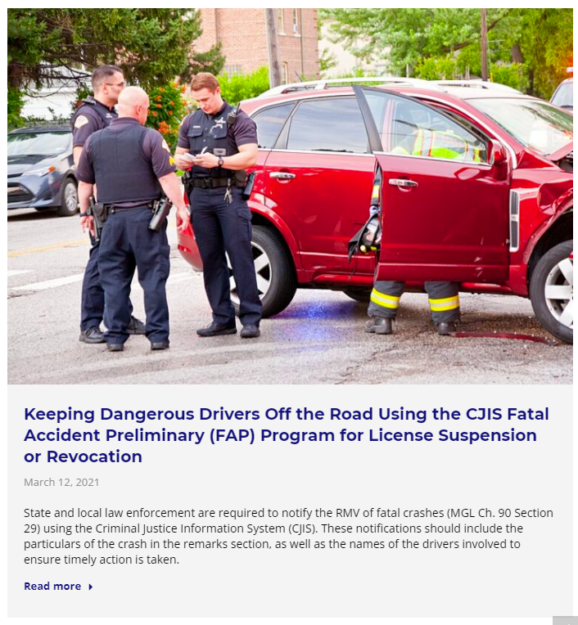
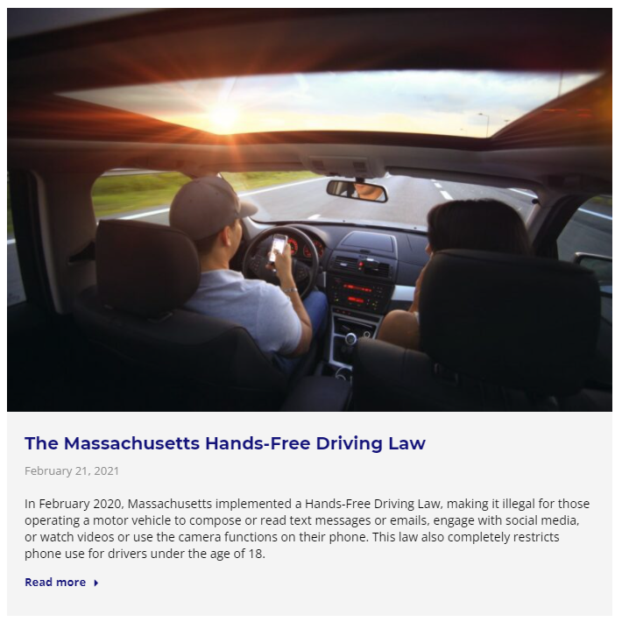
Phase Three: Continue Traffic Records News
Notes:
Traffic Records News page
TRCC and all TR stakeholders can provide items to share
UMassSafe post other traffic records topics and projects of relevance

Slide 24
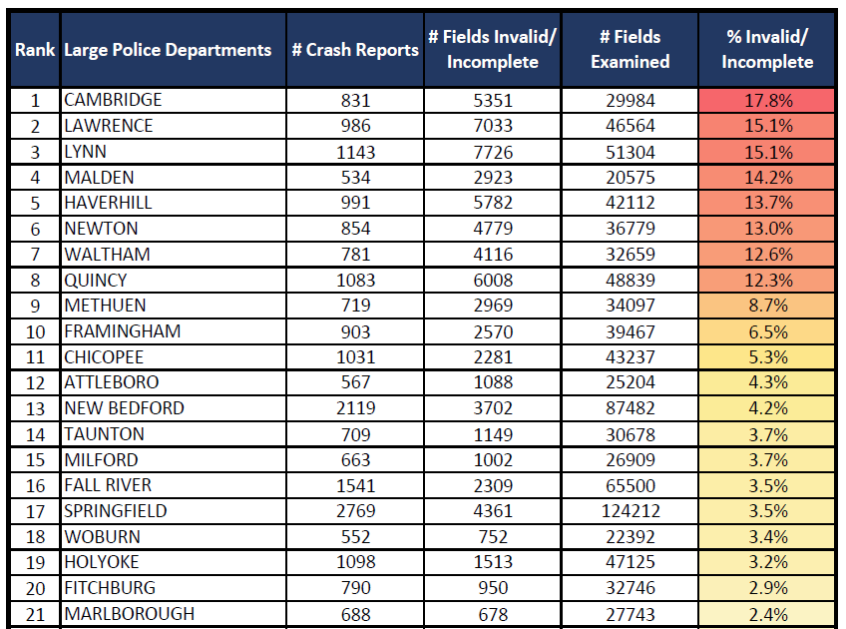
Phase Three: Completeness by LEA Ratings/Rankings
Sample output from FYY19 Accepted With Warning Data Quality Initiative
Notes:
Finally we want to expand the live information relative to data quality on the Crash E-Manual
- increases in users
- provide statistics and relative info to LEA supervisors
- ultimately improve DQ

Slide 25
Project Benchmark & Performance Measures
This project will improve the completeness of Massachusetts crash data by decreasing the rate in which occupant coded fields (protective system, sex, transported by, injury severity, ejected) are incomplete in police crash reports queried within Impact MassDOT data tool by 20% (2.23 relative percentage points) from 11.15% (62369/621595) in January-June 2021 to 8.92% in October-December 2022.
Benchmark Incomplete Rate
Goal Incomplete Rate
11.15%
8.92%

Slide 26
Comments or Questions?
www.MassCrashReportManual.com
Contact Information
Jenn Gazzillo - gazzillo@ecs.umass.edu
Robin Riessman - riessman@ecs.umass.edu
University of Massachusetts
www.umasssafe.org
(413) 577 1035
Phase I & II of this project was implemented by UMassSafe with input from the Executive Office of Public Safety and Security/Office of Grants and Research, MassDOT Highway Division and RMV Division, the Massachusetts State Police, and various local police representatives. The project was undertaken with Section 405-c funding from the National Highway Traffic Safety Administration, provided through the Massachusetts Executive Office of Public Safety and Security Office of Grants & Research and the Massachusetts Traffic Record Coordinating Committee.

