Slide 1
Underutilized Properties Program (UPP) Guidance Webinar
Community One Stop for Growth

Slide 2
Webinar Road Map
What is the Community One Stop for Growth?
Where does this program fit in the One Stop?
Important program parameters.
How to be competitive.
Examples of successful applications.
Completing the application.
Key dates and information.

Slide 3
What is the Community One Stop for Growth?
The Community One Stop for Growth is the main driver of economic development in the Commonwealth.
The One Stop is a single application portal and collaborative review process designed to streamline the experience for the applicant and better coordinate economic development programs and staff on engagement and grant making.

Slide 4
What is the Community One Stop for Growth?
Executive Office of Economic Development | MassDevelopment Finance Agency | Executive Office of Housing and Livable Communities
Mass Works Infrastructure Program Rural & Small Town Development Fund Urban Agenda Grant Program Massachusetts Downtown Initiative | Underutilized Properties Program Site Readiness Program Collaborative Workspaces Program Brownfields Redevelopment Fund Real Estate Services Technical Assistance | HousingWorks Infrastructure Program Housing Choice Grant Program Community Planning Grants Program

Slide 5
Underutilized Properties Program (UPP) Overview
MassDevelopment
MassDevelopment is the state’s development finance agency and land bank, working with businesses, nonprofits, banks, and municipalities to stimulate economic growth across the Commonwealth.
What We Offer
Finance
Bond Financing
Grants
Loans & Guarantees
Tax Credits
PACE Financing
The Commonwealth’s Land Bank
As a land bank, we help smaller and under-resourced communities address vacant properties; help address larger or more complex properties or projects across the state; and administer and distribute funding.
Real Estate
Development Projects
Technical Assistance
Site Readiness Program

Slide 6
UPP Overview (continued)
Program Staff
Shayvonne Plummer
Real Estate Development Project Manager
Email: splummer@massdevelopment.com
Purpose of the program
Assistance for projects that will improve, rehabilitate or redevelop blighted, abandoned, vacant or underutilized properties to achieve the public purposes of eliminating blight, increasing housing production, supporting economic development projects, and increasing the number of commercial buildings accessible to persons with disabilities.
Who’s eligible?
Municipalities
Municipal agencies or authorities (Redevelopment Authority, Economic Development Industrial Corporation, Economic Development Authorities)
Nonprofit and for-profit entities

Slide 7
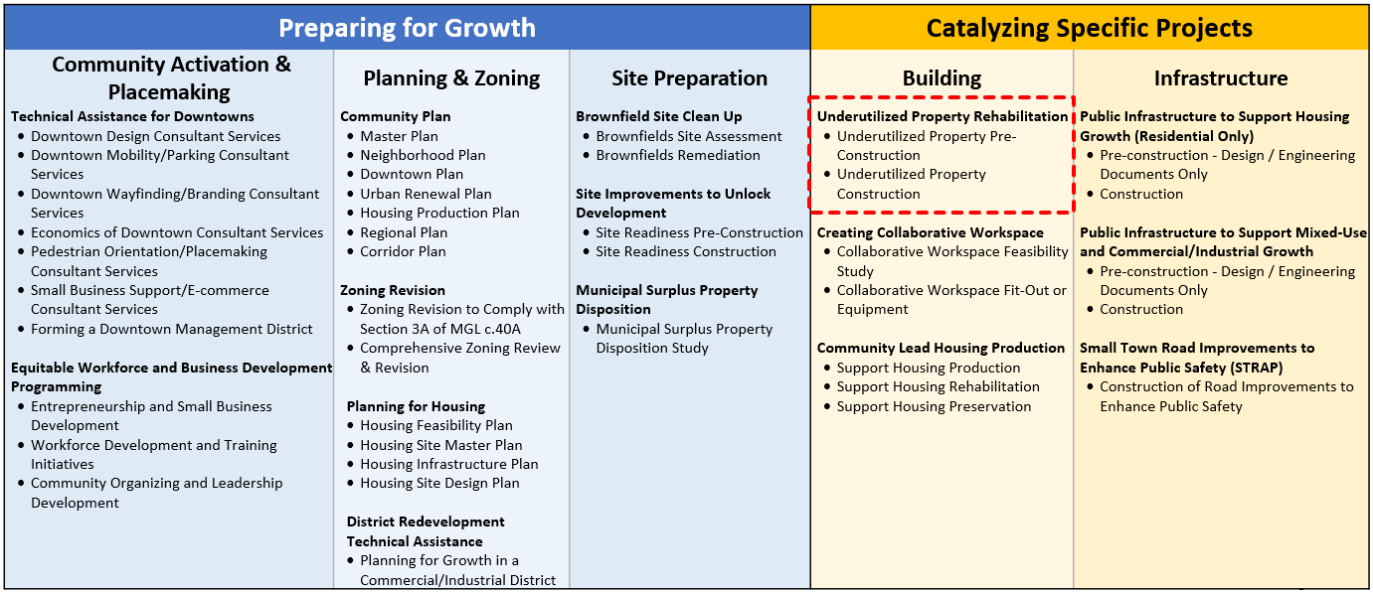
Where Does UPP Fit in the One Stop?

Slide 8
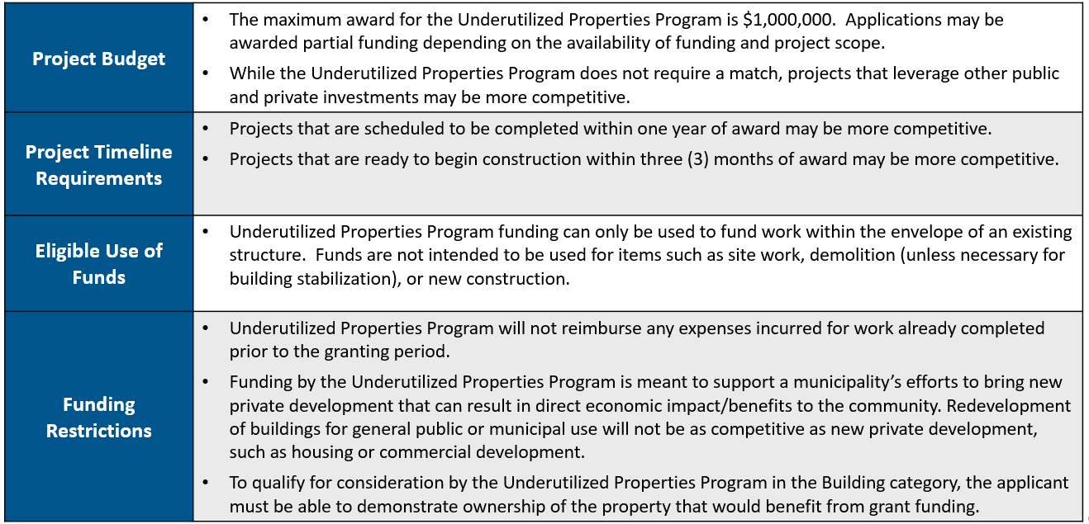
Project Parameters

Slide 9
How to be Competitive
What is the key information that program reviewers take into consideration?
The proposed use of the grant funds must be consistent with the categories of eligible uses.
How the use of grant funds will enhance the public purpose goals in the program’s establishing legislation including, but not limited to, eliminating blight, supporting the economic vitality of downtowns and town centers, facilitating the production of workforce and low-income housing and increasing the number of commercial buildings accessible to persons with disabilities.
In addition to enhancing the public purposes set forth in the statute, how the applicant demonstrates the economic benefits of the funded improvements in terms of jobs/housing units enabled by the increased occupancy as well as spill-over benefits for the surrounding community.
Project timelines that can be completed within the fiscal year are preferred.
Except for requests for design funding, applicants must demonstrate that the proposed improvements have been designed and permitted such that work can start within two months of a grant award. Successful applicants will be able to demonstrate their experience (or the experience of their design and construction team) with similar projects.
How applicants demonstrate the financial need for the support.

Slide 10
How to be Competitive (continued)
Are there any particularly important questions?
The following sections and questions are important and should not be left blank:
Project Overview Questions
Grant Funding Request Chart
Project Outcomes Questions
Site Information Questions
What attachments should applicants be prepared to include in their applications?
All applications must include a letter of support from the municipality clearly articulating the proposed funding’s public purpose/ benefit.
For-profit entities will need to make clear the public purposes advanced by their proposed funding request.

Slide 11
Successful Application Example #1
Applicant: | Adams Theater, Adams
Project Description: | In May 2021, developer Yina Moore purchased the 11,056 square foot Adams Theater that included an unused auditorium and two vacant street-front spaces. UPP funds were used for the auditorium electric upgrade, HVAC, new roof, and an accessible new floor.
What Made the Project Successful: | The Adams Theater is a multifunctional performance venue that has accelerated downtown economic development. The applicant was able to clearly demonstrate the financial need for support as well as the use of grant funds to enhance public purpose goals including eliminating blight, supporting the economic vitality of downtown Adams, and increasing commercial building accessibility to persons with disabilities.

Slide 12
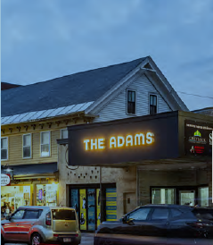
Adams Theater

Slide 13
Successful Application Example #2
Applicant: | Franklin Food Pantry
Project Description: | The nonprofit applicant received funds to convert a former auto repair shop into a community food pantry to address social and health disparities. The new location will allow the pantry to operate for more hours and increase access to healthy food. It also includes office space to allow for confidential client support. The UPP funds were used to renovate vacant garage into expanded food pantry to address social and health disparities, expand services to meet need.
What Made the Project Successful: | The Franklin Food Pantry is a strong organization with an important mission. The applicant was able to demonstrate the financial need for the support and was able to demonstrate their experience (or the experience of their design and construction team) with similar projects.

Slide 14
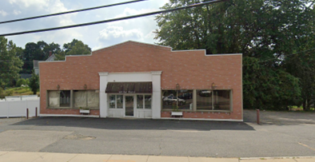
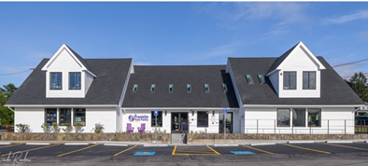
Franklin Food Pantry (before and after)

Slide 15
Successful Application Example #3
Applicant: | 8 Station St LLC
Project Description: | Total interior demolition of a vacant bank and attached offices. 16 new residential units with 4 meeting affordability guidelines (they will be forever deed restricted as affordable). The funding was used for electrical, plumbing, interior unit finishes to include window coverings, HVAC, and roof replacement.
What Made the Project Successful: | The applicant demonstrated how the use of grant funds will enhance the public purpose goals in the program’s establishing legislation including, but not limited to, eliminating blight, supporting the economic vitality of downtowns, and facilitating the production low-income housing. The applicant demonstrated the project could be completed within the fiscal year. The applicant was able to demonstrate their experience (or the experience of their design and construction team) with similar projects.

Slide 16
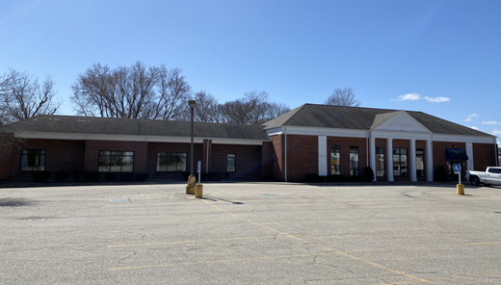
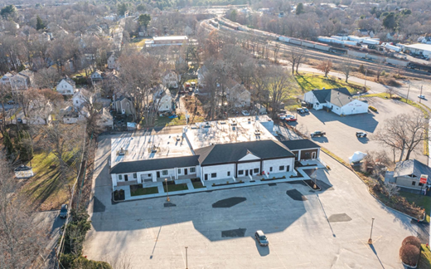
8 Station Street LLC (before and after)

Slide 17
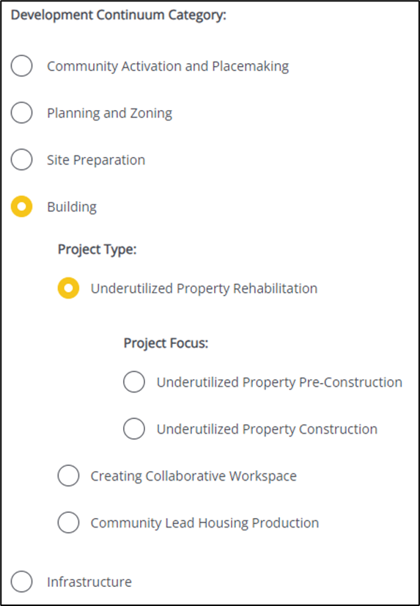
Completing the Full Application
Key Question: In Section 2 of the Full Application, applicants are asked to indicate the Project Category. To be reviewed by UPP, applicants should make the following selections in question 2.4:
Visit www.mass.gov/onestop to view: One Stop Webinar 2: Application Guidance
Development Continuum: | Building
Project Type: | Underutilized Property Rehabilitation
Project Focus: | Select the most appropriate Project Focus option for your application

Slide 18
FY25 Round Timeline
Jan.
Full Application and Expression of Interest Open (January) – The Full Application is the official form for submitting all funding requests. Applicants may now begin to work on applications in the IGX system, however applications will only be accepted during the submission period.
One Stop Guidance Phase (January – May) – A series of webinars will be hosted be both the One Stop Team and staff from each program within the One Stop. In addition, office hours will be hosted to answer applicant questions. Visit www.mass.gov/onestop for the full schedule of webinars and office hours.
Full Application Submission Period (May-June) – Applicants may submit their Full Application(s) beginning May 6, 2024. All applications must be submitted by the Full Application deadline of 11:59 p.m. on Wednesday, June 5.
Review and Evaluation (July – August) – All complete and eligible Full Applications submitted by the deadline will be reviewed and evaluated by the corresponding program managers at each state agency. The One Stop team will also conduct joint application reviews across agencies. Based on the program’s criteria, each program will prepare its list of applications recommended for funding, to be further reviewed and approved by agency and Secretariat leadership.
Notification of Grant Decisions (September) – Once final recommendation have been approved, applicants will be notified of grant decisions in writing, and announcement events will be scheduled.
Sept.

Slide 19
Opportunities for Guidance
Visit www.mass.gov/onestop for more information on:
Expression of Interest
Complete an Expression of Interest to see if your project(s) is eligible for funding through the One Stop and get tips for preparing your application.
One Stop and Program Webinars
Recordings of all One Stop webinars are now available on the One Stop website.
Office Hours
One Stop General Guidance Office Hours – One Stop staff will hold office hours to discuss general One Stop process and technology questions.
Program Office Hours – Staff from each program will hold an office hour to answer applicant questions related to the program.
Office hours: UPP office hours will be held on Thursday, March 7 at 10:00 a.m.

