Slide 1
Compiled and Presented by the Injury Prevention and Control and Injury Surveillance Programs
Massachusetts Department of Public Health
Unintentional Fall Injuries among Massachusetts Older Adults (65+ Years): Surveillance Findings,
DPH Prevention Strategies,
and a Call to Action
This presentation was developed for and shared with the Massachusetts Prevent Injuries Now! Network (MassPINN) and the Massachusetts Falls Coalition.

Slide 2

Introduction: Fall Injuries in Older Adults (65+ Years)
Huge and preventable public health problem
  And the older adult population is increasing!
A leading cause of loss of independence
Understanding fall risks and protective factors and deploying prevention methods is essential to reducing these events
We need “all hands-on deck” to address this issue (e.g., primary and specialty clinicians, pharmacists, architects, urban planners, vision specialists, exercise specialists, insurers)

Slide 3
Presentation: Fall Injuries in Older Adults (65+ Years)
This presentation will provide:
  The latest Massachusetts (MA) data on unintentional fall injuries
  An overview of current fall prevention resources and DPH fall prevention activities
  Time for discussion about the action steps that can be taken to improve our current work and the quality of life for older adults in MA and the challenges that are faced

Slide 4
Data Sources
Death data from the Massachusetts Registry of Vital Records and Statistics, DPH
Hospital Stay data from the MA Inpatient Hospital Discharge and MA Outpatient Observation Stay Databases (summed total), Center for Health Information and Analysis. Note: annual data presented represents the federal fiscal year
Emergency Department data from the MA Emergency Department Discharge Database, Center for Health Information and Analysis. Note: annual data presented represents the federal fiscal year
Community Survey Data from the Massachusetts Behavioral Risk Factor Surveillance System, MA Department of Public Health
U.S. Death Data from Centers for Disease Control and Prevention, National Center for Injury Prevention and Control. Web-based Injury Statistics Query and Reporting System (WISQARS)
Population Data are based on the U.S. Census annual population estimates, as queried via the UMass Donahue Institute and the Missouri Census Data Center (2021-2022).

Slide 5
Leading Types of Injury Deaths, Hospital Stays, and Emergency Department (ED) Visits, MA Residents, All Ages, 2022
RANK | Injury Deaths* | Nonfatal Injury-related Hospital Stays** | Nonfatal Injury-related Emergency Department (ED) Visits**
1 | Unintentional Drug Poisonings (n=2,472, 43%) | Unintentional Falls (n=26,205, 58%) | Unintentional Falls (n=160,014, 33%)
2 | Unintentional Falls (n=1,260, 22%) | Unintentional Motor Vehicle Traffic (n=3,508, 8%) | Unintentional Strikes By or Against an Object (n=53,202, 14%)
3 | Suicides (n=624, 11%) | Unintentional Drug Poisonings (n=3,058 7%) | Unintentional Motor Vehicle Traffic (n=51,239, 11%)
4 | Unintentional Motor Vehicle Traffic (n=467, 8%) | Self-inflicted Injuries (n=2,562, 6%) | Unintentional Cut/Pierce (n= 34,669, 7%)
5 | Unintentional Suffocation (n=200, 4%) | Unintentional Strikes By or Against an Object (n=909, 2%) | Assaults (n=16,555, 3%)
Eighty-nine percent of all unintentional fall deaths, 75% of all fall hospital stays, and 38% of all fall ED visits are among older adults (65+ years)
Data sources: Registry of Vital Records and Statistics, MA Department of Public Health. * Please be advised that 2022 data are preliminary and subject to change. Raw preliminary data may be incomplete or inaccurate and have not been fully verified, and revisions are likely to occur following the production of these data. The Department of Public Health strongly cautions users regarding the accuracy of statistical analyses based on preliminary data and particularly with regard to small numbers of events; ** Federal Fiscal year (Oct 1, 2021 – Sep 30, 2022) MA Inpatient Hospital Discharge and Observation Stays (Hospital Stays) and MA Emergency Department Discharges Databases, Center for Health Information and Analysis.

Slide 6
Magnitude of the Problem: Unintentional Fall Injury
In 2022, fall injuries among MA residents 65+ years resulted in:
In 2020, survey*** data found:
1 in 4 (25.6%) community-dwelling older adults in MA reported having had a fall in the previous 12 months
10% reported having had a fall injury
The number of fall injuries treated outside of MA acute care hospitals (layer of the pyramid below ED visits) is unknown
1,118
Deaths*
19,735
Hospital Stays**
60,290
Emergency Department Visits**
Data sources: Registry of Vital Records and Statistics, MA Department of Public Health. * Please be advised that 2022 data are preliminary and subject to change. Raw preliminary data may be incomplete or inaccurate and have not been fully verified, and revisions are likely to occur following the production of these data. The Department of Public Health strongly cautions users regarding the accuracy of statistical analyses based on preliminary data and particularly with regard to small numbers of events; ** Federal Fiscal year (Oct 1, 2021 – Sep 30, 2022) MA Inpatient Hospital Discharge and Observation Stays (Hospital Stays) and MA Emergency Department Discharges Databases; ***Massachusetts Behavioral Risk Factor Surveillance System, MA Department of Public Health

Slide 7
Trends: Unintentional Fall Death Rates, MA Residents 65+ Years, 2010-2022 (with U.S. Comparison)
From 2014-2022, the average annual percent change in the MA crude rate was 6.4% (p<.05)*
From 2010 to 2022, MA rate increases were experienced across demographic groups (age, race & ethnicity, sex, and rural & non-rural)
The reasons for the increase are not well understood but are likely multifactorial
MA age-adjusted rate increased 119% from 2010 to 2022
Note that the Y axis does not begin at zero
Data sources: CDC WISQARS (Web-based Injury Statistics Query and Reporting System), Accessed 7/11/2024 https://wisqars.cdc.gov/create-reports/ ; *Joinpoint analysis

Slide 8
Trends: Rates of Nonfatal Hospital Stays and ED Visits Associated with Fall Injuries, MA Residents Ages 65+ Years, 2017-2022*
Age-adjusted rates of Hospital Stays and ED visits for nonfatal fall injuries declined during the pandemic and during this period did not have the same upward trend seen for fatal fall rates
Note that the Y axes do not begin at zero
Data sources: *Data for years presented represents federal fiscal years (October 1-September 30), MA Inpatient Hospital Discharge and Observation Stays (Hospital Stays) and MA Emergency Department Discharges Databases, Center for Health Information and Analysis.

Slide 9
Select Demographics: Age, Sex, Rurality of Residence, MA Residents Ages 65+ Years, 2022*
AGE: Fall death and nonfatal injury rates (per 100,000 population) increase exponentially with increasing age subgroup
  Individuals ages 85+ years experienced 30.8, 9.0, and 4.2 times the rate of deaths, hospital stays and ED visits, respectively, of individuals in the 65-69 year age group
SEX: Males experience higher rates of death, while females experience higher rates of nonfatal hospital stays and ED visits
  Death rates among males were 1.1 times that of females
  Hospital stay and ED visit rates among females were 1.7 and 1.4 times that of males, respectively
RURALITY: Individuals not residing in a rural town had slightly higher rates of fall-related deaths and hospital stays (1.5 and 1.3 times, respectively), compared with individuals who did reside in a rural town
  However, individuals residing in a rural town had slightly higher rates of ED visits for nonfatal fall injuries (1.1. times), compared with individuals that did not
Data Sources: : Registry of Vital Records and Statistics, MA Department of Public Health. MA Inpatient Hospital Discharge and Observation Stays (Hospital Stays) and MA Emergency Department Discharges Databases; * Please be advised that 2022 data are preliminary and subject to change. Raw preliminary data may be incomplete or inaccurate and have not been fully verified, and revisions are likely to occur following the production of these data. The Department of Public Health strongly cautions users regarding the accuracy of statistical analyses based on preliminary data and particularly with regard to small numbers of events; Federal Fiscal year (Oct 1, 2021 – Sep 30, 2022)

Slide 10
Select Demographics: Average Annual Fall Death Rates by Race and Ethnicity, MA Residents Ages 65+ Years, 2018-2022
Rates presented are crude rates. Excludes persons listed of “another” and “unknown” race (n=22);
nH/ nL: Non-Hispanic/Non-Latinx
*This rate is based on a count < 20 and may be unstable.
** PI (Pacific Islander) race is combined with the Asian race in the death database.
Data sources: Registry of Vital Records and Statistics, MA Department of Public Health. Please be advised that 2022 data are preliminary and subject to change. Raw preliminary data may be incomplete or inaccurate and have not been fully verified, and revisions are likely to occur following the production of these data. The Department of Public Health strongly cautions users regarding the accuracy of statistical analyses based on preliminary data and particularly with regard to small numbers of events.

Slide 11
Select Demographics: Average Annual Rates of Hospital Stays and ED Visits for Nonfatal Fall Injury by Race/Ethnicity, MA Residents Ages 65+ Years, 2018-2022*
Rates presented are crude rates. Graphics exclude persons listed of “other” and “unknown” race (n=6,010 ED Visits and n=2,136 Hospital Stays)
Data Sources: MA Inpatient Hospital Discharge and Outpatient Observation Stay Databases (“Hospital Stays”), Center for Health Information and Analysis; MA Emergency Department Discharge Database, Center for Health Information and Analysis. *Data for years presented represents federal fiscal years (October 1-September 30),

Slide 12
Select Types of Injuries: Fall-related Traumatic Brain Injuries and Hip Fractures, MA Residents 65+ Years, 2022*
Traumatic Brain Injuries (TBI) and hip fractures are injuries that may result in lengthy recovery and/or permanent disability.
28% of fall-related hospital stays and 17% of deaths were associated with a hip fracture.
26% of fall-related ED visits, 18% of hospital stays, and 42% of deaths were associated with a TBI.
Data Sources: : Registry of Vital Records and Statistics, MA Department of Public Health. MA Inpatient Hospital Discharge and Observation Stays (Hospital Stays) and MA Emergency Department Discharges Databases; * Please be advised that 2022 data are preliminary and subject to change. Raw preliminary data may be incomplete or inaccurate and have not been fully verified, and revisions are likely to occur following the production of these data. The Department of Public Health strongly cautions users regarding the accuracy of statistical analyses based on preliminary data and particularly with regard to small numbers of events; Federal Fiscal year (Oct 1, 2021 – Sep 30, 2022)

Slide 13
Circumstances of Falls: Fatal and Nonfatal Fall Injuries, MA Residents Ages 65+ Years, 2022*
Surveillance data on the circumstances leading to fall injuries is largely limited to International Classification of Disease codes (ICD-10 and ICD-10-CM).
In 2022, many fall deaths (84%) and a sizable percent of hospital stays and emergency department visits for nonfatal fall injuries (25% and 19%, respectively), receive a code for "unspecified fall"
  "Fall on same level from slipping, tripping, stumbling" accounted for 28% and 41%, respectively, of nonfatal fall hospital stays and ED visits but <1% of fatal falls
  "Fall on and from stairs and steps" accounted for 4% of fall deaths, 9% of nonfatal fall hospital stays, and 8% of nonfatal fall ED visits
  Frequencies of events in these (and other) categories is likely an undercount due to the large number of events receiving a code for "unspecified fall"
Data Sources: : Registry of Vital Records and Statistics, MA Department of Public Health. MA Inpatient Hospital Discharge and Observation Stays (Hospital Stays) and MA Emergency Department Discharges Databases; * Please be advised that 2022 data are preliminary and subject to change. Raw preliminary data may be incomplete or inaccurate and have not been fully verified, and revisions are likely to occur following the production of these data. The Department of Public Health strongly cautions users regarding the accuracy of statistical analyses based on preliminary data and particularly with regard to small numbers of events; Federal Fiscal year (Oct 1, 2021 – Sep 30, 2022)

Slide 14
Location of Injury, Fatal and Nonfatal Fall Injuries, MA Residents Ages 65+ Years, 2022*
Fall Injuries Among MA Residents Ages 65+ | Emergency Department Visits | Inpatient Hospitalizations¹ | Deaths
Total Fall Injuries among persons aged 65+ | 60,290 | 15,012 | 1,118
Number of fall injuries with location code² | 22,682 | 3,836 | 1,056
Percent of fall injuries with a location code | 37.6% | 25.6% | 94.5%
Most frequent fall locations
Home³ | 46.9% | 69.9% | 56.4%
Kitchen | 14.6% | 11.0% | not available
Dining | 0.7% | 0.2% | not available
Bathroom | 22.5% | 28.2% | not available
Bedroom | 17.3% | 16.6% | not available
Outside home⁴ | 10.1% | 11.6% | not available
Other location in home | 34.7% | 32.4% | not available
Nursing Home | 10.9% | 8.3% | 24.9%
¹ Presents only hospitalized patients, excludes those in observation bed stays. ² Includes cases that have detailed Y92 codes assigned. ³ Includes single family homes, condos, apartments, etc. ⁴ Includes garage, driveway, yard, garden, swimming pool.
Data Sources: : Registry of Vital Records and Statistics, MA Department of Public Health. MA Inpatient Hospital Discharge and Observation Stays (Hospital Stays) and MA Emergency Department Discharges Databases; * Please be advised that 2022 data are preliminary and subject to change. Raw preliminary data may be incomplete or inaccurate and have not been fully verified, and revisions are likely to occur following the production of these data. The Department of Public Health strongly cautions users regarding the accuracy of statistical analyses based on preliminary data and particularly with regard to small numbers of events; Federal Fiscal year (Oct 1, 2021 – Sep 30, 2022)

Slide 15
Inpatient Discharge Dispositions and Total Acute Care Hospital Charges, Fall Injuries Among MA Residents 65+ Years, 2022
Among older adults with a fall-related hospitalization:
  67% of those who sustained a hip fracture were discharged to a Skilled Nursing Facility (vs. 46% of the stays not involving a hip fracture)
  in 5.2% of the cases involving a hip fracture, the source of the admission was a Skilled Nursing Facility
Total Hospital Charges (hospital stays and ED visits) associated with fall injuries were $1.1 Billion in FFY2022 (includes all discharge dispositions).
Data Sources: MA Inpatient Hospital Discharge and Observation Stays (Hospital Stays) and MA Emergency Department Discharges Databases; Federal Fiscal year (Oct 1, 2021 – Sep 30, 2022)

Slide 16
Risk and Protective Factors for Falls: National Survey Data, 2018
Reported falls was higher among older adults (65+ years) who also reported:
  Poor health 48.1% (vs. 16.4% reporting excellent health)
  Blind/difficulty seeing 42.1% (vs. 26.2% without difficulty)
  Difficulty concentrating 48.5% (vs. 25.0% without difficulty)
  Difficulty walking/climbing stairs 46.3% (vs. 20.4% without difficulty)
  Difficulty performing errands alone 53.0% (vs. 24.6% without difficulty)
  Difficulty dressing/bathing 58.7% (vs. 25.6% without difficulty)
Reported falls was lower among older adults also reporting:
  Any physical activity in past month 24.9% vs.33.1%
Data Source: MMWR Morb Mortal Wkly Rep. 2020 Jul

Slide 17
Fall Injury Risk Factors: Massachusetts Residents, Ages 65+ Years, 2020
In 2020, MA older adults with certain medical conditions were statistically significantly* more likely to report a fall-related injury in the previous 12 months compared to those without the condition.
Data source: Massachusetts Behavioral Risk Factor Surveillance System, MA Department of Public Health. Notes: *These conditions are statistically significant at the (P<.05 level). However, causality should not be assumed. Poor mental health includes persons who reported experiencing 15+ days of poor mental health in the past month. Disability is defined as having answered "Yes" to one or more of the following questions: deaf or difficulty hearing; blind or have serious difficulty seeing even when wearing glasses; physical, mental, or emotional condition or serious difficulty concentrating, remembering or making decisions; serious difficulty walking or climbing stairs, difficulty dressing or bathing, difficulty doing errands alone such as visiting a doctor’s office or shopping due to physical, mental, or emotional condition.

Slide 18
Summary of the Data Findings
Falls and fall injuries are common events in older adults and result in substantial loss of life and huge health care costs. Many fatal and nonfatal falls occur in the home.
Difficulties with activities of daily living, reported poor health, and select chronic diseases are associated with higher fall injuries
Age-adjusted fall death rates in MA and US have significantly increased in the past decade
  Fatal fall death rates have increased across all subgroups of age, race/ ethnicity, sex, and rurality-level of residence.
  MA nonfatal fall injury rates have not had similar increases
Fall death and nonfatal injury rates differ across demographic groups
  Differences are especially great by age subgroup, with the oldest age group experiencing much higher rates
Hip fractures and traumatic brain injuries are commonly associated with fatal and hospital-treated events

Slide 19
General Fall Prevention
DPH Injury Prevention and Control Program

Slide 20
Fall Injury: Model For Primary and Secondary Prevention
Nonmodifiable human factors (examples):
Age, cognitive impairment (if untreatable), permanent physical disabilities (blindness, neurological, etc.)
Potentially modifiable human factors (examples): strength, balance, bone density, vision, hearing, alcohol/drug intake, medications (impacting alertness, balance, etc.), mental health problems, knowledge
Human Factors
Environmental factors-(structural, cultural), examples:
Lighting, handrails, walking/tub surfaces, bed/toilet height, insurance policies/coverage, availability of strength, balance, bone building classes, professional training, footwear, EMS/Trauma/Rehab System
FALL
Force of Gravity

Slide 21
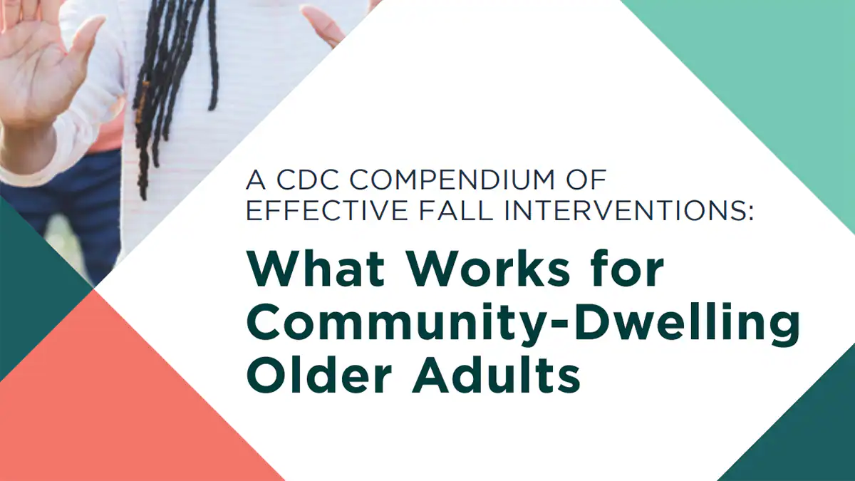
Evidence-Based Resources
Strategies to prevent falls in the home and in the community include:
These include interventions focused on exercise, home modifications, clinical interventions, and multifaceted interventions that addresses multiple risk factors.
  CDC STEADI: An initiative that encourages clinical fall prevention by providing the tools to healthcare providers, older adults, families, and caregivers, on how to reduce the risk of falls.
  CDC Compendium: A collection of effective falls interventions designed to help public health practitioners, service providers, clinicians, and other community members who want to help address older adult falls
(STEADI: https://www.cdc.gov/steadi/index.html;
Compendium: https://www.cdc.gov/falls/interventions/falls-compendium.html)

Slide 22
DPH Fall Prevention Activities
Coalitions: Coordinating coalitions and networks of injury prevention practitioners
Communications and training: Creating and distributing educational materials and trainings to our coalitions and partners.
Policy: Informing laws, policies, and regulations that promote safer behaviors, and implementing state statutes and regulations

Slide 23

Coalitions
DPH coordinates biannual meetings of the Massachusetts Commission on Falls Prevention.
Since 2013, the Commission has issued biennial reports to the state legislature with extensive recommendations for preventing falls in Massachusetts.
The Falls Coalition aims to raise awareness about the serious problem of older adult falls and associated injuries and promote the availability of successful prevention strategies to help reduce falls rates in Massachusetts.
From 2022 to 2023, the Coalition convened 54 professionals from 37 different organizations.

Slide 24
Communication
DPH sends out monthly newsletters to the 157 subscribers on the Falls Prevention Coalition mailing list with the updates on data and research, community and professional events, job opportunities, and funding around falls prevention.
  Occasionally, information is also distributed to the 132 subscribers on the MassPINN coalition mailing list.
DPH hosts several falls prevention pages on its injury prevention websites at:
  mass.gov/orgs/injury-prevention-and-control-program
  mass.gov/injury-surveillance-program

Slide 25
Training
DPH presented older falls prevention-specific training as part of a 2023 training series for service providers to:
  Understand the burden of falls-related injuries nationally and locally in Massachusetts
  Understand the risk and protective factors related to falls
  Identify and raise awareness of different resources, services, activities, and tools available to prevent a fall
Engaged 13 participants from state agencies, community-based service providers, and hospitals.
Covered state- and national-level data and risk and protective factors.
DPH is able to provide falls-specific injury prevention trainings and technical assistance to other organizations.

Slide 26
Policy
2010 Statute created the Massachusetts Commission on Falls Prevention
13-member statutory body charged with investigating older adult falls and recommending best strategies and practices for reducing falls and fall-related injuries, as well as the healthcare costs associated with them.
Commission membership includes representatives from:
  DPH
  MassHealth
  Executive Office of Elder Affairs
  Home Care Alliance of Massachusetts
  Massachusetts Assisted Living Association
  Massachusetts Medical Society
  American Physical Therapy Association of Massachusetts
  Massachusetts Association for Occupational Therapy
  Massachusetts Senior Care Association
  Massachusetts Association of Councils on Aging
  Massachusetts Home Care
  American Association of Retired Persons

Slide 27
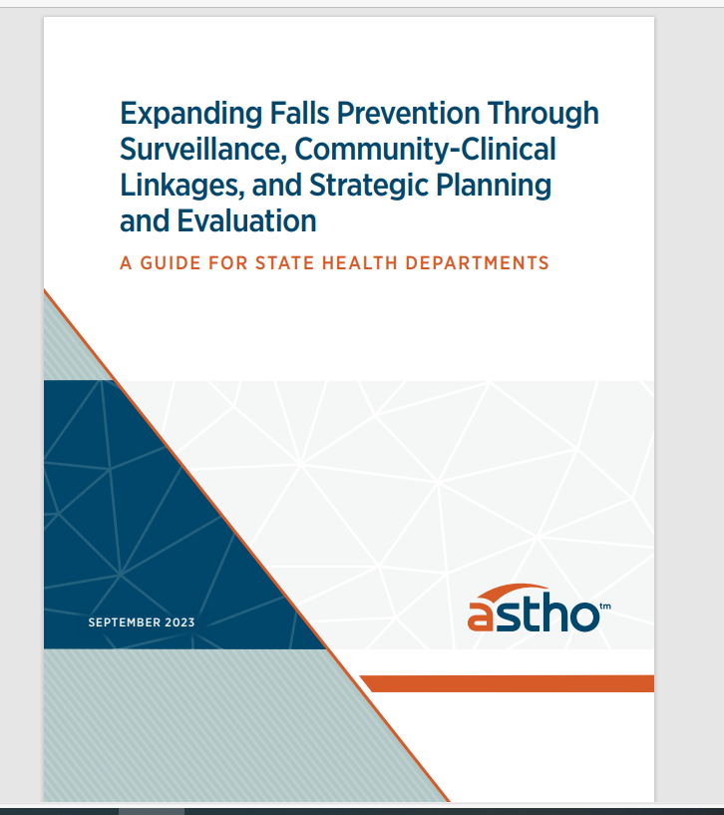
Policy: Falls Commission 2024 Report
A 2023 report from the Association of State and Territorial Health Officials (ASTHO) offers state health departments guidance on improving falls surveillance and prevention activities.
The 2024 Falls Commission report aims at implementing the ASTHO guidance on:
  Understanding the current state of falls surveillance and falls prevention activities
  Identifying opportunities to build community-clinical linkages to prevent falls
  Laying the groundwork for a comprehensive, statewide falls prevention strategy

Slide 28
Challenges and Barriers
There are many challenges to reducing falls and fall-related injuries in older adults:
  The population 65 and over is fast-growing in the U.S.
  Shortage of Primary Care Physicians with often inadequate time to spend with patients to address fall risk.
  Healthcare providers may not be aware of STEADI screening tools and may lack the most up-to-date information on the evidence-based fall prevention programs that exist.
  Costs of interventions to reduce fall risks, such as home modifications and senior housing.

Slide 29
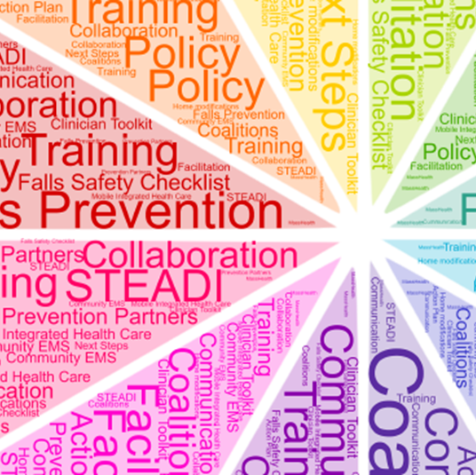
Call to Action
What role can Falls Coalition (members and organizations) play in helping us disseminate the data and resources described in this PPT? Are there professional audiences we can engage? (DPH would also like to develop messaging tailored to specific audiences.)
How can we improve our collaborations to address barriers being faced?
What is working that you would like to share and see replicated and/or potentially included on this PPT?

Slide 30



Connect with DPH
X: @MassDPH
LinkedIn:
Massachusetts Department of Public Health
mass.gov/DPH

