Slide 1
UNIT I
GREETINGS

Slide 2
WHAT PHRASES IN SPANISH
DO YOU ALREADY KNOW?

Slide 3
INITIAL ENCOUNTER

Slide 4
GREETINGS
HELLO!
¡HOLA!
WELCOME!
¡BIENVENIDOS!
GREETINGS!
¡SALUDOS!

Slide 5
GREETINGS
B
U
E
N
A
S
BUENOS
DÍAS
TARDES
BUENAS
NOCHES

Slide 6
FORMAL VS INFORMAL
¿CÓMO ESTÁ?
¿CÓMO ESTÁS?
When we greet an individual.
¿CÓMO ESTÁN?
When we greet a group.

Slide 7
INTERACTION
POTENTIAL RESPONSES
¡BUENAS!
G
R
E
E
T
I
N
G
S
¡HOLA!
¿CÓMO ESTÁ?
¿BIEN Y USTED?
BIEN
QUÉ BUENO

Slide 8
UNIT I - INTERACTION I
v
Listen to the audio.
What word did the manager use to greet the customer?
Saludos
Buenas
Hola
What type of greeting does the manager use?
Formal
Informal
A mix
What question does the manager ask after the initial greeting?
¿Cómo te llamas?
¿De dónde es?
¿Primer vez que nos visita?

Slide 9
ACTIVITY
v
Instructions: In pairs in a breakout room, practice using the initial greeting. Each student will pick a role (customer or manager) and then switch once the first round is over. You may choose to do a formal or informal interaction.
You can find the script of the first audio here: 📄

Slide 10
Take a minute to contemplate these questions.
Who do we greet formally?
Who do we greet informally?

Slide 11
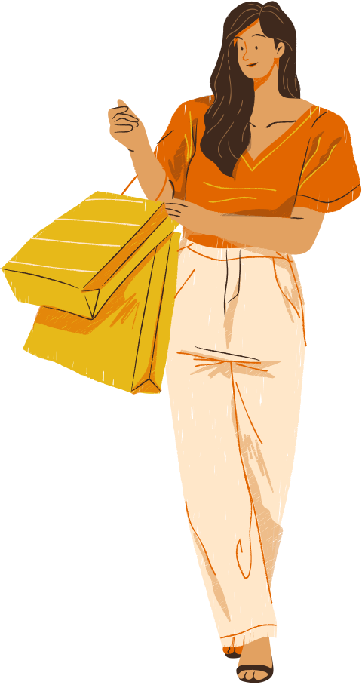
DO WE GREET YOUNG PEOPLE FORMALLY OR INFORMALLY THE FIRST TIME WE MEET THEM?

Slide 12
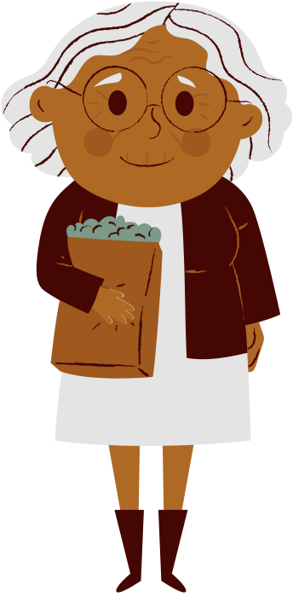
DO WE GREET THE ELDERLY FORMALLY OR INFORMALLY? SHOULD WE ALWAYS GREET THEM FORMALLY?

Slide 13
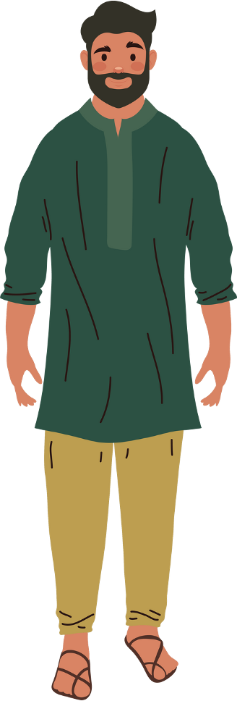
SO, SAY, WE’RE MEETING THIS PERSON FOR THE FIRST TIME. SHOULD OUR GREETING BE FORMAL OR INFORMAL?

Slide 14
HOW SHOULD WE GREET ADOLESCENTS WHEN WE FIRST MEET THEM? AND AFTER THAT?

Slide 15
AND WHAT ABOUT BABIES?

Slide 16
OH! IT LOOKS LIKE THIS PERSON HAS COME FOR A SECOND VISIT. DO WE GREET HER FORMALLY OR INFORMALLY?

Slide 17
Take a minute to contemplate these questions.
Who do we greet formally?
Who do we greet informally?

Slide 18
UNIT I - INTERACTION II
v
Listen to the audio.
What word did the manager use to greet the customer?
Hola
Saludos
Buenas tardes
What type of greeting does the manager use?
Formal
Informal
A mix
What question does the manager ask after the initial greeting?
¿Nos ha visitado antes?
¿A qué viene?
¿Buscas algo?

Slide 19
FOLLOWING-UP
Follow-up questions that make people feel welcomed.
¿PRIMERA VEZ QUE NOS VISITA?
¿QUÉ TAL SU DÍA?
¿NOS HA VISITADO ANTES?
¿ES/SON DEL ÁREA?

Slide 20
INTERACTION
POTENTIAL RESPONSES
FOL
LOW
UP
¿PRIMERA VEZ QUE NOS VISITA?
SÍ.
BIENVENIDO/A
¡GRACIAS!

Slide 21
UNIT I - INTERACTION III
Listen to the audio.
What question does the manager ask to determine if the customer has visited before?
¿Lo he visto antes?
¿Primera vez que nos visita?
¿Ha venido anteriormente?
How does the customer respond to the manager's question about previous visits?
Gracias
No
Sí
What type of greeting does the manager use? Formal or informal?
Formal
Informal
A mix

Slide 22
ACTIVITY
Instructions: In pairs in the breakout rooms, practice using the initial greeting plus a follow-up question. Each student will pick a role (customer or manager) and then switch once the first round is over.
You can find the script of the audios here: 📄

Slide 23
UNIT I - INTERACTION IV
Let’s listen to the audio.
What questions in Spanish did you hear?
Write them in your notebook.

Slide 24
MATCH THE FOLLOWING PHRASES WITH THEIR ENGLISH TRANSLATION.
BUENOS DÍAS
WELCOME
¡HOLA!
GREETINGS
SALUDOS
HOW ARE YOU?
¿CÓMO ESTÁ?
HELLO!
BIENVENIDOS
GOOD MORNING

Slide 25
ACTIVITY
While listening to the recordings in the next slide, look at scripts of the audios and identify the correct form(s) to use in the greeting. In pairs, practice these dialogues several times with a partner and swap roles regularly.
You can find the scripts here: 📄

Slide 26
UNIT I - INTERACTION I
UNIT I - INTERACTION II
UNIT I - INTERACTION III

Slide 27
ACTIVITY
1. Pair up with a partner.
2. Set a timer for 2 minutes.
3. Take turns greeting each other in Spanish using different phrases.
4. Try to use as many variations as possible (formal, informal, follow-ups).
5. After 2 minutes, switch roles and repeat.
6. Keep track of how many unique greetings you can use!

Slide 28
Some examples:
- ¡Hola! ¿Cómo está?
- ¡Buenos días! ¿Es su primera vez aquí?
- ¡Buenas tardes! ¿Cómo le puedo ayudar hoy?
- ¡Bienvenido/a! ¿Qué busca hoy?
- ¡Hola! ¿Cómo estás? ¿Qué le puedo ofrecer?

Slide 29
Progress check:
- How many unique greetings did you use?
- Which greetings felt most natural?
- Which greetings do you need to practice more?
- Share your favorite greeting with the group!

Slide 30
Exit Task
Instructions: In pairs in the breakout rooms, create your own dialogue using the scripts. Each student must pick a role (customer or manager) and practice the dialogue a few times; then switch roles. If you wish to perform your dialogues from memory or spontaneously, please feel free to do so. When you return to the classroom, please feel free to perform your dialogue for the class. Afterwards your classmates must repeat what they heard.
You can find the script of the audios here: 📄

