Slide 1
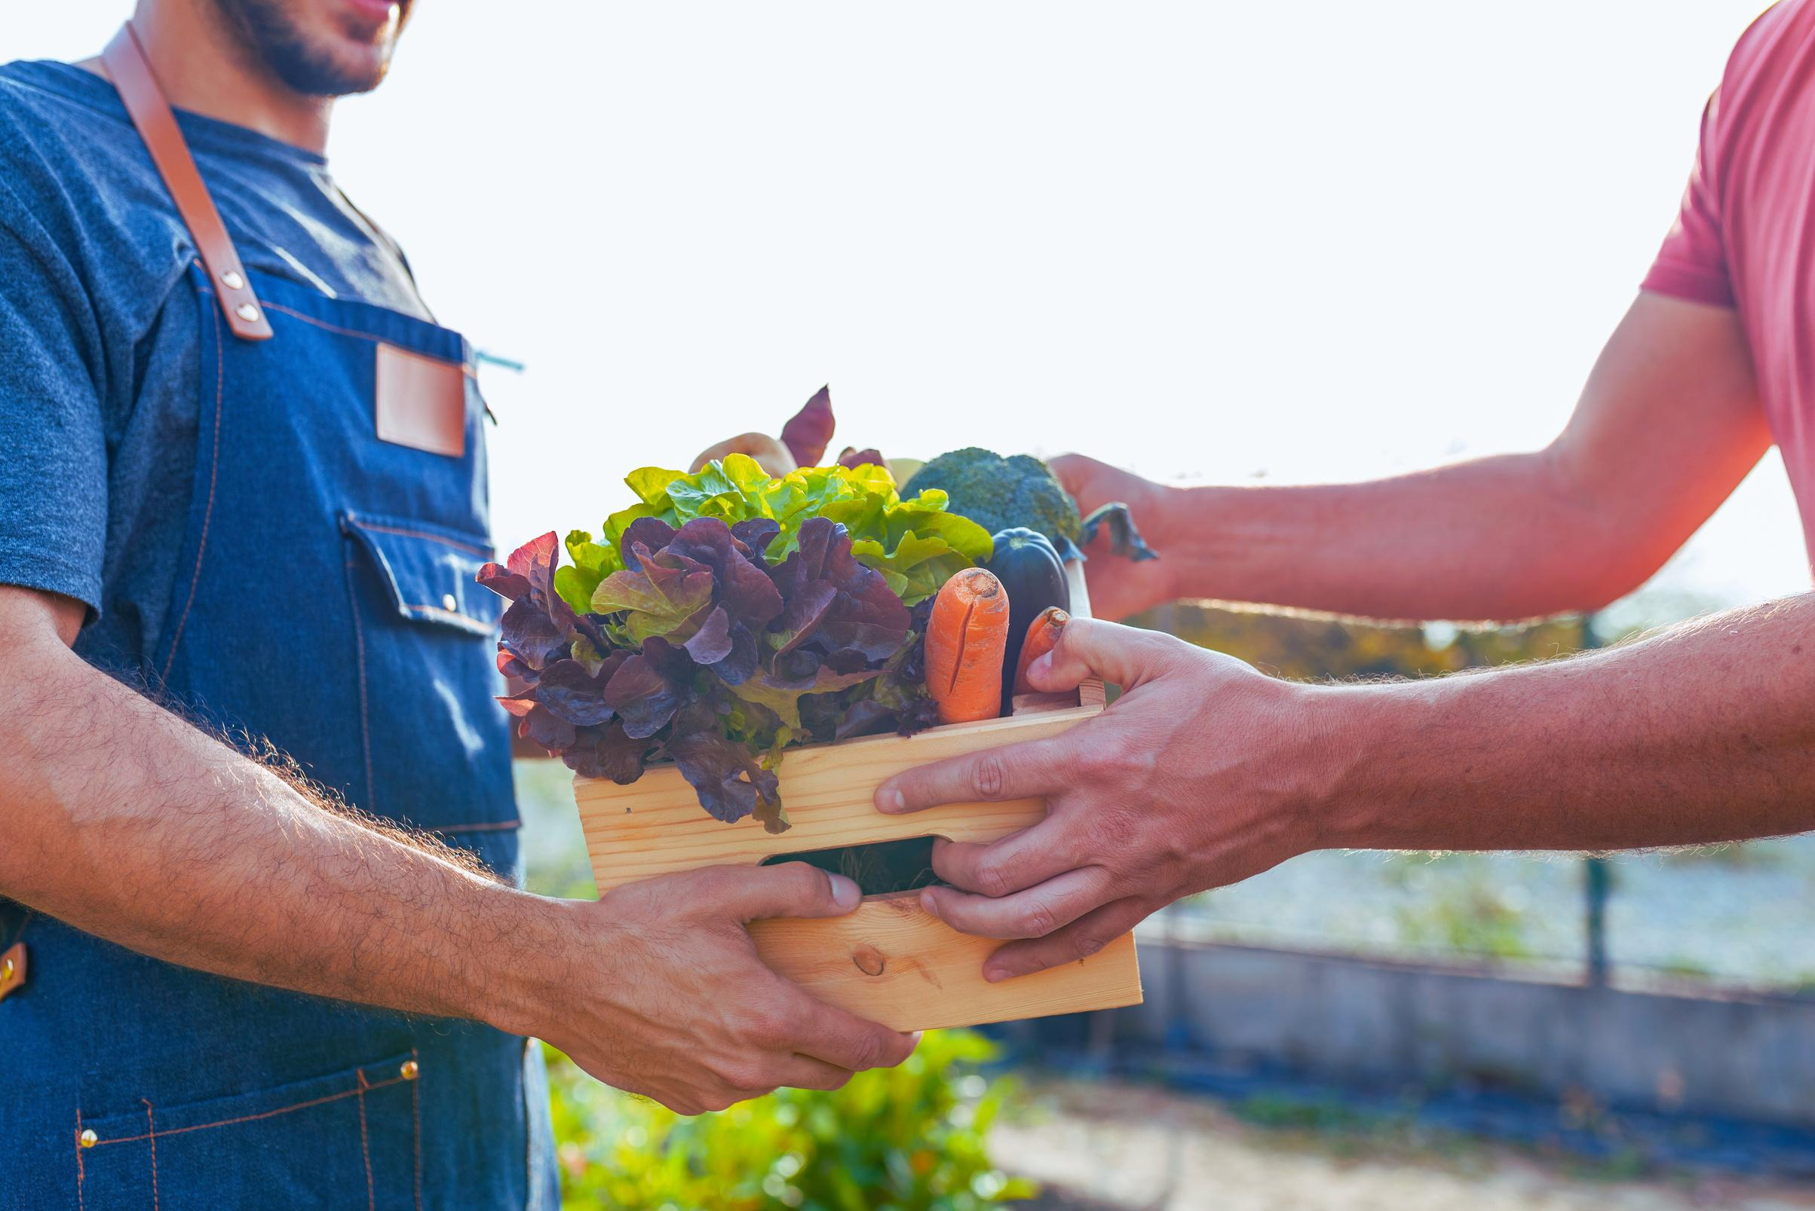





UNIT IV
PRODUCE

Slide 2

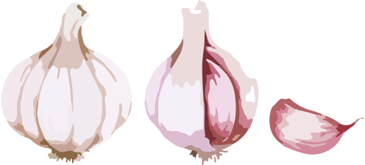
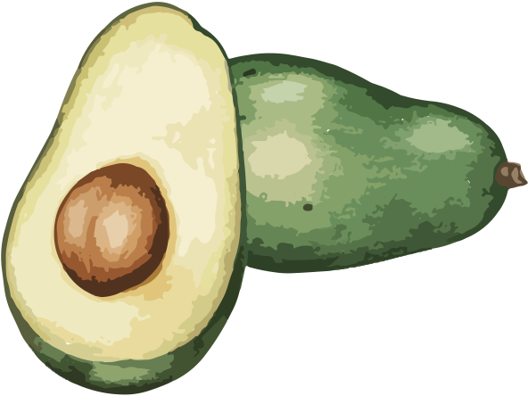
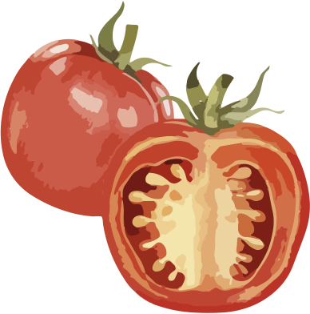

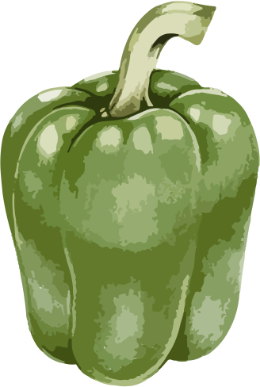
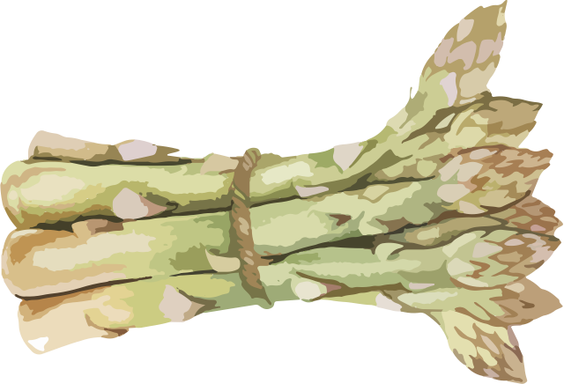
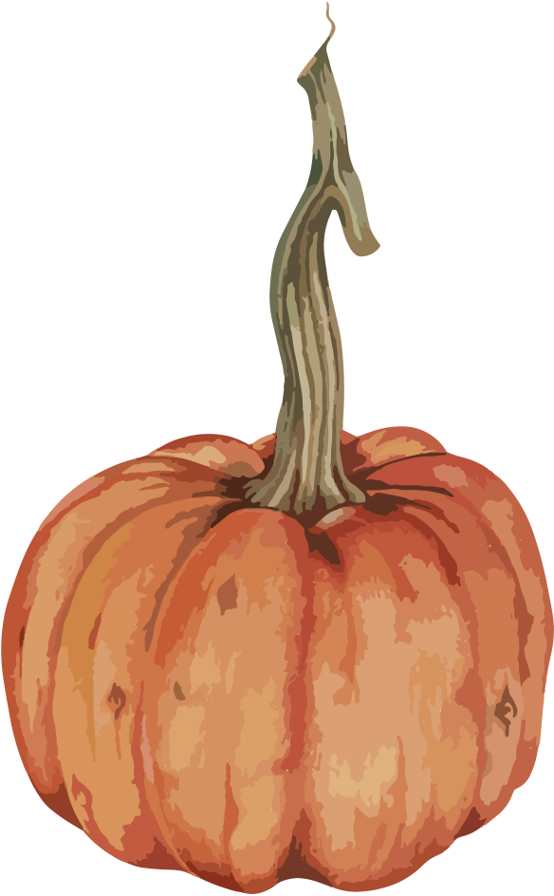
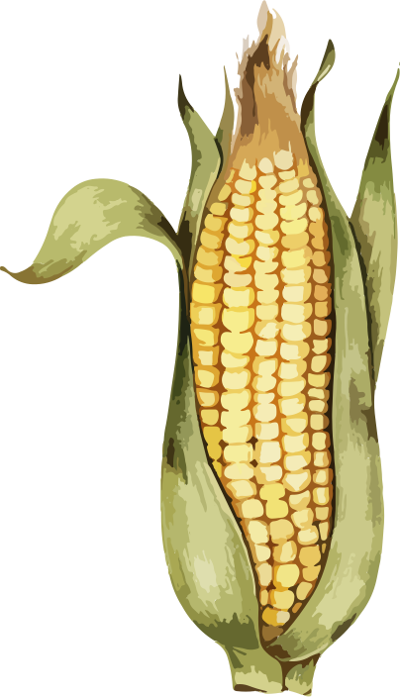
WHAT VEGETABLE NAMES IN SPANISH
DO YOU ALREADY KNOW?

Slide 3

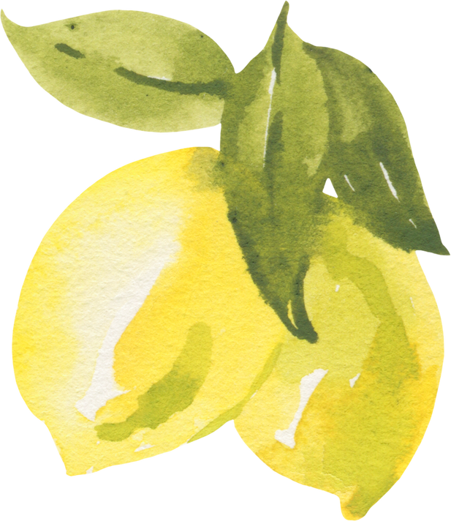

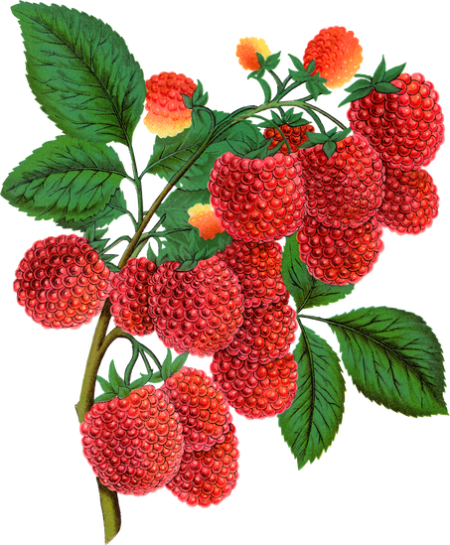

WHAT FRUIT NAMES IN SPANISH
DO YOU ALREADY KNOW?

Slide 4
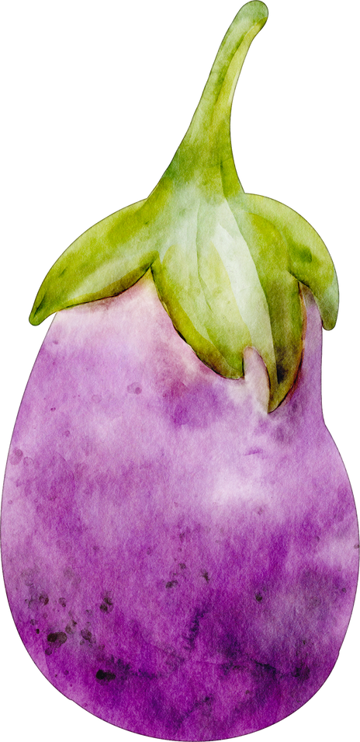
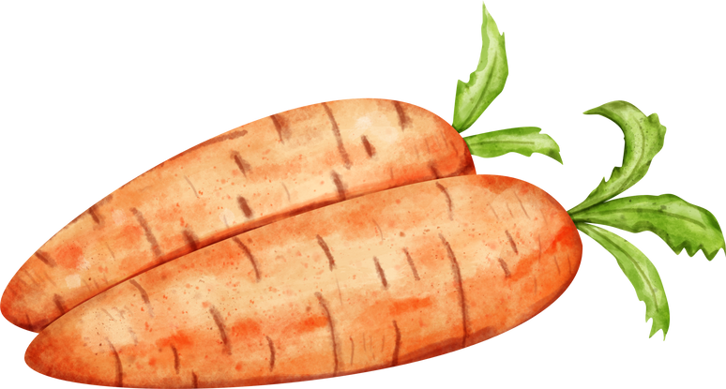
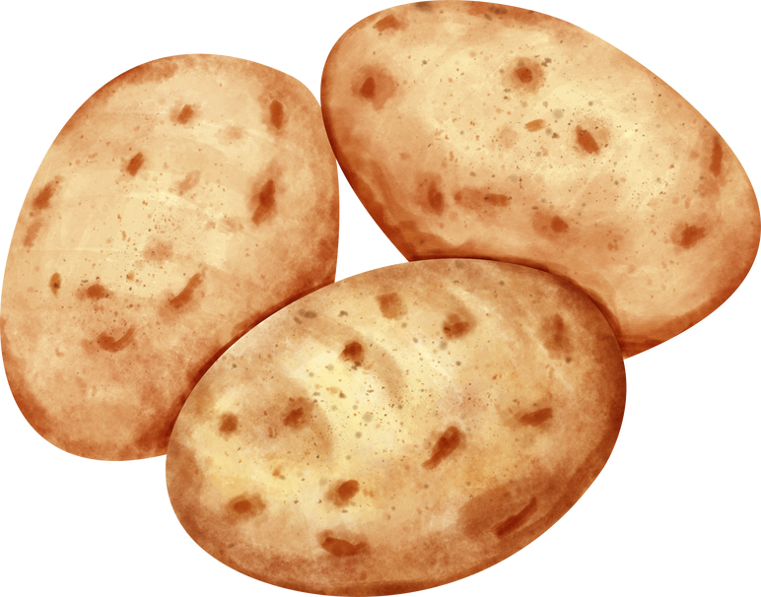
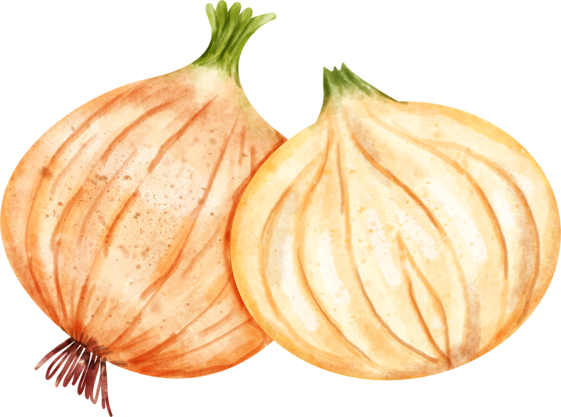
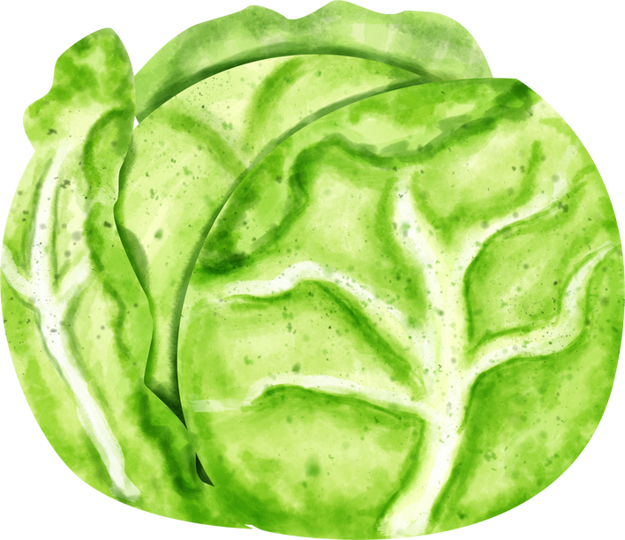
VEGETABLES
Listen to the teacher call out the names of the vegetables.

Slide 5

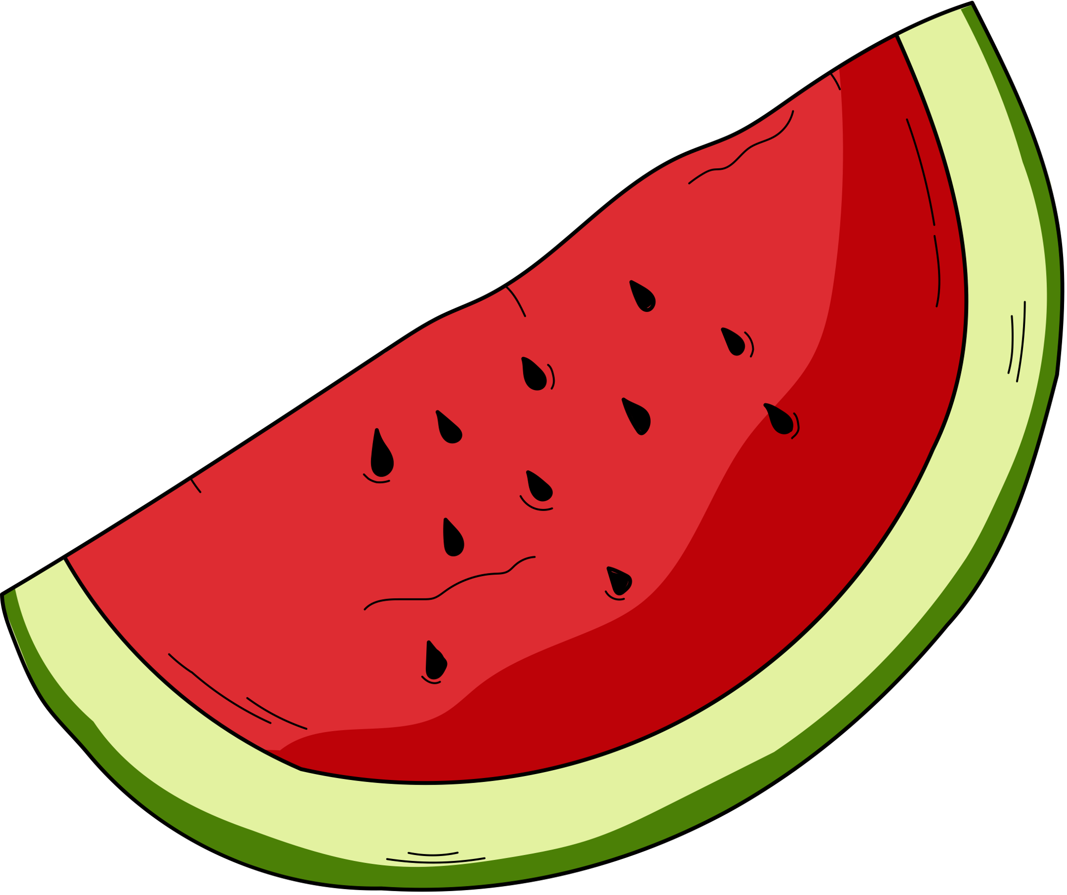


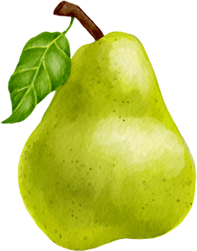
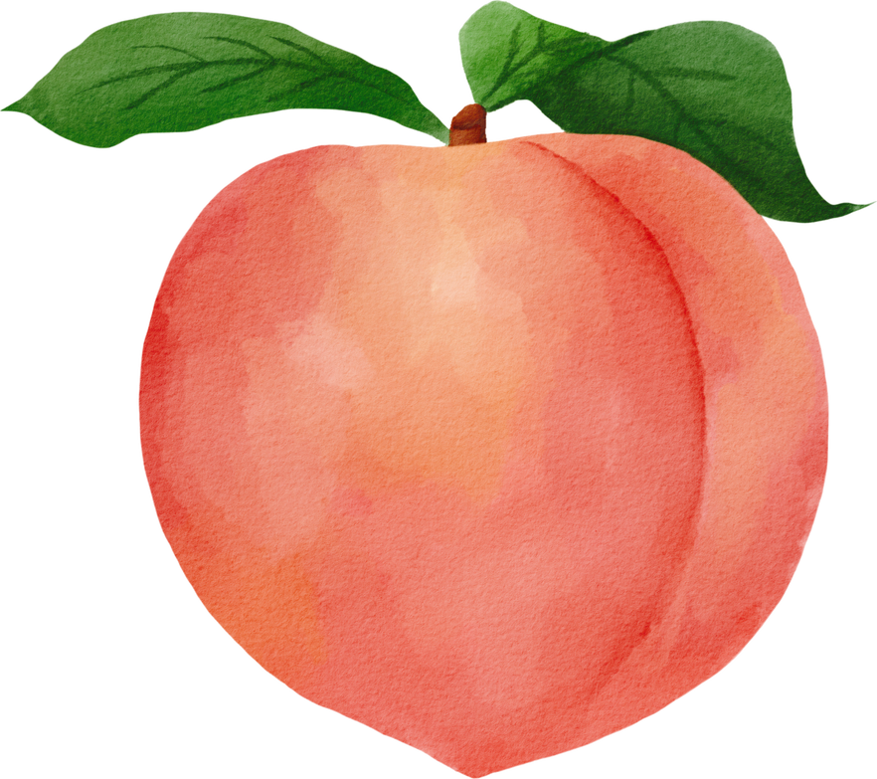
FRUITS
FRUITS
Listen to the teacher call out the names of the fruits.

Slide 6
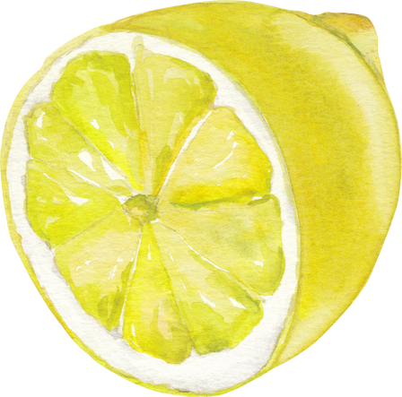

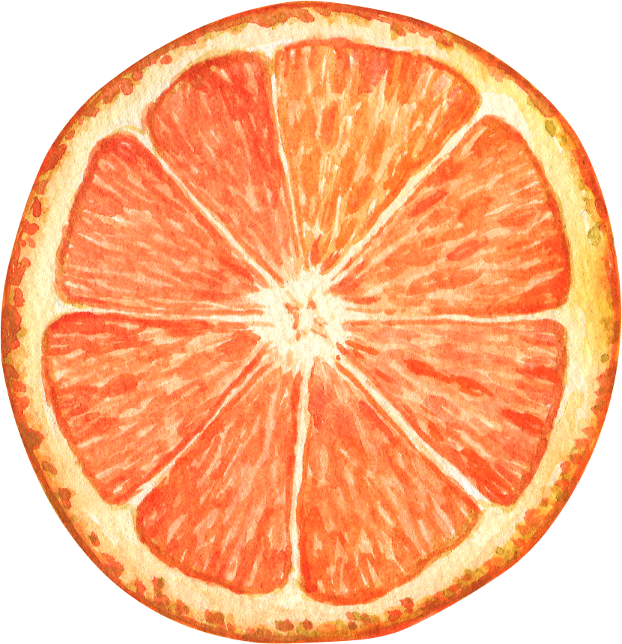
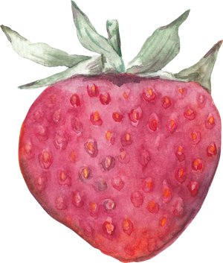
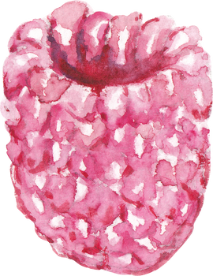
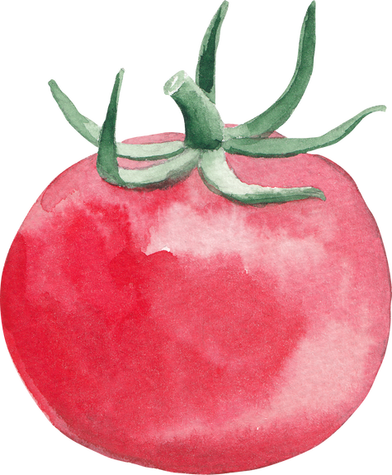
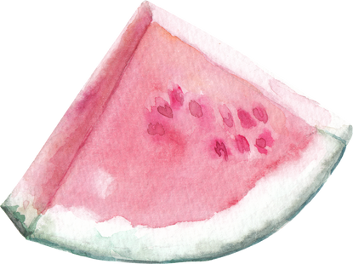
INITIAL ENCOUNTER

Slide 7

UNIT IV – INTERACTION I
Listen to the audio.
What type of greeting does the manager use?
  Formal
  Informal
How does the manager give directions to Veggie Cart?
  Camina hasta el final. A la izquierda. Está al frente de Legen Dairy.
  Camina hasta allá. A la izquierda. Está al frente de Leafy Delight.
  Camina hasta allí. A la izquierda. Está al lado de Leafy Delight.
What specific items is the customer looking for?

Slide 8
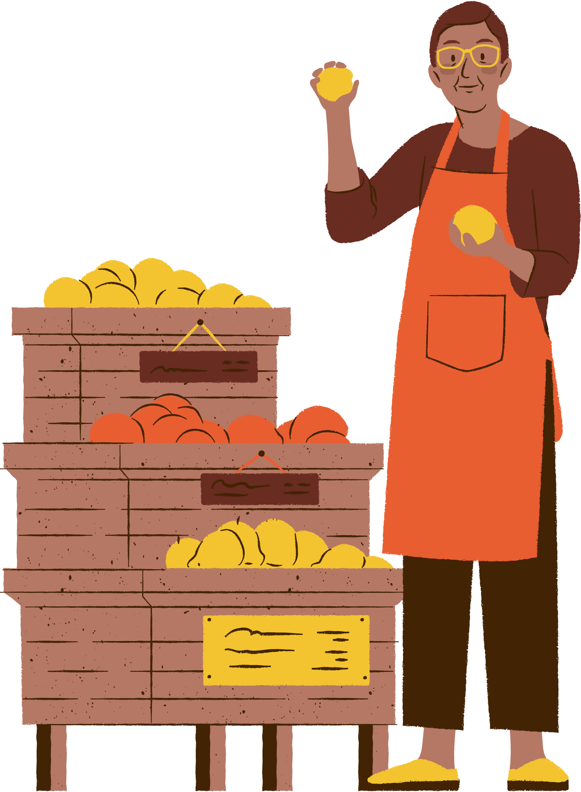
GREETINGS
QUESTIONS
QUESTIONS
Manager:
¿BUSCA ALGO EN ESPECÍFICO?
Looking for something specific?
¿QUÉ LE PUEDO OFRECER?
What can I offer you?

Slide 9
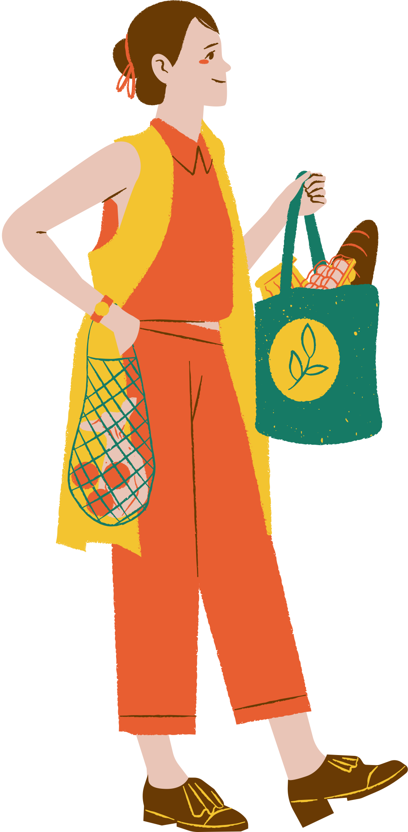
QUESTIONS
GREETINGS
QUESTIONS
Customer:
¿TIENE TOMATES HOY?
Do you have tomatoes today?
¿ES TEMPORADA DE TOMATES?
Are tomatoes in season?

Slide 10
ANSWERS
Manager:
PUEDE ENCONTRAR *PRODUCE EN *VENDOR.
You can find *produce at *vendor.
SÍ, LOS PUEDE ENCONTRAR EN *VENDOR
What can I get you?

Slide 11
UNIT IV – INTERACTION II
Listen to the audio.
What does the manager ask the customer right after the initial greeting?
  ¿Qué se le ofrece?
  ¿A dónde va?
  ¿Qué le puedo ofrecer?
How does the manager give directions to Veggie Cart?
  Camine derecho. Al final, a la izquierda.
  Camine a la derecha. Al final, a la izquierda.
  Camine directo. Al final, a la izquierda.
What specific items is the customer looking for?

Slide 12
UNIT IV – INTERACTION II
Listen to the audio.
Instructions: In pairs, the students will draft their own short script in which they employ these phrases. To start, you will write a dialogue by yourself in 10 mins. The dialogue should feature a farmers market manager and a Spanish-speaking customer who is looking for something in particular. The farmers market manager should welcome the customer and help them find what they are looking for. Here is a link to some scripts that have phrases you can use to write your own original dialogues. Once you’ve written your script, you will be assigned a partner. You and a partner should practice performing both of your scripts and each take turns role playing the farmers market manager and the Spanish-speaking customer.

Slide 13
MORE PRODUCE AND INGREDIENTS FOR INTERNATIONAL FOODS

Slide 14

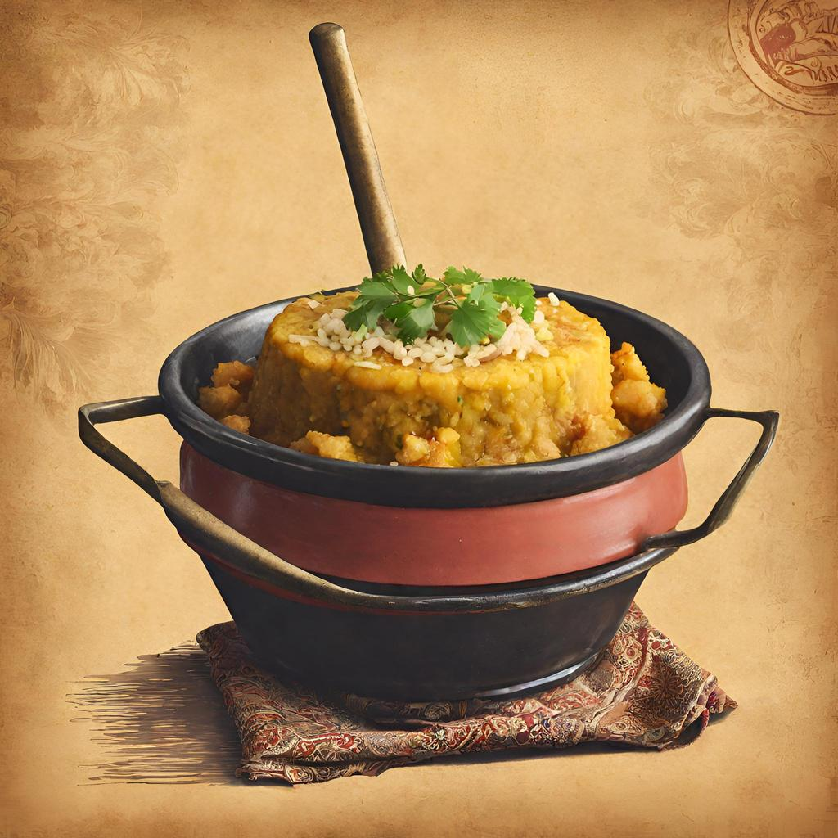
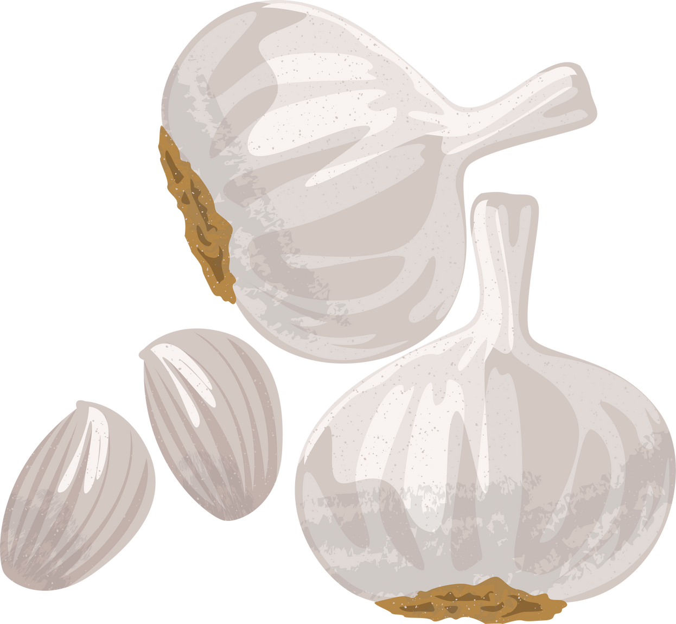
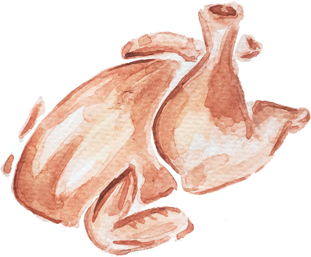
PUERTO RICO
Ajo
Pollo
MOFONGO

Slide 15

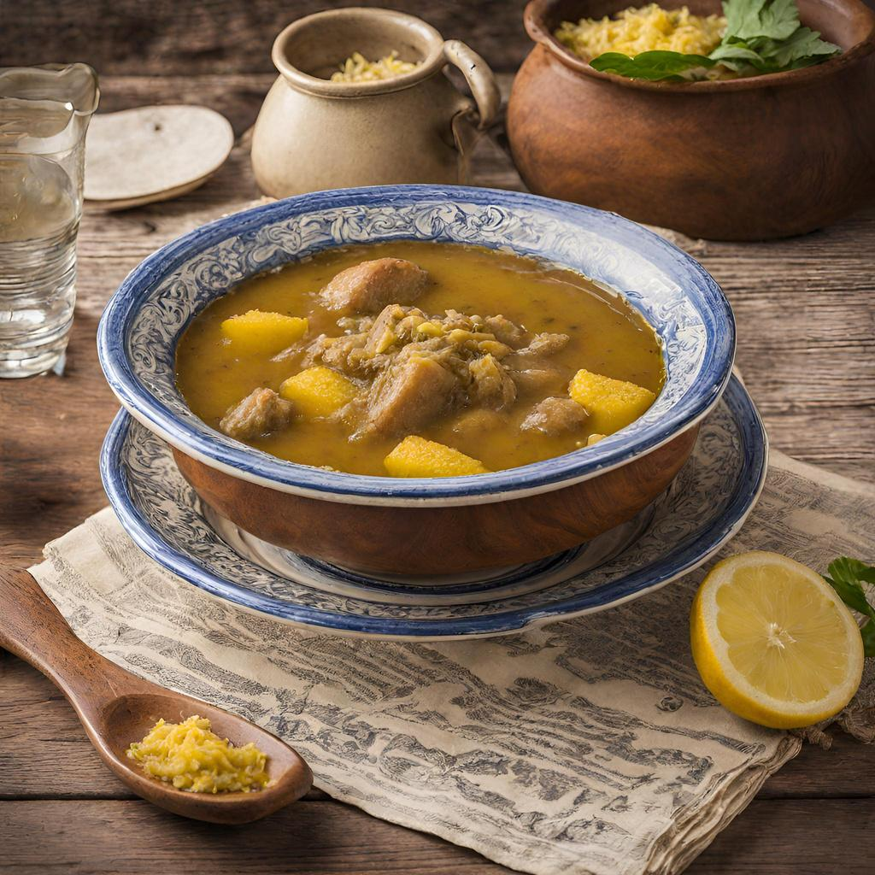
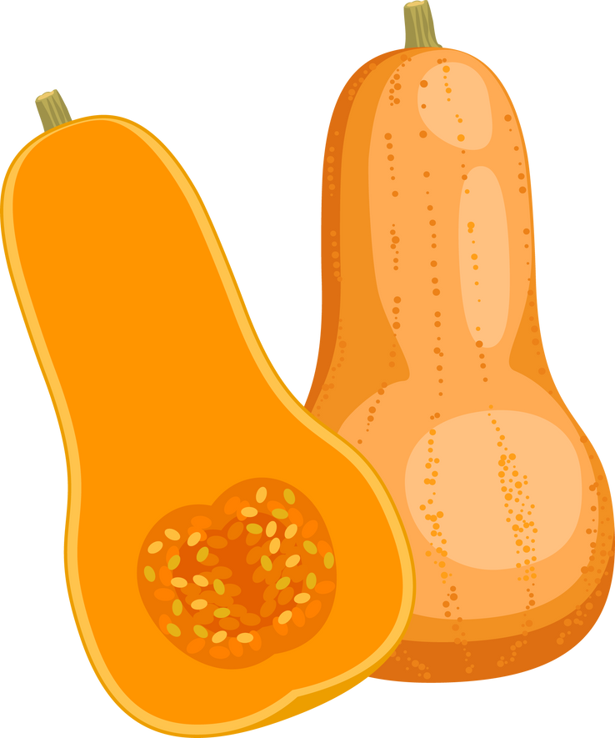
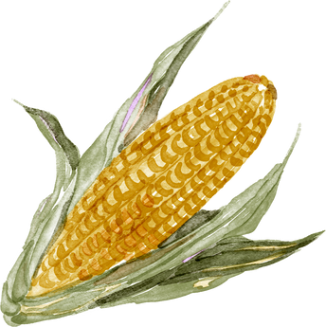
REPÚBLICA DOMINICANA
Calabacín
Maíz
Pollo
SANCOCHO

Slide 16
ACTIVITY
What protein and vegetables can we find in mofongo?
What protein and vegetables can we find in sancocho?

Slide 17

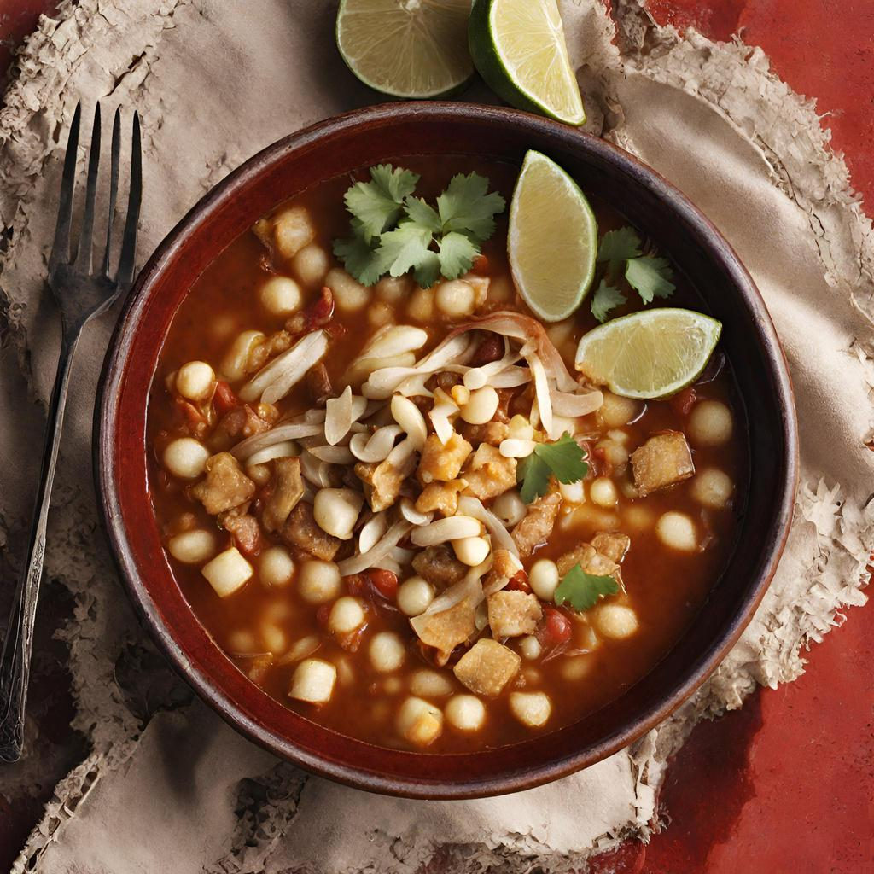
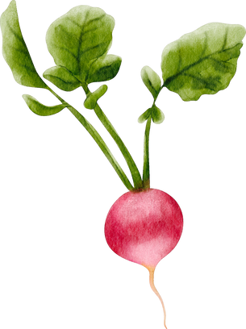
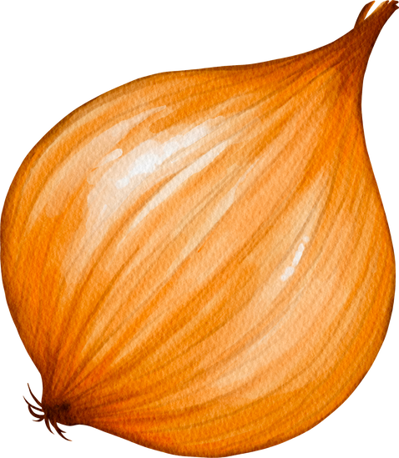
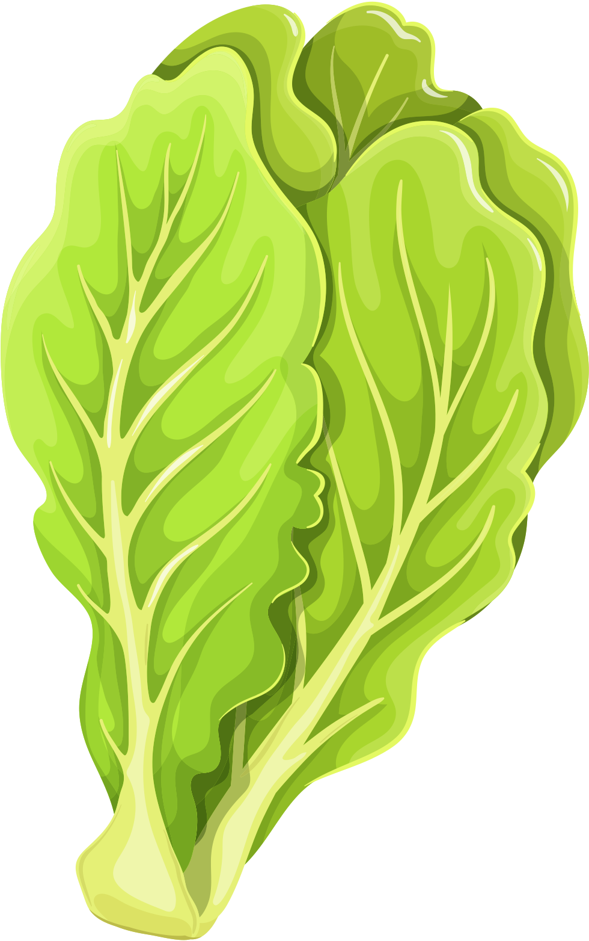
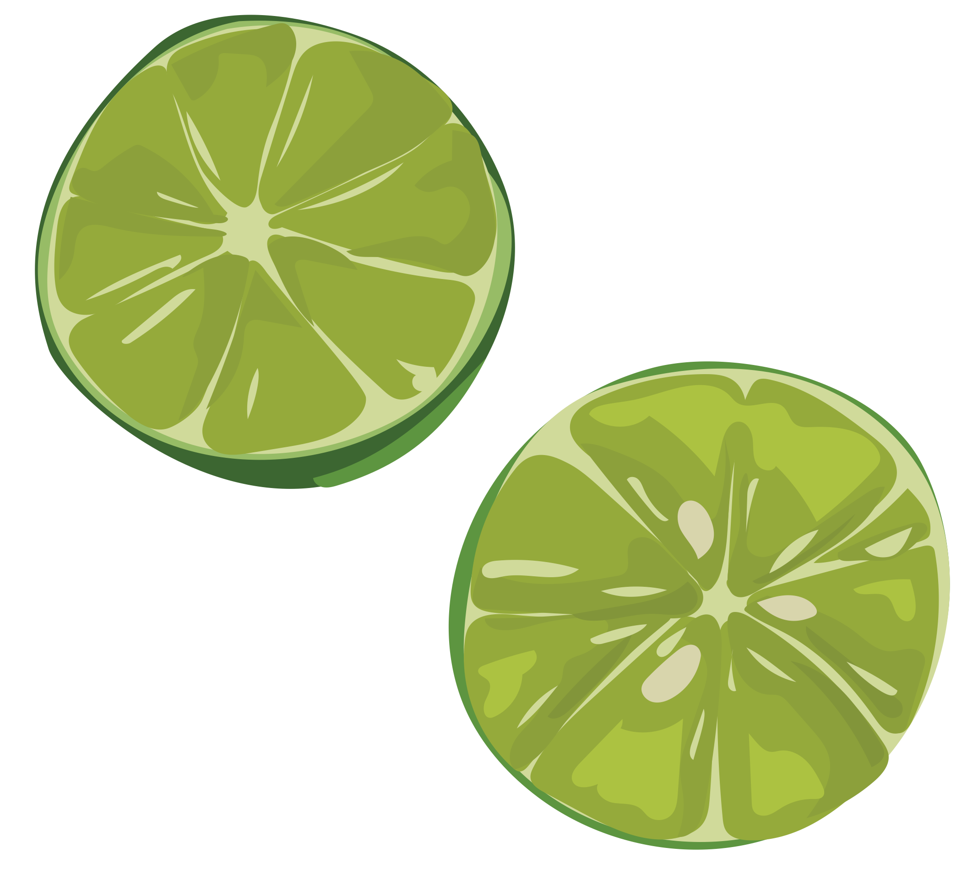
MÉXICO
Cebolla
Rábano
Ajo
Lechuga
Romana
Maíz
Limón
POZOLE

Slide 18

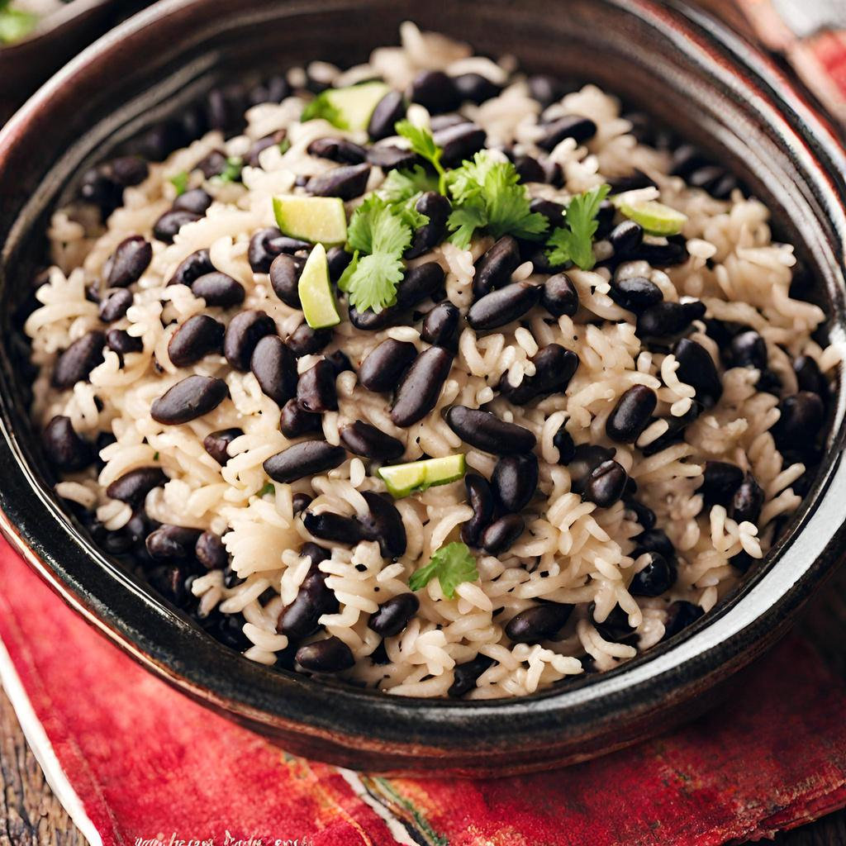

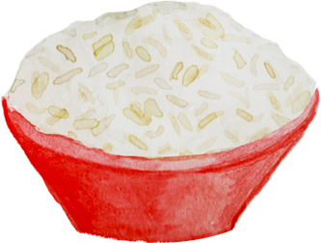

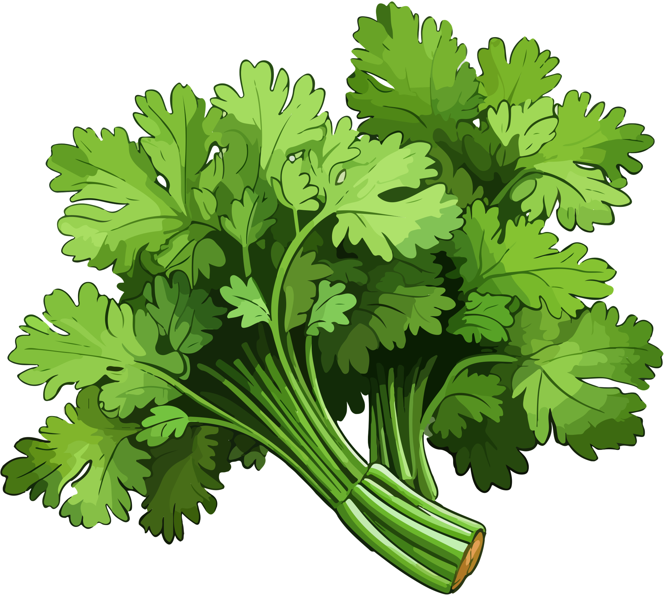

CUBA
Frijoles
Arroz
Pimiento Rojo
Cilantro
Pimiento Amarillo
Cebolla
ARROZ CONGRÍ

Slide 19
ACTIVITY
What protein and vegetables can we find in pozole?
What protein and vegetables can we find in arroz congri?

Slide 20

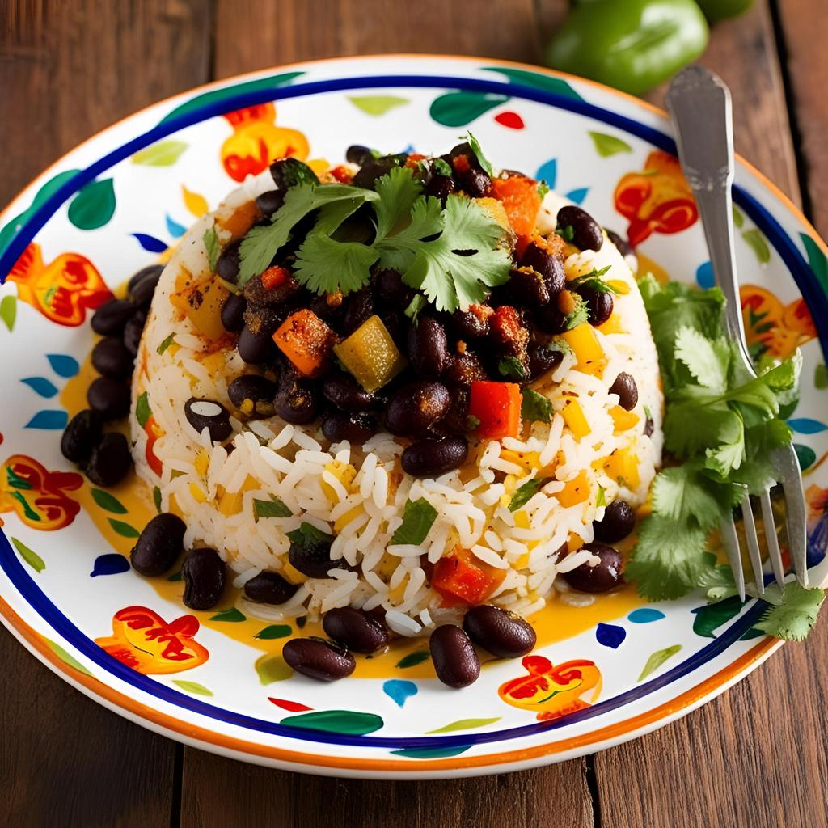
COSTA RICA
Frijoles
Pimiento Rojo
Arroz
GALLO PINTO
Cilantro

Slide 21

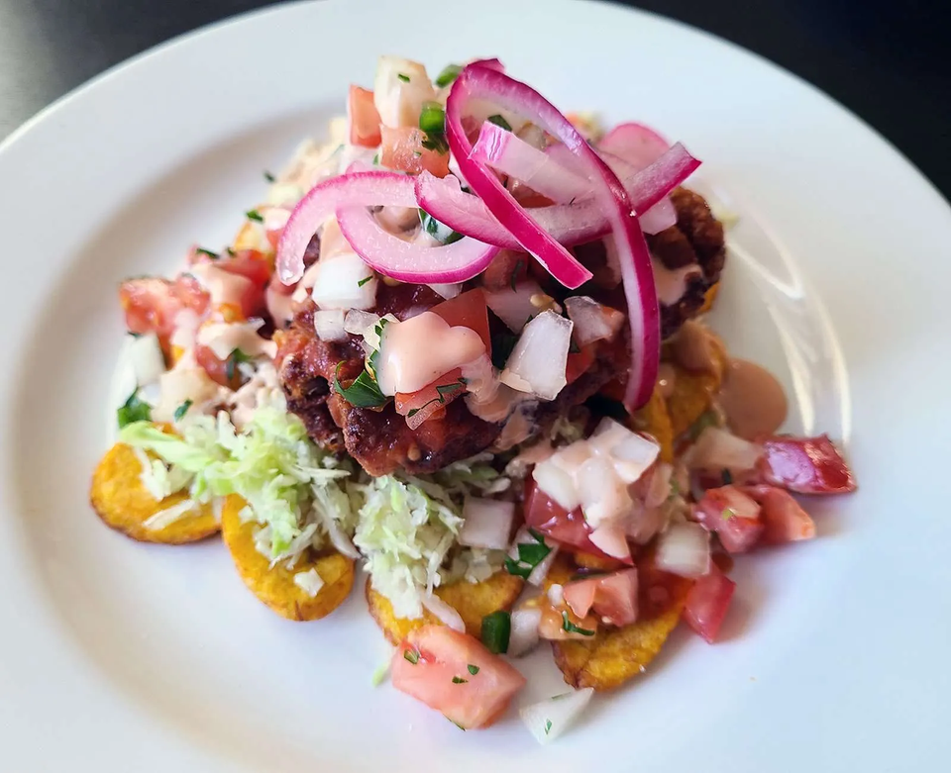
HONDURAS
Pollo
Pimiento Rojo
Tomates
POLLO CHUCO
Cebolla

Slide 22
ACTIVITY
What protein and vegetables can we find in gallo pinto?
What protein and vegetables can we find in pollo chuco?

Slide 23
VEGETABLES
WHAT VEGETABLE NAMES IN SPANISH
HAVE WE LEARNED WITH THESE DISHES?
GARLIC
ROMAINE LETTUCE
SQUASH
CORN
RADISH
RED/YELLOW PEPPERS
ONION
CILANTRO

Slide 24
VEGETABLES
DID YOU GET THESE RIGHT?
AJO
LECHUGA ROMANA
CALABACÍN
MAÍZ
RÁBANO
PIMIENTO ROJO/ AMARILLO
CEBOLLA
CILANTRO

Slide 25
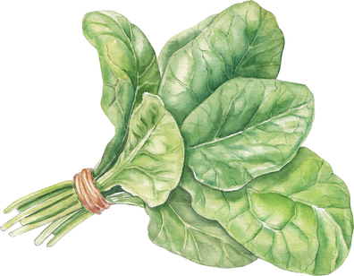
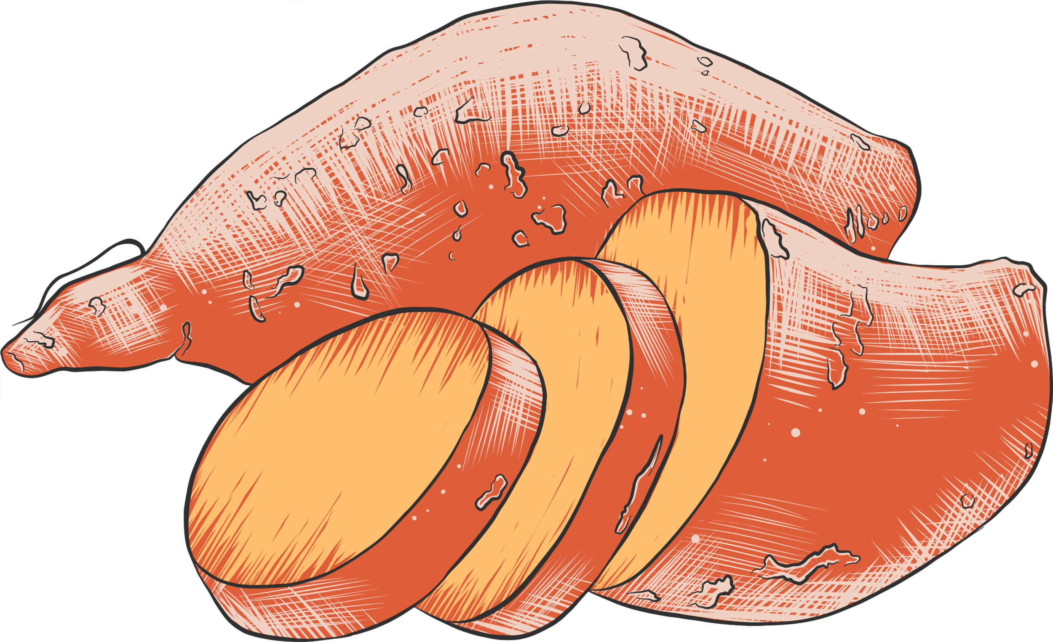
VEGETABLES
WHAT OTHER VEGETABLE NAMES IN SPANISH
HAVE WE LEARNED?
TOMATOES
EGGPLANT
ASPARAGUS
SPINACH
POTATOES
CARROT
SWEET POTATOES
LETTUCE

Slide 26
VEGETABLES
DID YOU GET THESE RIGHT?
TOMATES
BERENJENA
ESPÁRRAGO
ESPINACA
PAPAS
ZANAHORIA
BATATA
LECHUGA

Slide 27
PRACTICE
MATCH THE FOLLOWING VEGETABLE NAMES TO THEIR ENGLISH TRANSLATIONS.
LETTUCE
MAIZ
CORN
PIMIENTO ROJO
LECHUGA
RED PEPPER
PIMIENTO AMARILLO
CILANTRO
CILANTRO
YELLOW PEPPER

Slide 28
PRACTICE
MATCH THE FOLLOWING VEGETABLE NAMES TO THEIR ENGLISH TRANSLATIONS.
POTATO
TOMATE
GARLIC
BERENJENA
PAPA
ONION
CEBOLLA
AJO
TOMATO
EGGPLANT

Slide 29
UNIT IV – INTERACTION III
Listen to the audio.
How is this conversation in terms of formality? Is this conversation formal or informal?
What specific item is the customer looking for?
What does she ask about that specific item?
  ¿Es temporada de *item?
  ¿Le quedan *item?
  ¿Tienen *item?

Slide 30
ACTIVITY
While listening to the recordings in the next slide, look at scripts of the audios and identify the correct form(s) to use when asked about produce. In pairs, practice these dialogues several times with a partner and swap roles regularly.
You can find the scripts here: 📄

Slide 31
UNIT IV - INTERACTION I
UNIT IV - INTERACTION II
UNIT IV - INTERACTION III

Slide 32
Exit Task
Instructions: In pairs, the students will draft their own short script. In this version, the student that plays the customer must have a list of items they are looking for and the student that plays the manager must repeat each item and give them directions to different vendors in which they will find them.
You can find the scripts for the audio here: 📄

