Slide 1
Unauthorized Practice of Immigration Law (UPIL)
Office of Attorney General Andrea Joy Campbell
How To Avoid Immigration Fraud

Slide 2
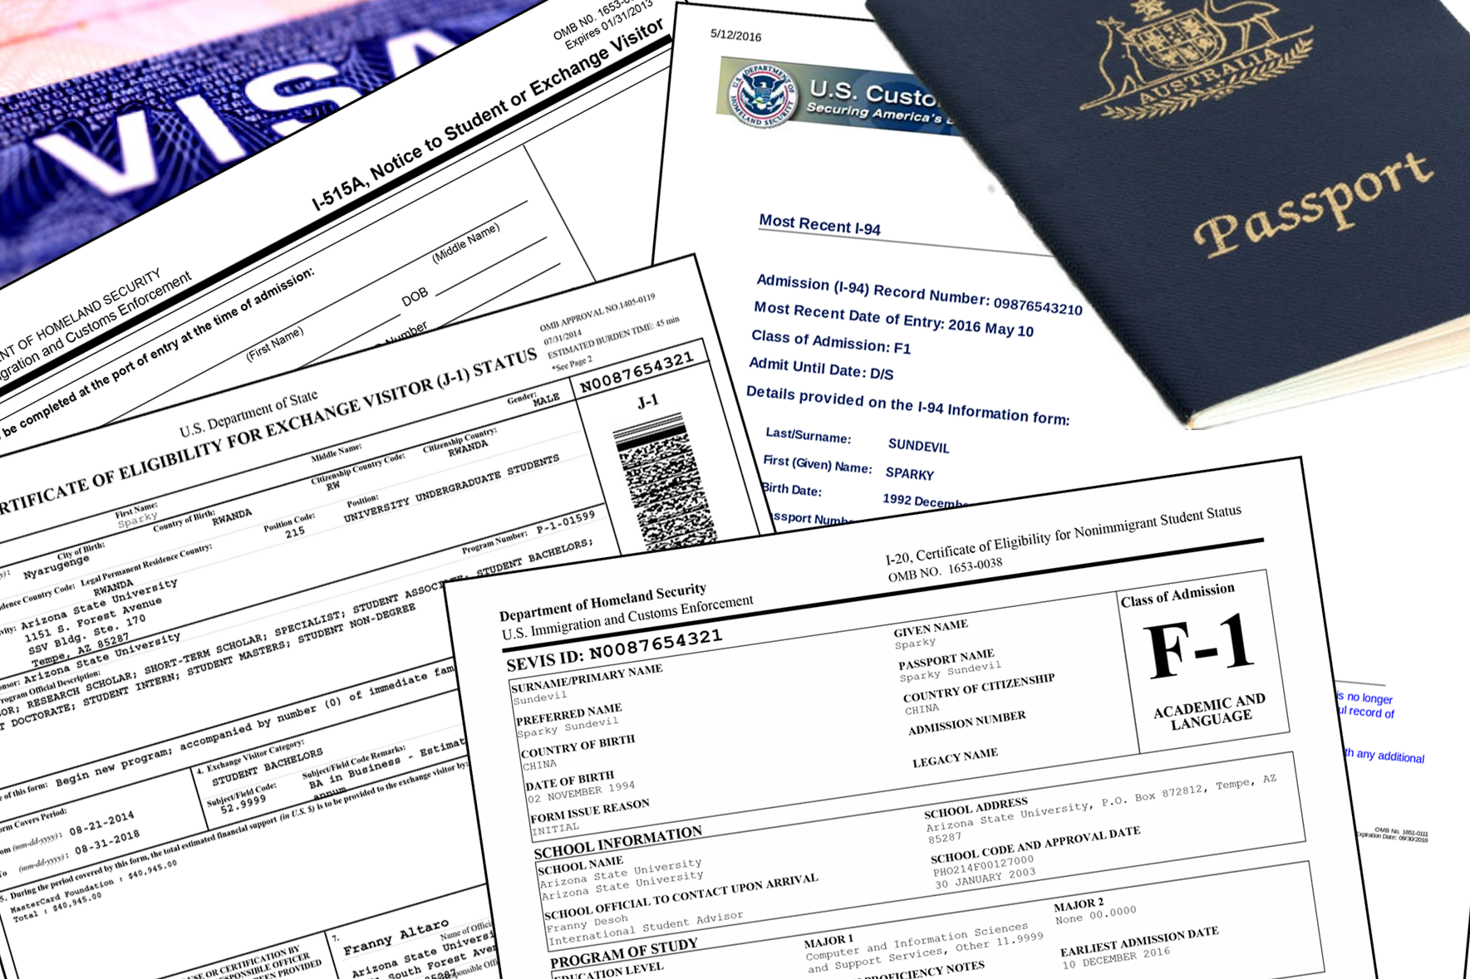
Avoid fraud—work with an attorney!
The immigration process can be complicated – work with a licensed attorney who will help you get it right!

Slide 3
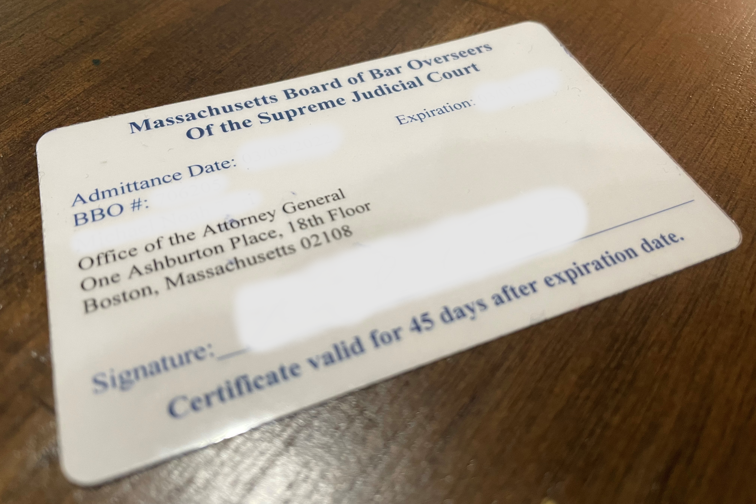
If you or someone you know needs help with immigration filings…
ONLY an attorney or “accredited representative” can give legal advice on immigration matters
Ask to see their bar card or proof of accreditation
AVOID “notarios” or unlicensed people who ask for lots of money to apply for work authorization and a social security card

Slide 4
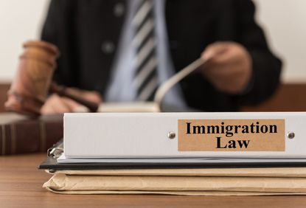
A Licensed Attorney/Accredited Representative Can:
Explain the law and advise you on any options you have
Give you a written agreement explaining services they will provide and any fees they will charge
File immigration forms or applications on your behalf
Represent you in court or before government officials
Give you updates on your case, including proof your application has been submitted

Slide 5
How to avoid becoming a victim of fraud?
If someone claims to be an attorney, look them up!
https://www.massbbo.org/s/
Don’t pay for immigration forms – you can download them online for free
Don’t sign blank forms, and understand everything you sign
Always keep your original personal documents (passport, birth certificates)
Get copies of everything filed on your behalf
Get a receipt for all payments

Slide 6
What are the potential consequences?
If you take advice from someone who is not licensed to work on immigration applications:
Your application for work authorization could be rejected
You could lose money you need for other important things
It could hurt your chances of getting legal status or a green card

Slide 7
How can you find legal help?
Find legal aid agencies near you:
https://miracoalition.org/resources/legal-services/
Find a qualified private lawyer:
https://ailalawyer.com/
Verify that anyone you work with is a licensed attorney or an “Accredited Representative”
https://www.massbbo.org/s/
https://www.justice.gov/eoir/recognized-organizations-and-accredited-representatives-roster-state-and-city

