Slide 1
Urban Agenda Grant Program Guidance Webinar
Community One Stop for Growth

Slide 2
Road Map
What is the Community One Stop for Growth?
Urban Agenda Grant Program Overview
Where does Urban Agenda Fit in the One Stop?
Important Program Parameters
How to Be Competitive
Examples of Successful Applications
Completing the Full Application
Key Dates and Opportunities to Get Guidance

Slide 3
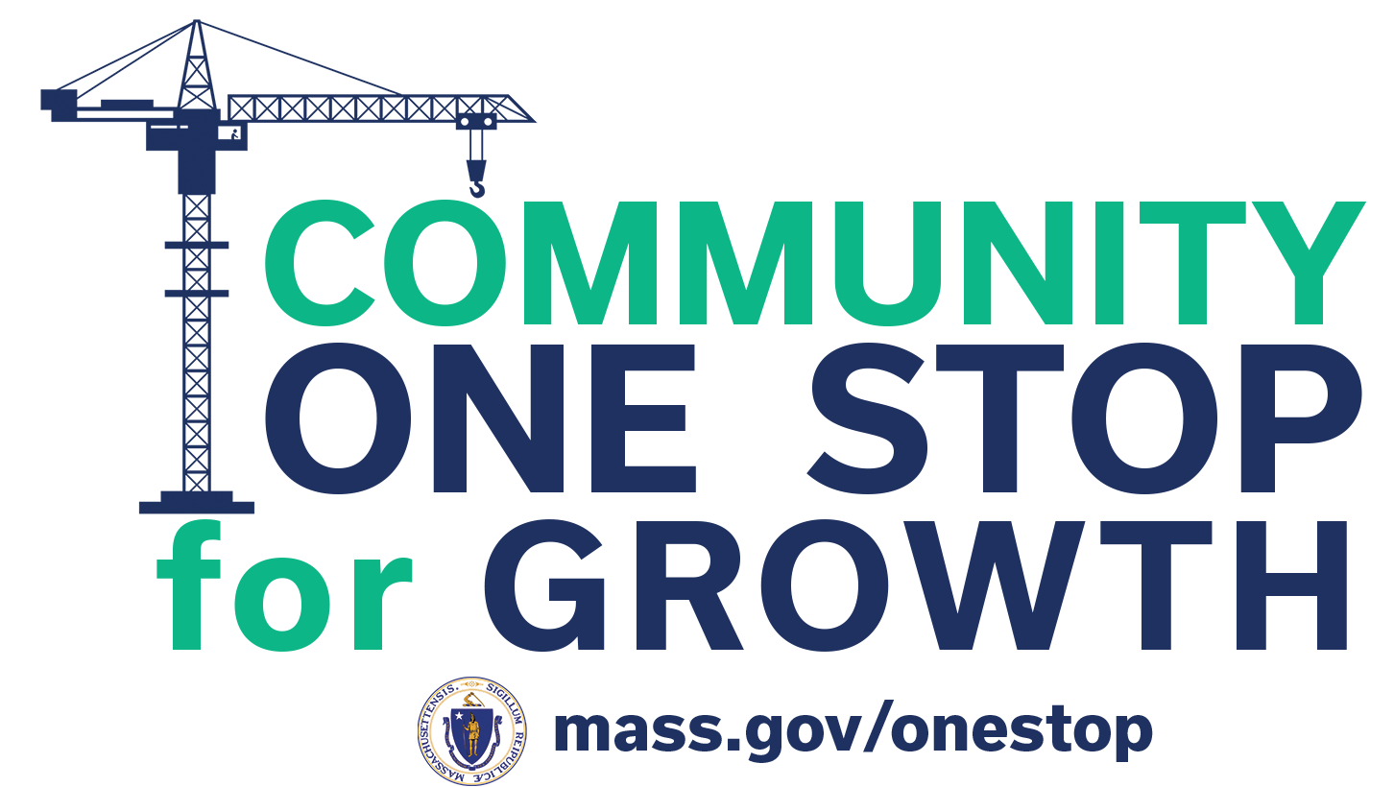
What is the Community One Stop for Growth?
The Community One Stop for Growth is the main driver of economic development in the Commonwealth.
The One Stop is a single application portal and collaborative review process designed to streamline the experience for the applicant and better coordinate economic development programs and staff on engagement and grant making.
Executive Office of Economic Development | MassDevelopment Finance Agency | Executive Office of Housing and Livable Communities
MassWorks Infrastructure Program Rural Development Fund Urban Agenda Grant Program Massachusetts Downtown Initiative | Underutilized Properties Program Site Readiness Program Collaborative Workspaces Program Brownfields Redevelopment Fund Real Estate Services Technical Assistance | HousingWorks Infrastructure Program Housing Choice Grant Program Community Planning Grants Program

Slide 4
Where Does Urban Agenda Fit in the One Stop?
Preparing for Growth |  |  | Catalyzing Specific Projects
Community Activation & Placemaking | Planning & Zoning | Site Preparation | Building | Infrastructure
Technical Assistance for Downtowns Downtown Design Consultant Services Downtown Mobility/Parking Consultant Services Downtown Wayfinding/Branding Consultant Services Economics of Downtown Consultant Services Pedestrian Orientation/Placemaking Consultant Services Small Business Support/E-commerce Consultant Services Forming a Downtown Management District Equitable Workforce and Business Development Programming Entrepreneurship and Small Business Development Workforce Development and Training Initiatives Community Organizing and Leadership Development | Community Plan Master Plan Neighborhood Plan Downtown Plan Urban Renewal Plan Housing Production Plan Regional Plan Corridor Plan Zoning Revision Zoning Revision to Comply with Section 3A of MGL c.40A Comprehensive Zoning Review & Revision Planning for Housing Housing Feasibility Plan Housing Site Master Plan Housing Infrastructure Plan Housing Site Design Plan District Redevelopment Technical Assistance Planning for Growth in a Commercial/Industrial District | Brownfield Site Clean Up Brownfields Site Assessment Brownfields Remediation Site Improvements to Unlock Development Site Readiness Pre-Construction Site Readiness Construction Municipal Surplus Property Disposition Municipal Surplus Property Disposition Study | Underutilized Property Rehabilitation Underutilized Property Pre-Construction Underutilized Property Construction Creating Collaborative Workspace Collaborative Workspace Feasibility Study Collaborative Workspace Fit-Out or Equipment Community Lead Housing Production Support Housing Production Support Housing Rehabilitation Support Housing Preservation | Public Infrastructure to Support Housing Growth (Residential Only) Pre-construction - Design / Engineering Documents Only Construction Public Infrastructure to Support Mixed-Use and Commercial/Industrial Growth Pre-construction - Design / Engineering Documents Only Construction Small Town Road Improvements to Enhance Public Safety (STRAP) Construction of Road Improvements to Enhance Public Safety

Slide 5
Urban Agenda Overview
Program Staff | Alexandra Puleo, Deputy Director for Communities & Programs Program Manager to be hired
What is the Purpose of the Program? | The Urban Agenda Grant Program is a competitive grant program that funds community-driven responses to community-defined economic opportunities.
Who is Eligible? | Non-profit organizations and governments (municipalities, etc)

Slide 6
Important Project Parameters
Project Budget | Maximum award of $100,000
Project Timeline Requirements | Typically ~6 month timeline Project must be completed by June 30, 2025
Eligible Use of Funds | General operating support for innovative and collaborative community economic development projects.
Key Parameters | Cost reimbursement grant Capital expenses, including real estate purchase, construction and/or renovation, are not eligible uses of funds for this program. The grant program will not reimburse indirect costs exceeding 15% of the total budget.

Slide 7
How To Be Competitive

Slide 8
How To Be Competitive
Target Population | Well-defined target population that will benefit from the project. Members of the target population have been engaged in developing and/or carrying out the project. Clear articulation of how the project will advance equitable opportunities in the community.
Outcomes and Impact | Specific and measurable outcomes tied to the community-identified economic need or opportunity. Impacts are reasonable given the scope of the project and the size of the grant request.
Project Need | Articulation of the identified economic need/opportunity that the project will address. Description of how the project's activities directly respond to the opportunity. Evidence that project has deep and broad ties to community and project’s goals reflect the community’s priorities.
Collaboration and Partnerships | Existing community coalition or collaboration with a thoughtful and intentional group of partners. Active and ongoing coalition participation in project planning and implementation. Innovation of the collaboration: leveraging existing strengths and developing new local capacity and leadership.
Capacity to Succeed | Logical progression from scope of work described to the outcomes and impacts anticipated. Evidence of strategic, timely and equity-oriented project planning and/or implementation thus far. Clear and appropriate project timeline outlining key benchmarks, preferably on a monthly basis. Detailed budget, including total project budget, allocation of the requested grant funds, and reasonable overhead costs.

Slide 9
Successful Application Example #1
Applicant: | Lawrence CommunityWorks
Project Description: | The Community Educator Pipeline (CEP) program is a workforce development initiative that both creates career pathways for low-income Lawrence parents (and other community members) and diversifies the educator workforce in the city's public schools. It is a component of the Lawrence Working Families Initiative, a cross-sector collaborative and two-generation approach to student success through family economic progress, supporting parents with education, training, and job placement/advancement.
What Made the Project Successful: | Robust, ongoing partnership with multiple types of partners (nonprofits, public schools, higher education, individual community members) Responds to specific community-identified needs Focus on clearly defined community and geographic area Equity considerations built in

Slide 10
Successful Application Example #2
Applicant: | Town of Middleborough
Project Description: | The Town of Middleborough’s Exploratory Year Program will fund hands-on education, training, and workforce development for high school graduates. The program aims to support local businesses by connecting successful YouthWorks interns to community businesses for mentorship and mini-apprenticeships.
What Made the Project Successful: | Focus on single geographic community Responding to community-specific needs Multiple community benefits – serves both local business, youth workforce development, resident retention Robust public/private partnership (Chamber of Commerce, public schools, student group, MassHire, etc)

Slide 11
Successful Application Example #3
Applicant: | New North Citizen's Council (Springfield)
Project Description: | The Nueva Visión Nuevo Trabajo program uses the Individualized Placement Support (IPS) model for workforce development to support Springfield’s Latino community. Through this model, participants will receive help to find and keep a regular paid job in the competitive labor market while also supporting the local businesses that hire program participants.
What Made the Project Successful: | Clear target population Specific geographic focus Equity is central to project Responds to community-identified need Robust partnership includes government, nonprofits, private sector

Slide 12
Completing the Full Application
Key Question: In Section 2 of the Full Application, applicants are asked to indicate the Project Category. To be reviewed by {Program}, applicants should make the following selections in question 2.4:
Development Continuum: | Community Activation & Placemaking
Project Type: | Equitable Workforce and Business Development Programming
Project Focus: | Entrepreneurship, Small Business Development and Technical Assistance, Workforce Development, Training Initiatives, and Job Pipelines, and Community Organizing and Leadership Development.
For more information on completing the Full Application, visit www.mass.gov/onestop , and view One Stop Webinar 2: Application Guidance.

Slide 13
Opportunities for Guidance
Visit www.mass.gov/onestop for more information on:
Expression of Interest
Complete an Expression of Interest form to see if your project(s) is eligible for funding through the One Stop and get tips for preparing your application
One Stop and Program Webinars
Recordings of all One Stop webinars are now available on the One Stop website
Office Hours
One Stop General Guidance Office Hours – One Stop staff will hold office hours to discuss general One Stop process and technology questions
Program Office Hours – Staff from each program will hold an office hour to answer applicant questions related to the program
The Urban Agenda Grant Program’s office hours will be held on February 28, 2024 at 11am
Registration is on the One Stop website: https://www.mass.gov/guides/community-one-stop-for-growth
Please submit question(s) in advance and specify the question is for Urban Agenda Office Hours

Slide 14
FY25 Round Timeline
JAN
Jan.
Full Application and Expression of Interest Open (January) – The Full Application is the official form for submitting all funding requests. Applicants may now begin to work on applications in the IGX system, however applications will only be accepted during the submission period.
One Stop Guidance Phase (January – May) – A series of webinars will be hosted be both the One Stop Team and staff from each program within the One Stop. In addition, office hours will be hosted to answer applicant questions. Visit www.mass.gov/onestop for the full schedule of webinars and office hours.
Full Application Submission Period (May-June) – Applicants may submit their Full Application(s) beginning May 6, 2024. All applications must be submitted by the Full Application deadline of 11:59 p.m. on Wednesday, June 5.
Review and Evaluation (July – August) – All complete and eligible Full Applications submitted by the deadline will be reviewed and evaluated by the corresponding program managers at each state agency. The One Stop team will also conduct joint application reviews across agencies. Based on the program’s criteria, each program will prepare its list of applications recommended for funding, to be further reviewed and approved by agency and Secretariat leadership.
Notification of Grant Decisions (September) – Once final recommendation have been approved, applicants will be notified of grant decisions in writing, and announcement events will be scheduled.
Sept.

