Slide 1
MA EEC
Grants Survey (October)– QRG

Slide 2
Table of Contents
Login
October Survey
Instructions
Grant Expenditure Information
Grant Investment Information
Workforce Investment Information
Enrollment Information
Family Access Information
Review Summary

Slide 3
Login

Slide 4
Login
Enter Username and Password
Click on ‘Login’ button
1
2
If you forgot your password, click on ‘Forgot Password’
If you are having a problem logging into your account, click on ‘Support Ticket’

Slide 5
Grant Management
You will enter the Portal
Scroll down to Grants Management
No key points

Slide 6
Grant Management
Click on ‘View Grants’

Slide 7
Select Grant Type
Select an appropriate program and click on ‘Log in’ button
This provider has one Program available but there chances of showing multiple programs on this page.

Slide 8
October Survey

Slide 9
Dashboard
Click on Please complete the survey button
‘Please complete the survey’ button will be visible only if the applicant has at least one approved funding month
Grants Survey will work the same way for non-licensed providers as it does for licensed providers

Slide 10
Instructions

Slide 11
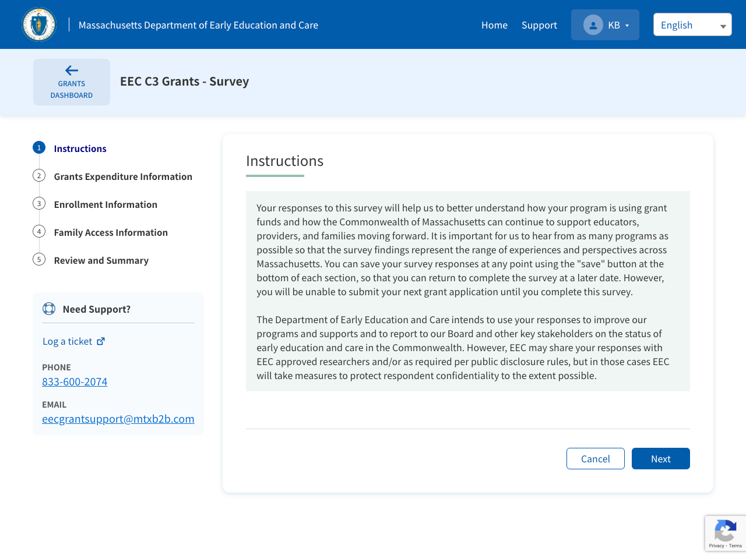
Instructions
Once you start the survey, you will land on Instructions page
Read the instructions
Click on ‘Next’ button
1
This guide provides step-by step instructions to complete FCC Grants Survey for October. The process of completing GSA survey will be the same as FCC but questions will vary.
2

Slide 12
Grant Expenditure Information

Slide 13
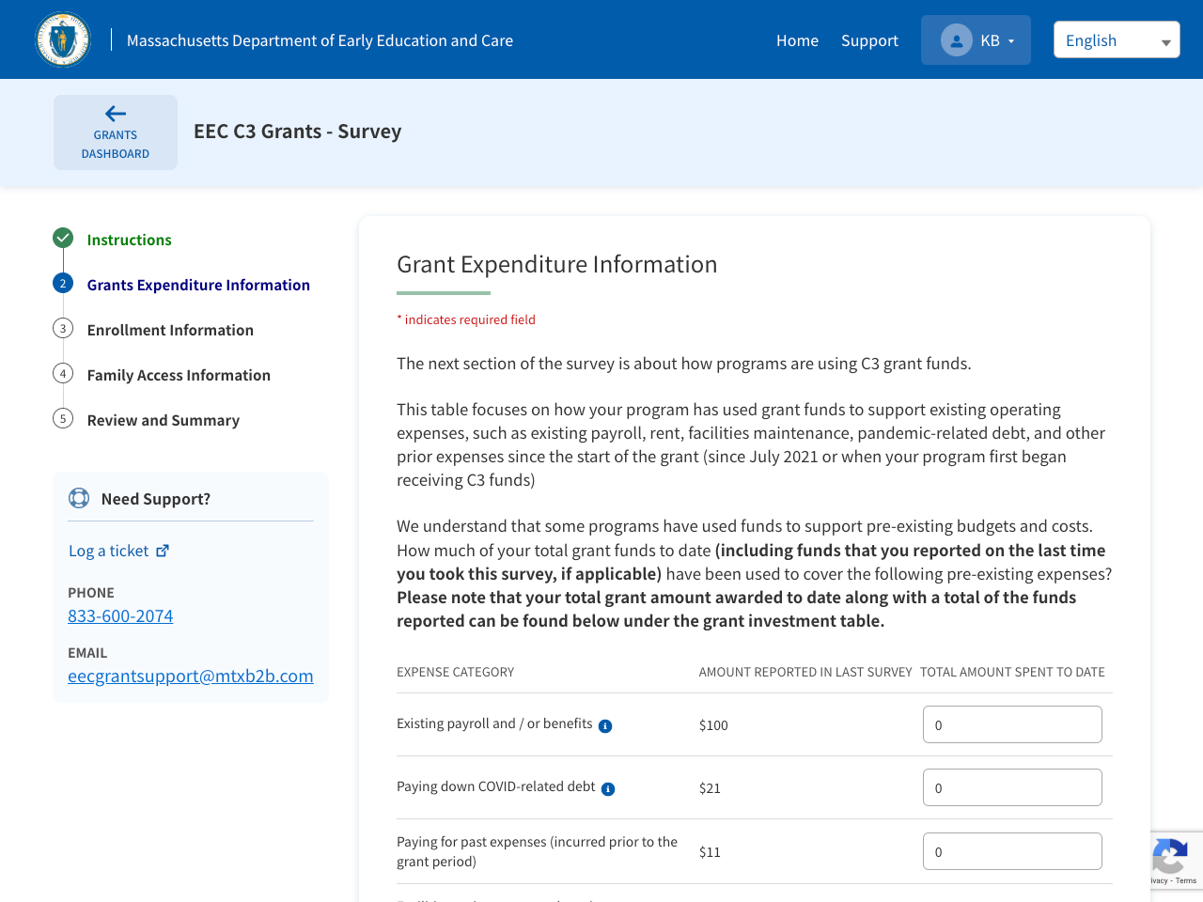
Grant Expenditure Information
Fill in the Total Amount Spent to Date
The amount reported in last Survey is auto-populated
Total Amount spent to date should be greater than the amount reported in last survey
The provider can showcase how the program is using grant funds to support existing operating expenses
The fund expenditure and investments can not exceed Grant Award

Slide 14
Grant Expenditure Information
If you have filled ‘Other Expenses’ filed, provide more information below on how you spent these funds
No key points

Slide 15
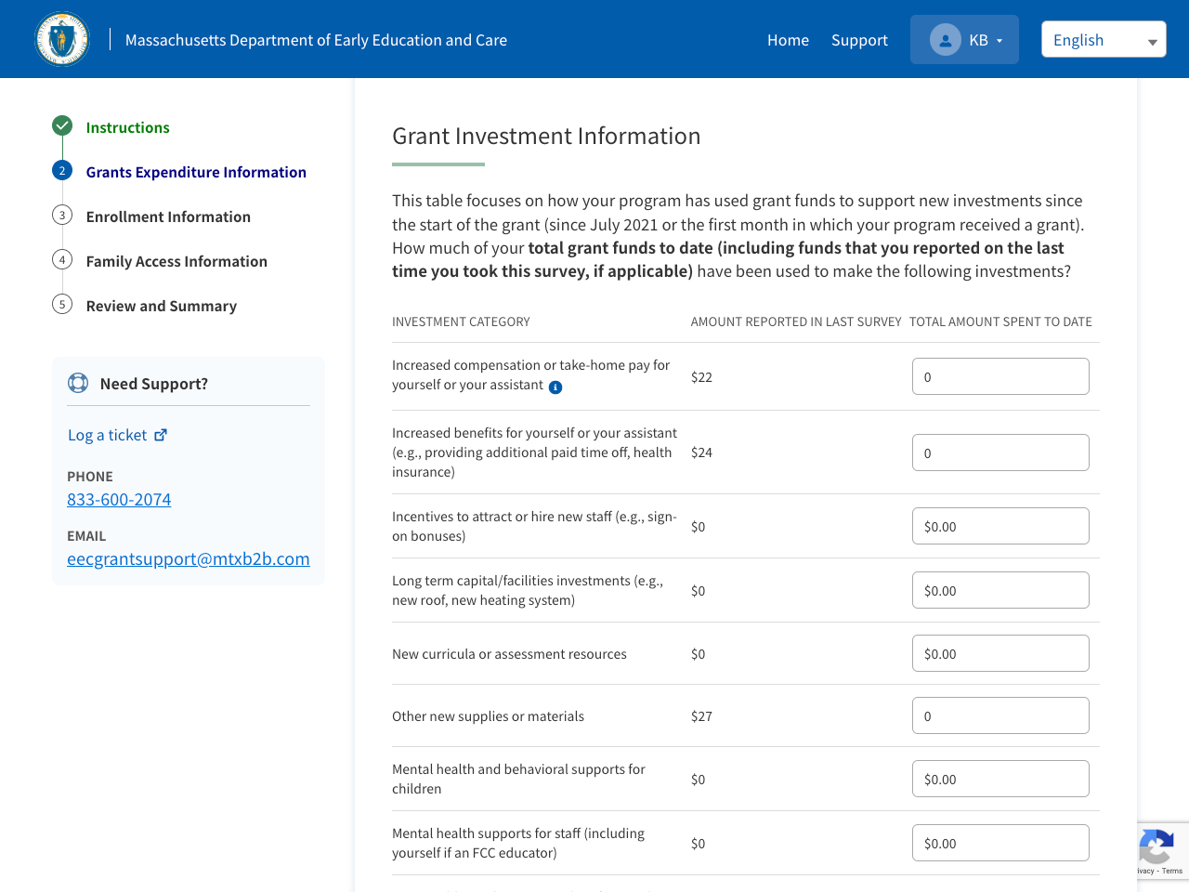
Grant Investment Information
Scroll down to ‘Grant Investment Information’ section and fill in the information
The amount reported in last Survey is auto-populated from the previous survey report
Total Amount spent to date should be greater than the amount reported in last survey

Slide 16
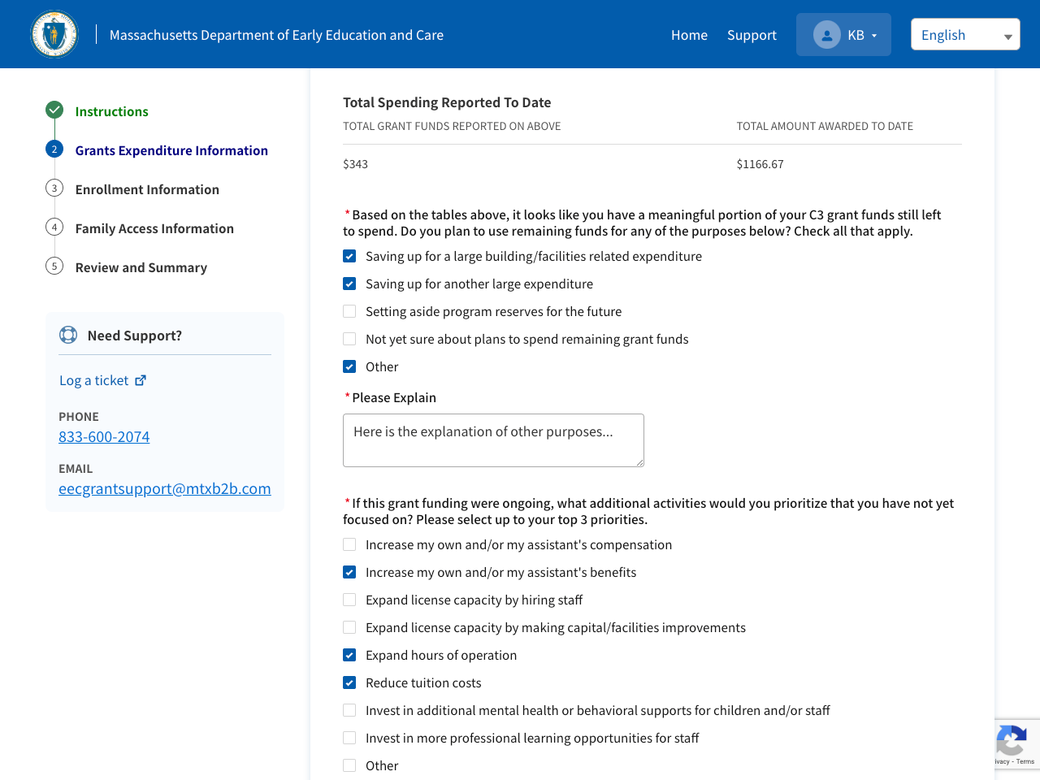
Grant Investment Information
Check the options to indicate how you plan to use grant funds that you have not yet spent
If you select Other, you need to specify your plan in the additional field
1
2
No key points

Slide 17
Workforce Investment Information
Scroll down to ‘Workforce Investment Information’ section
Answer all the questions on this page

Slide 18
Workforce Investment Information
Fill in the number of educators benefited from increased compensation since July 2022?’

Slide 19
Workforce Investment Information
If your answer is Yes to ‘have you provided incentives, such as bonuses or stipends, to any assistants’ question, enter the no.of educators benefited from incentives.
If your answer is No to the same question, proceed with next question
No key points

Slide 20
Workforce Investment Information
Select all the added or improved benefits for yourself from the list below
No key points

Slide 21
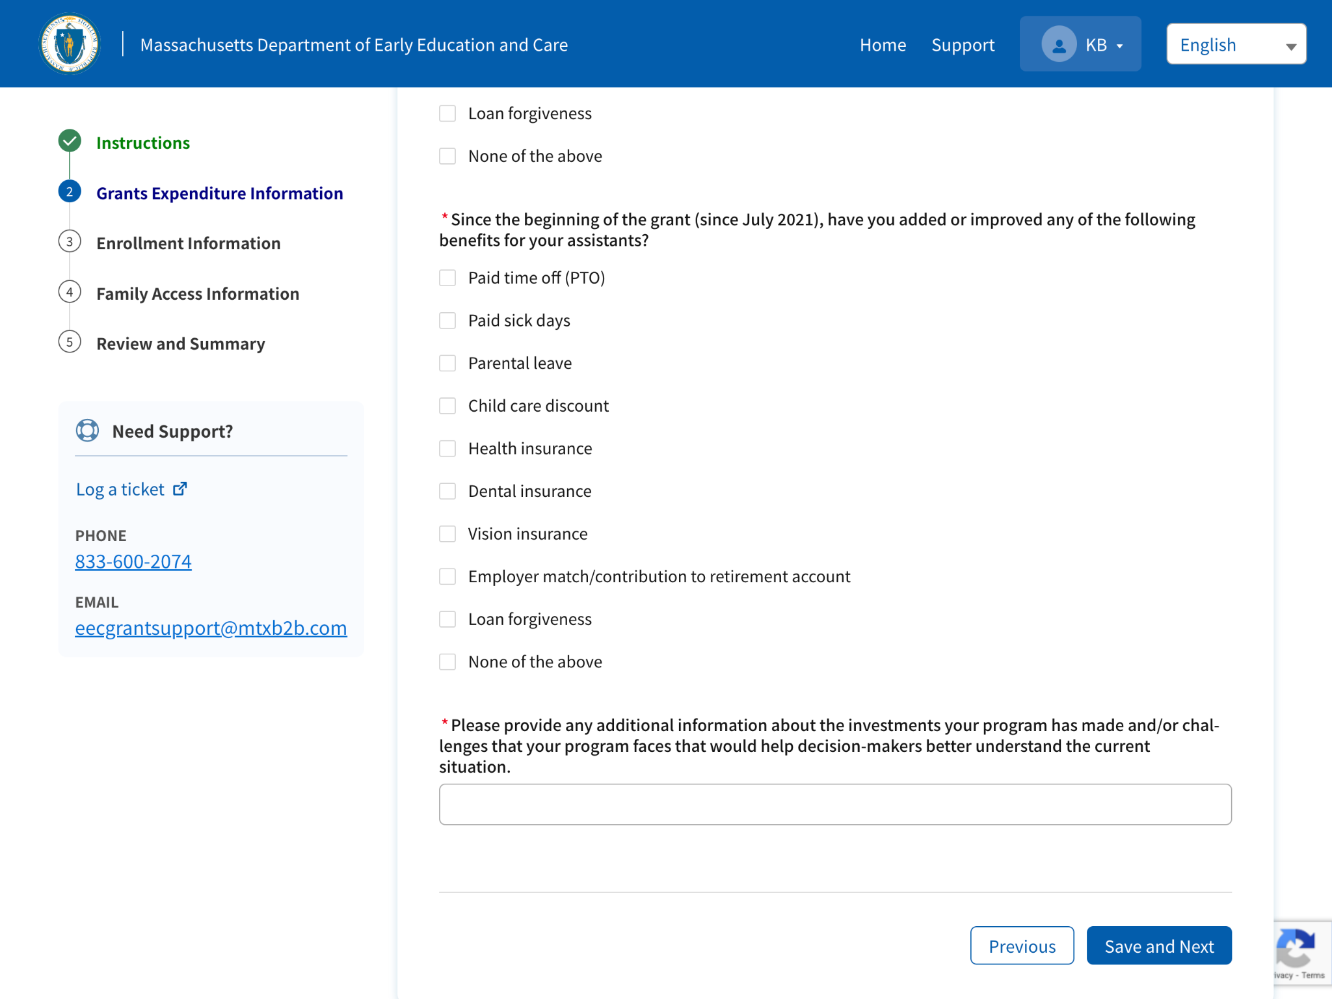
Workforce Investment Information
Select all the added or improved benefits for your assistants, from the list below
Provide additional information about the workforce investments your program has made and/or workforce challenges your program faces
Click Save and Next
1
No key points
2
3

Slide 22
Enrollment Information

Slide 23
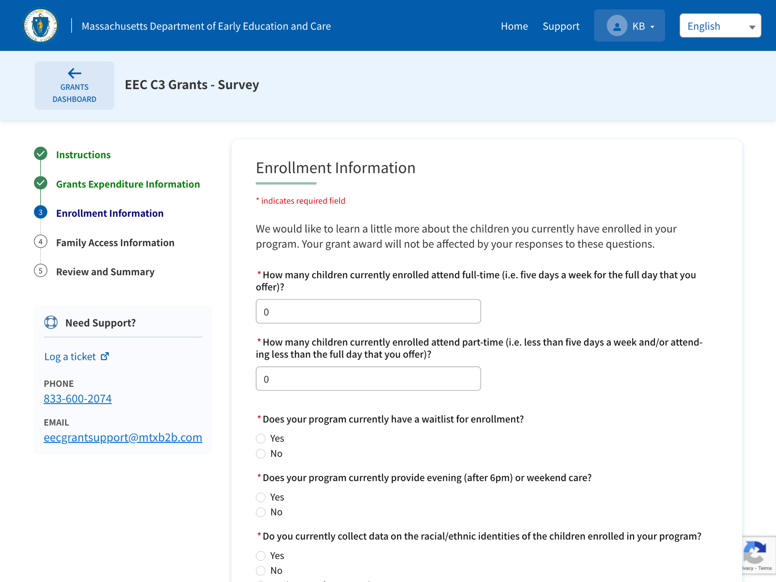
Enrollment Information
Populate all the required and mandatory fields in this section
On this page, the provider will be able to give details about currently enrolled children. Use your best guess to estimate this information as grant awards will not be affected by responses. Information provided will only be used to publicly report on child care enrollment and the impact of the public funding EEC is distributing.

Slide 24
Enrollment Information
If you answer ‘Yes’ to ‘Does your program currently have a waitlist for enrollment’ fill in the waitlist number in the subsequent field
Answer ‘Yes/No’ to ‘Does your program provide evening (after 6pm) or weekend care’ question
1
2
No key points

Slide 25
Enrollment Information
If you collect data on the racial/ethnic identities of the children enrolled in your program, check ‘Yes’, and indicate the information in the subsequent fields
Currently enrolled Hispanic children should not exceed the total number of students currently enrolled

Slide 26
Enrollment Information
If you collect data on the family incomes of the children enrolled, check ‘Yes’ and enter the number of children enrolled from each income range
After entering all the information scroll down and click Save and Next
1
The sum of children currently enrolled from families within each income range should equal the sum of children currently enrolled. If unable to estimate this information for families, a value of 0 may be entered for each section
2

Slide 27
Family Access Information

Slide 28
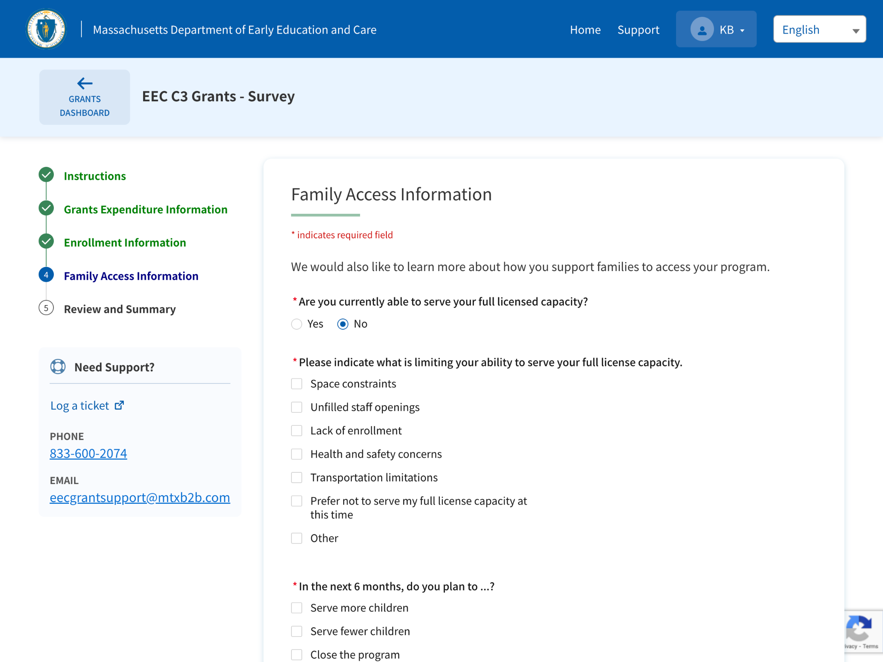
Family Access Information
If you answer ‘No’ to the ‘Are you currently able to serve full licenced capacity?’ question, check all the reasons that are limiting your ability to serve your full license capacity
No key points

Slide 29
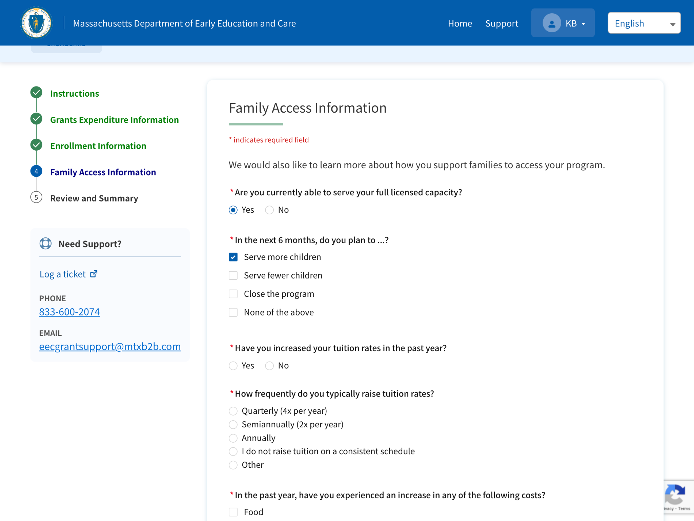
Family Access Information
If you answer Yes to ‘Are you currently able to serve full licenced capacity?’ question, select your plans in next 6 months
No key points

Slide 30
Family Access Information
If you answer Yes to ‘Have you increased your tuition rates in the past year’ question, indicate the percentage of tuition rates raised in the past year
Answer how frequently you typically raise tuition rates
Check all options for which you have experienced an increase in the past year
1
2
No key points
3

Slide 31
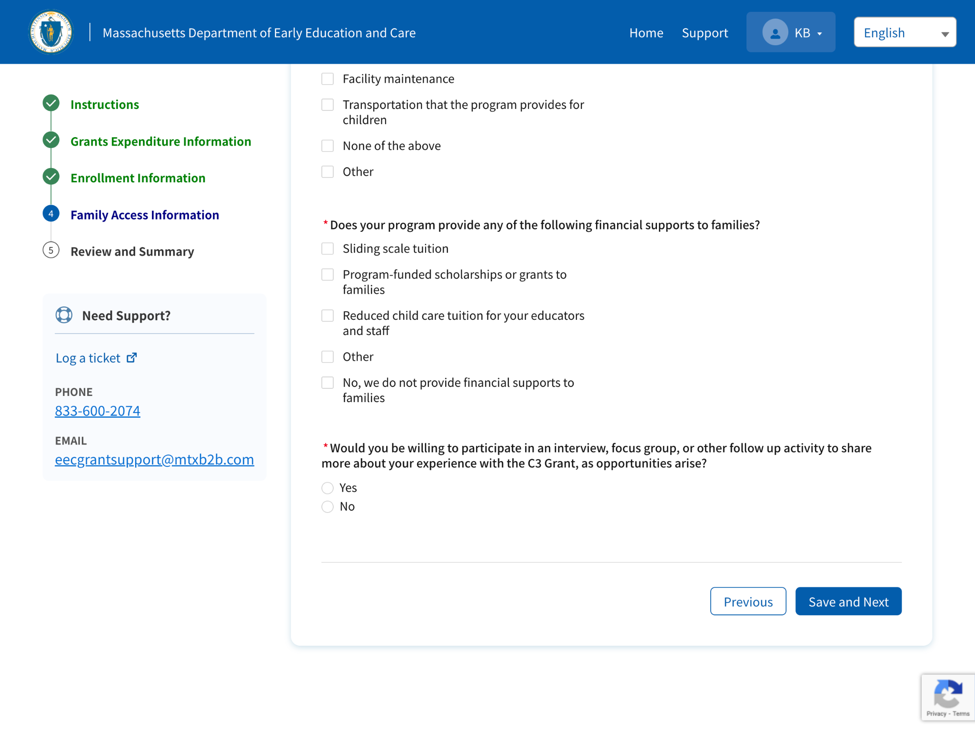
Family Access Information
Select all the financial supports your program provides to the families
Answer ‘Yes’, if you are willing to participate in an interview or focus group to share more about your experience with the C3 Grant
Click Save and Next
1
2
No key points
3

Slide 32
Review Summary

Slide 33
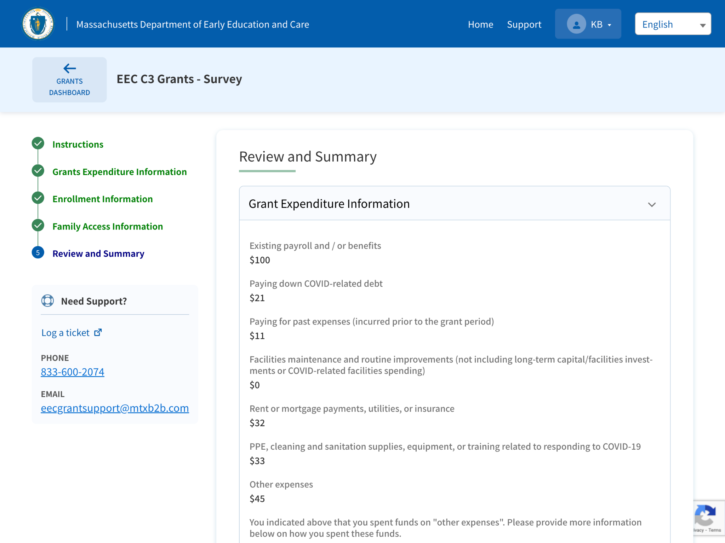
Review Summary
Review all the details
All information that was entered by the applicant in the previous sections will be populated on the Review Summary page

Slide 34
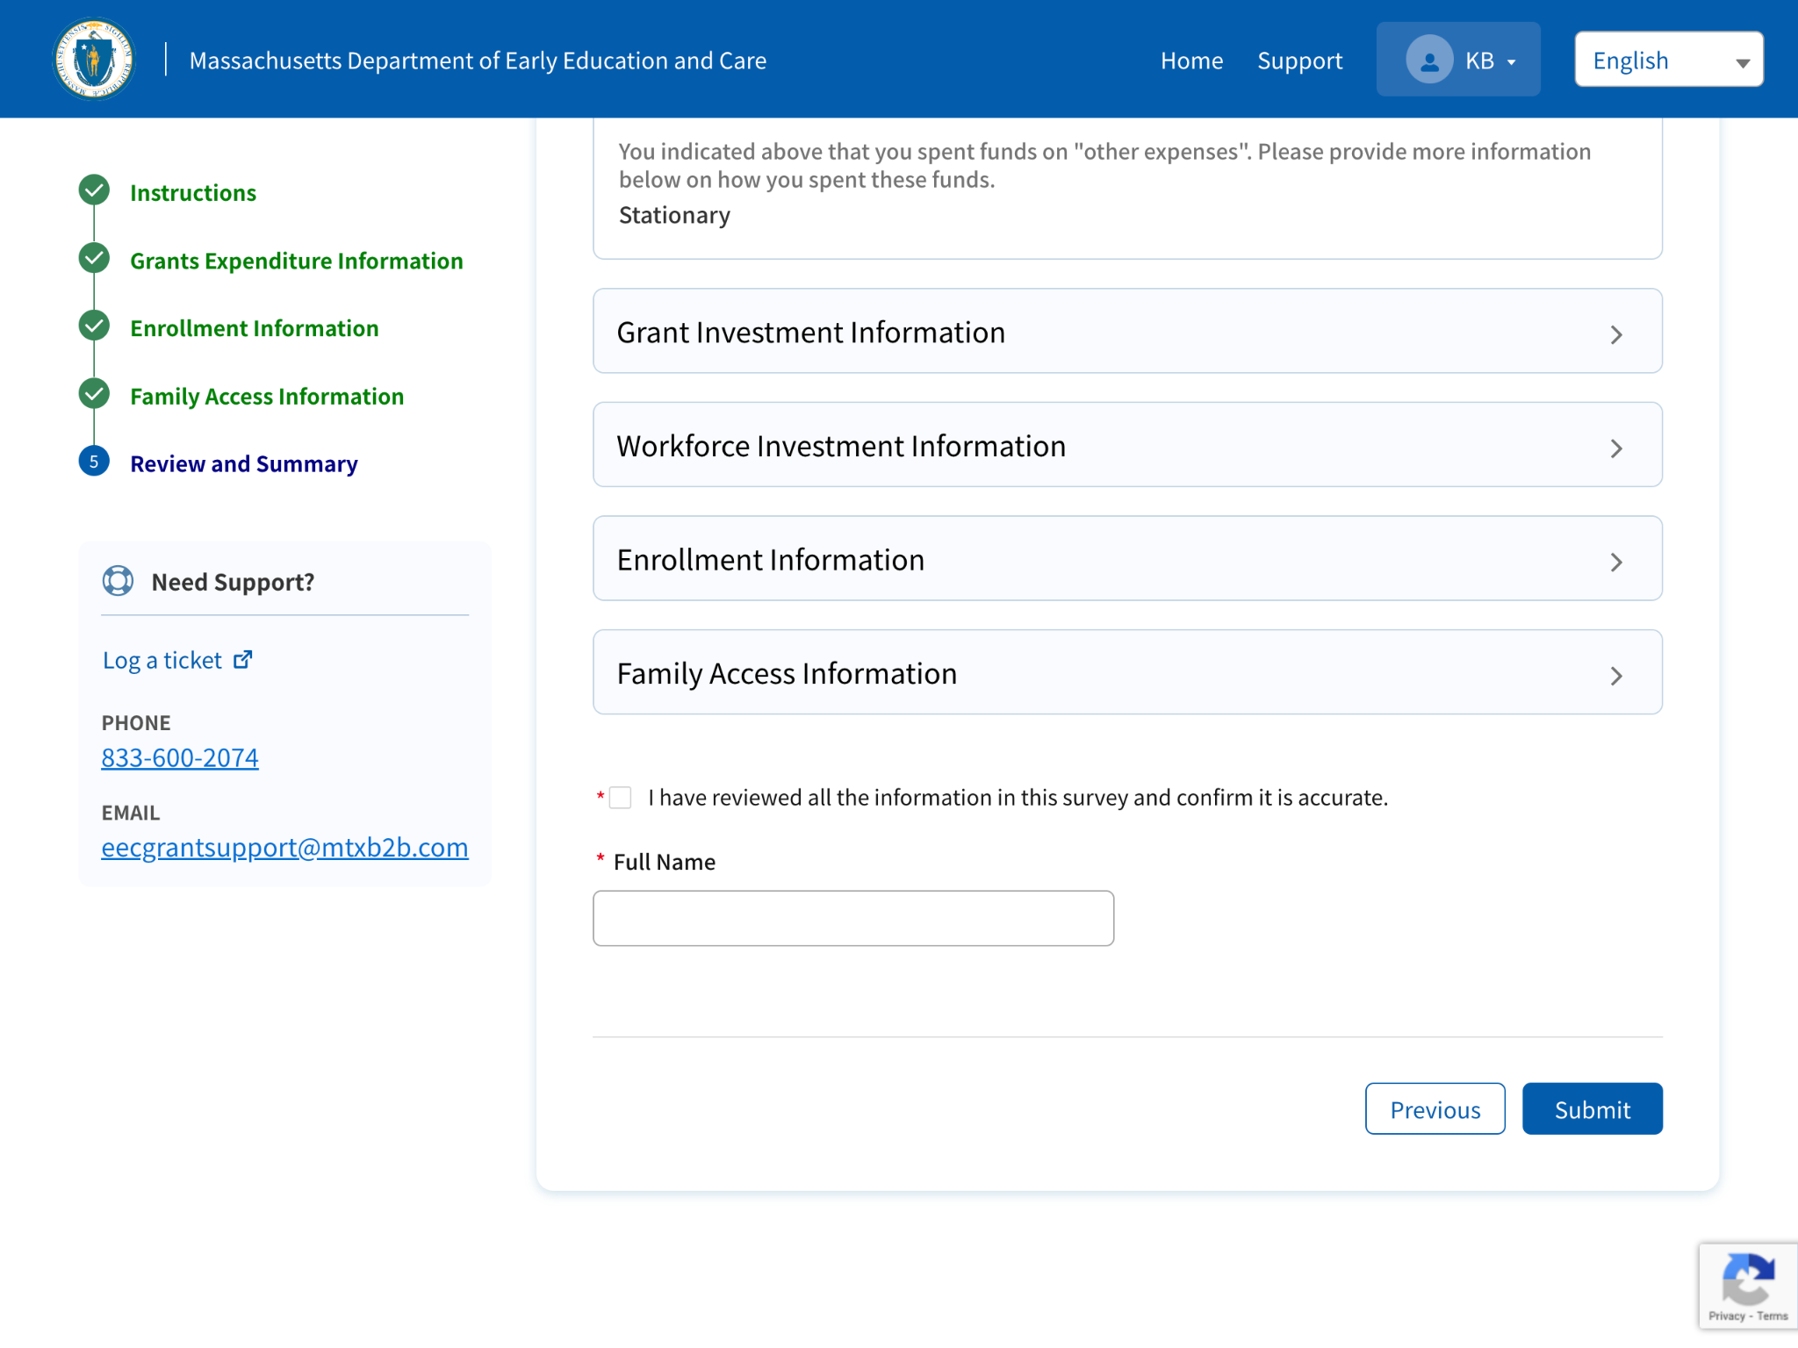
Review Summary
Click on the ‘arrows’ to expand the sections individually and review all the details
Check the attestation box
Provide Full Name
Click on Submit button
1
2
No key points
3
4

Slide 35
Dashboard
Click on Review your responses to open the Survey. You will only be able to review your responses
A success message will display on the page
The system will confirm that the survey is completed by displaying “The October Survey Form Is Complete” on the page

