Slide 1


WMC Compact & Telehealth Experience
Micah Matthews, MPA, Deputy Executive Director
Mass. Telehealth Task Force | November 12, 2025

Slide 2
Disclosures
No financial conflicts to declare. Here in my professional capacity.
No organizational conflicts to declare. Active participant in regulatory groups focusing on best practices, telehealth and AI policy.
Primary author of WMC Telehealth & Continuity of Care Policy
  FSMB
  Uniform Laws Commission

Slide 3
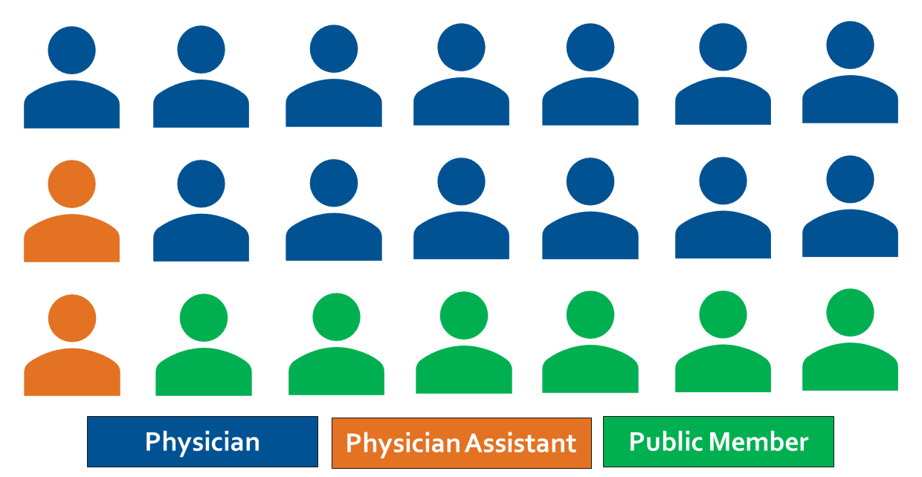
WMC Composition

Slide 4
Learning Objectives
WMCs Experience as a Compact Member State
Washington Experience with Shield Laws
Telemedicine/Practice Registries

Slide 5
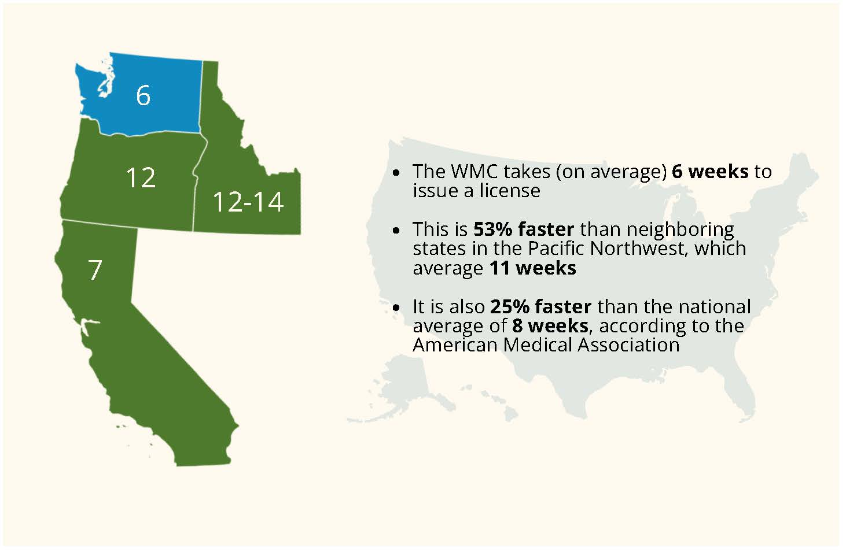
WMC Licensing Background

Slide 6
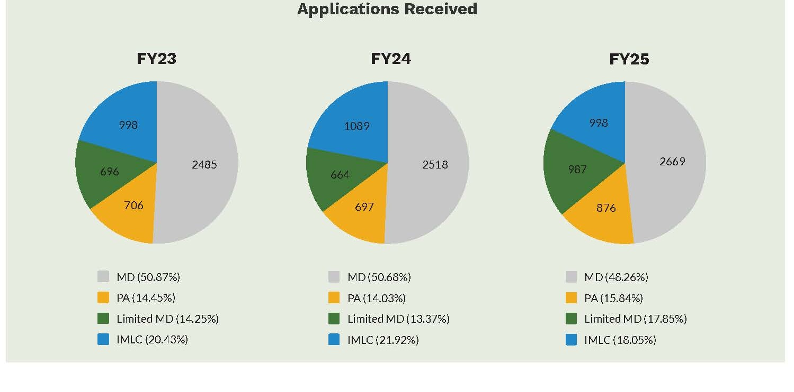

Slide 7
Background-Compact
WMC Introduced Compact in 2016, passed 2017
  Underestimation of use
  Result=extra $$$
  Did not start issuing LOQs until 2018 (IT issue)
Pandemic
  VHCP Act
  Conversion

Slide 8
Mass. Compact Questions
Has the Compact improved access?
  Rural/underserved?
  Others?
  Oregon and California
Alternative licensing models
  Clinical Experience (IMGs)
  Reciprocity
  Regional Regulation Concept

Slide 9
Shield Laws
WA 2023 legislation
  Prohibits the WMC (and others) from denying a license due to action on “Covered Services” that occurred in another state unless the standard of care was violated.
  Prohibits WMC from taking discipline related to a covered service that occurred in another state unless the standard of care was violated.
  Subpoena requirements:
    Attestation
    Submit to WA Court Jurisdiction
    Fines

Slide 10
Registries
Local access and control-regional or national reach
Common internationally
Biggest issues:
  Access and removal standards
  Legal structure to stand them up
  National, regional, affiliated models, specialty (rare disease/transplant).

Slide 11

Thank You
Micah Matthews, MPA, CPM
Deputy Executive and Legislative Director
Micah.Matthews@wmc.wa.gov

