Slide 1
Supportive Planning and Operations Team (SPOT) Initiative Webinar
Quality Assurance and Performance Improvement – An Overview
June 1, 2017
Disclaimer: Participation in this educational offering is not mandatory for regulatory compliance nor do actions or tools and resources discussed in it ensure regulatory compliance.

Slide 2
Welcome to the Webinar!
Katherine T. Fillo, Ph.D, RN-BC
Director of Clinical Quality Improvement
Bureau of Health Care Safety & Quality
Massachusetts Department of Public Health

Slide 3
Today’s Speakers
Donna Hurd, MSN, RN
Gabby Katz, MPP
Rosanna Bertrand, PhD
Jen Pettis, MSN, RN, WCC

Slide 4
Polling Question: How Many Are Participating?
How many people (including yourself) are participating in this webinar together?
1 (it’s just me)
2–3
4–5
6 or more
Participate in the poll on the right.

Slide 5
Polling Question: Who Is Participating?
Who is participating in today’s webinar?
Administrator
Director of nursing
QAPI coordinator
Department heads
Mid-level managers
Front-line staff
Participate in the poll on the right.

Slide 6
Objectives
Upon completion of the webinar, participants will be able to:
Recall elements of an effective Quality Assurance and Performance Improvement (QAPI) plan
Identify potential indicators of the outcomes of care and quality of life
List the full range of care and services provided by their facility
Name systems of care and management practices that may be included in a QAPI plan
Select examples of evidence to define and measure indicators of quality
Recognize potential adverse events that may occur in a long-term care facility

Slide 7
QAPI Requirements
The Reform of Requirements for Long-Term Care Facilities Final Rule includes QAPI requirements for all certified long-term care facilities.
Each facility must present its QAPI plan to the State Survey Agency no later than one year after the promulgation of the regulation.
However, viewing the development of a QAPI plan only as an exercise aimed at meeting a requirement is missing an opportunity to ensure a systematic, comprehensive, and data-driven approach to care.

Slide 8
Reaching Beyond Minimum Standards
Effective QAPI is not only about meeting minimum standards – it is about continually aiming higher.

Slide 9
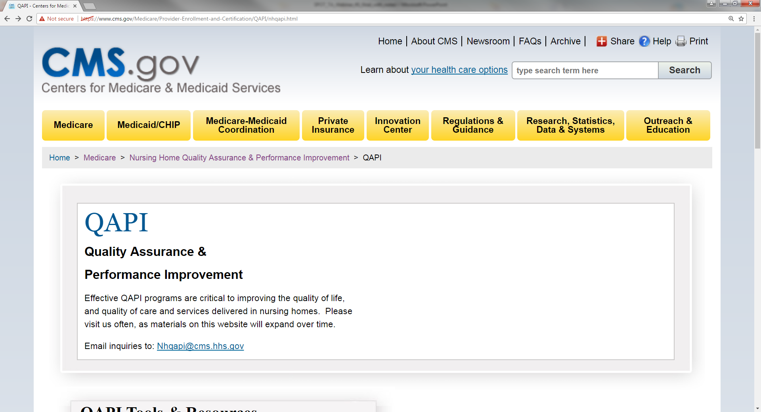
Reaching Beyond Minimum Standards
http://go.cms.gov/Nhqapi

Slide 10
An Effective QAPI Plan
Serves as a framework for an ongoing, effective, comprehensive, and data-driven QAPI program
Addresses the full range of care and services provided by the facility, all systems of care, and management practices
Includes clinical care, quality of life, and resident choice
Reflects the complexities of the facility and the unique care and services it provides
Describes how all levels of staff, residents, and families are engaged in QAPI
Is a living document

Slide 11
The Team
The composition of teams involved in QAPI activities will vary, depending on the activity.
Generally, each team should be composed of interdisciplinary members and should include various levels of staff.
Additionally, family members and residents may be team members, though for confidentiality reasons they may not review certain data or information that identifies individuals.

Slide 12
The Purpose, Guiding Principles, and Scope for QAPI
Taking time to articulate the purpose, develop guiding principles, and define the scope will help the team to:
Understand how QAPI will be used and integrated into your facility, and
Develop the written QAPI plan.

Slide 13
Purpose Statement
The purpose statement describes how QAPI will support the overall vision and mission of the facility.
May include:
What the facility team strives to achieve through the QAPI plan
How the facility team works to continuously improve the care and services received by residents
Who reviews the plan and how often the reviews occur
How and to whom revisions to the QAPI plan will be communicated

Slide 14
Guiding Principles
The guiding principles describe the facility’s beliefs and philosophy pertaining to QAPI.
Examples:
In our facility, QAPI includes all employees, all departments, and all services provided.
Our facility sets goals for performance and measures progress toward those goals.
Through QAPI, our team focuses on systems and processes, rather than individuals.
Our facility has a culture that encourages, rather than punishes, employees who identify errors or system breakdowns.

Slide 15
Scope
The scope of the QAPI plan outlines what types of care and services are provided by the facility, and includes:
Types of care (e.g., dementia care, short-term care),
Specific services (e.g., clinical care, dining services), and
Key issues (e.g., resident choice, safety).

Slide 16
Polling Question: Guiding Principles
What do QAPI guiding principles describe?
How QAPI will support the overall vision and mission of the facility
The facility’s beliefs and philosophy pertaining to QAPI
All care and services that the QAPI program will address
How the facility team works to continuously improve the care and services
Participate in the poll on the right.

Slide 17
Governance and Leadership – Roles and Responsibilities
The governing body and/or executive leadership is responsible and accountable for ensuring that:
An ongoing QAPI program is defined, implemented, and maintained while addressing identified priorities
The QAPI program is sustained during transitions in leadership and staffing
Adequate resources are available for QAPI
The QAPI program identifies and prioritizes problems and opportunities
Corrective actions address gaps in systems, and are evaluated for effectiveness
Clear expectations are set around safety, quality, rights, choice, and respect

Slide 18
Governance and Leadership – Building the Plan (1)
Describe who has the responsibility and accountability to ensure that QAPI is implemented in the facility.
Identify the members of the QAPI steering committee.
Outline how the governing body or executive leadership will be made aware of QAPI activities.
Discuss how QAPI will be adequately resourced.
Describe how the facility will ensure that all staff receive training regarding QAPI.

Slide 19
Governance and Leadership – Building the Plan (2)
Discuss how residents, families, and all levels of staff will be engaged in QAPI.
Describe how leadership fosters a culture where QAPI is a priority.
Articulate leadership’s expectations around safety, quality, rights, choice, and respect by balancing safety with resident-centered rights and choice.
Discuss how leadership establishes and maintains a climate of open communication and respect.

Slide 20
Using the Best Available Evidence
The facility must utilize the best available evidence to define and measure indicators of quality and facility goals that reflect processes of care, and facility operations that have been shown to be predictive of desired outcomes for residents of a nursing home.
Potential sources of evidence include:
State and national benchmarks,
Published best practices, and
Clinical guidelines.

Slide 21
Incorporating Feedback, Data Systems, and Monitoring
Systems, policies, and procedures related to program feedback, data systems, and monitoring should address how the facility:
Obtains and uses feedback and input from direct care staff, other staff, residents, and resident representatives
Identifies, collects, and uses data and information from all departments, including using the information to develop and monitor performance indicators
Develops, monitors, and evaluates performance indicators
Systematically identifies, reports, tracks, investigates, analyzes, and uses data and information related to adverse events in the facility

Slide 22
Potential Adverse Events in Nursing Homes
The Centers for Medicare & Medicaid Services (or CMS) has categorized potentially preventable adverse events into three categories including those related to:
Medication,
Resident care, and
Infections.
See the complete list: https://www.cms.gov/Medicare/Provider-Enrollment-and-Certification/QAPI/Downloads/Potentially-Preventable-Adverse-Events.pdf

Slide 23
Feedback, Data Systems and Monitoring – Building the Plan
Describe the overall system that will be put in place to monitor care and services, drawing data from multiple sources.
Identify the sources of data that the team will monitor.
Describe the process for collecting, analyzing, and communicating the information.
Identify who will receive the information, in what format, and how frequently information will be disseminated.

Slide 24
Examples of Measures/Indicators
Process Measures
Outcome Measures
The percentage of newly admitted residents receiving admission skin assessments
The percentage of residents who were offered an annual influenza vaccination
The percentage of residents whose dietary preferences were obtained and documented
The percentage of residents with nursing home acquired pressure ulcers
Resident and family satisfaction scores
Infection rates
The percentage of residents with functional improvement or decline

Slide 25
Polling Question – Potential Sources of Evidence
Which of the following represent potential sources of evidence to define indicators of quality? Select all that apply.
Office of Inspector General reports
Occupational Safety and Health Administration (OSHA) guidelines
Information from the Centers for Disease Control and Prevention (CDC)
Resources from the Agency for Healthcare Research and Quality (AHRQ)
Participate in the poll on the right.

Slide 26
Utilizing Systematic Analysis and Systemic Action
In the QAPI plan, nursing home teams should articulate how they will:
Use a systematic approach to determine underlying causes of problems,
Develop corrective actions that will be designed to effect change at the systems level, and
Monitor the effectiveness of performance improvement activities.

Slide 27
Systematic Analysis and Systemic Action – Building the Plan (1)
Describe how the facility team will use a systematic approach to fully understand the root cause of an issue and the systems involved.
Examples of tools the team can use to identify the cause and contributing factors:
Failure Mode and Effects Analysis (FMEA)
Five Whys
Fishbone Diagram
Flowcharting

Slide 28
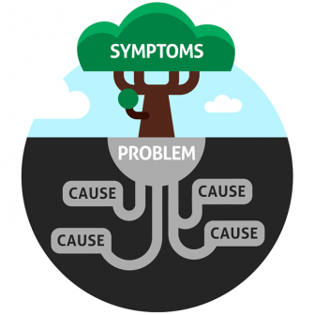
Systematic Analysis and Systemic Action – Building the Plan (2)
Choose actions that are tightly linked to the root causes and that lead to a system or process change.
Interventions or corrective actions should:
Target the elimination of root causes,
Be achievable, objective, and measurable, and
Prevent future events and promote sustained improvement.

Slide 29
Program Activities
Set priorities for performance improvement activities that focus on high-risk, high-volume, or problem-prone areas
Track, analyze, and prevent medical errors and resident events
Conduct distinct performance improvement projects (PIPs)

Slide 30
Program Activities – Building the Plan
Describe how the facility team will:
Conduct PIPs,
Identify potential topics for PIPs,
Prioritize PIPs,
Charter PIPs, and
Designate PIP teams.
Discuss how PIP teams will conduct their work.

Slide 31
The PDSA Model
Plan
Do
Study
Act

Slide 32
Recap
In today’s webinar, we shared:
Several elements of an effective QAPI plan
Information about and examples of process and outcome measures/indicators
Ideas that may help you to define all types of care and services provided by your facility as well as systems of care and management practices that may be included in a QAPI plan
Examples of evidence to define and measure indicators of quality
Information about potential adverse events that may occur in a long-term care facility

Slide 33
Contact Us!
Email the Abt SPOT Initiative Team at:
NursingHomeQI@massmail.state.ma.us

Slide 34
Questions and Webinar Evaluation

Slide 35
Resources
Advance Copy - Revisions to State Operations Manual (SOM), Appendix PP Revised Regulations and Tags https://www.cms.gov/Medicare/Provider-Enrollment-and-Certification/SurveyCertificationGenInfo/Downloads/Survey-and-Cert-Letter-17-07.pdf
Medicare and Medicaid Programs; Reform of Requirements for Long-Term Care Facilities: Final Rule https://www.federalregister.gov/documents/2016/10/04/2016-23503/medicare-and-medicaid-programs-reform-of-requirements-for-long-term-care-facilities

Slide 36
References
QAPI at a Glance (includes several tools to support teams in developing their QAPI plans, including the Guide for Developing Purpose, Guiding Principles, and Scope for QAPI, the Guide for Developing a QAPI Plan, and the Goal Setting Worksheet) https://www.cms.gov/medicare/provider-enrollment-and-certification/qapi/downloads/qapiataglance.pdf
Centers for Medicare & Medicaid Services Nursing Home QAPI Web site (includes links to many tools and resources): http://go.cms.gov/Nhqapi

