Slide 1
Supportive Planning and Operations Team (SPOT) Initiative
Root Cause Analysis
July 20, 2017
Disclaimer: Participation in this educational offering is not mandatory for regulatory compliance nor do actions or tools and resources discussed in it ensure regulatory compliance.

Slide 2
Welcome to the Webinar!
Suzanne Cray, Director
Health Care Integration and Strategic Initiatives
Bureau of Health Care Safety & Quality
Massachusetts Department of Public Health

Slide 3
Today’s Speakers
Donna Hurd, MSN, RN
Gabby Katz, MPP
Rosanna Bertrand, PhD
Jen Pettis, MS, RN, WCC

Slide 4
Objectives
Upon completion of this webinar, attendees will be able to:
Describe the steps in the root cause analysis (RCA) process,
Explain what types of incidents or events are appropriate for RCA,
Describe who should be on the team to conduct RCA, and
Describe the difference between a contributing factor and a root cause.

Slide 5
What is RCA?
RCA is a process for identifying the underlying factors or causes of an adverse event or near-miss.
Often what seems to be the obvious reason for an event or problem may not be the real reason behind it.
RCA leads to digging deeper and deeper looking for the reasons behind the reasons.

Slide 6
RCA Example
Problem: Medications are not delivered to residents in a timely manner. Often medications scheduled for 8 a.m. are not delivered until 9:30 a.m. or later.
Possible reason: Nurses are not aware of the facility policy requiring delivery of medications within a two-hour window (1 hour before and 1 hour after scheduled time).
Possible solution: In-service or retrain the nurses.
RCA: All morning medications on the unit are scheduled for the same time (8 a.m.) allowing only about 2 minutes/resident.
Stronger solution: Address the root cause by allowing nurses more time (stagger medication times).

Slide 7
The Goals of RCA
To find out:
What happened,
Why it happened, and
What changes need to be made to prevent it from happening again.

Slide 8
Getting Started with RCA
Identify a problem that needs RCA.
Assemble a team.
Construct the timeline of events.
Identify contributing factors.

Slide 9
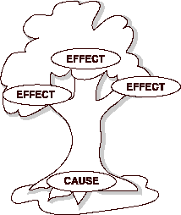
Getting Started with RCA (cont.)
Identify root causes.
Design the “fix.”
Measure success.

Slide 10
Step 1: Identify the Problem
Events and issues may come from a variety of sources, for example:
Incident reports,
DPH citations,
Resident or family complaints, or
Staff report of near-misses.
High priority should be given to events that resulted (or could have resulted) in significant harm to a resident.

Slide 11
Step 1: Identify the Problem (cont.)
The facility should have a process for selecting events that require RCA.
Once a problem is identified, gather preliminary information (e.g., incident reports, details of the event).

Slide 12
Example Problem
CNA Mary needed to transport Mrs. T to the dining room.
She located a wheelchair and brought it to Mrs. T’s room.
She assisted Mrs. T. into the wheelchair.
Mary noticed blood on Mrs. T’s pant leg and a long nasty gash on her calf.
“She may need stitches,” explained the charge nurse. “What happened?”
The footrests on the wheelchair did not fully swivel out of the way for the transfer.
“Maybe she cut her leg on the footrest,” Mary responded.

Slide 13
Polling Question
Please check all that apply. What details do we know?
The resident sustained an injury requiring stitches while transferring into a wheelchair.
The CNA was not careful during the transfer.
The injury may have happened during a transfer to the wheelchair.
The CNA explained the process of the transfer to the resident.
The CNA used a gait belt with the transfer.
The footrests on the wheelchair did not fully swivel out of the way for the transfer.

Slide 14
Let’s Chat!
Based on our example, what additional details would we want to know?
Please use the chat feature on the webinar to type in other things that you may want to find out through an RCA.

Slide 15
Step 2: Assemble the Team
Designate a leader.
Individuals selected must be familiar with the processes and systems associated with the event.
Individuals involved in the event may or may not be appropriate for the team.
Keep the number of supervisory people involved to a minimum.
Maintain confidentiality.

Slide 16
Step 2: Assemble the Team (cont.)
At the first meeting:
Orient the team to the RCA process,
Explain role of the leader and members,
Assign someone to record notes,
Decide meeting dates and times, and
Review rules of behavior and expectations.

Slide 17
Step 3: Construct a Timeline
Share preliminary details of the event.
Outline the event beginning with the first known fact and progressing through the final known fact.
Stick with the facts at this stage; causal factors are added later.

Slide 18
Step 3: Construct a Timeline (cont.)
CNA went to resident room with the wheelchair
CNA explained transfer process to resident
CNA helped the resident stand and transfer from lounge chair to wheelchair
CNA placed gait belt on resident
CNA saw blood on resident’s leg and notes skin tear
Resident was transferred to ED for evaluation
CNA notified charge nurse
Resident returned from ED with 25 sutures in calf

Slide 19
Step 3: Construct a Timeline (cont.)
Does the timeline “tell the story” of the incident?
If not, the timeline may need to be extended further back in time or expanded to include what happened after the event.
Does each step logically flow from the one preceding it?

Slide 20
Step 4: Identify Contributing Factors
Contributing factors are situations, circumstances, or conditions that increase the likelihood of an adverse event.
Look at each step of the timeline while the group brainstorms.
Ask what was going on at each step that might have increased the likelihood the event would occur.

Slide 21
Step 4: Identify Contributing Factors
CNA had a hard time finding a wheelchair. She found the one she used buried in a unit closet.
Maintenance had tagged the wheelchair to not be used but did not remove it from the unit.
The CNA did not notice that the wheelchair was tagged; a tag was found on the floor of the closet during the investigation.
CNA went to resident room with the wheelchair.
There is no consistent process to notify the maintenance dept. that something needs repair. Sometimes nursing calls maintenance directly, sometimes issues are reported to the DON or Administrator.
Maintenance is responsible for wheelchair repairs but they do not have a system for regular checking of chairs.

Slide 22
Step 4: Identify Contributing Factors
CNA looked around for someone to help her but everyone was busy or off the floor on break.
The resident was late for a special activity that she was looking forward to.
CNA uses the wheelchair even after she notices that both footrests will not swing completely back.
CNA saw blood on resident’s leg and notes skin tear.
CNA helped the resident stand and transfer from lounge chair to wheelchair .
The CNA was reprimanded the previous week for not completing her assignment on time.

Slide 23
Step 5: Identify Root Causes
All incidents have a direct cause.
The direct cause may not be the root cause.
Root causes are underlying faulty process or system issues that lead to a harmful or potentially harmful event.
There may be more than one root cause.
Contributing factors are not root causes.

Slide 24
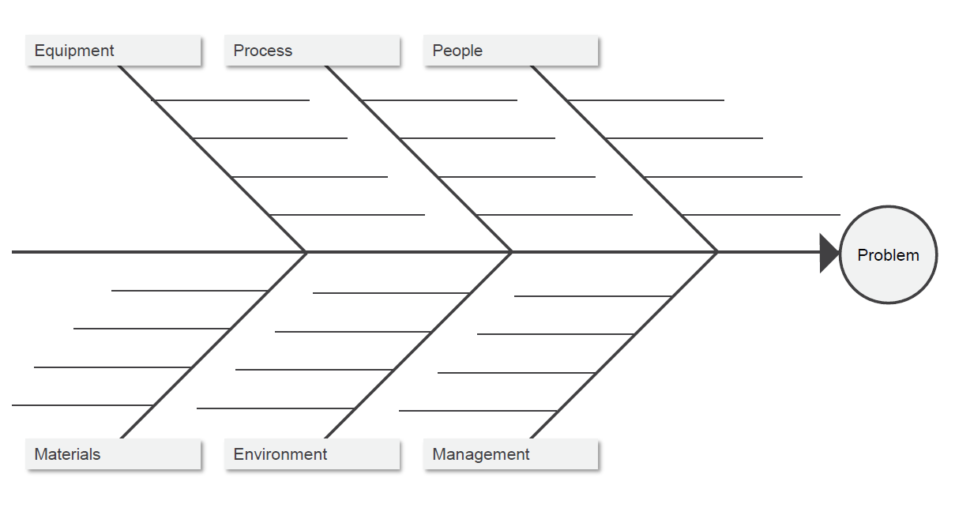
Step 5: Identify Root Causes
Use RCA tools!
Five Whys
Fishbone Diagram

Slide 25
Tools for Conducting RCA
Five Whys Tool
Ask why or what caused this problem.
Ask if this response was corrected, would the problem reoccur.
If yes, then this is a contributing factor, not a root cause.
Keep asking why until the root cause is identified.

Slide 26
Five Whys Example
Problem
Mrs. T has a laceration on her leg.
Why?
Because she hit her leg on the wheelchair footrest.
Why?
Because the footrest did not fold back out of the way.

Slide 27
Five Whys Example (cont.)
Why?
Because the chair is old or damaged.
Why?
Because there is no set process or schedule for ensuring wheelchair maintenance or for removing damaged equipment from the units.
Why?
Because the footrest was stuck or didn’t stay back when the aide pushed it back.

Slide 28
Fishbone Diagram
The Fishbone Tool is a cause and effect diagram.
Can help the team to sort ideas into categories.
Problem is the head of the fish.
Contributing factors are the bones of the fish.

Slide 29
Fishbone Diagram
Equipment
Process
People
No consistent system for notifying Maintenance about repairs
Wheelchair with sharp edge
CNA uses wheelchair even though damaged
CNA unable to find wheelchair
CNA rushing to complete assignment
Maintenance has no system for regular checking of wheel chairs
Wheelchair tagged “not for use”
CNA trying to get resident to activity
Wheelchair tagged but not removed from unit
CNA unable to find someone to help
Resident with serious injury
Maintenance tag on the floor
Wheelchair shoved in the closet
CNA reprimanded for not completing assignment on time
CNAs not assigned breaks that ensure adequate staffing coverage
Materials
Environment
Management

Slide 30
Step 6: Design and Implement Changes
Evaluate each root cause to determine how to best reduce or eliminate it.
Choose actions that address each root cause.
Develop at least one corrective action for each root cause.
Aim for corrective actions ranked strong or intermediate.
Corrective actions that change the system and do not allow errors are the strongest.

Slide 31
Step 6: Design and Implement Changes (cont.)
Examples of Actions by Strength Category
Stronger | Intermediate | Weaker
Architectural/ physical plant changes New device with usability testing before purchasing Simplify the process and remove unnecessary steps Standardize equipment or process | Checklist/cognitive aid Eliminate look- and sound-alikes Read back Enhanced documentation/ communication Redundancy | Double-checks Warnings and labels New memorandum Training Additional study/analysis

Slide 32
Polling Question
Which corrective action is unlikely to result in lasting change?
Development of a checklist
Simplifying the process
Reminding staff of a step
Standardizing equipment

Slide 33
Step 6: Design and Implement Changes (cont.)
Clearly state what is to be done, by whom, and when.
Clearly defined plans will enable monitoring of implementation of corrective actions.
If a particular action cannot be accomplished, look for other ways to change the process – doing nothing should not be an option.

Slide 34
Step 7: Measure Success
Gather data to measure success of corrective actions.
Measure the following:
Was the corrective action implemented?
Are staff complying with changes
Have the changes made a difference?

Slide 35
Additional Handout
Root Cause Analysis Performance Improvement Project (PIP) Template

Slide 36
Questions and Webinar Evaluation

