Slide 1
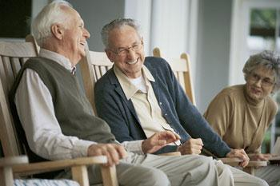
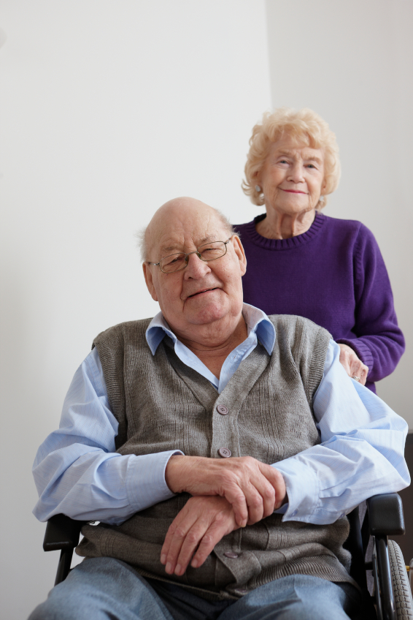
Supportive Planning and Operations Team (SPOT) Initiative
Team Communication
September 28, 2017
Disclaimer: Participation in this educational offering is not mandatory for regulatory compliance nor do actions or tools and resources discussed in it ensure regulatory compliance.

Slide 2
Welcome to the Webinar!
Suzanne Cray, Director
Health Care Integration and Strategic Initiatives
Bureau of Health Care Safety & Quality
Massachusetts Department of Public Health

Slide 3
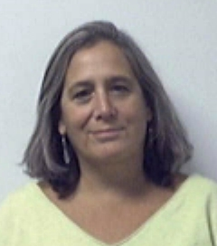
Today’s Speakers
Donna Hurd, MSN, RN
Gabby Katz, MPP
Rosanna Bertrand, PhD
Jen Pettis, MS, RN, WCC

Slide 4
Polling Question: How Many Are Participating?
How many people (including yourself) are participating in this webinar together?
1 (it’s just me)
2 – 3
4 – 5
6 or more
Participate in the poll on the right.

Slide 5
Polling Question: Who Is Participating?
Who is participating in today’s webinar?
Administrator
Director of nursing
QAPI coordinator
Department heads
Mid-level managers
Front-line staff
Other
Participate in the poll on the right.

Slide 6
Objectives
Upon completion of this webinar, attendees will be able to:
List characteristics of effective communication.
Identify challenges to effective communication within a nursing home.
Describe how staff can use Briefs, Huddles, and the CUS technique to promote resident safety.
Explain how the Two-Challenge Rule can be used to ensure resident safety concerns are clearly articulated and understood.

Slide 7
The Importance of Effective Communication
“According to sentinel event data compiled by the Joint Commission between 1995 and 2005, ineffective communication was identified as the root cause of 66 percent of reported errors.”
Source: Agency for Healthcare Research and Quality. (2015). TeamSTEPPS for office-based care: Communication. Retrieved from https://www.ahrq.gov/teamstepps/officebasedcare/module3/office_comm.html

Slide 8
Effective Communication
All team members should speak up and feel safe doing so.
Effective communication:
Promotes resident safety and quality.
Helps staff members understand what is expected.
Enhances staff resident and family satisfaction.

Slide 9
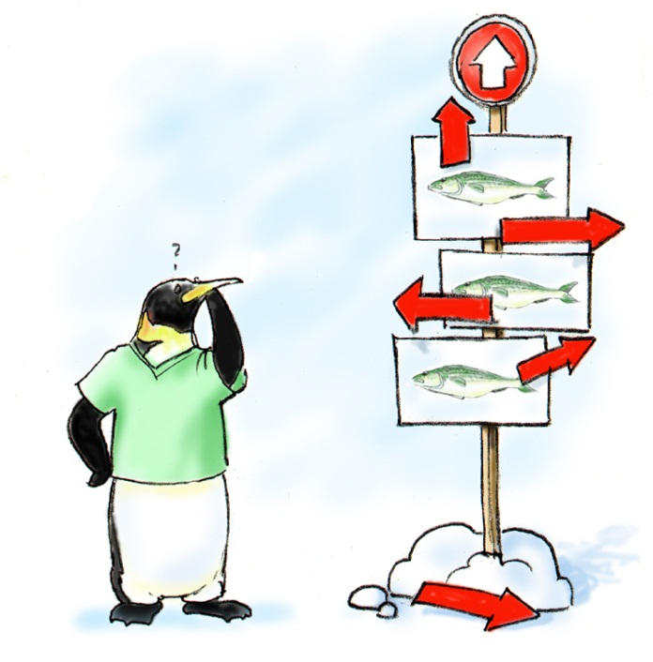
Effective Communication
Brief
Timely
Complete
Clear

Slide 10
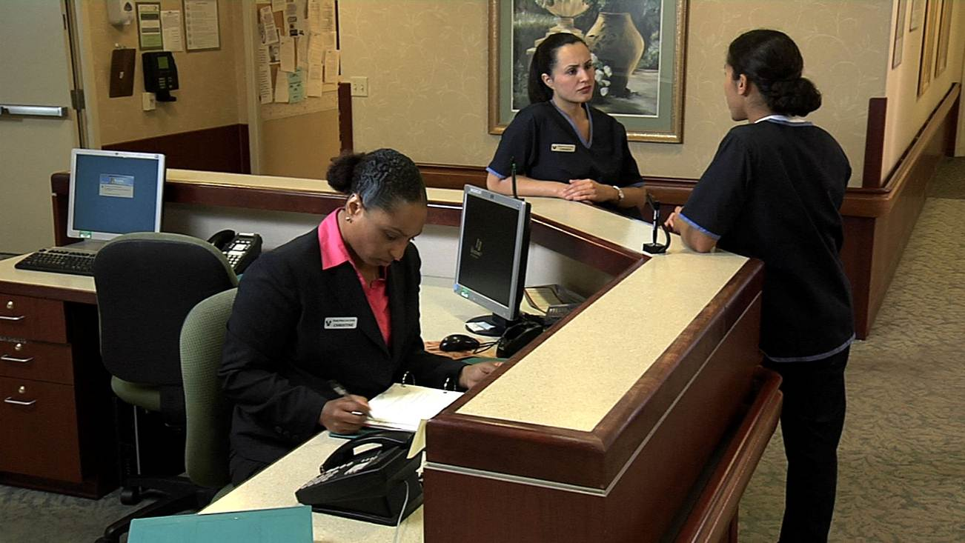
Opportunities to Improve Team Communication Video

Slide 11
Video Debrief
Did the team members communicate essential information to each other?
Did the team demonstrate mutual respect toward one another?
Did the team address issues and concerns?
What are some specific actions that could have been taken to improve the outcome?

Slide 12
Let’s Chat: Challenges to Effective Communication
What are some challenges that may limit the effectiveness of communication?

Slide 13
TeamSTEPPS® Can Help!
TeamSTEPPS® stands for Team Strategies and Tools to Enhance Performance and Patient Safety.
TeamSTEPPS® focuses on team structure and the teamwork system, leadership, situation monitoring, mutual support, and communication.

Slide 14
Effective Communication
Some things to consider when communicating:
The audience.
The mode of communication.
The standards associated with the specific mode of communication.
The power of nonverbal communication.

Slide 15
Communication Strategies
Briefs
Huddles

Slide 16
Briefs
Planning is essential for team success.
Briefs:
Clarify who will lead the team.
Open lines of communication.
Prepare the team.
Reduce disruptive or unexpected behaviors.

Slide 17
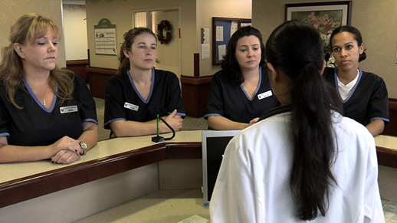
Briefs
Team membership and role
Clinical status of the team’s residents
Team goals, pitfalls and barriers
Issues affecting team operations

Slide 18
Video Debrief
Who is the team leader?
Did the team develop a comprehensive plan?
Did the team address contingencies?

Slide 19
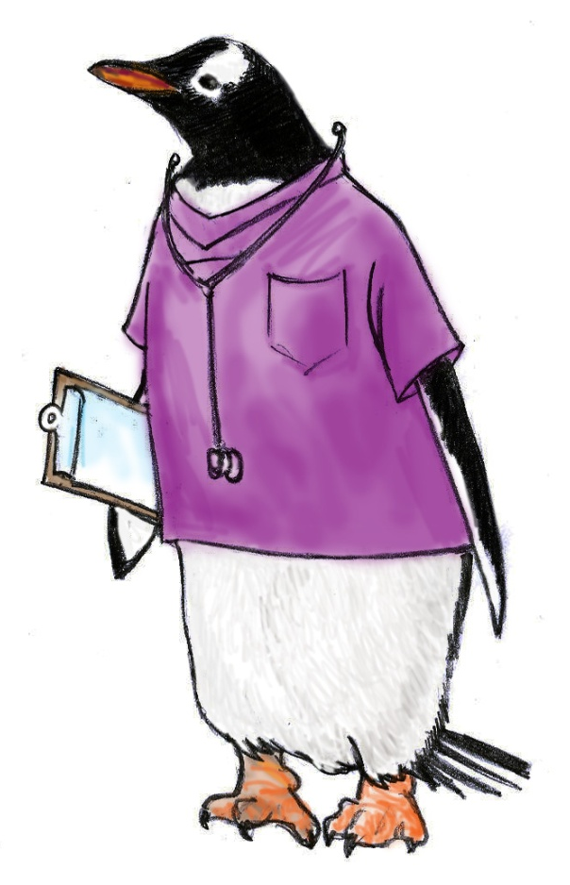
Briefing Checklist Example

Slide 20
Huddle
Ad hoc, “touch-base” meetings that allow the team to:
Reinforce plans.
Solve problems.
Discuss critical issues and emerging events.
Anticipate outcomes and likely contingencies.
Assign resources.
Express concerns.

Slide 21
Video Debrief
What necessitated the huddle?
What key information was shared?

Slide 22
A Huddle Example

Slide 23
Polling Question
Please check all that apply. Which of the following likely warrant a huddle?
Concerns about a specific resident’s condition.
Changes in staffing that occur mid-shift.
A newly-scheduled resident appointment that will occur in three weeks.
A call from a family during which they expressed concerns about their loved one.
An outbreak of illness on another unit in the nursing home.

Slide 24
Two-Challenge Rule
1
2

Slide 25
The Two-Challenge Rule
Advocate and assert your statement at least twice if the initial assertion is ignored.
Two attempts may come from the same person or different team members.
If no response, take a stronger course of action.

Slide 26
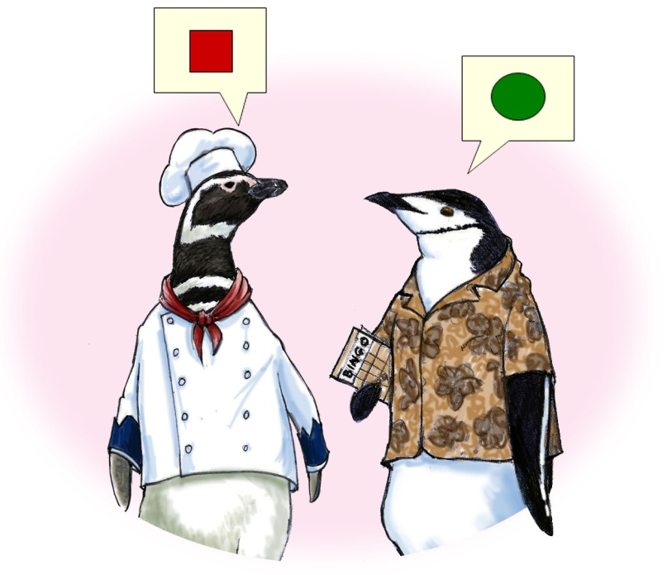
What if You are Challenged by a Team Member with the Two-Challenge Rule?
Don’t ignore it; instead acknowledge the concerns.
Stop.
Resolve the safety issue.

Slide 27
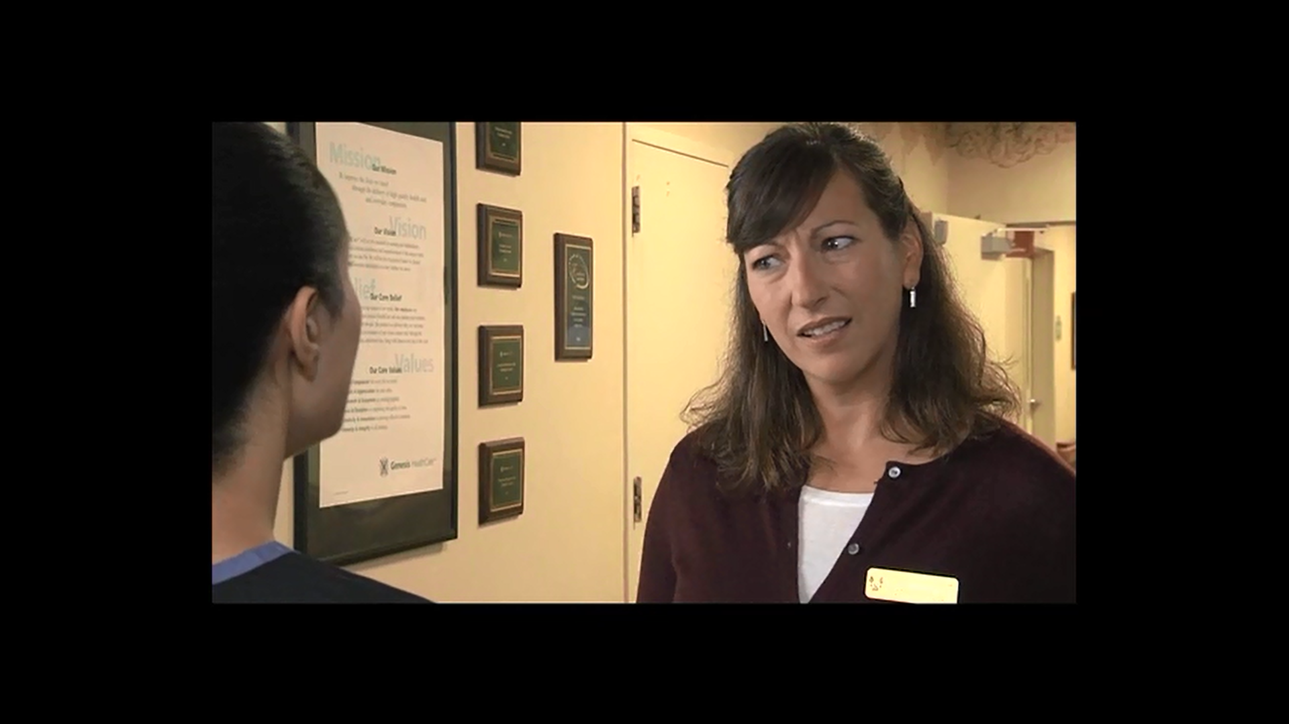
Two-Challenge Rule

Slide 28
Video Debrief
How was the first “challenge” presented?
How was the second “challenge” presented?
What was the stronger course of action used by Jennifer, the recreation therapist?
How did using the Two-Challenge Rule improve the outcome of the scenario?

Slide 29
Polling Question
Please check all that apply. What would help your team implement the use of the Two-Challenge Rule in your nursing home?
Communicating to all staff the value of the Two-Challenge Rule.
Involving all levels of staff in determining how to implement the Two-Challenge Rule.
Creating a safe space for direct care staff to practice the Two- Challenge Rule.
Gathering feedback about how the implementation of the Two-Challenge Rule is impacting staff.
Using multiple ways to communicate the implementation of the Two-Challenge Rule.

Slide 30
Resident Scenario
A physical therapy aide (PTA) is working with Mr. Larkin in the gym.
Mr. Larkin is working at a slower pace and breathing harder than usual.
The PTA’s level of concern leads her to interrupt the physical therapist (PT) and report the changes in Mr. Larkin’s status.
The PT responds that she will assess Mr. Larkin when she finishes with the resident with whom she is currently working.

Slide 31
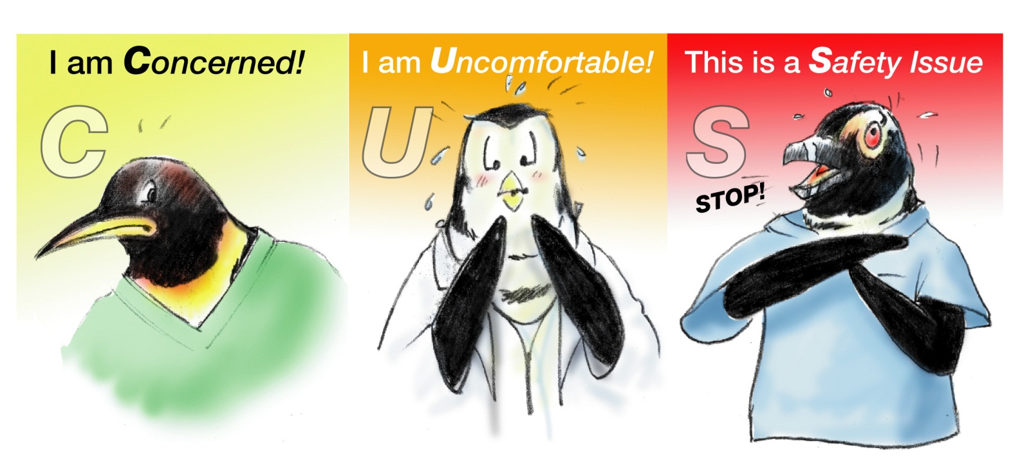
CUS Words
Please use CUS Words but only when appropriate!

Slide 32
CUS Words
I am Concerned.
This makes me Uncomfortable.
This is a resident Safety issue.

Slide 33
Video Debrief
How was the “challenge” presented?
The PTA stated, “I’m concerned…”
The PTA was uncomfortable with the resident’s breathing.
She feared that his safety was at risk.

Slide 34
Another Example of Using CUS
Mary, a certified nursing assistant, asks her partner, Jessica, to help her reposition two residents in bed.
The two residents, Mrs. North and Mrs. Peck, are roommates.
Following repositioning Mrs. North, Jessica begins to work with Mrs. Peck while Mary is washing her hands.

Slide 35
Using CUS
I am Concerned.
This makes me Uncomfortable.
This is a resident Safety issue.
Jessica, I am concerned about spreading germs from Mrs. North to Mrs. Peck. I am uncomfortable without both of us washing our hands before repositioning Mrs. Peck.
It could be a safety issue if we don’t wash our hands first and Mrs. Peck gets sick or an infection.

Slide 36
Polling Question
What should Cali do?
Tell Mr. Jackson that he’ll have to wait until later to get up when her CNA partner returns.
Transfer Mr. Jackson by herself as directed by the nurse.
Use CUS to communicate her concern for Mr. Jackson’s safety if she were to transfer him alone.
Make a scene in the hallway, calling the nurse incompetent.

Slide 37
Polling Question
Please check all that apply. In what situations might you use CUS in the nursing home?
The CNA assigned to monitor the dining room lets you know she is just stepping out for a moment.
The maintenance man enters the room of a resident on precautions without putting on gown, mask, and gloves.
A physician doesn’t wash her hands before examining a resident.
The dietary aide pours a glass of water for a resident on a thickened liquid diet.

Slide 38
Questions and Webinar Evaluation

Slide 39
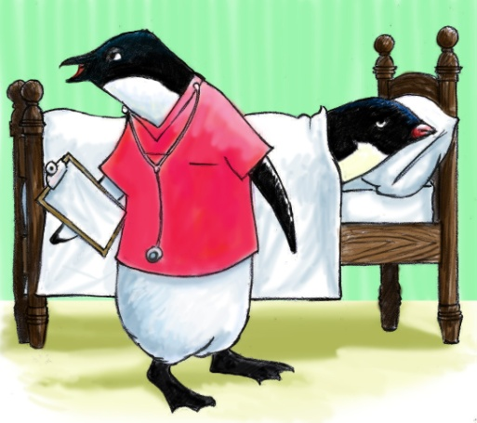
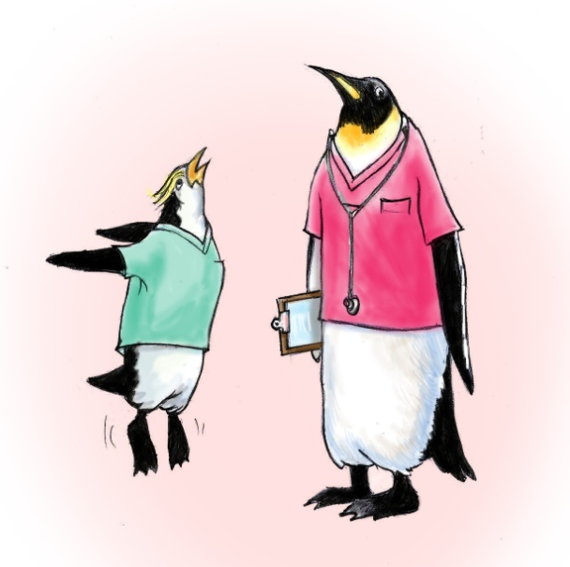
Resources
TeamSTEPPS® Long-Term Care Version
https://www.ahrq.gov/teamstepps/longtermcare/index.html

