Slide 1
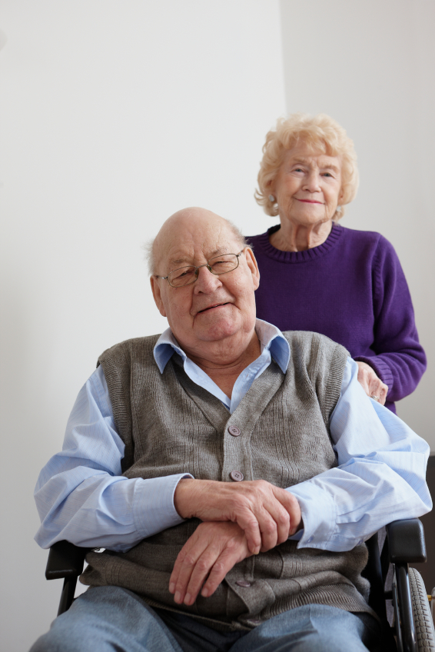
Supportive Planning and Operations Team (SPOT) Initiative
Engaging Residents and Families in Quality Assurance and Performance Improvement
November 16, 2017
Disclaimer: Participation in this educational offering is not mandatory for regulatory compliance nor do actions or tools and resources discussed in it ensure regulatory compliance.

Slide 2
Welcome to the Webinar!
Suzanne Cray, Director
Health Care Integration and Strategic Initiatives
Bureau of Health Care Safety & Quality
Massachusetts Department of Public Health

Slide 3
Today’s Speakers
Donna Hurd, MSN, RN
Gabby Katz, MPP
Rosanna Bertrand, PhD
Jen Pettis, MS, RN, WCC

Slide 4
Polling Question
How many people (including yourself) are participating in this webinar together?
1 (it’s just me)
2–3
4–5
6 or more
Participate in the poll on the right.

Slide 5
Polling Question
Who is participating in today’s webinar?
Administrator
Director of nursing
QAPI coordinator
Department heads
Mid-level managers
Front-line staff
Other
Participate in the poll on the right.

Slide 6
Objectives
Upon completion of this webinar, attendees will be able to:
Describe resident and family engagement in QAPI.
Explain the benefits of engaging residents and family members in QAPI.
Identify how resident and family engagement in QAPI supports person-centered care.
Give examples of how to engage residents and family members in QAPI.

Slide 7
Reminder – What is QAPI?
QAPI is the coordinated application of two mutually-reinforcing aspects of a quality management system:
Quality Assurance (QA) and
Performance Improvement (PI).

Slide 8
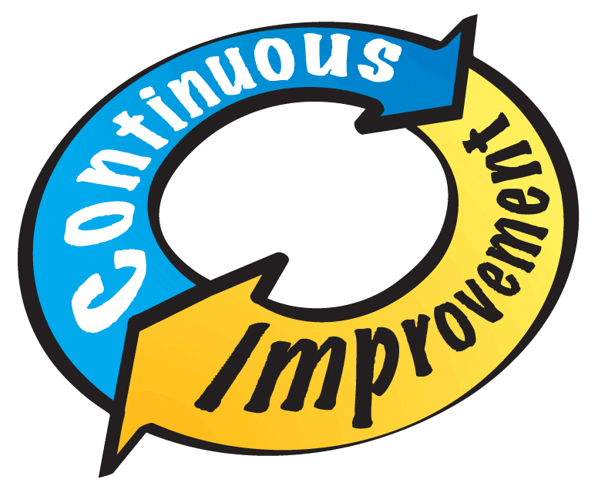
Reminder – What is QAPI?
QAPI means a quality management system through which the nursing home team:
Uses a systematic, comprehensive, and data-driven approach.
Develops interventions that address the underlying system, not only the symptom.
Continuously monitors performance.
Engages everyone including residents and family members to continuously identify problems and opportunities for improvement.

Slide 9
What Does Resident and Family Engagement in QAPI Mean?
We use “family” broadly to include participants in a person’s health care including informal caregivers, along with the primary caregivers.
Resident and family engagement in QAPI means that they are involved in activities intended to enhance quality of life, quality of care, and safety for all residents.
Meaningful involvement means that resident and family voices are heard when setting quality goals and evaluating progress toward the goals.

Slide 10
Polling Question
Why is it important to engage residents and families in QAPI? (check all that apply)
It promotes the concept of working “with” residents and families rather “for” residents.
Resident and family perspectives are critical when working to improve quality.
Engaging residents and families lets them know their views are valued.
Participate in the poll on the right.

Slide 11
What are the Benefits of Resident and Family Engagement in QAPI?
Fosters further engagement and spreads interest to other residents and families.
Creates an environment that promotes trust and respect.
Builds partnerships between staff and residents and their families.

Slide 12
What are the Benefits of Resident and Family Engagement in QAPI?
Facilitates resident and family familiarity with nursing home staff and their roles.
Staff obtain enriched knowledge of what is important to residents and their families.
Staff understand and respect residents’ choices, dignity, and rights to purposeful living.

Slide 13
Outcomes of Resident and Family Engagement in QAPI
Enhanced resident and family satisfaction.
Better quality of care and quality of life.
Improved clinical outcomes.
Increased staff satisfaction.
Reinforced person-centered care (PCC).

Slide 14
How Does Engaging Residents and Family Members in QAPI Support PCC?
Encouraging resident and family involvement in the facility’s QAPI supports a sense of control over the quality of their care and life.
Meeting the person-centered goals of each individual will create a health care system that fully engages residents and families in the design, delivery, and evaluation of care.
The concept of PCC is a central theme of the Reform of Requirements for Long-Term Care Facilities Final Rule.

Slide 15
Let’s Chat
In what types of quality-related activities are residents and families involved at your nursing home?
In what activities might they become involved?

Slide 16
How can Residents’ and Families’ Engagement Contribute to QAPI?
By identifying problems as well as areas for improvement in the delivery of care and services.
By identifying and addressing safety concerns in the environment.
By identifying improvements that will enhance the quality of life for all residents in the nursing home.

Slide 17
Let’s Chat
What are some potential barriers to engaging residents and families in QAPI?

Slide 18
Ideas for Gathering Input from Residents and Families
Resident council
Suggestion boxes
Family council
Care plan meetings
Quality meetings
Surveys

Slide 19
Polling Question
How does your nursing home team gather input from residents and families about opportunities for improvement (check all that apply):
Resident council meetings
Family council meetings
Satisfaction surveys
Suggestion box
Care conferences
Resident/family attendance at QAPI meetings
Other
Participate in the poll on the right.

Slide 20
483.10 Resident Rights: F565
§483.10(f)(5) The resident has a right to organize and participate in resident groups in the facility.
(iii) The facility must provide a designated staff person who is approved by the resident or family group and the facility and who is responsible for providing assistance and responding to written requests that result from group meetings.

Slide 21
483.10 Resident Rights: F565
(iv) The facility must consider the views of a resident or family group and act promptly upon the grievances and recommendations of such groups concerning issues of resident care and life in the facility.
(A) The facility must be able to demonstrate their response and rationale for such response.
(B) This should not be construed to mean that the facility must implement as recommended every request of the resident or family group.

Slide 22
Purpose of Resident and Family Groups
Discuss and offer suggestions about facility policies and procedures.
Support each other.
Plan resident and family activities.
Participate in educational activities.
For any other purpose.

Slide 23
Family Council: Getting Started
Determine family interest in a council.
Introduce family members, residents, and staff to the idea.
Encourage families to participate.

Slide 24
Family Council: Sample Introductory Meeting Agenda
Explanation of family councils.
Questions and discussion.
Determination of the families’ desire for a council.
Plans for the next meeting.
Selection of temporary officers.
Determination of the council’s wishes to engage a staff advisor.

Slide 25
Family Council: Meeting Checklist for Council Leaders
Identify and secure a meeting room.
Plan the agenda.
Notify participants.
Gather meeting resources.
Facilitate the meeting.
Follow up after the meeting.

Slide 26
Ideas to Share QAPI Efforts with Residents and Families
In
Newsletters
Resident council
Family council
Bulletin boards
Informal discussions
Care plan meetings
Quality meetings

Slide 27
QAPI Bulletin Board Example #1

Slide 28
QAPI Bulletin Board Example #1

Slide 29
QAPI Bulletin Board Example #1

Slide 30
QAPI Bulletin Board Example #2

Slide 31
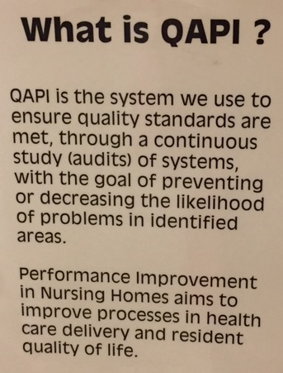
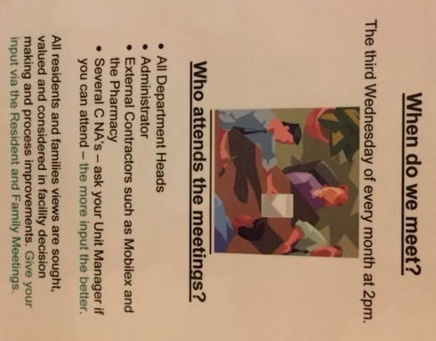
QAPI Bulletin Board Example #2

Slide 32
QAPI Bulletin Board Example #2

Slide 33
Share Your Success!
Press releases
Community groups and senior centers
Local news coverage
Conferences
Journals

Slide 34
Key Points about Engaging Residents and Families in QAPI
Listen to the voice of the resident and their family members.
Residents and families should be at the table when facility quality issues are discussed.
Promote working “with” rather than “for” residents.
Educate residents on their rights and let residents and families know how to convey concerns.
Stress the importance of resident and family participation.

Slide 35
Listening to the Voice of the Resident
The goal of resident and family engagement in QAPI is to set a place for them at the decision-making table.

Slide 36
Resources to Promote Resident and Family Engagement in QAPI
Consumer Engagement in Nursing Home Quality – A Fact Sheet
https://www.cms.gov/Medicare/Provider-Enrollment-and-Certification/QAPI/Downloads/QAPI-Consumer-Factsheet.pdf
A Resident Perspective on Quality Improvement & Person-Centered Care
https://www.youtube.com/watch?v=P5AwdwSlWlw&feature=youtu.be
The Family Council Guide: A guide to organizing and maintaining an effective family council
http://humanservices.arkansas.gov/dms/oltcdocuments/famguide.pdf
Promoting Participation in Family Councils
http://theconsumervoice.org/uploads/files/issues/promoting-participation-2012.pdf

Slide 37
Questions and Webinar Evaluation

