Slide 1
Monkeypox Cases and People Vaccinated by Age,
Sex and Race/Ethnicity
Massachusetts Department of Public Health– Wednesday, November 23, 2022
The Monkeypox Cases and People Vaccinated by Age, Sex and
Race/Ethnicity Report will be updated weekly and posted on Thursday
All data included in this report are preliminary and subject to change. Data on demographics of cases is obtained through electronic reports by healthcare providers and laboratories and from cases during case interviews and entered into the Massachusetts Electronic Disease Surveillance System (MAVEN). Data on demographics of people vaccinated is obtained through provider reports into the Massachusetts Immunization Information System (MIIS).

Slide 2
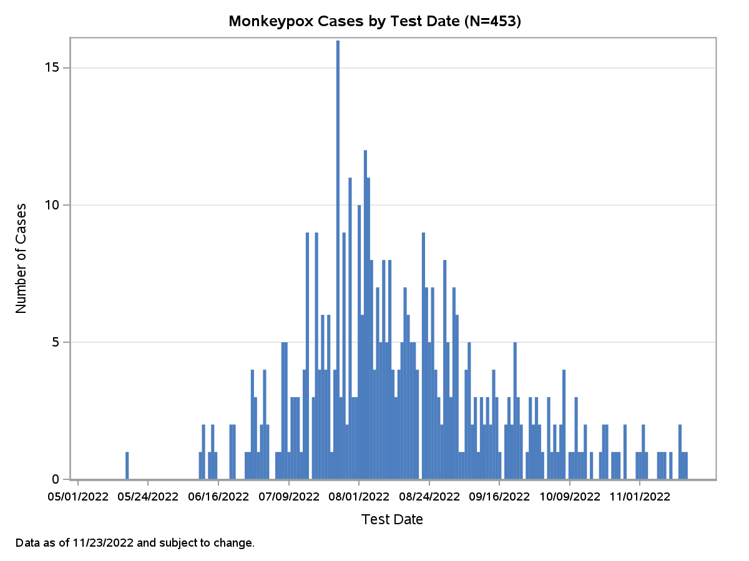
Monkeypox Cases – Epidemic Curve
453 confirmed and probable cases of monkeypox have been reported in MA as of 11/23/2022
There have been 4 new cases since the last report on 11/17/2022

Slide 3
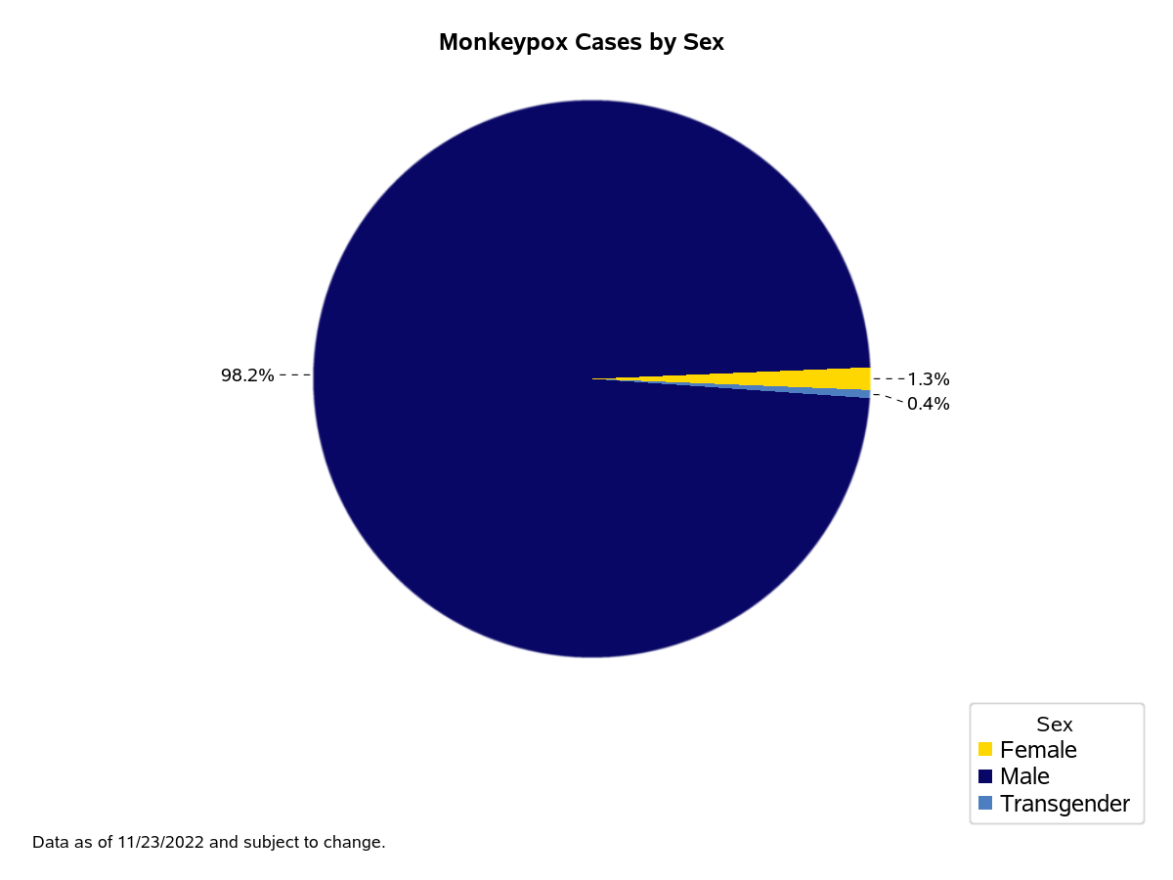
Monkeypox Cases by Sex

Slide 4
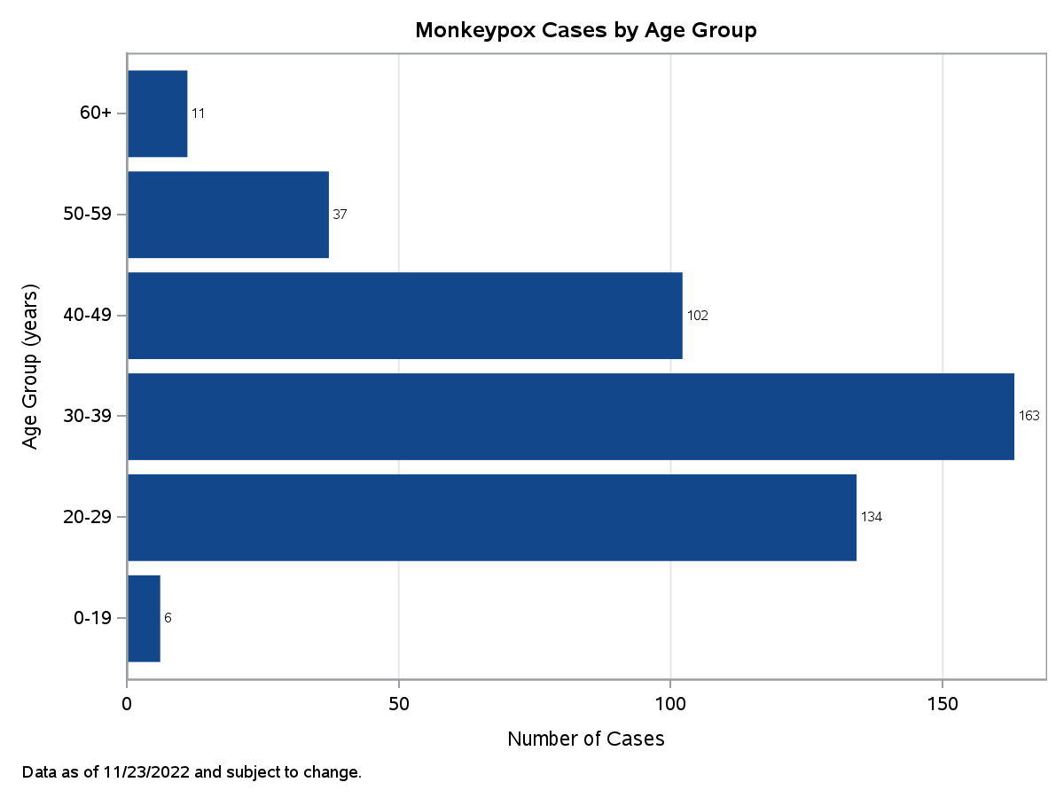
Monkeypox Cases by Age Group

Slide 5
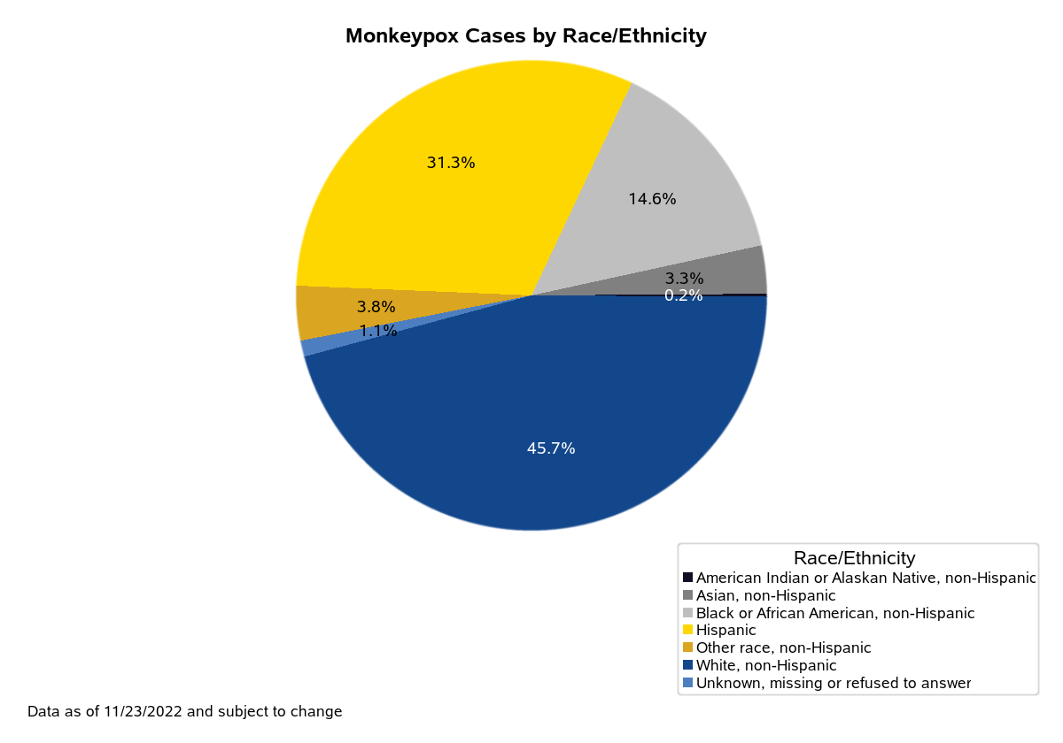
Monkeypox Cases by Race/Ethnicity

Slide 6
Monkeypox Vaccines
Since June 1, 2022, 32,716 JYNNEOS vaccine doses have been administered to 19,693 people.
6,678 people have received only one dose of vaccine and 13,007 have received two doses.
 | Number of People Vaccinated | Percentage of Total Vaccinated
SEX
Male | 18,092 | 92%
Female | 1,529 | 8%
Other | 35 | 0%
Unknown | 37 | 0%
AGE GROUP
0-19 | 203 | 1%
20-29 | 5,038 | 26%
30-39 | 5,929 | 30%
40-49 | 3,087 | 16%
50-59 | 3,076 | 16%
60+ | 2,360 | 12%
RACE/ETHNICITY
American Indian or Alaskan Native, non-Hispanic | 22 | 0%
Asian, non-Hispanic | 1,231 | 6%
Black or African American, non-Hispanic | 993 | 5%
Hispanic | 2,538 | 13%
Native Hawaiian or Pacific Islander, non-Hispanic | 14 | 0%
Other race, non-Hispanic* | 1,314 | 7%
White, non-Hispanic | 12,272 | 62%
Unknown, missing or refused to answer | 1,309 | 7%
Data as of 11/22/2022 and subject to change
*Includes multi-race, non-Hispanic

Slide 7
TPOXX
Since June 1, 2022, providers have reported treating 208* people with TPOXX to the Department of Public Health.
TPOXX is a prescription antiviral medication that may help treat monkeypox infection.
Not everyone with monkeypox should be treated but it may help reduce severe disease.
 | Number of People Treated with TPOXX | Percentage of Total Treated
SEX
Male | 200 | 96%
Female | 7 | 3%
Other | 1 | <1%
Unknown
AGE GROUP
0-19 | 4 | 2%
20-29 | 49 | 24%
30-39 | 83 | 40%
40-49 | 47 | 23%
50-59 | 18 | 9%
60+ | 7 | 3%
RACE/ETHNICITY
American Indian or Alaskan Native, non-Hispanic | 0 | 0%
Asian, non-Hispanic | 4 | 2%
Black or African American, non-Hispanic | 26 | 13%
Hispanic | 67 | 32%
Native Hawaiian or Pacific Islander, non-Hispanic | 0 | 0%
Other race, non-Hispanic* | 5 | 2%
White, non-Hispanic | 99 | 48%
Unknown, missing or refused to answer | 7 | 3%
*Includes out of state residents not included in Massachusetts case counts and presumptive treatment of patients prior to testing in accordance with CDC guidelines.
Data as of 11/23/2022 and subject to change
*Includes multi-race, non-Hispanic

