Slide 1
Welcome Family Statewide Expansion Advisory Committee
September 2026 Convening
Workforce Training and Capacity: Onboarding and Training for Welcome Family Nurses

Slide 2






Welcome and DPH BFHN Team Introductions
Stephanie Doyle, MS
Deputy Director of Strategy & Implementation
Bureau of Family Health & Nutrition
Christine Silva, MPH
Director, Massachusetts Home Visiting Initiative
Division of Pregnancy, Infancy, & Early Childhood
Danielle Biggins, MS
Home Visiting Implementation Specialist
Division of Pregnancy, Infancy, & Early Childhood
Elaine Fitzgerald Lewis, DrPH, MIA
Director, Bureau of Family Health & Nutrition
State Title V Maternal and Child Health Director
Project Support Team

Slide 3
Advisory Committee areas of focus
Objective | Build awareness | Community engagement in services and system coordination | Workforce training and capacity | Workforce recruitment and retention | Quality monitoring and program evaluation strategy | Equity in utilization and experience | Timely response to community need and emerging acute issues
Intended Outcome | Broader reach and higher referral and utilization rates across regions. | Better coordination of community services and referrals. | Consistent, high-quality, family-centered service delivery. | Achieve adequate staffing to support service expansion. Improved staff stability and workforce diversity. | Data-driven program decisions and improved family outcomes. | More equitable participation and outcomes across all families and regions. | Welcome Family becomes a trusted source of accurate public health information which can be leveraged to connect with families directly aligning with public health priorities.

Slide 4
September 2026 Meeting Objectives
By the end of this meeting, participants will be able to:
Provide input on key competencies Welcome Family nurses should have to be successful.
Propose onboarding and professional training supports that will strengthen the Welcome Family workforce and quality of service.
Provide input on state-led versus program-led responsibilities for the development of a statewide system of onboarding and training.

Slide 5
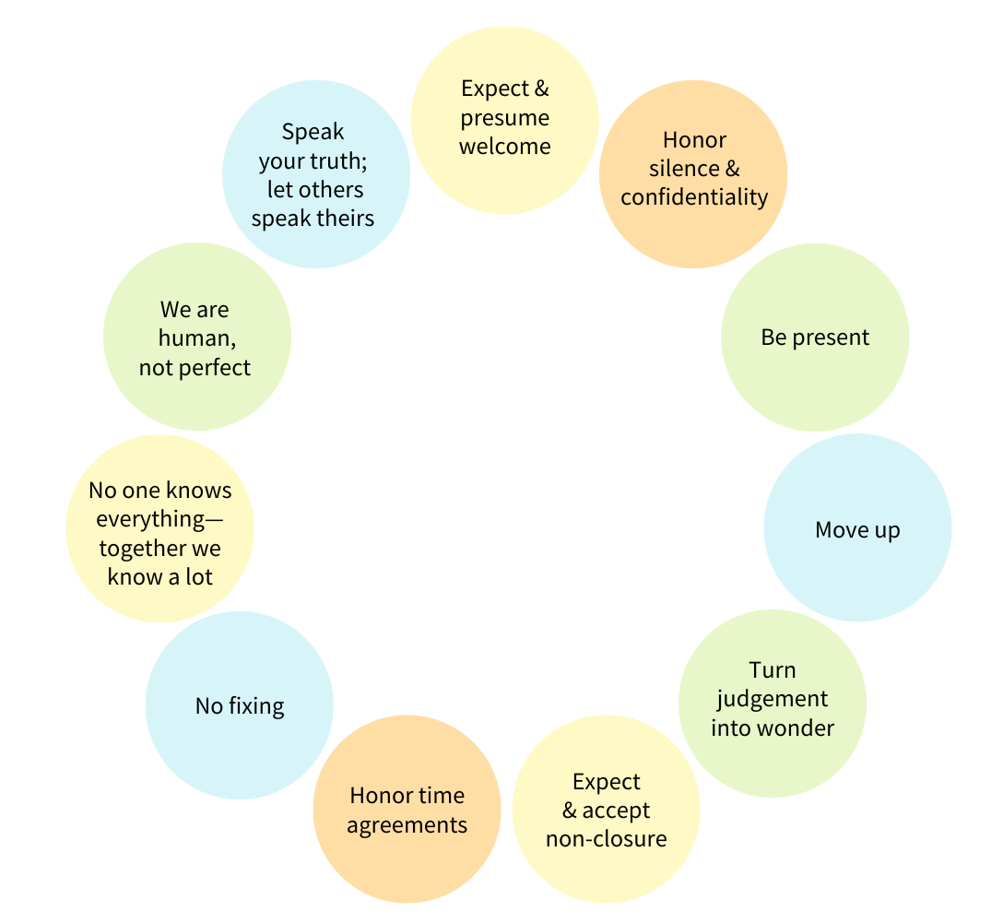
September 2026 Agenda:
Onboarding and Training for Welcome Family Nurses
# | Topic
1 | August Input Recap
2 | Nurse Competencies Review of Current State and Competency Framework Mentimeter Word Cloud Chat Waterfall
3 | Onboarding and Training Chat Waterfall Poll Breakout Discussions
Advisory Committee Group Agreements
Source: JustLead Washington

Slide 6
Active participation today!
Click this to open the chat function

Slide 7
Active participation today! (continued)
Click ‘Raise Hand’ and unmute ‘Mic’ to ask questions and make comments

Slide 8
Summary of August Input
Welcome Family Program Level:
  Establish process to vet or maintain quality standards amongst community-based referral sources following a Welcome Family visit, especially for, but not exclusively related to, clinic-based vs private lactation support.
  Consistent and timely records of key contacts with community-based referral organizations.
  Ensure Welcome Family programs are prepared to align referrals with insurance status for families served. (this was from one individual, not a group consensus).
  Equip Welcome Family nurses and staff with knowledge of the local service landscape to effectively connect families with available community resources.
State Level:
  Ensure Welcome Family collects and analyzes data that assesses barriers to entering systems of care, including challenges experienced by families, or challenges posed by capacity of community providers.
  Continue to allow self-referrals by families.
  Consider expanding the role of CHWs within the Welcome Family model, recognizing the value they bring to family engagement and support. Accordingly, CHWs may be included as part of the staffing model, but the nurse remains responsible for conducting the Welcome Family visit.

Slide 9
Welcome Family Nurse Competencies

Slide 10
Statewide System of Training and Onboarding: Current State
Welcome Family nurse competencies were developed in response to the evidence-based model, community input and pilot program experience.
Welcome Family programs must assess nurse competencies as part of supervision requirements.
DPH requires three annual trainings across all programs: mandatory reporting for child abuse and neglect, home visitor safety and community resources.
Currently, there is no statewide training system of training for Welcome Family. Programs are responsible for providing training and onboarding for their staff.

Slide 11
Current Competencies for Welcome Family Nurses
Building on a foundational expectation of maternal and child health and licensed nursing clinical skills and experience, additional competencies include:
1. Cultural Sensitivity
2. Infant feeding including breastfeeding
3. Motivational Interviewing
4. Fundamentals of home visiting, including home visitor safety
5. Family Engagement
6. Knowledge about trauma-informed care
7. Knowledge of community resources & collaboration with others in the field
8. Knowledge and skills for screening and discussing:
postpartum depression and anxiety
substance use
domestic violence
9. Knowledge of maternal and postpartum care
10. Knowledge of newborn care
11. Child Abuse and Neglect
12. Reflective Practice

Slide 12
Mentimeter Word Cloud
What competencies were you glad to see included?
1. Cultural Sensitivity
2. Infant feeding including breastfeeding
3. Motivational Interviewing
4. Fundamentals of home visiting, including home visitor safety
5. Family Engagement
6. Knowledge about trauma-informed care
7. Knowledge of community resources & collaboration with others in the field
8. Knowledge and skills for screening and discussing:
postpartum depression and anxiety
substance use
domestic violence
9. Knowledge of maternal and postpartum care
10. Knowledge of newborn care
11. Child Abuse and Neglect
12. Reflective Practice

Slide 13
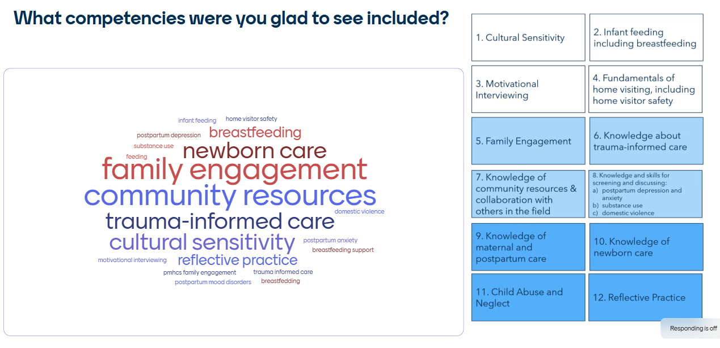
Wordcloud results

Slide 14
Chat Waterfall 1
Please share if there are competencies missing that should be expected of a Welcome Family nurse, and why.
1. Cultural Sensitivity
2. Infant feeding including breastfeeding
3. Motivational Interviewing
4. Fundamentals of home visiting, including home visitor safety
5. Family Engagement
6. Knowledge about trauma-informed care
7. Knowledge of community resources & collaboration with others in the field
8. Knowledge and skills for screening and discussing:
postpartum depression and anxiety
substance use
domestic violence
9. Knowledge of maternal and postpartum care
10. Knowledge of newborn care
11. Child Abuse and Neglect
12. Reflective Practice

Slide 15
Onboarding and Training

Slide 16
Chat Waterfall 2
What was the best training or onboarding experience you ever had?
What made it great?

Slide 17
POLL
Which competencies reflect the greatest opportunity for the state to develop a system of strategies, tools or resources that support Welcome Family programs and their nurses? Choose your top 3
1. Cultural Sensitivity
2. Infant feeding including breastfeeding
3. Motivational Interviewing
4. Fundamentals of home visiting, including home visitor safety
5. Family Engagement
6. Knowledge about trauma-informed care
7. Knowledge of community resources & collaboration with others in the field
8. Knowledge and skills for screening and discussing:
postpartum depression and anxiety
substance use
domestic violence
9. Knowledge of maternal and postpartum care
10. Knowledge of newborn care
11. Child Abuse and Neglect
12. Reflective Practice

Slide 18
Breakout Group Discussions
What strategies, tools, resources and other supports should comprise the future statewide system of training for Welcome Family? For instance:
  Should there be an online training platform that hosts on-demand training modules and live virtual trainings?
  Should there be in-person trainings and skills workshops?
  What other onboarding and training support would be helpful to ensure nurses are successful in their roles?
  What support should continue after initial onboarding, so nurses continue to feel successful?
  What should the state prioritize in designing the system?

Slide 19
Breakout Group Instructions
Breakout Discussion Time:
Room 1: Infant Feeding Including Lactation
Room 2: Family Engagement
Room 3: Knowledge and skills for screening and discussing:
postpartum depression and anxiety
Large group debrief after

Slide 20

Looking Ahead
Meeting dates and times:
Mondays at 2pm EST
October 19, 2026***
November 9, 2026
December 14, 2026
January 11, 2027
February 8, 2027
March 8, 2027
April 12, 2027
May 10, 2027

Slide 21
Evaluation Poll
Scale for all questions: 1–5, with 5 = Strongly Agree
This meeting provided sufficient opportunities for members to share input and perspectives.
Participating in this meeting was engaging and satisfying.
Meeting facilitation encouraged respectful, inclusive participation from all members.
I had the information I needed to feel prepared to participate in this meeting.
Open comment: Is there anything we should consider or do differently for the next meeting?

Slide 22
Thank you!
Welcome Family Statewide Expansion Advisory Committee

