Slide 1


Massachusetts Children’s Behavioral Health Initiative (CBHI)
Summary of FY2019 Wraparound Fidelity Monitoring Results
Eric Bruns, PhD | Spencer Hensley, MS
September 25, 2019

Slide 2
Agenda
Introductions
Latest research and national context
Review Massachusetts fidelity data
Implications and recommendations
Appendices

Slide 3
Wraparound Adherence
What do we want to measure?
Wraparound Principles:
  Family voice and choice
  Team-based
  Natural supports
  Collaboration
  Community-based
  Culturally competent
  Individualized
  Strengths-based
  Persistence
  Outcome-based

Slide 4
Wraparound Implementation
What do we want to measure?
Implementing the practice model:
The Four Phases of Wraparound
Phase 1A
Engagement and Support
Phase 1B
Team Preparation
Phase 2
Initial Plan Development
Phase 3
Implementation
Phase 4
Transition
Time
4

Slide 5

Key Elements of Wraparound
Grounded in Strengths Perspective
Driven by Underlying Needs
Supported by an Effective Team Process
Determined by Families
Includes Natural and Community Supports
Outcomes-Based

Slide 6

FIDELITY TOOLS
Wraparound Fidelity Index, Short Form (WFI-EZ)
Team Observation Measure, version 2 (TOM 2.0)

Slide 7

Wraparound Fidelity Index, Short Form
Items on fidelity are based on Wraparound involvement and the key elements, and the self-administered survey also includes sections on satisfaction and outcomes.
A. WRAPAROUND INVOLVEMENT: My team meets regularly (for example, at least every 30-45 days)
B. EXPERIENCES IN WRAPAROUND: With help from members of our Wraparound team, my family and I chose a small number of the highest priority needs to focus on.
  Key Element: Needs-Based
C. SATISFACTION: Since starting Wraparound, our family has made progress toward meeting our needs.
D. OUTCOMES: Since starting Wraparound, the child/youth has had a new placement in an institution.
Section B. Experiences in Wraparound
 | Strongly Agree | Agree | Neutral | Disagree | Strongly Disagree | Don’t Know
B1. My family and I had a major role in choosing the people on our Wraparound team. | ◻ | ◻ | ◻ | ◻ | ◻ | ◻
B2. There are people providing services to my child and family who are not involved in my Wraparound team. | ◻ | ◻ | ◻ | ◻ | ◻ | ◻
B3. At the beginning of the Wraparound process, my family described our vision of a better future to our team. | ◻ | ◻ | ◻ | ◻ | ◻ | ◻
B4. My Wraparound team came up with creative ideas for our plan that were different from anything that had been tried before. | ◻ | ◻ | ◻ | ◻ | ◻ | ◻

Slide 8

Team Observation Measure, Version 2
Consists of 41 indicators across eight subscales
  Six subscales are dedicated to the Key Elements, one evaluates meeting attendance, and one assesses facilitation skills
Generates Total Fidelity based on all eight subscales, and Key Element Fidelity based on the six designated subscales

Slide 9
During FY2019, a total of 1407 fidelity forms were collected!
Tool | N of Forms Collected
WFI-EZ | 623
TOM 2.0 | 784
TOTAL | 1407

Slide 10


National Means
WFI-EZ
Approximately 20 sites, 1,200 forms
  Span geographic area, size, focus on urban and rural areas, number of youth served
TOM 2.0
6 sites, 169 forms
  Two Midwestern counties (one urban, one rural)
  One southern state
  Three urban counties
National Means are averaged by site, so no single site has a disproportionate influence over the national mean

Slide 11
LATEST RESEARCH & NATIONAL CONTEXT
Importance of the State Policy and Funding Context to Wraparound Quality and Fidelity
New UW WERT approach to evaluating fidelity and collecting, managing data from WFAS tools

Slide 12
State system factors and their influence on implementation, skill attainment, and fidelity: What is truly “malleable”?
Eric Bruns, Ph.D., Elizabeth M. Parker, Ph.D., Jonathan Olson, Ph.D., Spencer Hensley, MA, & Michael D. Pullmann, Ph.D.
University of Washington School of Medicine, Department of Psychiatry
Marlene Matarese, Ph.D., Kim Estep, M.A., & Michelle D. Zabel, MSW
University of Maryland School of Social Work, Institute for Innovation & Implementation
11th Annual Conference on the Science of Dissemination and Implementation in Health
Washington, DC
December 4, 2018

Slide 13
Features of Care Management Entities
Case rate (all-inclusive or partial) approach to financing care
Care monitoring and review, including utilization management with incentives for quality and costs
Contract with and manage provider networks
  Including EBPs, crisis support, youth/family peer support
Screening, assessment, and clinical oversight
Information management
  Including outcomes, satisfaction, fidelity
Training, coaching, and supervision for CME staff and practitioners in the service array
Convening of funders, system partners, stakeholders, advocates

Slide 14
CME state
CMHC state

Slide 16
CME model demonstrating positive Rx & residential outcomes for youth with SEBD

Slide 17

WrapTrack 2.0
WrapStat
A new way to facilitate fidelity and outcomes monitoring for Wraparound Initiatives

Slide 18

A multi-method approach to assessing the quality and context of individualized care planning and management for children and youth with complex needs and their families
WFI-EZ
TOM 2.0
Interview: Wraparound Fidelity Index, v. 4
Observation: Team Observation Measure, Version 2.0
Program & System Assessments: Stakeholder Survey / Standards Assessment
Survey: short form, WFI-EZ
CSWI/ WIPS
DART
Chart Review: Document Assessment and Review Tool, v.2
www.wrapinfo.org
Notes:
Today’s WFAS consists of 5 Tools.
From EB article: Meta-analyses of interventions delivered in “real world” systems have shown that “services as usual” are often no more effective than no service at all. Services based on evidence for effectiveness have a better chance of succeeding, but they must be delivered with quality and model fidelity if they are to produce positive effects.
Practice model: phases and activities
Principles cut across activities of the practice model
Organizational and System-level supports without which adherence to the principles and practice model is unlikely

Slide 19

Overall Goals for the “New WrapTrack” (WrapSTAT)
Storing information for all youth
  Not just youth who were administered a tool
  Allows for reporting on outcomes and demographics for entire population served
Data needs all in one place
  Collection
  Tracking
  Reports
Information on program
  Helps us know what is working (i.e. ideal caseload, staff turnover rates)

Slide 20
System Hierarchy
5 levels
  Uber (WERT)
  Collaborator (multi-organization configuration; possibly State)
  Organization (multi-agency configuration; possible MCO)
  Agency (e.g., agencies with multiple sites or offices)
  Site (lowest level at which evaluation will happen or reports are needed)

Slide 21
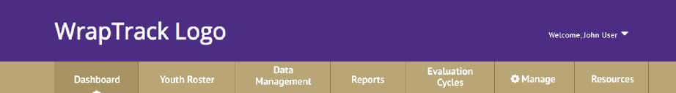
Overview
Notes:
Show the menu bar, describe 7 major functions

Slide 22
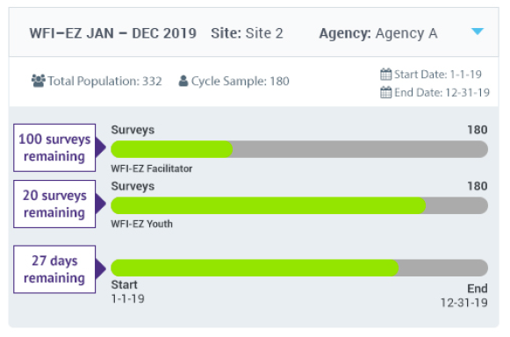
Notes:
Describe that the new Wrap Track provides info in the dashboard on completion of the evaluation cyc;le

Slide 23
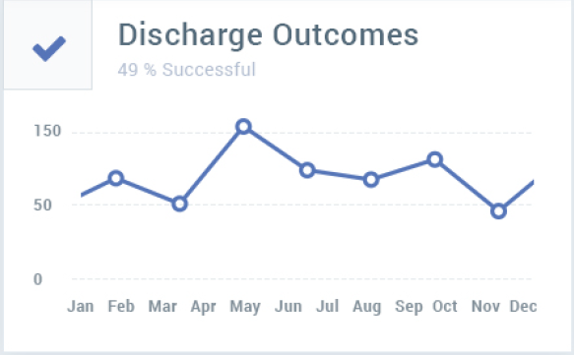
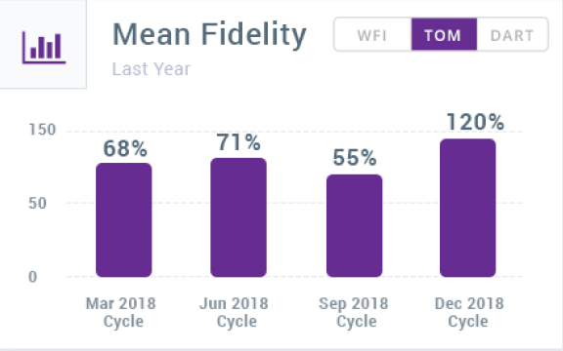
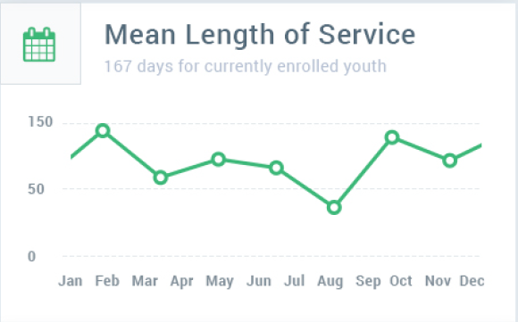
Notes:
Describe that the new WT shows info on outcomes, LOS, and past fidelity evaluations in the dasboard

Slide 24
Youth Roster
Purpose: Entering youth into the system and managing information on all enrolled youth
  Can enter in larger batch upload, download roster and update info
  CSV file
Fidelity evaluation samples will be pulled from youth on this roster
Includes variables on enrollment / discharge dates and discharge status
  Allows for tracking of critical outcomes over time:
  Length of enrollment
  Overall Success of discharged youth/families

Slide 25
Evaluation Cycles
Purpose:
  Initiates a unique fidelity evaluation “project”
  Defines the “rules” for the “project”

Slide 26
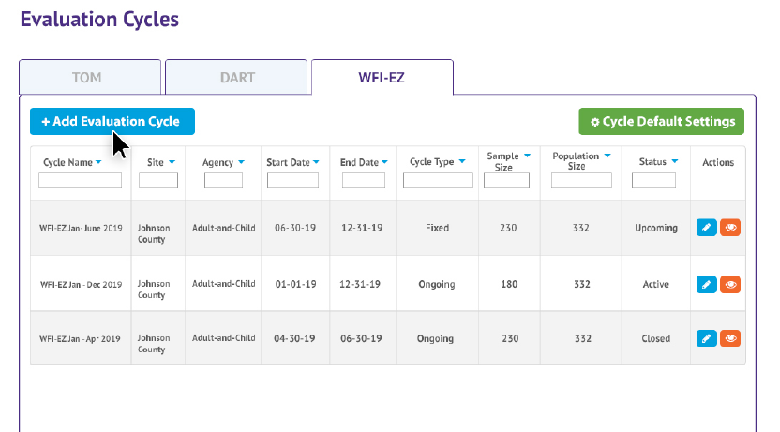
Notes:
Describe that the new Wrap Track allow the user to define the parameters for an evaluation project and then returns a sample

Slide 27
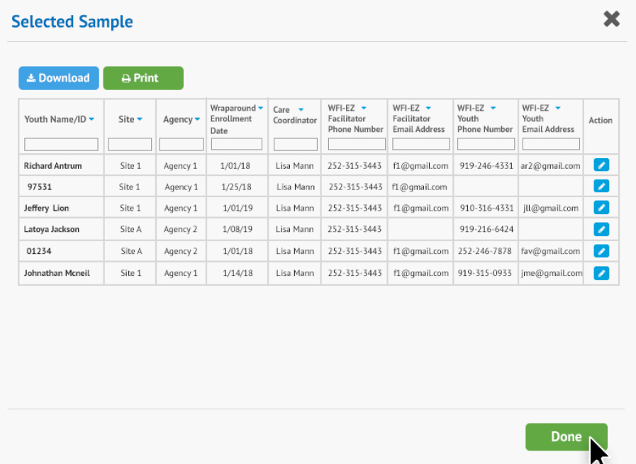
Notes:
Describe that the new Wrap Track then returns a roster of youth with details

Slide 28
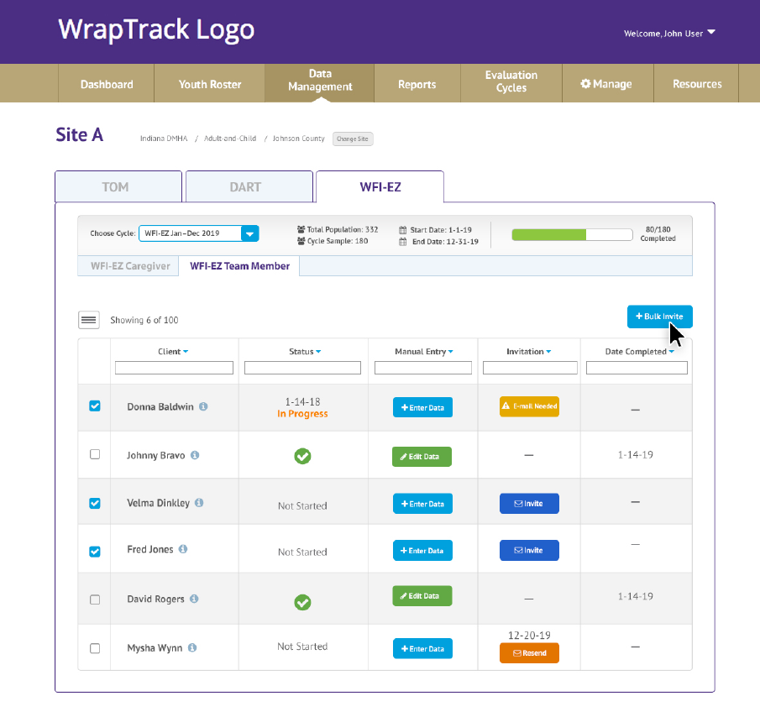
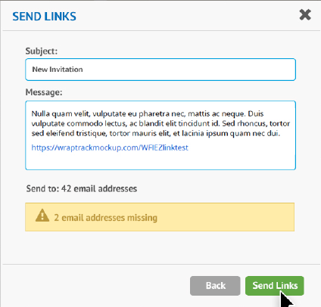
Email forms
Enter & edit data
Form status
Notes:
Describe that the new Wrap Track allows active management of data collection, including sending emails, reviewing status, etc

Slide 29
Reports
Purpose: Aid data visualization and analysis
Changes:
  Pull data by organization, facilitator, NOT by creator
Example Reports:
  Demographics
  Fidelity scores
  Item level means
  Relative strengths and areas for improvement

Slide 30

MASSACHUSETTS RESULTS
Scores on the WFI-EZ & TOM 2.0

Slide 31


Youth Summary
WFI-EZ
Number of Youth Assessed | 623 forms and youth
Age of Youth & Frequencies
Mean (SD) | 12 (3.7)
Range | 4 – 19
0-4 | 11 (2%)
5-9 | 189 (30%)
10-14 | 270 (43%)
15-18 | 151 (24%)
19 and older | 2 (<1%)
Missing | 0
Gender
Male | 408 (65%)
Female | 215 (35%)
Transgender | 0
Race | N | %
White | 145 | 23%
Black or African American | 210 | 34%
Asian | 7 | 1%
Amer. Indian/Alaska Native | 1 | <1%
Unk./Declined to specify | 182 | 29%
Hispanic | 240 | 39%
TOM 2.0
Number of Youth Assessed | 765 (783 forms)
Age of Youth & Frequencies
Mean (SD) | 11 (4.1)
Range | <1 – 21
0-4 | 12 (1%)
5-9 | 154 (20%)
10-14 | 225 (29%)
15-18 | 154 (20%)
19 and older | 21 (3%)
Missing | 199 (26%)
Gender
Male | 461 (60%)
Female | 296 (39%)
Transgender | 8 (1%)
Race | N | %
White | 380 | 50%
Black or African American | 81 | 11%
Asian | 23 | 3%
Amer. Ind./AK Native/Haw. | 3 | <1%
Other/Missing | 72 | 9%
Hispanic | 190 | 24%

Slide 32
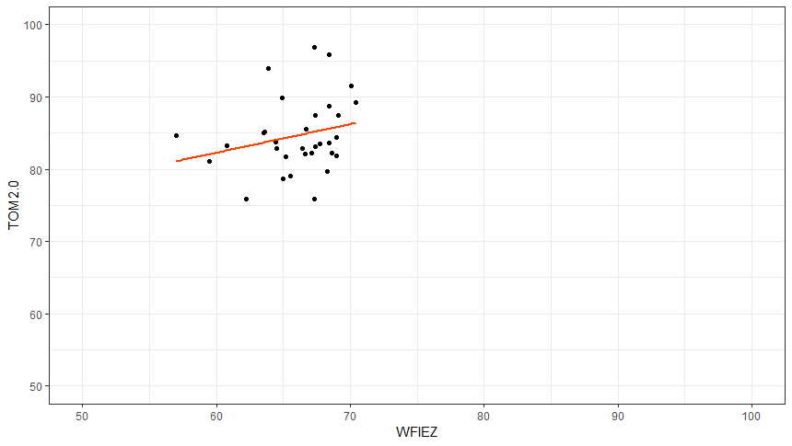
WFI-EZ & TOM 2.0 were not very strongly correlated at the CSA level
Pearson R Correlation =0.240
Significance = 0.19
N = 32

Slide 33
WFI-4 & TOM Correlations
This is WFI-EZ and TOM 2.0
2011

Slide 34
TOM 2.0 scores continue to be higher, on average, than the WFI-EZ sample across all Key Elements
TOTAL SCORE

Slide 35
WRAPAROUND FIDELITY INDEX, SHORT FORM
Massachusetts Fidelity

Slide 36

Fidelity Scores by Key Element
 | Total | Key Element
 | Mean Overall | Effective Teamwork | Natural & Community Supports | Needs-Based | Outcomes-Based | Strength & Family Driven
MA 2018 | 66% | 66% | 58% | 69% | 66% | 71%
MA 2019 | 66% | 66% | 59% | 69% | 68% | 70%
National Mean | 72% | 68% | 66% | 74% | 75% | 78%

Slide 37
Scores were slightly lower among surveys completed by an interviewer
Note: There were 8 surveys where the completion method was not recorded.

Slide 38
A note about National Means
Our National Means are simply site-level averages of any large site that uses the WFI-EZ.
  They are not benchmarks for “high fidelity” or “high quality”
  Some of the sites in our national sample collect their data less rigorously than Massachusetts.
    Convenience samples and low response rates result in fidelity profiles for youth/families that are not representative of the overall initiative.
    This results less useful and accurate pictures of fidelity/quality (and usually higher scores)

Slide 39
Fidelity Scores by Key Element
Total
Score
36

Slide 40
Total Fidelity

Slide 41

Most respondents report basic characteristics of Wraparound occurred during services

Slide 42

Item-Level Results
Strengths & Areas for Improvement
Strength:
>.3 standard deviations (SD) above national mean = green box
Areas for Improvement:
>.3 standard deviations (SD) below national mean = red box
Please Note: Strengths and weaknesses are calculated with the national mean and national standard deviation, and then are compared to MA data.

Slide 43
Effective Teamwork
(0.3 Standard Deviation above/below National Mean)
 |  | National
ITEMS | MA 2019 | SD | Mean
B2. There are people providing services to my child and family who are not involved in my Wraparound team. | 0.0 | 0.4 | -0.3
B4. My Wraparound team came up with creative ideas for our plan that were different from anything that had been tried before. | 0.8 | 0.2 | 1.1
B7. I sometimes feel like our team does not include the right people to help my child and family. | 0.8 | 0.6 | 0.8
B15. Members of our Wraparound team sometimes do not do the tasks they are assigned. | 0.8 | 0.6 | 0.7
B22. At each team meeting, my family and I give feedback on how well the Wraparound process is working for us. | 0.7 | 0.2 | 1.2

Slide 44
Effective Teamwork
Strongly Agree
Neutral
Strongly Disagree

Slide 45
Natural Supports
(0.3 Standard Deviations above/below National Mean)
 |  | National
ITEMS | MA 2018 | SD | Mean
B9. Being involved in Wraparound has increased the support my child and family get from friends and family. | 0.5 | 0.2 | 0.9
B10. The Wraparound process has helped my child and family build strong relationships with people we can count on. | 0.7 | 0.2 | 1.1
B12. Our Wraparound team does not include any friends, neighbors, or extended family members. | -0.1 | 0.4 | 0.1
B16. Our Wraparound team includes people who are not paid to be there (e.g., friends, family, faith). | 0.0 | 0.2 | 0.5
B18. Our Wraparound plan includes strategies that do not involve professional services (things our family can do ourselves or with help from friends, family, and community). | 0.8 | 0.3 | 0.6
Notes:
Values:
B9 NM = 0.91
B10 NM = 1.08
B12 NM = 0.12
B16 NM = 0.47
B18 NM = 0.55

Slide 46
Natural Supports
Strongly Agree
Neutral
Strongly Disagree
Notes:
B9: p = .000
B10: p = .000
B12: p = .000
B16: p = .000
B18: p = .146

Slide 47
Needs-Based
(0.3 Standard Deviations above/below National Mean)
 |  | National
ITEMS | MA 2018 | SD | Mean
B5. With help from members of our Wraparound team, my family and I chose a small number of the highest priority needs to focus on. | 1.0 | 0.2 | 1.3
B6. Our Wraparound plan includes strategies that address the needs of other family members, in addition to my child. | 0.8 | 0.3 | 1.1
B8. At every team meeting, my Wraparound team reviews progress that has been made toward meeting our needs. | 1.0 | 0.2 | 1.3
B13. My family was linked to community resources I found valuable. | 0.8 | 0.3 | 1.0
B23. I worry that the Wraparound process will end before our needs have been met. | 0.2 | 0.2 | 0.0
Notes:
Values:
B5 NM = 1.30
B6 NM = 1.12
B8 NM = 1.33
B13 NM – 0.98
B23 NM = 0.00

Slide 48
Needs-Based
Strongly Agree
Neutral
Strongly Disagree
Notes:
B5: p = .000
B6: p = .000
B8: p = .000
B13: p = .000
B23: p = .004

Slide 49
Outcomes-Based
(0.3 Standard Deviations above/below National Mean)
 |  | National
ITEMS | MA 2018 | SD | Mean
B19. I am confident that our Wraparound team can find services or strategies to keep my child in the community over the long term. | 0.8 | 0.2 | 1.2
B20. Because of Wraparound, when a crisis happens, my family and I know what to do. | 0.9 | 0.2 | 1.1
B21. Our Wraparound team has talked about how we will know it is time for me and my family to transition out of formal Wraparound. | 0.7 | 0.2 | 0.7
B24. Participating in Wraparound has given me confidence that I can manage future problems. | 0.7 | 0.2 | 1.0
B25. With help from our Wraparound team, we have been able to get community support and services that meet our needs. | 0.6 | 0.2 | 1.0
Notes:
Values:
B19 NM = 1.19
B20 NM = 1.11
B21 NM = 0.70
B24 NM = 1.04
B25 NM = 1.04

Slide 50
Outcomes-Based
Strongly Agree
Neutral
Strongly Disagree
Notes:
B19: p = .000
B20: p = .000
B21: p = .051
B24: p = .000
B25: p = .000

Slide 51
Strength & Family Driven
(0.3 Standard Deviations above/below National Mean)
 |  | National
ITEMS | MA 2018 | SD | Mean
B1. My family and I had a major role in choosing the people on our Wraparound team. | 0.7 | 0.4 | 1.1
B3. At the beginning of the Wraparound process, my family described our vision of a better future to our team. | 0.9 | 0.2 | 1.4
B11. At each team meeting, our Wraparound team celebrates at least one success or positive event. | 0.8 | 0.2 | 1.2
B14. My Wraparound team came up with ideas and strategies that were tied to things that my family likes to do. | 0.7 | 0.2 | 1.1
B17. I sometimes feel like members of my Wraparound team do not understand me and my family. | 0.8 | 0.5 | 0.8
Notes:
Values:
B1 NM = 1.11
B3 NM = 1.39
B11 NM = 1.17
B14 NM = 1.10
B17 NM = 0.76

Slide 52
Strength & Family Driven
Strongly Agree
Neutral
Strongly Disagree

Slide 53
Satisfaction
Notes:
p = .000

Slide 54
Satisfaction
(0.3 SDs above/below National Mean)
 |  | National Mean
ITEMS | MA 2018 | SD | Mean
C1. I am satisfied with the wraparound process in which my family and I have participated. | 1.0 | 0.2 | 1.4
C2. I am satisfied with my child or youth's progress since starting the wraparound process. | 0.8 | 0.2 | 1.1
C3. Since starting wraparound, our family has made progress toward meeting our needs. | 0.7 | 0.1 | 1.2
C4. Since starting wraparound, I feel more confident about my ability to care for my child/youth at home. | 0.7 | 0.2 | 1.2
Notes:
Values:
C1 NM = 1.41
C2 NM = 1.05
C3 NM = 1.18
C4 NM = 1.15

Slide 55
Satisfaction
(Frequency and Percent of Response Options)
ITEMS | Strongly Disagree (-2) | Disagree (-1) | Neutral (0) | Agree (1) | Strongly Agree (2) | Don’t Know (Not Scored) | Average (-2 to 2)
C1. I am satisfied with the wraparound process in which my family and I have participated. | N=12 (2%) | N=31 (5%) | N=23 (4%) | N=453 (73%) | N=101 (16%) | 3 (<1%) | 1.0
C2. I am satisfied with my child or youth's progress since starting the wraparound process. | N=11 (2%) | N=57 (9%) | N=57 (9%) | N=426 (68%) | N=70 (11%) | 2 (<1%) | 0.8
Notes:
Values:
C1 NM = 1.41
C2 NM = 1.05
C3 NM = 1.18
C4 NM = 1.15

Slide 56
Satisfaction
Strongly Agree
Neutral
Strongly Disagree

Slide 57
Outcomes
Graph indicates percentage of respondents who answered “Yes” to each item.

Slide 58
Functioning Outcomes
Very much
Not at
all

Slide 59
Comments from Caregivers
Positive experience with Wraparound
  “This has empowered me. My child is managing his emotions now, even though it is a difficult time for him. I would love to participate in getting the word out to other families about how great this service is.”
  “Through the wraparound process, my daughter has learned to express her feelings better and know that there are others ‘rooting for her.’”
  “The wrap around is really a great benefit for me. I feel like I actually have someone who cares, listens, and wants to help my family as much as she possibly can to her ability.”

Slide 60
Comments from Caregivers
Positive experience with Wraparound
  “My child has improved quite a bit since starting wraparound. Her grades have gone up considerably and she is doing better expressing her feelings and speaking up more so she can be heard clearly”
  “I absolutely appreciate their help. They helped do tasks I could not have been able to do on my own.”
  “BEST THING I EVER DONE. OUR TEAM IS NON-JUDGEMENTAL, SUPPORTIVE AND ALWAYS HELPFUL AND PRESENT.”

Slide 61
Comments from Caregivers
Negative experience with Wraparound
  “I feel like we had check lists that the team crossed off, but that the overall function of the family wasn't considered at all. We were cut from program very quickly, nothing in place for us to follow.”
  “Lack of awareness when it came to community services, issues of homelessness. I had to seek out services in an emergency and they only supported my daughter by taking her to a family member's house. I did NOT feel supported as a parent.”

Slide 62
Comments from Caregivers
Negative experience with Wraparound
  “Also it has been hard for me to know what my role is, what the ICC role is, what the function of the family partner is, what the role of the IH Therapist is, etc. I often feel like I have more to do and manage now than I did before wraparound without seeing matching results. I am happy to have people to talk to about our issues so I don't feel so isolated but I wish that there was more understanding about autism so that I didn't have to explain everything so often. Perhaps staff training from MGH Aspire and/or AANE would help. I guess for some reason I just expected more help and more results with someone facilitating the process instead of me having to reach out for things to happen.”

Slide 63

SUMMARY OF WFI-EZ FINDINGS

Slide 64

Summary of Results
Like last year, the high-level WFI-EZ results suggest that fidelity in Massachusetts is lower than in other places around the country:
  All CSAs scored at or below the National Mean for the WFI-EZ Total Score
  Key Element scores fall significantly below the National Mean except for Effective Teamwork, which was comparable

Slide 65
Strengths
Relative to our national mean, caregivers in Massachusetts are…
  …more likely to say that their Wraparound plan includes informal strategies
  …less likely to think that the process will end before they are ready.

Slide 66
Areas for Improvement
WFI-EZ results are largely similar to previous years’ results.
Caregivers do not report that natural supports are part of their teams
Satisfaction with the Wraparound process is lower than the national average.
Caregivers are less likely to report that their team is working effectively than are caregivers in the national mean--less likely to report coming up with creative and new ideas and less likely to report having the opportunity to provide feedback about the process.
Caregivers worry that the Wraparound process will end before their needs have been met.
Caregivers are less likely to report that Wraparound has connected them to community supports and services than are caregivers from the national mean.
Caregivers do not strongly agree that their plans are tied to things they like to do.

Slide 67
TEAM OBSERVATION MEASURE, VERSION 2
Massachusetts Fidelity

Slide 68
The majority of TOMs were done during Follow-Up meetings
Type of Meeting | Percent
Initial Team/Planning Meeting | 18%
Follow-up Meeting | 75%
Discharge Meeting | 7%
Other | 0%

Slide 69

Scores by Subscale
TOM 2.0 Subscale |  | National Mean
1. Full Meeting Attendance | 67.4% | 65.5%
2. Effective Teamwork | 94.9% | 85.7%
3. Driven by Strengths & Families | 88.1% | 73.8%
4. Based on Priority Needs | 84.2% | 66.7%
5. Use of Natural & Community Supports | 79.2% | 67.3%
6. Outcomes-Based Process | 83.0% | 57.6%
7. Skilled Facilitation | 93.0% | 82.5%
Total TOM 2.0 Score | 84.3% | 71.6%
Total Key Elements Score | 84.7%
Does not include “Full Meeting Attendance” or “Skilled Facilitation.”

Slide 70
Scores by Subscale

Slide 71
Total Fidelity

Slide 72
Team Membership & Attendance
 | 2017 |  | 2018 |  | 2019
Number of Meetings Assessed | 761 |  | 765 |  | 784
Youth | 285 | 37% | 263 | 34% | 292 | 37%
Parent (birth or adoptive) | 647 | 85% | 628 | 82% | 614 | 78%
Foster parent | 22 | 3% | 17 | 2% | 17 | 2%
Caregiver (if different from parent or foster parent) | 83 | 11% | 93 | 12% | 73 | 9%
Sibling | 71 | 9% | 57 | 8% | 46 | 6%
Facilitator | 728 | 96% | 730 | 95% | 709 | 90%
Friend of parent/caregiver | 32 | 4% | 20 | 3% | 17 | 2%
Friend of youth | 3 | <1% | 5 | <1% | 6 | 1%
Extended family member | 53 | 7% | 67 | 9% | 60 | 8%
School representative | 137 | 17% | 111 | 15% | 126 | 16%
Family support partner or advocate | 560 | 72% | 558 | 73% | 549 | 70%
Mental health provider | 557 | 68% | 502 | 66% | 511 | 65%
Mental health agency representative | 60 | 8% | 55 | 7% | 49 | 6%
Social services representative/social worker | 147 | 16% | 156 | 20% | 128 | 16%
Medical provider | 22 | 3% | 24 | 3% | 26 | 3%
Juvenile justice representative/probation officer | 7 | 1% | 8 | 1% | 7 | 1%
Court appointed special advocate (CASA) | 1 | <1% | 3 | <1% | 2 | <1%
Attorney | 5 | 1% | 6 | 1% | 12 | 2%
Community support or other natural support | 59 | 7% | 63 | 8% | 46 | 6%
There is little variability in the percentages of team members attending meetings since 2017.
Gold box denotes natural support role on the team

Slide 73
Team Members Present, 2019
The highlighted columns represent natural supports

Slide 74
Natural support attendance has fallen relative to previous years

Slide 75
Strengths &
Areas for Improvement
Item-Level Results

Slide 76
What is a Relative Risk?
Relative Risks compare the chances (or risk) that some event occurs.
For example, a Relative Risk can answer the question, “How much lower or higher are the chances that a youth attends a Wraparound meeting if they get Wraparound in Massachusetts rather than somewhere else?”

Slide 77
What is a Relative Risk?
In our data…
  When RRs are more than 1.00, the risk of an event occurring were higher in Massachusetts than in our National Mean
  When RRs are less than 1.00, the risk of an event occurring were lower in Massachusetts than in our National Mean

Slide 78
What is a Relative Risk?
“No difference in the risk…”
“Risk is twice as high…”
“Risk is half…”
0
∞
.125
.25
.5
1.00
2
4
8

Slide 79
Item-Level Results
Strengths & Areas for Improvement
Strength:
  Relative Risk > 1.30 = green box
Area for Improvement:
  Relative Risk< 0.70 = red box

Slide 80
Full Meeting Attendance
ITEMS | MA 2019 | NM | RR (95%CI)
1a. At least one parent/caregiver was present at the meeting. N=754 | 100% | 98.9% | 1.01 (0.82 - 1.25)
1b. The youth was present at the meeting. (N/A for youth age 10 or younger.) N=465 | 60% | 93.5% | 0.64 (0.51 - 0.81)
1c. All key representatives from school, child welfare, and juvenile justice agencies who are on the team OR seem integral to the family’s plan were present at the meeting. N=578 | 58% | 45.4% | 1.28 (0.97 - 1.69)
1d. All other service providers who are on the team OR seem integral to the family’s plan were present at the meeting. N=696 | 70% | 69.4% | 1.01 (0.79 - 1.28)
1e. All peer partners (e.g., family advocates, family support partners, youth support partners, etc.) who are on the team were present at the meeting. N=667 | 90% | 67.5% | 1.33 (1.05 - 1.69)
1f. At least one natural support for the family was present at the meeting. N=761 | 24% | 19.8% | 1.21 (0.82 - 1.79)
Notes:
1f is the lowest scored item on the entire TOM 2.0

Slide 81
Effective Teamwork
ITEMS | MA 2019 | NM | RR (95%CI)
2a. All team members demonstrated a full understanding about what the Wraparound process is, the need for a single plan, and what they will contribute to the process to help the youth and family. N=761 | 96% | 94.0% | 1.02 (0.82 - 1.27)
2b. Talk was well-distributed across team members, and each team member made a meaningful contribution. No one or two people dominated the conversation or remained virtually silent during the meeting. N=761 | 96% | 86.6% | 1.11 (0.89 - 1.38)
2c. Since the last team meeting, all team members have followed through with their previously assigned tasks/action steps or at least demonstrated diligent efforts to do so. N=619 | 91% | 85.1% | 1.07 (0.86 - 1.34)
2d. There was a clear understanding of who would be responsible for following through on the tasks and strategies necessary to help the youth and family meet their needs. N=761 | 95% | 82.1% | 1.16 (0.92 - 1.45)
2e. Team members demonstrated a consistent willingness to compromise or explore further options when there was disagreement. N=387 | 96% | 84.7% | 1.13 (0.91 - 1.42)

Slide 82
Driven by Strengths & Families
ITEMS | MA 2019 | NM | RR (95% CI)
3a. The parent/caregiver(s) and/or other family members constructively contributed to the care planning process (e.g., by articulating their needs, explaining their perspectives, and/or suggesting a potential service, support, or strategy). N=753 | 99% | 92.8% | 1.07 (0.86 - 1.33)
3b. The youth constructively contributed to the care planning process (e.g., by articulating their needs, explaining their perspectives, and/or suggesting a potential service, support, or strategy). (N/A for youth age 10 or younger.) N=362 | 63% | 85.9% | 0.73 (0.58 - 0.93)
3c. The team identified or reviewed at least one functional strength of the youth that was used in planning to develop a strategy to meet their needs. N=761 | 86% | 56.8% | 1.51 (1.18 - 1.95)
3d. The team identified or reviewed at least one functional strength of the parent/caregiver or family as a whole that was used in planning to develop a strategy to meet their or the youth’s needs. N=749 | 85% | 52.7% | 1.61 (1.25 - 2.09)
3e. Team members avoided blaming and remained focused on solutions, rather than dwelling on negative events. N=761 | 96% | 91.2% | 1.05 (0.85 - 1.31)

Slide 83
Based on Priority Needs
ITEMS | MA 2019 | NM | RR (95% CI)
4a. Before beginning to brainstorm strategies, the team explicitly articulated, prioritized, and/or reviewed and confirmed the youth’s and family’s needs to plan for/address during the meeting. N=761 | 91% | 80.8% | 1.13 (0.90 - 1.41)
4b. Every need that was planned for/addressed during the meeting was articulated as the underlying reason(s) why a problematic situation or behavior was occurring, and was not simply stated as a deficit, problematic behavior, or service need. N=747 | 87% | 63.8% | 1.36 (1.07 - 1.74)
4c. Planning focused on the underlying needs of other family members, not just the identified youth. N=738 | 89% | 67.0% | 1.33 (1.05 - 1.69)
4d. For every need that was planned for/addressed during the meeting, the team brainstormed more than one strategy to meet the need before deciding on next steps. N=714 | 84% | 80.0% | 1.05 (0.84 - 1.32)
4e. The team discussed how they will know the youth and family’s needs have been sufficiently met to warrant a transition out of formal Wraparound services. N=665 | 66% | 47.9% | 1.38 (1.05 - 1.81)

Slide 84
Use of Natural
& Community Supports
ITEMS | MA 2019 | NM | RR (95% CI)
5a. The team encouraged the youth’s and family’s positive connection to their natural supports (extended relatives, friends, neighbors, clergy, business owners, etc.) by exploring their current level of connection and integrating activities to foster connections into the Plan of Care. N=732 | 81% | 66.9% | 1.21 (0.95 - 1.54)
5b. The team encouraged the youth’s and family’s positive connection to their community through participation in community activities, clubs, and/or other informal organizations by exploring their current level of connection and integrating activities to foster connections into the Plan of Care. N=727 | 88% | 66.7% | 1.32 (1.04 - 1.68)
5c. Natural supports (e.g., extended relatives, friends, neighbors, clergy, business owners, etc.) are actively involved in implementing strategies in the Plan of Care or Crisis Plan developed and/or discussed at the meeting. N=633 | 53% | 40.0% | 1.33 (0.99 - 1.77)
5d. The Plan of Care or Crisis Plan developed and/or discussed at the meeting supports the youth’s integration into the least restrictive residential and/or educational environment possible. N=682 | 97% | 94.2% | 1.03 (0.83 - 1.28)
5e. The Plan of Care or Crisis Plan developed and/or discussed at the meeting represents a balance between informal (natural and community) and formal strategies, services, and supports. N=714 | 73% | 60.7% | 1.20 (0.94 - 1.54)

Slide 85
Outcomes-Based Process
ITEMS | MA 2019 | NM | RR (95% CI)
6a. The team reviewed how close the youth and family are to achieving their vision, mission, or Wraparound team goal (i.e., the overarching purpose of Wraparound involvement). N=669 | 81% | 54.7% | 1.48 (1.15 - 1.91)
6b. The team reviewed the status of task/action step completion since the last meeting. N=633 | 93% | 77.4% | 1.20 (0.96 - 1.51)
6c. The team monitored progress toward meeting needs and achieving outcomes/goals since the last meeting. N=635 | 95% | 72.1% | 1.32 (1.04 - 1.66)
6d. Progress toward meeting needs and achieving outcomes/goals since the last meeting was evaluated using objective and verifiable measures, not just general or subjective feedback. N=627 | 77% | 50.3% | 1.53 (1.18 - 1.99)
6e. For any new outcome or goal (i.e., what it would look like if a need was met) developed during the meeting, the team discussed and agreed upon a specific and measurable way to evaluate progress. N=465 | 75% | 54.3% | 1.38 (1.07 - 1.79)

Slide 86
Skilled Facilitation
ITEMS | MA 2019 | NM | RR (95% CI)
7a. The facilitator prepared the needed documents and materials prior to the meeting, such as the Plan of Care, Crisis Plan, data on progress, etc., and had enough copies to share with each team member. N=761 | 91% | 77.9% | 1.17 (0.93 - 1.47)
7b. The meeting followed a clear agenda that provided an understanding of the overall purpose of the meeting and the priority agenda items. N=761 | 94% | 79.6% | 1.18 (0.94 - 1.48)
7c. The facilitator reflected and summarized team members’ contributions, probed for further information, and generally stimulated productive brainstorming and discussion. N=761 | 91% | 80.8% | 1.13 (0.90 - 1.41)
7d. The facilitator was dynamically engaged in the process and was able to maintain an appropriate momentum and members’ focus throughout the meeting. N=761 | 95% | 80.2% | 1.18 (0.94 - 1.49)
7e. The facilitator was able to manage disagreement and conflict and make sure all team members’ opinions and ideas were heard. N=284 | 95% | 87.9% | 1.08 (0.87 - 1.35)

Slide 87

SUMMARY OF TOM 2.0 FINDINGS

Slide 88

Summary of Results
Every CSAs scored above the National Mean for the Total TOM 2.0 Score
Effective Teamwork & Skilled Facilitation scores were very high; both above 90%
Meeting attendance continues to be a struggle, particularly natural and community supports.
  Teams appear to be made up of Facilitator, Caregiver, Family Support Partners, and Therapists. Few others attend meetings.
  These were the same results we saw the last two years.

Slide 89
Strengths
Effective Teamwork scores are near perfect. According to raters, Teams appear to be working well together, assigning tasks, and following through on responsibilities (2a-2e)
Similarly, the items under Skilled Facilitation are all over 90%. Raters found the facilitators to be prepared, organized, and engaged (7a-7e).
Most teams identify functional strengths of both youth and parents (3c-3d)
The process is based around underlying needs, and not simply around bad behaviors (4b)
Teams are actively monitoring progress towards meeting needs and goals (6a - 6c)

Slide 90
Areas for Improvement
Youth are often not present. When they are, they often do not constructively contribute to care planning (1a and 3b)
Natural supports are also not often present, and when they are do not actively participate in care planning (1f and 5c)
Only about two thirds of teams discussed transition and how the family will know they are ready to transition out of formal Wraparound services (4e)

Slide 91
SITE-LEVEL FIDELITY
Z-Scores

Slide 92
Z-Scores
A z-score tells us how many standard deviations the original observation falls away from the mean, and in which direction
We compared each CSA with the state average

Slide 93


WFI-EZ & TOM 2.0 Z-Scores

Slide 94
WFI-EZ & TOM 2.0 Z-Scores

Slide 95

Room for Growth
Top Performers

Slide 96
Room for Growth
Top Performers

Slide 97
IMPLICATIONS

Slide 98
Statewide Fidelity Results
Another extraordinary data collection effort!

Slide 99
WFI-EZ and TOM Total Scores
As in previous years, TOM scores were markedly higher than WFI-EZ scores, and this is particularly noticeable relative to our national comparison samples. Nearly all CSAs TOM scores were higher than the national mean, while all CSA's WFI-EZ scores were lower. TOM and WFI-EZ scores were not closely related at the CSA level.

Slide 100
WFI-EZ and TOM Total Scores
Caregivers and TOM raters perceive the Wraparound process differently.
There are several plausible explanations:
  More training about the TOM 2.0 is needed.
  More training about Wraparound practice and principles is needed.
  The difference arises out of differences in the tools themselves.
  Caregivers are unsatisfied for reasons unrelated to fidelity, and their responses to WFI-EZ fidelity questions are colored by their satisfaction.

Slide 101
Team Attendance
Only 16% of team meetings observed included a natural support, and only 37% included the youth. When they are present, TOM raters report that youth and natural supports don't contribute to the meeting.
Key representatives from child serving agencies also rarely attend meetings.

Slide 102
Satisfaction
Satisfaction with the Wraparound process and family progress again fell below the National Mean.

Slide 103
APPENDICES
Fidelity by Key Element/Subscale
Z-Scores

Slide 104
APPENDIX A
Fidelity by Key Element/Subscale

Slide 105

Fidelity by Key Element
 | N | Total | ET | NCS | NB | OB | SFD
Coastal | 20 | 69% | 66% | 63% | 70% | 73% | 74%
Plymouth | 21 | 64% | 61% | 59% | 69% | 65% | 66%
RVW | 20 | 64% | 62% | 54% | 64% | 66% | 72%
Springfield | 20 | 65% | 66% | 54% | 68% | 68% | 67%
Brockton | 20 | 69% | 70% | 65% | 71% | 68% | 71%
Holyoke | 20 | 70% | 71% | 62% | 75% | 71% | 75%
New Bedford | 20 | 67% | 66% | 62% | 70% | 71% | 68%
Lawrence | 20 | 67% | 68% | 59% | 69% | 71% | 70%
Lynn | 21 | 62% | 63% | 53% | 68% | 62% | 65%
CSR | 20 | 67% | 67% | 61% | 70% | 67% | 69%
Greenfield | 20 | 67% | 64% | 63% | 70% | 70% | 69%
Attleboro | 20 | 69% | 68% | 57% | 72% | 71% | 77%
N Central | 20 | 67% | 65% | 58% | 70% | 71% | 69%
Worcester W | 20 | 64% | 64% | 54% | 69% | 68% | 67%
Worcester E | 19 | 67% | 68% | 65% | 68% | 67% | 69%
Malden | 20 | 65% | 64% | 57% | 70% | 65% | 69%
ALL | 623 | 66% | 66% | 59% | 69% | 68% | 70%
National Mean | -- | 72% | 68% | 66% | 74% | 75% | 78%

Slide 106
Fidelity by Key Element
 | N | Total | ET | NCS | NB | OB | SFD
Fall River | 20 | 68% | 67% | 59% | 73% | 71% | 71%
Gandara | 20 | 68% | 68% | 65% | 69% | 69% | 71%
Cambridge | 20 | 67% | 67% | 60% | 68% | 70% | 71%
Cape Ann | 20 | 65% | 63% | 57% | 68% | 68% | 68%
Haverhill | 20 | 66% | 63% | 61% | 72% | 70% | 67%
C and I | 20 | 70% | 67% | 62% | 72% | 72% | 78%
Walden | 2 | 57% | 60% | 50% | 60% | 58% | 58%
Dimock | 20 | 65% | 66% | 58% | 65% | 69% | 68%
Lowell | 20 | 66% | 67% | 55% | 70% | 68% | 69%
Harbor | 20 | 64% | 62% | 58% | 66% | 67% | 65%
Arlington | 20 | 68% | 68% | 59% | 71% | 70% | 74%
Pittsfield | 20 | 68% | 69% | 62% | 71% | 72% | 69%
Hyde Park | 20 | 68% | 69% | 55% | 69% | 74% | 72%
Park Street | 20 | 61% | 55% | 57% | 63% | 63% | 66%
Framingham | 20 | 60% | 59% | 54% | 63% | 56% | 66%
S Central | 20 | 69% | 69% | 60% | 71% | 70% | 73%
ALL |  | 66% | 66% | 59% | 69% | 68% | 70%
National Mean | -- | 72% | 68% | 66% | 74% | 75% | 78%

Slide 107

Fidelity by Subscale
 | N | Total | KE | TMA | ET | DSF | BPN | NCS | OBP | SF
Coastal | 8 | 73% | 76% | 55% | 92% | 94% | 71% | 70% | 48% | 79%
Plymouth | 58 | 80% | 82% | 60% | 91% | 93% | 77% | 69% | 80% | 94%
RVW | 24 | 95% | 96% | 86% | 100% | 98% | 95% | 95% | 92% | 100%
Springfield | 27 | 86% | 88% | 69% | 97% | 91% | 88% | 69% | 93% | 96%
Brockton | 25 | 88% | 92% | 69% | 98% | 94% | 91% | 85% | 91% | 91%
Holyoke | 21 | 83% | 83% | 72% | 97% | 79% | 85% | 71% | 84% | 92%
New Bedford | 14 | 90% | 93% | 66% | 98% | 97% | 86% | 87% | 98% | 100%
Lawrence | 40 | 80% | 82% | 55% | 92% | 88% | 77% | 74% | 81% | 94%
Lynn | 35 | 89% | 92% | 66% | 98% | 90% | 87% | 91% | 95% | 97%
CSR | 26 | 96% | 98% | 80% | 100% | 99% | 98% | 98% | 98% | 100%
Greenfield | 21 | 86% | 87% | 72% | 97% | 92% | 83% | 79% | 83% | 93%
Attleboro | 12 | 75% | 75% | 67% | 88% | 85% | 72% | 69% | 62% | 85%
N Central | 22 | 92% | 93% | 80% | 99% | 90% | 95% | 81% | 98% | 100%
Worcester E | 16 | 84% | 84% | 76% | 94% | 77% | 84% | 88% | 74% | 95%
Worcester W | 30 | 91% | 94% | 68% | 100% | 95% | 95% | 79% | 99% | 100%
Malden | 11 | 82% | 85% | 56% | 95% | 85% | 89% | 46% | 93% | 94%
ALL | 765 | 86% | 84% | 68% | 95% | 88% | 84% | 76% | 84% | 94%
National Mean | -- | 72% | 71% | 66% | 86% | 74% | 67% | 67% | 58% | 83%

Slide 108
Fidelity by Subscale
 | N | Total | KE | TMA | ET | DSF | BPN | NCS | OBP | SF
Fall River | 27 | 87% | 89% | 67% | 92% | 93% | 94% | 81% | 83% | 96%
Gandara | 38 | 77% | 78% | 60% | 90% | 81% | 75% | 65% | 78% | 91%
Cambridge | 17 | 84% | 84% | 72% | 94% | 85% | 79% | 76% | 83% | 94%
Cape Ann | 22 | 69% | 65% | 73% | 83% | 81% | 61% | 52% | 45% | 86%
Haverhill | 27 | 82% | 83% | 68% | 92% | 86% | 83% | 70% | 80% | 91%
C and I | 28 | 83% | 86% | 66% | 88% | 95% | 87% | 86% | 70% | 88%
Walden | 14 | 86% | 88% | 70% | 96% | 93% | 85% | 79% | 85% | 95%
Dimock | 22 | 81% | 82% | 69% | 96% | 82% | 80% | 73% | 78% | 90%
Lowell | 14 | 80% | 80% | 66% | 100% | 69% | 81% | 58% | 96% | 98%
Harbor | 26 | 82% | 83% | 66% | 95% | 80% | 82% | 75% | 81% | 93%
Arlington | 15 | 87% | 89% | 69% | 97% | 91% | 83% | 80% | 94% | 95%
Pittsfield | 19 | 77% | 77% | 64% | 94% | 87% | 70% | 64% | 67% | 88%
Hyde Park | 19 | 90% | 94% | 64% | 97% | 91% | 99% | 86% | 96% | 96%
Park Street | 26 | 90% | 92% | 69% | 99% | 89% | 93% | 83% | 98% | 98%
Framingham | 35 | 80% | 79% | 69% | 97% | 79% | 77% | 64% | 78% | 96%
S Central | 26 | 89% | 92% | 68% | 100% | 92% | 93% | 82% | 95% | 94%
ALL | 765 | 84% | 86% | 68% | 95% | 88% | 84% | 76% | 84% | 94%
National Mean | -- | 72% | 71% | 66% | 86% | 74% | 67% | 67% | 58% | 83%

Slide 109
APPENDIX B
Z-Scores

Slide 110

WFI-EZ & TOM 2.0 Z-Scores
CSA | WFI-EZ Z-Scores | TOM 2.0 Z-Scores
Arlington | 0.73 | -0.98
Fall River | 0.76 | 0.80
Framingham | -2.13 | -0.70
Gandara | 0.76 | 2.22
Greenfield | 0.41 | 2.41
Harbor | -0.79 | 0.11
Haverhill | 0.11 | -0.35
Holyoke | 1.41 | 0.89
Hyde Park | 0.54 | -0.23
Lawrence | 0.44 | -0.31
Lowell | -0.18 | -1.12
Attleboro | 0.99 | 0.54
Lynn | -1.25 | -1.73
Malden | -0.34 | -1.18
New Bedford | 0.44 | 0.54
N Central | 0.18 | -0.51

Slide 111
WFI-EZ & TOM 2.0 Z-Scores
CSA | WFI-EZ Z-Scores | TOM 2.0 Z-Scores
Park Street | -1.70 | -0.29
Pittsfield | 0.76 | -0.19
Plymouth | -0.70 | 1.82
RVW | -0.83 | 0.09
S Central | 0.83 | -0.47
Springfield | -0.50 | -0.35
Brockton | 0.96 | -0.05
Walden | -2.94 | -0.01
Worcester W | -0.54 | -0.17
Worcester E | 0.41 | -1.73
Cambridge | 0.34 | -0.49
Cape Ann | -0.37 | 1.03
C and I | 1.31 | 1.35
CSR | 0.21 | 0.18
Coastal | 0.96 | -0.55
Dimock | -0.28 | -0.59

