Slide 1
Housekeeping
Please…..
Keep your line muted unless asking a question
Please introduce yourself in the chat
Use the chat, raise your hand or unmute your line to ask a question
This training deck will be shared next week on Mass.gov

Slide 2

WIOA Title I
Adult and Dislocated Worker Program
July 2026
MassHire Programs & Services are funded in full by US Department of Labor (USDOL) Employment and Training Administration grants. Additional details furnished upon request.

Slide 3
TOPICS
  Importance of WIOA
  Eligibility Criteria for Adults and Dislocated Workers
  Source Documentation
  Career Services / Training
  Career Planning
  Coordination with WIOA Partner Programs
  Shared Customers

Slide 4
Importance of the Workforce Innovation and Opportunity Act
WIOA focuses on serving individuals with barriers to employment and seeks to ensure these individuals receive access to quality of services.
Services provided to eligible individuals under the WIOA Title I Adult and Dislocated Worker Program lead to pathways for economic self-sufficiency.
Notes:
WIOA was signed into law July 22, 2014 and replaced WIA the Workforce Investment Act. This program provides funding for training and education for in demand skills across the 16 areas in Massachusetts and nationally from USDOL.

Slide 5
WIOA Adult/DW Priority of Service
Priority Ordering (for training and individualized services)
First, to Veterans and eligible spouses who are also included in the groups given statutory priority for WIOA adult formula funds.
Second, to non-covered persons (that is, individuals who are not Veterans or eligible spouses) who are included in the groups given priority for WIOA adult formula funds.
Third, to Veterans and eligible spouses who are not included in WIOA’s priority groups.
Fourth, priority populations established by the Local Workforce Development Board
Last, to non-covered persons outside the groups given priority under WIOA
Notes:
So priority 1 and 2 seem redundant but they are not. Priority 1 is for Veterans and Eligible spouses who are also receiving public assistance, other low income or are basic skills deficient. Priority 2 is persons who are non veteran or eligible spouses are also receiving public assistance, other low income or are basic skills deficient. Priority 4 is established by local policy. Priority 5 is everyone else who do not fall under the previous categories. Any questions on Priority of Service.

Slide 6
WIOA Adult Eligibility/Priority of Service
Citizenship or Work Authorized, and Selective Service Compliance and 18 or older
WIOA gives priority of Individualized and Training Services to the following individuals:
  Covered persons (Veterans and eligible spouses)
  Public assistance
  Other low income
  Basic skills deficient
  The Local Board and the Governor may establish a process that also gives priority to other individuals eligible to receive such services, provided it is consistent with priority of service for Veterans. (§680.600(c)) *
*VETERANS PRIORITY OF SERVICE
Veterans under WIOA sec. 3(63)(A) and 38 U.S.C. 101 receive priority of service in all Department of Labor-funded training programs under 38 U.S.C. 4215 and described in 20 CFR 1010. A Veteran must still meet each program’s eligibility criteria to receive services under the respective employment and training program.
Notes:
Basic skills deficient would be anyone with Education levels below 9th grade or an English language learner.

Slide 7
WIOA Dislocated Worker Eligibility
Criteria
Citizenship or Work Authorized and Selective Service Compliance and 18 or older and One or more of the following five (5) conditions:
  Employment Status of Received Notice of Layoff
    or Employment Status of Not Employed
    and a UI Claimant (Active/Expired/Exhausted)
  Layoff Status of Terminated/Laid Off
    and (either a UI Claimant (active/Expired/Exhausted)
    or Work History record with a Layoff ID (Rapid Response)
  Workforce Attachment = Yes AND is unlikely to return to a previous industry or occupation
  Displaced Homemaker
  Layoff Status of Unemployed, Previously Self Employed
  WIOA Key Terms and Definitions
Notes:
The link below explains statuses such as Dislocated Worker, Displaced Homemaker and Attachment Workforce.

Slide 8
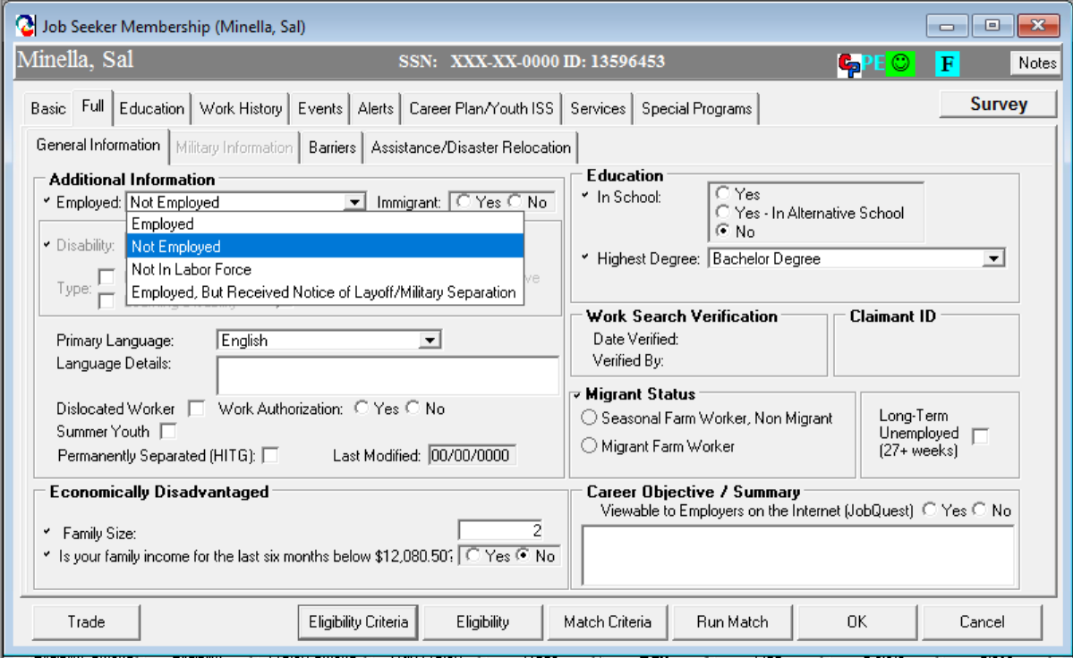
WIOA Dislocated Worker Eligibility
Employment Status
Notes:
How do we enter this in Moses, we will go through each of the eligibilities and where to find them in Moses. For Dislocated worker we would select Not Employed on the General information tab in the additional information field. Please be sure Not In Labor Force is not selected, you will not receive credit for outcomes, DOL does not include them because they are not looking for work by their definition.

Slide 9
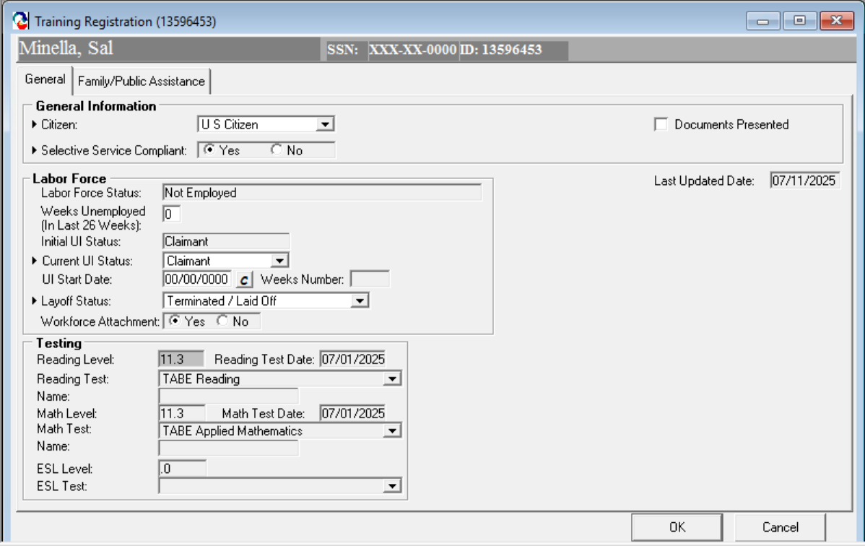
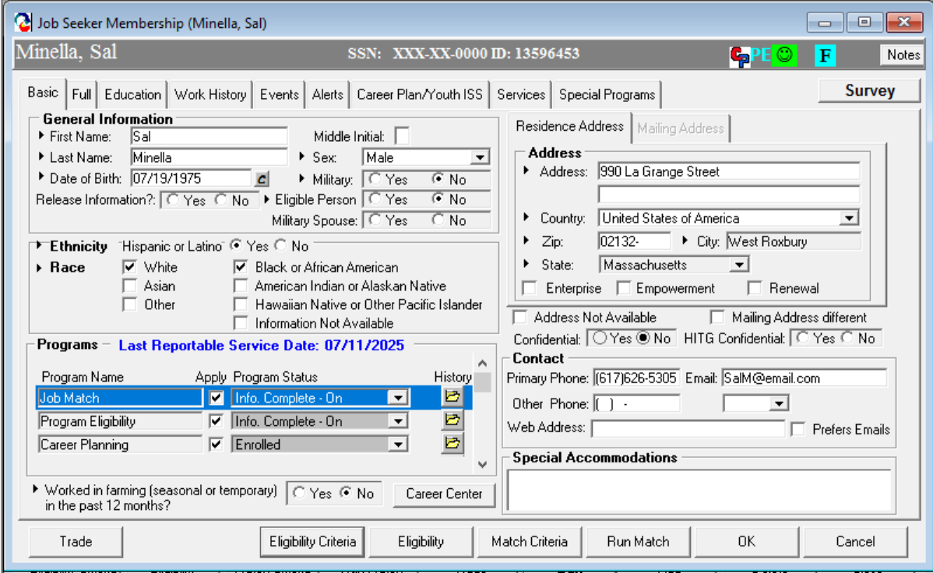
WIOA Dislocated Worker Eligibility
UI Claimant Status, Layoff Status, Workforce Attachment
Notes:
To enter Dislocated Worker status you would click the Eligibility Criteria from the bottom of the any screen as seen in the inset. On the next screen you will find the Current UI status, layoff status and workforce attachment. This will also populate from UI if they are a claimant, but you must confirm the information is current and correct.

Slide 10
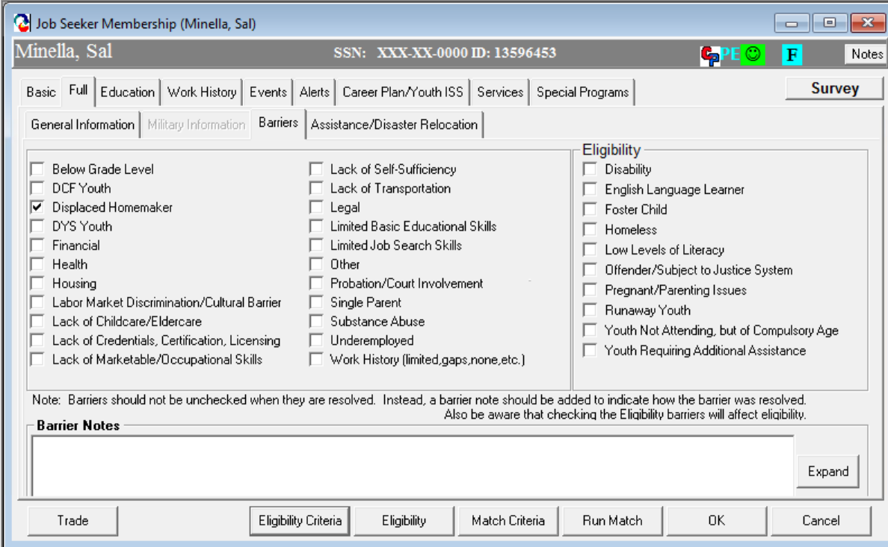
WIOA Dislocated Worker Eligibility
Displaced Homemaker
Notes:
For displaced homemaker you would check off displaced homemaker on the barriers section in the full tab and put notes in the Barrier notes section as to how this barrier effects the customer and how you are going to address it.

Slide 11
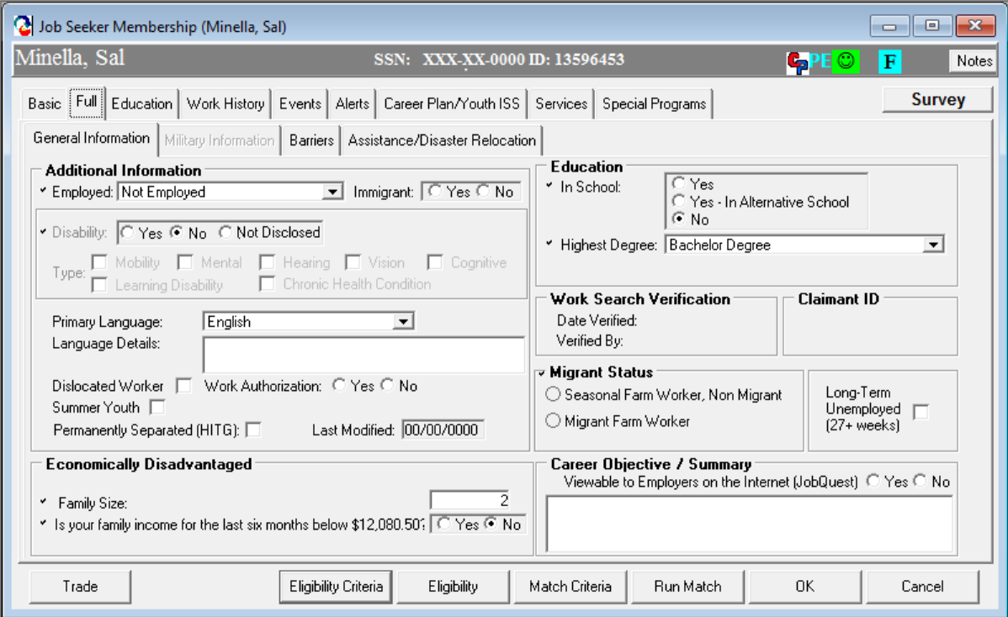
Income Stuff
Self-Attestation Question on Full Tab
Notes:
To enter economically disadvantaged go to the general information tab to the Economically disadvantaged section near the bottom. This does not make them eligible for any programs, but it does give you the lower living standards based upon their family size which is updated annually. This field is also part of the federal reporting. To do the next part you would click the Eligibility Criteria button.

Slide 12
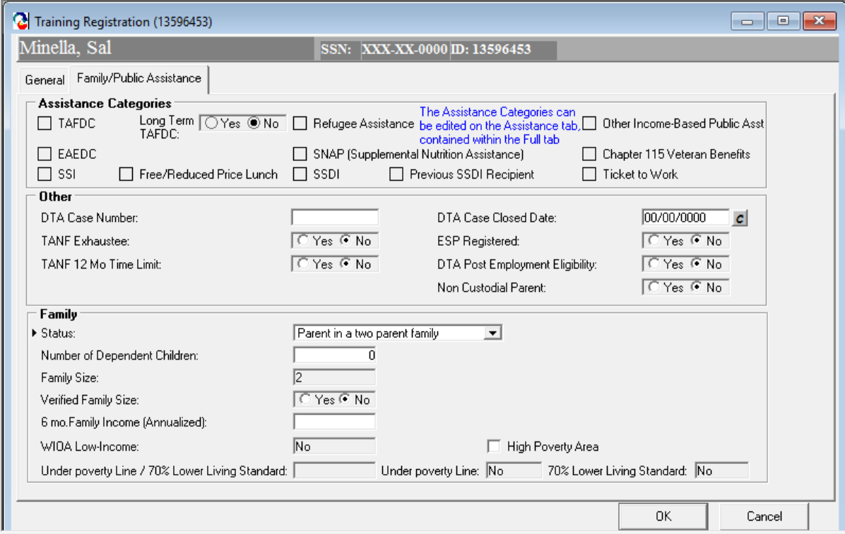
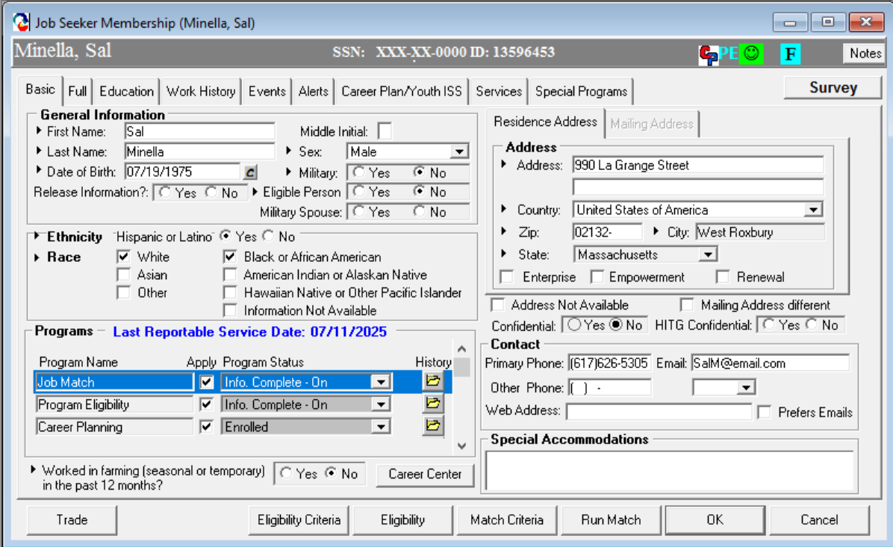
Income Stuff
Verifying Income in the Eligibility Criteria Area
Notes:
Again, clicking the eligibility criteria button at the bottom of the screen. This will pull over the family size from the previous screen to fill in the family section. Please do not enter anything in the 6 month family income area unless you have calculated and confirmed it with the customer. If you have not confirmed it, leave it blank. Any questions on Eligibility?

Slide 13
Source Documentation
Documentation is necessary to support Adult and Dislocated Worker eligibility and priority of service.
Staff must verify and confirm individuals are eligible to participate in Adult and Dislocated Worker program services through an examination of documents.
Documentation may be stored electronically; however, documentation must be available to program monitors, fiscal monitors, and auditors. (Security protocols to safeguard personal information must be in place.)
Local areas must retain records for a period of at least three (3) years after the submittal of the final closeout expenditure report for that funding period.
100 DCS 18.101.6 Eligibility Requirements for WIOA Title I Adult and Dislocated Worker

Slide 14
WIOA Eligibility Documentation in a Virtual Environment
Verifying Eligibility Documentation via Live Stream
Allows verification of eligibility documentation through livestream or video sharing such as Zoom, WebEX or other virtual media platforms.
A printout or an electronic copy of a screenshot containing the eligibility document verified must be included in the customer’s file.
Electronic Signatures
Participants must still sign documents when required.
Fillable forms and the use of electronic signatures is allowed.
Staff may have the participant email agreement to the content of the required form.
The email must be kept in the participant file.
Documenting MOSES
Staff must document the “Notes” section in MOSES when eligibility documentation was obtained via live stream and a printout or screen shot of the eligibility document is included in the customer’s file.
  100 DCS 18.111 WIOA Eligibility Documentation In A Virtual Environment
Notes:
This a newer policy developed during the pandemic to allow for centers to continue to collect eligibility documents and enroll participants in programs who were not able to provide them in person. Definitely read this policy fully if you use this method for collecting documentation.

Slide 15
Applicant Statement
DOL encourages grant recipients to consider the impacts on equity and accessibility when developing source documentation policies and procedures.
As referenced in TEGL 23-19 Change 1 – career centers/workforce boards considering restrictions on the use of self-attestation should consider while other documentation sources are preferred when practical, self-attestation is an important option for populations with barriers to obtaining eligibility and reporting documents (such as disconnected youth, American Indian and Alaska Native populations, individuals experiencing homelessness, justice involved individuals, refugees, disaster impacted individuals, and others) and help ensure such populations are able to equitably access services.
TEGL 23-19 Change 1 | U.S. Department of Labor (dol.gov)
Notes:
In regards to use of Applicant Statements, you will want to be sure to fully read TEGL 23-19-1 Change 1. We do not want to exclude anyone who is having issues with providing documentation, but it should be used as a last resort. Moses notes must be clear and very detailed in these cases. Any questions on Source Documentation or Applicant Statements?

Slide 16
Career Services
Basic Services
Basic Career Services: Universally accessible and made available to all individuals seeking employment and training.
  Services include:
  Eligibility Determination
    Initial Skills Assessment
    Labor Exchange Services
    Information on Programs and Services
    Program Referrals
Basic services must be made available in at least one comprehensive Career Center per local area.
Basic Career Services may be provided by Adult and Dislocated Worker staff and Employment Services staff.
Notes:
Basic services can also include use of the resource room or attending workshops.

Slide 17
Career Services
Individualized Career Services
Individualized Career Services: Made available to participants after staff determine such services are required to retain or obtain employment consistent with applicable statutory priorities.
  Specialized Assessment
  Development of Individualized Employment Plan (IEP) or Career Action Plan (CAP)
Jointly developed by the participant and career planner to create an on-going strategy to identify:
      Employment Goals
      Achievement Objectives
      Appropriate combination of services for the participant to achieve the employment goals
Notes:
These programs require enrollment to be accessible to the customer.

Slide 18
Career Services
Counseling
  Counseling
  Work Experiences (including transitional jobs)
  Transitional Jobs are time limited and wage-paid work experiences up to 100 percent subsidized.
      Must be combined with career and supportive services
      Established work history to demonstrate success in the workplace and develops skills
      Local Boards may use 10% of funds to support transitional jobs
        Individualized Career Services may be provided by Adult and Dislocated Worker staff and Employment Services staff.
Notes:
These programs require enrollment to be accessible to the customer.

Slide 19
Career Services
Requirements
All customers enrolled in WIOA Title I Adult and DW program receiving individualized career services will have an Individualized Employment Plan (IEP) also known as the Career Action Plan (CAP).
The CAP is an individualized career service plan consisting of connected activities, jointly developed by the participant and career center staff.
The CAP is an ongoing strategy used to identify:
  Employment Goals
  Achievement Objectives
  Appropriate Combination of Services
  The CAP must be monitored by staff to ensure effectiveness.
  Career Planning must be documented in the Career Plan in MOSES
  MassWorkforce Issuance 100 DCS 08.112.3: Career Planning for WIOA Youth, Adult and Dislocated Worker Customers
  Career Planning Elements: Attachment A
Notes:
The CAP or IEP is a living document and must be continually monitored to ensure the customer is on track for success or to see if changes are needed.

Slide 20
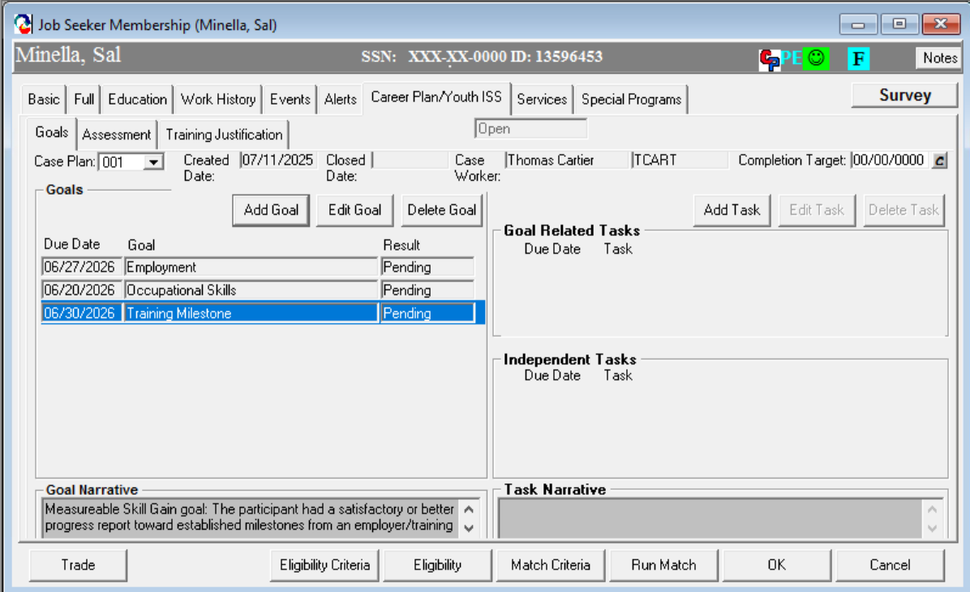
Career Plan in MOSES
Goals Tab
Notes:
How do we do this? We use the Career Plan/Youth ISS tab Moses of course. The first tab we use to set goals for the customer by breaking down the steps needed to obtain employment. This is also where we enter Measurable Skills Gains which we cover in the WIOA Performance training coming up.

Slide 21
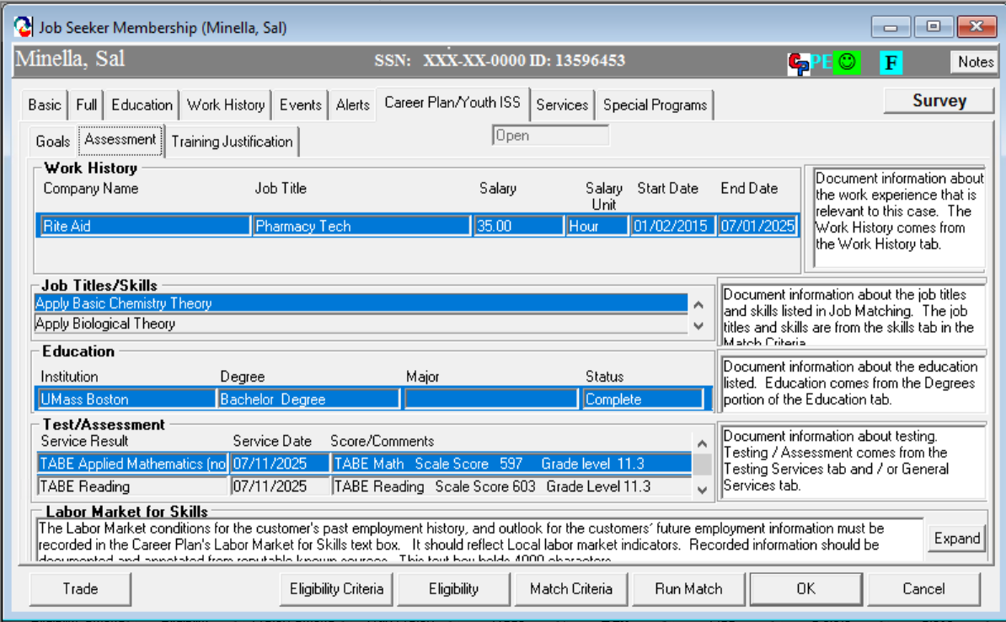
Career Plan
Assessment Tab
Notes:
The next tab we use is Assessment. This is a summary of all the assessments. You will want to make notes on the side for things like cori, sori. Any specialized skills and education as well as any test/assessment notations. And finally, everyone's favorite LMR. Be sure you have gone over the LMR with the customer, so they understand the skills needed, salary range and outlook on their careers.

Slide 22
Training Services
Training may be provided whether the individual has received basic or individualized career services first or not.
  Exception – When career services are not provided before training, career center staff and partner program staff must adhere to the Local Board’s policy to provide justification of the circumstances in which to provide services without first providing career services.
  Case file must contain a determination of the need for training services.
  Training can be justified through the use an interview, evaluation, assessment, or career planning.
  The following tools can be used to justify training (the list below is not intended to be limiting):
    Work Keys Placement Quiz or Exam
    MassHire CIS
    Academic Assessment Tool
Notes:
For the exception, if a customer is working with Mass Rehab and has received assessments and is being prepared to attend training by providing transportation or adaptive equipment for training provided by us. There is a policy in the next couple of slides regarding Shared Cusotmers as well.

Slide 23
Training Services continued…
Individual Training Account (ITA)
Training provided by an Eligible Training Provider (ETP)
Participants must have access to the Eligible Training Provider List (ETPL)
  The ETPL is accessible to all local MassHire Centers and customers through Masshire Job Quest
  The Local Board must fulfil the consumer choice requirements in 20 CFR 680.340
Notes:
The customer has the choice to select the eligible training provider who fits their needs the best.

Slide 24
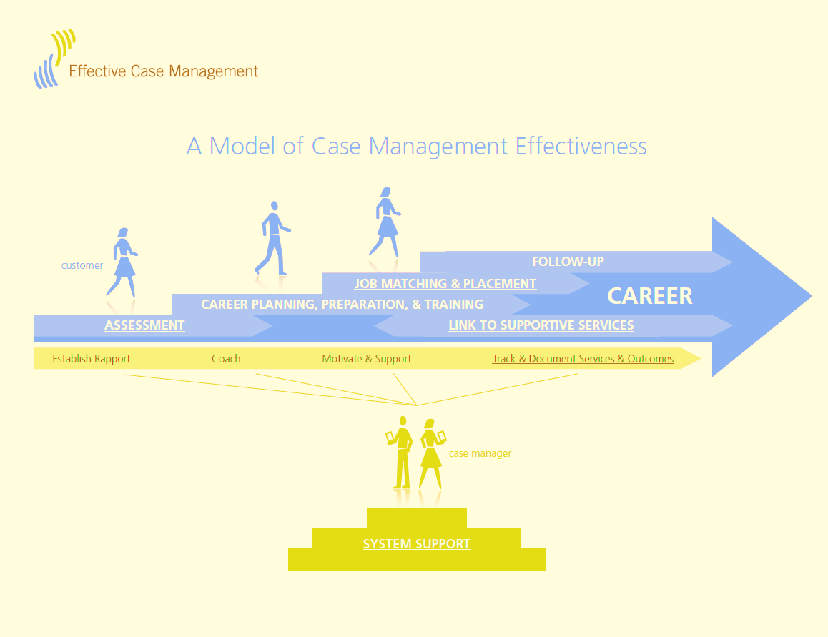
Effective Case Management
Notes:
This is the framework for Case Management. We bring the customer through assessments, career planning, preparation and training, job matching and placement then on to follow-up services. Notice the yellow band throughout this process we are here to offer support beginning with establishing a rapport, coaching and motivating and then tracking and following up with the customer to ensure their new job is going well. Any questions on Career Planning?

Slide 25
Supportive Services and Needs Related Payments
Supportive Services
Available to Adults and Dislocated Workers participating in Title I career services or training activities.
Enables the individual to participate in career services or training activities.
Needs Related Payments
Designed to provide participants with financial assistance to participate in training services.
Participants must be enrolled in a training program in order to receive needs-related payments.
100 DCS 08.106: Supportive Services and Needs-Related Payments for Title I Adults, Dislocated Worker and Youth Policy
Notes:
These are payments to assist with things like bus passes, scrubs, childcare or fuel assistance. A local policy must be in place before these payments are issued to define when, how, why and how much the payments will be. Be sure payments are not duplicated.

Slide 26
Coordination with WIOA Partners
Partner Program | Population | Services
WIOA Title I Youth Program (Youth Service Providers) | ISY and OSY 14 -24 | Comprehensive assessments, career planning, support services, alternative education, work-based learning experiences, and occupational skills training.
WIOA Title II Adult Education and Family Literacy (Adult Education Providers) | Adults 16 and older not currently enrolled, or required to be enrolled in high school. | Assist adults to become literate and obtain the knowledge and skills necessary for employment and economic self-sufficiency.
Vocation Rehabilitation Title IV (Mass Rehabilitation Commission and Mass Commission for the Blind) | Individuals must have a physical or mental impairment that is a substantial impediment to employment. | Preparation for placement in competitive integrated employment.
Senior Community Employment Service Program Title V (Older Workers) | Individuals age 55 an older | Provides opportunities for community services and work-based training for older workers.
TANF and SNAP (Department of Transitional Assistance) | Low-income individuals and families. | Assists low-income individuals and families meet their basic needs, improve their quality of life.
Notes:
We don’t do this alone. We have WIOA partners to assist customers with barriers that maybe outside of our scope. This was a big change from WIA to WIOA. These are the WIOA required partners. In the first column you will see the name of the Partner Program, next the Population they serve and last the services they provide.

Slide 27
Shared Customers
A key reform of WIOA is strategic alignment of workforce partners to serve individuals that have a variety of needs.
Job Seekers and Youth that are eligible to receive service from more than one WIOA Partner Program are considered shared customers (this also includes businesses.)
Shared customers benefit from services and resources delivered across multiple WIOA Partner Programs.
Shared customers must be tracked in MOSES.
Co-location of Partner staff in the career centers will lead to increased number of shared customers
Joint Partner Policy Commination: 01.2018 – WIOA Partner Shared Customer
Notes:
Shared customers must be documented in Moses and services can not be duplicated.

Slide 28
Coordination with Partner Programs
Coordination with partner programs is encouraged in order to create a continuum on services for shared customers.
Results of intake and assessment will help to identify additional services and resources a customer needs for successful program participation.
Example 1:
Participant receives occupational skills training funded by WIOA.
Participant is referred to Adult Education Program for ESOL.
Example 2:
Participants enrolled in Career Center Services (Workshops).
MassAbility provides accommodations to participate in workshops.

Slide 29
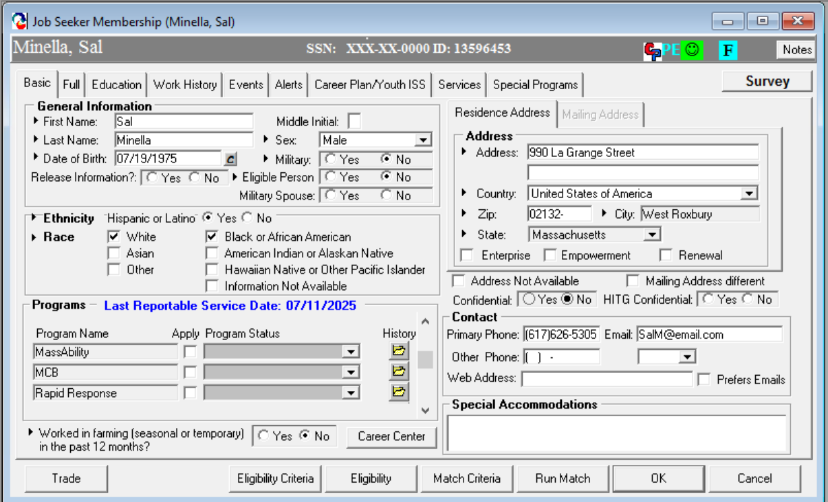
Documenting the Shared Customer in MOSES
Notes:
After you have confirmed your customer is working with a partner agency you will enroll them in the programs section on the Basic tab of Moses. Scroll down until you find the partner and then click apply and save. Of course you will enter notes to tell how you confirmed this and details of services and assistance they receive,

Slide 30
Follow- Up Services
Follow-Up Services: Provided for 12 months after the first day participants are placed in unsubsidized employment. Local area policies must define appropriate follow-up services.
  Follow-Up Services Include:
    Providing individuals counseling about the workplace
    Career planning and counseling
    Information about additional educational opportunities
    Referral to support services available in the community and peer support groups
    Case management administrative follow-up
    100 DCS 08.102.1: WIOA Title I Follow Up Services Policy
Notes:
Please keep in mind these are not blue bold services. Blue bold services will restart you’re your 12 month follow up clock. You also need to add notes in Moses to describe what type of follow up services you provided the customer.

Slide 31
Tracking Follow-Up Services in MOSES
Follow-up variants for tracking
  Required 12 Month Follow-up
    Overarching, required by law
  After Exit Follow-up Services
    Specific services delivered after exit (e.g. Counseling)
  Retention Services
    Extremely Important for federal performance
  Employment Follow-up Services
    Possibly extremely important for federal performance
Notes:
The next couple of slides show screenshots will show how they look in Moses. Employment services goals have not been negotiated as of yet, but are being tracked to establish future goals.

Slide 32
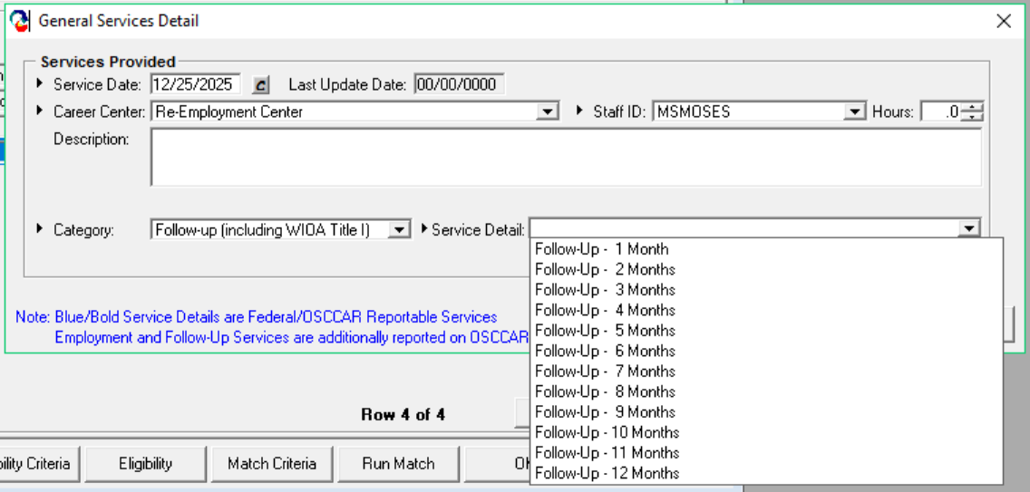
Types of Follow Up
Required 12 Month Follow Up
Notes:
In the general services tab in Moses you would select Follow-up Including WIOA. These are not blue bold services and will not restart your clock.

Slide 33
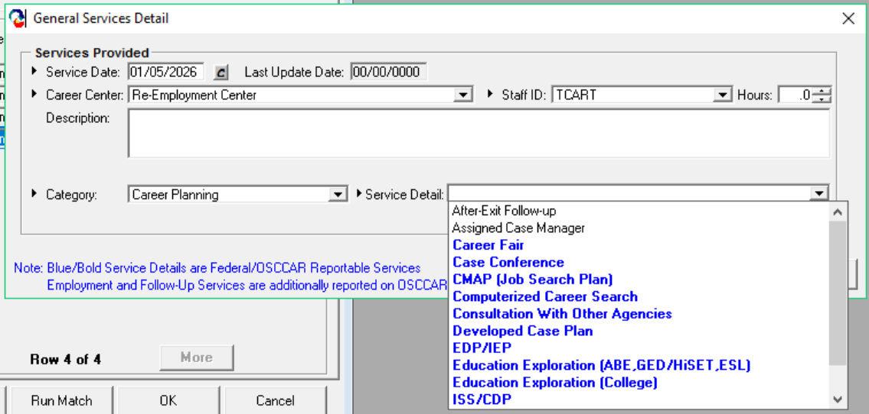
Types of Follow Up
Services Detail Window
After Exit Follow Up Services
(Use the After Exit Follow-up service detail so that a new participation cycle is not created)
Notes:
There is a non blue-bold service under each service category for follow-up, notice the After Exit Follow in plain text. Be sure to use the non blue/bold service and enter details in the notes section of Moses.

Slide 34
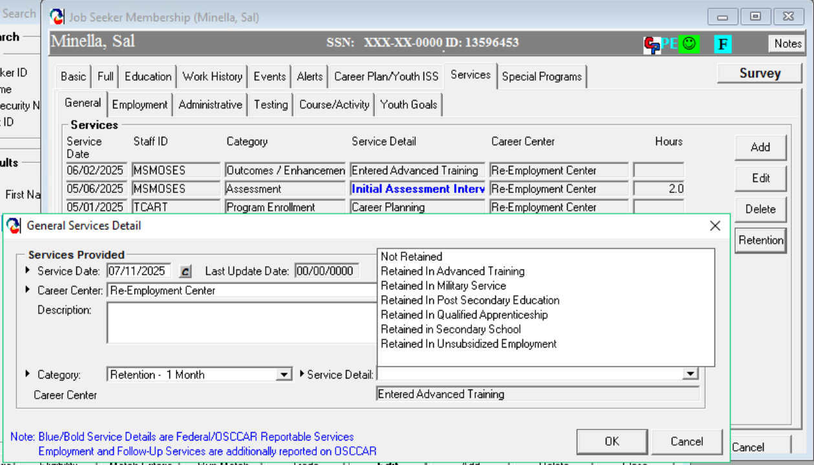
Types of Follow Up
Retention Services (Month 1-12)
Notes:
To enter retention services in Moses go to the General tab under the Services tab. Select a previous service requiring Retention, the Retention button it will become active. When you click on the retention button the General Services Detail window will appear. Moses lists retention by months, so to enter 2nd quarter after exit retention service you would select the 6 month option. The Service Details are performance related to obtain a positive outcome for Federal reporting.

Slide 35
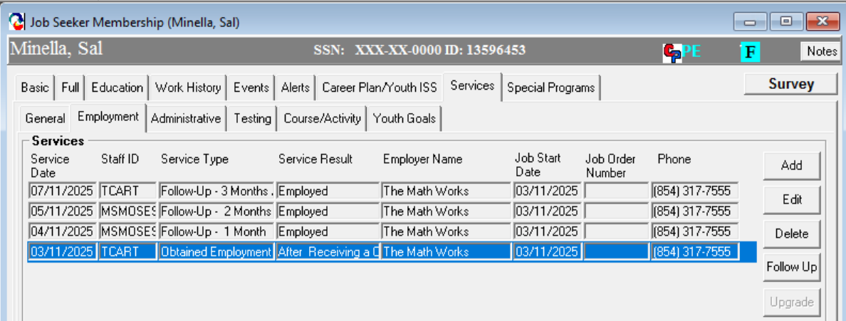
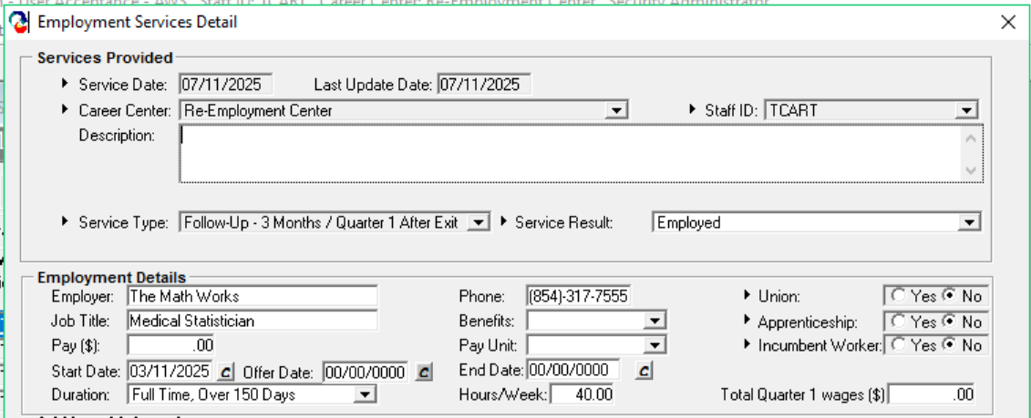
Types of Follow Up
Employment Follow Up
Notes:
To enter employment, follow up services in Moses go to the Employment tab in the Services tab. Select the obtained employment service, the Follow up button it will become active. When you click on the follow up button the General Services Detail window will appear. Moses lists follow up by months so to enter 2nd quarter after exit follow up service you would select the 6 month option. Notice the total quarter 2 wages circled in blue, this is if your customer is working the federal government, a religious organization or is self-employed. We do not receive wage matches from DUA or SWIS for these employers. You will need to enter the wages for Federal reporting only if we will not get a wage match.

Slide 36
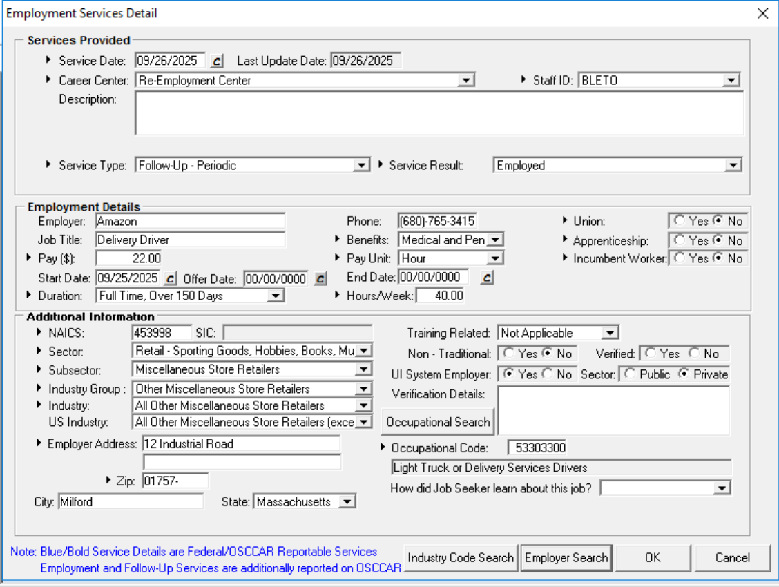
Types of Follow Up
Employment Detail Window
Notes:
During your follow-up you may have a customer inform you they have changed jobs. Do not enter a new employment service. In the follow-up screen you will select the Employer Search button at the bottom of the screen and update with the new employer. If you add a new employment it will reset your 12 month follow up clock to zero.

Slide 37

Questions?
Questions?

Slide 38
Resources
Workforce Innovation and Opportunity Act
  Workforce Innovation and Opportunity Act: Department of Labor Only – Final Rule
  Department of Labor TEGL 10-16, Change 3 Performance Accountability
  Department of Labor TEGL 19-16 Guidance on the Adult and Dislocated Worker Program
    Workforce GPS – Workforce Systems Strategy Website
      https://ion.workforcegps.org/
      Workforce GPS – Yes, WIOA Can!
      MassHire WIOA Training Material | Mass.gov
Notes:
These are some fanatic resources especially the WIOA Final rule at 399 pages. My favorite is TEGL 10-16 Change 2 at 80 pages.

