Slide 1
One Stop Operator Procurement Training
National State Peer to Peer Technical Assistance and Training
Puerto Rico TAT Project
Massachusetts Division of Career Services
US DOL ETA-Region 1

Slide 2
Welcome
Introductions
Carmen Rodriguez, US DOL ETA
Tim Martin, US DOL ETA
Alice Sweeney, Massachusetts, Department of Career Services
Diane Hurley, Massachusetts, Department of Career Services
David Manning, Massachusetts, Department of Career Services
Natasha Vazqueztell Cordero, Puerto Rico Department of Economic Development and Commerce

Slide 3
WebEx Housekeeping
Directions for Conference Call (1-866-816-0330 participant#:9520698
Please Mute your phone line
Do not put your telephone on hold if it plays music
Hit *6 to mute and unmute line

Slide 4
National State Peer to Peer Technical Assistance
Supports WIOA implementation
Allows for State to State peer learning opportunity
Addresses areas of program improvement
Identifies models and examples that may be replicated throughout workforce system
State of Massachusetts Grant Recipient
Funding expires June 20, 2018

Slide 5
WIOA One Stop Operator Regulations
WIOA Sec. 107 (10) and Sec 121(d)(2)(A)
20 CFR 678.605 (a): Consistent with paragraphs (b) and (c) of this section, the Local WDB must select the one-stop operator through a competitive process, as required by sec. 121(d)(2)(A) of WIOA, at least once every 4 years. A State may require, or a Local WDB may choose to implement, a competitive selection process more than once every 4 years.
20 CFR 678.605 (c): All other non-Federal entities, including subrecipients of a State (such as local areas), must use a competitive process based on local procurement policies and procedures and the principles of competitive procurement in the Uniform Guidance set out at 2 CFR 200.318 through 200.326. All references to “noncompetitive proposals” in the Uniform Guidance at 2 CFR 200.320(f) will be read as “sole source procurement” for the purposes of implementing this section.
20 CFR 678.615 (a): Local WDBs may compete for and be selected as one-stop operators, as long as appropriate firewalls and conflict of interest policies and procedures are in place. These policies and procedures must conform to the specifications in § 679.430 of this chapter for demonstrating internal controls and preventing conflict of interest.
Training and Employment Program Letter (TEGL) 15-16: In situations in which the outcome of the competitive process is the selection of the Local WDB itself as the one-stop operator, the Governor and the Chief Elected Official must agree to the selection of the Local WDB as required by WIOA sec. 107(g)(2).

Slide 6
Commonwealth of Massachusetts Peer-to-Peer Technical Assistance
Puerto Rico
WIOA Firewalls Related to the One-Stop Procurement Process
Massachusetts Executive Office of Labor and Workforce Development Department of Career Services

Slide 7
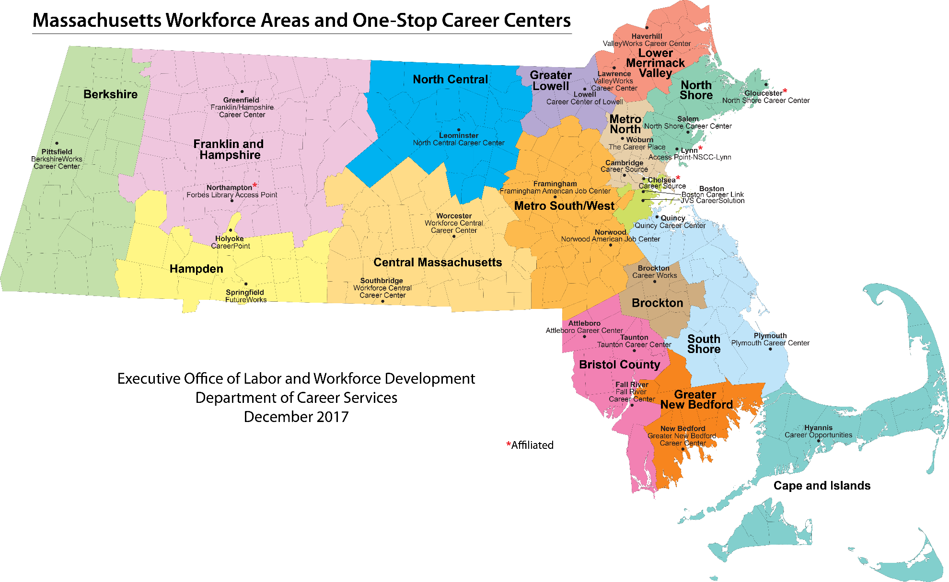
CURRENT LANDSCAPE
MA WORKFORCE SYSTEM
16 Workforce Development Areas & Boards
29 Career Centers
25 Comprehensive Centers (full service)
4 Affiliated Centers orAccess Points (limited service)

Slide 8
MA WORKFORCE SYSTEM
The MA Workforce Development System comprises 16 Workforce Development Areas (WDAs) led by 16 employer-driven Workforce Development Boards (Local Boards) currently operating 29 One-Stop Career Centers (OSCCs)
The MA Workforce Development System is characterized by several different types of organizational structures (municipal, consortium, non-profit, for-profit)
Prior to the implementation of the Workforce Investment Act (WIA) (1998), 4 of the 16 Local Areas received an exemption to the Wagner-Peyser merit staffing requirement that is still in effect in those areas
The merit staffing requirement remains in 12 of the 16 Local Areas
The Massachusetts Competitive Selection Policy required the One-Stop Operator to also be the provider of some or all of the career center services

Slide 9
LOCAL AREA COMPOSITION
Under WIOA
Chief Elected Official
Fiscal Agent
Local Board
Lead Operator/Service Provider
DCS
DUA
MRC
MCB
DTA
ACLS
SCSEP
DCS – WIOA Title I, W-P, Trade, JVSG
DUA – Unemployment Compensation
MRC and MCB - Voc. Rehab.
DTA – Transitional Assistance
ACLS – WIOA Title II
SCSEP – WIOA Title V

Slide 10
One-Stop Operator Procurement PROCESS & RULES
Review critical regulations and process rules:
WIOA law & regulations, OMB regulations, TEGL 15-16 & state/local competitive selection rules
Common agreement to the idiosyncrasies of the local procurement
Documenting local process (regulations, by-laws, minutes of meetings, RFP Guidance, review and recommendations, timelines, contracting authority and structure-length of time, funding limits and liabilities )
RFP inclusions, restrictions & alignment with state plans & certifications, TA on questions, advertising, review, appeals
Clarification of roles (WDB, CEO, Operator, Fiscal Agent, partners (state & local) – potential bidders must not be part of the RFP process
Formal agreement to conflict of interest and open meeting & voting rules
Appeal conditions and state and local appeal timelines

Slide 11
DCS OVERSIGHT ROLE
MA authorized the Local Workforce Development Boards (WDB) to conduct the procurement for Lead operator/Service Provider
DCS conducted local meetings with all parties on the RFP process and conflicts/firewalls, then met separately with each Local Board & municipal procurement officers who would issue the RFP
Was the process, including the appeals process, in writing (Policy) at all levels and was it understood at all levels by all parties?
Were WIOA Partners involved in the review process?
Did all parties adhere to process firewalls, conflict and open meeting rules & the specific RFP Roles of operator, service providers, WDB, state and fiscal agent?
Was discussion and recommendation based solely on the documentation provided in the application, and not on outside factors (e.g. past experience with bidder)?

Slide 12
DCS OVERSIGHT ROLE (continued)
Was the information provided to all parties at the bidders conference, as well as sharing of subsequent questions and answers to all registered bidders consistent across the board?
Were all parts of the procurement documented for compliance purposes? (Meeting minutes, dissemination of information, Questions, Technical assistance, advertising, submission criteria & timelines met, visits & presentations available and consistently conducted, failed competition or sole source documented)
Did appeals take place and were they properly conducted?

Slide 13
LOCAL AREA COMPOSITION
Model: Fiscal Agent is the Municipality
Chief Elected Official
Local Board
Municipal Employees
FH Board Non-Profit Employees
Fiscal Agent
Municipal Employees
Lead Operator/Service Provider
Municipal Employees
DCS
DUA
8 Local Areas: Boston**, Bristol, Franklin/Hampshire (FH), Lowell, Merrimack Valley*, North Shore, South Shore and Worcester
Fiscal Agent is municipality
One-Stop Operator is internal to sub-recipient (6); OS Operator is a community college(1)*, OS Operator is non or for-profit**
Firewalls & Internal Controls: Fiscal Agent/RFP (Board or city) or Fiscal Agent/Bidder

Slide 14
LOCAL AREA COMPOSITION
Model: Fiscal Agent is the LWDB
Chief Elected Official
Fiscal Agent
is the Local Board
Local Board
Non-Profit Employees
Lead Operator/Service Provider
Non-Profit Employees
For-Profit Employees
DCS
DUA
7 Local Areas:*Berkshire, ***Brockton, *Cape & Islands, *Hampden,
*New Bedford, **Metro North and ****North Central
OS Operator is external to sub-recipient
(*non-profit, **for-profit, ***University, ****Consortium)
Fiscal Agent is the Local Board
Firewalls & Internal Controls: Board/Fiscal, Board/Bidder (OS Operator)

Slide 15
LOCAL AREA COMPOSITION
Model: Fiscal Agent is a Non-Profit
Chief Elected Official
Fiscal Agent
Non-Profit Entity
Local Board
Non-Profit Employees
Lead Operator/Service Provider
For-Profit Entity
DCS
DUA
1 Local Area: Metro South/West
OS Operator is external to sub-recipient
Fiscal Agent is a non-profit entity
Firewalls & Internal Controls: Board/Fiscal, Board/Bidder (OS Operator)

Slide 16
POST SELECTION
All 16 Areas completed the selection process. A full-board vote was required to ratify the One-Stop Operator/Service Provider recommendation
In 12 areas, the current service providers were awarded the Lead Operator/Service Provider bid
In 4 areas, there are new Lead Operators/Service Providers:
2 Areas have selected a For-Profit Agency
1 Area has selected a Community College
1 Area entered into a sole-source “Consortium” agreement
MA will use this experience to clarify definitions and strengthen policies and procedures for the next competitive operator/service provider selection process

Slide 17
MA LOCAL CONFIGURATIONS
RE-CAP
FISCAL AGENT | ONE-STOP OPERATOR
Municipality | Municipality
Municipality | Community College
Municipality | For-Profit/Non-Profit
Workforce Board | For-Profit/Non-Profit
Workforce Board | University
Workforce Board | Consortium
Non-Profit | For-Profit

Slide 18
PROCESS RULES OF THUMB
The Fiscal agent is in a unique pivot point position as the Fiscal Agent must provide general information to all bidders and also more detailed information to their business partner entities in the normal course of business particularly when the business entities now occupy conflicting places in the bid process
Firewall conflicts generally arise if the Fiscal Agent does not carefully differentiate the type of information they are providing in the bid process to the WDB (RFP) and to the OS/SP (Bidder)
For example, if the Fiscal Agent is helping the WDB develop the RFP budget structure in order to elicit specific responses, they cannot also help the OS/SP bidder construct their bid budget because the OS/SP will know the response that is sought, hence a conflict
The Fiscal Agent assisting the OS/SP bidder must still give generic budget information to the WFB/bid developer in the normal course but must be careful not to ask how it will be used if the Fiscal Agent expects that it may be used to develop the RFP
Care must always be taken by parties that may become conflicted to be knowledgeable re: agendas and alert re: discussions and remove themselves from meetings where they think they may hear information, however seemingly insignificant, that may/will place them in conflict
Minutes must be kept for all RFP-related meetings and following firewall rules will prevent discussions at formal and informal meetings from becoming the basis for appeals later

