Slide 1
Commonwealth of Massachusetts
Workforce Innovation and Opportunity Act (WIOA) Combined State Plan

Slide 2
Background Information

Slide 3
WIOA Stakeholder Process (Nov 2014)
WIOA STEERING COMMITTEE: VISION BRAINSTORM
Demand Driven
Employer-driven model, “flip the model”
Be truly job-driven
Regular/routine contact with industry re: changing hiring needs/process (e.g. online applications)
Define why we have an employer-driven model, and make mission/vision clear: to gather intelligence and form operational partners
Look at effective models like Apprenticeship
Partnerships
Look at system in partnership with all stakeholders
Stabilize partner networks
Service Delivery & Systems Improvement
Re-think approach to workforce system, refocus service delivery models
Think about those “screened out”, and resources that can be brought to bear to address their needs, ramps to basic skills
Look at local Board composition (effective & engaged Board members)
Need better system collecting and sharing consumer information on training (Community Colleges, proprietary training programs)
Robust use of technology and social media
Professional development of staff (training about training)

Slide 4
WIOA Planning & Stakeholder Engagement
WIOA Steering Committee
System Priorities
Eligible Training Provider List (ETPL) Workgroup
Workforce Board Standards/ Certification
(JS&E Sub-group)
Career Center Standards & Selection Process (statewide baselines)
(JS&E Sub-group)
Performance Measurement
(JS&E Sub-group)
Business Strategies
(JS&E Sub-group)
Youth Workgroup
Job Seeker and Employer (JS&E) Workgroup
Business Focus Groups
(direct input on “demand driven”)
Notes:
WIOA STEERING COMMITTEE: VISION BRAINSTORM
Demand Driven
Employer-driven model, “flip the model”
Be truly job-driven
Regular/routine contact with industry re: changing hiring needs/process (e.g. online applications)
Define why we have an employer-driven model, and make mission/vision clear: to gather intelligence and form operational partners
Look at effective models like Apprenticeship
Partnerships
Look at system in partnership with all stakeholders
Stabilize partner networks
Service Delivery & Systems Improvement
Re-think approach to workforce system, refocus service delivery models
Think about those “screened out”, and resources that can be brought to bear to address their needs, ramps to basic skills
Look at local Board composition (effective & engaged Board members)
Need better system collecting and sharing consumer information on training (Community Colleges, proprietary training programs)
Robust use of technology and social media
Professional development of staff (training about training)

Slide 5
WIOA Combined State Plan: Timeline
Task | Timeframe
State Board formed Steering Committee to guide state plan process | November 2014
Steering Committee directs planning process | February – November 2015
Draft State Plan submitted to Governor | November 13, 2015
State Plan public review and comment period Draft plan published online Listening Sessions/Public Forums | January – February 2016
State Board briefed on State Plan | February 25, 2016
Governor approves/signs State Plan | March 2016
Massachusetts submits State Plan to USDOL for approval from multiple federal agencies | March 2016
Final Federal WIOA Regulations (affecting WDB Certification, Career Center Selection Process, Performance Measures and overall State Plan) | June 2016
All WIOA provisions take effect | July 1, 2016

Slide 6
Overview of
Combined State Plan

Slide 7
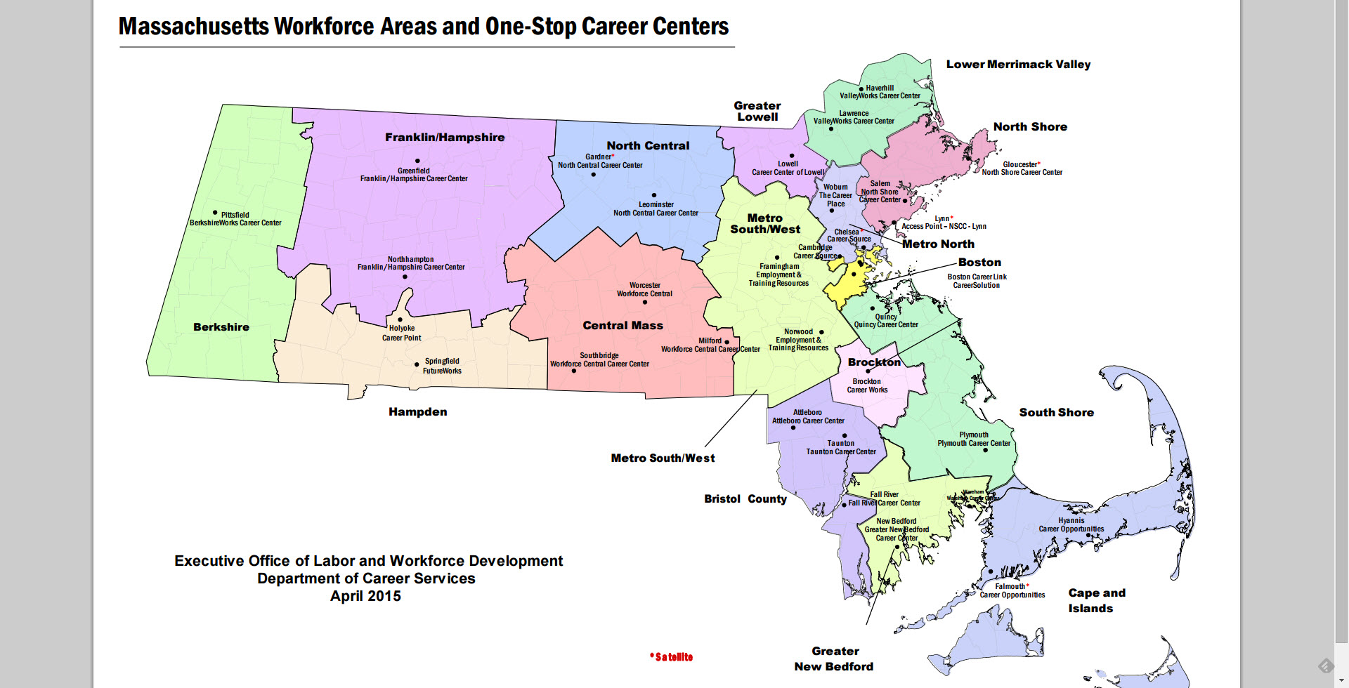
Current DOL Funded Workforce System

Slide 8
Context for Combined State Plan
Labor Market Overview
Economic Development Plan (Recs)
Task Force on Individuals Facing Chronically High Rates of Unemployment (Federal System Recs)
Workforce Skills Cabinet Integrated Planning
WIOA Steering Committee Visioning

Slide 9
WIOA Hallmarks of Excellence
The Revitalized Workforce System embodies four hallmarks of excellence:
One-Stop career centers, the foundation of the public workforce system, will provide first-rate customer service to businesses and jobseekers;
The demands of businesses and workers will drive public workforce system actions and solutions;
Through strategic partnerships and regional coordination, the public workforce system will support strong regional economies, and play an active role in community and workforce development; and;
Continuously improve through accountability, best practice identification, evaluation, and data driven decision making

Slide 10
Key Areas of Work in Combined Plan: WIA to WIOA Comparison
Element | Workforce Investment Act (WIA) | Workforce Innovation & Opportunity Act (WIOA)
State Planning | State plan reflected siloed program design and delivery; required partners to develop independent state plans to submit to respective federal agencies | State plan represents coordination and joint strategy development between workforce partners; one state plan for several federally-funded programs submitted to federal gov’t
Workforce Partner Engagement | Partner engagement episodic, driven by funding opportunity or local innovation | Mandates workforce partners on state and local level coordinate and align programs to develop career pathways for targeted populations with barriers to employment
Regional Planning | Requires 16 workforce regions; cross-region typically based on pursuit of sector grants | Requires 16 workforce regions; mandates a smaller number that “roll up” the 16 workforce regions; allows for joint planning and resource-sharing
Workforce Board Certification | Established baseline standards for WIB certification | Enhances certification standards to require local boards to articulate/implement region’s workforce strategic plan
One-Stop Career Center (OSCC) Infrastructure | One Stop Career Center costs supported by WIA Titles I & III funding; shared costs were negotiated locally | Mandates WIOA partners contribute to One Stop Career Center infrastructure fund and shared costs (cash / in-kind)
Statewide One-Stop Career Center (OSCC) Standards | No criteria to determine operational standards for career centers | Establishes “floor” for OSCC standards to be implemented statewide; requires partner engagement and coordination; competitive selection
Priority of Service | Priority of service for Veterans | Priority of service for individuals with barriers to employment (Vets, TANF/SNAP, Individuals with Disabilities, etc.)
State Workforce Board | Business-led, but required representation created large board (MA 65 members) | Business-led, but fewer required members allows for smaller board (MA 33 members)

Slide 11
WIOA Combined State Plan
What is in the Plan?
Describes the state’s strategy for implementing the Workforce Innovation and Opportunity Act’s (WIOA) principles and policies through WIOA core and partner programs
WIOA Combined State Plan is Organized Into:
Strategic Planning Elements
Economic & Labor Market Analysis
Vision, Goals, Strategy
Operational Planning Elements
State Operating Systems and Program Administration
Assurances
Submitted every 4 years to the federal Department of Labor (USDOL)
MA submitting a Combined State Plan and must include WIOA Core Program partners; others optional
Draft State Plan developed by WIOA Steering Committee
Link to Public Comment Process: www.mass.gov/massworkforce/state-plan

Slide 12
WIOA Combined Plan Partners
WIOA Federally Funded Program(s)* | State Agency
Adult, Dislocated Worker & Youth Programs (WIOA Title I) FY16 Federal Allocation: $52M $5.2M Governor’s Discretionary Resources $46.8 Required to be distributed to 16 workforce areas | Department of Career Services (DCS) Executive Office of Labor and Workforce Development (EOLWD)
Adult Education and Family Literacy (Adult Education) (WIOA Title II) | Adult and Community Learning Services (ACLS), Department of Elementary and Secondary Education (DESE)
Wagner-Peyser Act (WIOA Title III) | DCS, EOLWD
Vocational Rehabilitation – Title IV | Massachusetts Rehabilitation Commission (MRC); Massachusetts Commission for the Blind (MCB)
Temporary Assistance to Needy Families (TANF) and Supplemental Nutrition Assistance Program (SNAP) (employment and training programs) | Department of Transitional Assistance (DTA)
Unemployment Insurance | Department of Unemployment Assistance (DUA), EOLWD
Trade Adjustment Assistance | DCS, EOLWD
Jobs for Veterans State Grants Program (JVSG) | DCS, EOLWD
Senior Community Service Employment Program (SCSEP) | Executive Office of Elder Affairs (EOEA)
State Voluntary Partners | State Agency
Higher Education Institutions | Department of Higher Education
Economic Development (MA Office of Business Development) | Executive Office of Housing and Economic Development
Office of Refugees and Immigrants | Office of Refugees and Immigrants
Department of Housing and Community Development | Department of Housing and Community Development
*Programs in bold and italicized are mandated WIOA partners in combined Plan; others are optional partners (more may be added)

Slide 13
Combined Plan: Strategic Planning Elements
VISION, GOALS, STRATEGIES
IN COMBINED PLAN

Slide 14
Combined Plan: Vision Statement
All Massachusetts residents will benefit from a seamless system of education and workforce services that supports career pathways for individuals and leads to a more informed, educated, and skilled workforce, which meets the Commonwealth’s businesses’ demands and sustains a thriving economy.
To achieve this vision, Massachusetts will engage businesses to understand their needs and develop an integrated education and workforce system that supports career pathways to prepare residents with foundation, technical, professional skills and information and connections to postsecondary education and training. WIOA partners will work to:
Design career pathways across partners aligned with business demand
Improve foundation skills and transition to postsecondary education and training for individuals with barriers to employment
Assist low-income individuals and families to achieve economic self-sufficiency through support services, labor-market driven credentialing, and employment
Meet the needs of job seekers and businesses who engage in the public workforce system (including partner programs)

Slide 15
Across Systems: Job Seeker Career Pathway Model
State and Local MOUs are designed around a “career pathway” approach based on customer perspective, not focused on the operations of funding streams.
CLASP GRAPHIC: http://www.clasp.org/resources-and-publications/publication-1/Alliance-WIOA-CP-Summary.pdf

Slide 16
Combined Plan: Goals & Strategy (I)
Goal I: Align economic, workforce, and education systems to coordinate systems based on skill needs in regions.
Strategy: Create a new, integrated Regional Planning process (to be named) across the economic, education, and workforce Secretariats.
New regional planning structure based on an aligned regional map between workforce areas, economic development, and education regions (see proposed map on next slide)
The 16 Workforce Investment Areas remain under WIOA, however the new regional planning process will reorganize higher level activities (e.g. data analysis, strategic planning, service mapping, etc.) into the new proposed structure.
Required coordinated teams led by Workforce Boards, Community Colleges & Vocational Technical Schools, Economic Development with partners (Community Based Organizations, HHS, etc.)

Slide 17
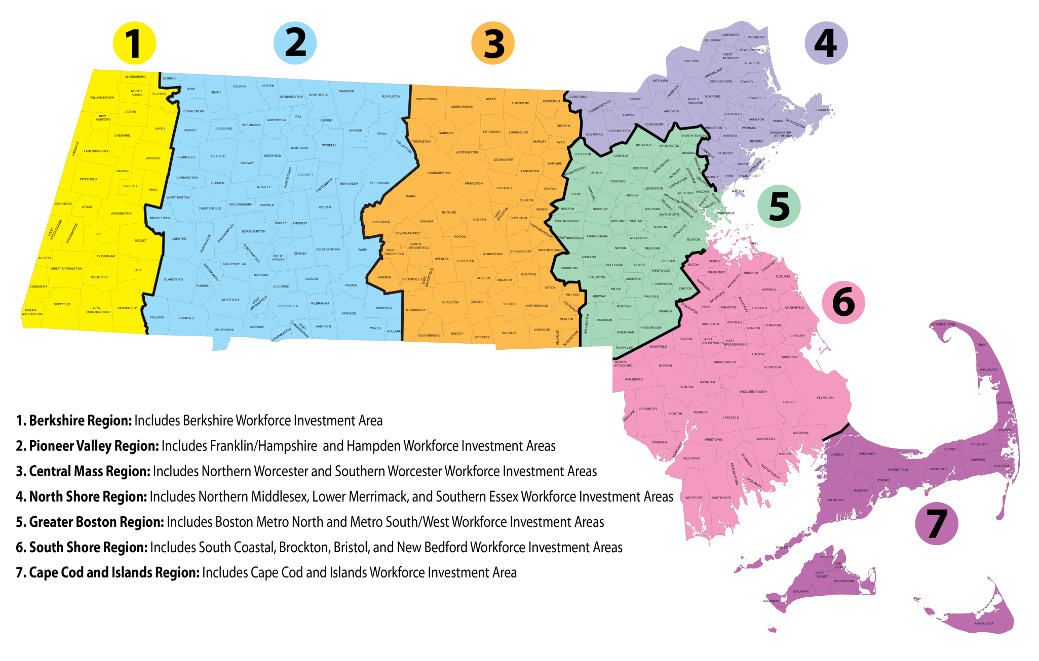
Regional Planning Map

Slide 18
Combined Plan: Goals & Strategy (II)
Goal II: Increase talent recruitment and hiring for business partners through business outreach, candidate referrals, and education & training activities that match business need.
Strategies:
Re-design of business services model at One Stop Career Centers (Demand-driven 2.0)
Coordinate business outreach and recruitment across economic development, workforce and education partners (Workforce Skills Cabinet MOU)
Develop new education and training models aligned to business need (WIOA Formula money for sector initiatives, Pay-for-Success Model, Workforce Competitiveness Trust Fund, etc.)

Slide 19
One-Stop Career Center Demand-Driven Model
Entry Point for Business
Assessment, Triage & Referral
Account Management
Service Delivery
Outcomes
Core Partner Agencies (Career Center, WDB, MRC, MCB, DTA, ABE)
Community College
Economic Development
Business to Business Referral
Job Fair
Job Posting
Assess business need and priorities
What are the skill needs?
Are there existing programs, resources, or capacity to meet business needs?
Are work-based training models appropriate?
Is customer eligible for Workforce Training Fund?
Account manager (agency) based on business need. Examples:
Talent sourcing & development = career center
Incumbent worker training = Workforce Training Fund
Economic incentives = MOBD
Layoff aversion
Business access to education and training resources
Referral to incentives
Successful hires
Employee retention
Repeat business/ referrals
Talent sourcing
Statewide Model for Career Center Business Service Reps and Tracking

Slide 20
Combined Plan: Goals & Strategy (III)
Goal III: Increase credentialing and job placement outcomes for individuals, including individuals with barriers to employment.
WIOA Prioritizes: Individuals with disabilities (example on next slide), low-income, low-skilled (including TANF/SNAP, Adult Education students & Immigrants), and Veterans etc.
Strategies:
Create/map regional “career pathways” or customer flows for each customer base across systems (Local MOU requirement with Core WIOA partners)
Implement new job seeker customer model and WIOA priority of services for individuals with barriers to employment at One-Stop Career Centers (OSCC)

Slide 21
SHARED CUSTOMER MODEL: SERVICE DESIGN, CAREER PATHWAYS, COSTS AND ACCOUNTABILITY (DRIVEN BY REGIONAL DEVELOPMENT BOARDS)
Individuals who do not qualify for VR. How many?
Individuals who are enrolled in VR and would benefit from co-enrollment How many?
Individuals eligible for VR who come to Career Center first.
How many?
JOB PLACEMENT (Target Rate? Rate for region or programs?)
CREDENTIAL (Target rate? Rate for region or individual programs?)
Enrolled Individuals: Vocational Rehabilitation Programming (MRC, MCB etc)
JOB QUEST PORTAL
Referrals, online registration, walk-ins etc
Customer Gets: OSCC Orientation
(Orientation done by Career Center and Core Program partner staff etc)
JOINT WORKSHOPS FOR POPULATION
Individuals use assessment tools like Inter Aptitude, Career Scope, Career Ready 101, TORQ, Benefits Counseling, Ticket-to-Work, post-placement accommodations etc
Customer Gets:
Career Action Plan
(Workshops done by Career Center and Core Program partner staff or external agencies (Umass etc) specific tools and resources.)
JOINT JOB FAIRS & INDUSTRY BRIEFS
Partners develop targeted recruitments
Customer Gets:
Connections to Business
(Workshops done by Business, Career Center and Core Program partner staff)
JOINT CASE MANGEMENT AND ACCESS TO CAREER PATHWAYS
Regions develop virtual or co-located “teams” across Core Program staffing to enhance job placement and credentialing pathways for population –shared case mgt, access to OJTs / ITAs, develop sector grants, community college navigators.
Customer Gets: EXPANDED case mgt team on job search and access to education and training to improve career path.
(Teams created with Career Center and Core Program partner staff, Community College Navigators, external agencies (Umass etc))
Enrolled Individuals: One-Stop Career Center Services

Slide 22
One-Stop Career Centers: New Job Seeker Customer Model
New statewide customer flow to manage individuals from various referral sources who are triaged based on new, intensive skill assessment tools to Job Ready and Skill Building Teams within the Career Center.

Slide 23
Combined Plan: Goals & Strategy (IV)
Goal IV: Increase credentialing and job placement outcomes for youth, including youth with barriers to employment.
Strategies:
Implement integrated career pathways for youth across WIOA Core Program Partners in regions (Local MOU)
Develop Statewide Policies to:
Align WIOA youth procurement process with Core WIOA Programs
Establish referral process between Title I Youth Program and Title II Adult Basic Education Program
Establish referral process between Title I Youth Program and youth (in families) receiving benefits TANF recipients
Establish referral process between Title I Youth Program and Title IV Vocational Rehabilitation

Slide 25
CROSS-SYSTEM
PERFORMANCE MEASURES

Slide 26
Combined Plan:
Performance Measures
State is required to implement mandatory federal performance measures
States are allowed to implement new state-designed performance metrics
MA, through the WIOA Performance Measurement (PM) workgroup, is discussing the creation of a Statewide Dashboard to monitor progress (combining federal and state measures)
All of the federal and proposed state-designed measures require broad access to wage record data (state statute must be changed)
The Performance Measurement workgroup is currently exploring:
Data each measure is meant to capture and what it would communicate;
Available data sources / agency capacity to capture the data;
Balance between exhaustive list and meaningful list;
Whether the performance measures will apply to all core WIOA partners or not (e.g. adult education in state-designed performance measures);
How the measures would be compared (i.e. by area, statewide, etc.);
Developing baseline data on program performance;
Future targets for performance measures.

Slide 27
Combined Plan:
Job Seeker Results
Evaluation Question | Measure (Federal Measures) | Who is Included in Measure? | Targets
Are programs achieving results for job seekers? | Employed 2nd Quarter after Exit (federal measure) Employed 4th Quarter after Exit (federal measure) Median Earnings 2nd Quarter After Exit (federal measure) Credential Attainment Rate (federal measure) Measureable Skill Gains (based on training/education gains) – (federal measure) Customers entering training and employed in a training related job (state-designed measure) | All measures applied to participants in each WIOA funding stream (reports separate by agency): All One Stop Career Center Customers (Specific One-Stop Career Center report or statewide rollup) Title II participants (adult education) Title IV vocational rehabilitation participants (MRC and MCB) | Federal Government sets target for federal measures. Agencies collect data starting July 1, 2016. The first year will serve as the baseline period as it is the first time any partner will be collecting this information in this format.

Slide 28
Combined Plan:
Results for Key Job Seeker Groups
Evaluation Question | Measure (State-Designed) | Who is Included In Measure? | Targets
Are programs achieving results for key populations? | Number and Percent of Veterans Employed 2nd Quarter After Exit Number and Percent of Individuals with Language Barriers Employed 2nd Quarter After Exit Number and Percent of Individuals without High School Equivalency at Enrollment who are Employed 2nd Quarter After Exit Number and Percent of Individuals receiving TANF or SNAP Employed 2nd Quarter After Exit Number and Percent of Individuals with a Disability Employed 2nd Quarter After Exit | All measures applied to each WIOA funding stream (separate reports): All One Stop Career Center Customers (One-Stop Career Center report or statewide rollup) Title II participants (adult education) Title IV vocational rehabilitation participants (MRC and MCB) | Agencies collect data starting July 1, 2016. The first year will serve as the baseline period as it is the first time any partner will be collecting this information in this format. Targets: TBD

Slide 29
Combined Plan:
Career Pathway Results
Evaluation Question | DRAFT Measure (State-Designed) | Who is Included In Measure? | Targets
Are programs assisting individuals to move along a career pathway toward self-sustaining wages? | Track an individual across programs over multiple years: Report on pattern of “bundled” services or service use across Career Centers, adult education, vocational rehab, higher education etc. services Number and percentage of individuals who complete a Career Action Plan (CAP) with assessments (education, TORQ, CRI, inventory) Number and percentage with CAP who complete education and training credentials called for in CAP (e.g. HiSet, ESOL, ITA, CEIS, community college through fin aid, NEG, TRADE, etc) in JobQuest (even if partner agency) Average length of time for credential completion Types of supports provided (daycare, transportation, coaching , etc.) Number and percentage of career pathways participants who attain self sufficiency wages after credential completion (for various quarters post completion) | Cohort-based, longitudinal report. Build cohort based upon individuals found across data systems with from agency referrals. | Targets: TBD NOTE: These measures require additional IT system development and costs to collect data for the measures.

Slide 30
Combined Plan:
Results for Business Customers
Evaluation Question | DRAFT Measure (State-Designed) | Who is Included In Measure? | Targets
Are programs meeting business need? | Measures reported by OSCC: Business Customer Satisfaction (survey tool) Number of businesses served Number of new businesses served Number of repeat businesses served Number of businesses served by industry type Number of Business Visits Weekly Number (and percent) of businesses registered with OSCC (JobQuest) who hire customers Number of hires per industry Retention rate for individuals hired by businesses registered with OSCC (JobQuest) who hire customers Number of business utilizing talent pipeline development services (Workforce Training Fund, OJT, apprenticeship, etc.) | Business customers of One-Stop Career Centers | Create a Business Engagement/OSCC Dashboard Targets: TBD NOTE: These measures require additional IT system development and costs to collect data for the measures.

Slide 31
Comments & Feedback
MA WIOA State Plan Website
www.mass.gov/massworkforce/state-plan

Slide 32
APPENDICES

Slide 33
Appendix I
Combined Plan: Operational Impacts on Partner Programs

Slide 34
Impact of WIOA on Unemployment Insurance
UI will continue to implement the following provisions with it partners:
Working with Rapid Response teams to provide services to employers and workers in mass layoff situations and conducting claim filing activities, when needed.
Integrating the state UI agency as a required One-Stop Career Center partner to help UI claimants access the full range of One-Stop Career Center services both on-line and in-person.
Connecting UI claimants to reemployment services through One Stop Career Centers through the Reemployment Services and Eligibility Assessment (RESEA) programs (national model and grants).
Providing effective services to veterans who file for benefits under the Unemployment Compensation for Ex-Service members (UCX) program.
Ensure that claimants are fully notified of deadlines and eligibility requirements associated with TRA, Alternative Trade Adjustment Assistance (ATAA), and Reemployment Trade Adjustment Assistance (RTAA) programs, and that communication with case managers for TAA participants is seamless.
Matching wage record data for WIOA performance reporting requirements.

Slide 35
Impact of WIOA on Adult Education
Adult Education
Better integrate ABE programming with core partner services to promote Career Pathways.
Continue to provide literacy and numeracy instruction, high school equivalency preparation classes, English for Speakers of Other Languages instruction, and family literacy to eligible adults through a diverse network of providers.
Continue to align instruction with College and Career Readiness Standards for Adult Education (a subset of the Common Core State Standards).
Continue to support a high quality professional development system.
Augment Adult Career Pathways models with WIOA requirements of Integrated Education and Training, Integrated English Literacy and Civics Education programs in order to meet the regional employer needs.

Slide 36
Impact of WIOA on Adult Education
Adult Education
Seek opportunities to strengthen connections with OSCCs and LWDBs at a regional level to leverage training resources available through partner programs.
Support ABE out-stationing in the OSCCs and cross partner collaborations in each region.
Promote universal intake and referral process across the core program partners for “shared” customers across partners.
Identify strategies for referrals and co-enrollment of youth 16-24 across core WIOA programs (e.g. connecting ABE out-of-school youth with YouthWorks programs).
Implement WIOA common performance measures for Adult Education by revising the current accountability system to support WIOA requirements.

Slide 37
Impact of WIOA on MCB Vocational Rehabilitation (VR)
Work with Core Program partners to promote Career Pathways for individuals who are legally blind and to improve the one-stop delivery system.
Strengthen the alignment of the MCB VR program with the other core programs of the workforce development system.
Emphasize the achievement of competitive integrated employment by individuals who are legally blind.
Enhance MCB's ability to coordinate and collaborate with employers to support the achievement of competitive integrated employment by providing training and technical assistance and increasing the availability of work-based learning experiences.
Heighten emphasis on the provision of services necessary to assist youth who are legally blind to achieve competitive integrated employment, including supported or customized employment.
Increase accountability and transparency through new performance measures.

Slide 38
Impact of WIOA on MRC Vocational Rehabilitation (VR)
MRC’s Mission Under WIOA:
MRC’s primary goal is to assist individuals with disabilities in choosing, obtaining, maintaining, and advancing in competitive employment.
Employer Engagement:
MRC continues to increase employer engagement efforts and strategies through job-driven trainings, on the job trainings, direct placement and other initiatives.
Transition Services to Students:
MRC must dedicate 15% of its resources for pre-employment transition services to high school students with disabilities by offering job exploration counseling, work-based learning experience, work-readiness training, counseling on enrollment in post secondary educational programs, self advocacy and mentoring.
Increased Interagency Collaboration:
MRC is enhancing collaboration with core partners including the Labor and Workforce Development, the Dept. of Education, Department of Developmental Services and other partners under WIOA to improve the workforce system in Massachusetts and ensure individuals with disabilities have every opportunity to obtain training and employment.

Slide 39
Impact of WIOA on Transitional Assistance (TANF & SNAP)
TANF & SNAP
Better integrate Department of Transitional Assistance staff and resources supporting Temporary Aid for Needy Families (TANF) recipients with Core Program partners to promote Career Pathways.
Promote universal intake and referral process across the Core Program partners for “shared” customers across partners.
Expand TANF access to specialized One-Stop Career Center services through performance-based funding under the state-funded Employment Services Program (up to 12 One-Stop Centers).
Work on strategies to increase Supplemental Nutrition Aid Program (SNAP) match and reimbursement to promote post-secondary attainment (e.g. through community colleges)

Slide 40
Appendix II
Combined Plan:
Operational Planning Elements

Slide 41
Workforce Board Certification
Certification process requires each Workforce Development Board to produce for state review:
Regional Planning materials (new WIOA requirement)
Strategic Plan
Performance Scorecard for Board’s Region
Revenue Plan
One Stop Career Center Operator Competitive Selection and Oversight
Youth Services Strategy and Oversight
Partnerships and MOUs
Core Partners and business representatives will participate on the Workforce Development Board Certification review team
Workforce Development Boards must pass all of the criteria in order to be certified
Workforce Development Boards must be reviewed and certified by September 30, 2016

Slide 42
Overview of Career Center Re-Design
Key Goals | Expected Outcomes | Strategy (WIOA Lever / Tool for Change)
Align Education and Workforce Systems to Labor Market | Resources and career pathways organized to economic need | Regional Planning (Workforce Skills Cabinet Initiative leveraging WIOA requirement for Regional Planning)
OSCC Priority of Services for Individuals with Barriers to Employment (Disabilities, Low-Skilled, Low-Income, TANF/SNAP, Veterans, etc.) | Create deeper service pathways at OSCCs Increase credentialing and job placement rates | Reductions in OSCC Customer Volume (improving economy) Declining Career Center traffic allows OSCCs to shift staff duties Redesign job seeker customer model for Career Centers statewide (through implementation of new Statewide OSCC Standards/ Competitive Selection Process) Reorganize job seeker staff into “job ready” and “skill building” teams Utilize assessment tools to segment customers into “job ready” and “skill development” service flows: Individuals with barriers to employment work with “skill building” teams to be provided individualized case managed services Individuals who are “job-ready” work with appropriate staff through self-directed and on-line tools to develop job profile and improve match to available jobs Require OSCCs to incorporate new service design for individuals with barriers to employment in OSCC Standards / Competitive Selection Process to implement WIOA Priority of Service Requirement “Pathway mapping” across systems/ share resources (State/Local MOU requirement) Leverage resources/ staffing from WIOA Core Program staff on “skill building” teams at OSCCs for customers with barriers to employment Tracking outcomes for individuals with barriers (state-designed performance dashboard)
Redesign and Coordinate Business Services (Demand-Driven 2.0) | Increase outcomes for businesses | Redesign business customer model for Career Centers statewide (through implementation of new Statewide OSCC Standards/ Competitive Selection Process – TBD after federal regulations Spring 2016) Coordinate staff development across core and partner agencies Tracking outcomes for business (state-designed performance dashboard)

Slide 43
Proposed Statewide One-Stop
Career Center (OSCC) Standards
STANDARD | STANDARD CRITERIA | STANDARD METRICS (BY OSCC)
Cost Effectiveness | Balanced budget Demonstrate alignment of resources to need, data, and outcomes Cost per participant analyses Strategies and experience utilizing non-Federal, leveraged resources | Balanced budget Cost per participant analyses Amount of non-federal resources leveraged for services
Integrated Services (with partners) | Implementation of new statewide job seekers and business customer flows (multi-partner shared workflows) Joint workshops/industry briefings Co-location (accessible and comprehensive center/satellites/access points) Shared data, outcomes, resources | See Performance Measurement Metrics (Dashboard Measures)
Performance Measurement | Career Center meets federal and state measures/dashboard Demonstrates responsive outcomes for individuals with barriers to employment Demonstrated experience using approach/process/outcomes | Dashboard Measures Federal WIOA Measures State-designed Job Seeker Measures (UNDER DISCUSSION) State-designed Business Measures (UNDER DISCUSSION) State-designed Career Pathway Measures Measures (UNDER DISCUSSION)
Demand Driven | Implementation of new statewide Demand-Driven 2.0 Business Model Demonstrates key sector investments Demonstrates that use of tools & data drives decisions and outcomes Evidence of business customer satisfaction Career Center service delivery built around regional career pathways (e.g. healthcare, etc.) | See Performance Measurement Metrics (Dashboard Measures)
Maximizing Access for Jobseekers and Business | Responsive service delivery structure (sites, hours, technology, ADA-compliance) Implementation of new statewide job seekers and business customer flows (multi-partner shared workflows) Effective plan of outreach to job seekers and businesses | See Performance Measurement Metrics (Dashboard Measures) ADA compliance Additional metrics to be considered
Effective Leadership and Management | Programming & resources are aligned with WDB vision/goals/plan Correctly cites and applies WIOA law and regulations; pass federal/state audits Staff development aligned with strategic goals for the region | OSCC services align with Workforce Development Board priority career pathways (e.g. ITA enrollments, business recruitment, industry panels etc) OSCC staff participation in state-sponsored professional development training

