Slide 1
Thank you for joining us for the Webinar today
Please Remember the following:
Mute Your Phone
If you receive a call & need to pick up, please disconnect from this call, answer the other call & then call the webinar number back when your call is over.
**When you hit the HOLD button while on the webinar, all of the
participants can hear the hold music & it disrupts the session.**

Slide 2
Commonwealth of Massachusetts Executive Office of Labor and Workforce Development Jennifer James Price
Workforce Innovation and Opportunity Act:
Overview of Key Changes and State Vision
Pre-Conference Webinar

Slide 3
DIRECTIONS FOR WEBINAR
Please mute your phone line or computer microphone!
Review of slides (questions at end)
Q&A with audience
You can submit questions via “chat” function and they will be reviewed
You can ask questions via call-line
Technical Questions: Please send to jennifer.james@state.ma.us (responses will be sent after the webinar)

Slide 4
Objectives for WEBINAR & CONFERENCE
Today’s webinar will provide basic WIOA information prior December 6th Conference:
High Level Overview of Change: What is different?
Background on WIOA & Timeline
Key Changes WIA versus WIOA
High Level Overview of WIOA in Massachusetts (Massachusetts State Plan)
Vision for Integrated System & Key Strategies in State Plan
Integrated Partnerships and Service Design: Person Centric
Demand-Driven Design
Priority Populations
Cross-Agency Coordination: Regional Planning & Local MOU Development
Comprehensive One Stop Career Center
Shared Customers, Costs and Infrastructure
Next Steps
The Conference on December 6th will provide participants with:
Testimony from state leaders on commitment to WIOA vision and implementation steps.
Workshops on tools that help multiple organizations build common vision and service integration strategies for Memorandum of Understanding in regions:
Career Pathways Models
Integrated Service Models
Customer-Centered Design Process and Tools
Business Service Models

Slide 5
BACKGROUND ON WIOA
The Workforce Innovation and Opportunity Act (WIOA), a federal act, was signed into law on July 22, 2014. WIOA is designed to help job seekers access employment, education, training, and support services to succeed in the labor market and to match employers with the skilled workers they need to compete in the global economy. WIOA is the first legislative reform of the public workforce system in fifteen years.
WIOA Principles: The federal Act promotes an integrated, job-driven public workforce system that links diverse, talented individuals to businesses to improve employment outcomes.
WIOA is based on four key pillars:
One-Stop Career Centers, the foundation of the public workforce system, will provide first-rate customer service to employers and jobseekers;
The demands of businesses and workers will drive public workforce system actions; and,
Through strategic partnerships and regional coordination, the public workforce system will support a strong workforce and strong regional economies.
Continuous QUALITY improvement through evaluation, accountability, best practice identification, and data driven decision making.
Four year WIOA State Plan
Submitted to the U.S. Departments of Labor, Education, and Health and Human Services.
A collaborative effort across federally funded programs that provide employment and training services for adults, dislocated workers, youth and veterans, adult education and literacy programs, vocational rehabilitation programs that assist individuals with disabilities in obtaining employment, and employment programs for those on public assistance and or with barriers to employment.

Slide 6
2016 TIMELINE

Slide 7
WIA to WIOA: WHAT IS THE SAME?
Core Missions and Foundation of Existing Systems
Workforce Boards – Private Sector Leadership on Policy and Performance Oversight for System
One-Stop Career Centers – Career Development, Training Pathways, Job Placement for Business and Job Seekers
Unemployment Insurance – Immediate Financial Relief for Unemployed
K-12 – College and Career Readiness for Youth
Vocational Technical Schools – Education and Technical Skills for Youth (and Adults)
Adult Education – Basic Education, including High School Equivalency and Language Skills leading to Transitions / Pathways
Vocational Rehabilitation – Intensive Benefits, Service Supports and Employment for Youth and Adults
Veteran’s - Intensive Benefits, Service Supports and Employment through federal, state, local systems
Low-Income Benefit Programs -TANF, SNAP, and other low-income benefit programs

Slide 8
WIA to WIOA: WHAT IS DIFFERENT?
SYSTEM VISION: CAREER PATHWAY DESIGN
Integrated Service Design: Person-Centric
“Demand-Driven” Design: Business-Centric
PRIORITY POPULATIONS
CROSS-AGENCY COORDINATION: EDUCATION AND WORKFORCE PLANNING
Regional Planning
Local Memorandum of Understanding (MOU)
INTEGRATED EDUCATION, TRAINING AND WORK EXPERIENCE
ACCOUNTABILITY AND PERFORMANCE

Slide 9
OVERVIEW OF WIOA IMPLEMENTATION IN MASSACHUSETTS
STATE PLAN

Slide 10
SYSTEM VISION: CAREER PATHWAY DESIGN
All Massachusetts residents will benefit from a seamless system of education and workforce services that supports career pathways for individuals and leads to a more informed, educated, and skilled workforce, which meets the Commonwealth’s businesses’ demands and sustains a thriving economy.
WIOA partners will work to:
Design career pathways across partners aligned with business demand
Improve foundation skills and transition to postsecondary education and training for individuals with barriers to employment
Assist low-income individuals and families to achieve economic self-sufficiency through support services, labor-market driven credentialing, and employment
Meet the needs of job seekers and businesses who engage in the public workforce system (including partner programs)

Slide 11
INTEGRATED SERVICE DESIGN: PERSON-CENTRIC
State and Local MOUs are designed around a “career pathway” approach based on customer perspective, not focused on the operations of funding streams.
CLASP GRAPHIC: http://www.clasp.org/resources-and-publications/publication-1/Alliance-WIOA-CP-Summary.pdf

Slide 12
INTEGRATED SERVICE DESIGN: PERSON-CENTRIC
Integrated Services: WIOA requires that WIOA programs and providers (Career Centers, adult education, vocational rehabilitation, TANF/SNAP, etc.) collocate, coordinate, and integrate activities and information (common intake, assessment, reporting) so that the system as a whole is accessible for individuals and businesses alike.
Ways to implement integration:
Pathway “Mapping” as part of local planning & partnership agreements (next section).
New set of statewide operational standards for One-Stop Career Centers.
New competitive selection process for operators of the Career Centers run by Workforce Development Boards and Chief Elected Officials.
Requirements in the Adult Education RFP and focus on “pathway” model.
Co-location of staff (out-stationing) and joint service design utilizing staff from program partners.
Co-enrollment in partner programs.

Slide 13
DEMAND-DRIVEN DESIGN: BUSINESS CENTRIC
Increase talent recruitment and hiring for business partners through business outreach, talent recruitment, matching and education and training activities that match business need.
Assessment, Triage & Referral
Account Management
Service Delivery
Outcomes
Entry Point for Business
Core Partner Agencies (Career Center, WDB, MRC, MCB, DTA, ABE)
Community College
Economic Development
Business to Business Referral
Job Fair
Job Posting
Assess business need and priorities
What are the skill needs?
Are there existing programs, resources, or capacity to meet business needs?
Are work-based training models appropriate?
Is customer eligible for Workforce Training Fund?
Account manager (agency) based on business need. Examples:
Talent sourcing & development = career center
Incumbent worker training = Workforce Training Fund
Economic incentives = MOBD
Layoff aversion
Talent sourcing
Business access to education and training resources
Referral to incentives
Successful hires
Employee retention
Repeat business/ referrals

Slide 14
PRIORITY POPULATIONS
WIOA requires states to connect supports and services along a continuum for priority populations that lead to long-term employment outcomes for individuals seeking services, especially those with significant challenges to employment.
Unemployment Insurance Claimants
Veterans
Youth and Adults with Disabilities
Low-Income
TANF, SNAP, homeless, and low-income individuals are a priority population across all WIOA programs.
Reentry – Returning Citizens
Older Workers
Out-of School Youth
WIOA Title I Youth funding shifts the focus on funding use from in-school to out-of-school youth.
Integrate ABE programming with core partner services to refer and co-enroll youth 16-24 and connect ABE out-of-school youth with core programs.
New referral, co-enrollment and transitional support service requirements for vocational rehabilitation.

Slide 15
CROSS-AGENCY COORDINATION – PLANNING
Statewide Memorandum of Understanding (MOU)
Articulates a coordinated vision for organizing the broadly defined public workforce system
Establishes agreement at the state level focused on designing partnerships and service delivery systems through the WIOA Core Program partners
Priority Populations (low-income, TANF/SNAP, disability, veterans, homeless, CORI, etc.)
Will establish a definition and set of shared and infrastructure costs
Will guide the establishment of local area partnerships and MOU agreements
Regional Planning – 7 Regions
The 16 Workforce Regions will now work across economic development, education and Workforce Development Boards in seven regions.
Workforce Boards will drive partnership with education and economic development.
Regional Planning Teams will review labor market analysis and build consensus on priority career pathways and industries across the three systems.
Local Memorandum of Understanding (MOU) – 16 Regions
“Umbrella” MOUs that focus on populations and service design (not funding streams).
Workforce Boards will lead partners develop MOUs and focus on demand-driven practice and integrate service design.

Slide 16
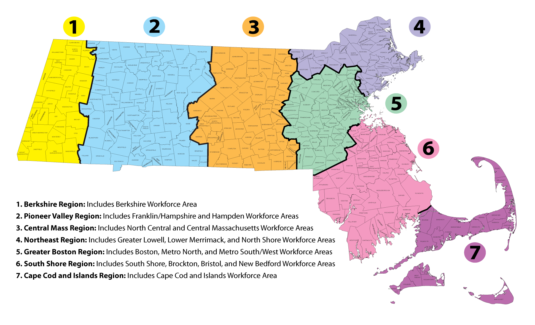
2017 Regional Planning: Alignment
Align economic, workforce and education systems to coordinate systems based on skill needs in regions.

Slide 17
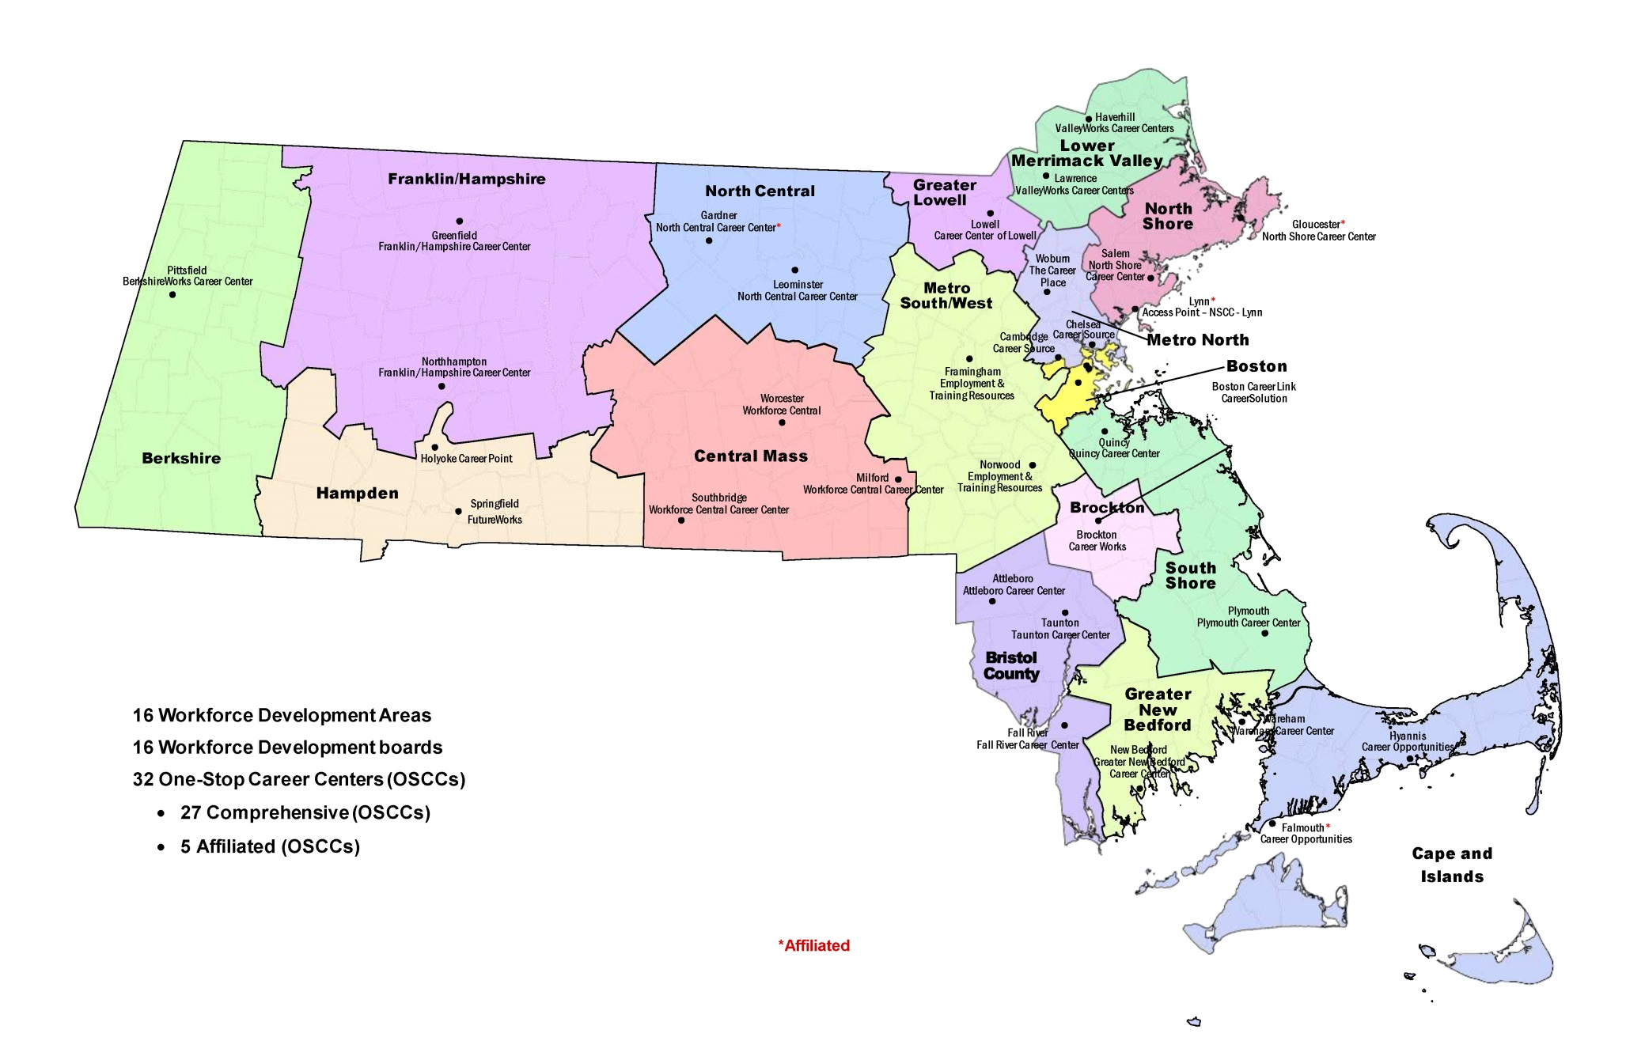
MA Workforce Development Regions – Local MOUs

Slide 18
Local MOU: PURPOSE
Establish the roles of local partners in the development of an integrated education and workforce system that supports career pathways in each region to prepare residents with foundation, technical, and professional skills, and provide information and connections to postsecondary education and training.

Slide 19
Local MOU: KEY PARTNERS
Required One-Stop Core Partners:
WIOA Title I (Adult, Dislocated Worker, Youth)
Title II (Adult Education and Family Literacy)
Title III (Wagner Peyser/Employment Service)
Title IV (Vocational Rehabilitation)
Temporary Assistance to Needy Families (TANF)
Supplemental Nutrition Assistance Program (SNAP)
Unemployment Insurance (UI)
Trade Adjustment Assistance (TAA)
Jobs for Veterans State Grant (JVSG) and
Senior Community Service Employment Program (SCSEP).
Voluntary Partners:
Economic development, higher education, homeless and housing organizations, community-based organizations etc.

Slide 20
Local MOU: PROCESS
The Local Board will convene Partners and other stakeholders (as defined locally) to discuss, negotiate and execute a local “umbrella” Memorandum of Understanding.
The development of the local MOU is a two-step process:
An Interim MOU based on a state developed template to be in place by June 30, 2016.
The Umbrella MOU must not be for less than three years and must be in place by July 1, 2017.
A joint policy from the WIOA partners was issued in draft explaining the process for the Interim and Umbrella MOUs.
http://www.mass.gov/massworkforce/issuances/joint-partner-communication/

Slide 21
Local MOU: CONTENT
The Local Board will convene Partners and other stakeholders (as defined locally) to discuss, negotiate and execute a local “umbrella” Memorandum of Understanding.
MOUs will include at a minimum:
VISION FOR SYSTEM ACROSS PARTNERS
PATHWAY “MAPS” FOR POPULATIONS
INTEGRATED SERVICE DESCRIPTIONS
SHARED CUSTOMER DEFINITIONS
ROLES FOR EACH PARTNER ALONG PATHWAY
DESCRIPTION OF COMPREHENSIVE CAREER CENTER
ROLES OF PARTNERS
ROLE OF OSCC IN SUPPORTING PATHWAY MAPS
SHARED COSTS BETWEEN PARTNERS
OSCC INFRASTRUCTURE COSTS

Slide 22
INTEGRATED SERVICE DESIGN: PERSON-CENTRIC
State and Local MOUs are designed around a “career pathway” approach based on customer perspective, not focused on the operations of funding streams.
CLASP GRAPHIC: http://www.clasp.org/resources-and-publications/publication-1/Alliance-WIOA-CP-Summary.pdf

Slide 23
COMPREHENSIVE ONE-STOP CAREER CENTER
A comprehensive One-Stop Career Center is a physical location where jobseeker and employer customers can “access” the programs, services, and activities of all required partners.
A comprehensive one stop center must provide:
Basic Career Services
Business Services
Access to Training Services
Access to any WIOA Employment and Training Services
Access to Employment Services
Access to Workforce and Labor Market Information
Access to Core Partners Programs and Services
Access to Unemployment Insurance
Customers must have access to these programs and services, and activities during regular business days. The Local Board may establish other services hours above and beyond regular business day hours to accommodate customer base.
All Comprehensive One-Stop Career Centers must be physically and programmatically accessible to individuals with disabilities.

Slide 24
SHARED CUSTOMER
DEFINITION: A shared customer is a job seeker or a business who is formally enrolled in services by more than one core program (at the same time or sequential) *
If applicable a “shared” customer must meet the eligibility criteria of the partner agency providing services.

Slide 25
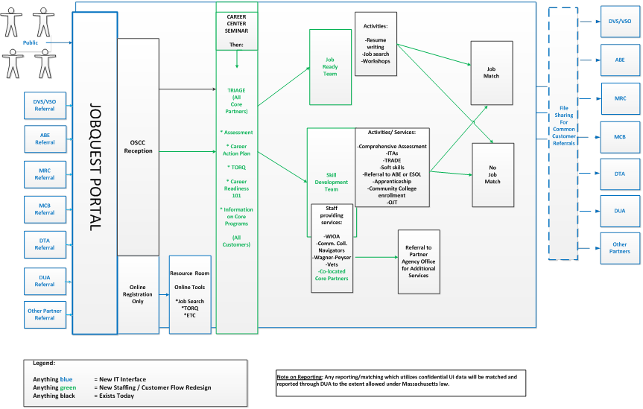
OSCC: ADULT JOB SEEKER CUSTOMER FLOW
New statewide customer flow to manage individuals from various referral sources who are triaged based on new, intensive skill assessment tools to Job Ready and Skill Building Teams within the Career Center.

Slide 26
Roles and Responsibilities of the Required OSCC Partners
Each required Partner must:
1. Provide access to its programs or activities through the OSCC delivery system, in addition to any other appropriate locations;
2. Use a portion of funds made available to the partner’s programs to:
Provide applicable career services;
Work collaboratively with State and Local Boards to establish and maintain the one-stop delivery system this includes jointly funding the one-stop infrastructure through partner contributions.

Slide 27
SHARED COSTS
DEFINITION: Cost of shared services that are provided through the Partner programs to an individual or business.
EXAMPLES INCLUDED BUT NOT LIMITED TO:
Initial Intake
Assessment
Review of Basic Skills
Identification of and Referral to Appropriate Services
Business Services
HOW ARE SHARED COSTS CALCULATED?
The federal government has not provided a consistent methodology across agencies (i.e. % of FTE, cost for % of program partner customer using OSCC, etc).
Methodology/ calculations are defined by local partners.

Slide 28
OSCC Infrastructure Costs
Each required Partner must support the one-stop delivery system by jointly funding the OSCC infrastructure through Partner contributions.
Each Partner must contribute to the OSCC whether or not they are physically located in the OSCC.
DEFINITION: Infrastructure Costs are non-personnel costs that support the general operation of the One Stop Center.
EXAMPLES
Rental of Facilities
Utilities and Maintenance
Equipment including assessment – related products and assistive technology for individuals with disabilities
Technology to facilitate access to the one-stop center

Slide 29
NEXT STEPS
Within the regions, Workforce Boards, One-Stop Career Centers and their partners will discuss how to maximize WIOA by working with together to improve outcomes for individuals and business. How do you collectively help build stronger pathways in the region?
Workforce Boards will reach out to WIOA partners to operationalize the Interim Local MOU Policy (forthcoming) and begin planning for comprehensive umbrella MOU (effective July 1, 2017).
Watch for joint state guidance on implementation steps going forward.
Attend the conference on December 6th!

Slide 30
QUESTIONS AND ANSWERS
Technical questions on regulations or other titles, please send to:
Jennifer James
jennifer.james@state.ma.us

