Slide 1

Partner Convening
Moving forward together
If you have difficulty hearing, CART (Communication Access Realtime Translation) displays the spoken words. Visit https://www.streamtext.net/player?event=WIOA to read the spoken words. Log in to the complimentary Westford Regency Guest Wifi Network.

Slide 2
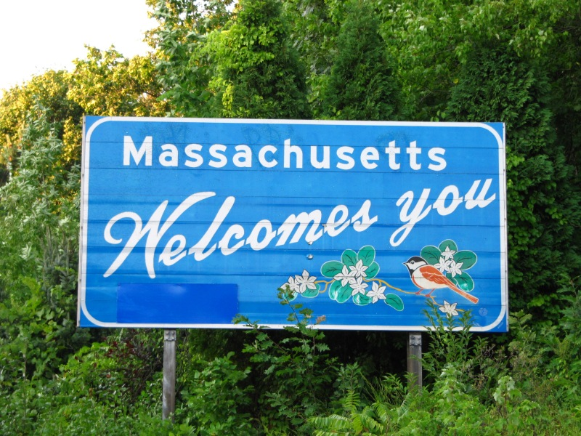

Slide 3
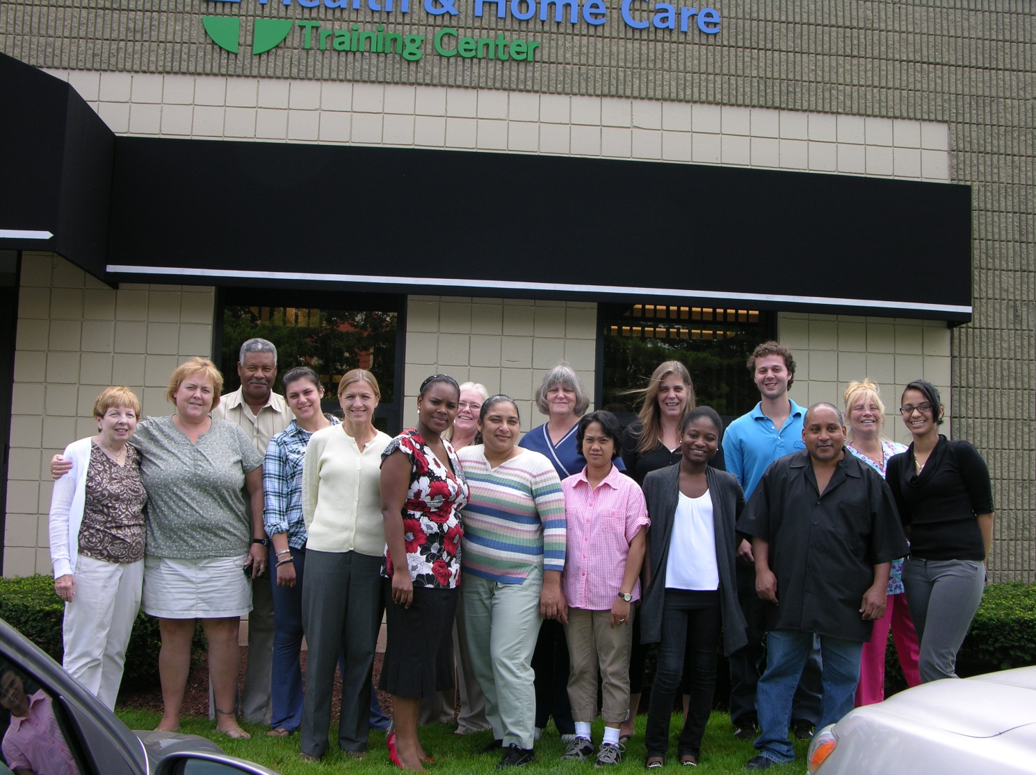
Direct Care Workforce Development group photo

Slide 4
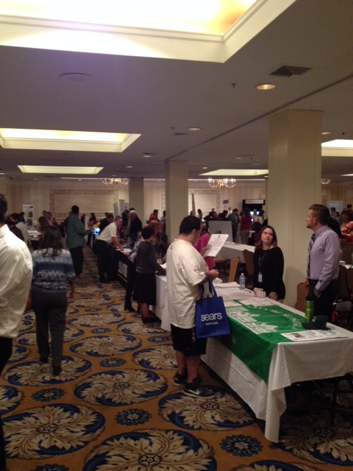
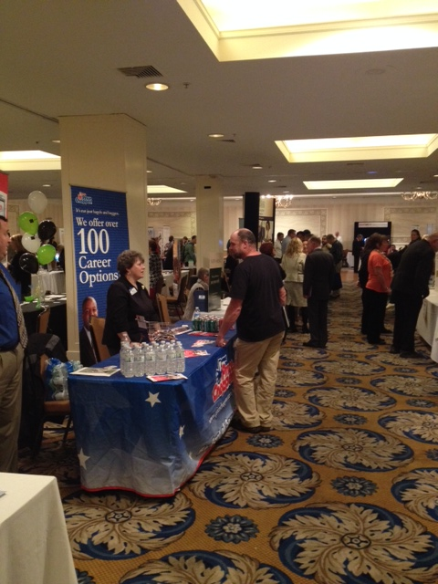
The BerkshireWorks Career Center Job Fair

Slide 5
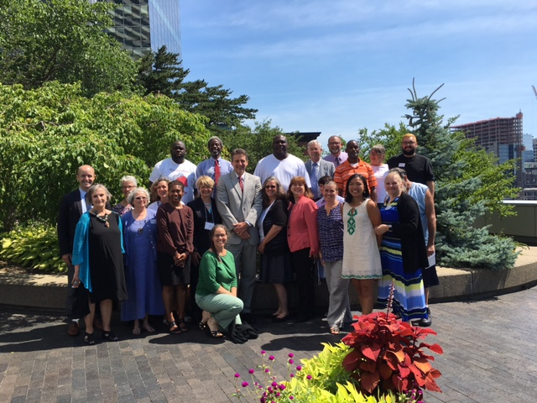
Working Cities Pittsfield Initiative celebration

Slide 6
Partner Convening
Moving forward together

Slide 7
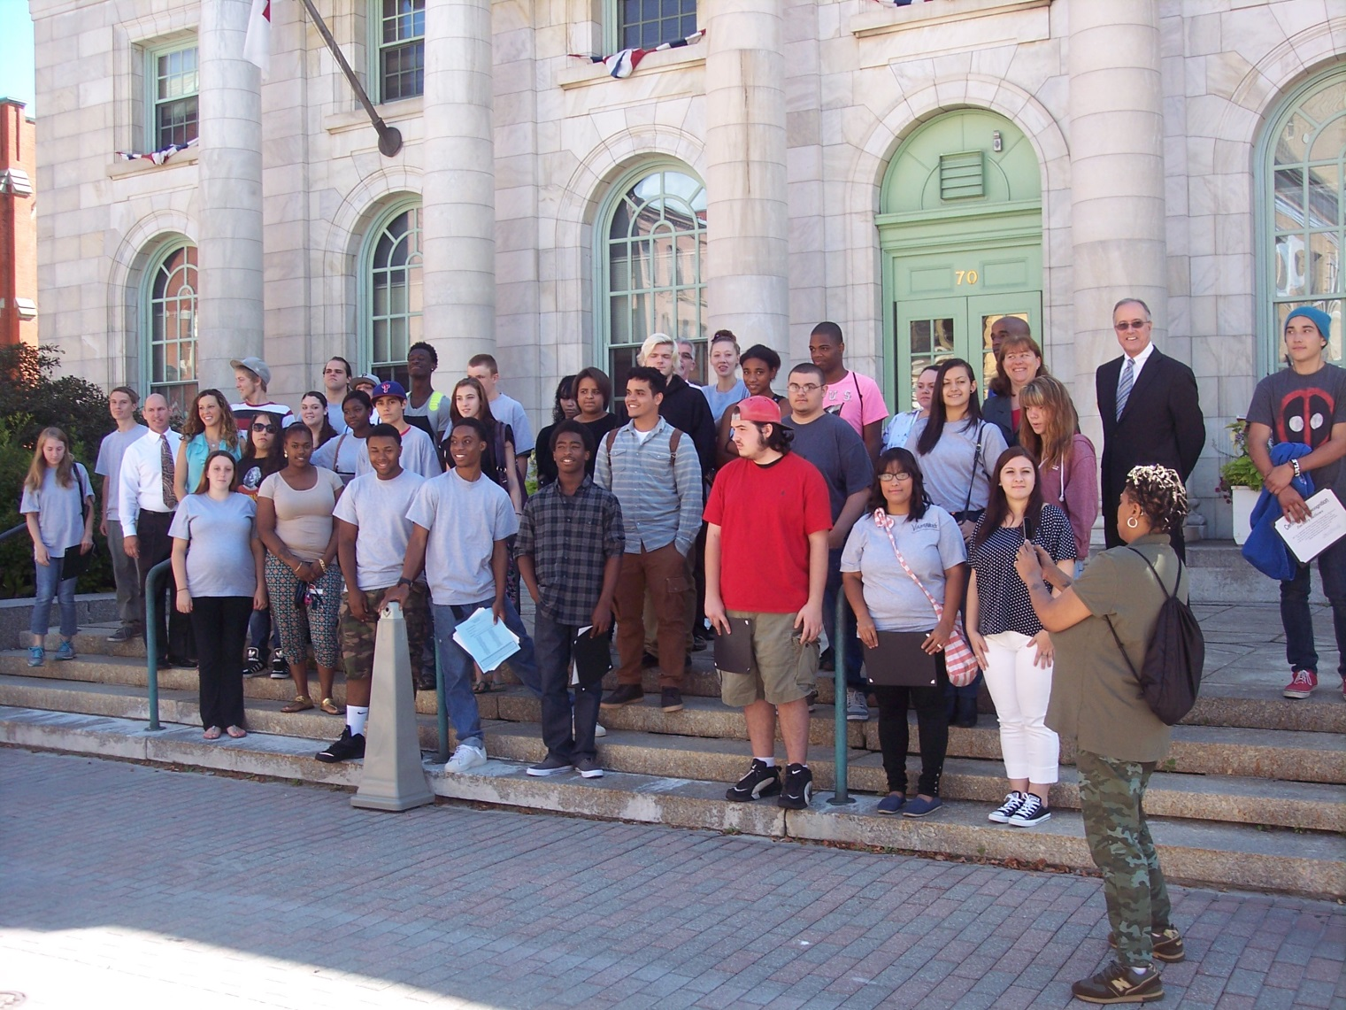
Youth Works participants pose with Pittsfield Mayor Daniel Bianchi after graduation

Slide 8
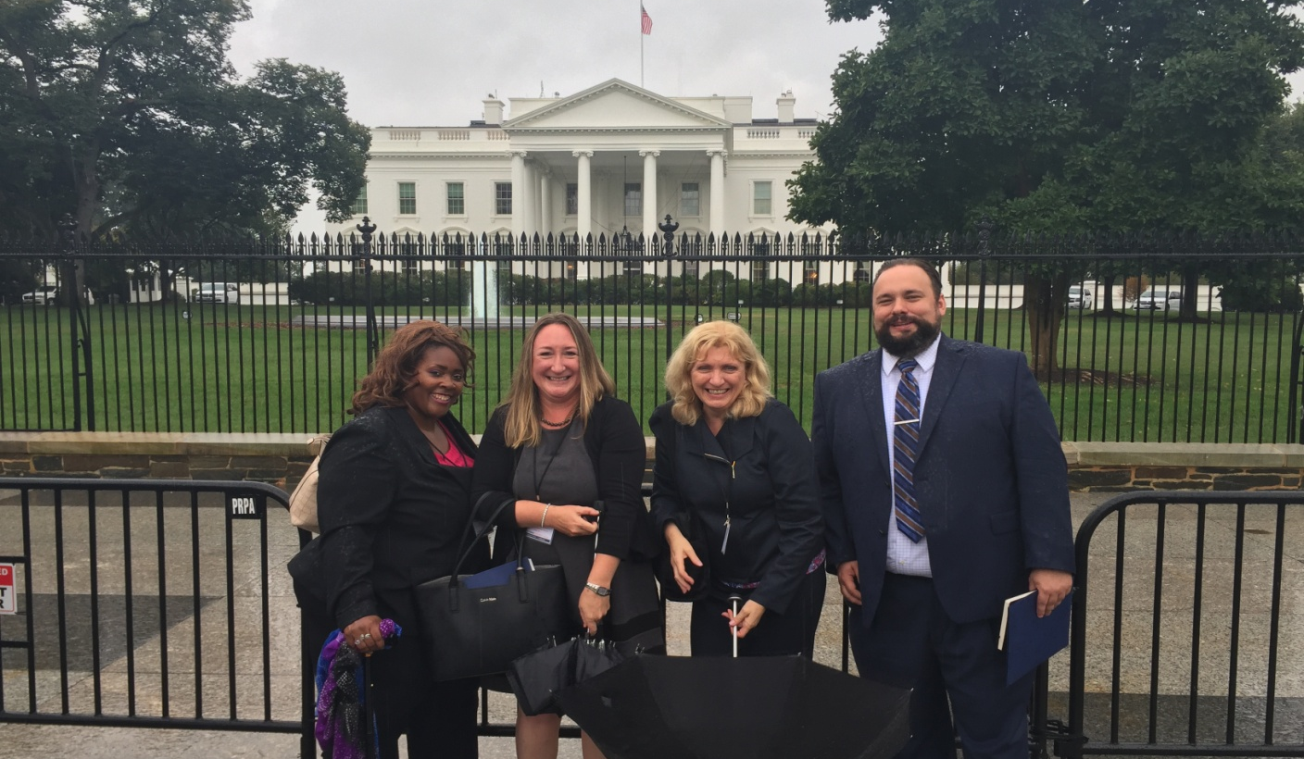
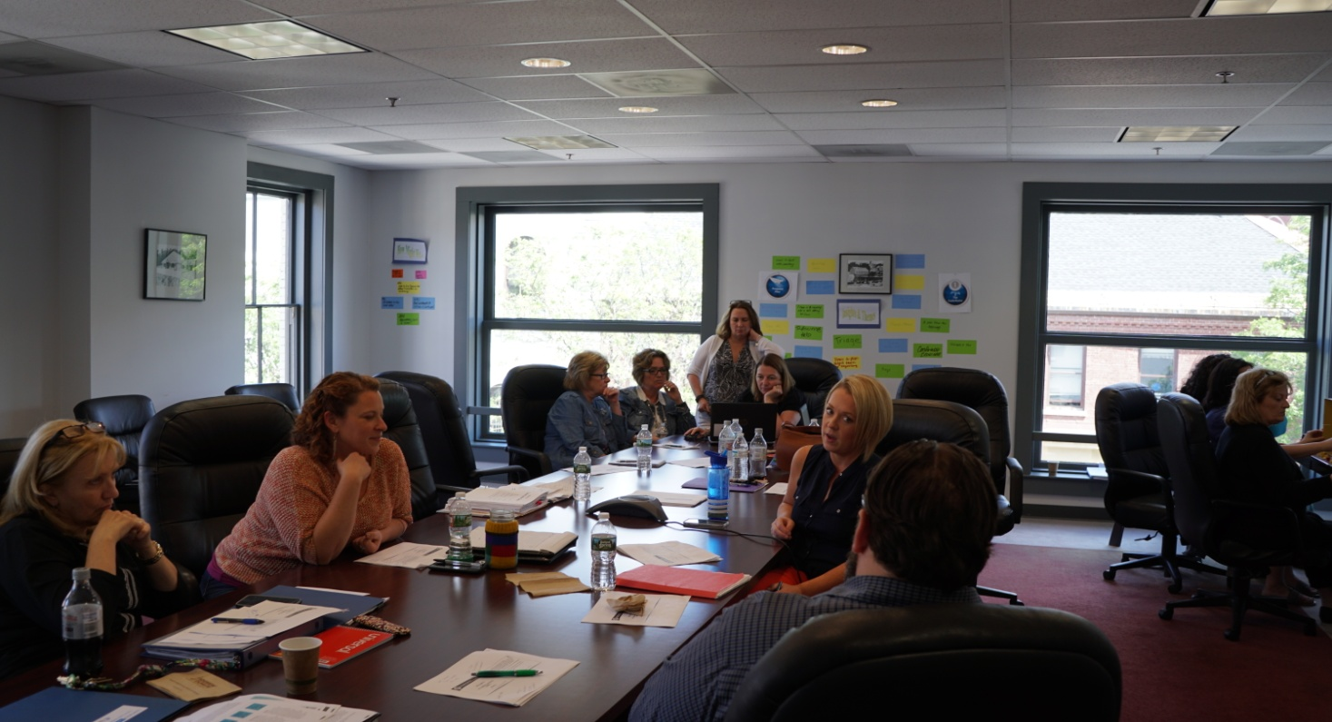
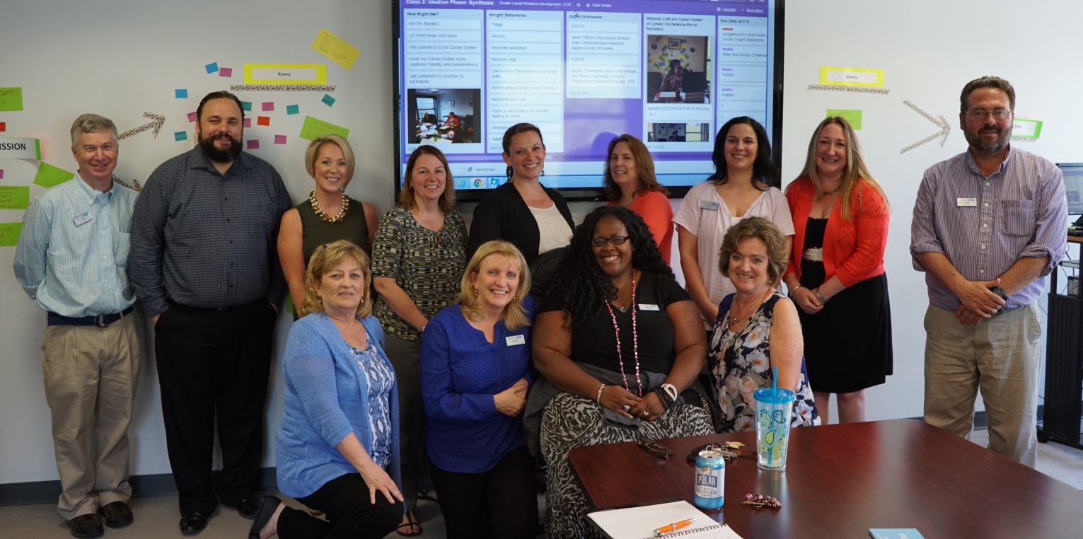
Greater Lowell Workforce Development Board Team

Slide 9
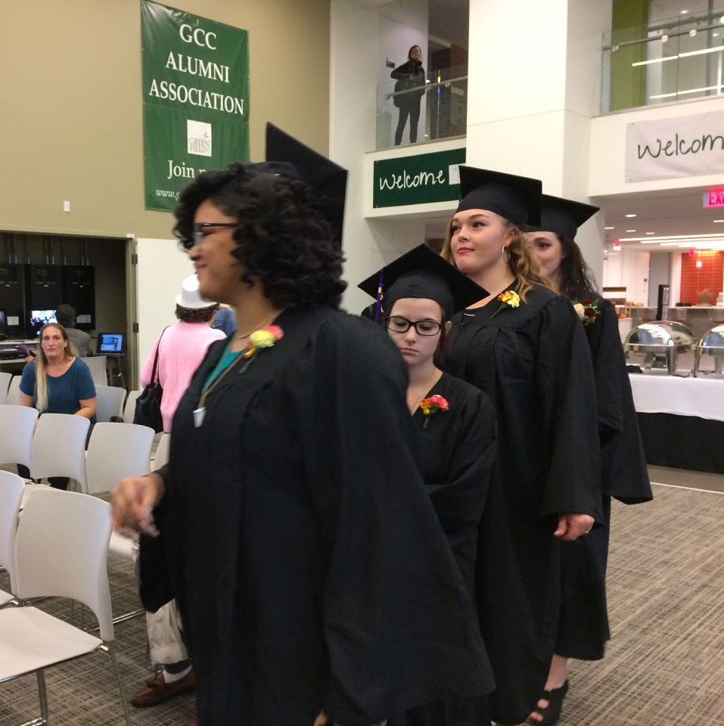
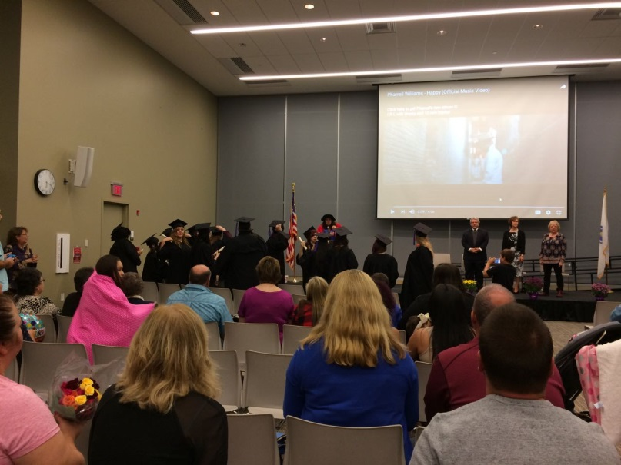
2016 Franklin County HiSet Graduation Ceremony.
A joint graduation for students participating in all of the partner Adult Basic Education Programs including Greenfield Community College, The Literacy Project, and Franklin Hampshire Career Center.

Slide 10
Partner Convening
Moving forward together

Slide 11
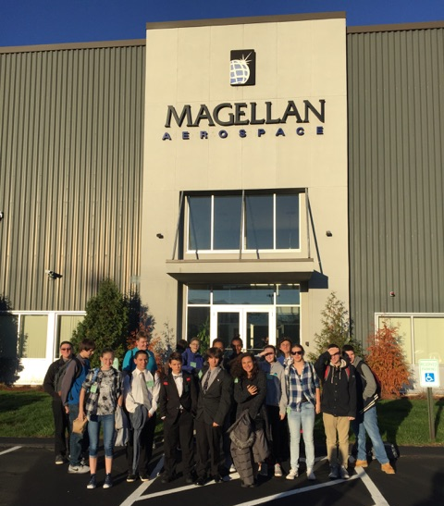
Advanced Manufacturing Day – Partnering with Business, MVWIB, ValleyWorks Career Center, Connecting Activities, and Haverhill High School

Slide 12
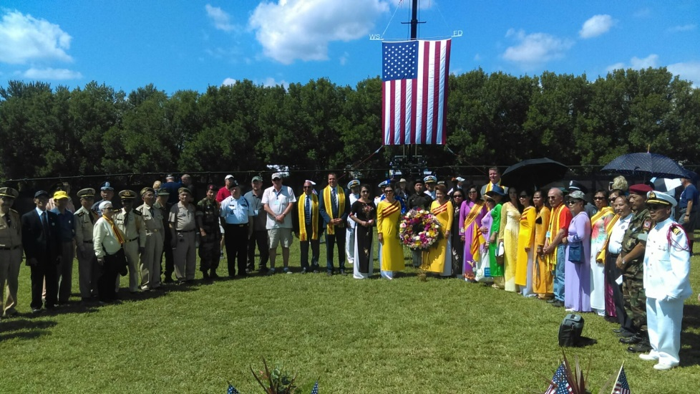

Veterans Appreciation Day at the Big E which was the venue for the Wall That Heals Event

Slide 13
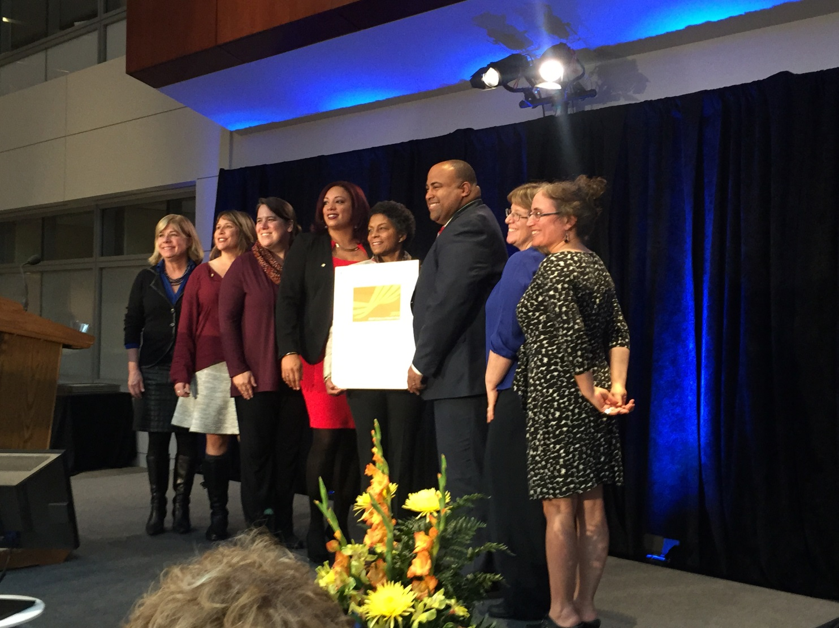
Lawrence Community Partnership Agencies receiving the 2015 RWJF Culture of Health prize

Slide 14
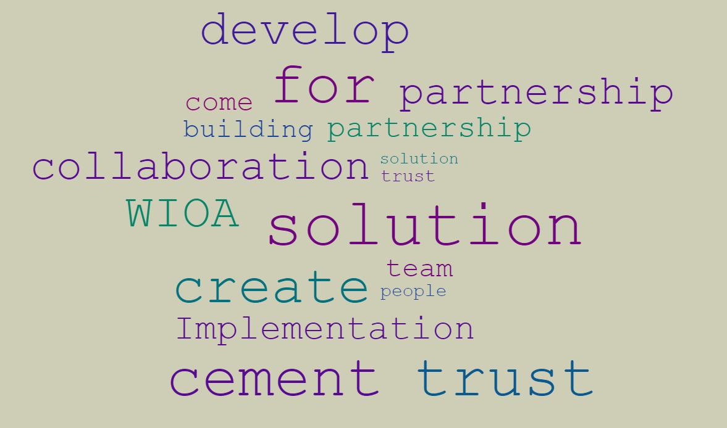

Slide 15
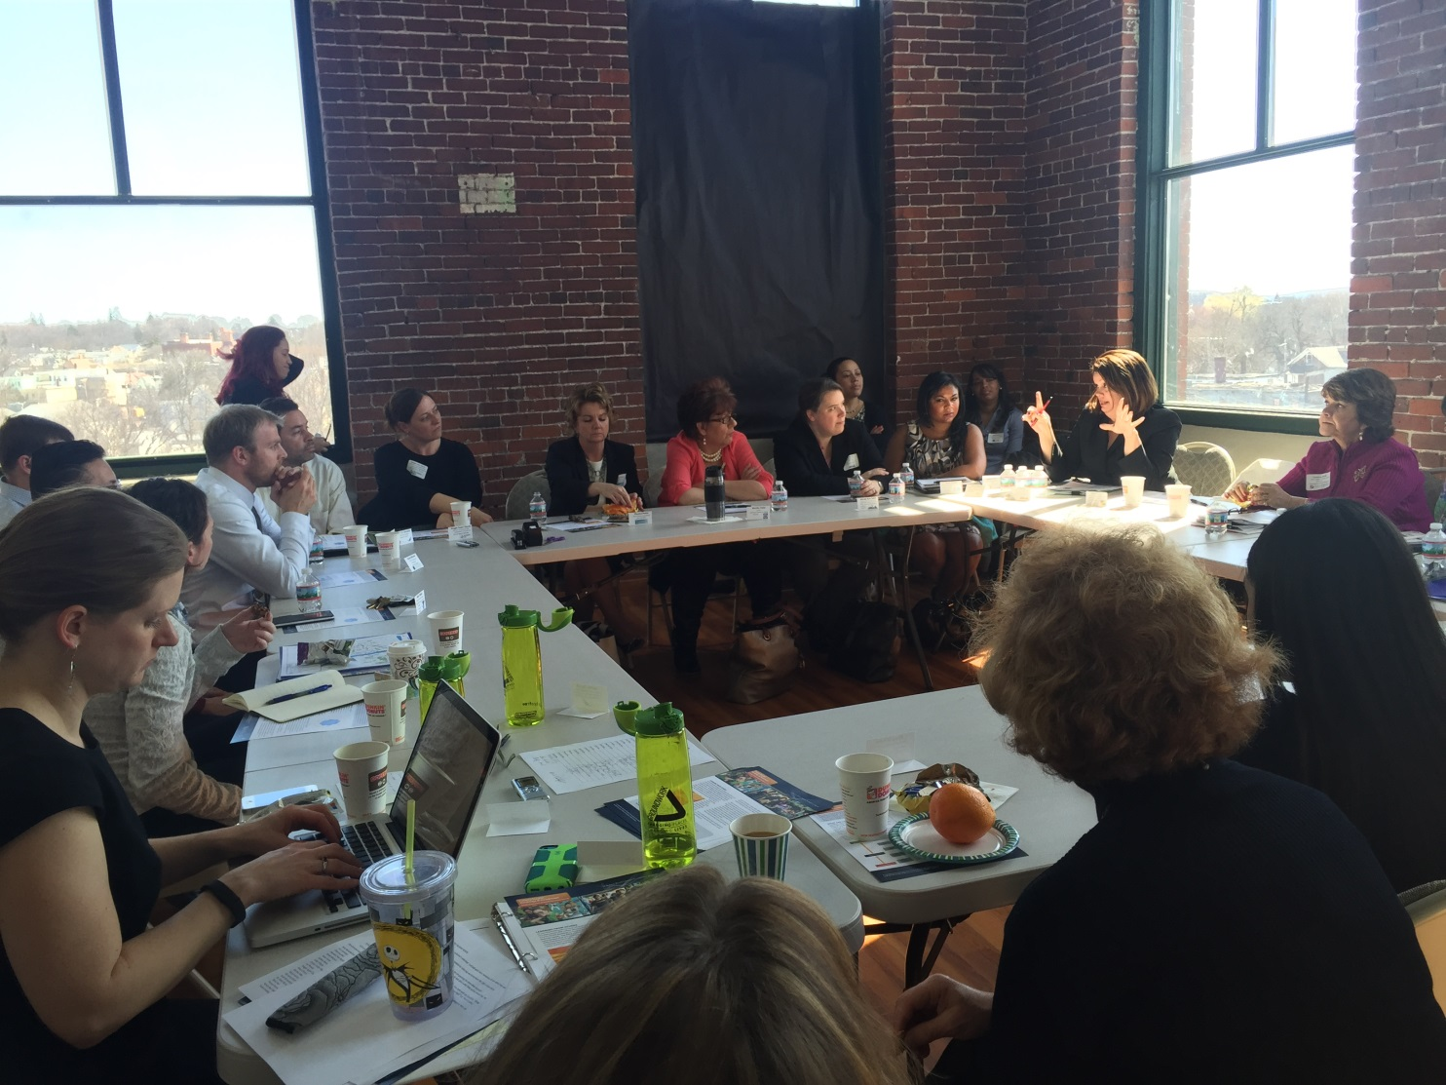
Lawrence Partners convening a Community Conversation for the RWJF Jury Panel

Slide 16
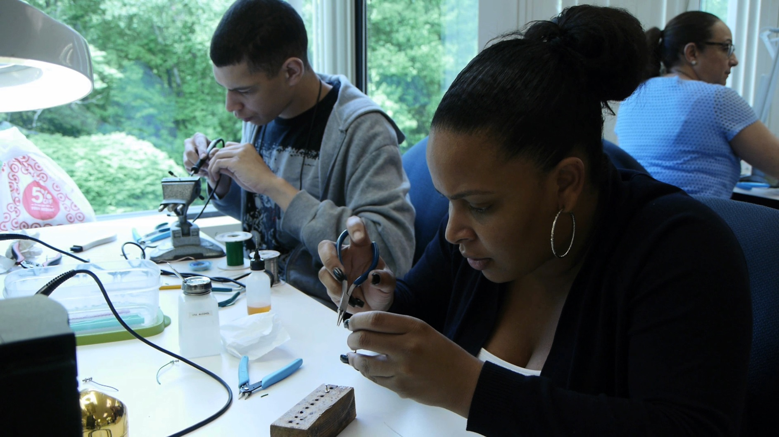
Northeast Advanced Manufacturing Consortium – Partners in Training for Regional Business Needs

Slide 17
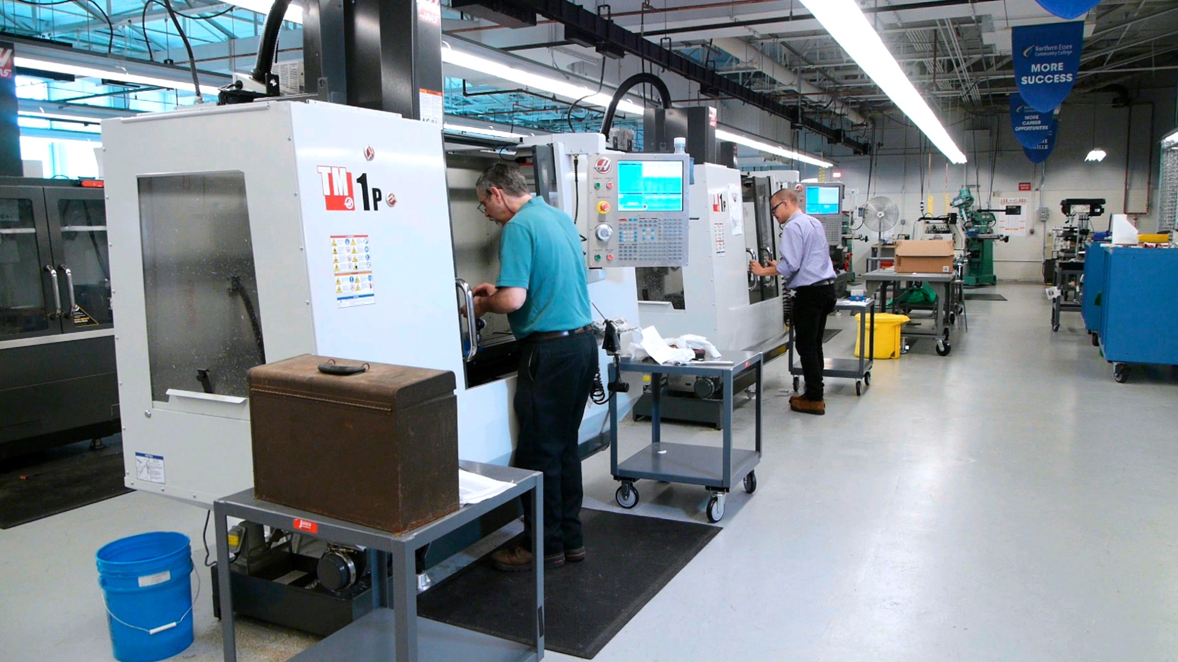
Northeast Advanced Manufacturing Consortium – Partners in Training for Regional Business Needs

Slide 18
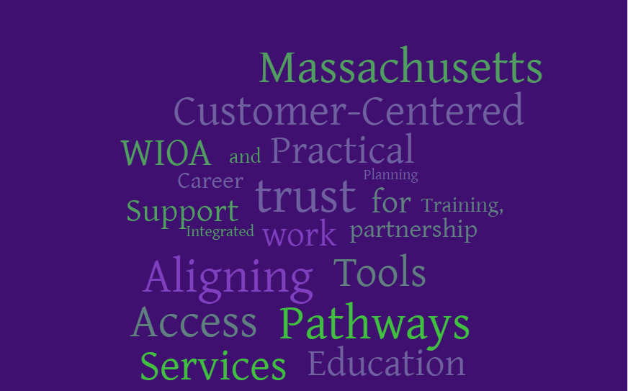

Slide 19
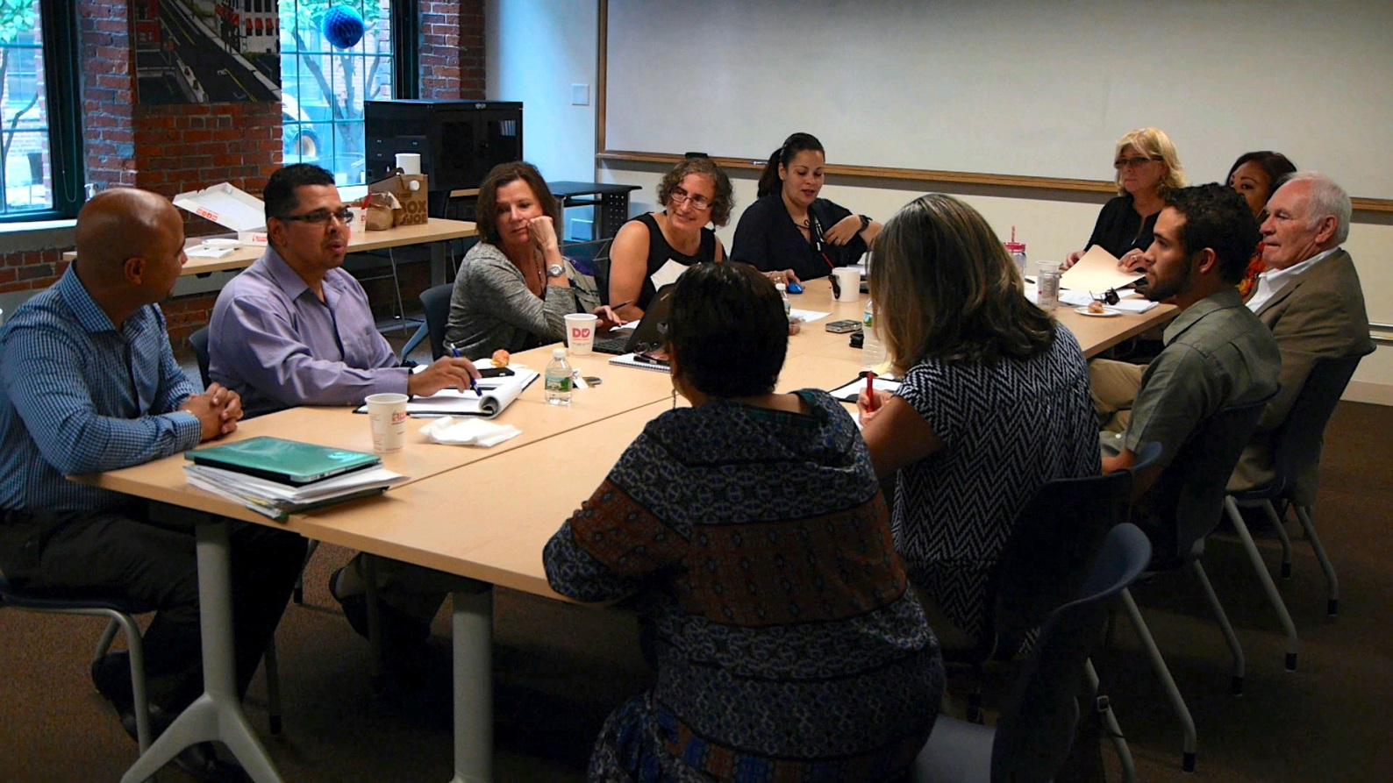
Federal Reserve Bank of Boston Working Cities Challenge Winner
Lawrence Working Families Initiative Steering Committee

Slide 20
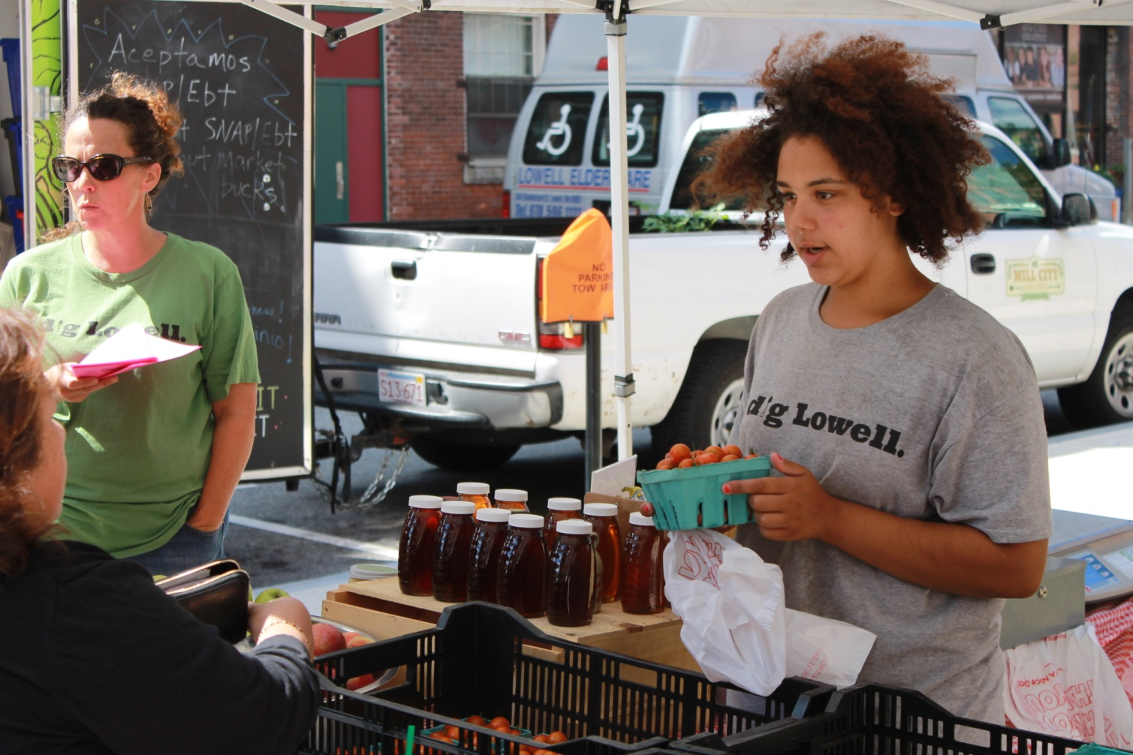
GLWDB Summer Youthworks Jobs Participant in the Mill City Grows Urban Farming Program

Slide 21
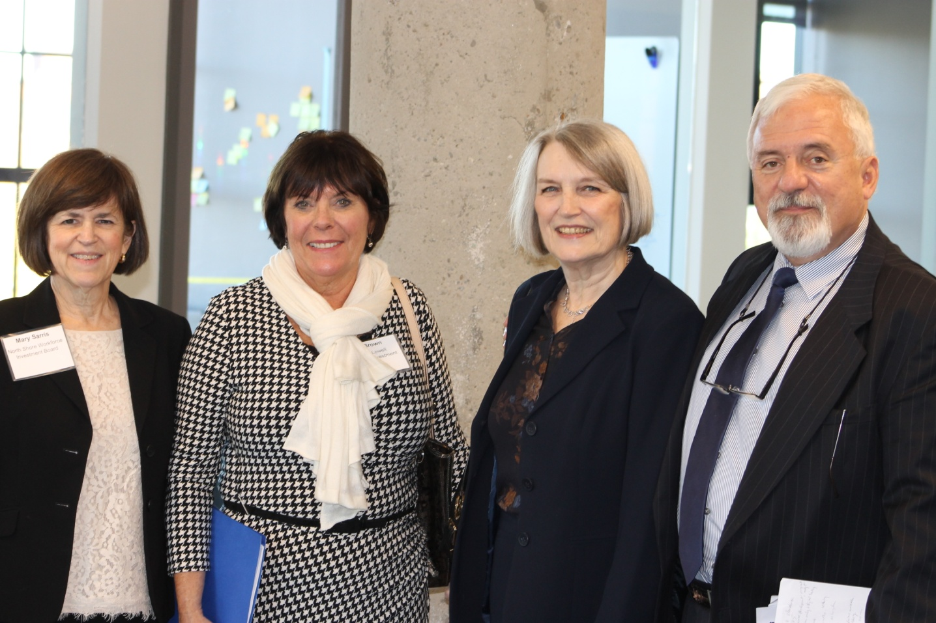
Northeast Advanced Manufacturing Consortium (NAMC): Mary Sarris, North Shore WIB, Gail Brown, GLWDB, Linda Bass, Metro North REB, Ralph Abislaiman Merrimack Valley WIB

Slide 22
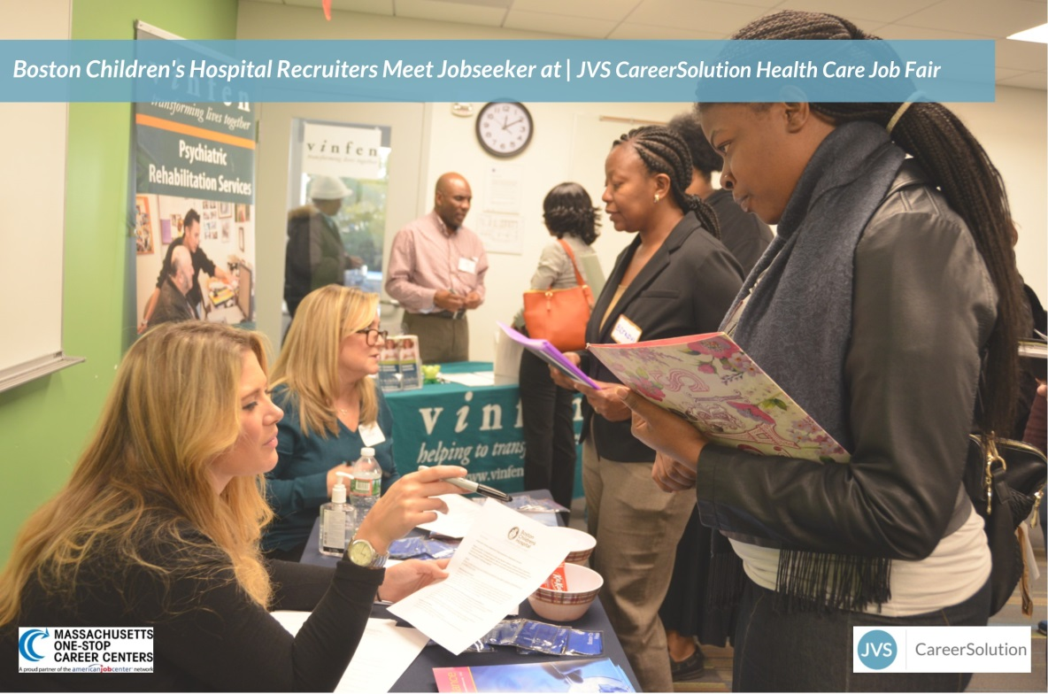
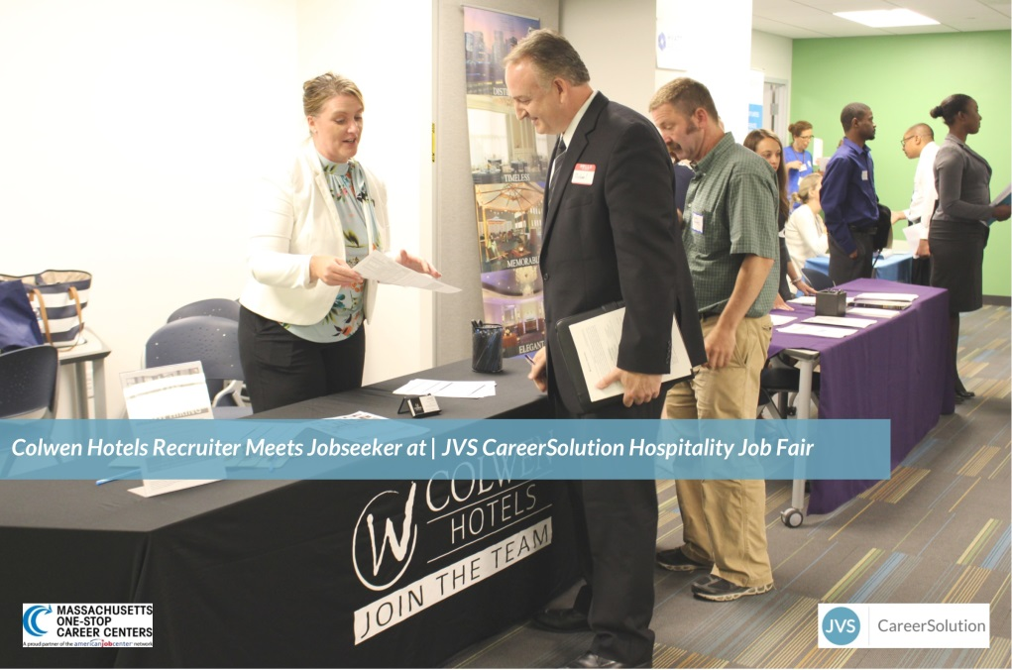

Slide 23
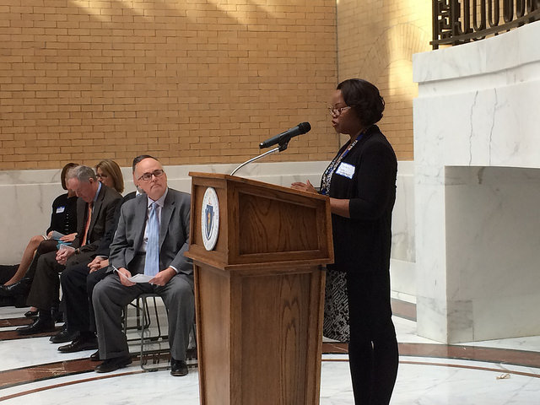
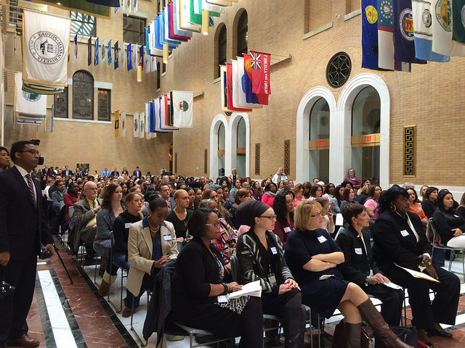
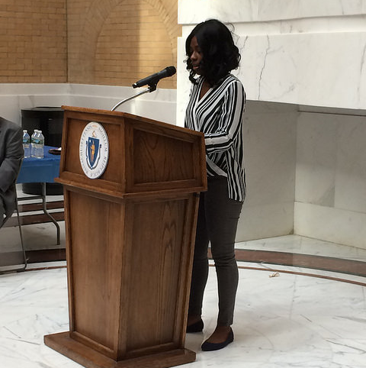
Department of Transitional Assistance honors 110 clients who successfully obtained employment in October 2016

Slide 24
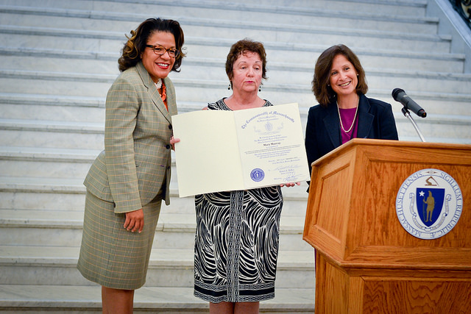
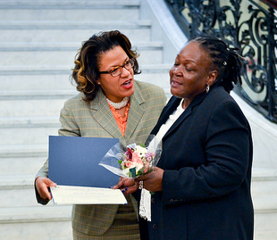
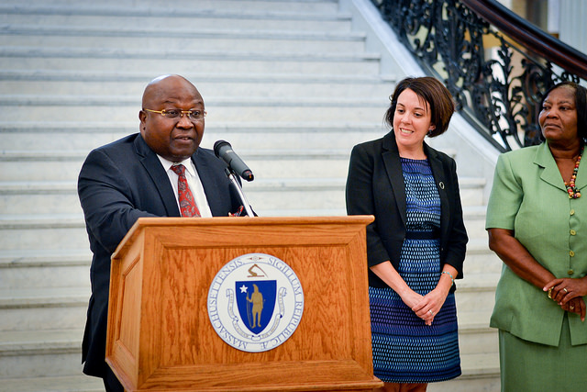
Executive Office of Elder Affairs and Executive Office of Labor and Workforce Development at the Older Workers Celebration, State House

Slide 25
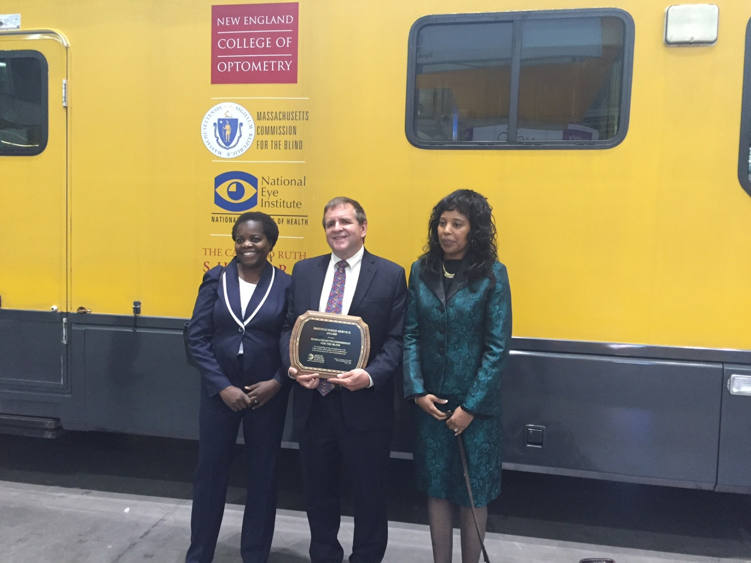
Massachusetts Commission for the Blind received an award for its work with the Mobile Eye Clinic.

Slide 26
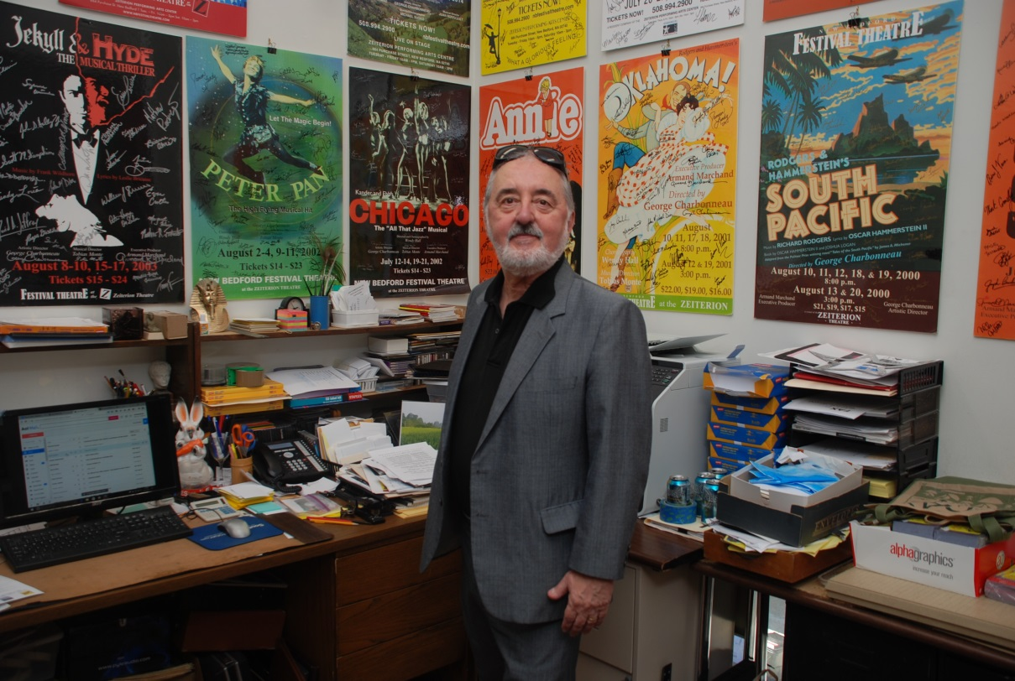
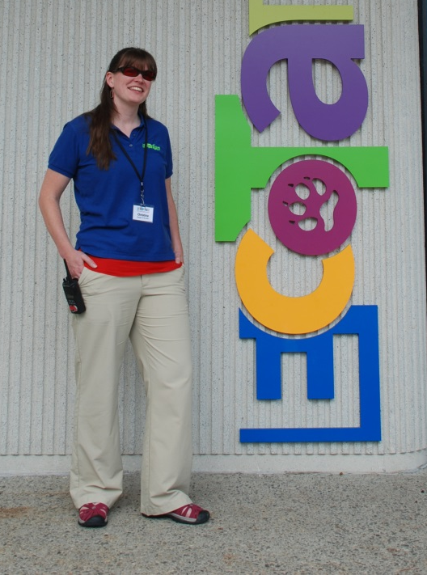
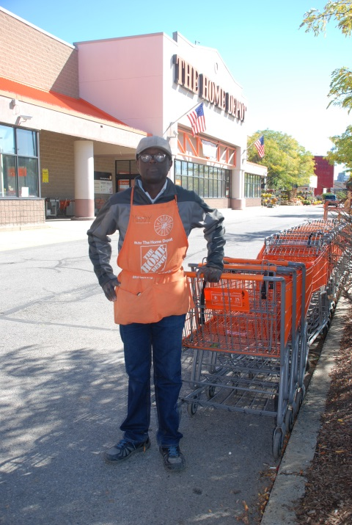
Olumide Oke, MCB Consumer and Home Depot employee
Christina Chappell, MCB Consumer and Worcester Ecotarium’s Manager of Education
Armand Marchand, MCB Consumer and Executive Producer, New Bedford Festival Theatre

Slide 27
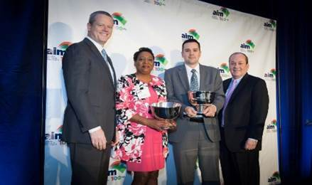
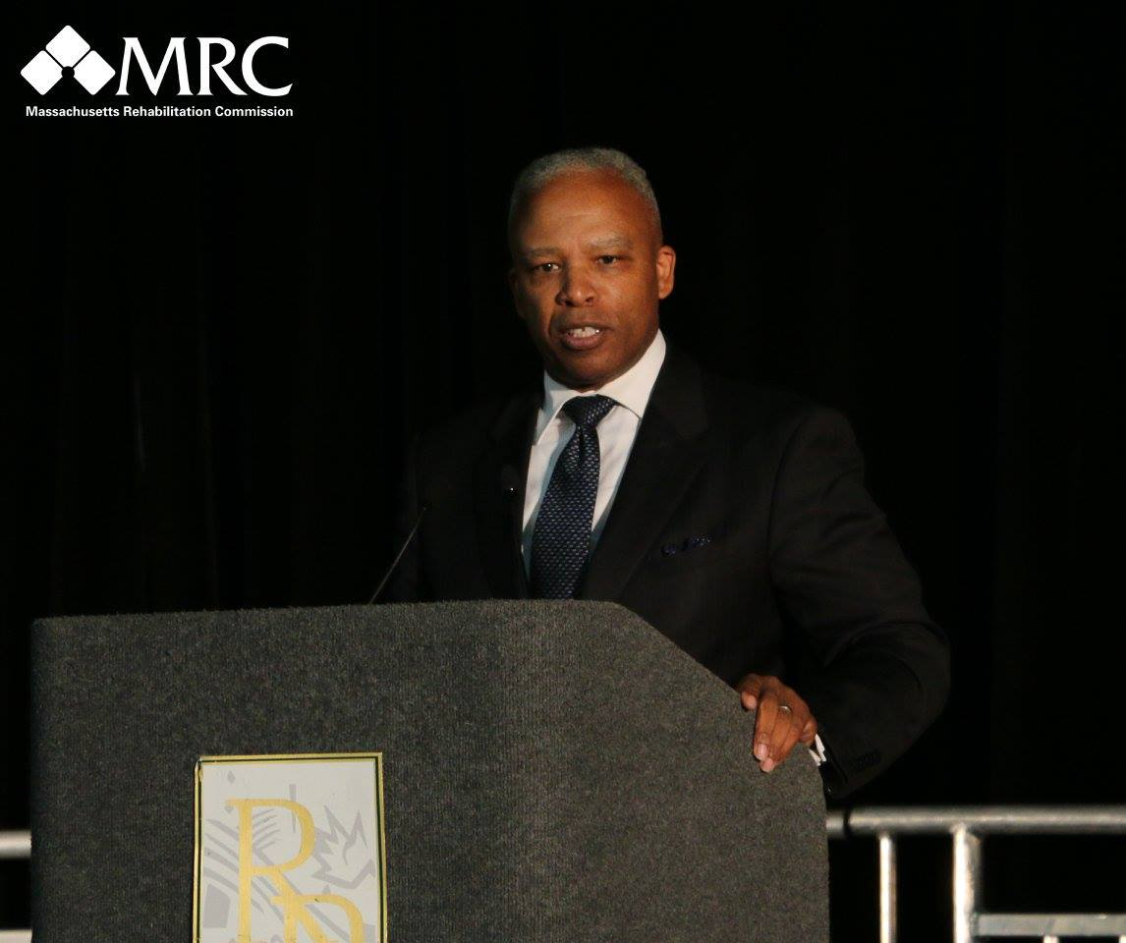
Secretary Ronald L. Walker, II—2016 MRC Employer Conference “Preparing the Next Generation of Workers”
Governor Baker & AIM Recognizes MRC-CVS “Job Driven Training Program”

Slide 28
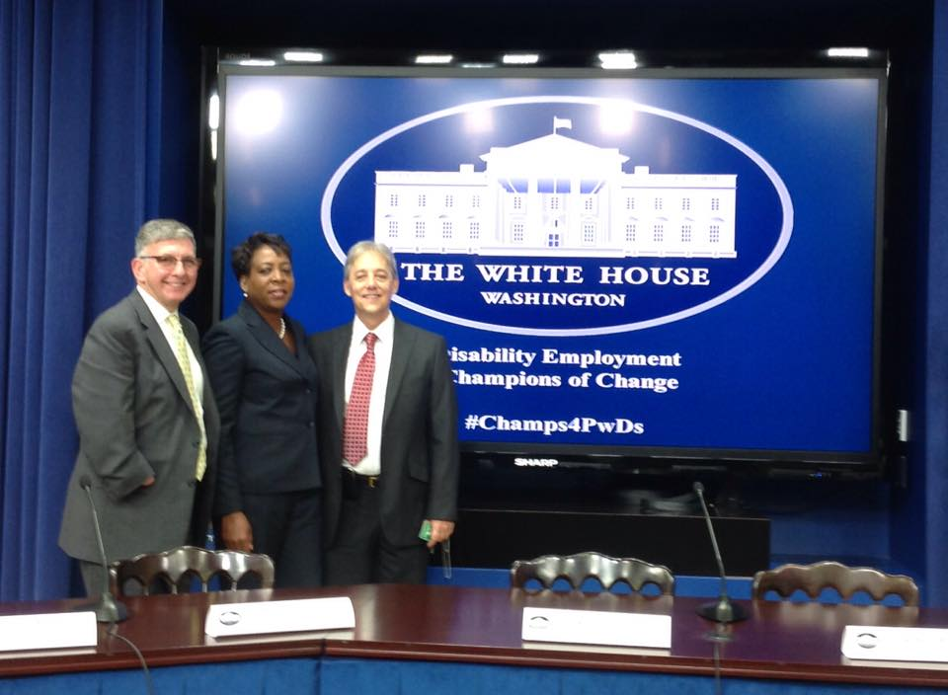
2014 Champions of Change White House Recognition
Spaulding Rehabilitation Hospital and MRC

