Slide 1


Massachusetts  Puerto Rico
National Peer-to-Peer
Technical Assistance and Training
WIOA Partner Presentation:
Building and Maintaining Partnerships
  Jennifer James, Undersecretary Labor and Workforce Development
  Kimberley Rowe-Cummings, Director Employment Service Program, Department of Transitional assistance
  Jolanta Conway, Massachusetts State Director Adult Education, Adult Community Learning Services
  Joan Phillips, Assistant Commissioner Massachusetts Rehabilitation Commission
  William Noone, Director MRC Research and Development
  John Oliveira, Deputy Commissioner Massachusetts Commission for the Blind
  Olga Yulikova, State Program Manager Senior Community Service Employment Program
March 5 - 7, 2018

Slide 2
WIOA Implementation
WIOA
July 2014 Enacted
Combined
State Plan
Draft
November 2015
Implementation Phase:
Technical Assistance & WIOA State Policy Guidance for local areas
April, 2016 –
On-going
Lead Operator
In Place
Local Signed
Umbrella
MOU
July 1, 2017
MWIB
Establishes
WIOA Steering Committee
October, 2014
Steering Committee &
Workgroups
October, 2014 – November, 2015
Final Rules
Enacted
August, 2016
Provisions
Take Effect
July 2015
*ETPL
*Eligibility
Submission of Combined State Plan
March, 3, 2016
Adjusted
April 1, 2016
DOL Final Approval
October, 2016
Policy & Planning in Regional Local Areas
April, 2017 -
March, 2018

Slide 3





Back in 2016… Overwhelm mode…where to start?

Slide 4



How Did We Get Here From There
We asked everyone to focus on change-making conditions and not the minutia of WIOA.
PARTNERSHIP LESSONS
From last 3 years (and the experts):
CHOICE
TEAM
TOOLS
Notes:
MANDATE VERSUS CHOICE
DEFINITION OF TRUST (Charles Feltman)
Choosing to make something important to you vulnerable to the actions of someone else.
IT IS THE SMALL MOMENTS (Brene Brown and many other researchers).
Consistent behavior (marble jar friends)
Own mistakes AND call out concerns
GENEROSITY
Old habits, “building the ship in the middle of the ocean” and 1,000 other reasons to not make assumptions.
The work is hard. High Need, High Stakes Resources

Slide 5
Partner and Stakeholder Engagement
WIOA Stakeholder Engagement Process
  MWDB established WIOA Steering Committee to take on key strategies to redesign the workforce system to align with vision of WIOA
  Steering Committee comprised of State Core Partners and other Workforce Partners
  Steering Committee establishes workgroups to address priorities in WIOA and provide recommendations to the Steering Committee on how to move WIOA implementation forward
  All workgroup include membership from State Core Partners

Slide 6
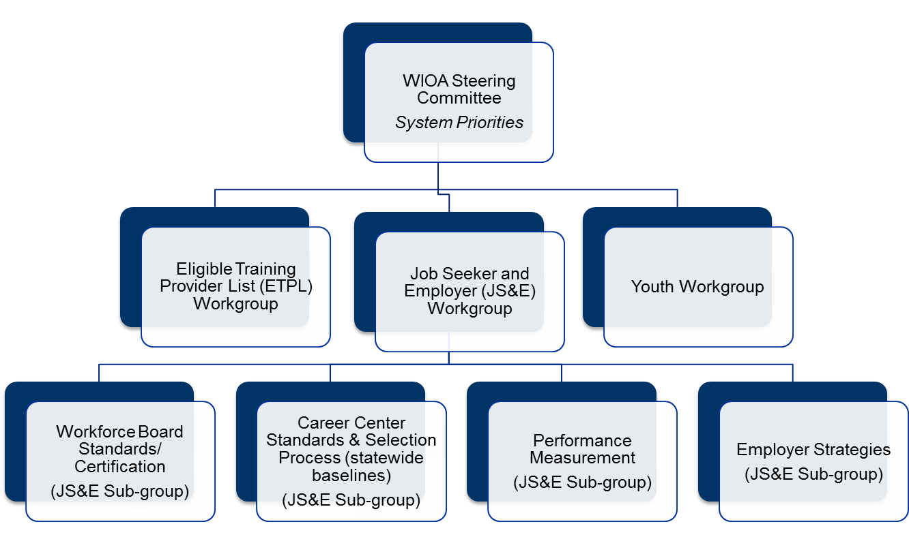
Partner and Stakeholder Engagement

Slide 7
Its All About The Team
COLLABORATION:
An unnatural act between unconsenting adults.
- Jocelyn Elders
A team is not a group of people who work together. A team is a group of people who trust each other.
- Simon Sinek

Slide 8
State plan: Goals
Goal I: Align economic, workforce and education systems to coordinate systems based on skill needs in regions
Goal II: Increase talent recruitment and hiring for business partners through business outreach, talent recruitment, matching and education and training activities that match business need
Goal III: Increase credentialing and job placement outcomes for individuals, including individuals with barriers to employment
Goal IV: Increase credentialing and job placement outcomes for youth, including youth with barriers to employment
Goal V: World class Labor Market Information System

Slide 9
Combined Planning: Process
Partners developed Combined Plan sections in accordance with vision and goals
Coordinated portal entry of combined plan submission
Coordinated portal revisions as requested by the federal reviewers
Collaboration of Regional Planning

Slide 10
Leveraging Resources
EOLWD/DCS had individual meetings with State Core Partner leadership to:
  Review the WIOA requirements for a comprehensive One-Stop Career Center in each workforce area and the role of each mandated OSCC partner
  Discuss the State Core Partner’s (agency) goal to meet WIOA requirements at the OSCC in a way that is reasonable for the partner program
  Discuss best practice models for workforce areas that the State Core Partner (agency) wants to promote in the umbrella MOUs
  Review key questions and issues that the 16 workforce areas will encounter for the MOU process on shared costs and infrastructure
  Discuss and identify any unique guidance that needs to be provided to all 16 workforce area for how the State Core Partner (agency) will meet the WIOA requirements to be part of the OSCC (including shared costs and infrastructure)
Meetings were informative and assisted State Core Partners with decisions related to:
  Approach to providing access to programs and services at the Career Centers
  Approach to shared services
  Approach to shared and infrastructure costs

Slide 11
One Vision For MA Workforce Partners:
All Massachusetts residents will benefit from a seamless system of education and workforce services that supports career pathways for individuals and leads to a more informed, educated, and skilled workforce, which meets the Commonwealth’s businesses’ demands and sustains a thriving economy.

Slide 12

State Vision: Break It Down
WE ASKED LOCAL AREAS TO START WITH A PROCESS…
Build a team in the region to create:
  A Business-driven framework focused on business need
  Integrated, customer-centered service design
  Career pathways for priority populations
  IMPACT

Slide 13
What Has Happened?
Hundreds of partners across systems and across the state engaging in ideas - dropping sterotypes and turf at the door, hitting the reset button - to shift the collective system and partner together
Launched new regional planning process (7 regions) to focus on talent shortages in regions and data analysis of critical career pathways in region
Completed procurement of One-Stop Career Center Operators, now 29 Centers statewide
16 Signed Umbrella MOUs focused on WIOA priority populations (shared resources and infrastructure)
Re-designed adult education (Title II) procurement process focused on career pathway vision and partnership across systems
NEW, nationally recognized partnership between Department of Transitional Assistance and One-Stop Career Centers serving 1,440 customers since May, 2017, 462 in FY17 and 978 to date in FY18
NEW pilots and integrated services with UI, Career Centers, SCEP, adult education, TANF/SNAP, and Vocational Rehabilitation for adults and youth
NEW data metrics and data sharing agreements to evaluate employment and wage impacts across WIOA partners
NEW automated integrated registration process partners working together to develop automate process that will provide customers and staff with a dashboard of services for both job seeker and business customers

Slide 14

WIOA Partner Convenings
  WIOA Partner Convening
      Held on December 6, 2016
      Testimonies from state leaders on commitment to WIOA vision and implementation steps
      Workshops on tools that help multiple organizations build common vision and service integration strategies for Memorandum of Understanding in workforce areas:
        Career Pathways Models
        Integrated Service Models
        Customer-Centered Design Process and Tools
        Business Service Models
        WIOA Partner Re-Convening
          Held on January 8, 2018
          Focus on local level partnerships
          Panel discussion with Local Workforce Boards and Partners on successes and challenges in operationalizing partnerships at the career centers
          Presentations from subject matter experts in motivational interviewing and accessibility

Slide 15
On-going Partner and stakeholder Engagement
WIOA Joint Policy Workgroup
  Ongoing WIOA policy meetings (bi-weekly) include all Partners to coordinate major activities and policies (e.g. Local Umbrella MOU development; OSCC Operator Selection; ACLS competitive procurement)
  Established in April 2016
  Membership includes leadership from State Core Partners and other Workforce Partners
  Bi-weekly meetings to strategize on cross agency partnerships, joint polices, guidance, and training necessary to move WIOA implementation forward

Slide 16
What’s Next
IMPLEMENT THE COMBINED PLAN
  Submit Regional Plan
    Use Labor Market Information to Inform Plan and MOU Process
  Customer-Centered Design: Strengthen Local Umbrella MOUs
    Strengthen Business-Driven Strategies to meet Business Customer Needs
    Strengthen Customer Flow and Career Pathway processes for Adult and Youth Across Partner Customer Populations
  Branding the Workforce System
    All Strategies Identified in Above Process Determines the Local Product Behind the Brand.

Slide 17
Massachusetts  Puerto Rico
National Peer-to-Peer
Technical Assistance and Training
Department of Transitional Assistance
March 5 - 7, 2018

Slide 18
Department of Transitional Assistance (DTA)
DTA’s mission is to assist and empower low-income individuals and families to meet their basic needs, improve their quality of life, and achieve long-term economic self-sufficiency.
DTA offers a comprehensive system of programs and supports to help individuals and families achieve greater economic self-sufficiency, including food and nutritional assistance cash assistance, and employment supports.
DTA is the state agency responsible for administering the Supplemental Nutrition Assistance Program (SNAP) and Temporary Assistance to Needy Families (TANF).
DTA serves one out of every eight residents in the Commonwealth including working families, children, elders, and people with disabilities.
DTA operates within 5 regions and has 23 local Transitional Assistance Offices (TAOs) across the state.

Slide 19
DTA Engagement With WIOA & the Workforce System
DTA is an essential partner in the state’s efforts to implement the Workforce Innovation and Opportunity Act (WIOA).
Since the submission of the combined plan, DTA has been working closely with EOLWD to plan for and implement a new, more integrated system of workforce development for DTA clients and others with significant barriers to work.
DTA’s commitment to this effort is two-fold:
Develop meaningful pathways to work and economic self-sufficiency for low-income, disabled and chronically un/underemployed individuals/families; and
Ensure individuals and families with significant barriers can access the workforce system with the support needed to attain and sustain employment.

Slide 20
Interagency Service Agreement: Departments of
Career Services & Transitional Assistance
Interagency Services Agreement (ISA) executed to set expectations for local collaboration, service delivery and performance AND TO provide funding for shared and infrastructure costs ($500,000 in FY17, $1M in FY18, $1M in FY19):
Purpose/expected outcomes :
Satisfaction of WIOA requirements for shared costs and infrastructure;
Increased partnership between DTA local offices (“TAOs” and One-Stop Career Centers (“OSCCs”);
Joint articulation of career pathway models for low-income individuals, including DTA clients;
Increased DTA client engagement and participation at the OSCCs via prioritization of TANF/SNAP recipients; and
Increased DTA client job placement and retention.

Slide 21
Responsibilities under ISA
State Partners (DTA/DCS)
Jointly develop guidance for use of funds, expected services to be delivered and outcomes to be achieved.
Review of local MOUs to ensure alignment with the purpose and goals of the ISA.
Negotiate shared and infrastructure costs/approach.
Develop and issue quarterly reports on the number of referrals, types of activities and services provided.
DCS distributes and manages DTA funds in support of the ISA.
DTA with DCS will monitor the delivery of services.
Local Partners (DTA Office / Career Centers)
Designating staff from both systems to work together on behalf of DTA clients.
Co-location of DTA staff at the OSCC to provide support, information and resources to OSCC staff and DTA clients.
Training for OSCC staff on the eligibility, work participation and other requirements of the TAFDC and SNAP Programs.
Establishing formal client referral mechanisms between DTA and the OSCC.
Working jointly to address key challenges for TAFDC and SNAP clients to participate in OSCCs activities such as transportation and child care.
Working jointly to ensure that TAFDC and SNAP clients receive tailored services, including job readiness, job matching, coaching and employment supports.

Slide 22
Massachusetts  Puerto Rico
National Peer-to-Peer
Technical Assistance and Training
Department of Elementary and Secondary Education
Adult Community Learning Services
March 5 - 7, 2018

Slide 23
Department of Elementary and Secondary Education
Adult and Community Learning Services (ACLS) administers Title II (AEFLA)
Award federal and state funding to a diverse network of approximately 100 providers across all 16 local workforce areas
Basic literacy and numeracy skills, adult secondary education and HSE preparation, English language acquisition, work readiness and career exploration, family literacy, and integrated education and training.
The current system serves approximately 19,000 adults annually and consists of the following program types:
    Community Adult Learning Centers (82 CALCs)
    Adult Career Pathways (45 ACPs)
    Integrated Education and Training Pilots (3 IETs & 12 IELCEs)
    ABE in Correctional Institutions (11)
    Workplace Education Programs (7)
    Transition to Community College Programs (10)
    Distance Learning Hubs (ESOL and ABE) (2)
    Primary Instruction by Volunteers (2)
Notes:
We added this slide. MCB had an intro slide.
With only 15 mins and a knowledgeable audience, we didn’t think too much was necessary.
If you wanted some demographics, Brian could provide easily.

Slide 24
History of Engagement With the Workforce System
Collaboration has included partners:
  Reviewing of grant proposal
  Monitoring local providers
  Identifying region career pathways and priorities
  Engagement in Adult Career Pathway programs (under WIA)
  Membership in each others’ boards
  Co-locating staff (AE out-stationing)
  Participating in local and statewide taskforces
  Incorporating Career Readiness Initiative (CR101)
Notes:
We changed the title. Sacha had “Overview of Engagement With the Workforce System “

Slide 25
Enhanced Collaborations as a Result of WIOA Implementation
State Level
  ACLS on all WIOA working groups, including steering committee
  Joint participation at state plan public forums
  Developed joint guidance (shared customers / local MOU development / infrastructure cost sharing) documents
  DOL participation at AE statewide events
  State AE staff participation in OSCC procurement process
  Partner engagement in AE Open & Competitive process (rebid of the adult ed. system)
  Review and feedback on regional blueprints
Notes:
We changed this title too (and used two slides). Sacha had “Improved Partnerships as a Result of WIOA Implementation “

Slide 26
Enhanced Collaborations as a Result of WIOA Implementation
Local Level
  All AE providers participating in local planning
  Career Readiness Initiative (CR101, Work Keys)
  Examples of cross agency collaboration include:
      AE classes visiting OSCC and receiving group orientation
      OSCC staff presenting at AE sites
      Co-location of services:
        OSCC staff providing regularly scheduled services at AE sites
        OSCC hosting targeted AE classes for special populations
  Local AE participation in OSCC procurement process
  Partners identify “shared customers”

Slide 27
Involvement in MOU and Infrastructure
Cost Sharing Agreements
State level agreement on AE contribution
Joint guidance
  Total amount contributed: $150,000
  The infrastructure cost to be distributed to the OSCC using the methodology that is based on FY17 total number of adult education students enrolled in the adult education programs in the local workforce area. These funds are to support the infrastructure cost at the OSCC.
  Locally negotiated in-kind shared costs
  AE staff out stationed in OSCC in each local workforce area
Notes:
I don’t know what else to add here

Slide 28
Referrals Across Agencies
Consistent state level communication
Reflected in MOU guidance
ACLS policy shift: Providers must prioritize partner referrals
Partners must identify shared customers

Slide 29
WIOA Performance Measures
To prepare the adult education system for implementation of WIOA, the state conducted a thorough review of existing policies and protocols. That work was grounded in the ACLS theory of Action:
If ACLS:
  Sets high organizational capacity bar for funding
  Sets clear expectations for student outcomes and program quality
  Frees organizations to design programs that meet the needs of students
  Provides robust feedback on program quality, and
  Provides high quality professional development
Then adults will make substantive educational progress and gain access to college and careers

Slide 30
Shifts In Adult Education
BEFORE
AFTER
Inputs
Compliance
“Widgetized” Funding
Outcomes
Flexibility
“Block” Per-Student Funding

Slide 31
WIOA Performance Measures – New Initiatives
Inform MA AE Priorities and Shifts
Revised Indicators of Program Quality
New performance standard aligned with WIOA measures (MSG) - focus on student outcomes
Revised polices - flexibility and focus on outcomes
Revised monitoring (program quality review), site visit and desk review protocols
Development of Integrated Education and Training Models (pilots)
Investment in AE data collection and reporting system - RFR to procure a new data management system
More streamlined PD system - rebid of the professional development system
Ongoing support and technical assistance training and webinars on: MSG, EFLs, federal reporting requirements

Slide 32
Key New Requirements in the FY19-22 O&C RFP
Required demonstrated past performance (WIOA)
Minimum program size – minimum of 50 annual seats
Program Cost - $2,300 - $3,300 per seat
Increased emphasis on:
    Development of career pathways, partnerships & collaboration
    Strong organizational capacity & leadership
    Innovation in program design
    Standards-based curriculum, instruction, and assessment
  Integrated education and training

Slide 33

Massachusetts  Puerto Rico
National Peer-to-Peer
Technical Assistance and Training
Massachusetts Rehabilitation Commission
Vocational Rehabilitation
March 5 - 7, 2018

Slide 34
MA Rehabilitation Commission (MRC) Engagement with the Workforce System
As a WIOA Core Partner, MRC is engaged with the MA Workforce System at the statewide, regional, and local levels:
MRC worked closely with all core partners to develop & submit the WIOA Combined State Plan;
MRC’s Commissioner is an appointed member of the Statewide Workforce Board;
Senior Staff serve as members of the WIOA Workforce Steering Committee, strategizing and overseeing the unified implementation of WIOA;
MRC has Area Director representation on boards in the 16 local workforce areas and serve on many WIOA workgroups and subcommittees;
MRC has staff liaisons to all Career Centers who manage the MRC/Career Center relationship, conduct various activities including information and referral sessions, and assist individuals with disabilities in taking advantage of the Career Center and MRC resources;
MRC is committed to developing joint policies and practices focused on career pathways for increased employment outcomes for individuals with disabilities.

Slide 35
Improved Partnerships as a Result of WIOA Implementation
Since enactment of WIOA, MRC has increased partnerships and collaborations with Career Centers and the Statewide Workforce System:
  MRC’s local, regional, and statewide managers attended the WIOA Partner Convening Conference in December 2016 and MRC Assistant Commissioner for Vocational Rehabilitation, Statewide Placement Director and an Employer Partner served as key presenters; MRC staff were also active participants in planning, identifying speakers and presenting at the 2018 WIOA re-convening
  MRC staff are trained on WIOA partnerships and have presented overviews of MRC services, eligibility and intake process to core partners
  MRC serves on a number of workgroups including: the Joint Policy Workgroup, Performance Measurement Workgroup, Workforce Systems Integration Workgroup, Job Seeker and Employer Subcommittee, and the Youth Workgroup, among others
  MRC developed relationships and joint efforts around data collection and WIOA Performance Reporting including joint state-level measures

Slide 36

Involvement in MOU and Infrastructure
Cost Sharing Agreements
State and local MOU’s are finalized and infrastructure and shared cost agreements made.

Slide 37
Referrals Across Agencies
MRC is currently modifying its Case Management System to track additional information on enrollment/involvement with WIOA Core Partners
An initial review of our case management data indicates that referrals from Career Centers account for approximately 1.6% of all referrals received by MRC
MRC is a partner in the Workforce Systems Integration Workgroup and its subcommittees focused on developing systems and processes to track shared customers and for effective data sharing amongst core partners

Slide 38
WIOA Performance Measures
MRC is on track to begin collecting and reporting data on the WIOA Performance Measures effective July 1, 2017 as required by the Rehabilitation Services Administration (RSA) as follows:
MRC has modified its MRCIS case management system to allow for required tracking and reporting of common measures
MRC has implemented an MOU and a data sharing process with the Department of Unemployment Insurance to obtain UI wage data required for WIOA reporting
All staff have been and will be continue to be trained on the Common Measures and implications of these measures, including sanctions
MRC is prepared to work with other WIOA Partners to submit the Statewide Performance Report beginning in August 2018

Slide 39
Access to Services
All Career Centers house a designated MRC point of contact. All MRC offices have Vocational Rehabilitation Counselors and/or Job Placement Specialists assigned to provide services at Career Centers.
Through the Career Centers, MRC consumers are provided access to training programs (i.e. computer related courses, CNA training and free Career Center workshops), among other services.
Creative collaborations occur across the state at the local levels ensuring individuals with disabilities have access to training and employment opportunities.
MRC is in discussions with one Career Center to develop a pilot to jointly prepare and train shared consumers for employment with one MRC and one Career Center employer account.
MRC is collaborating with the Department of Transitional Assistance (DTA) to provide employment services to individuals with disabilities who are receiving TANF benefits.

Slide 40
New Initiatives
MRC has received a $5 million demonstration grant from the Rehabilitation Services Administration to provide coordinated work-based learning experiences to students with disabilities
Career center staff serve on Career Discovery Teams which coordinate and plan work experiences and related services for students

Slide 41
Massachusetts  Puerto Rico
National Peer-to-Peer
Technical Assistance and Training
Massachusetts Commission For The Blind
Vocational Rehabilitation
March 5 - 7, 2018

Slide 42
MA Commission for the Blind:
Vocational Rehabilitation (VR)
The Massachusetts Commission for the Blind is a state agency that provides a wide range of social and rehabilitation services to Massachusetts residents of all ages who are legally blind.
The agency has a vocational rehabilitation program, separate from the Massachusetts Rehabilitation Commission, for persons who are legally blind. In addition, MCB rehabilitation teachers, mobility instructors, and assistive technology specialists work with agency rehabilitation counselors and workforce partners to ensure that workplaces are accessible and that consumers who are blind have these specialized wrap-around skills to succeed in employment.
MCB has six regional offices across the state. However, vocational rehabilitation counselors are able to meet consumers in their homes, workplaces, one-stop centers, or other convenient locations.
Effective October 3, 2016, MCB expanded Vocational Rehabilitation services to include a newly established low vision category for individuals with a progressive visual impairment (including dual sensory loss) with a diagnosis leading to legal blindness.

Slide 43
MCB Engagement with the Workforce System
While MCB has had an excellent relationship with the workforce system for many years, active collaboration has increased immensely since the enactment of WIOA in 2014. MCB staff have been meeting frequently with workforce staff in a number of different workgroups at both the state and local levels to cooperate on:
Planning, resulting in the development and approval of the Workforce Innovation and Opportunity Act (WIOA) Massachusetts Combined State Plan
Stakeholder engagement including joint public hearings and other opportunities for stakeholders to offer input
Providing guidance at the state level on MOU and infrastructure cost-sharing agreements that are being developed at the local level

Slide 44
Engagement with the Workforce System (cont’d)
Participating in local committees reviewing proposals submitted by organizations to operate One-Stop Career Centers
Developing common understandings of WIOA performance measures
Developing mechanisms to gather uniform data on WIOA performance measures
Developing MOUs to match UI wage data needed for WIOA performance measures

Slide 45
Engagement with the Workforce System (cont’d)
MCB Vocational Rehabilitation Program staff at all levels (vocational rehabilitation counselors, Regional Directors, program evaluation, IT, and senior administration staff) have been working with their counterparts within the workforce system for the past two years to realize the vision of WIOA resulting in improved outcomes such as:
A collaboration between our Southeastern Massachusetts office and Brockton's Youth Works that is developing internships for chronically unemployed youth
A collaboration between the Fall River Career Center and MCB’s VR staff that gave consumers the opportunity to attend a local job fair and achieve a competitive employment outcome

Slide 46
Massachusetts  Puerto Rico
National Peer-to-Peer
Technical Assistance and Training
Executive Office of elder affairs
Senior Community Service Employment Program
March 5 - 7, 2018

Slide 47
EOEA – SCSEP
SCSEP Goals & Objectives
The goals of this program are to help participants to:
Upgrade job skills for job placement
Find unsubsidized employment
Earn income during training
Get involved in his/her community
Provide the local program community with needed service

Slide 48
EOEA – SCSEP
SCSEP Eligibility Criteria
Age 55+
Unemployed
Resident of MA
125 % of Federal Poverty Rate
  (Family of 1 = $15,075)

Slide 49
SCSEP Program Capacity
Older Worker Statistics
FY 2017
SCSEP Capacity
FY 2017
Total Customers | 55+ | % of Total
149,047 | 34,462 | 23%
Total Customers | Annual Program Capacity
542 | 595

Slide 50
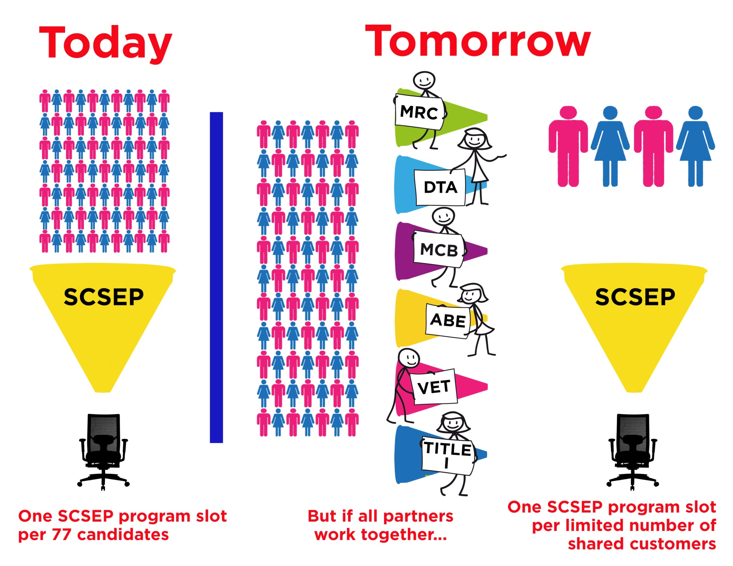
EOEA – SCSEP

Slide 51
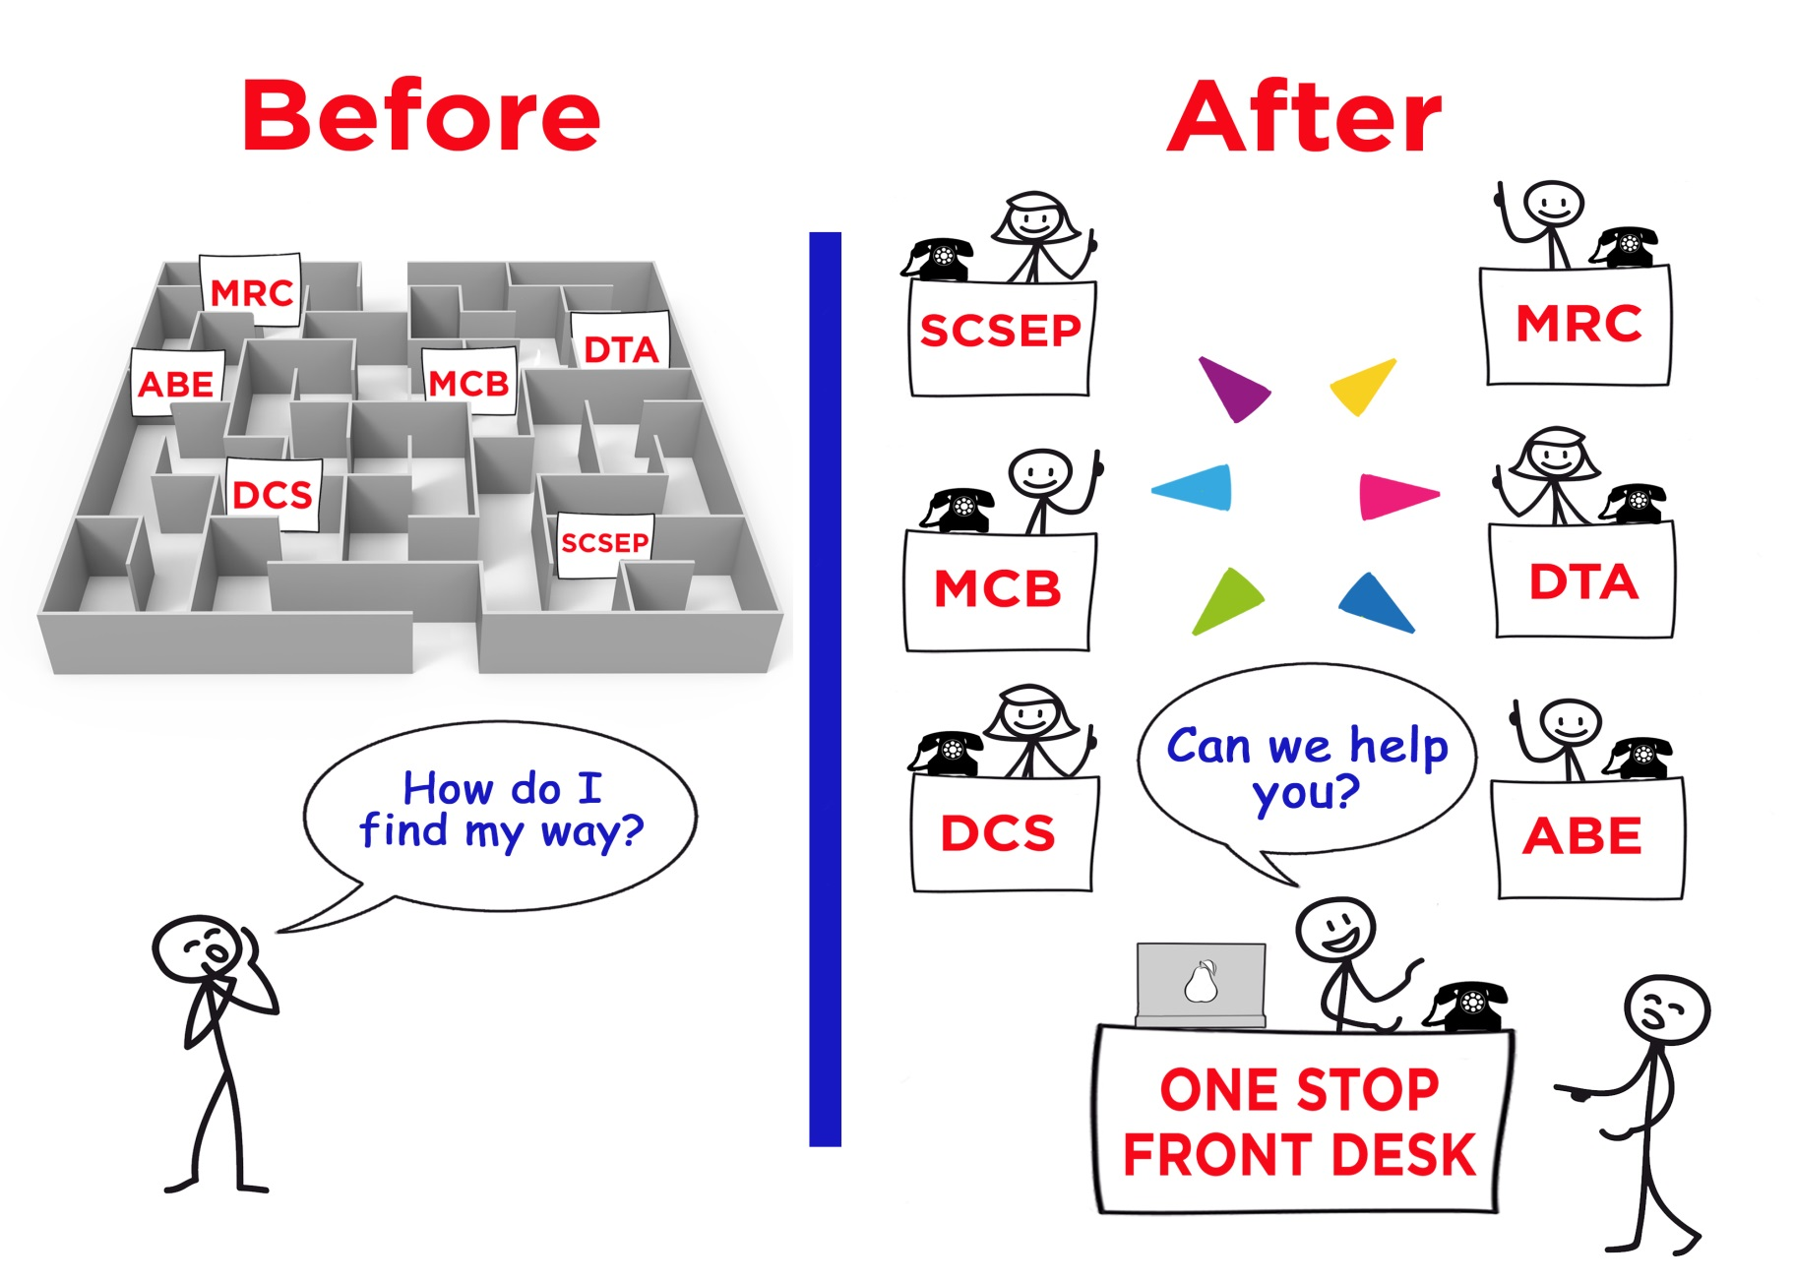
Combined System Service Delivery
We speak your language
¿Puedo ayudarle?
Posso ti ajudar?
Eske mwen ka edew?
我可以幫你嗎？
Tôi có thể giúp bạn hay không?

