Slide 1
WIOA Implementation
Update on Steering Committee

Slide 2
WIOA Steering Committee
WIOA Steering Committee will take on key priority and strategy issues (e.g. define demand-driven and “flip the system”, cross-agency partnerships) to inform the workgroups.
Committee will set-up functional workgroups that will report back to Committee. Workgroups will be outcome focused to ensure debate and dialogue lead to meaningful changes for our customers
Committee will bring policy and operational recommendations to the appropriate decision-makers (i.e. MWIB, Secretaries, State Administrators, etc.)
Timeline (attached)

Slide 3
WIOA Planning & Stakeholder Engagement Structure
WIOA Steering Committee
System Priorities
Eligible Training Provider List (ETPL) Workgroup
Workforce Board Standards/ Certification
(JS&E Sub-group)
Career Center Standards & Selection Process (statewide baselines)
(JS&E Sub-group)
Performance Measurement
(JS&E Sub-group)
Employer Strategies
(JS&E Sub-group)
Youth Workgroup
Job Seeker and Employer (JS&E) Workgroup
Business Focus Groups
(direct input on “demand driven”)

Slide 4
Demand-Driven
Steering Committee Topic #1: Re-think approach to workforce system, refocus service delivery models (“Demand Driven 2.0”)
Discussion: What does this mean in terms of systems-change and better outcomes for customers?
Develop demand-driven matrix to share with Workgroups

Slide 6
Demand-Driven Strategies
System Culture
Define “optimization” of system by business and job seekers (e.g. high volume versus quality of service?)
Incorporate a statewide set of “demand driven” principles (this document) in statewide policy, operations, staffing qualities etc as a “baseline” across system partners.
Policy / Operational leaders rethink structure and service flow based on “demand driven” principles
Intel on Business Demand
Design a state /regional process (through WIBs) to embed business hiring information across workforce partners. Structure system to share, follow-up, and respond to business intel/feedback with staff and job seekers (e.g. Training on hiring requirement for Penn national through discussion with WIB, OSCC, Colleges etc that was used to train front line staff in recruitment process)
Design state policy (regional planning?) to ensure each region has a clearly defined set of career pathways that are critical to the region shared across partners (TANF, ABE etc).
Define and design statewide policy to promote expectations on use of labor market information, industry panels, business outreach, BSR intel in regional service design (WIB and OSCC standards)

Slide 7
Demand-Driven Strategies
Service Design
Outline statewide policy/practices to support “universal access” and increase business engagement / increase job placement for high-need job seekers e.g.:
Identify required shifts in job responsibilities / descriptions for WIB staff, Wagner Peyser, WIOA paid staff, core WIOA partner staff etc. to ensure Career Center has capacity to engage and work with business.
Identify and promote models that increase job placement for customers with “barriers” that are designed on the requirements of an industry/ pathway for that population.
Create a statewide strategy to increase use of “business-based” models like “talent pipelines”, apprenticeship, internships, and other models for mainstream service delivery.
Professional Development
Layout framework for statewide professional development
Performance Results
Develop baseline for CSI (customer service indexing) metrics, including both business and job seeker performance metrics.
New metrics for business outcomes
Increase and measure credentials for job seekers (industry need)
Funding
Create WIB standards & accountability framework to incentivize demand-driven funding growth

Slide 8
Partnership Model for Effective Services
Steering Committee Topic #2: Define effective services across workforce partners.
Discussion: How can statewide partnerships improve outcomes for job seekers, employers and youth?
Implications for operating funding and services? (e.g. Co-location of staff, resource sharing, new referral and follow up processes, data analysis to show improved outcomes?)
How should the state design WIOA Infrastructure Funding (core programs provide resources to Career Centers)?
State level MOU with WIOA partners to define common partnership requirements ((foundation for regional MOUs)

Slide 9
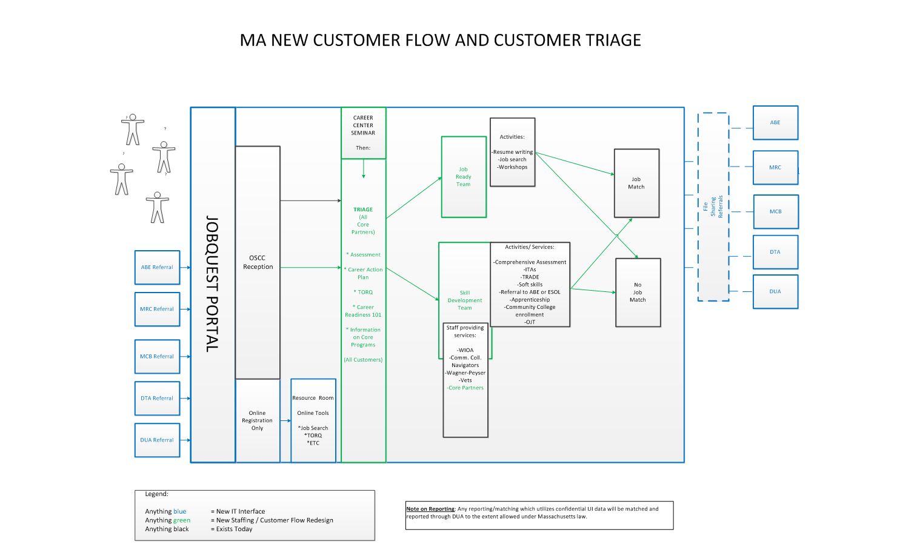

Slide 10
Job Seeker Customer Flow = Policy/Operational Strategies
State Partners work together to develop shared vision and partnership agreements (MOU).
Regions (WIBs) work with WIOA partners to develop regional shared vision and MOUs (based on state MOU).
WIOA partners (state and regional) define “shared” customers with each partner and design pathways (e.g. what assessment characteristics trigger MRC make a referral to adult education or a Career Center? How many people? Key needs and information through referral etc)
WIOA partners focus on their core competencies and rely on partners to leverage partner expertise and avoid duplication of service. (e.g. Career Centers are not adult education programs and work with ACLS providers to expand access. ACLS providers are not job placement agencies and can leverage Career Center services for students.)
Resources (technology, staff, information, funding etc) are shared to support partnerships and create the best possible service pathways for customers.
Career Centers shift “customer flow” and use technology for deeper assessments of a higher volume of customers to better triage customers to “Job Ready” staff teams versus “Skill Building” staff teams.
WIOA partners (regional) work together to define performance goals for shared customers (credentials? Jobs?) in the region.
State and regions develop accountability to vision. Regional Planning process, WIB Certification Process, statewide One Stop Career Center Standards and regional procurement of One-Stop Career Centers incorporate expectations in state and regional MOUs (including resource sharing, partnerships, customer flows – business and job seeker, and shared goals).

Slide 11
Pathways for Key Populations
Pathways across systems defined by Core Program Partners for particular populations (MOU)
Use mapping process or flow chart to ground discussion and invent areas for coordination/integration. NEXT SLIDE
Define “shared customer” between programs for each population (e.g. who and #individuals enrolled at MRC to co-enroll versus trigger direct referral)
Highlight areas of benefit to job seekers/clients/consumers/ students through CO-ENROLLMENT and the necessary service coordination, integration or cost sharing to support integrated services.

Slide 12
SHARED CUSTOMER MODEL: SERVICE DESIGN, CAREER PATHWAYS, COSTS AND ACCOUNTABILITY (DRIVEN BY REGIONAL BOARDS)
Individuals who do not qualify for ACLS, ORI, DTA programs referred to OSCCs. How many?
Individuals enrolled in ACLS, ORI, DTA programs.
How many?
Individuals eligible for ACLS programs, ORI, DTA (ESP funding) referred from Career Center to Partners. How many?
JOB PLACEMENT
CREDENTIAL
Enrolled Individuals: Adult Education (ACLS), Refugees & Immigrants, DTA programming
JOB QUEST PORTAL
Referrals, online registration, walk-ins etc
Customer Gets: OSCC Orientation
(Orientation done by Career Center and Core Program partner staff etc)
JOINT WORKSHOPS FOR POPULATION
Individuals use assessment tools like Interest Aptitude, Career Scope, Career Ready 101, TORQ, etc
Customer Gets:
Career Action Plan
(Workshops done by Career Center and Core Program partner staff or external agencies (specific tools and resources.)
JOINT JOB FAIRS & INDUSTRY BRIEFS
Career Centers and Core Program Partners develop targeted recruitments
Customer Gets:
Connections to Business
(Workshops done by business leaders, Career Center and Core Program partner staff)
JOINT CASE MANGEMENT AND ACCESS TO CAREER PATHWAYS
Regions develop virtual or co-located “teams” across Core Program staffing to enhance job placement & credentialing pathways for population –e.g. shared case mgt, access to OJTs / ITAs, develop sector grants for population, community college navigators etc.
Customer Gets: EXPANDED case mgt team on job search and access to education and training to improve career path.
(Teams created with Career Center and Core Program partner staff, Community College Navigators, external agencies (CBOs) etc)
Co-Enrolled Individuals: One-Stop Career Center Services & Core Program Partners Design Joint Services

Slide 13
Information
Steering Committee
http://www.mass.gov/lwd/eolwd/mwib/
Sub-Committees:
http://www.mass.gov/massworkforce/wioasubcommittees/

