Slide 1
WIOA Youth Program
Final Rules

Slide 2
Objectives
Highlight changes to the Eligibility Criteria for ISY and OSY
Review of the changes/clarification to the 14 Program Service Elements
Individual Service Strategy and Career Pathway Planning for Youth
Understanding Youth Performance Measures

Slide 3
WIOA Title I
Youth Eligibility

Slide 4
Out of School Youth Eligibility
Citizenship/ Work Eligible and Selective Service Compliance AND
Not Attending School
16 - 24 years at the time of enrollment AND,
One or more of the following:
School dropout
Within the age of compulsory school attendance, but has not attended school for at least the most recent complete school year calendar quarter
HS Grad/HiSET who is low-income and basic skills deficient or an English language learner
An offender
Homeless individual, a homeless child or youth, or a runaway
In foster care or has aged out of the foster care system
Pregnant or parenting
An individual with a disability
Low-income individual who requires additional assistance to enter or complete an educational program or to secure or hold employment
Notes:
Changes to a total of 9 barriers instead of 8 – separates a homeless individual and an individual in foster care – only two OSY barriers 2 of the 9 barriers require youth to be low income - Offender changed language from subject to juvenile justice and adult justice system

Slide 5
When is low-income not an eligibility criteria for OSY?
OSY are not required to be low-income if they are: a US citizen/ work eligible, not attending school, 16- 24 years old and meet one or more of the following criteria:
School dropout
Within the age of compulsory school attendance, but has not attended school for at least the most recent complete school year calendar quarter
An offender
Homeless individual, a homeless child or youth, or a runaway
In foster care or has aged out of the foster care system
Pregnant or parenting
An individual with a disability
Examples:
A high school dropout.
A high school graduate that has a disability.
A HISET recipient that is an offender.
A HiSET recipient that is a pregnant or a parent.

Slide 6
When is low-income an eligibility criteria for OSY?
OSY are required to be low-income if they are: a US citizen/ work eligible, not attending school, 16- 24 years old meets one of the following criteria:
HS Grad/HiSET and basic skills deficient or an English language learner
Individual who requires additional assistance to enter or complete an educational program or to secure or hold employment
Examples:
A high school graduate that is basic skills deficient and does not have any of the other 7 OSY barriers.
A HiSET recipient that is an English language learner and does not have any of the other 7 OSY barriers.
A high school graduate or a HiSET recipient that is not basic skills deficient or an English language learner, and does not have any of the other 7 OSY barriers but meets the locally defined definition of a youth requiring additional assistance.

Slide 7
In School Youth Eligibility
Citizenship/Work Eligible and Selective Service Compliance AND
In School AND 14 – 21 years old
Low Income
Attending School
One or more of the following:
Basic skills deficient
English language learner
An offender
Homeless individual, a homeless child or youth, or a runaway
In foster care or has aged out of the foster care system
Pregnant or parenting
Individual with a Disability
Requires additional assistance to enter or complete an educational program or to secure or hold employment
(not more than 5% allowed using this item)
Notes:
Changed from 7 to 8 barriers separates out homeless and foster care individual

Slide 8
What is Low Income for WIOA?
A WIOA Youth participant will be considered Low Income if any of the following are true:
They are receiving public assistance (TAFDC, EAEDC, SNAP, SSI)
Their family income is at or below 70% of the Lower Living Standard (LLS)
(or below Poverty Line for family of one (1))
They reside in a High Poverty Area
They have any of the following barriers:
Homeless/Runaway (as defined in McKinney Act)
Foster Care
They are in school and on a free or reduced lunch program

Slide 9
2 New Ways to Determine Low-Income Status for WIOA ISY/ OSY
Free and Reduced Price Lunch – Richard B. Russell National School Lunch Act
ISY Only
ISY that attend a designated low-income school do not automatically qualify as low-income
(Community Eligibility Provision)
High Poverty Area – The Census Bureau defines a “poverty area” as a census track where at least 20 percent of the residents are poor.
ISY and OSY
Poverty rate of 30 percent changed to 25 percent
* Poverty Threshold Census Tract Database was develop to assist program staff identify individuals living in a High Poverty Area

Slide 10
Low Income Exception (5% Window Eligibility)
Five percent of WIOA youth participants, who would ordinarily be required to be low-income for eligibility, and who meet all other eligibility requirements, may be non low income.
The 5% calculation is based on the percent of youth newly enrolled in the fiscal year and served by the program in the local area’s WIOA youth program.

Slide 11
WIOA Youth Program Provisions
Paid and Unpaid Work Experiences for ISY and OSY
At least 20% of local Youth formula funds must be used for work experiences
Out –of –School Youth
Local areas must spend a minimum percent of 75 percent of PY 2016 / FY 2017 funds on OSY.
Procurement and Service Provider Selection
Grant recipient/fiscal agent has the option to provide directly some or all of the youth workforce investment activities.
.

Slide 12
WIOA 14 Program Service Elements

Slide 13
WIOA Program Elements
Program Element | Description | MOSES Activity and/or Service
Tutoring, Study Skills Training, Instruction* | Development of educational achievement skills that leads to the completion of the requirements for a secondary or post secondary school diploma/credential. | Educational Training, HiSET/ASE Dropout Prevention/Tutoring Basic ABE Basic ESL/ESOL Adult Ed/Literacy w/Training
Alternative Secondary School* | Alternative secondary school services, or drop out recovery services. | Alternative School
Work Experience* Summer Employment Pre apprenticeship pgms Internships/Job Shadowing OJT Opportunities | Work experiences which include summer employment, year round employment, pre-apprenticeship, internships/Job-Shadow and On-the-job training opportunities. | Work Exp/Summer Youth Academic/Occ Learning – Summer Work Experience In the Job Training Workplace Training/Coop Ed Pgms Job Readiness Training Subsidized Employment
Occupational Skills Training* | An organized program of study that provides specific vocational skills that lead to proficiency in performing actual tasks and technical functions required by certain occupational fields. | Occupational Skills Training Private Sector Training Pre Employment Skills Training Entrepreneurial Training Skill Upgrade and Retraining
* Included in Education and Training

Slide 14
WIOA Program Elements
Program Element | Description | MOSES Activity and/or Service
Education concurrently w/Workforce Prep* | Integrated education and training that occur concurrently and contextually with workforce preparation. | Education w/Workforce Prep
Leadership Development | Opportunities that encourage responsibility, confidence, employability, self-determination and other positive social behaviors. | Community Service Leadership Development
Supportive Services | Services that enable youth to participate in program activities such as assistance with book, fees, school supplies, transportation, and legal aid services. | Supportive Services – except Needs Related Payment
Adult Mentoring (12 months min) | Participants receive adult mentoring for a period of not less than 12 months that connects to the youth’s goals. | Mentoring
Follow-up Services (12 months) | Follow-up services are provided for 12 months unless the participants declines to receive follow-up services or cannot be located or contacted. | Follow-Up (Title I)
* Included in Education and Training

Slide 15
WIOA Program Elements
Program Element | Description | MOSES Activity and/or Service
Comprehensive Guidance & Counseling | Individualized counseling which includes drug and alcohol abuse, and mental health counseling, and referral to partner programs. | Comprehensive Guidance and Counseling
Financial Literacy Education* | Support the ability of participants to create budgets, learn how to manage spending, credit, and debt. | Financial Literacy Education Counseling / Financial Counseling
Entrepreneurial Skills Training* | Entrepreneurial skills training provides the basics of starting and operating a small business. | Entrepreneurial Skills Training
Labor Market Services | Participants receive access to career counseling, career exploration, career awareness, and the use of labor market tools. | Job Search Automated Labor Exchange Job Order Search Labor Market Info Resource Room
Transition to Post Secondary Education* | Participants receive access to job exploration counseling, work based learning experiences, instruction in self-advocacy, work readiness training. | Post Sec/Training Transition Activities Counseling / Trans to Post Sec Ed/Training
* Included in Education and Training

Slide 16
The Individual Service Strategy (ISS) and Career Pathway Planning

Slide 17
Individual Service Strategy Plan
An Individual Service Strategy (ISS) plan must be developed for each youth participant and is based on an objective assessments that include review of participants:
skill levels
service needs
strengths
The ISS must:
Include career planning and the results of objective assessments
Include education and employment goals
Include achievement objectives and services
Directly link to one or more performance indicators
Identify an appropriate career pathway

Slide 18
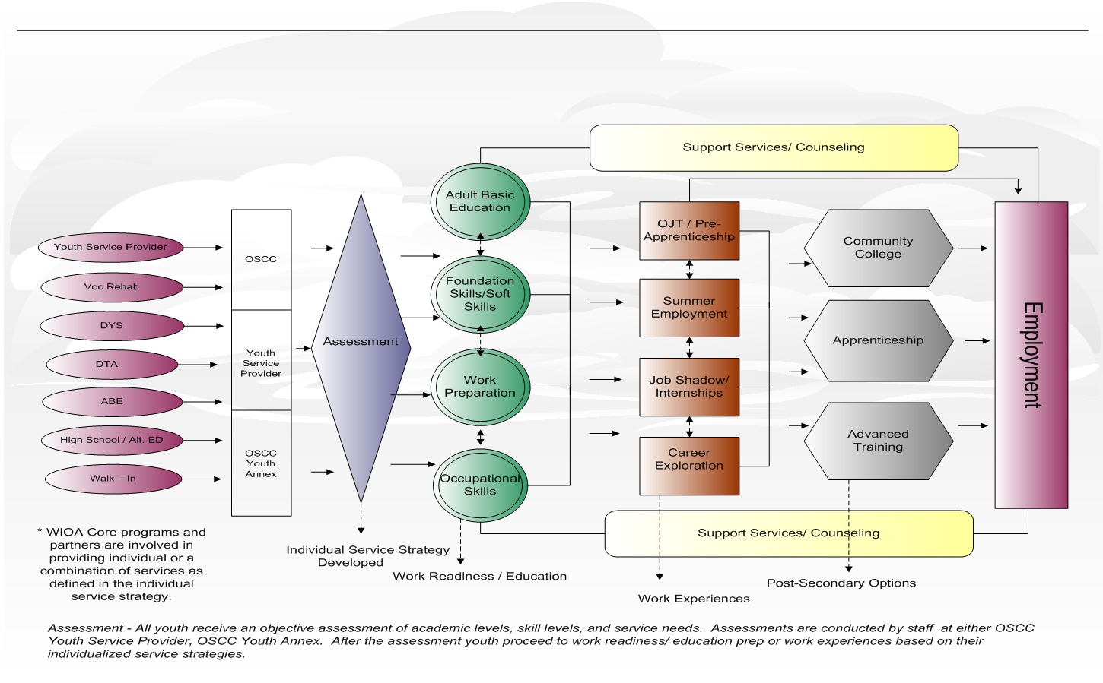
Youth Service Delivery Framework

Slide 19
WIOA Career Pathway
CAREER PATHWAY—The term ‘‘career pathway’’ means a combination of rigorous and high-quality education, training, and other services that—
Aligns with the skill needs of industries;
Prepares individuals to be successful in education options;
Includes counseling to support education and career goals;
Includes contextualized learning within an occupational cluster;
Organizes education, training, and other services that accelerates education and career advancement;
Enables the attainment of a secondary and at least one postsecondary credential;
Supports entrance or advancement within a specific occupation or occupation cluster.

Slide 20
Career Pathway Planning
Career services, training services, support services, individual employment plans, business services
WIOA Title I Adult, Youth Dislocated Worker
Adult education & literacy, digital literacy, workforce preparation, individual education plans
WIOA Title II Adult Education
Support services, intensive case management, work study
Human Services
Career, and technical education, integrated education & training, professional development
Carl Perkins Career and Technical Education
WIOA Title III Employment Services
WIOA Title IV Vocational Rehabilitation Services
(TANF,SNAP E&T, others)
Career pathway partnership activities across key public systems - Center for Law Action and Social Policy graphic.
Assessment tools to identify appropriate career pathway’s can include:
MASSCIS
Career Ready 101
My Next Move
Career One-Stop - GetMyFuture

Slide 21
WIOA Performance Indicators

Slide 22
WIOA Youth Performance Indicators
Performance Measure | Negotiated Goals | Cohort Periods
In Employment or Post Secondary Education or Training in the 2nd Quarter After Exit | 74% | FY2018: 07/01/2016 – 03/31/2017 FY2019: 04/01/2017 – 03/31/2018
In Employment or Post Secondary Education or Training in the 4th Quarter After Exit | 72% | FY2018: 07/01/2016 – 09/30/2016 FY2019: 10/01/2016 – 09/30/2017
Median Wages 2nd Quarter After Exit | not negotiated | FY2018: 07/01/2016 – 03/31/2017 FY2019: 04/01/2017 – 03/31/2018
Credential Attainment | 65% | FY2018: 07/01/2016 – 09/30/2016 FY2019: 10/01/2016 – 09/30/2017
Measureable Skill Gain | not negotiated | FY2017: 07/01/2016 – 06/30/2017 FY2018: 07/01/2017 – 06/30/2018 FY2019: 07/01/2018 – 06/30/2019
Employer Retention Measure | not negotiated | FY2018: 07/01/2016 – 03/31/2017 FY2019: 04/01/2017 – 03/31/2018

Slide 23
WIOA Youth Performance Indicators
In Employment or Post Secondary Education or Training during the 2nd Quarter After Exit:
Number of Title I youth participants who exited during the reporting period who are employed, in education, or in occupational skills training during the second quarter after exit.
Participants reported as Not in Labor Force are excluded from the measure
Tracking/Reporting:
Wage records from UI database or
6 month employment follow-up services from employment tab or
6 month retention services from general tab.

Slide 24
WIOA Youth Performance Indicators
Not in Labor Force:
(from the PIRL report)
those participants who are not employed and are not actively looking for work, including those who are incarcerated.

Slide 25
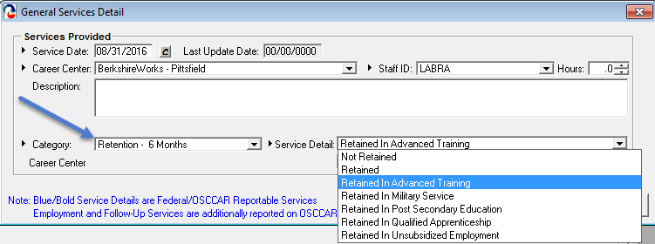
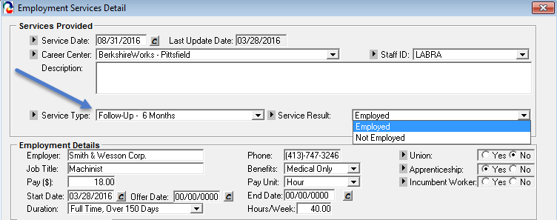
WIOA Youth Performance Indicators
In Employment or Post Secondary Education or Training during the 2nd Quarter After Exit:

Slide 26
WIOA Youth Performance Indicators
In Employment or Post Secondary Education or Training during the 4th Quarter After Exit:
Number of Title I youth participants who exited during the reporting period who are employed, in education, or in occupational skills training during the fourth quarter after exit.
Participants reported as Not in Labor Force are excluded from the measure
Tracking/Reporting:
Wage records from UI database or
12 month employment follow-up services from employment tab or
12 month retention services from general tab

Slide 27
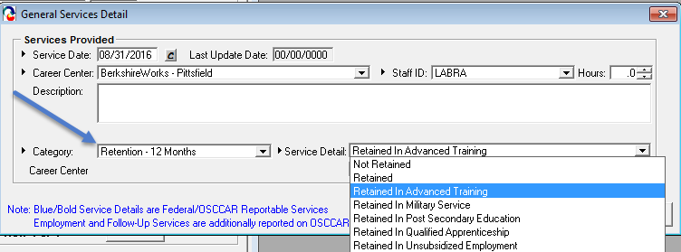
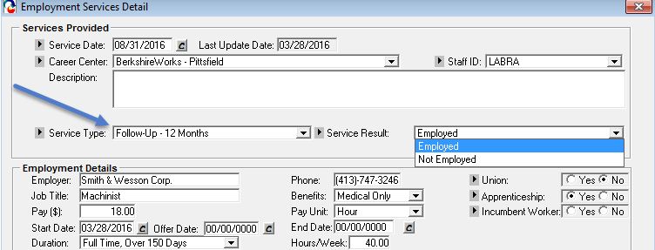
WIOA Youth Performance Indicators
In Employment or Post Secondary Education or Training during the 4th Quarter After Exit:

Slide 28
WIOA Youth Performance Indicators
Median Wages 2nd Quarter After Exit:
The median wage of those youth employed in the 2nd quarter after exit.
Participants reported as Not in Labor Force are excluded from the measure
Tracking/Reporting:
Wage records only!
The difference between median and average:
The median of {5, 6, 7, 9, 28} = 7
The average of {5, 6, 7, 9, 28} = 11

Slide 29
WIOA Youth Performance Indicators
Credential Attainment:
Number of participants who exited during the reporting period that were in a postsecondary education or training program and who obtained a recognized postsecondary credential during the program or within one year after exit;
plus the number of participants who exited that were in a secondary education program and who obtained a secondary education diploma or its equivalent during the program or within one year after exit AND who were also employed or enrolled in an education or training program leading to a recognized postsecondary credential within one year after exit.
Tracking/Reporting:
Attainment [service] of degree, certificate, license or other credential AND, if secondary education diploma, then
Wage records from UI database or
employment follow-up services (1 – 12)from employment tab or
Outcome of Entered Post Secondary or Entered Advanced Training and/or
Retention services (1 – 12)

Slide 30
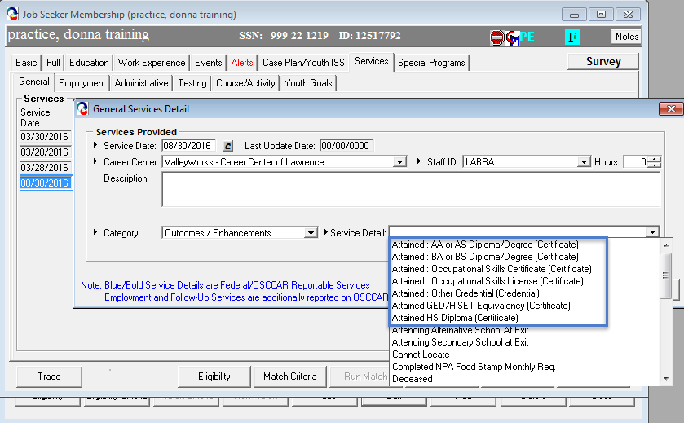
WIOA Youth Performance Indicators
Credential Attainment:

Slide 31
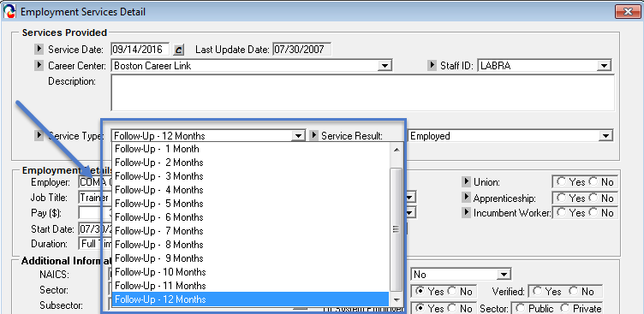
WIOA Youth Performance Indicators
Credential Attainment (for secondary school diplomas/equivalents):
and/or Retention Services

Slide 32
WIOA Youth Performance Indicators
Measureable Skill Gain (meeting one or more):
Of those enrolled in education or training:
WIOA Positive MSG (Type #1) | WIOA Positive MSG (Type #2) | WIOA Positive MSG (Type #3) | WIOA Positive MSG (Type #4) | WIOA Positive MSG (Type #5)
Educational Achievement | Secondary School Diploma | Transcript/Report Card | Training Milestone | Skills Progression
# of participants that are basic skills deficient at program entry who achieve a gain of one or more educational functioning levels. | # of participants that do not have a secondary education diploma at program entry and who attain a high school diploma or equivalent. | # of participants enrolled in either secondary or post secondary whose transcript/report card for one (1) academic year is achieving the state unit’s policies for academic standards. | # of participants enrolled in on the job training, apprenticeship or work experience with a satisfactory or better progress report toward an established milestone from an employer/training provider. | # of participants successfully completed an exam that is required for a particular occupation, or progress in attaining technical or occupational skills as evidenced by trade-related benchmarks (e.g. knowledge based exams)

Slide 33
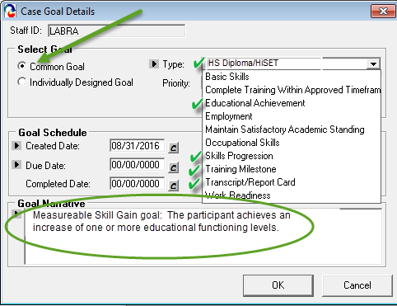
WIOA Youth Performance Indicators
Measureable Skill Gain: (continued)
Tracking/Reporting:
Attainment service, test scores
Case Management goals

Slide 34
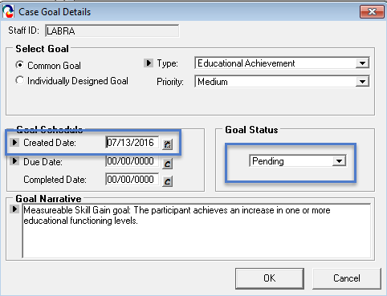
WIOA Youth Performance Indicators
Measureable Skill Gain: (continued)
Tracking/Case Management goals

Slide 35
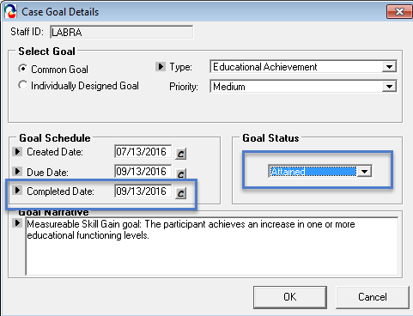
WIOA Youth Performance Indicators
Measureable Skill Gain: (continued)
Tracking/Case Management goals

Slide 36
WIOA Youth Performance Indicators
Employer Retention Measure:
Of those exiters who are employed in the 2nd quarter after exit AND in the 4th quarter after exit, those that are employed with the same employer in both quarters (using the employer FEIN from wage records).
Tracking/Reporting:
Wage records from UI database

Slide 37
Key MOSES Data Entry Points
Performance Measure | Cohort Periods
In Employment or Post Secondary Education or Training in the 2nd Quarter After Exit | Employment Tab Follow-up Month 6 (Q2), Month 12 (Q4) (or all months as they occur)
In Employment or Post Secondary Education or Training in the 4th Quarter After Exit | General Services tab Retention button Month 6 (Q2), Month 12 (Q4) (or all months as they occur)
Credential Attainment | General Services tab Attainment services
Measureable Skill Gain | Case Management tab goals

Slide 38
Global Exclusions from Performance
Must be identified and documented by the end of the 3rd quarter after exit:
Institutionalized
Health/Medical Care
Deceased
Reservist Called to Active Duty
Youth Mandated to Relocation Program/Foster Care
Family Care exclusions gone!

Slide 39
Some Other Stuff

Slide 40
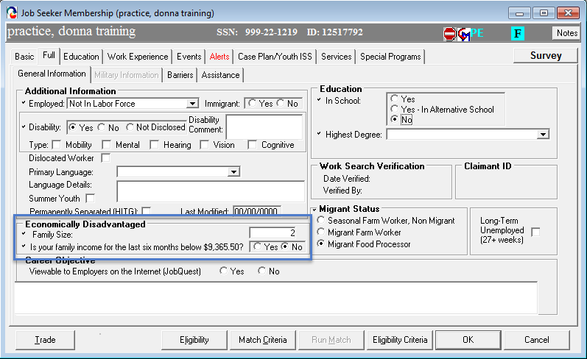
Other Stuff
Self Attestation Question on Full Tab

Slide 41
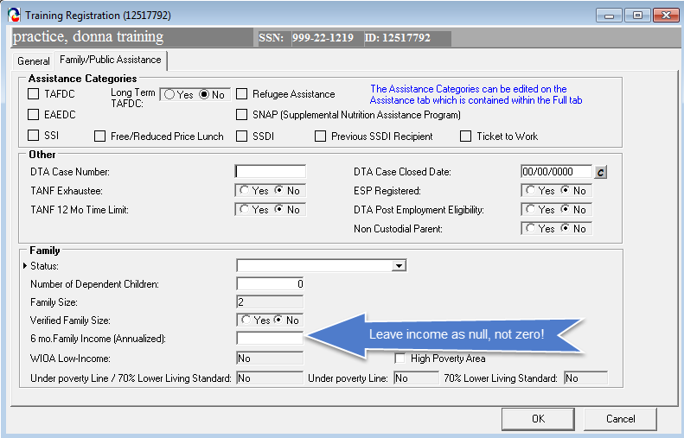
Other Stuff
Enter Null When Not Verifying Income

Slide 42
Resources
Massachusetts Career Information System
http://www.mass.gov/massworkforce/resources/masscis/
Career Ready 101
http://www.mass.gov/massworkforce/careerready/tools/career-ready-101/
Workforce Innovation and Opportunity Act
https://www.congress.gov/bill/113th-congress/house-bill/803/text
Workforce Innovation and Opportunity Act: Department of Labor Only – Final Rule
https://www.gpo.gov/fdsys/pkg/FR-2016-08-19/pdf/2016-15975.pdf
Department of Career Services Youth Program Resource Page
http://www.mass.gov/massworkforce/programs/youth/

