Slide 1


WIOA YOUTH PROGRAM
https://www.mass.gov/masshire-career-centers
January 11, 2019

Slide 2
Topics
Importance of WIOA
Eligibility criteria for in-school youth and out-of-school youth
Source Documentation
14 Program Elements
Individual service strategy (ISS) and Career Pathways
Leveraging partner programs

Slide 3

Importance of the Workforce Innovation and Opportunity Act (WIOA)
WIOA increases access to opportunities for employment, education, training, and support services to individuals, particularly those with barriers to succeed in the labor force.
WIOA provides funding for local areas to offer programs for in-school and out-of-school youth that provide a pathway to a GED, HiSET, high school diploma, higher education, industry-recognized training, and a career.

Slide 4
Out of School Youth Eligibility
US Citizenship/ Work Eligible and Selective Service Compliance AND
Not Attending School
16 - 24 years at the time of enrollment AND,
One or more of the following:
School dropout
Within the age of compulsory school* attendance, but has not attended school for at least the most recent complete school year calendar quarter
HS Grad/HiSET who is low-income and basic skills deficient or an English language learner
An offender
Homeless individual, a homeless child or youth, or a runaway
In foster care or has aged out of the foster care system
Pregnant or parenting
An individual with a disability
Low-income individual who requires additional assistance to enter or complete an educational program or to secure or hold employment
* Compulsory school age in Massachusetts in between the ages of 6-16.

Slide 5
When is low-income not an eligibility criteria for OSY?
OSY are not required to be low-income if they are: a US citizen/ work eligible, not attending school, 16- 24 years old and meet one or more of the following criteria:
School dropout
Within the age of compulsory school attendance, but has not attended school for at least the most recent complete school year calendar quarter
An offender
Homeless individual, a homeless child or youth, or a runaway
In foster care or has aged out of the foster care system
Pregnant or parenting
An individual with a disability
Examples:
A high school dropout.
A high school graduate that has a disability.
A HISET recipient that is an offender.
A HiSET recipient that is a pregnant or a parent.

Slide 6
When is low-income an eligibility criteria for OSY?
OSY are required to be low-income if they are: a US citizen/ work eligible, not attending school, 16- 24 years old meets one of the following criteria:
HS Grad/HiSET and basic skills deficient or an English language learner
Individual who requires additional assistance to enter or complete an educational program or to secure or hold employment
Examples:
A high school graduate that is basic skills deficient and does not have any of the other 7 OSY barriers.
A HiSET recipient that is an English language learner and does not have any of the other 7 OSY barriers.
A high school graduate or a HiSET recipient that is not basic skills deficient or an English language learner, and does not have any of the other 7 OSY barriers but meets the locally defined definition of a youth requiring additional assistance.

Slide 7
In School Youth Eligibility
US Citizenship/Work Eligible and Selective Service Compliance AND
In School AND 14 – 21 years old
Low Income
Attending School
One or more of the following:
Basic skills deficient
English language learner
An offender
Homeless individual, a homeless child or youth, or a runaway
In foster care or has aged out of the foster care system
Pregnant or parenting
Individual with a Disability
Requires additional assistance to enter or complete an educational program or to secure or hold employment
(not more than 5% allowed using this item)

Slide 8
What is Low Income for WIOA?
A WIOA youth participant will be considered Low Income if any of the following are true:
They are receiving public assistance (TAFDC, EAEDC, SNAP, SSI)
Their family income is at or below 70% of the Lower Living Standard (LLS)
(or below Poverty Line for family of one (1))
They reside in a High Poverty Area
They have any of the following barriers:
Homeless/Runaway (as defined in McKinney Act)
Foster Care
They are in school and on a free or reduced lunch program

Slide 9
Low-Income status for can also be determined by the following:
Free and Reduced Price Lunch – Richard B. Russell National School Lunch Act
ISY Only
ISY that attend a designated low-income school do not automatically qualify as low-income
(Community Eligibility Provision)
High Poverty Area
ISY and OSY
Poverty rate of 25 percent – where at least 25 percent of the residents are economically disadvantaged.
* Poverty Threshold Census Tract Database was develop to assist program staff identify individuals living in a High Poverty Area

Slide 10

Low Income Exception (5% Window Eligibility)
Five percent of WIOA youth participants, who would ordinarily be required to be low-income for eligibility, and who meet all other eligibility requirements, may be non low income.
The 5% calculation is based on the percent of youth newly enrolled in the fiscal year and served by the program in the local area’s WIOA youth program

Slide 11
Source Documentation
Documentation is necessary to support WIOA Title I Youth Eligibility
Local Areas must verify and confirm that youth are eligible to participate in WIOA youth services through an examination of documents.
Documentation may be stored electronically, however documentation must be available to program, fiscal monitors, and auditors for monitoring purposes.
Local Areas must retain records for a period of at least three (3) years after the submittal of the final closeout expenditure report for that funding period.
Acceptable forms of source documentation can be found in MassWorkforce Issuance 100 DCS 19.101.2 : WIOA Title I Youth Eligibility Policy

Slide 12
Examples of Acceptable Source Documentation
Youth is out of school and homeless (Example include and are not limited to the following:)
Age - Birth Certificate/US Passport
US Citizenship/Work Authorization – Birth Certificate/ Unexpired Alien Registration Card with Authorization to Work
Selective Service Compliant – Selective Service online Verification
Out of school Verification - HSD/ HiSET Certificate/ HS Transcript
Homeless – Letter from shelter/ Applicant Statement with Corroborating Witness
Youth is in school and an offender (Example include and are not limited to the following:)
Age – Federal, State or local government identification card that includes date of birth
US Citizenship/Work Authorization – Certificate of Naturalization
Selective Service Compliant – Stamped post office receipt of registration
In School Youth Verification – Report Card/ Letter from school on school letter head
Low-Income – School lunch verification form with youth’s name/ Print out from Poverty Threshold Census Tract database
Offender – Court documentation/ Written statement from State/Local agency

Slide 13
WIOA Youth Program Provisions
Paid and Unpaid Work Experiences for ISY and OSY
At least 20% of local Youth formula funds must be used for work experiences
Work Experience:
Summer and other employment opportunities throughout the school year
Pre-apprenticeship programs
Internships and job-shadowing
On-the-Job training pportunities
MassWorkforce Issuance 100 DCS 19.106: WIOA Title I Youth Work Experience Expenditure Requirement
Out–of–School Youth
Local areas must spend a minimum of 75 percent of program funds on OSY.

Slide 14
WIOA Program Elements All youth must have access to the 14 WIOA program service elements
Program Element | Description | MOSES Activity and/or Service
Tutoring, Study Skills Training, Instruction | Development of educational achievement skills that leads to the completion of the requirements for a secondary or post secondary school diploma/credential. | Educational Training, HiSET/ASE Dropout Prevention/Tutoring Basic ABE Basic ESL/ESOL Adult Ed/Literacy w/Training
Alternative Secondary School | Alternative secondary school services, or drop out recovery services. | Alternative School
Work Experience Summer Employment Pre apprenticeship programs Internships/Job Shadowing OJT Opportunities | Work experiences which include summer employment, year round employment, pre-apprenticeship, internships/Job-Shadow and On-the-job training opportunities. | Work Exp/Summer Youth Academic/Occ Learning – Summer Work Experience In the Job Training Workplace Training/Coop Ed Pgms Job Readiness Training Subsidized Employment
Occupational Skills Training | An organized program of study that provides specific vocational skills that lead to proficiency in performing actual tasks and technical functions required by certain occupational fields. | Occupational Skills Training Private Sector Training Pre Employment Skills Training Entrepreneurial Training Skill Upgrade and Retraining

Slide 15
WIOA Program Elements
Program Element | Description | MOSES Activity and/or Service
Education concurrently w/Workforce Prep | Integrated education and training that occur concurrently and contextually with workforce preparation. | Education w/Workforce Prep
Leadership Development | Opportunities that encourage responsibility, confidence, employability, self-determination and other positive social behaviors. | Community Service Leadership Development
Supportive Services | Services that enable youth to participate in program activities such as assistance with book, fees, school supplies, transportation, and legal aid services. | Supportive Services – except Needs Related Payment
Adult Mentoring (12 months min) | Participants receive adult mentoring for a period of not less than 12 months that connects to the youth’s goals. | Mentoring
Follow-up Services (12 months) | Follow-up services are provided for 12 months unless the participants declines to receive follow-up services or cannot be located or contacted. | Follow-Up (Title I)

Slide 16
WIOA Program Elements
Program Element | Description | MOSES Activity and/or Service
Comprehensive Guidance & Counseling | Individualized counseling which includes drug and alcohol abuse, and mental health counseling, and referral to partner programs. | Comprehensive Guidance and Counseling
Financial Literacy Education | Support the ability of participants to create budgets, learn how to manage spending, credit, and debt. | Financial Literacy Education Counseling / Financial Counseling
Entrepreneurial Skills Training | Entrepreneurial skills training provides the basics of starting and operating a small business. | Entrepreneurial Skills Training
Labor Market Services | Participants receive access to career counseling, career exploration, career awareness, and the use of labor market tools. | Job Search Automated Labor Exchange Job Order Search Labor Market Info Resource Room
Transition to Post Secondary Education | Participants receive access to job exploration counseling, work based learning experiences, instruction in self-advocacy, work readiness training. | Post Sec/Training Transition Activities Counseling / Trans to Post Sec Ed/Training

Slide 17

Individual Service Strategy Plan
An Individual Service Strategy (ISS) plan must be developed for each youth participant and must:
Include career planning and the results of objective assessments
Include education and employment goals
Include achievement objectives and services
Directly link to one or more performance indicators
Identify an appropriate career pathway

Slide 18
Assessments
Assessments are important in determining the appropriate services for youth.
The ISS is based on an objective assessments that includes a review of participant:
academic skill levels
skill levels
service needs
Strengths and assets
Basic Skills Deficient – a youth that is at or below the 8th grade level in English reading, writing, or computing skills as evidenced by a generally accepted standardized test.
Testing tools for measuring educational functioning levels (EFLs) must be on the National Reporting Systems (NRS) federally approved list of assessments. (CASA, TABE, MAPT, etc.)

Slide 19
Assessments
Local areas may use formalized testing tools that are valid and reliable. Testing tools should also be appropriate, fair, and cost effective and easy to administer and interpret results.
Assessment Tool Examples:
MASSCIS
Work Keys Curriculum
My Next Move
Career One-Stop - GetMyFuture
MySkills MyFuture

Slide 20

Enrollment
In order to participate in the WIOA youth program the following must occur:
Eligibility determination
Objective assessment
Development of the ISS
Participation in any of the 14 program elements

Slide 21
WIOA Career Pathway
CAREER PATHWAY—The term ‘‘career pathway’’ means a combination of rigorous and high-quality education, training, and other support services that—
Aligns with the skill needs of industries;
Prepares individuals to be successful in education options;
Includes counseling to support education and career goals;
Includes contextualized learning within an occupational cluster;
Organizes education, training, and other services that accelerates education and career advancement;
Enables the attainment of a secondary and at least one postsecondary credential;
Supports entrance or advancement within a specific occupation or occupation cluster.

Slide 22
Career Pathway Concept using a customer centered design approach
Education
Training
Support Services
Putting the individuals needs at the center of service delivery.

Slide 23






Leveraging Partner Programs

Slide 24
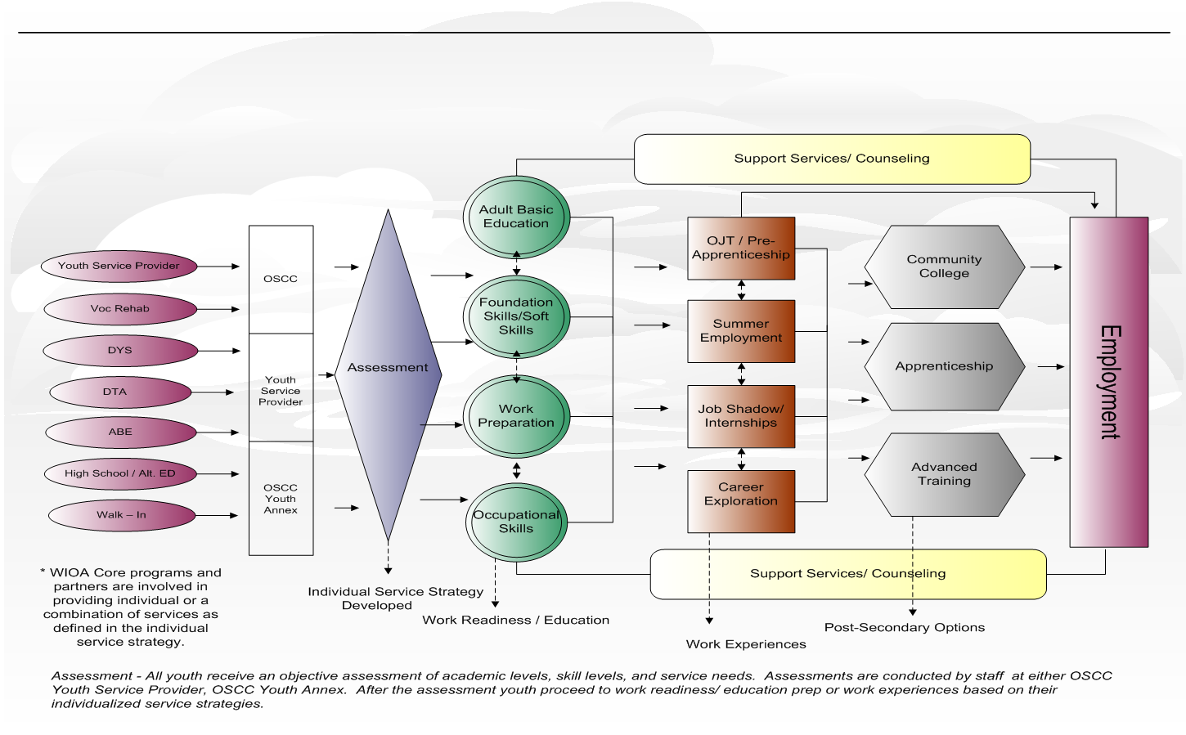
Youth Service Delivery Framework

Slide 25
Resources
Massachusetts Career Information System
http://www.mass.gov/massworkforce/resources/masscis/
Career Ready 101
http://www.mass.gov/massworkforce/careerready/tools/career-ready-101/
Workforce Innovation and Opportunity Act
https://www.congress.gov/bill/113th-congress/house-bill/803/text
Workforce Innovation and Opportunity Act: Department of Labor Only – Final Rule
https://www.gpo.gov/fdsys/pkg/FR-2016-08-19/pdf/2016-15975.pdf
Department of Labor TEGL 10-16 Performance Accountability
https://wdr.doleta.gov/directives/corr_doc.cfm?DOCN=8226
Department of Career Services Youth Program Resource Page
http://www.mass.gov/massworkforce/programs/youth/

