Slide 1
YOUTH WORKGROUP
PRESENTER: Sacha Stadhard

Slide 2
Mission/Purpose of Workgroup
Mission Statement
To provide a framework for establishing an integrated service delivery system that supports positive outcomes for disconnected youth.
Purpose
To identify state level policy changes to create effective outcomes for youth.
Focus Areas
Increase services to out-of-school youth (OSY) and older youth
Increase services to youth with disabilities
Career Pathway Development
Expand access to work experiences for in-school and out-of-school youth through:
  On – The – Job Training
  Pre-Apprenticeship / Apprenticeship
  Individual Training Accounts
  Internships / Job Shadowing

Slide 3
Methodology
The group engaged WIOA Core Partner Programs, Workforce Partners, Workforce Boards, and Youth Service Providers
We held monthly meeting to discuss the key changes in the WIOA Youth Program and to develop strategies for alignment of services and resources for youth.
We reviewed new WIOA Youth Eligibility requirements.
The group discussed WIOA CORE partner requirements.

Slide 4
Key Issues
  Program models for serving out-of-school youth (OSY) and older youth
  State level coordination of youth services and resources
  Referrals between Core Partner Programs
  Cross trainings for agency staff

Slide 5
Policy Recommendations
Issue a Policy focused on a New referral process between Title I Youth Program and Title II Adult Basic Education Program
  Policy will outline a referral process for youth 16-24 to:
    ABE programs for literacy skills and the attainment of secondary credentials and;
    to WIOA youth service providers who can provide occupational skills training and work experiences and;
    include description of appropriate roles for OSCC staff and ABE staff to support career pathways for youth.
  As well as a process for co-enrollment between Title I and Title II to support the integrated educational and training needs of youth through career pathways.
Issue a Policy focused on a New referral process between Title I Youth Program and Title IV Vocational Rehabilitation
  Policy will outline a referral process for youth 14 -24 to:
    Vocational Rehabilitation to receive support services and accommodations needed to participate in youth program services and;
    from Vocational Rehabilitation to youth service providers to provide pre-employment transitions services as required under WIOA which include: job exploration counseling, work readiness training, and work-based experiences; and
    include a description of appropriate roles for OSCC staff and Vocational Rehabilitation staff to support career pathways for youth with disabilities.

Slide 7
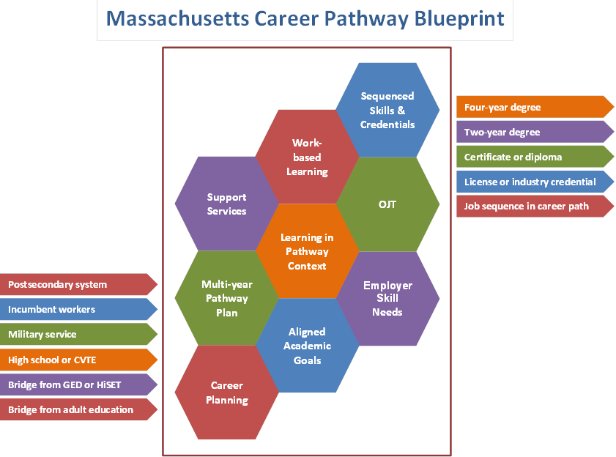

Slide 8
Operational Changes
Key operational changes include:
  Information Sharing
  Cross Trainings for agency staff
  Standard Referral Forms
  Increase staff knowledge base for referrals to available services
Two subgroups developed to address operational issues:
  Youth with Disabilities subgroup
    Develop a common referral form
    Identify Best Practices
    Map out a Service Delivery Strategy for Youth with Disabilities
    Identify Service Provider and Technical Assistance and Support Needs
  Out-of-School Youth subgroup
    Outreach / Recruitment Strategies
    Identify Best Practices
    Leverage Existing Resources
    Identify Service Provider and Technical Assistance and Support Needs
    Identify of new programs models for OSY and older youth

Slide 9
Performance Standards
Increase services to out-of-school youth
Increase services to youth with disabilities
Increase access to work experiences
Co-enrollment with WIOA Core Programs and workforce partners
Measure of referrals between WIOA Core Program and workforce partners
Longitudinal measure of outcomes for WIOA youth who participate in career pathways

Slide 10
Expected Product for State Plan
Youth Procurement Policy 100 DCS 19.100
  Describes State – developed criteria used by local boards in awarding grants for youth workforce investment activities…
Youth Requires Additional Assistance Policy (Revised for WIOA)
  Contains language for the State policy of Requires Additional Assistance Policy to complete an educational program, or to secure or hold employment.
  Career Pathway Vision Statement
  Concurrently increasing knowledge, skills, workforce preparation and academic skills, competencies, credentials, and assisting youth in making educated career choices informed by and aligned with industry/ employers skill needs.
  Adoption of the WIOA Youth Career Pathway Model
  Adoption of the Massachusetts Career Pathway Blueprint
  Policy recommendations for referrals to Title II (ABE) and Title IV (Vocational Rehabilitation)

