Slide 1


WIOA YOUTH/ADULT PROGRAM
PERFORMANCE
https://www.mass.gov/masshire-career-centers
January 11, 2019

Slide 2
WIOA Performance Indicators
Adult/DW/Youth
WIOA Performance Indicators

Slide 3
WIOA Performance Indicators
Performance Measure | FY 2019 State Goals | FY 2019 Exit* Cohort Range
Employment in the 2nd Quarter After Exit Youth: add or in Education or Training | Adult: 86.0 Dislocated Wrkr: 86.0 Youth: 80.5 | 07/01/2017 – 06/30/2018
Employment in the 4th Quarter After Exit Youth: add or in Education or Training | Adult: 78.0 Dislocated Wrkr: 85.0 Youth: 73.0 | 01/01/2017 – 12/31/2017
Median Wages 2nd Quarter After Exit | Adult: $5,200 Dislocated Wrkr: $7,700 Youth: not neg | 07/01/2017 – 06/30/2018
Credential Attainment | Adult: 71.0 Dislocated Wrkr: 60.0 Youth: 70.5 | 01/01/2017 – 12/31/2017
Measureable Skill Gain* (not exiter based) | not negotiated | 07/01/2018 – 06/30/2019
Employer Retention Measure | not negotiated | 01/01/2017 – 12/31/2017

Slide 4
WIOA Performance Indicators
Exit Quarter - Represents the calendar quarter in which the date of exit is recorded for the participant.
2017 |  |  | 2017 |  |  | 2017 |  |  | 2017
JAN | FEB | MAR | APR | MAY | JUN | JUL | AUG | SEP | OCT | NOV | DEC
2018 |  |  | 2018 |  |  | 2018 |  |  | 2018
JAN | FEB | MAR | APR | MAY | JUN | JUL | AUG | SEP | OCT | NOV | DEC

Slide 5
WIOA Performance Indicators
In Employment [or Education or Training] during the 2nd Quarter After Exit:
Number of participants who exited during the reporting period who are employed, in education*, or in occupational skills training during the second quarter after exit.
Tracking/Reporting:
Primarily Wage records from UI database
Employment follow-up services from employment tab with verified wage! Retention services from general tab (for Education outcome).
* Includes those in secondary school

Slide 6
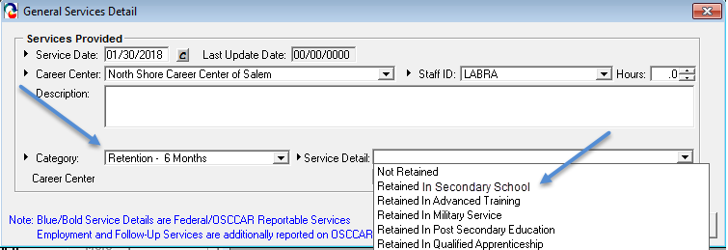
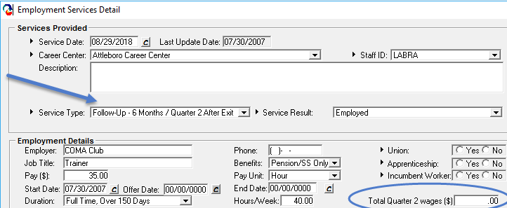
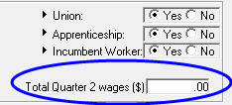
WIOA Performance Indicators
In Employment, Education, or Training during the 2nd Quarter After Exit:

Slide 7
WIOA Performance Indicators
In Employment [or Education or Training] during the 4th Quarter After Exit:
Number of participants who exited during the reporting period who are employed, in education*, or in occupational skills training during the fourth quarter after exit.
Tracking/Reporting:
Wage records from UI database
Employment follow-up services from employment tab with verified wage! Retention services from general tab (for Education outcome).
* Includes those in secondary school

Slide 8
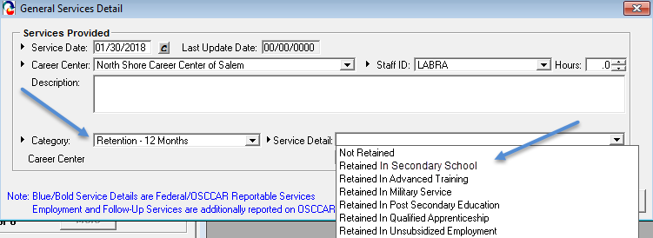
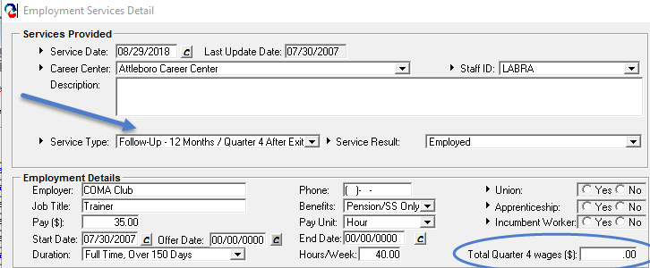
WIOA Performance Indicators
In Employment, Education, or Training during the 4th Quarter After Exit:

Slide 9
WIOA Performance Indicators
Median Wages 2nd Quarter After Exit:
The median wage of those exiters employed in the 2nd quarter after exit.
Tracking/Reporting:
UI Wage records
Employment follow-up services from employment tab
The difference between median and average:
The median of {5, 6, 7, 9, 28} = 7
The average of {5, 6, 7, 9, 28} = 11

Slide 10
WIOA Performance Indicators
Education and Training (from tegl 10-16) as applied to the Credential Attainment measure:
For Adults/Dislocated Workers: All participants that received training that was not OJT or Customized Training
For Youth: All ISY plus OSY who participate in one of the following:
the program element occupational skills training
secondary education during participation in the title I Youth program
postsecondary education during participation in the title I Youth program
Title II-funded adult education during participation in the title I Youth program
YouthBuild during participation in the title I Youth program
Job Corps during participation in the title I Youth program

Slide 11
WIOA Performance Indicators
Credential Attainment:
Number of participants who exited during the reporting period that were in an education or training program (excluding OJT and Customized Training) and who obtained a recognized postsecondary credential during the program or within one year after exit;
plus the number of participants who exited that were in a secondary education program and who obtained a secondary education diploma or its equivalent during the program or within one year after exit AND who were also employed or enrolled in an education or training program leading to a recognized postsecondary credential within one year after exit.
Tracking/Reporting:
Attainment [service] of degree, certificate, license or other credential AND,
if secondary education diploma, then
Wage records from UI database or employment follow-up services (w/verified wage) Retention in Entered Post Secondary or Entered Advanced Training (any quarter)

Slide 12
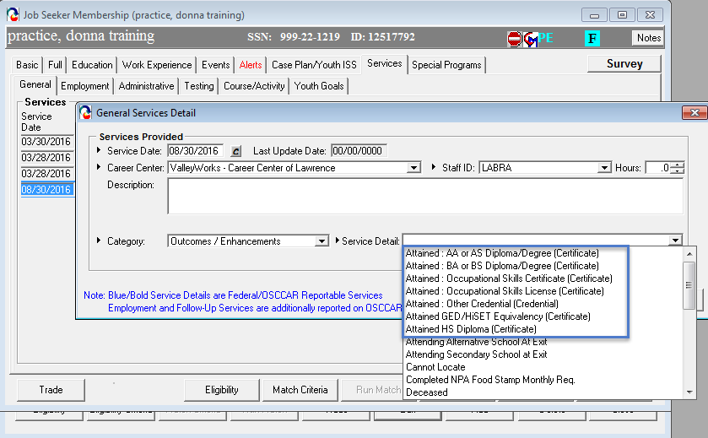
WIOA Performance Indicators
Credential Attainment:

Slide 13
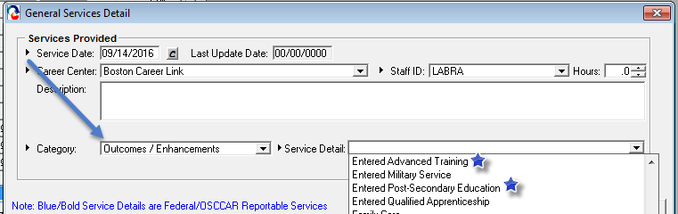
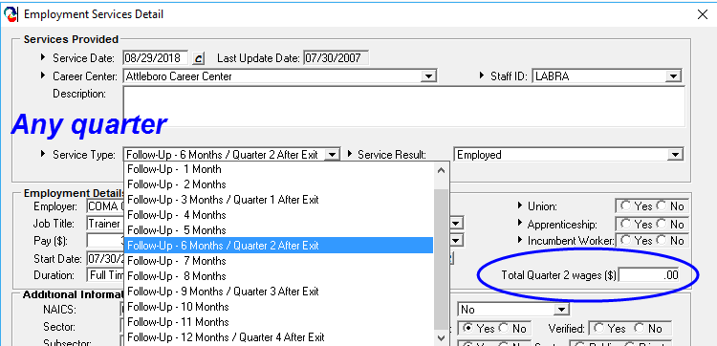
WIOA Performance Indicators
Credential Attainment (for secondary school) diplomas/equivalents):
and Retention Services

Slide 14
WIOA Performance Indicators
Measureable Skill Gain (meeting one or more):
Of those enrolled in education or training:
WIOA Positive MSG (Type #1) | WIOA Positive MSG (Type #2) | WIOA Positive MSG (Type #3) | WIOA Positive MSG (Type #4) | WIOA Positive MSG (Type #5)
Educational Achievement | Secondary School Diploma | Transcript/Report Card | Training Milestone | Skills Progression
# of participants who are receiving instruction below the post secondary education level, who achieve a gain of one or more educational functioning levels. | # of participants that do not have a secondary education diploma at program entry and who attain a high school diploma or equivalent. | # of participants enrolled in either secondary or post secondary whose transcript/report card, for a sufficient number of credit hours, is achieving the state unit’s policies for academic standards. | # of participants with a satisfactory or better progress report, towards established milestones, such as completion of OJT or completion of one year of an apprenticeship program or similar milestones, from an employer or training provider who is providing training | # of participants successfully completed an exam that is required for a particular occupation, or progress in attaining technical or occupational skills as evidenced by trade-related benchmarks (e.g. knowledge based exams)

Slide 15
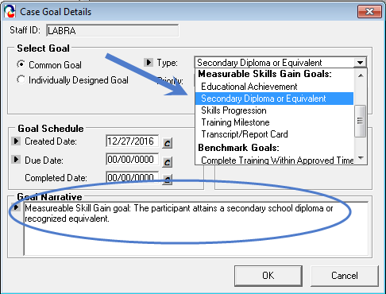
WIOA Performance Indicators
Measureable Skill Gain: (continued)
Tracking: Attainment service, test scores, Case Management goals

Slide 16
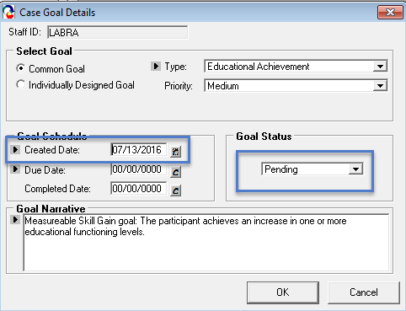
WIOA Performance Indicators
Measureable Skill Gain: (continued)
Tracking/Case Management goals

Slide 17
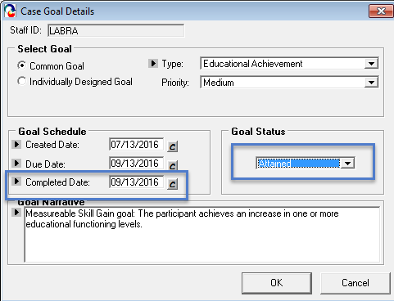
WIOA Performance Indicators
Measureable Skill Gain: (continued)
Tracking/Case Management goals

Slide 18
WIOA Performance Indicators
Employer Retention Measure:
Of those exiters who are employed in the 2nd quarter after exit AND in the 4th quarter after exit, those that are employed with the same employer in both quarters (using the employer FEIN from wage records).
Tracking/Reporting:
Wage records from UI database

Slide 19
Key MOSES Data Entry Points
Performance Measure | Tracking Point
In Employment or Education or Training in the 2nd Quarter After Exit | Employment Tab/General Services Tab Follow-up Month 6 (Q2), (or all months as they occur) Retention Month 6 (Q2), (or all months as they occur)
In Employment or Education or Training in the 4th Quarter After Exit | Employment Tab/General Services Tab Follow-up Month 12 (Q4), (or all months as they occur) Retention Month 12 (Q4), (or all months as they occur)
Credential Attainment | General Services tab Attainment services Plus for secondary credential, employment follow up and/or retention (any quarters)
Measureable Skill Gain | Case Management tab goals (plus any attainments, test scores, etc.)

Slide 20
Global Exclusions from Performance
Must be identified and documented by the end of the 3rd quarter after exit:
Institutionalized
Health/Medical Care
Deceased
Reservist Called to Active Duty
Youth Mandated to Relocation Program/Foster Care

Slide 21
Some Other Stuff

Slide 22
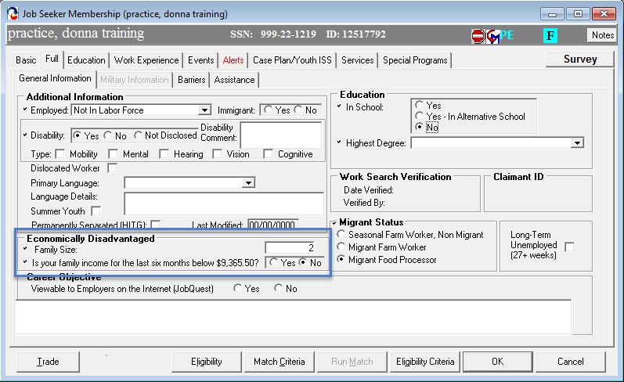
Other Stuff
Self Attestation Question on Full Tab

Slide 23
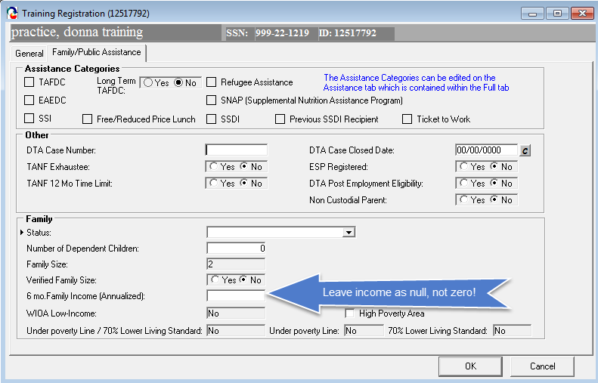
Other Stuff
Enter Null When Not Verifying Income

Slide 24
Resources
Massachusetts Career Information System
http://www.mass.gov/massworkforce/resources/masscis/
Career Ready 101
http://www.mass.gov/massworkforce/careerready/tools/career-ready-101/
Workforce Innovation and Opportunity Act
https://www.congress.gov/bill/113th-congress/house-bill/803/text
Workforce Innovation and Opportunity Act: Department of Labor Only – Final Rule
https://www.gpo.gov/fdsys/pkg/FR-2016-08-19/pdf/2016-15975.pdf
Department of Labor TEGL 10-16 Change 1 Performance Accountability
https://wdr.doleta.gov/directives/corr_doc.cfm?DOCN=3255
Department of Career Services Youth Program Resource Page
http://www.mass.gov/massworkforce/programs/youth/

